Slide 1
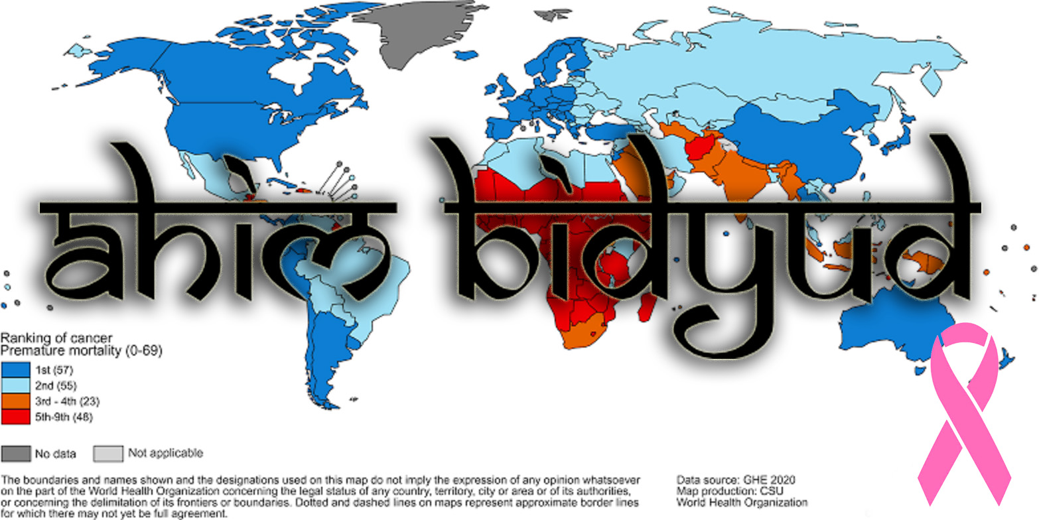

Slide 2
About : Ahim Bidyud
This project tells about the cancer patients who are addicted to alcoholic . It is the dashboard which represents the data of cancer patients who are suffering by alcoholic problems and their respective age defect for both male and female. This Website helps people to analyze who are suffering from cancer, and it helps to take some precautions.

Slide 3
* Architcture *
Data
Together for Analysis
Data Sets
Collections of Data
Numpy and Pandas
High-Performance Data Manipulation
Web Design
Displayed on the internet
Host
Server Offering Resources

Slide 4
Tools of the Project :
Numpy - It is library for the python programing and it supports for the multiple dimension arrays and matrices along with large collection of mathematical functions to operate on these arrays.
Pandas – It aims to the fundamental high level building block for doing pratical, real world data analysis in python.
Matplotlib – It is a collection of functions that make matplotlib work like MATLAB. Each pyplot function makes some change to a figure.
Sklearn – It is the most useful and robust library for machine learning in python.
Seaborn – It is an open source python library built on top of matplotlib. It is used for data visualization and exploratory data analysis.

Slide 5
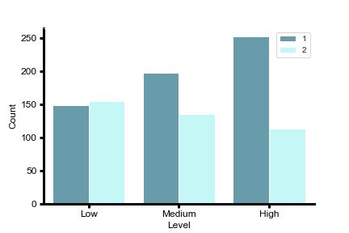
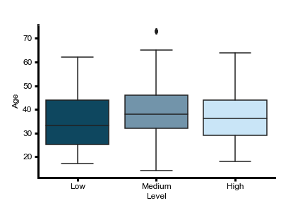
* CBC test for Male and Female *
* Risk factors by Age *

Slide 6
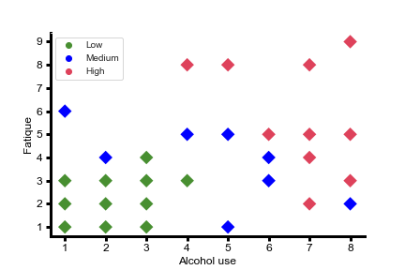
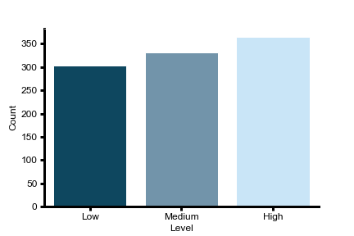
* Effected by Alcohol *
* Ratio of Risk *

Slide 7
EDA
Plotter Function
Feature Selection
Its an type survey of the cancer effected members in the specified zones. This type of survey procedure many help to effected and non-effected persons to be medicalized and to educate for precautions.

Slide 8
