Slide 1
MLP-Assignment5
Jayasri Tudi(1319475)
Rajasekhar Reddy(1317710)
Anish Jayakumar Balaji(1321505)
Venkatesh Nyamagoudar(1310504)
Ajay Kumar Karre(1306126)

Slide 2
Outline
Data Description
Classification
Results

Slide 3
Data Description
→ It has 5 columns
→ First column – Target Class(Target feature)
→ Other columns - Attributes(Train features)

Slide 4
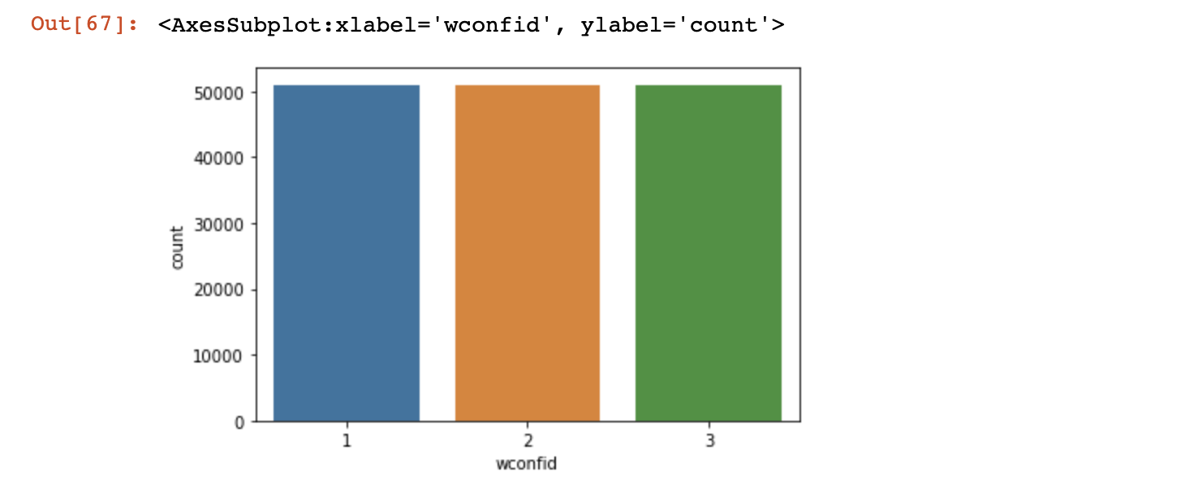

Slide 5
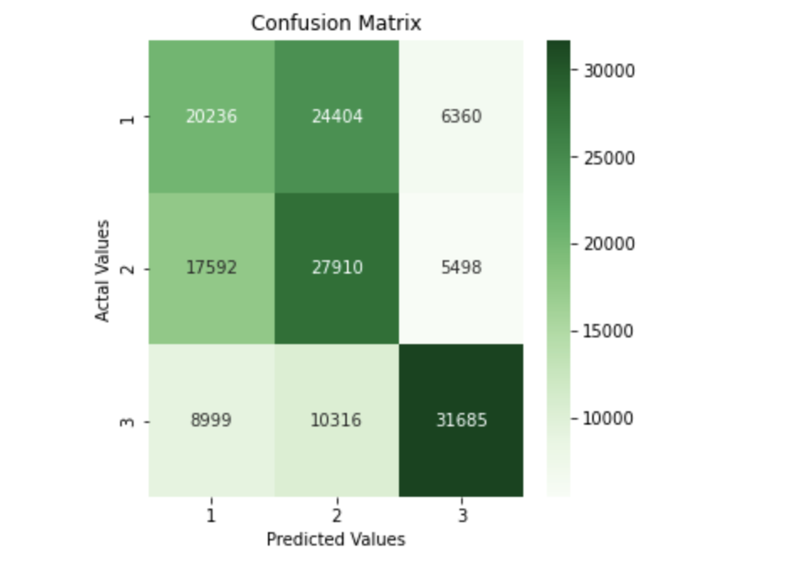
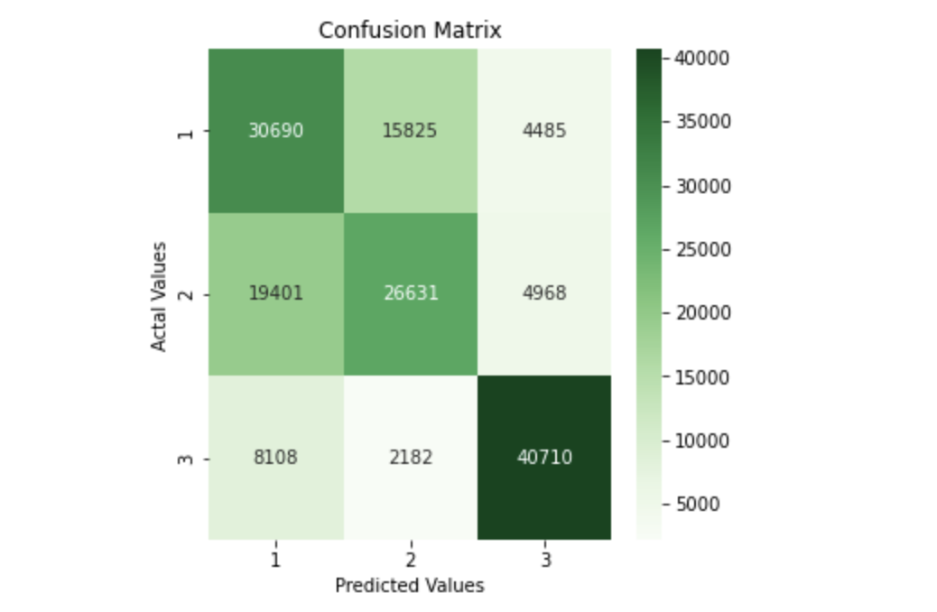
Confusion Matrix Comparison
Hidden Layers - 10
Hidden Layers - 60

Slide 6
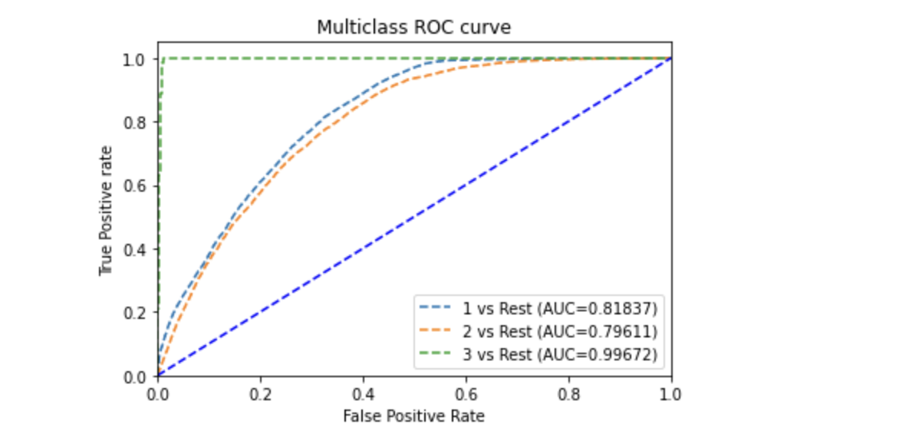
Comparison of ROC Curves
SVM- ROC AUC Curves for 60 hidden layers.

Slide 7
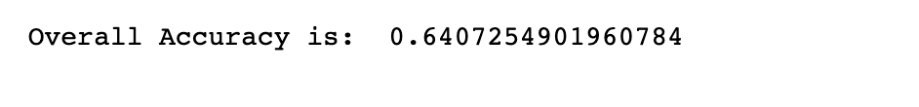
Accuracy Comparison
Overall Accuracy with 60 hidden layers.

Slide 8
Performance Metrics Evaluation
Algorithm | Sensitivity | Specificity | F1-Score | ROC | AUC
MLP-1 | 0.6017 | 0.7303 | 0.5620 | 0.8183 | 0.8137
MLP-2 | 0.5221 | 0.8234 | 0.5569 | 0.7961 | 0.7961
MLP-3 | 0.7982 | 0.9073 | 0.8048 | 0.9967 | 0.9967

Slide 9
THANK YOU

