Slide 1
TRAFFIC SIGN BOARD DETECTION

Slide 2
INTRODUCTION
Traffic sign recognition is crucial for autonomous vehicles and driver-assistance systems.
By correctly identifying traffic signs, these systems can enhance road safety and improve driving experiences.
Deep learning, particularly Convolutional Neural Networks (CNNs), have become the go-to approach for achieving high accuracy in traffic sign recognition tasks.

Slide 3
OBJECTIVES
In this project, I constructed a CNN model to classify traffic signs from the GTSRB German traffic sign dataset.
I preprocessed and augmented the training data to enhance model generalizability and robustness.
The model's performance will be evaluated on a separate test set to assess its effectiveness.
Finally, I visualized the model's predictions to gain insights into its strengths and weaknesses.

Slide 4
DATASET AND ITS ATTRIBUTES
4
The GTSRB dataset is a widely used benchmark for traffic sign recognition tasks.
It encompasses over 50,000 images categorized into 43 distinct traffic signs.
Each image is labeled with the corresponding traffic sign class, providing valuable ground truth data for training the model.

Slide 5
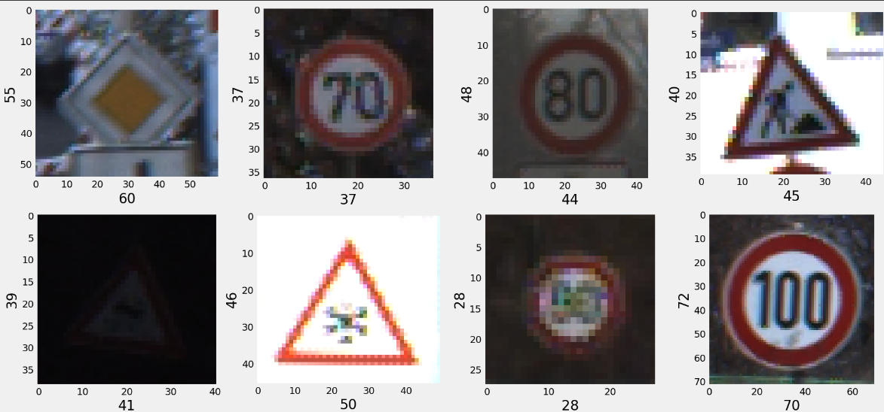
SAMPLE DATA IN DATASET

Slide 6
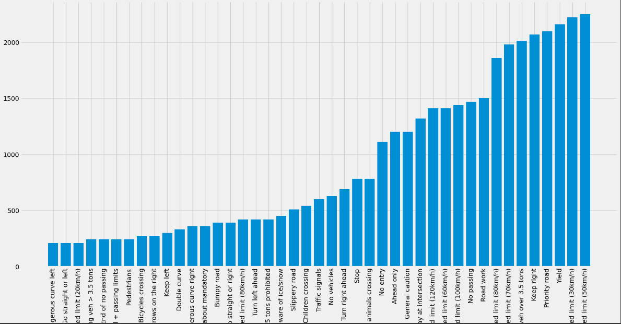
DATASET VISUALIZATION

Slide 7
Proposed Methodology
My approach leverages a CNN architecture specifically designed to excel in image classification tasks.
The CNN architecture incorporates convolutional layers for feature extraction, pooling layers for dimensionality reduction, and fully connected layers for classification.

Slide 8
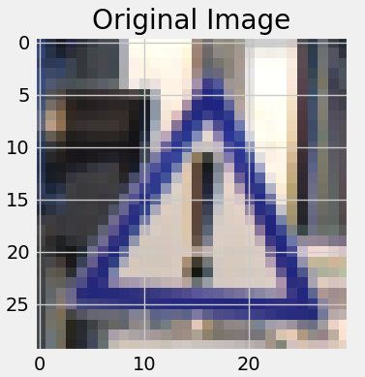
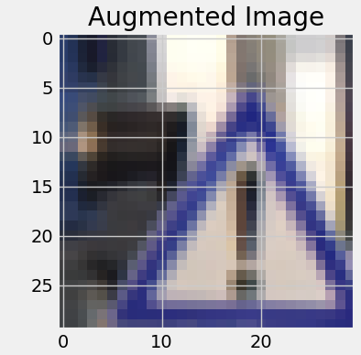
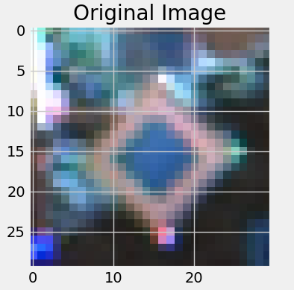
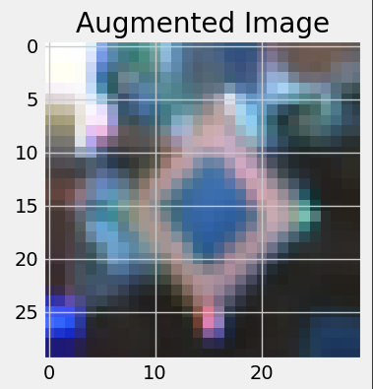
DATA AUGMENTATION
To artificially expand the dataset and improve the model's ability to handle variations in real-world traffic signs, I employed data augmentation techniques

Slide 9

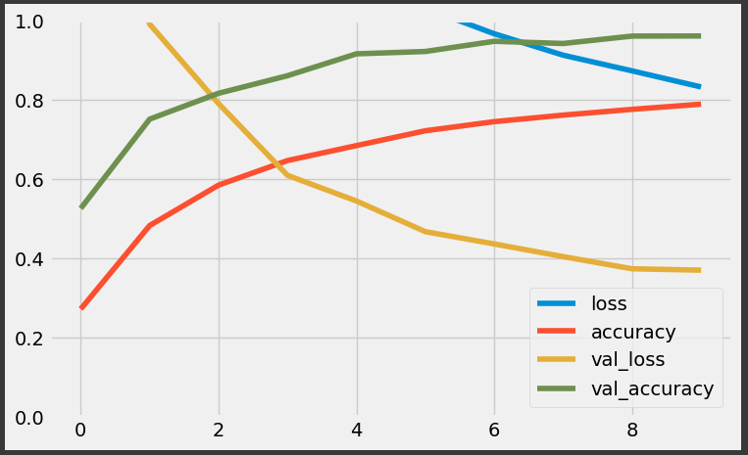
METRICS FOR MY WORK
ACCURACY:
VALIDATION GRAPH:

Slide 10
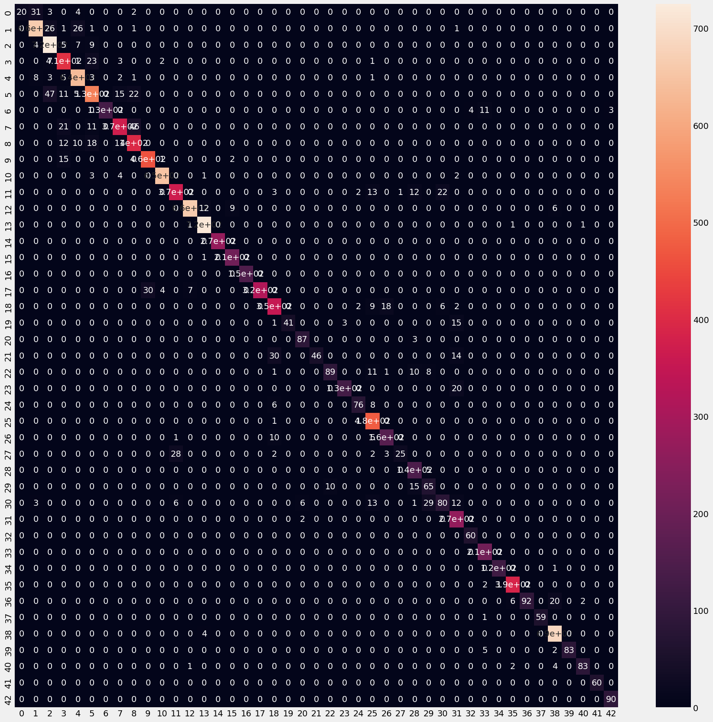
CONFUSION MATRIX

Slide 11
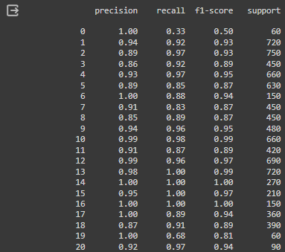
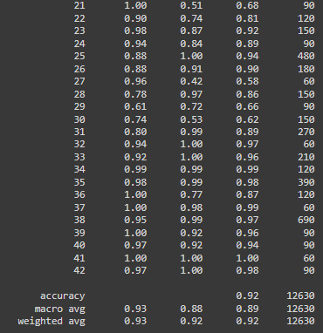
CLASSIFICATION REPORT

Slide 12
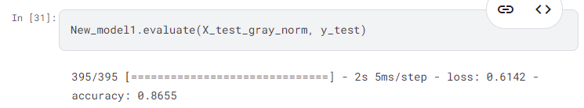
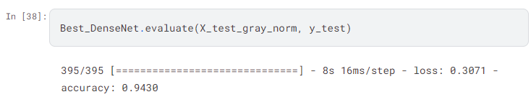
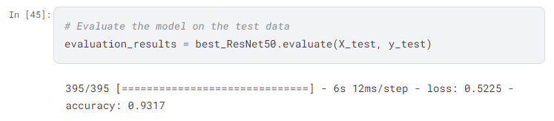
PREVIOUS WORKS METRICS
ALEXNET MODEL
2. DENSENET MODEL
RESNET 50

Slide 13
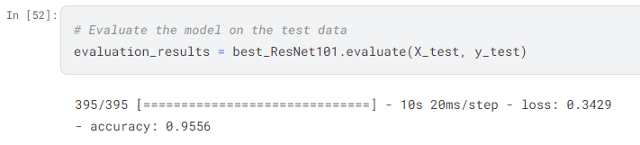
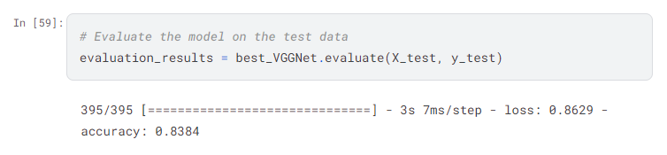
PREVIOUS WORKS METRICS
4. RESNET 101
5. VGGNET

Slide 14
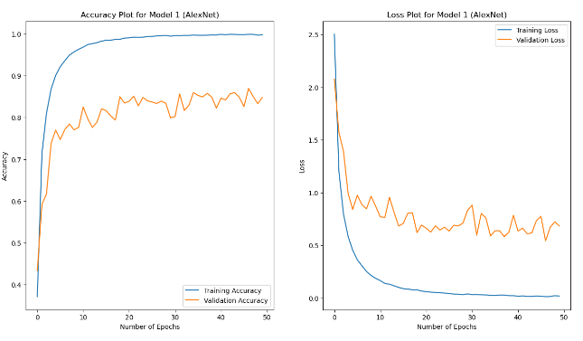
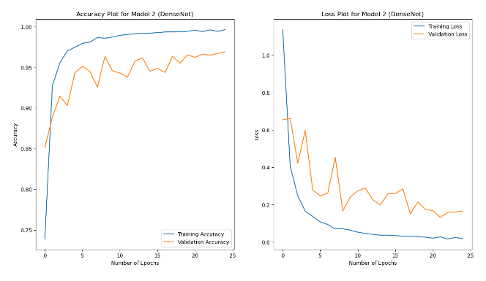
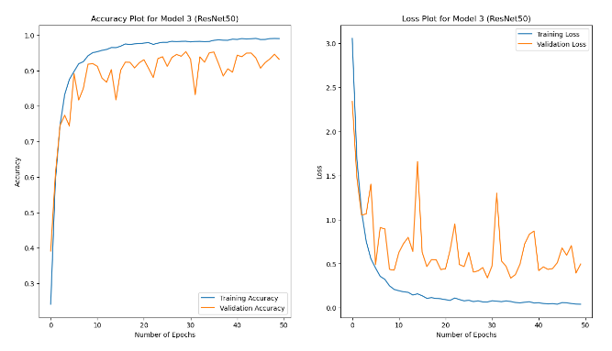
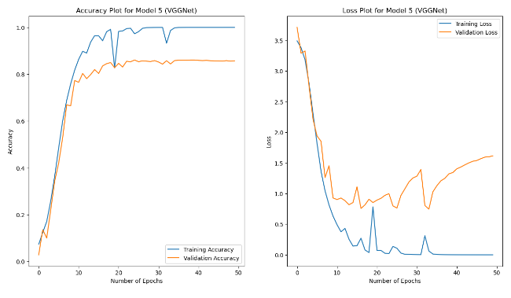
ACCURACY AND LOSS PLOTS FOR PREVIOUS WORKS

Slide 15
COMPARISION
MODEL NAME | ACCURACY | PRECISION | RECALL | F1-SCORE | SUPPORT
ALEXNET | 86.5 | 0.97 | 0.86 | 0.91 | 90
DENSENET | 94.3 | 0.90 | 0.99 | 0.94 | 90
RESNET 50 | 93.1 | 0.74 | 0.81 | 0.77 | 90
RESNET 101 | 95.5 | 1.0 | 1.0 | 1.0 | 90
VGG NET | 83.8 | 0.69 | 1.0 | 0.82 | 90
CNN (MY MODEL) | 92.4 | 0.97 | 1.0 | 0.98 | 90

Slide 16
COMPARISION
Accuracy: Densenet achieves the highest overall accuracy (94.3%), followed by my model (92.4%) and ResNet 101 (95.5%). This indicates strong performance for these models in correctly identifying traffic signs.
Precision (False Positives): My model and AlexNet have the highest Precision (97.0%), suggesting they excel at avoiding false positives (identifying non-signs as signs).
Recall (Missing Signs): My model achieves a perfect Recall (100%), indicating it detects all traffic signs in the dataset. However, this might come at the cost of a few false positives.
F1-Score (Balance): My model has the highest F1-score (98.0%), suggesting a good balance between precision and recall compared to other models.

Slide 17
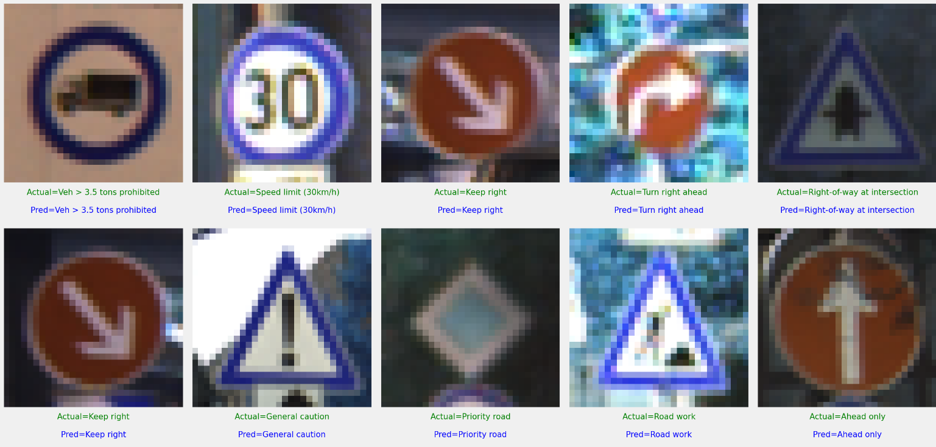
PREDICTIONS ON TEST DATA

Slide 18
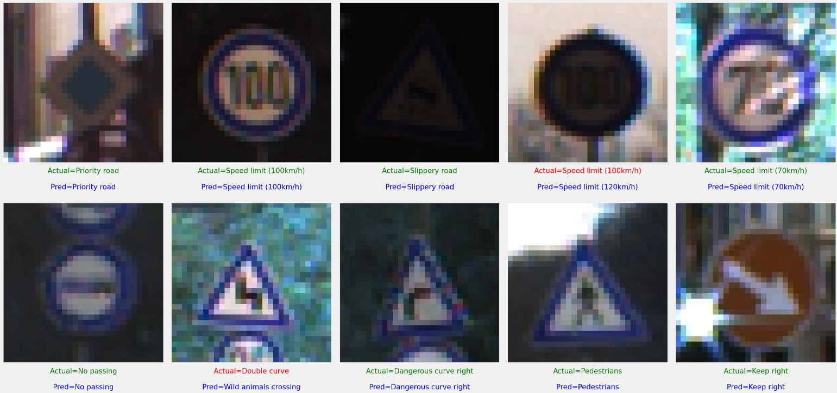
PREDICTIONS ON TEST DATA

Slide 19
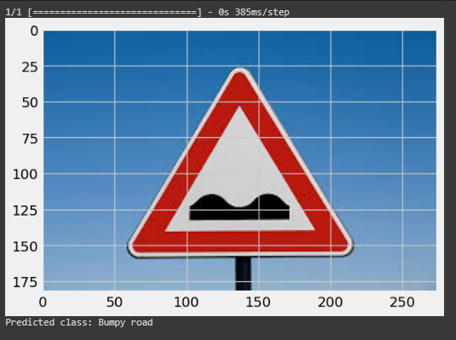
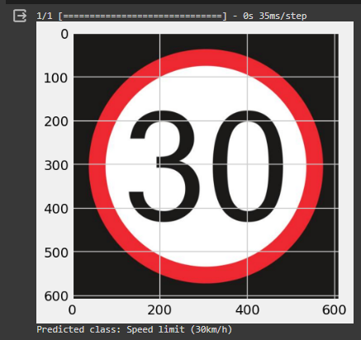
PREDICTIONS

Slide 20
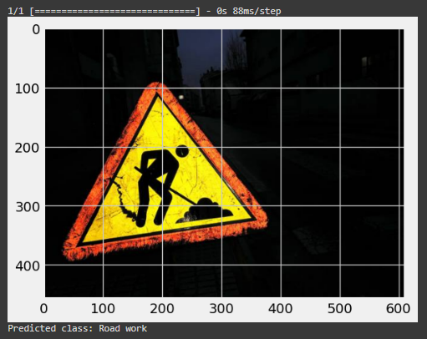
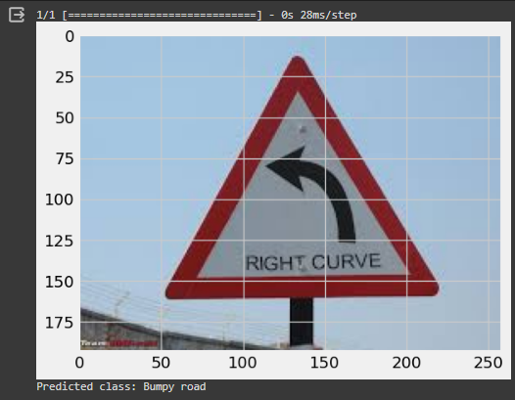
PREDICTIONS

Slide 21
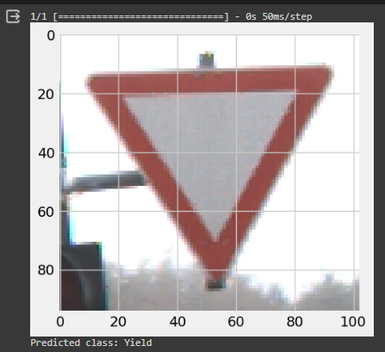
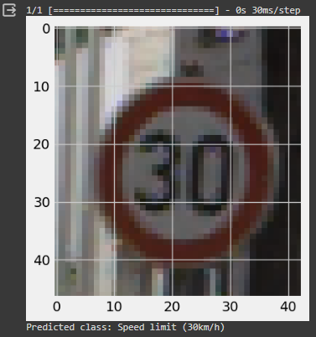
PREDICTIONS

Slide 22
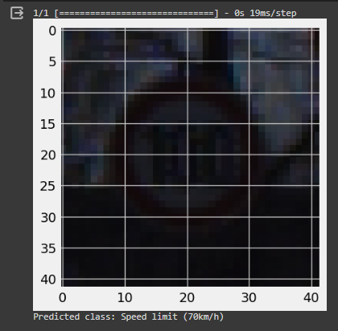
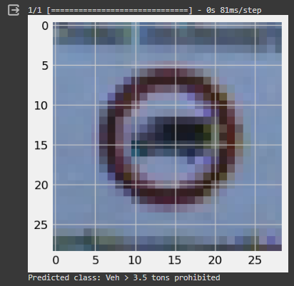
PREDICTIONS

Slide 23
PROS
Large and well-annotated: The GTSRB dataset is a widely used benchmark with a large number of images (over 50,000) covering 43 different traffic signs. This abundance of data allows researchers to train robust and accurate traffic sign detection models.
Standardized format: The dataset is well-organized and easy to work with, with consistent image sizes and annotations for each sign. This standardization makes it a good starting point for researchers to develop and compare their detection algorithms.
High accuracy achievable: Due to the dataset's qualities, researchers have been able to achieve very high accuracy rates (over 90%) for traffic sign detection on the GTSRB. This success makes it a valuable tool for benchmarking and validating new approaches.

Slide 24
CONS
Limited real-world variability: The images in the GTSRB dataset are captured under controlled conditions with good lighting and clear backgrounds. This can lead to models that struggle with real-world scenarios with variations in lighting, weather, and occlusions (like signs partially blocked by objects).
Focus on classification, not localization: While the dataset provides bounding boxes for signs, the primary focus is on classification (recognizing the type of sign). This might not be ideal for researchers who want to develop models that not only identify signs but also precisely locate them within an image.
Lack of diversity: The dataset only includes German traffic signs. This limits the generalizability of models trained on it to other countries with different signage systems.

Slide 25
CONCLUSION
This project demonstrates the effectiveness of CNNs in traffic sign classification tasks.
The developed model achieved promising accuracy on the GTSRB dataset.
Future work could involve exploring techniques like transfer learning with pre-trained models or incorporating more sophisticated architectures to potentially improve performance, especially for challenging classes.
For complex images, we can combine object segmentation and traffic sign recognition. Segmentation isolates the sign using deep learning models, then a separate CNN classifies the segmented image for accurate traffic sign detection and recognition. This approach can be more robust but requires significant computational resources and large training datasets.

Slide 26
Thank you

