Slide 1

Knowledge Sharing On Device Drivers Filesystem
By, Under Guidence of
Raja Shekar J Naresh K

Slide 2
Outlines :
Device Drivers
Booting of Linux OS
File System (Ext2)
Elf file

Slide 3
Device Drivers
Character Device Drivers
Ex : serial ports , parallel ports ,terminal ,e.t.c
Block Device Drivers
Ex : Hard disks

Slide 4
Character Driver
Steps to create a simple character driver
make -C /lib/modules/$(shell uname -r)/build M=$(PWD) modules
sudo insmod ./modules/MyCharDev.ko
sudo mknod -m 666 ./MyCharDev c major minor
Unlink - To remove the node

Slide 5
Two types of major and minor number region allocation
int register_chrdev_region(dev_t first, unsigned int count, char* name);
  Static allocation where it’s not sure if you’ll get the requested region.
int alloc_chrdev_region(dev_t *dev, unsigned int firstminor, unsigned int count, char *name);
  Dynamic allocation of the device numbers by the kernel.
  You will definitely get a free major number assigned.
To free the assigned major and minor numbers in the exit function:
void unregister_chrdev_region(dev_t first, unsigned int count);
To create proc entry for driver
proc_create("mydev",0666,NULL,&myops);

Slide 6
Three macros are used mostly
To get a dev_t from the major and the minor number:
MKDEV(int major, int minor);
To get the major or minor number from a dev_t :
MAJOR(dev_t dev);
MINOR(dev_t dev);
Unregistering the device
unregister_chrdev_region(Dev_Id , 1)

Slide 7
Booting process of Linux
There are six stages of typical Linux boot process
  BIOS
  MBR
  GRUB
  Kernel
  Init/Systemd
  Runlevel

Slide 8
File System
What is File System ?
Why do OS need it ?
Types of File System
  Linux – ext family,Squashfs,e.t.c
  Windows – NTFS,FAF,exFAT

Slide 9
Ext2 File System
Features of Ext2 filesystem
Max Volume size
Max File size
Max number of files
Naming Convention
File Acess
File Attributes
File Operations

Slide 10
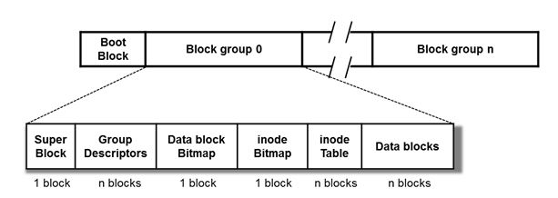
Ext2 File System Layout

Slide 11
Superblock
It always starts at byte 1024
It is the master file system structure
It stores global file system constants like
  Block size
  Inode size
  Number of blocks
  Number of inodes
  Magic number
  Many more ….

Slide 12
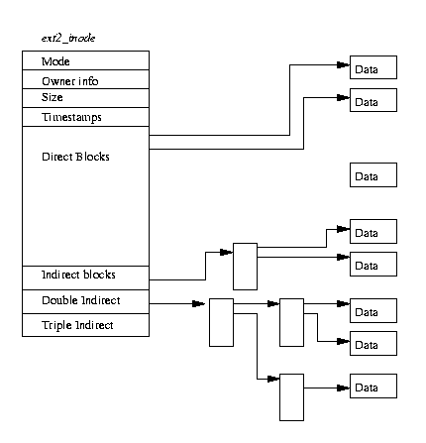
Inode structure

Slide 13
Blockgroup Descriptor
It stores block bitmap
Inode bitmap
Inode tables
Free Blocks and inodes
Used directories count
Some of

Slide 14
Elf File
It is common standard file format for executable files , object code,shared libraries and core dumps.
It is chosen as standard binary format for all unix-like systems on x86 processor.
It supports different endiannesses and address sizes.
This feature made it to be adopted by many different operating systems on many different hardware platforms.

Slide 15
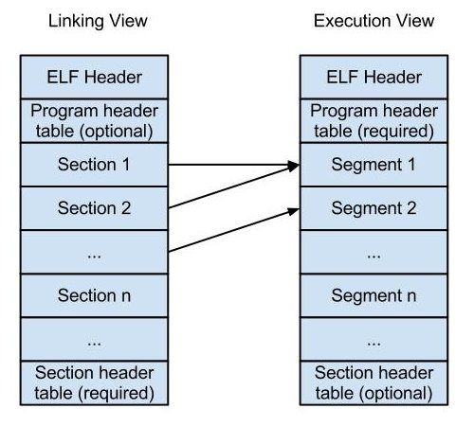
ELF File Format

Slide 16
ELF Header
It stores details like
  Target Machine
  Target Operating System
  Object File Type
  Offset Address of program header table and section header table
  Size of the headers (Elf,program,section)
  Number of entries in program header and Section Header
  Elf_header_All_members

Slide 17
Program and Section Header
Program header
Section header
Symbol table

Slide 18
Queries ?

Slide 19
THANK YOU

