Slide 1
Application of Machine Learning Algorithms in Presumptive Diagnosis of Urinary System Diseases
Presented by:
Rajashree Dahal

Slide 2
Outline
Objective
Introduction
Dataset
Literature Review
Methodology
Results
Conclusion

Slide 3
Objective
Problem Statement
Our goal is to predict whether the patient has inflammation or nephritis or both or none.
Objectives
The expert system was developed to assist healthcare professionals in diagnosing and treating patients.
Trained the dataset on multiple machine learning algorithms and compared the performance metrics such as precision, recall, f1 score and confusion matrix.

Slide 4
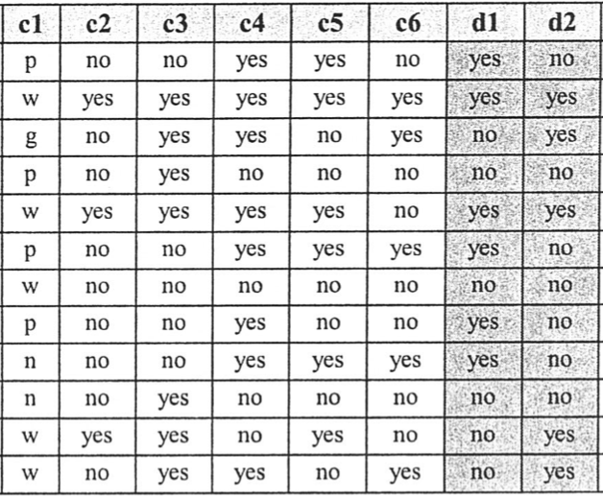
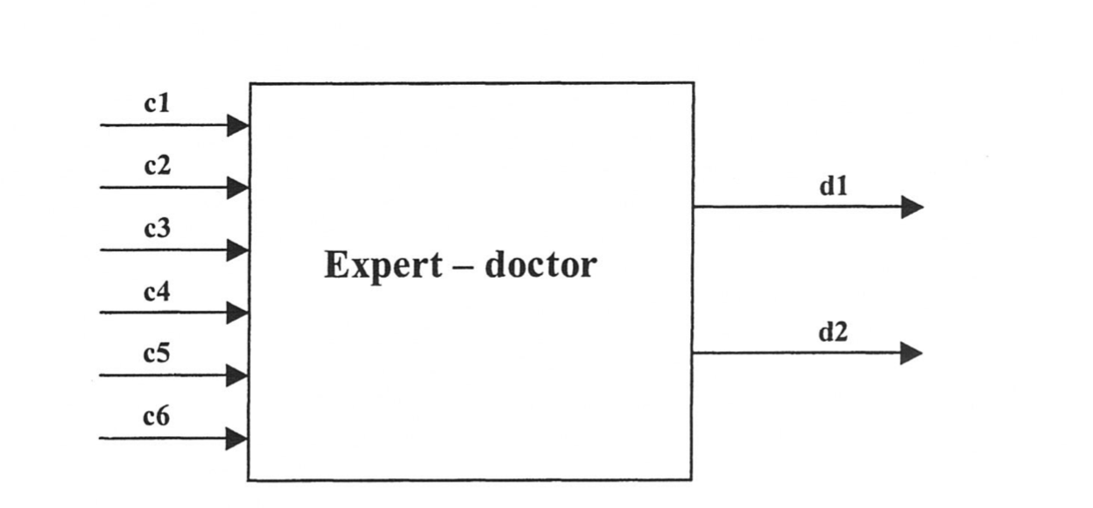
Introduction
The expert system that we had come up with will have 4 consequences for the given 6 features. The table below shows the output consequences.
Acute Inflammation of urinary bladder is characterized by sudden occurence of pains in the abdomen region and the urination.
Acute nephritis of renal pelvis begins with sudden fever, nausea and vomiting.
n=normal temperature(36⁰-37⁰) C,
p=subfebrile temperature(37⁰-38⁰) C,
g=febrile state(38⁰-40⁰) C,
w=high fever(above 40⁰) C,
Notes:
Our expert based system is going to look like.

Slide 5
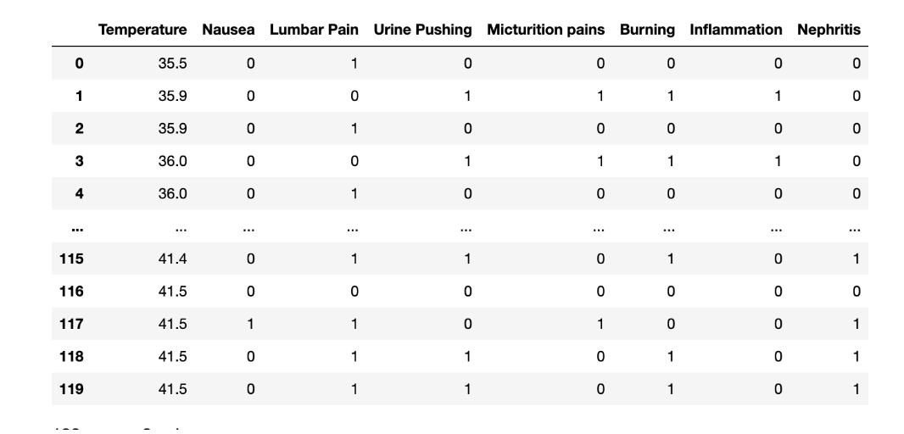
Dataset
Acute Inflammation Dataset
The dataset includes information on 120 patients.
Each patient is described by six clinical features and two diseases.
Temperature – continuous.
Other features – categorical

Slide 6
Literature Review
Authors | Title | Findings/Limitations
Czerniak, J. M., & Zarzycki, H. (2003) | Application of rough sets in the presumptive diagnosis of urinary system diseases. | Introduces an expert model system which performs presumptive diagnosis on acute Nephritis and acute Inflammation
(Baxt, 1995) (Saritas, 2012) | Application of artificial neural networks to clinical medicine, Prediction of Breast Cancer Using Artificial Neural Networks | AI implemented in the field of medicine for several purposes, including the categorization and diagnosis of illnesses, the suggestion of treatments.
Ozkan et al. (2018) | Diagnosis of urinary tract infection based on artificial intelligence methods | Implemented classification task to diagnosis UTI with Decision Tree, SVMs. Random Forest and ANN .

Slide 7
Methodology
Finding out Possible Use Cases
Correlation Analysis
Implementation of machine learning algorithms
Experimental result
Inflammation (d1) | Nephritis(d2) | Condition/ Output for ML models
0 | 0 | None
1 | 0 | OnlyInflammation
0 | 1 | OnlyNephritis
1 | 1 | bothNephritisAndInflammation
Use Case Implementation
Pre-processed data

Slide 8
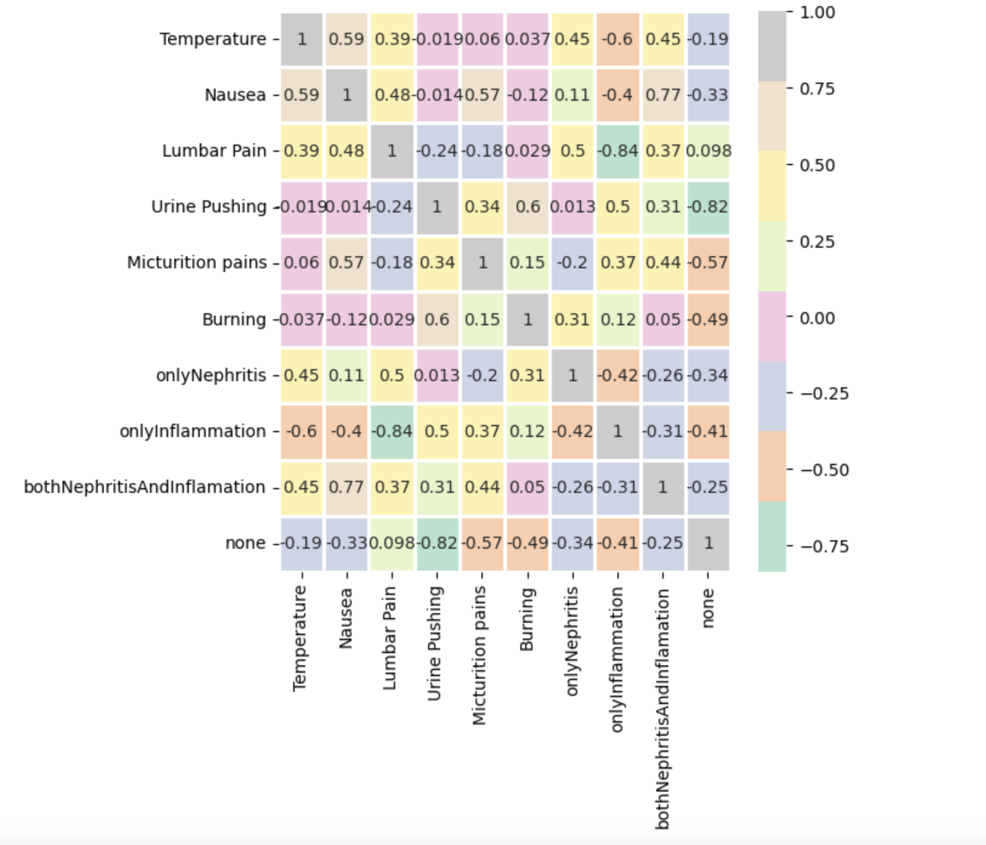
Results -Correlation Analysis

Slide 9
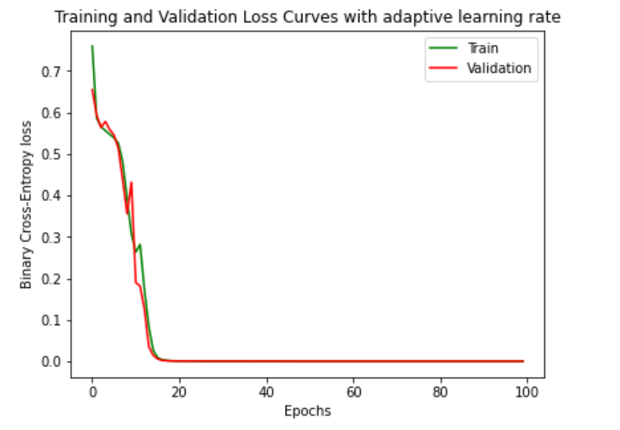
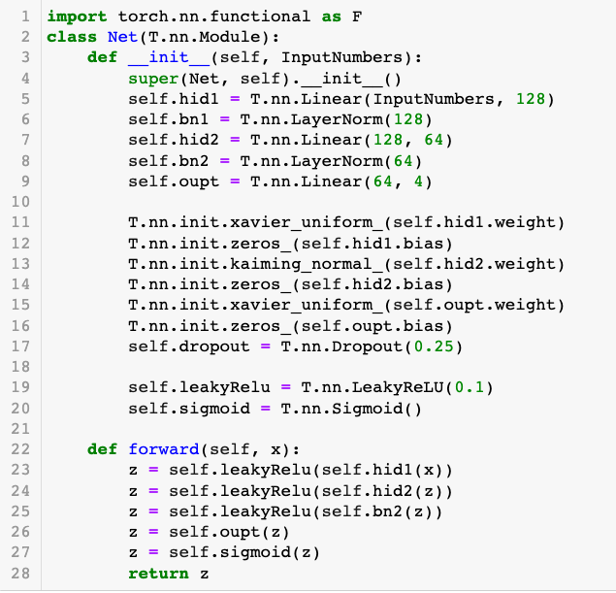
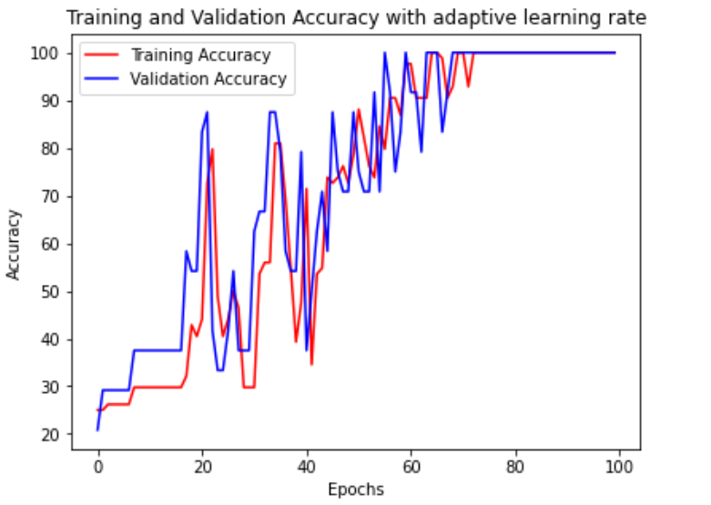
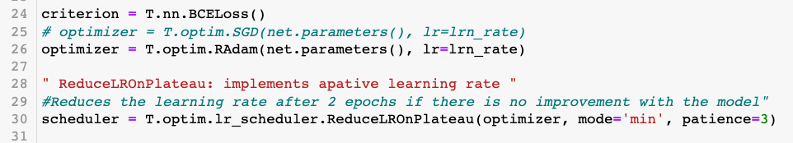
Results -ANN
Baseline Settings
Training and Validation Loss and Accuracy

Slide 10
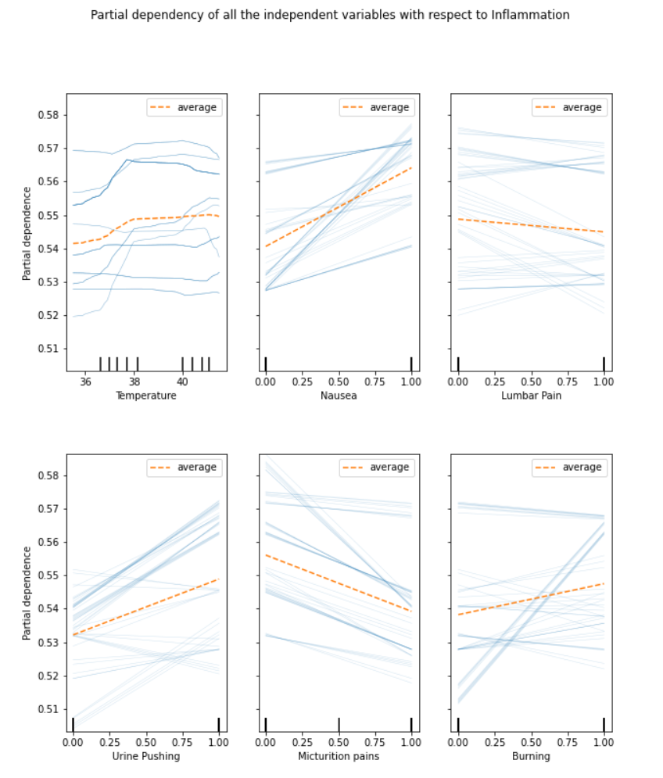
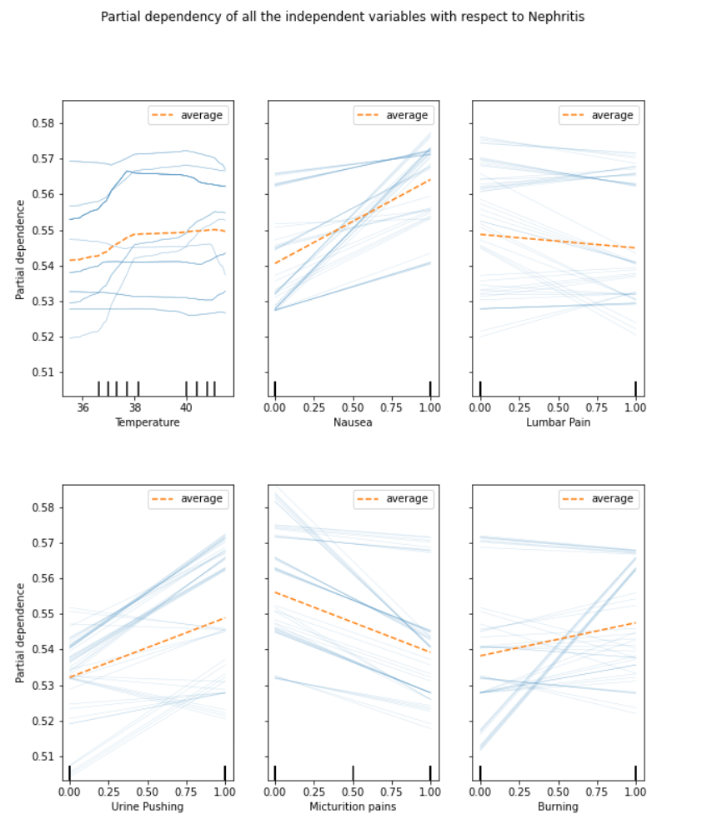
Results -ANN
Partial Dependence plots

Slide 11
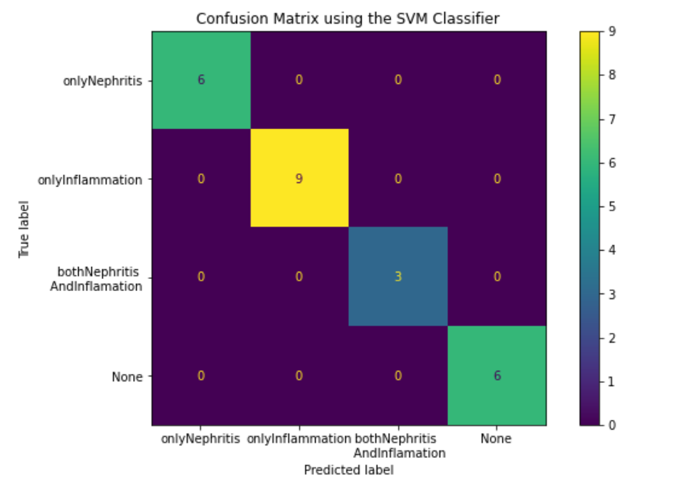
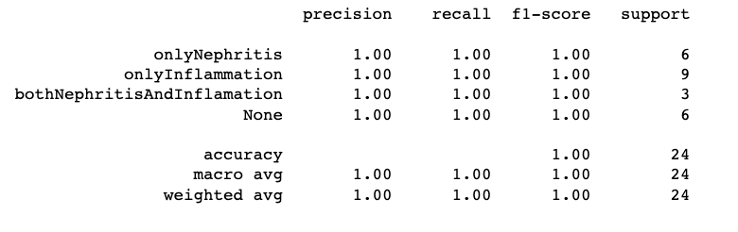
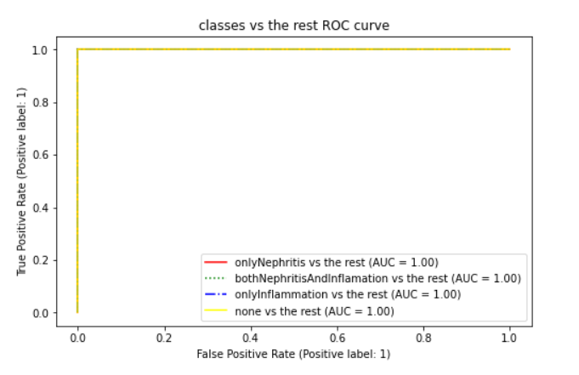
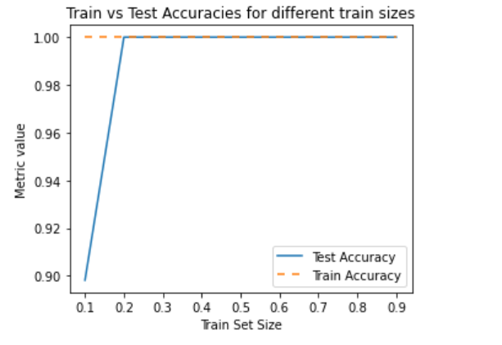
Results– SVM Classifier

Slide 12
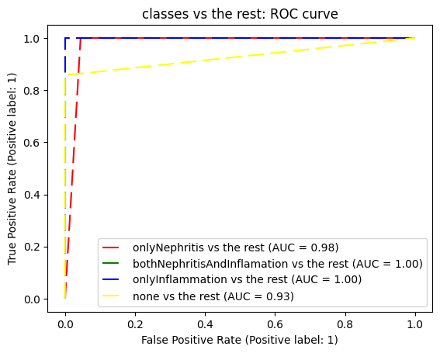
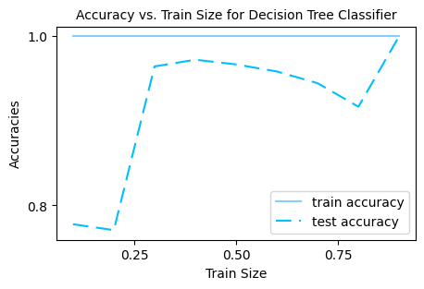
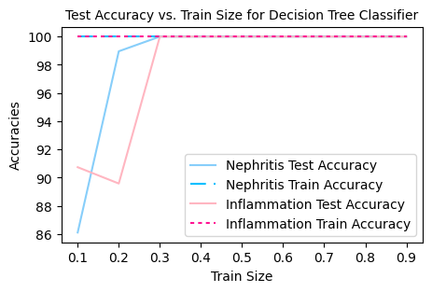
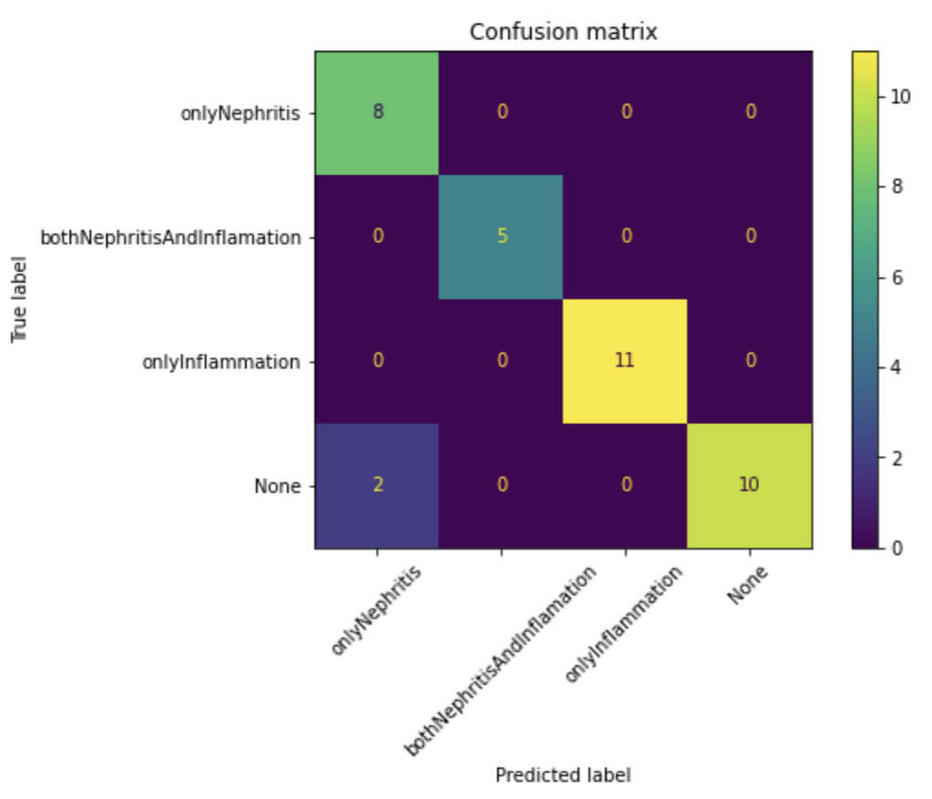
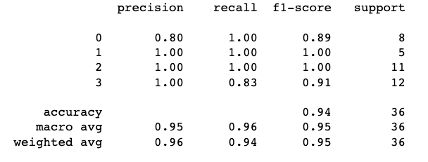
Results -Decision Tree Classifier
Train Size =0.7
Notes:
Generate synthetic data(The goal of creating synthetic datasets is to generate data that mimics the statistical properties of real-world data) so that we might have more dataset so that the model will be able to get more meaning insights from the dataset.
Further research can be carried out integrating weighted average of each model to give the final prediction.

Slide 13
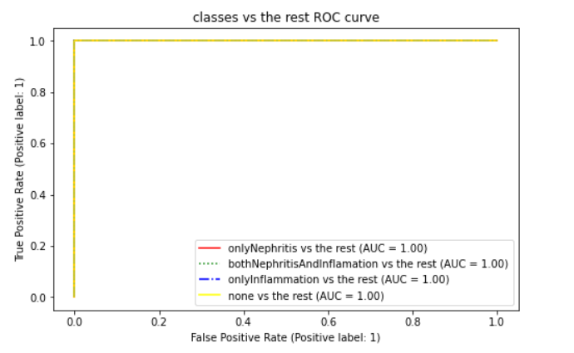
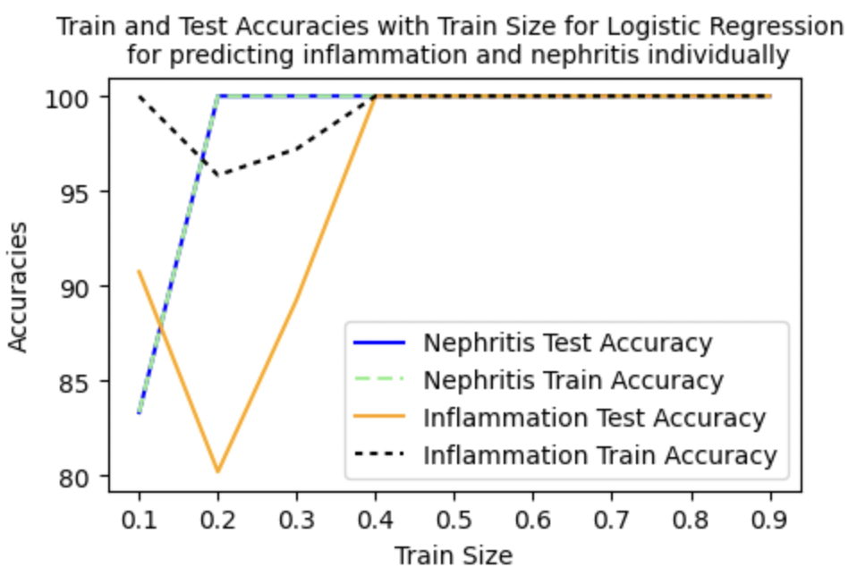
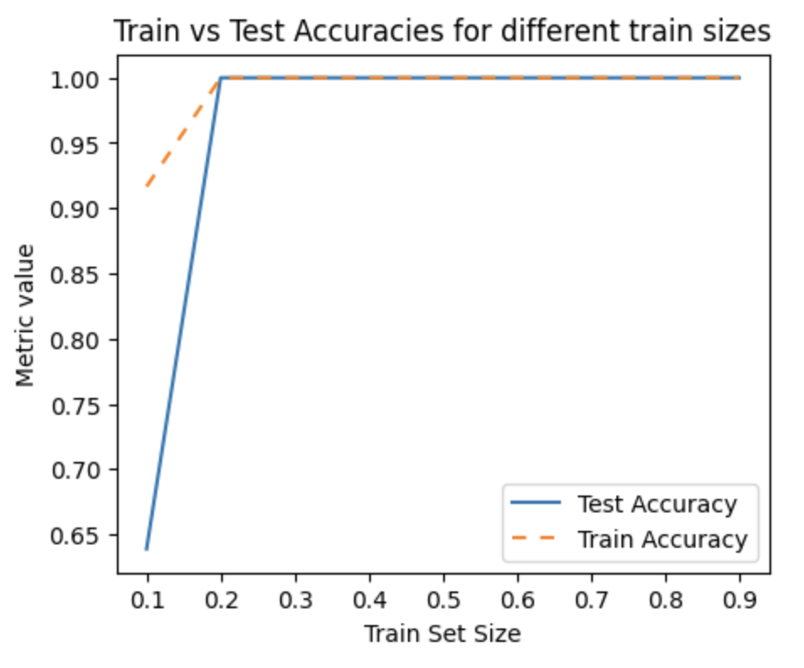
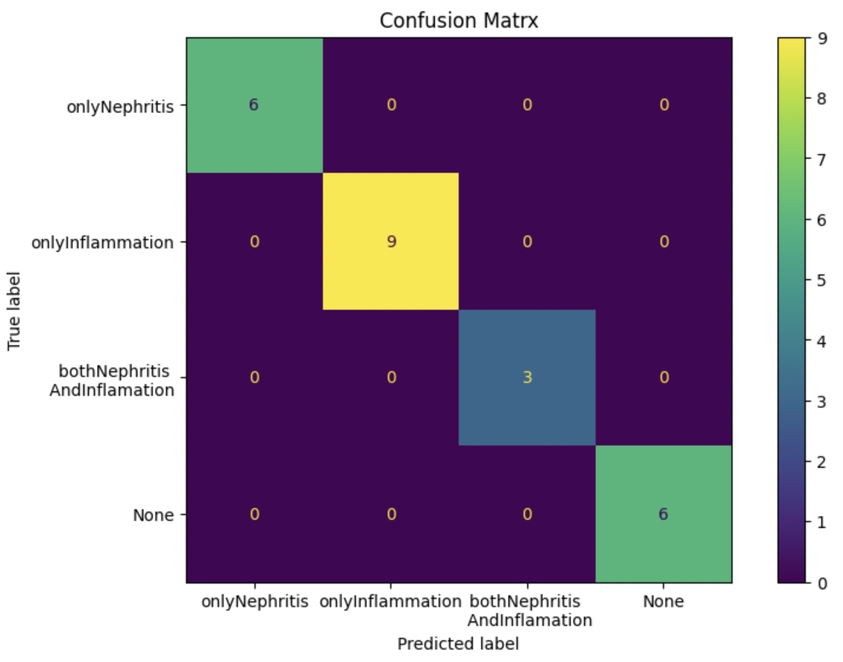
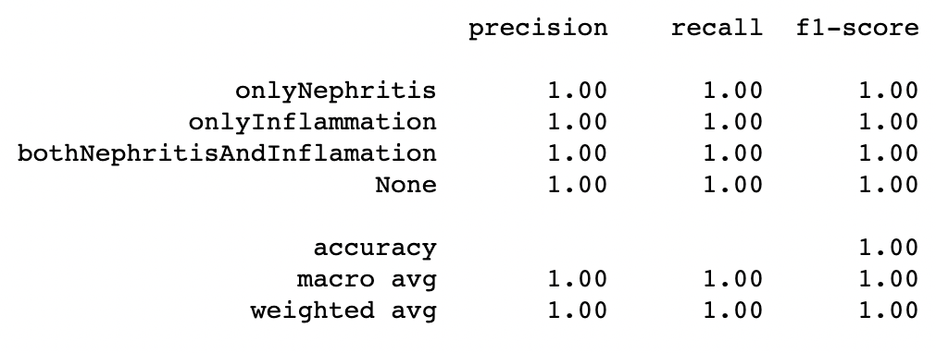
Results -Logistic Regression
Train Size =0.8

Slide 14
Conclusion
All the algorithms that we used performed well with 100% accuracy.
There is a probability of getting overfitting as our dataset is small.
For further work one can work on generate synthetic data using GAN so that we might have more dataset.
Further research can be carried out integrating weighted average of each model to give the final prediction.
Notes:
generate synthetic data using (GAN) - The goal of creating synthetic datasets is to generate data that mimics the statistical properties of real-world data.
the model will be able to get more meaning insights from the dataset.
(If the dataset consists of very simple patterns, then it is possible that a model can easily fit to the data and achieve perfect accuracy. )

Slide 15
References
Czerniak, J. M., & Zarzycki, H. (2003). Application of rough sets in the presumptive diagnosis of urinary system diseases. In Springer eBooks (pp. 41–51). Springer Nature. https://doi.org/10.1007/978-1-4419-9226-0_5
Baxt, W. G. (1995). Application of artificial neural networks to clinical medicine. The Lancet, 346(8983), 1135–1138. https://doi.org/10.1016/s0140-6736(95)91804-3
Ozkan, I. A., Koklu, M., & Sert, I. U. (2018). Diagnosis of urinary tract infection based on artificial intelligence methods. Computer Methods and Programs in Biomedicine, 166, 51–59. https://doi.org/10.1016/j.cmpb.2018.10.007

