Slide 1
Financial Analysis
By Rajashree Gavali

Slide 2
Data Source
The Data Source is provided by the top 500 companies based on full market capitalization from the eligible universe which is then collated and preprocessed by me using Python programming.

Slide 3
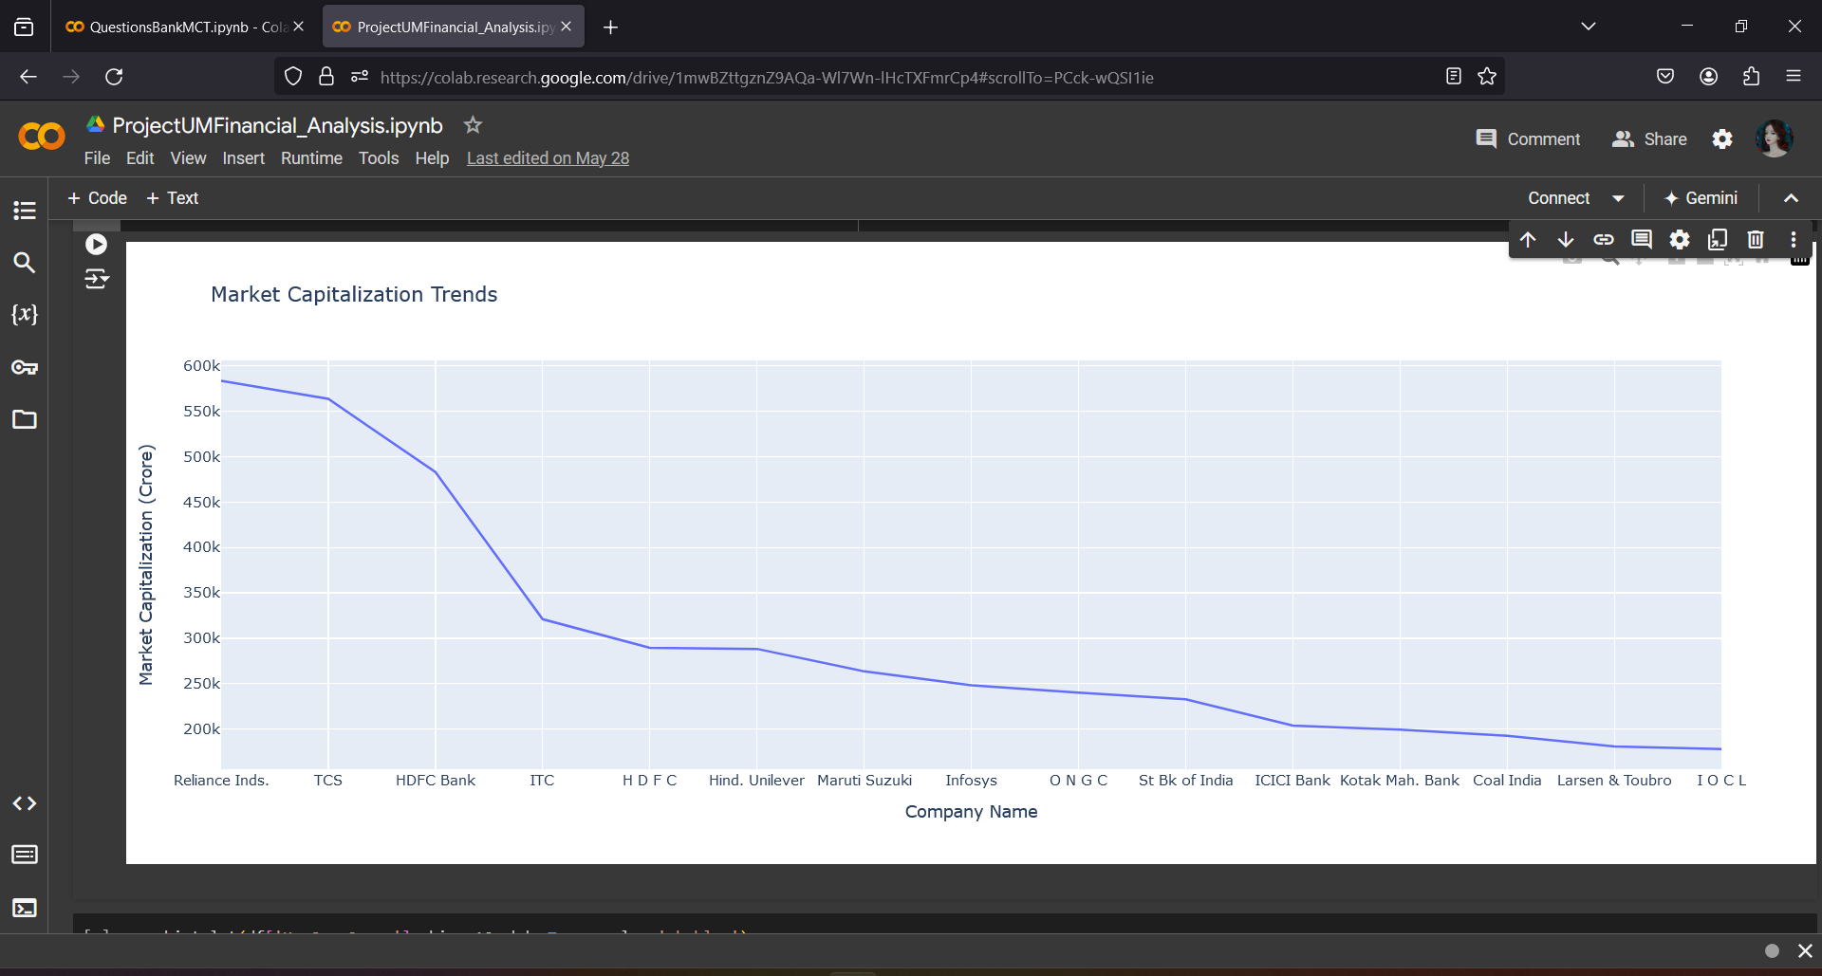
Market Capitalization Trends

Slide 4
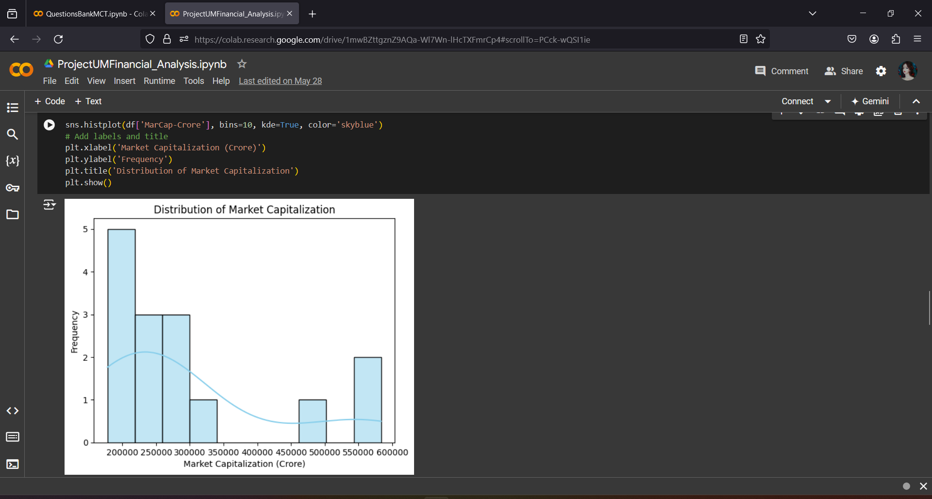
Distribution of Market Capitalization

Slide 5
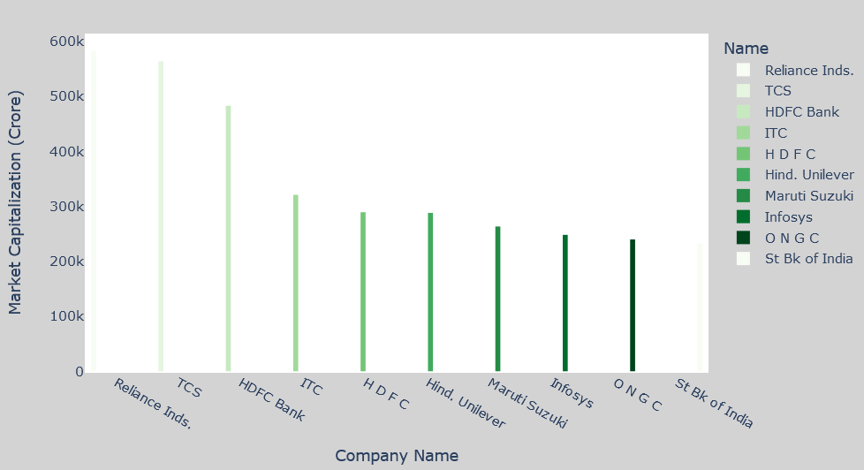
Market Capitalization of Top 10 Companies

Slide 6
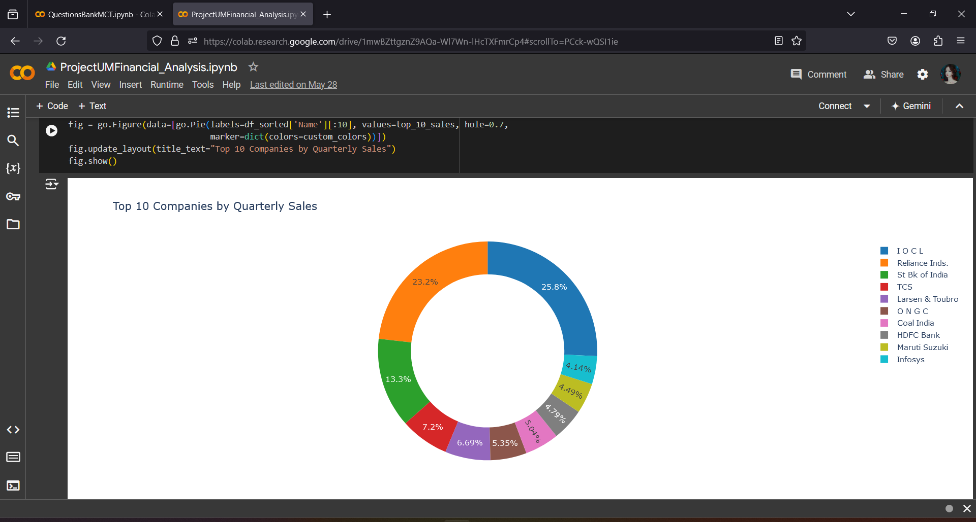
Top 10 Companies By Quarterly Sales

Slide 7
Detailed Analysis
Indian Oil Corporation Limited (IOCL) has consistently demonstrated robust quarterly sales performance.
In the most recent quarter, IOCL achieved remarkable sales figures, positioning it as a leader in the oil and gas sector.
The company’s revenue from operations during this period reflects its strong market presence and efficient business operations.
IOCL’s sales growth can be attributed

Slide 8
Thank You

