Slide 1
Crop Production Analysis
By Rajashree Gavali

Slide 2
Data Source
Primary Crop Production Data provided by the Indian Government from 1977 to 2015
Data contains detailed descriptions under the following sections:
State Name, District Name, Crop Year, Season, Crop type, Area and Production

Slide 3
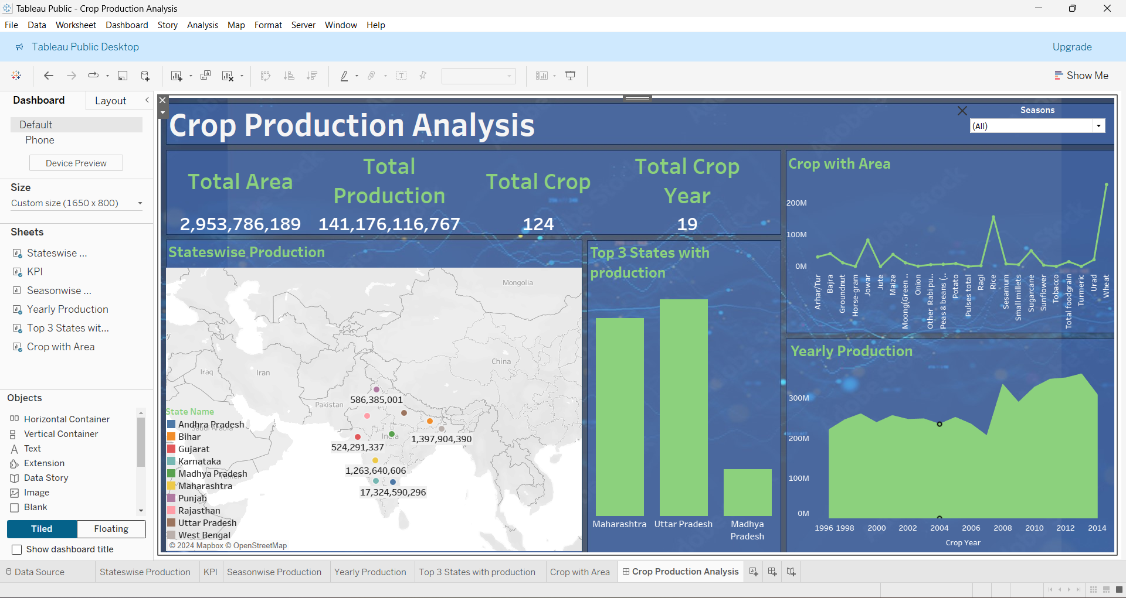
Highest Crop Producing States

Slide 4
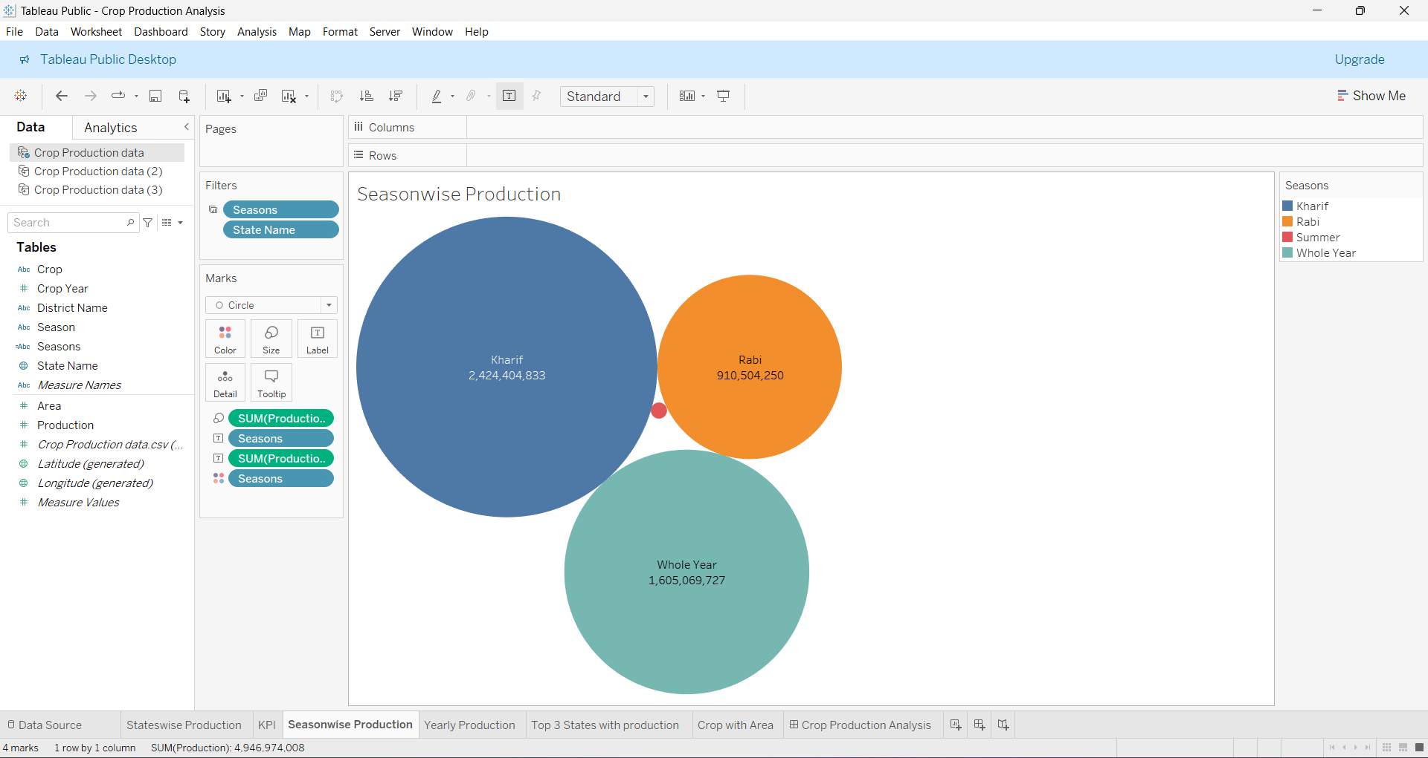
Season-wise Production

Slide 5
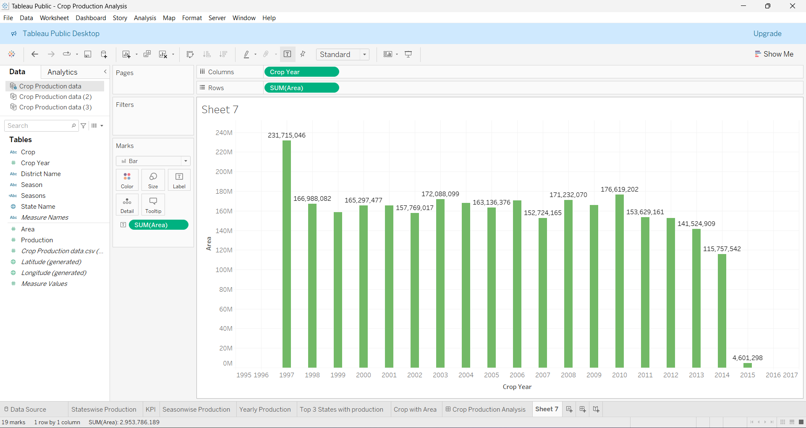
Yearly Production

Slide 6
Area under crop production

Slide 7
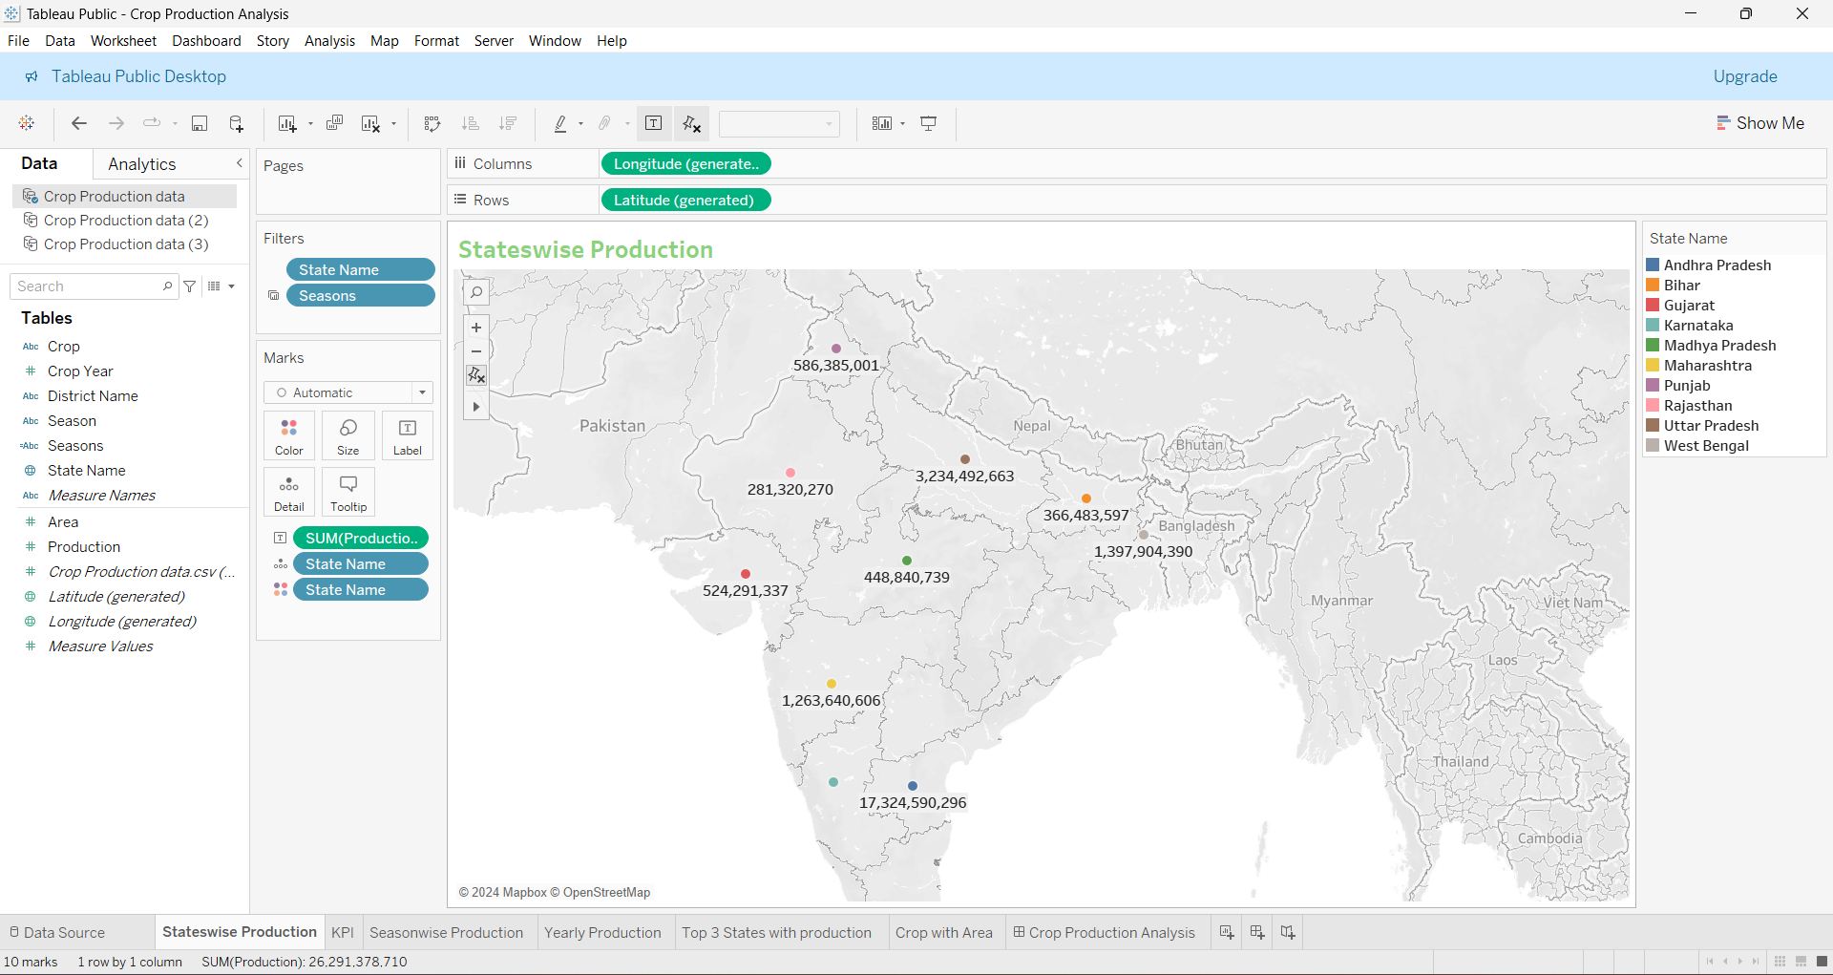
State wise production

Slide 8
Key Performance Indicators
Total Area
Total Production
Total Crop
Total Crop Year

Slide 9
Thank You

