Slide 1
CAR PRICE PREDICTION
Prepared by
Rajashri Sadafule Darveshi

Slide 2
Problem statement
With the covid 19 impact in the market, we have seen lot of changes in the car market. Now some cars are in demand hence making them costly and some are not in demand hence cheaper. With the change in market due to covid 19 impact, the previous ML models are not performing well.

Slide 3
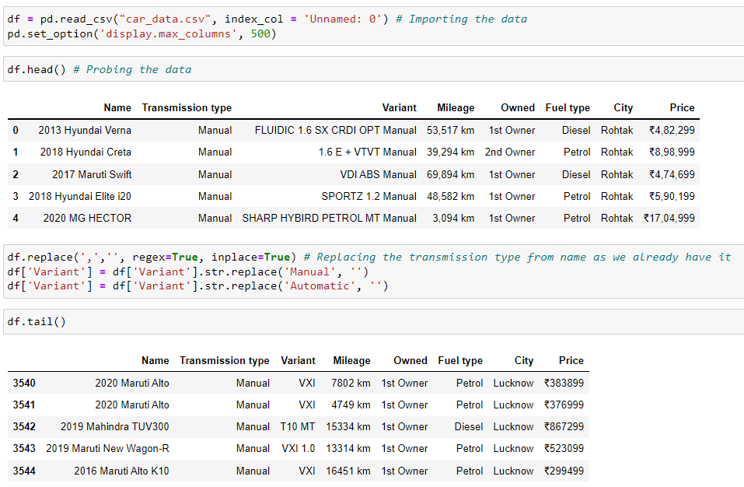

Slide 4
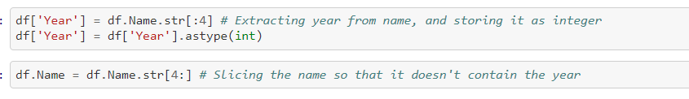
Data cleaning
Here I have removed the transmission type form the car name as it was a double entry
Extracting year from the car name and creating a new column containing the year

Slide 5
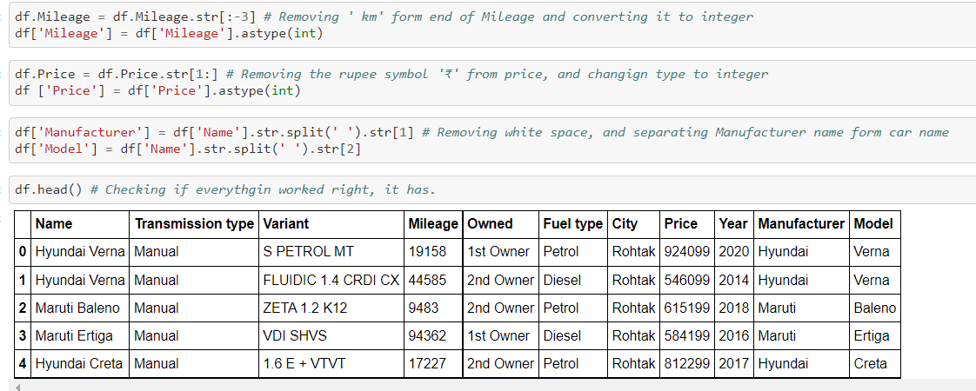
Extracting the car mode, and the cars manufacturer form the name.
Now name column is done its work and it can be dropped form the dataset.

Slide 6
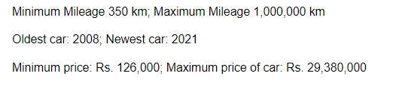
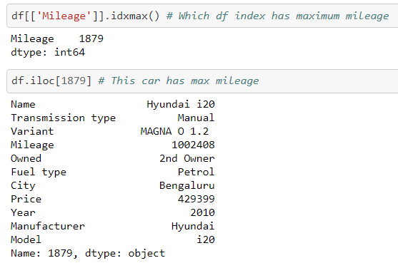
EDA
Lets dig deeper into the end points
Max mileage on this i20 car with a mileage of 1002408 and year 2010. the previous owner(s) drove a lot.

Slide 7
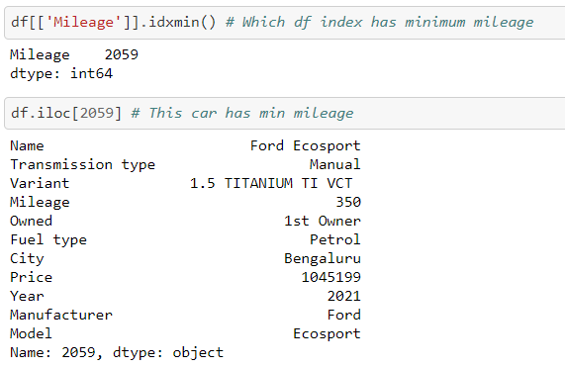
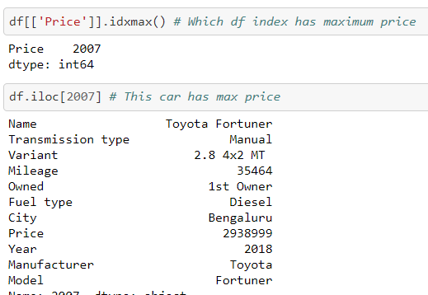
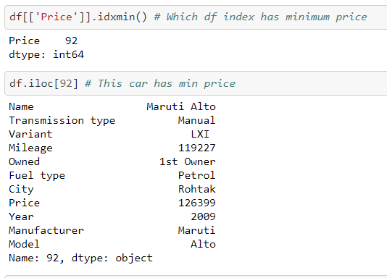
This ford eco sport has minimum mileage of just 350 km
Maximum price of car in data is this fortuner
Minimum price is of this Alto

Slide 8
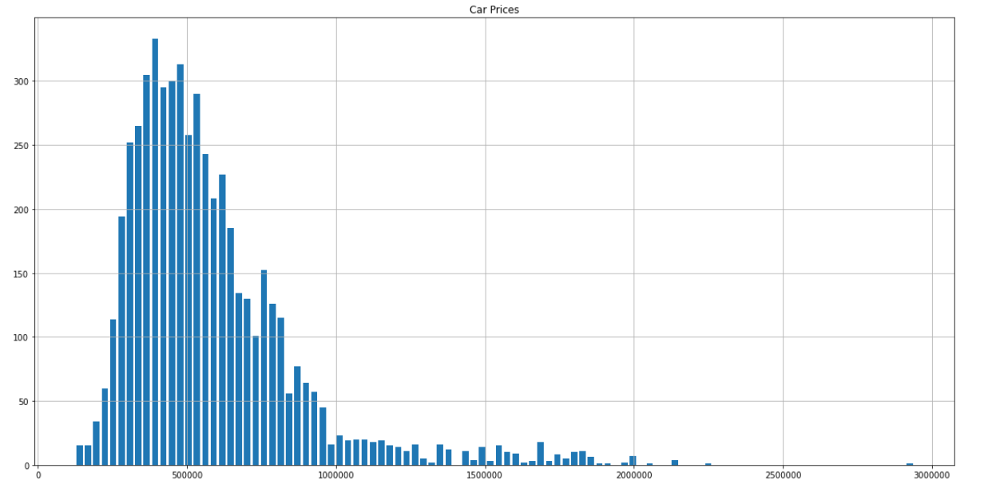
Car prices distribution
We can see we have quite some range on the prices of the cars.

Slide 9
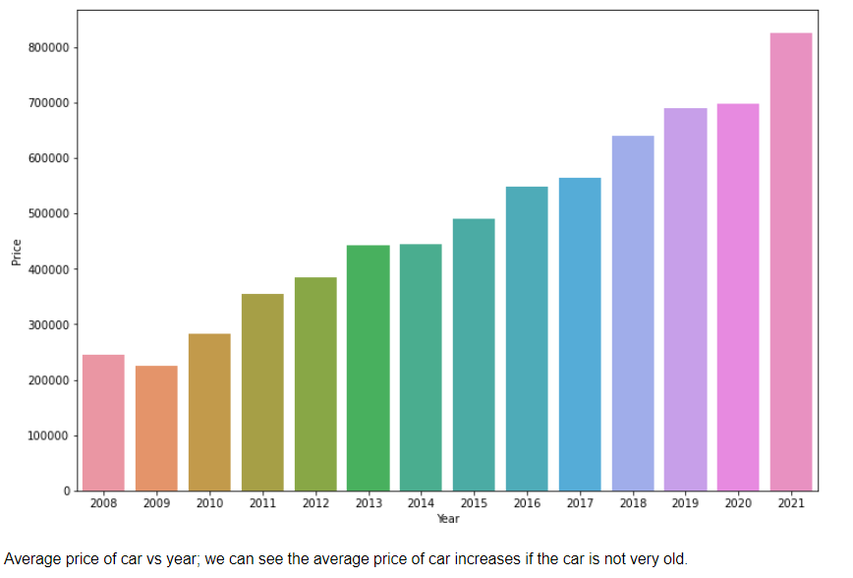
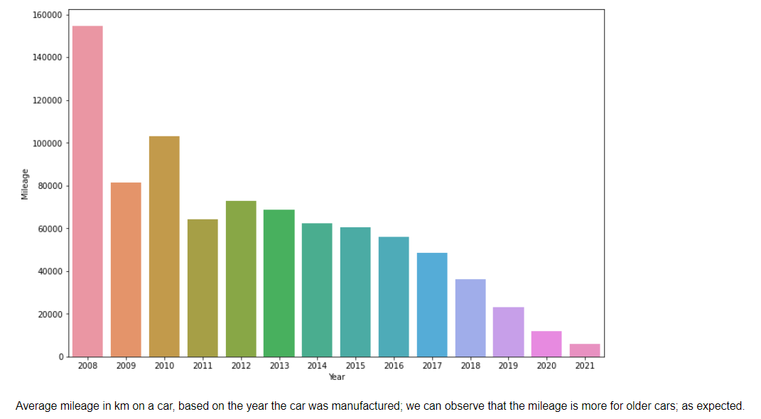
Car price and mileage stats based on year

Slide 10
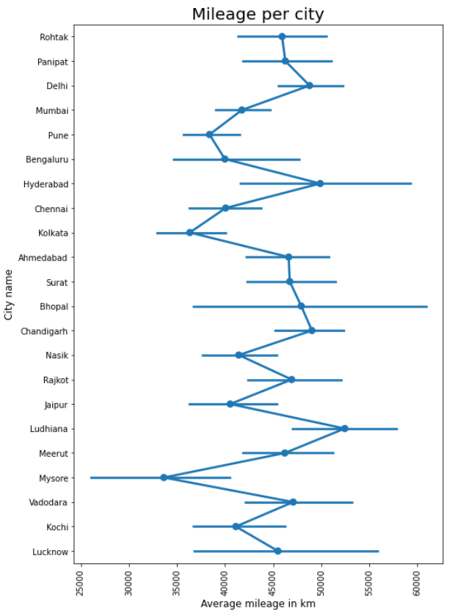
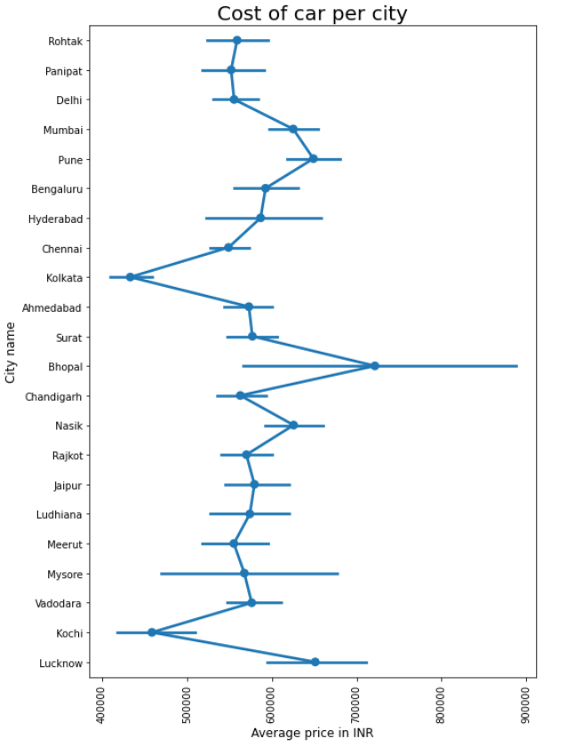
Average price of car according to city in which it was listed. Bhopal has the most expensive cars and Kochi has the least expensive cars.
Average mileage of car (in km) according to city in which it was listed. Ludhiiana has the most driven cars and Mysore has the least driven cars.

Slide 11
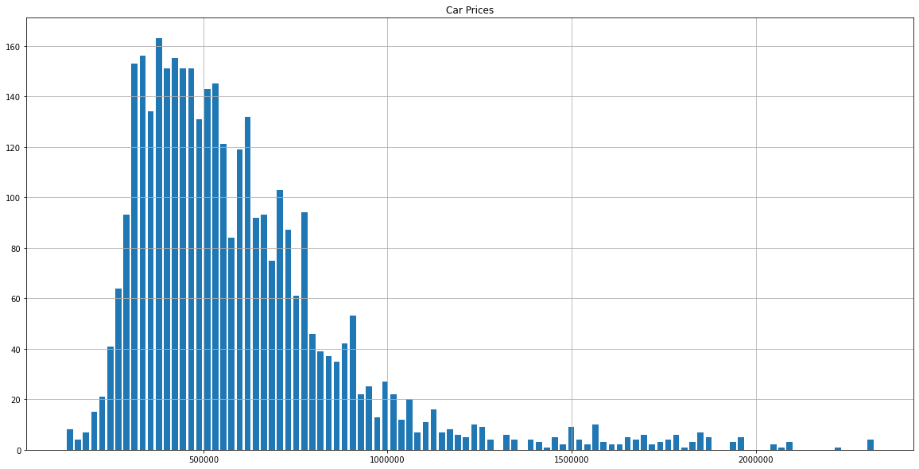
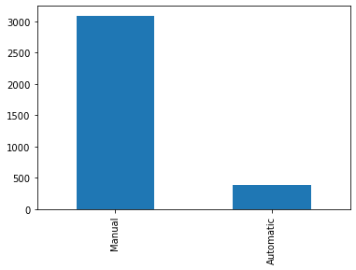
EDA
Looking at distribution of selling price of car, which is our target variable. We can observe that the distribution is right skewed
As expected cars which have automatic transmission are on average priced above Rs. 800,000 and cars which have manual transmission are on average price around Rs. 500,000

Slide 12
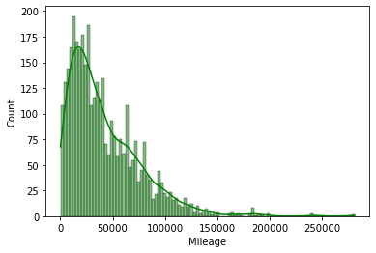
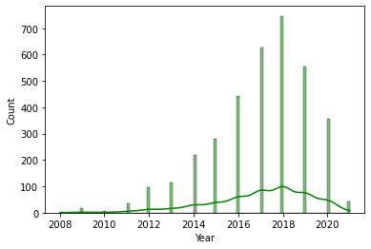
EDA
Most of the mileage of cars is less that 200,000 km
Most of the year range from 2012-2020

Slide 13
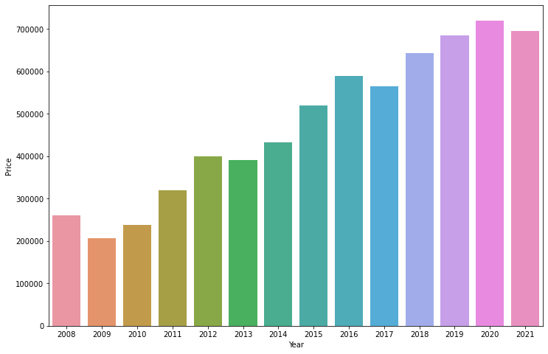
EDA
Average price of car vs year; we can see the average price of car increases if the car is not very old.

Slide 14
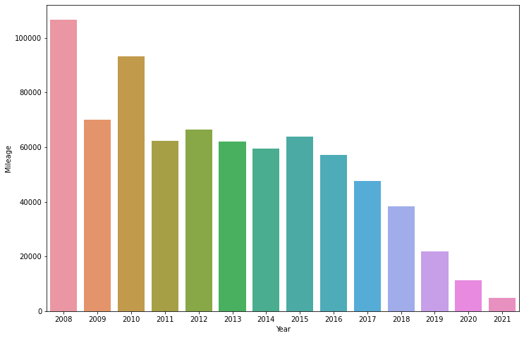
EDA
Average mileage in km on a car, based on the year the car was manufactured; we can observe that the mileage is more for older cars; as expected

Slide 15
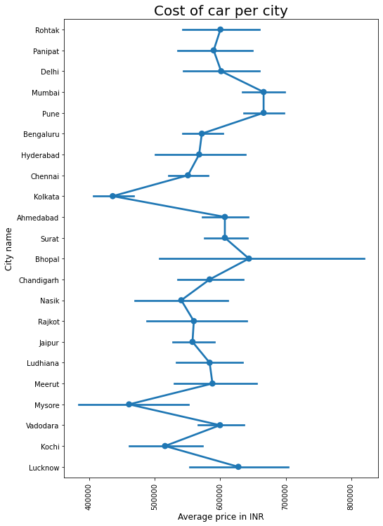
Average price of car according to city in which it was listed. Bhopal has the most expensive cars and Mysore has the least expensive cars

Slide 16
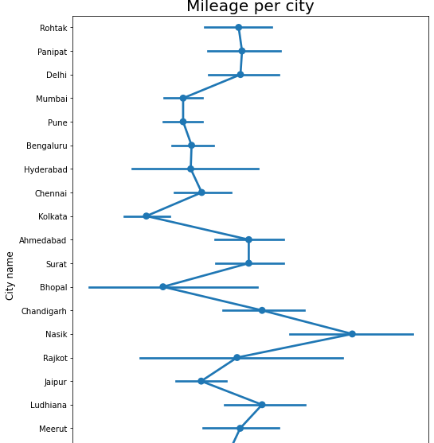
Average mileage of car (in km) according to city in which it was listed. Nashik has the most driven cars and Kolkata has the least driven cars

Slide 17
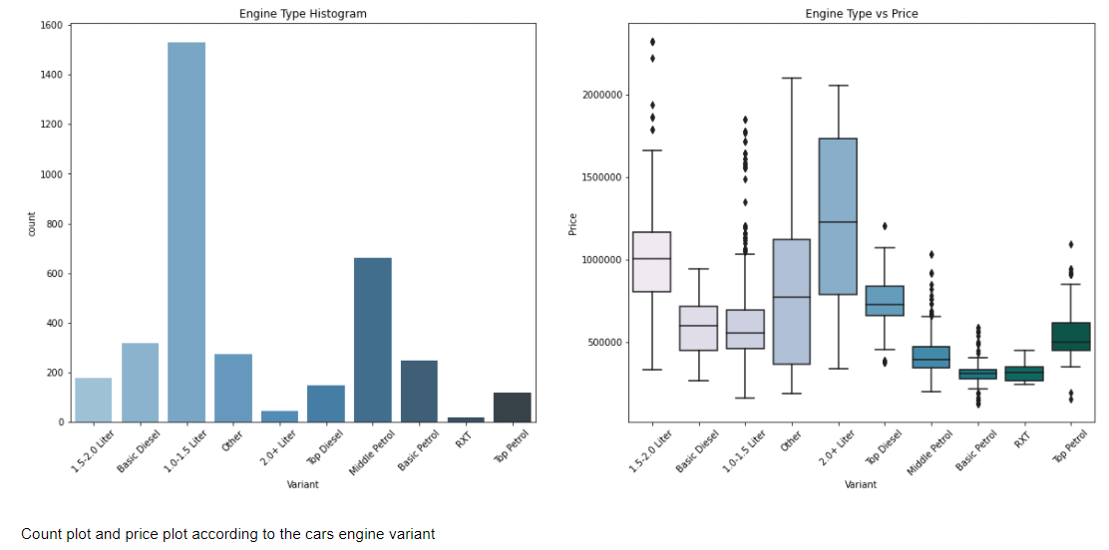
Plot of engine variant vs car

Slide 18
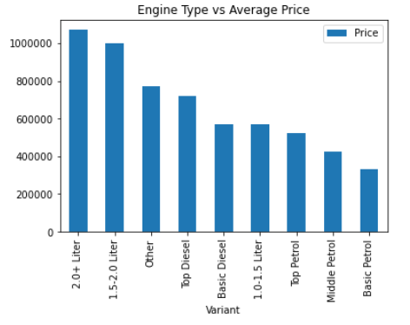
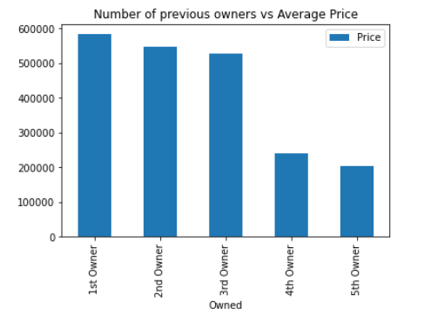
We can see that 2+ liter engine range is the most expensive engine size.
1.0-1.5 liter engines are cheaper and basic petrol is the cheapest
We can observe that as number of owners go up, the average price of car decreases, this is what one would expect.

Slide 19
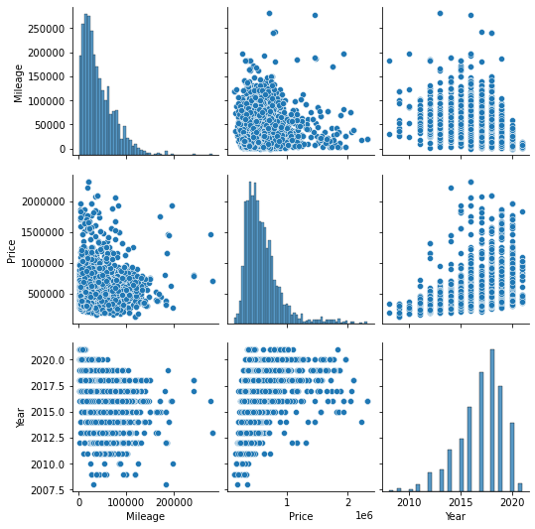
Multi variate analysis
Multi variate analysis between the various numerical variables. Year, Mileage and Price.

Slide 20
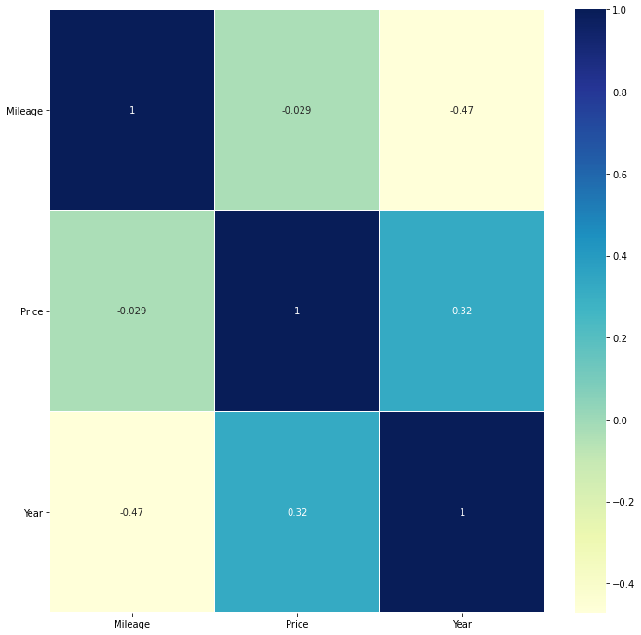
Heat map co-relation
We can see that price is negatively affected by mileage i.e. the more mileage a car has the lower its price.
And the price is positively co-related with the year, as newer the more expensive it is.

Slide 21
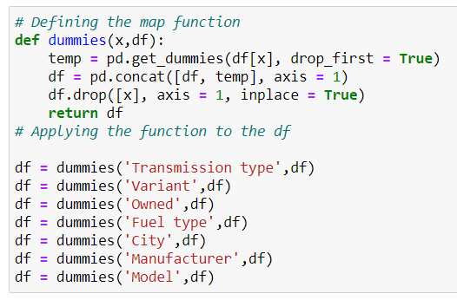
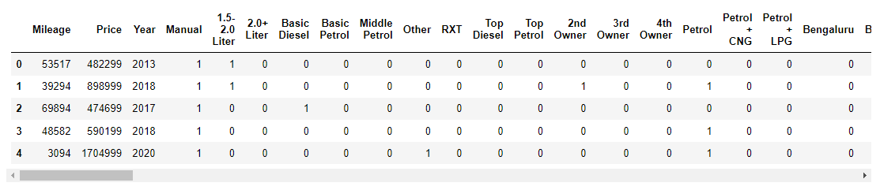
Data preprocessing
Creating a dummy function, and replacing these variables using the function.
This function basically creates dummy columns of the categorical variables

Slide 22
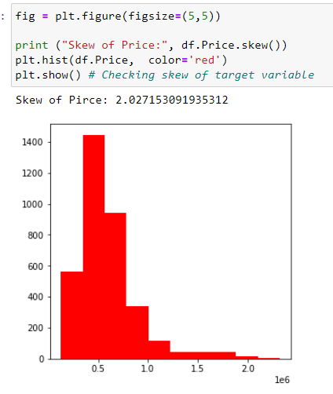
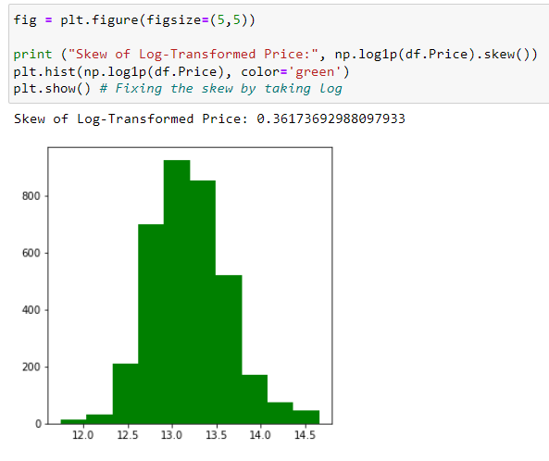

Slide 23
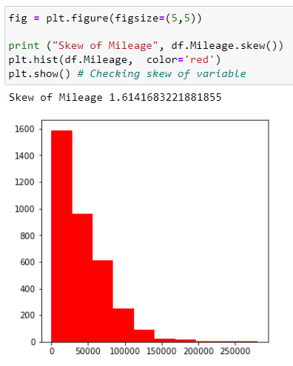
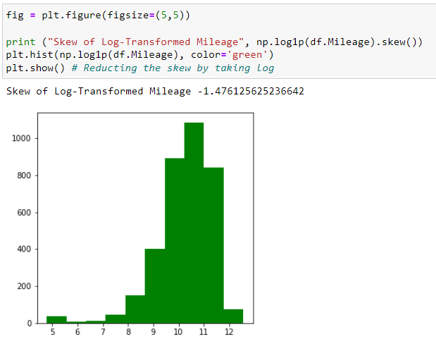

Slide 24
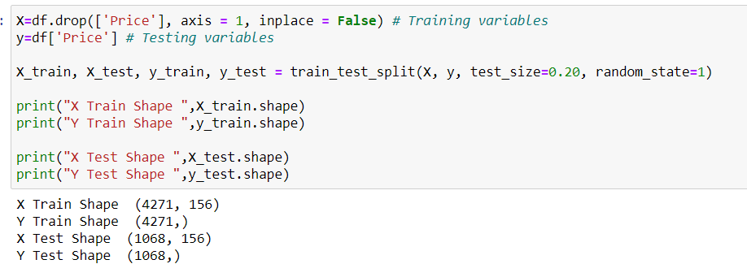
Model building
Price is the target variable. Here we can see the shape off the training and testing data. (80/20)

Slide 25
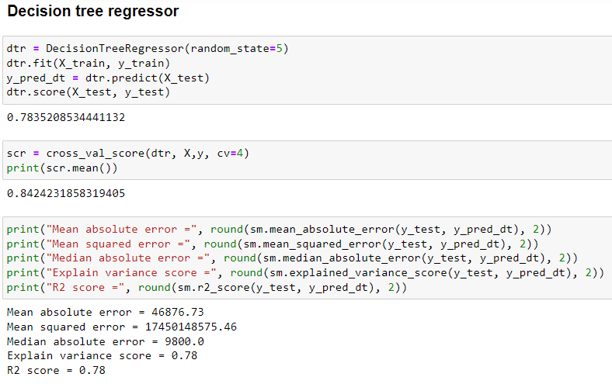

Slide 26
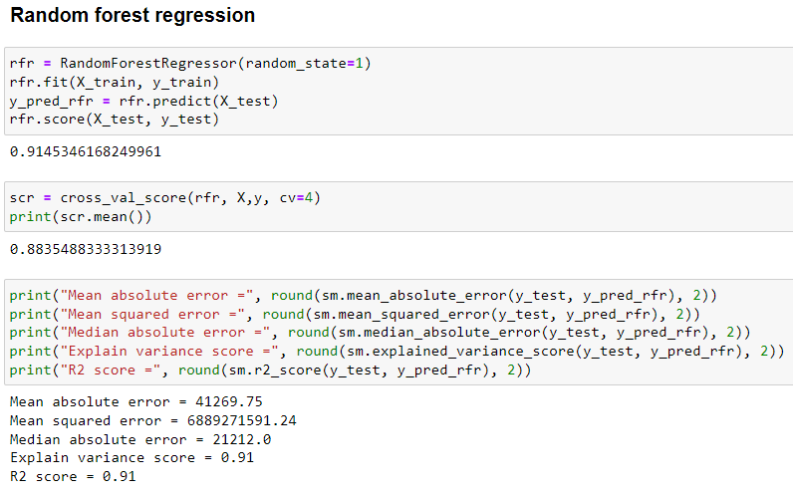

Slide 27
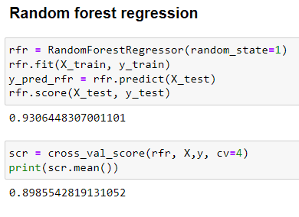
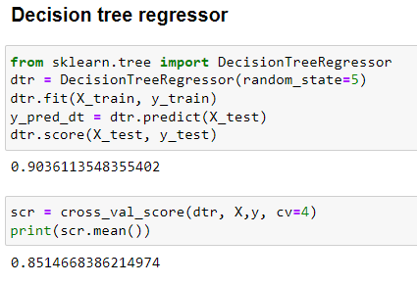

Slide 28
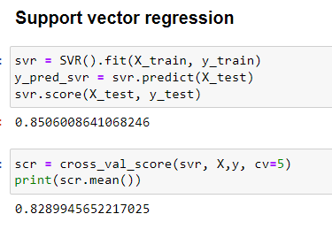

Slide 29
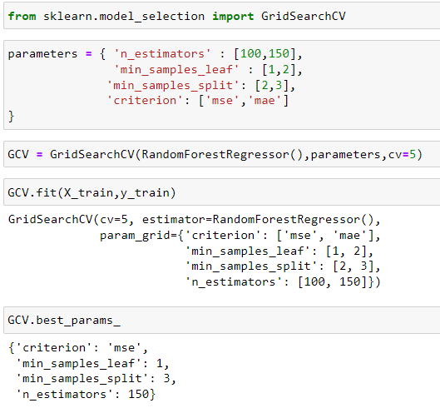
Hyper parameter tuning
Hyper parameter tuning was performed on the best performing algorithm, which was the random forest regression.
I will be performing hyper parameter tuning on the random forest regressor model, as it gave the best performance
These variables were selected, the tuning took many hours to complete.
The best parameters were used to train another accurate model.

Slide 30
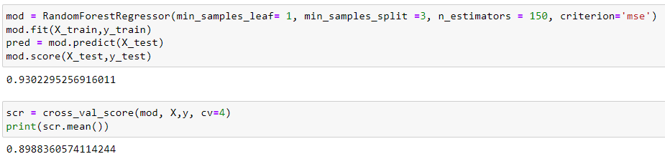
Training best model
This is the best model with a cross validation, R-squared result of 0.943
I will be performing hyper parameter tuning on the random forest regressor model, as it gave the best performance

Slide 31
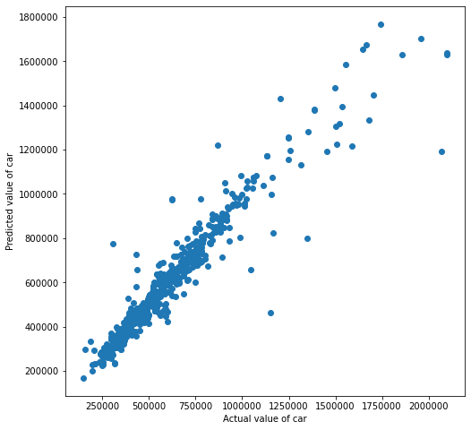
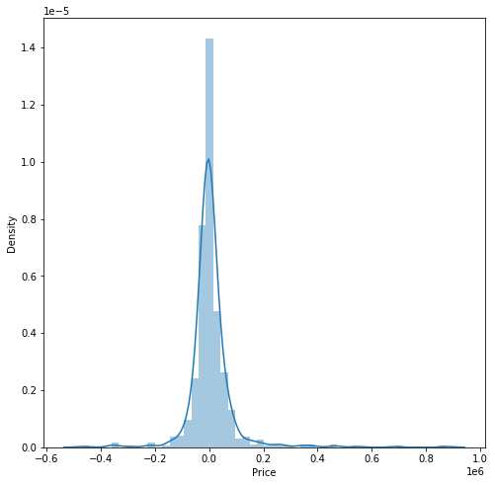
Scatter plot of predicted vs actual price
Distribution plot of (predicted value – actual value)
After observing these graphs we can conclude that the model is performing very well and it is ready to be sent to the vendors.

Slide 32
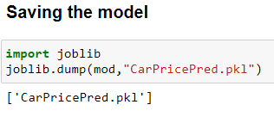
Saving random forest regressor model, as it gave the best performance

Slide 33
Thank You

