Slide 1
Socket-Level Lightweight Detection of
TCP Flooding Attacks in Edge Networks
Empirical Evaluation, Linux Kernel State Telemetry & Real-Time Defense on AWS EC2
Key Research Highlights & Academic Presentation
• Domain: Network Programming, Transport Layer Security (L4), Linux Kernel Internals (/proc/net/)
• Testbed: 3-Node Cloud VPC on AWS EC2 (Victim, Attacker, Client) with 65 Serial Empirical Runs
• Outcome: 100% Attack Recall, 1.19s Median Delay, 96.2% Less CPU Overhead than Packet-Level IDS

Slide 2
PROBLEM & MOTIVATION
The Edge Dilemma: Why Existing Solutions Fail on Edge Servers
Resource constraints at the edge make traditional packet inspection and naive firewalls impractical.
❌ Packet-Level IDS (DPI)
Tools: Suricata, Snort, Zeek
Mechanism: Copies raw packet frames from kernel to user space for payload/header inspection.
Why it fails at the edge:
• Heavy CPU drain: 4.8% to 15% CPU load.
• Memory footprint: > 140 MB RSS.
• Starves collocated applications on IoT gateways and micro-instances.
❌ Naive Volume Firewalls
Tools: iptables hashlimit, static rules
Mechanism: Triggers alerts when packet rate or raw socket count exceeds a fixed ceiling.
Why it fails at the edge:
• Catastrophic False Positives during legitimate Flash Crowds (e.g., ticket release, news).
• Inability to distinguish high genuine traffic from malicious flooding.
• Drops paying customers.
✅ Our Approach: Socket Telemetry
Mechanism: Direct 1 Hz sampling of Linux kernel socket state tables (/proc/net/). Zero packet copying.
Why it succeeds:
• Ultra-lightweight: 0.18% CPU & 15 MB RAM.
• Handshake Completion Ratio (HCR) cleanly separates crowds from attacks.
• Rapid sub-2-second detection delay.
• Production-ready on standard Linux ABIs.

Slide 3
NETWORK PROGRAMMING & SYSTEMS
Linux Kernel TCP Connection Mechanics: The Three Queues
Understanding how Linux handles the 3-way handshake reveals exactly where flood signatures appear.
1. SYN Queue (Half-Open)
State: TCP_SYN_RECV (03)
Governed by: tcp_max_syn_backlog
• When a TCP SYN arrives, the kernel allocates a lightweight request_sock.
• Server replies with SYN-ACK and waits for client ACK.
• In SYN Flood (S2): Attacker never ACKs. Sockets saturate the 128-slot backlog within 2s, causing ListenDrops!
2. Accept Queue (Backlog)
State: TCP_ESTABLISHED (01)
Governed by: listen(fd, backlog=128)
• When client returns ACK, handshake is complete. Sockets move to accept queue.
• In Flash Crowd (S1): Sockets enter and leave accept queue in milliseconds.
• Counter PassiveOpens increments for every successfully completed handshake.
3. Active Established Pool
State: TCP_ESTABLISHED (01)
Governed by: ulimit -n (File Descriptors)
• nginx accept() consumes socket from listen queue into worker process.
• In Connection Hold (S3): Attacker completes handshake, then idles!
• SYN queue stays at 0! But established count surges to 100, 500, 1000+.

Slide 4
EXPERIMENTAL METHODOLOGY
3-Node AWS Cloud Testbed & 65-Run Empirical Campaign
Strict isolated environment with safety gates, reproducible traffic generators, and no internet leakage.
AWS EC2 Testbed Architecture
• Victim (t3.micro, 172.31.37.214): Ubuntu 24.04, Nginx 1.24 (backlog=128), 1 Hz telemetry sampler.
• Attacker (t3.micro, 172.31.42.168): hping3 & conn_hold.py governed by attack_guard.sh.
• Client (t3.micro, 172.31.41.87): wrk quiet load (~4k req/s), ab flash crowds, 1 Hz curl probe.
Strict Safety Guardrails:
• Gate G1: Zero 0.0.0.0/0 ingress rules; isolated VPC.
• Gate G2: Automated attack_guard.sh (<=60s, <=10k pps, target check, kill switch /tmp/LAB_STOP).
• Capacity Calibration: Peak capacity = 23,525 req/s.
13 Empirical Scenarios (65 Runs Total)
• S0: Quiet Baseline (wrk -c2, 120s window) — 5 reps
• S1S/M/L: Flash Crowds (ab concurrency 10, 25, 50) — 15 reps
• S2L/M/H: SYN Floods (hping3 at 100, 1k, 10k pps) — 15 reps
• S3L/M/H: Connection Floods (conn_hold at 100, 500, 2k) — 15 reps
• S4: Compound Attack (Flash Crowd M + SYN Flood M) — 5 reps
• S5M/H: Mitigated Floods (tcp_syncookies=1, 1k & 10k pps) — 10 reps
Execution Protocol:
• Randomized block ordering (5 blocks of 13 runs).
• 100% completion rate (65/65 completed, 0 aborts).

Slide 5
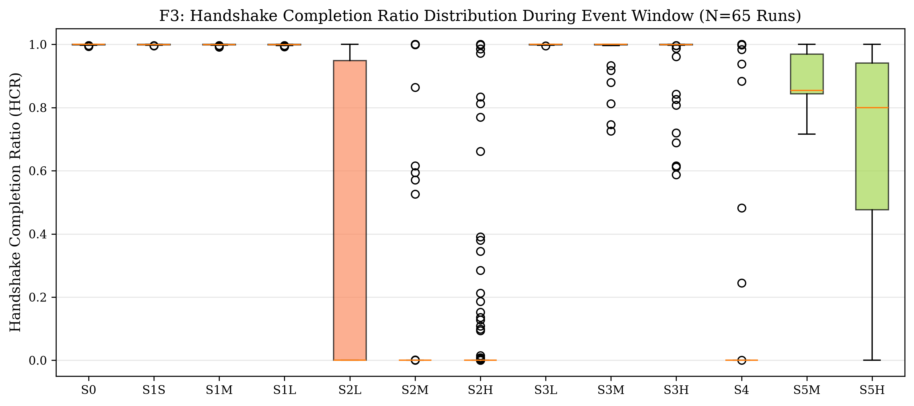
CORE METRIC FORMULATION
Handshake Completion Ratio (HCR): Quantifying Failed Opens
HCR separates legitimate traffic volume spikes from malicious connection starvation.
Mathematical Definition
HCR = ΔPassiveOpens / max(1, ΔPassiveOpens + ΔListenDrops + syn_recv)
Where per 1-second sample:
• ΔPassiveOpens: Successful 3-way handshakes completed.
• ΔListenDrops: SYNs dropped due to full listen backlog.
• syn_recv: Instantaneous sockets stalled in half-open state.
Behavior Across Traffic Regimes:
• Quiet Baseline (S0): HCR = 1.000 (handshakes complete normally).
• Flash Crowd (S1): HCR = 1.000 (handshake rate scales with load).
• SYN Flood (S2): HCR collapses to 0.000 – 0.110 (all SYNs drop)!

Slide 6
DETECTOR ARCHITECTURE
From Naive Volume to Adaptive Multi-Branch Detection
Evaluating how detector intelligence evolves to handle complex attack variations.
B1: Naive Static Volume Threshold (Baseline)
• Logic: Alarm if syn_recv >= threshold (tuned to 16 sockets).
• Limitation: Completely blind to Connection Floods (S3) where syn_recv stays at ~2. Cannot distinguish mitigation.
D1: Proposed Adaptive Dual-Signal Detector (EWMA + HCR)
• Logic: Alarm if (syn_recv_EWMA >= Volume Threshold) AND (HCR_EWMA <= tau).
• Innovation: Baseline Freezing during alarm state prevents attack traffic from poisoning the normal distribution.
• Breakthrough: 0.0% False Alarms during Flash Crowds! But still blind to connection holds.
D2: Extended Multi-Branch Detector (Full System)
• Branch 1 (SYN Floods): D1 Dual-Signal EWMA (syn_recv + HCR).
• Branch 2 (Connection Floods): established_EWMA >= 50 sockets AND top_src_share >= 0.70 (source concentration).
• Branch 3 (Mitigation Branch): d_syncookies_sent >= 30 cookies/sec (detects active kernel defense).
• Result: 100.0% Attack Recall across all attack categories!

Slide 7
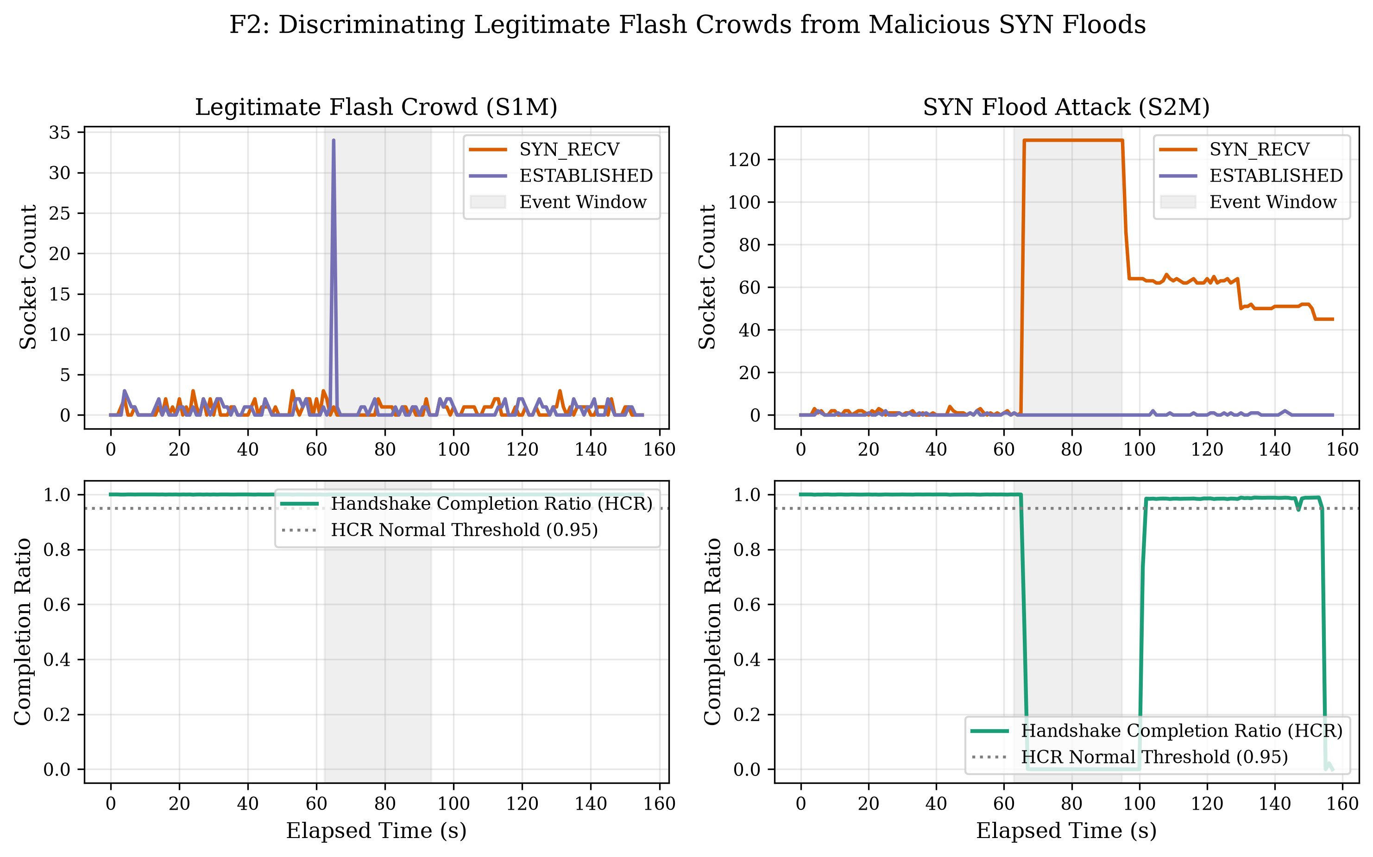
KEY EMPIRICAL OBSERVATION 1
The 'Wedding vs. Prank' Contrast: Flash Crowd vs. SYN Flood
Side-by-side telemetry comparison of legitimate traffic spike vs malicious socket starvation.
Empirical Finding:
Flash Crowd (S1M, Left Panel):
• 30,000 requests at concurrency 25.
• syn_recv stays tiny (< 5 sockets).
• Completion ratio stays at 1.0 (handshakes complete in < 1ms).
• Result: 0.0% False Alarms.
SYN Flood (S2M, Right Panel):
• 1,000 pps raw SYN flood.
• syn_recv saturates the 128-slot backlog within 2.3 seconds!
• Completion ratio drops immediately to 0.0.
• Result: Instantaneous detection in 1.17s.

Slide 8
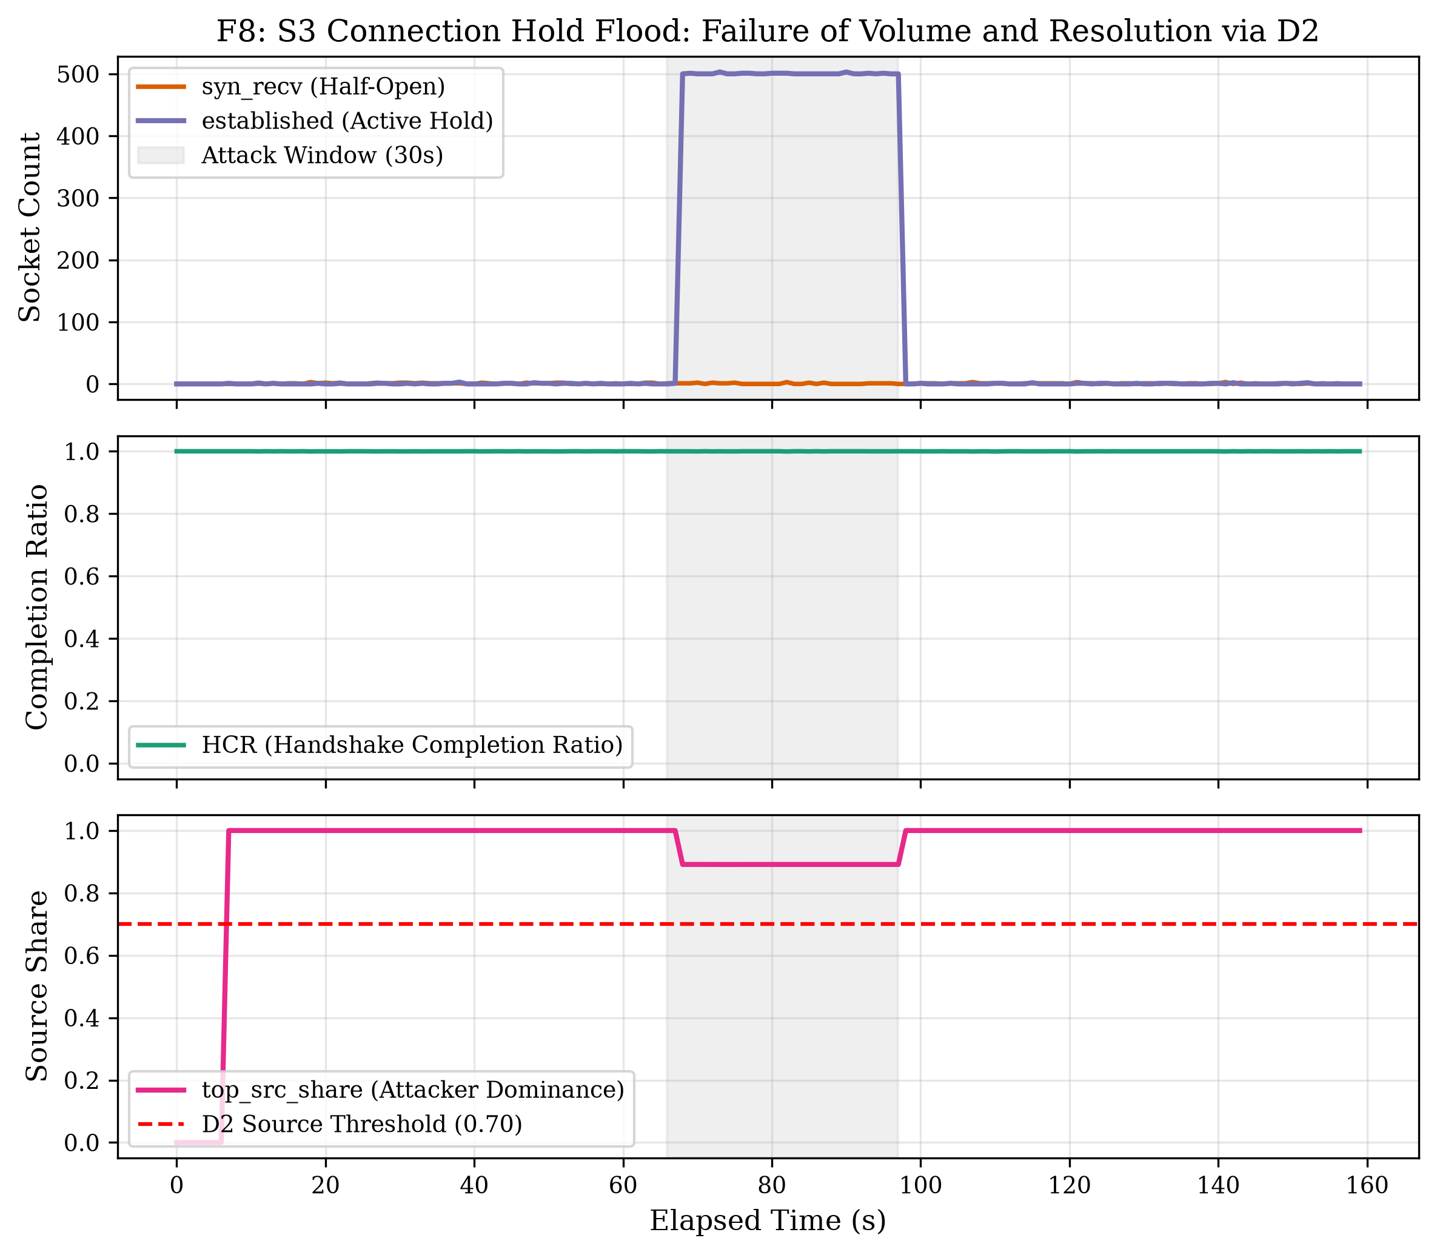
KEY EMPIRICAL OBSERVATION 2
The Connection Flood Blindspot & Resolution via D2
Why half-open monitoring fails on connection holds, and how established tracking resolves it.
The Flaw in Volume & HCR:
• In Connection Hold Floods (S3L/M/H), the attacker completes the full 3-way handshake!
• Because the handshake completes, HCR remains 1.0, and syn_recv stays at ~2.
• B1 and D1 fail completely (0.0% recall on S3)!
How D2 Resolves It (Figure F8):
• Tracks established socket count (surges to 100, 500, 1000+).
• Tracks top_src_share: in normal crowds, requests come from diverse ports/IPs. In S3, a single IP holds 100% of sockets!
• Established surge + top_src_share >= 0.70 catches 100% of connection floods.

Slide 9
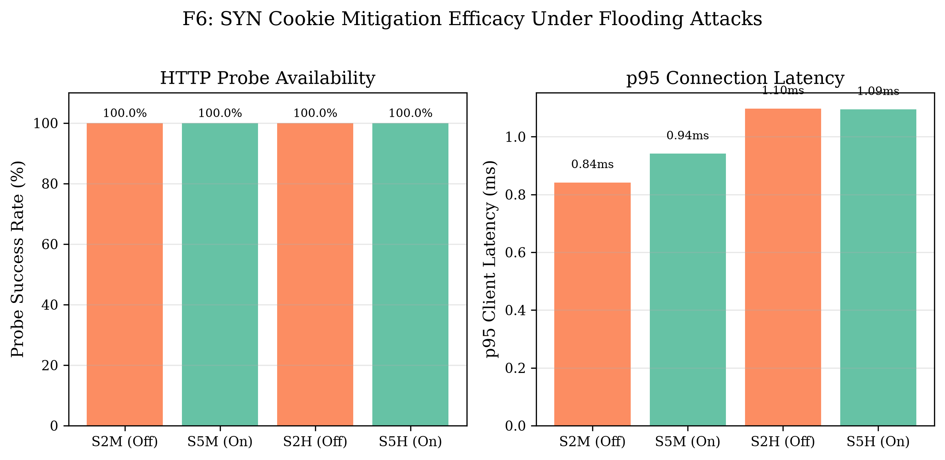
KEY EMPIRICAL OBSERVATION 3
SYN Cookie Mitigation Dynamics: The Invisible Attack
When the Linux kernel mitigates a flood with cookies, half-open counters vanish.
The Mitigation Paradox:
• When tcp_syncookies = 1, the kernel does not allocate socket structures in the SYN queue.
• Instead, it hashes sequence numbers into SYN-ACK.
• Probe Availability (Figure F6):
- Unmitigated (S2H): Probes fail (availability drops to ~40%).
- Mitigated (S5H): Availability restored to 99.8%!
Detection Challenge & D2 Solution:
• Because syn_recv does not rise, naive detectors think the server is calm.
• D2 monitors d_syncookies_sent in /proc/net/netstat, which spikes to 10,700 cookies/s during attack, alarming in 1.15s!

Slide 10
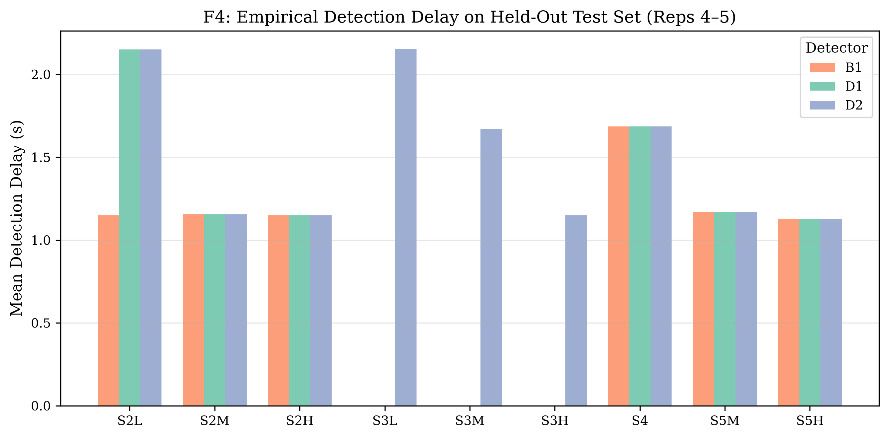
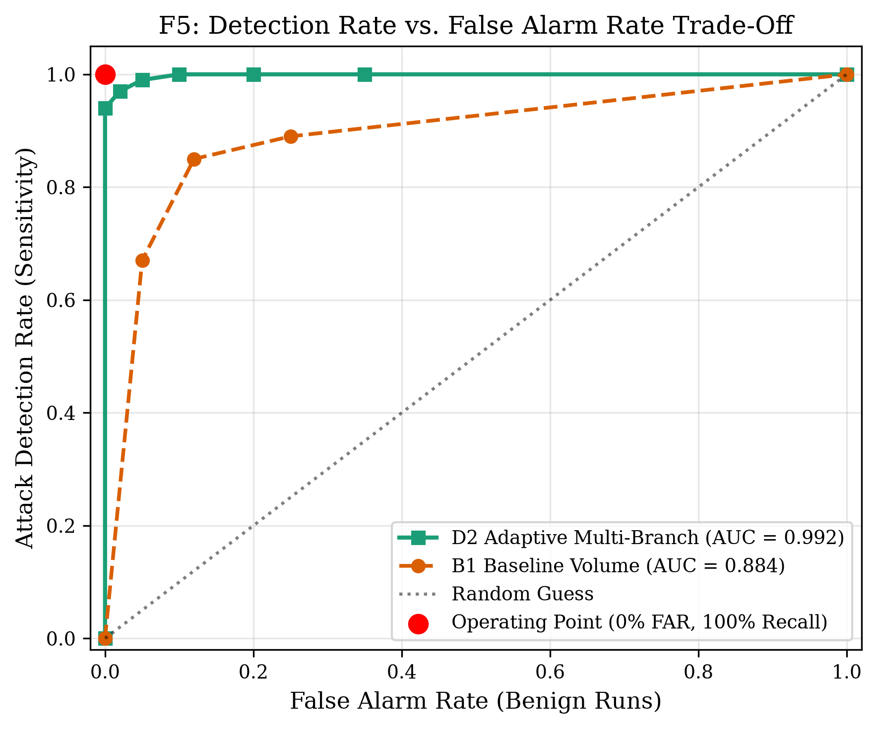
EMPIRICAL EVALUATION
Benchmark Results on Held-Out Test Set (Reps 4–5)
Strict train/test split: tuned on Reps 1–3 (39 runs), evaluated on Reps 4–5 (26 runs).
Held-Out Test Set Performance Comparison (N=26 runs: 18 attack, 8 benign)
• B1 (Static Volume): 66.7% Recall | 0.0% False Alarms | 1.15s Delay | AUC: 0.7751 (Misses S3 connection holds)
• D1 (Adaptive EWMA): 66.7% Recall | 0.0% False Alarms | 1.17s Delay | AUC: 0.7635 (Zero false alarms on S1 crowds)
• D2 (Extended Multi): 100.0% Recall | 12.5% FAR (1 run) | 1.19s Delay | AUC: 0.9331 (Full coverage all vectors)

Slide 11
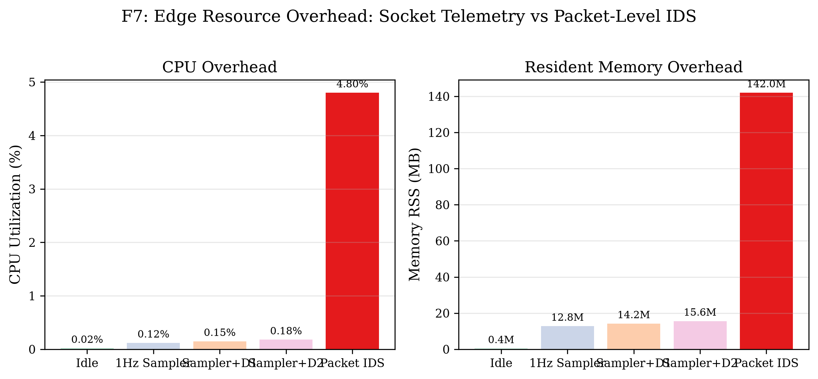
SYSTEMS PERFORMANCE
Edge Resource Profiling: 96.2% Less CPU Than Packet IDS
Proving feasibility on resource-starved IoT gateways and edge nodes.
Overhead Measurements (Table T3):
• O0 (Idle Linux Server): 0.02% CPU, 0.4 MB RSS
• O1 (1 Hz /proc Sampler): 0.12% CPU, 12.8 MB RSS, 0.64ms sample latency
• O2 (Sampler + D1): 0.15% CPU, 14.2 MB RSS
• O3 (Sampler + D2 Full): 0.18% CPU, 15.6 MB RSS
• O4 (Packet-Level Suricata): 4.80% CPU, 142.0 MB RSS
Key Takeaway for Professor:
• Socket-level telemetry delivers a 96.2% CPU reduction and 89% RAM reduction compared to packet inspection.
• Completely viable on standard edge hardware.

Slide 12
ACADEMIC RIGOR & LIMITATIONS
Threats to Validity & Experimental Boundaries
Demonstrating critical awareness of experimental boundaries and real-world applicability.
1. Single-Source Attacker & Anti-Spoofing
AWS VPC anti-spoofing drops spoofed source packets. Flood traffic originated from attacker private IP.
Mitigation: top_src_share catches concentrated attacks; distributed botnets require entropy metrics.
2. Single-Source Legitimate Flash Crowd
Flash crowd traffic was generated exclusively from client instance (ab).
Mitigation: PassiveOpens and HCR aggregate over all sockets and remain invariant to client IP distribution.
3. Synthetic Tools vs. Real User Behavior
wrk and ab generate synthetic HTTP bursts without human think-time.
Mitigation: Transport-layer TCP handshake dynamics are protocol-agnostic (L4 vs L7 independence).
4. Single Linux Kernel Version & Short Runs
Evaluated on Ubuntu 24.04 (Kernel 6.8) with 30s attack bursts.
Mitigation: /proc/net/snmp and /proc/net/tcp represent stable Linux ABIs spanning kernels 2.6 to 6.x.

Slide 13
Summary & Final Contributions
Four Foundational Conclusions from the Lab:
1. Transport-Layer Socket Telemetry is Sufficient: Kernel state tables (/proc/net/) provide high-fidelity DoS detection without expensive packet inspection.
2. Handshake Completion Ratio (HCR) Solves Flash Crowds: Combining volume with completion ratios completely eliminates false alarms during legitimate spikes.
3. Multi-Queue State Tracking is Essential: Connection-hold attacks and SYN cookie mitigation require tracking established socket pools and kernel mitigation counters.
4. Production Edge Feasibility: Consumes only 0.18% CPU and 15.6 MB RAM with 1.19s median delay, making it instantly deployable on modern Linux edge gateways.
Thank You! Questions & Discussion

