Slide 1

Global Unicorn Startup Analysis: Identifying High-Success Countries & Industries
A Data Analytics Project using SQL and Excel
Raja Sree Samala

Slide 2


PROBLEM STATEMENT
Business Question:
  Which countries have the strongest unicorn funding environments?
  Which industries attract the most investment in those countries?
Why it matters:
  Founders need to know where to start their startup for best access to capital.
  Investors want to understand which geographic markets and sectors have the highest deal flow.
  Understanding funding patterns helps predict where the next billion-dollar successes are most likely.

Slide 3







DATASET OVERVIEW
Time Period
Source
Kaggle - global unicorn companies dataset (startups valued at >=1B USD)
unicorns thhat reached unicorn status between 2007 and 2022
Records and Global coverage
Key fields used
  Country
  Industry
  Year founded
  year joined (unicorn year)
  Total raised
  Valuation
1,037 unicorn companies in 46 countries across all continents

Slide 4





METHODOLOGY
Tools Used: MySQL (phpMyAdmin) for data cleaniing and aggregation, Excel for Pivot Tables and charts.
Data Cleaning: Converted funding text ($7.44B / $500M) into a numeric column in millions of USD using a CASE + REPLACE SQL update.
Analysis Approach:
  Grouped unicorns by country to find top 5 countries by total funding.
  For those countries, grouped by industry to calculate number of unicorns and total funding per industry.
  Exported results to Excel and built a pivot chart.

Slide 5



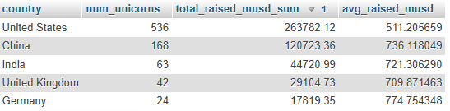

KEY FINDING #1 - TOP 5 COUNTRIES BY TOTAL RAISED
SQL Query
Result
  The United States and China together account for around 66% of total unicorn funding in the dataset.
  India, UK, and Germany emerge as secondary hubs with significant startup ecosystems.

Slide 6
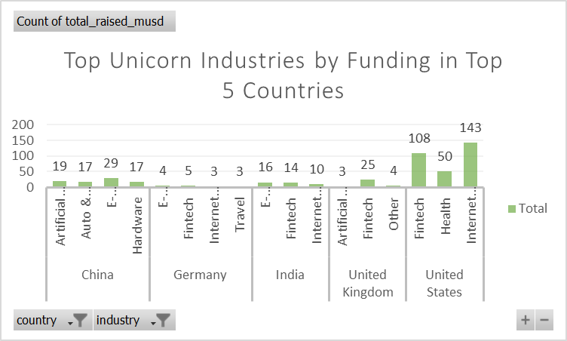
KEY FINDING #2 - TOP UNICORN INDUSTRIES BY FUNDING IN TOP
5 COUNTRIES (MAIN VISUALIZATION)
  Fintech, Health and Internet software & services lead in the United States.
  E-commerce and direct-to-consumer emerges as the top funded industry in India and Germany.
  China and UK shows unique success in Aritificial Intelligence.

Slide 7
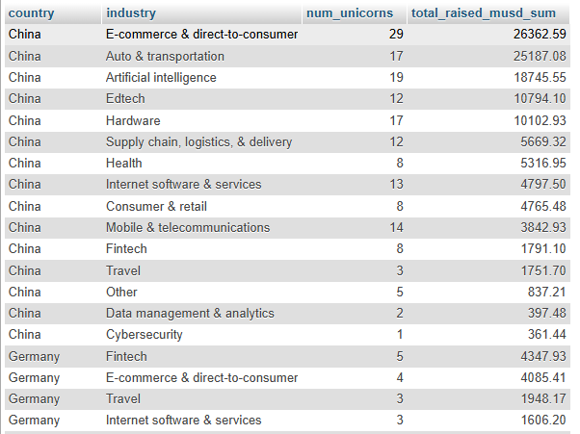
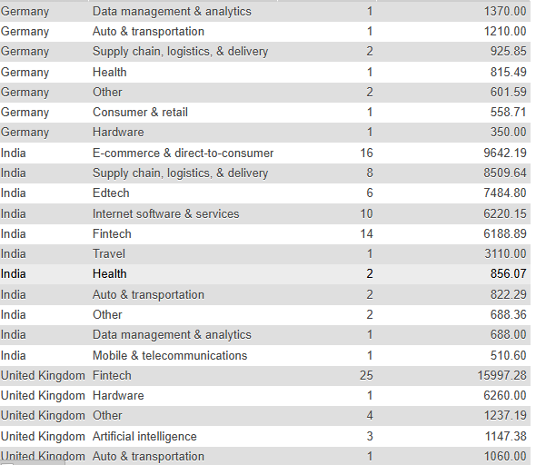
INDUSTRY BREAKDOWN (DETAILED TABLE)
Funding Distribution by Industry Within Top 5 Industries

Slide 8
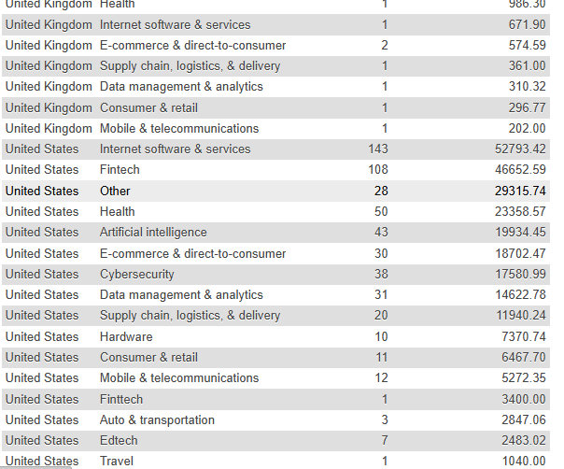
INDUSTRY BREAKDOWN (DETAILED TABLE)
Funding Distribution by Industry Within Top 5 Industries
  Consumer platforms (e-commerce, fintech) attract consistent funding across all top countries, while AI and Health Tech sho regional variation.

Slide 9
KEY INSIGHTS AND STRATEGIC IMPLICATIONS
For Founders - Choose Your Market by Industry:
  United States diminates overall (301 unicorns, fintech leads with 108) - best for consumer tech, fintech, and software-as-a-service.
  China excels in e-commerce & direct-to-consumer (29 unicorns) and AI (52 unicorns) - prioritize if building consumer platforms or AI products.
  India emerging strong in fintech (14) and e-commerce (16) - lowest capital requirements but fastest-growing market.
  Germany focuses on secialized tech: E-commerce (15), fintech (5), and AI (4) - niche but quality funding.

Slide 10
KEY INSIGHTS AND STRATEGIC IMPLICATIONS
For Investors - Industry Trends:
  Fintech is globally consistent (top 3 in US, India, UK) - proven scalable model.
  E-commerce & direct-to-consumer dominate China and India - Asia-Pacific consumer boom.
  AI is emerging fast (52 in China, growing in US) - future frontier.
Market-Specific strategy:
  Start in US/China for largest capita; pools: pivot to India for cost efficiency and growth.

Slide 11
LIMITATIONS AND CAVEATS
  Data represents only unicorns (companies already valued at $1B+), not all startups—survivorship bias exists.
  Funding amounts are aggregated total raised, not first-round or timing-adjusted.
  Company headquarters location may not reflect actual investor geography or market dynamics.
  Dataset snapshot: represents unicorns as of a specific date (not continuously updated).

Slide 12
CONCLUSION & NEXT STEPS
Summary:
  This analysis reveals that unicorn funding is concentrated in the United States, China, and emerging hubs like India and Germany.
  Industry choice matters: consumer tech dominates globally, but regional preferences vary.
Future Research:
  Analyze success rate by industry and country (which sectors actually exit profitably?).
  Track funding round trends over time (do newer unicorns raise faster?).
  Study post-unicorn performance (do larger funding amounts correlate with higher valuations?).

Slide 13
TAKEAWAY
"Data-driven decisions help founders choose ecosystems and industries where capital is flowing—and success is most likely."

Slide 14


github.com/Rajasree37-pixel
Thank You
www.linkedin.com/in/rajasree-samala

