Slide 1
BANK MANAGEMENT SYSTEM
Rajat dabade 2015bcs056
Aniket baad 2015bcs062
Ankush khobragade 2015bcs070

Slide 2
Introduction
Bank Management System provides a web interface to manage the bank accounts of all the customers in a user friendly and efficient way.

Slide 3
Objectives
To study Node.js
To study HTML, Bootstrap, JavaScript
To study MySQL
To study designing of web pages

Slide 4
Project Profile
Front End
HTML
Bootstrap
CSS
JavaScript
Back End
Node.js
MySQL
Architecture
MVC

Slide 5
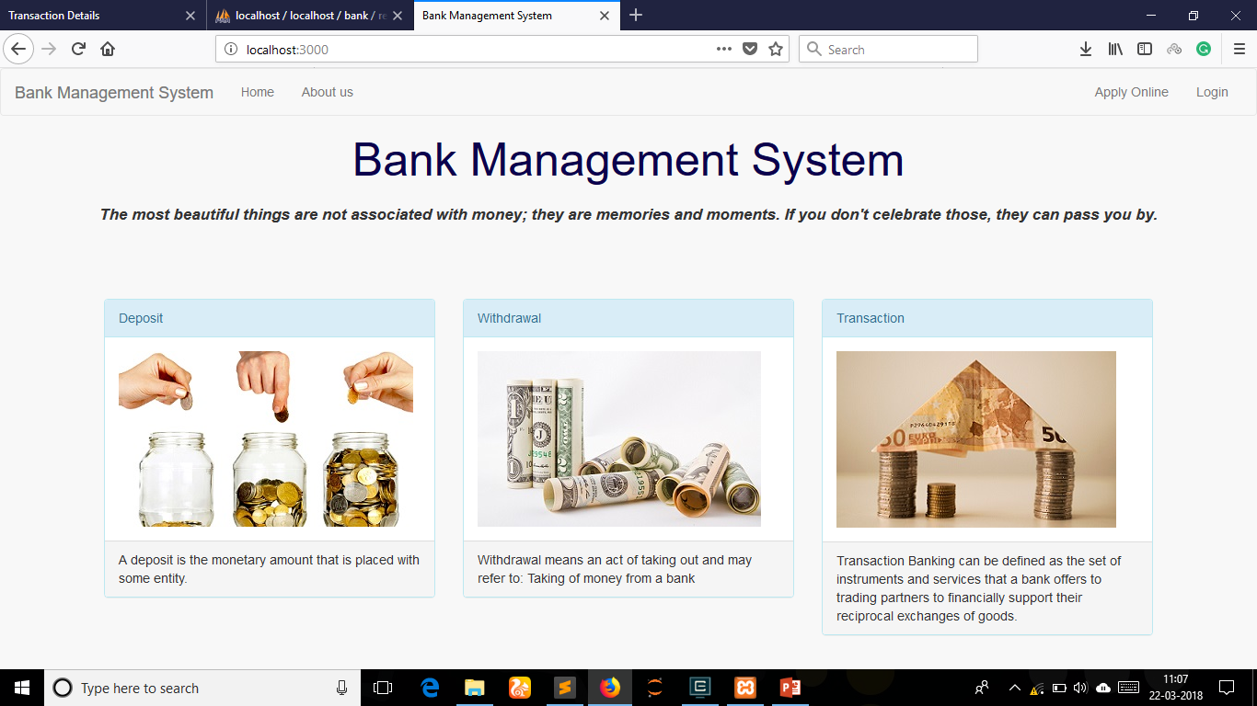
Project View

Slide 6

Project View

Slide 7

Project View

Slide 8
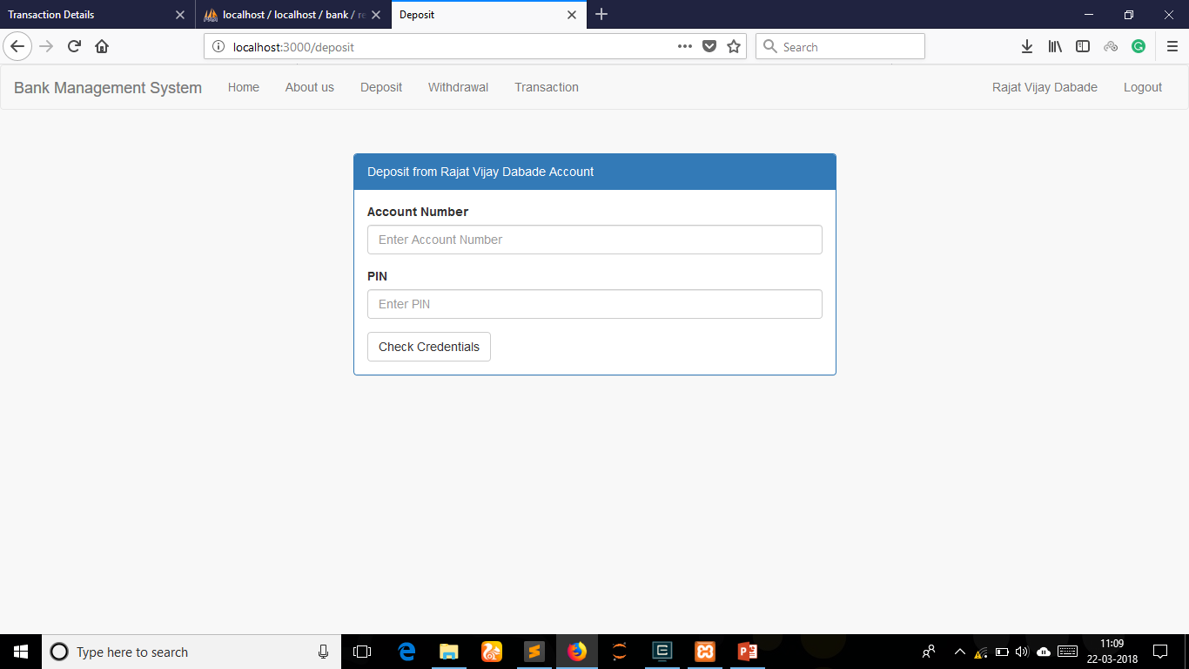
Project View

Slide 9
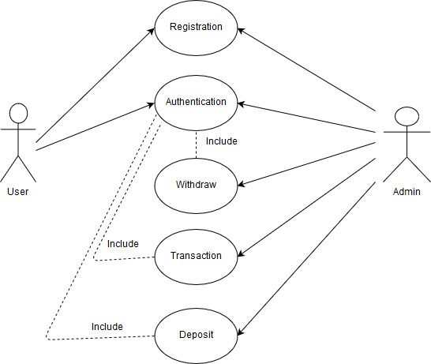
Use Case

Slide 10
Thank You !!

