Slide 1
Diffusion-Guided Clean-Label Poisoning of CNN Classifiers
From feature interpolation (PGD) to feature-collision guidance inside reverse diffusion
Rajat Dulal · Deakin University
Master of Applied Artificial Intelligence · Supervisor: Prof. Dr. Gang Li

Slide 2
Motivation and research aim
Why it matters
Research aim
1
Backdoors hide in training data
Image classifiers run in healthcare, vehicles, surveillance and biometrics. A backdoored model behaves normally until the attacker's condition appears.
Design and evaluate stealthy clean-label backdoor attacks on CNN image classifiers, and test whether diffusion models improve on GAN- and PGD-based poison generation.
2
Clean-label attacks are the hard case
Poisons keep their correct labels, so they pass human and automated label checks. Training data is often external or crowd-sourced.
SIT723 · Phase 1
Feature interpolation + PGD inversion (baseline)
3
The open problem
Existing attacks often need high poison ratios or strong attacker knowledge, or give up stealth for strength. Diffusion models were almost unexplored as poison generators for CNNs.
SIT746 · Phase 2
Feature-collision guidance inside reverse diffusion
Rajat Dulal · Clean-label poisoning via guided diffusion
2 / 16
Notes:
Give the examiners context first: why clean-label poisoning matters, what is missing, and the two-phase structure of the programme. Phase 1 is the baseline; Phase 2 is the contribution.
2

Slide 3
Literature review and identified gaps
Clean-label attack families
Feature collision: Poison Frogs, Hidden Trigger. Poisons collide with the target in feature space.
Adversarial / generative: Label-Consistent (GAN interpolation), CleanSheet.
Limited information: Narcissus. Surrogate trained on target class only, inward-pointing trigger.
Identified gaps
1
Arbitrary triggers
Perturbations start from noise or a fixed pattern, not a semantic target-class representation.
2
High attacker knowledge
Many attacks assume white-box access or a large poisoning ratio.
Diffusion models in prior work
As defences: DiffPure, ECLIPSE.
As the poisoning target: Pan et al.
As a two-stage generator: Souri et al. make base images with guided diffusion, then run gradient matching.
3
Diffusion as a single-stage generator
No work puts the collision objective inside the sampling loop for CNN classifiers. This thesis targets this gap.
Rajat Dulal · Clean-label poisoning via guided diffusion
3 / 16
Notes:
Brief by design. Phase 1 addressed gaps 1 and 2 (semantic prototype, black-box surrogate). Phase 2 targets gap 3. The claim is narrow: not first to use diffusion in poisoning, but first, to my review, to embed the collision loss in the sampling loop for CNN classifiers.
3

Slide 4
Research questions and how far the evidence goes
RQ1
Partly answered
RQ2
Partly answered
RQ3
Qualified yes
Maximise ASR while keeping CDA high
Robustness across architectures, settings, defences
Diffusion vs. GAN / PGD generation
Stealth/strength trade-off mapped in both phases (λ in Phase 1, t_start in Phase 2). Not yet tuned to a best operating point.
Cross-architecture transfer and a pretrained-victim failure are measured. Neural Cleanse, STRIP, ANP and DiffPure are not yet run.
Higher ASR with 10× fewer poisons than Phase 1, but the comparison is not like-for-like and purification robustness is untested.
Rajat Dulal · Clean-label poisoning via guided diffusion
4 / 16
Notes:
RQs are unchanged from SIT723. RQ3 is the focus of the talk; RQ1 and RQ2 are addressed to the extent shown, and I say so explicitly.
4

Slide 5
PGD baseline vs. prior diffusion work vs. ours
PGD feature collision
Poison Frogs, Phase 1 (this thesis)
Clean base image
→
PGD pixel optimisation
→
Poison
Bounded ℓ∞ pixel perturbation bolted onto a real image
Diffusion, two-stage
Souri et al. 2024
Guided diffusion makes base image
→
Gradient matching (Witches' Brew)
→
Poison
Diffusion improves the starting point; it does not do the collision
Diffusion, single-stage
This thesis (Phase 2)
Partial forward diffusion (SDEdit)
→
Reverse steps guided by collision loss
→
Poison
Attack objective lives inside the denoising trajectory
Adjacent, not the same: DiffPure/ECLIPSE are defences; CBV targets vision-language models; Pan et al. poison the diffusion model itself.
Rajat Dulal · Clean-label poisoning via guided diffusion
5 / 16
Notes:
This is the relationship slide the supervisor asked for. PGD baseline = Phase 1. Souri et al. = closest prior art, two-stage. Ours = single-stage. The claim is deliberately narrow: not first to use diffusion for poisoning, but first (to my review) to put the collision objective inside the sampling loop for CNN classifiers.
5

Slide 6
Completed
Phase 1 baseline: stealthy but weak
80.37%
14.50%
0.9993
0 / 250
Clean accuracy
Attack success
Mean SSIM
ℓ∞ violations
Method
Surrogate on target-class images → class prototype → interpolate base latent toward it (λ = 0.35) → invert to pixels with PGD (ε = 8/255). Labels stay correct.
Why it motivates Phase 2
Near-perfect stealth, but the conservative shift (λ, ε, 250 poisons, ResNet-18 victim) barely moves the decision boundary. ASR sits far below Poison Frogs and Narcissus.
Reading the numbers
Phase 1 used 250 poisons (5% of the base class, 0.5% of the training set), a ResNet-18 victim and a different class pair. It is the PGD reference point, not a controlled control arm.
Rajat Dulal · Clean-label poisoning via guided diffusion
6 / 16
Notes:
Keep this short. The point is that Phase 1 is stealthy and under-tuned; it is the reference the diffusion method is positioned against.
6

Slide 7
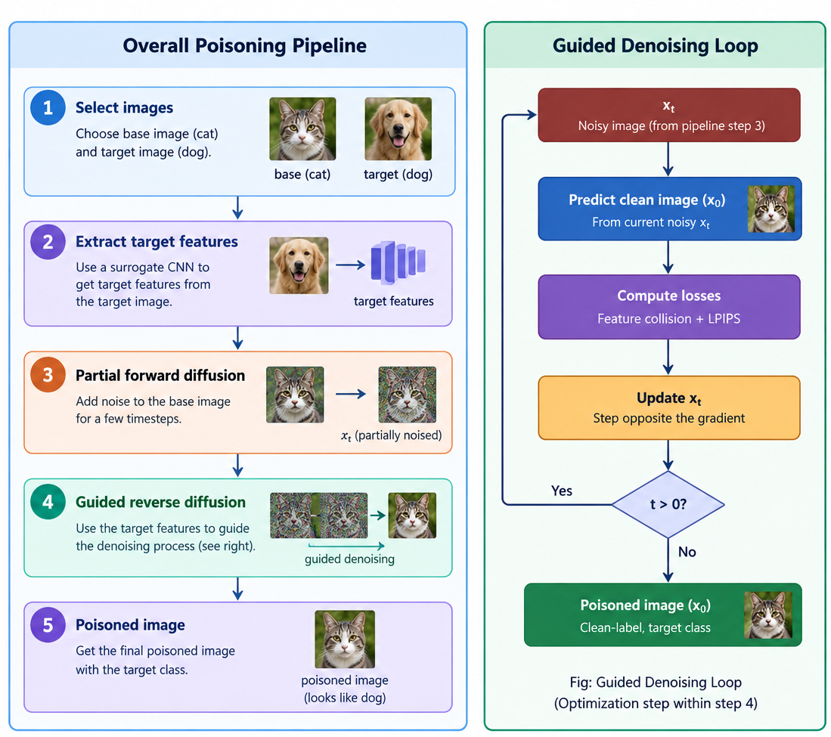
Method overview: guided reverse diffusion pipeline
Left: pipeline
Pick a cat base and a dog target, get the target's features from the surrogate, partially noise the base image, then run guided reverse diffusion.
Right: the loop
At every reverse step, predict the clean image, score feature collision plus LPIPS, and nudge the sample against the gradient until t = 0.
Reading step 5
The poison keeps the cat label and still looks like a cat. 'Target class' means its features are pulled toward dog, not that it is relabelled.
Thesis Figure 3.2
Rajat Dulal · Clean-label poisoning via guided diffusion
7 / 16
Notes:
Figure 3.2 from the thesis. Walk left to right, then explain the loop on the right is step 4 expanded. Make the clean-label point explicit: the label stays cat.
7

Slide 8
Method: collision guidance inside every reverse step
1
Extract target features
2
Partial forward diffusion
3
Predict clean image
4
Guided update
fₜ = φ(xₜ) from a surrogate CNN
Noise base image to t_start (SDEdit); keeps coarse structure and label
UNet gives ε̂, then x̂₀ at each step
Step against ∇ of the loss; repeat down to t = 0
L = ‖φ(x̂₀) − fₜ‖² + λ_lp · LPIPS(x̂₀, x_b)
xₜ₋₁ = SchedulerStep(ε̂, xₜ) − g · (t/T) · ∇L
Collision term pulls features toward the target; LPIPS keeps the image close to the base. Frozen google/ddpm-cifar10-32, no diffusion training.
Threat model: attacker injects correctly labelled poisons only, uses a surrogate, never sees victim weights. The diffusion model is a generator, not a target or defence.
Rajat Dulal · Clean-label poisoning via guided diffusion
8 / 16
Notes:
Main-result settings: t_start = 100, guidance g = 100. The sweep on slide 11 covers 50, 100, 300. The earlier deck said t ≈ 250; 250 is only the MNIST setting.
8

Slide 9
Experimental setup
Task
Poison budget
CIFAR-10, dog→cat: base class cat (poison keeps cat label), target class dog
25 diffusion-guided images, about 0.05% of the 50,000 training images
Surrogate
Victim
Lightweight 4-block CNN, 15 epochs; guides the diffusion loop
Same-architecture CNN trained from scratch (8 epochs, Adam)
Metrics
Compute
CDA on the test set; target-class ASR on 1,000 held-out dog images
Free-tier Colab/Kaggle T4; single run per setting, no confidence intervals
Rajat Dulal · Clean-label poisoning via guided diffusion
9 / 16
Notes:
Be upfront that these are single-run point estimates with short victim training. 1,000 test images means ASR resolution of 0.1 percentage points.
9

Slide 10
Completed
Headline: 25 poisons lift dog→cat ASR to 30.8%
+30.1 pp
ASR increase at t_start = 100, g = 100
Clean accuracy: 72.89% clean-trained vs 78.74% poison-trained, so no accuracy drop that would flag the poisons.
Labels are untouched; poisons are real-looking cat images.
Caveat: one run, one class pair. Phase 1 (14.5%) is not a controlled comparison.
Rajat Dulal · Clean-label poisoning via guided diffusion
10 / 16
Notes:
Strongest single piece of evidence. Be careful with the 78.74 vs 72.89 accuracy gap: it is consistent with the clean-label constraint, but it is a single run, so do not read it as poisoning improving accuracy.
10

Slide 11
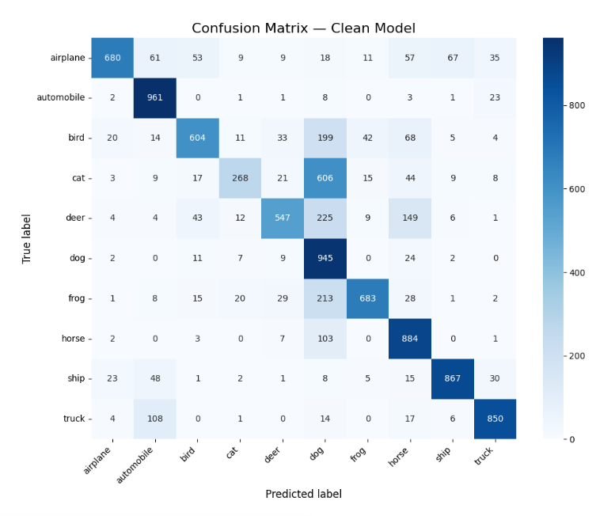
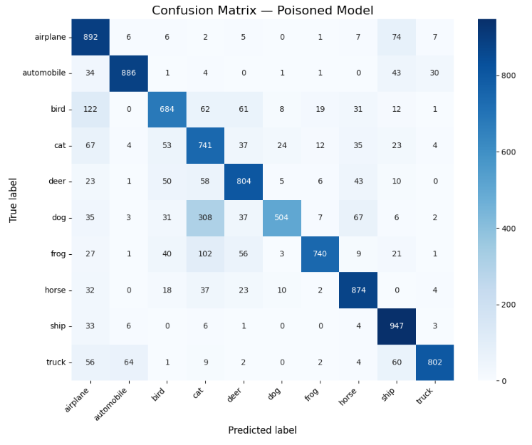
Confusion Matrix: 25 poisons lift dog→cat ASR to 30.8%
Result: Inserting 25 poisons (0.05%) increased the misclassification of dog class to cat class from 7 samples to 308 samples which is 30.10% increase.

Slide 12
Completed
Partial-diffusion depth trades stealth for strength
t_start | Clean acc. | Poisoned acc. | ASR gain
50 | 71.45% | 78.34% | +27.5 pp
100 | 72.89% | 78.74% | +30.1 pp
300 | 71.45% | 70.08% | +44.2 pp
Deeper noising gives the reverse process more room to move away from the base image. At t_start = 300 ASR peaks, but poisoned-model accuracy falls below the clean baseline, which weakens the clean-label stealth argument.
Rajat Dulal · Clean-label poisoning via guided diffusion
11 / 16
Notes:
Same shape of trade-off as λ in Phase 1. Clean baselines differ slightly per run (71.45 / 72.89 / 71.45) because each run retrains the clean victim; this is one reason multi-seed runs are future work.
11

Slide 13
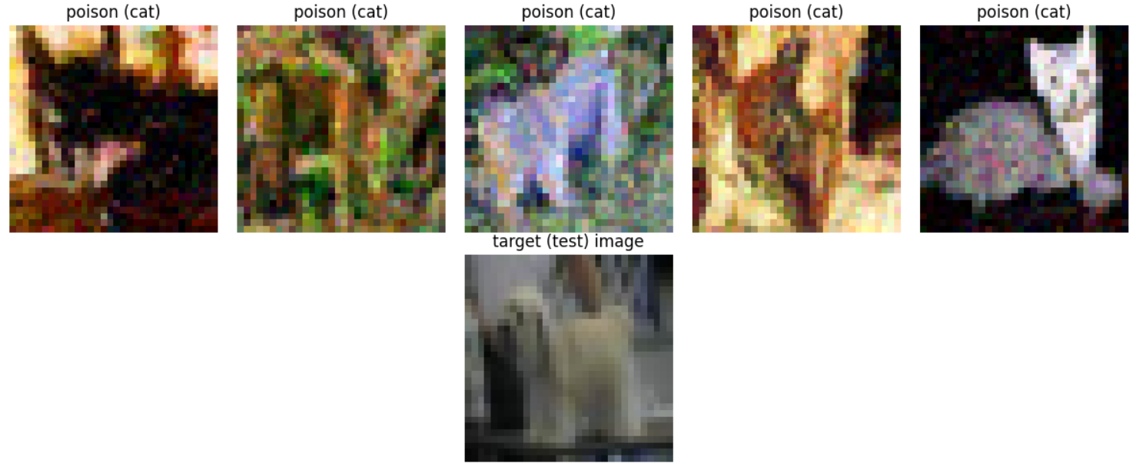
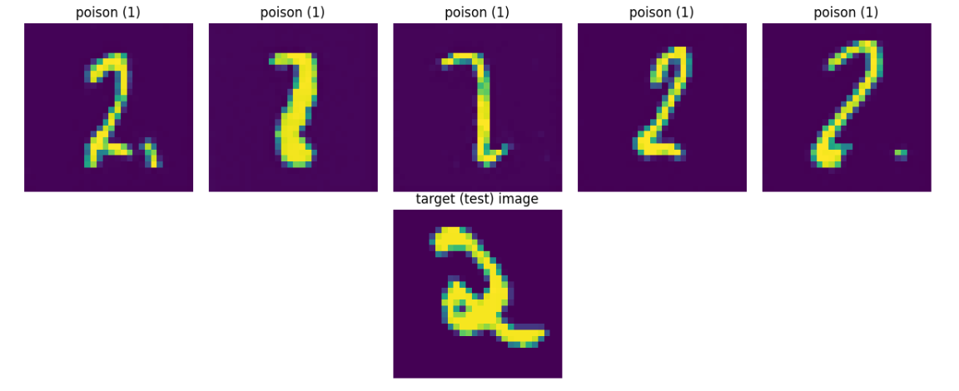
Completed (CIFAR-10) · Qualitative (MNIST)
What the poisons look like
CIFAR-10: guided-diffusion poisons, all labelled cat, with the dog target image below
MNIST proof of concept (g = 100, t_start = 250): the mechanism works on a different dataset and DDPM
At this guidance strength the CIFAR-10 poisons are visibly textured. There is no quantitative stealth metric (SSIM/LPIPS) for Phase 2 yet, so stealth here is a visual claim only.
Rajat Dulal · Clean-label poisoning via guided diffusion
12 / 16
Notes:
Honest point: Phase 1 has SSIM 0.9993; Phase 2 has no SSIM reported. Do not claim the diffusion poisons are more stealthy than PGD poisons; the thesis does not show that.
12

Slide 14
Preliminary
Where it transfers, and where it does not
Cross-architecture: weaker but real
+8.6 pp on a residual CNN (16.1% vs 7.5% baseline), and clean accuracy drops 80.51% → 75.27%. Guidance appears partly tied to the surrogate's feature geometry. One extra architecture only.
Negative result: pretrained victim
Against an ImageNet-pretrained ResNet fine-tuned on CIFAR-10, the poisons produced no measurable shift. Strong pretrained features appear to resist the short fine-tune. Reported as a boundary on the threat model.
Rajat Dulal · Clean-label poisoning via guided diffusion
13 / 16
Notes:
Both are kept in deliberately. The pretrained-victim result has no numbers table in the thesis; describe it as 'no measurable shift' rather than quoting a figure.
13

Slide 15
Evidence status: what is done, preliminary, and open
Completed
Partially Completed
Further Work
Phase 1 PGD baseline on CIFAR-10 / ResNet-18
Phase 2 main result: dog→cat, 25 poisons
t_start sweep at 50, 100, 300
Full guided-diffusion pipeline and DiffPure-style module implemented
Cross-architecture transfer (one extra architecture)
MNIST proof of concept (qualitative only)
Pretrained-victim negative result (no shift observed)
DiffPure purification
Advance defence mechanisms like Neural Cleanse, STRIP, ANP
More class pairs, more seeds, quantitative stealth metrics
Rajat Dulal · Clean-label poisoning via guided diffusion
14 / 16
Notes:
This slide replaces the old 'in progress / planned' wording. The purification comparison is implemented but not executed to a meaningful sample size, so it is listed under not yet run, not under completed.
14

Slide 16
Conclusion: contribution and evidence
Embed the feature-collision objective inside the reverse diffusion trajectory of a frozen, pretrained DDPM, so the poison is generated in a single stage rather than generated first and optimised afterwards.
0.70% → 30.80%
up to 45.00%
14.50%
dog→cat target-class ASR with only 25 poison images (same-architecture victim, t_start = 100)
ASR at deeper partial diffusion (t_start = 300), at some cost to clean accuracy
ASR of the PGD feature-interpolation baseline (Phase 1, 250 poisons, different class pair and victim)
Scope: single-run estimates on CIFAR-10. Transfer is partial and fails against a strongly pretrained victim. Purification robustness and standard-defence tests are still open (slide 14), and the diffusion-vs-PGD comparison is directional, not controlled.
Rajat Dulal · Clean-label poisoning via guided diffusion
16 / 16

Slide 17


Thank You
Questions & Discussion
Rajat Dulal | Deakin University | SIT746 Research Project (Advanced)

