Slide 1


Slide 2
INTRODUCTION
Blood bank is an independent body of any medical field . It is one of the most important constituent . At times it is life saver blood bank being practiced from last 40 to 50 yrs . the bank has following groups of bloods
A
A+
B
B+
B-
AB
O

Slide 3
Functional components of the project:
Registration Screen: If the user is not registered, then registration screen should be available
Blood Order: This screen will show all the types of blood units with their values and minimum quantity that should be ordered. On selecting any one of the Blood type, user is shown the columns for the quantity to be entered. After entering the quantity, price is automatically set by the system based on the product price data. On adding to catalog, kindly check the inventory and take appropriate action.
Login: A screen that is used by the admin , the staff members and the buyer to login into to their respective pages.
Staff Registration: This Screen will show the Admin the details that should be filled to register a new staff member.
Donar Registration: This screen is used by the staff members to register a new donar.
Update Passwords – A screen from where the admin, the staff members and the buyers can change and update their respective login passwords.
Contact Information – Contact information regarding the office addresses with phones and faxes are provided on this screen.

Slide 4
OBJECTIVE
The most important is to save the life of the patients.
To provides the correct blood group to the required patients.
To provide timely blood to the patients.
To help the doctors to take an instinct decision.
To provide an immediate solutions to any queries.
It also helps in research and development on various cases.
To store and have sufficient quantity of all the blood groups.
Even on non availability of the blood, the blood bank provides the blood.

Slide 5
TOOLS / PLATFORM USED
There are many technologies which we can use for developing software but we have used following:
Project Category : Multimedia
Used Operating System : Windows 8
Front End : ASP.NET 4.5
Back End : SQL-SERVER 2005

Slide 6
Software Requirement
Server
Browser : IE 6.0 or later
Database : MS SQL Server 2005
Web server : Internet Information Server (IIS) 7.5
Operating System : Windows
Client
Browser : IE 6.0 or any browser
Operating System : Any O.S. Windows/Linux/Solaris
Developer
Browser : IE 6.0 or any browser
IDE : Visual Studio 2010
Database : MS SQL Server 2005
Operating System : Windows 7
Web server : Internet Information Server (IIS) 7.5
Documentation tool : MS-Word, MS-PowerPoint
Designing tool : VS
Scripting language : C#

Slide 7
Hardware Specification
Server :
Processor : 1 .0 (GHz) Pentium processor
RAM : 1 GB
HDD : 80GB
Display : 1024 x 768 High color-32-bit
Client :
Processor : P3 866 MHz or later
RAM : 512 MB
HDD : 40GB
Display : 1024 x 768 High color-32-bit SOFTWARE
Developer :
Processor : 1 .0 (GHz) Pentium processor
RAM : 1 GB
HDD : 40GB
Display : 1024 x 768 High color-32-bit SOFTWARE

Slide 8
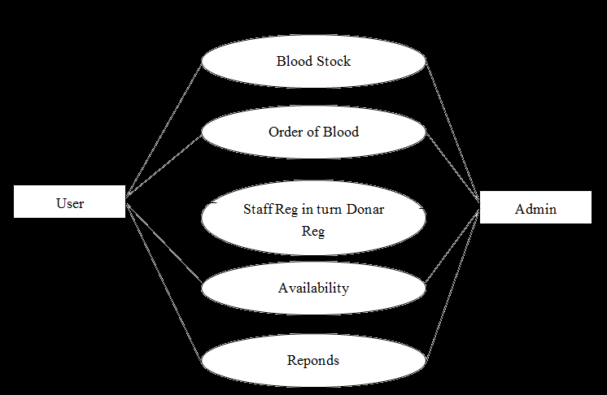
Data flow diagram

Slide 9
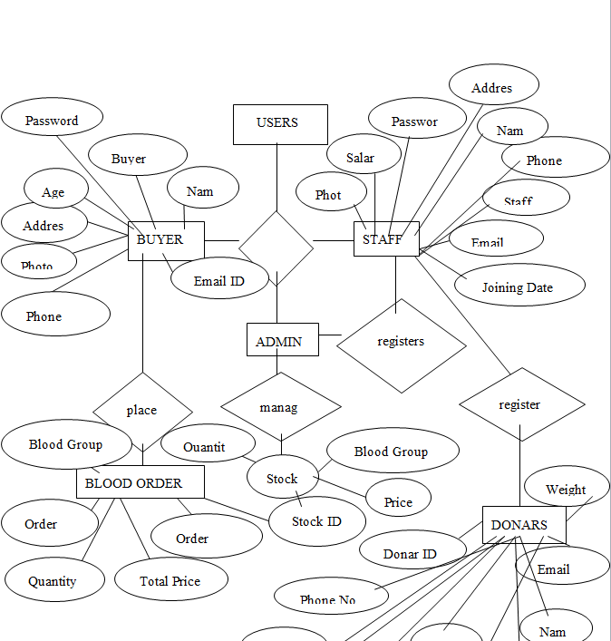
E-R DIAGRAM

Slide 10
MySQL Database Management System
MySQL, the most popular Open Source SQL database management system, is developed, distributed, and supported by MySQL AB. MySQL AB is a commercial company, founded by the MySQL developers. It is a second generation Open Source Company that unites Open Source values and methodology with a successful business model.
A database is a structured collection of data. It may be anything from a simple shopping list to a picture gallery or the vast amounts of information in a corporate network. To add, access, and process data stored in a computer database, you need a database management system such as MySQL Server. Since computers are very good at handling large amounts of data, database management systems play a central role in computing, as standalone utilities or as parts of other applications.

Slide 11
Entity & Attribute
Entity :-
An Entity is an object, place, person, concept, or activity about which an enterprises data.
Attribute :-
An attribute is the characteristics property of an existing entity. The difference between attribute type and attribute instance has to be Understood.

Slide 12
MODULE DESIGN
The system after careful analysis has been identified to be presented with the following modules:
This project is divided into 8 modules:
Home
Login
Admin
Registration
Staff
Buyer
Donar
Contact Us

Slide 13
DATA STRUCTURE
LOGIN TABLE :-
COLUMN NAME | DATA TYPE | ALLOW NULLS
Username (PRIMARY KEY) | nvarchar(50) | No
Password | nvarchar(50) | Yes
Type | nvarchar(50) | Yes

Slide 14
STAFF REGISTERATION TABLE :-
COLUMN NAME | DATA TYPE | ALLOW NULLS
StaffID (PRIMARY KEY) | Int | No
Name | nvarchar(50) | Yes
PhoneNo | numeric(18,0) | Yes
EmailID | nvarchar(50) | Yes
Address | nvarchar(100) | Yes
JoiningDate | nvarchar(MAX) | Yes
Salary | numeric(18,0) | Yes
Password | nvarchar(50) | Yes
Photo | nvarchar(50) | Yes

Slide 15
DONAR REGISTERATION TABLE :-
COLUMN NAME | DATA TYPE | ALLOW NULLS
DonarID (PRIMARY KEY) | Int | No
Name | nvarchar(50) | Yes
PhoneNo | numeric(18,0) | Yes
EmailID | nvarchar(50) | Yes
Address | nvarchar(100) | Yes
BloodGroup | nvarchar(10) | Yes
Quantity | numeric(18,0) | Yes
Weight | numeric(18,2) | Yes
Age | nvarchar(10) | Yes
Photo | nvarchar(50) | Yes
DonDate | nvarchar(MAX) | Yes

Slide 16
BUYER REGISTERATION TABLE :-
COLUMN NAME | DATA TYPE | ALLOW NULLS
BuyerID (PRIMARY KEY) | Int | No
Name | nvarchar(50) | Yes
Password | nvarchar(50) | Yes
EmailID | nvarchar(50) | Yes
Address | nvarchar(MAX) | Yes
Age | Int | Yes
PhNo | numeric(18,0) | Yes
Photo | nvarchar(MAX) | Yes

Slide 17
ORDER TABLE :-
COLUMN NAME | DATA TYPE | ALLOW NULLS
OrderID (PRIMARY KEY) | Int | No
StockID (FOREIGN KEY) | Int | Yes
BGName | nvarchar(50) | Yes
Quantity | numeric(18,0) | Yes
Price | numeric(18,0) | Yes
UserName | nvarchar(50) | Yes
ContactNo | numeric(18,0) | Yes
Address | nvarchar(100) | Yes
Totalprice | numeric(18,0) | Yes
OrderDate | nvarchar(50) | Yes

Slide 18
STOCK :-
COLUMN NAME | DATA TYPE | ALLOW NULLS
StockID (PRIMARY KEY) | Int | No
BloodGrpName | nvarchar(50) | Yes
Quantity | numeric(18,0) | Yes
Price | numeric(18,2) | Yes

Slide 19
BLOOD GROUP TABLE :-
COLUMN NAME | DATA TYPE | ALLOW NULLS
BloodGrpID (PRIMARY KEY) | Int | No
BloodGrpName | nvarchar(50) | Yes

Slide 20
Validations
On the basis of specified task, function security and privilege levels, we can divide whole system into following users-
System Administrator-
  Owner that takes care of maintenance for the online movie buying.
User-
  One of significant user of this movie buying site who impart efficient participation in communication through forum . They can also enjoy whole availability of movie materials .
No record can be saved till all the necessary entries are done.
Only administrator can perform sophisticated tasks like registration of STAFF, controlling.

Slide 21
SECURITY MECHANISM
Some of the measures can be taken as follow:-
Various validation checks are being applied on all the forms for authenticated management of data.
As well as various validations are also applied on the form controls so as top have reliable entry of data.
Backup of Database must be done at the regular interval by the administrator.
Updating the password at regular interval.
Secure ASP.NET application, by start with a hardened operating system and .NET Framework installation base, and then apply secure application configuration settings to reduce the application's attack profile.

Slide 22
Future Scope and further enhancements
This System being web-based and an undertaking of Cyber Security Division, needs to be thoroughly tested to find out any security gaps.
A console for the data centre may be made available to allow the personnel to monitor on the sites which were cleared for hosting during a particular period.
Moreover, it is just a beginning; further the system may be utilized in various other types of auditing operation viz. Network auditing or similar process/workflow based applications...

Slide 23
REFERENCES
1. Mastering Asp.Net with c# Black Book.
2. Mastering Wrox Book for asp.net with C#.
3. Software Engineering ‘A practitioner’s approach’ – Roger S. Pressman, (McGraw- Hill International Edition)
4. SQL SERVER ‘The Complete Reference’ – Looney Koch
Website:
www.socialsite.com
www.w3schools.com
www.google.com
www.codeproject.com

