Slide 1

DBMS PROJECT
SOFTWARE PROJECT MANAGEMENT
SYSTEM

Slide 2
SPM SYSTEM
What is it ?
SPM : Software project management is an art and science
of planning and leading software projects
It is a sub-discipline of project management
in
which software projects are planned, implemented, monitored and controlled

Slide 3
SUPERHEAD
HEAD
MANAGER
EMPLOYEE
ADMIN

Slide 4
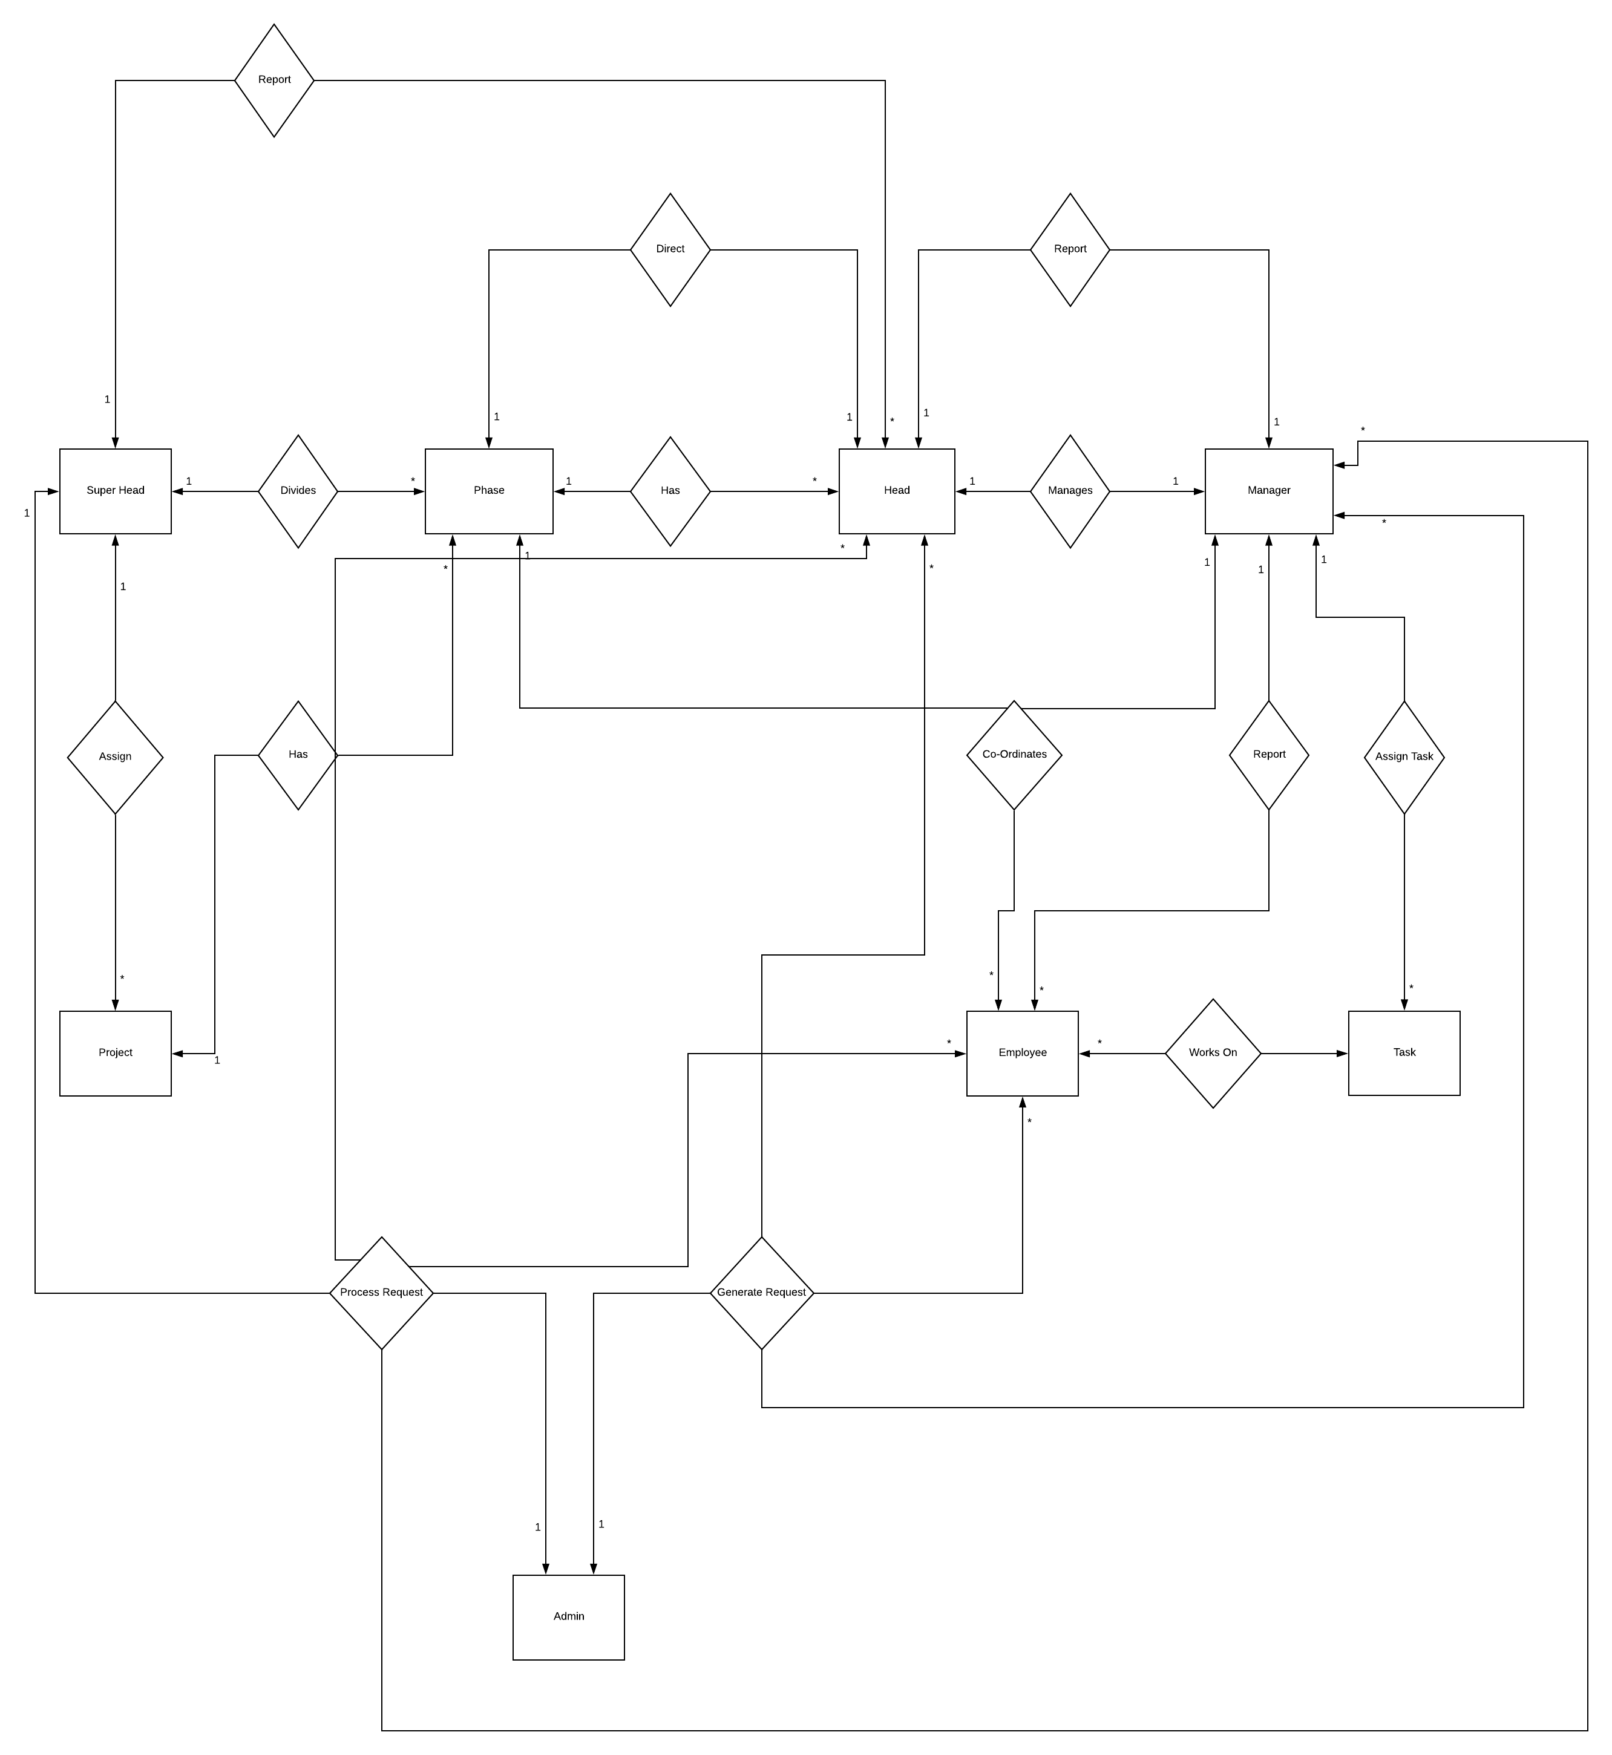
ER-Diagram

Slide 5
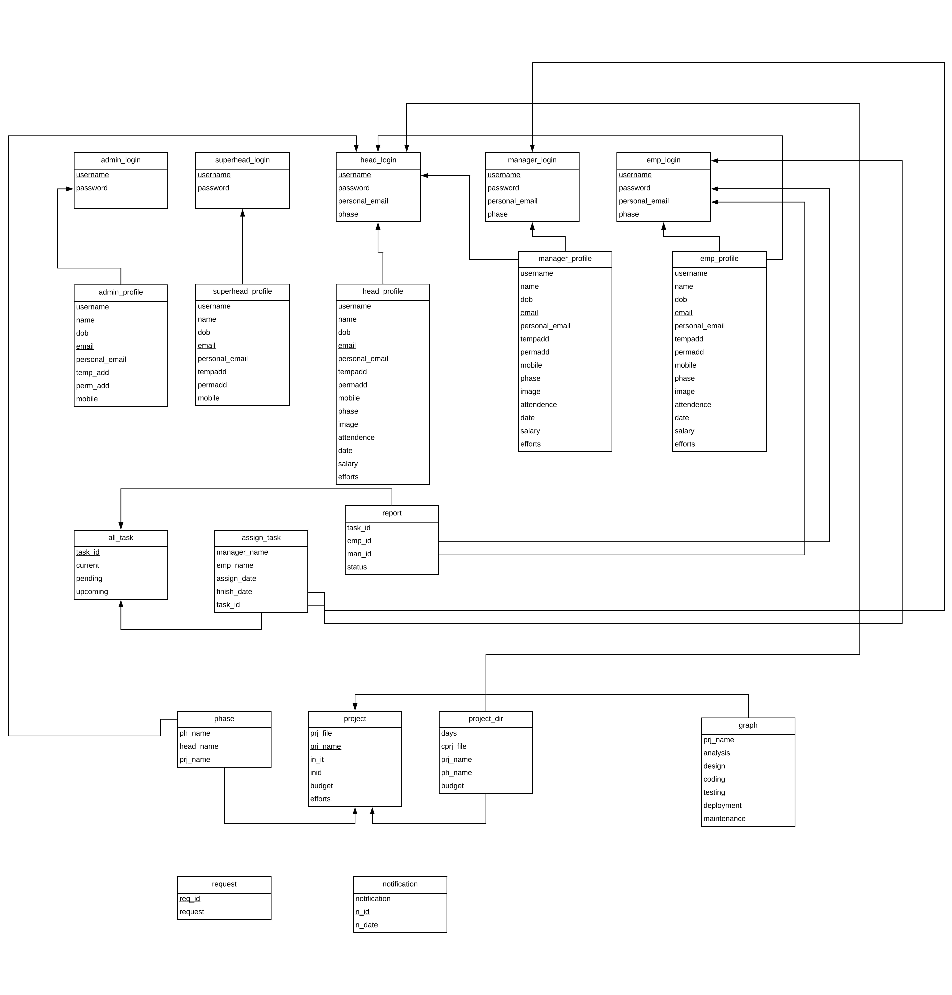
RELATION SCHEMA

Slide 6
Common Features
All of them can update their personal details
All of them can update & reset password from their profile page
All of them can send and receive email (localhost email server)
All of them can receive notifications regarding project
All of them can made (technical) request to ADMIN
All of them can see general project details except ADMIN
All of them can see general project details
All of them can see current project details except ADMIN
All of them can take part in forum
All of them can track their progress details except admin

Slide 7
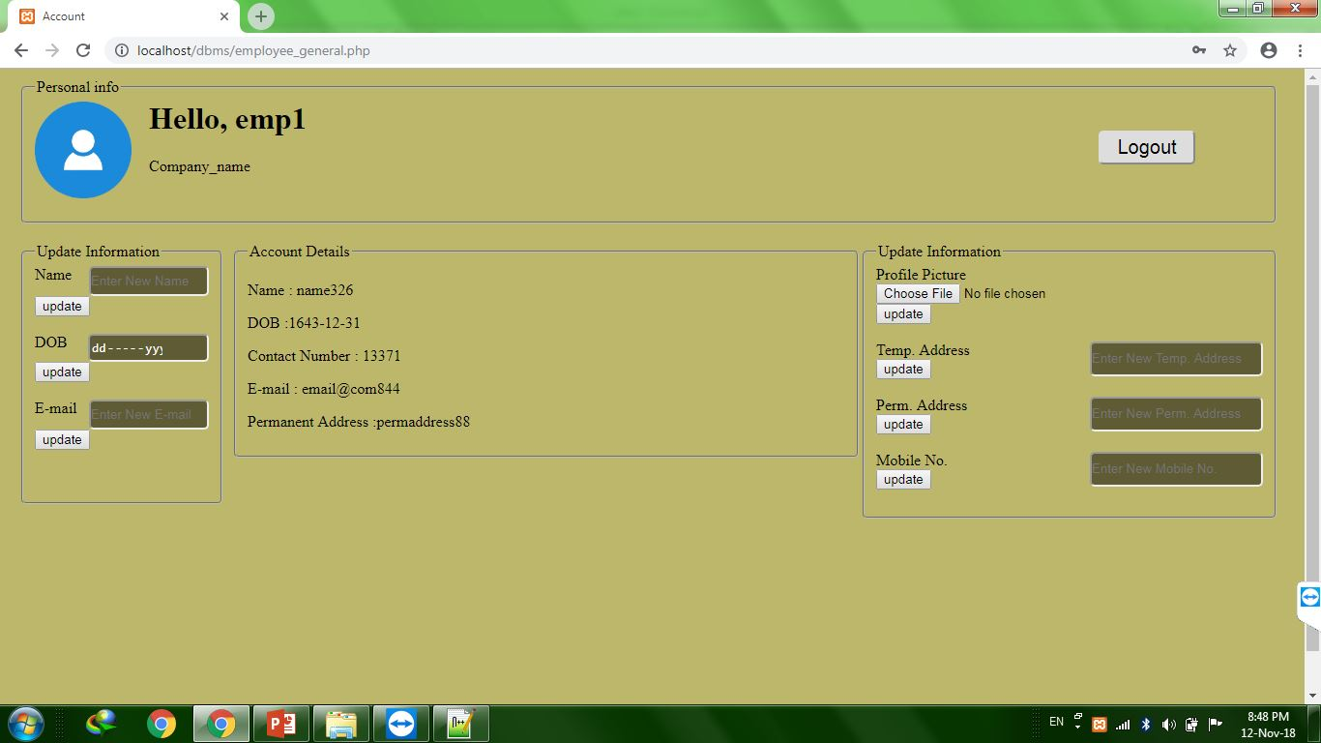

Slide 8
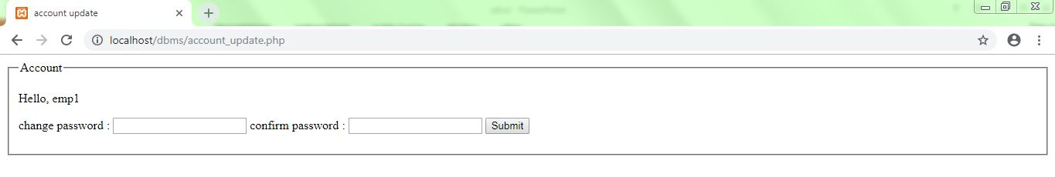

Slide 9
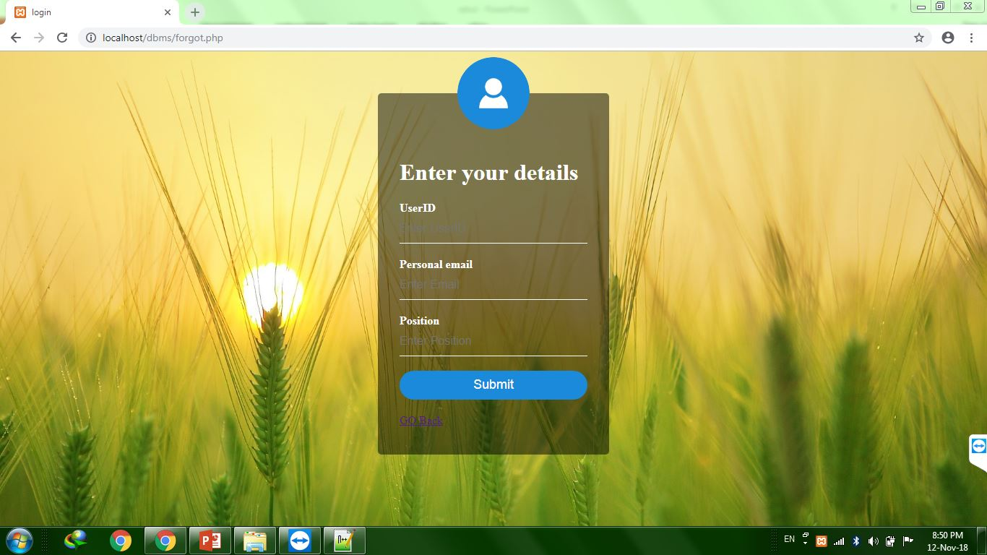

Slide 10
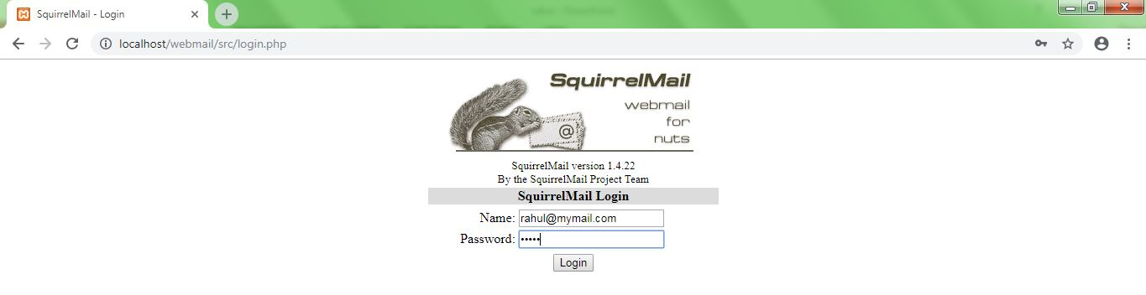

Slide 11
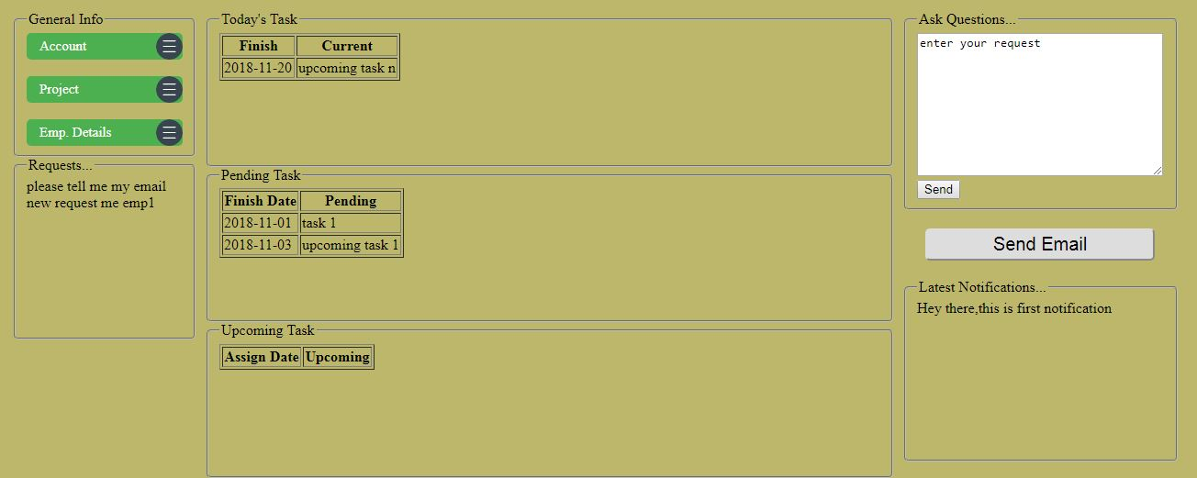

Slide 12
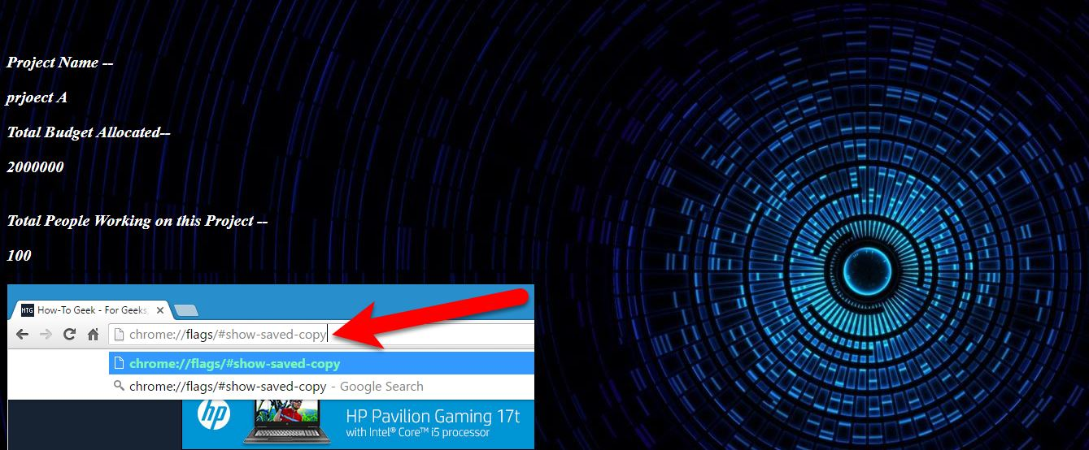

Slide 13
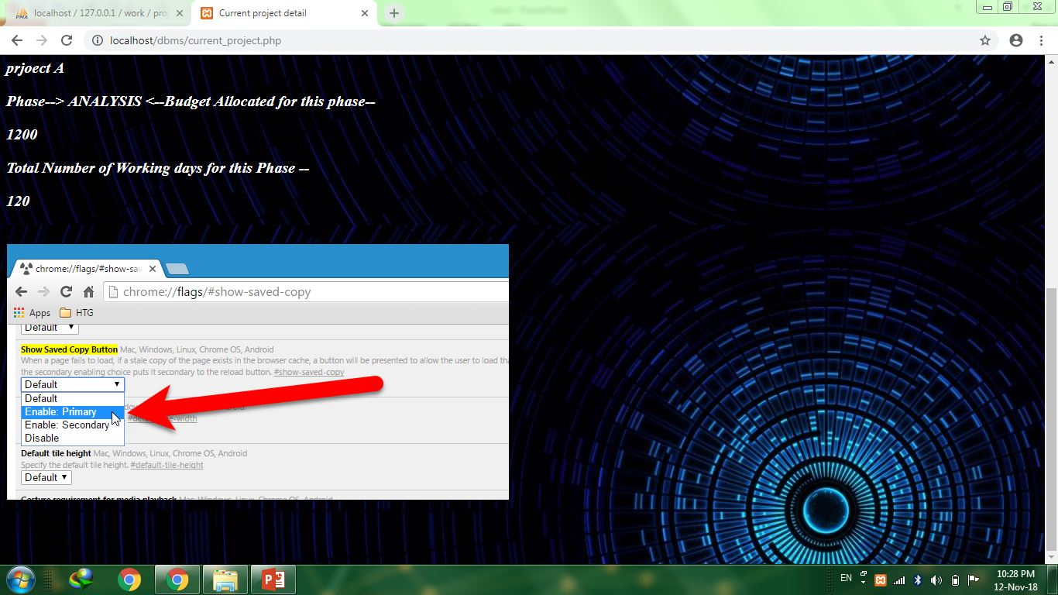

Slide 14
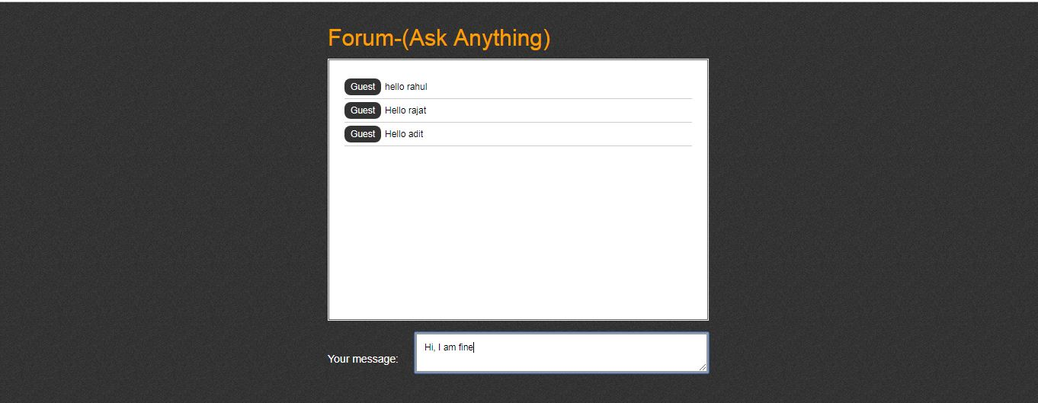

Slide 15
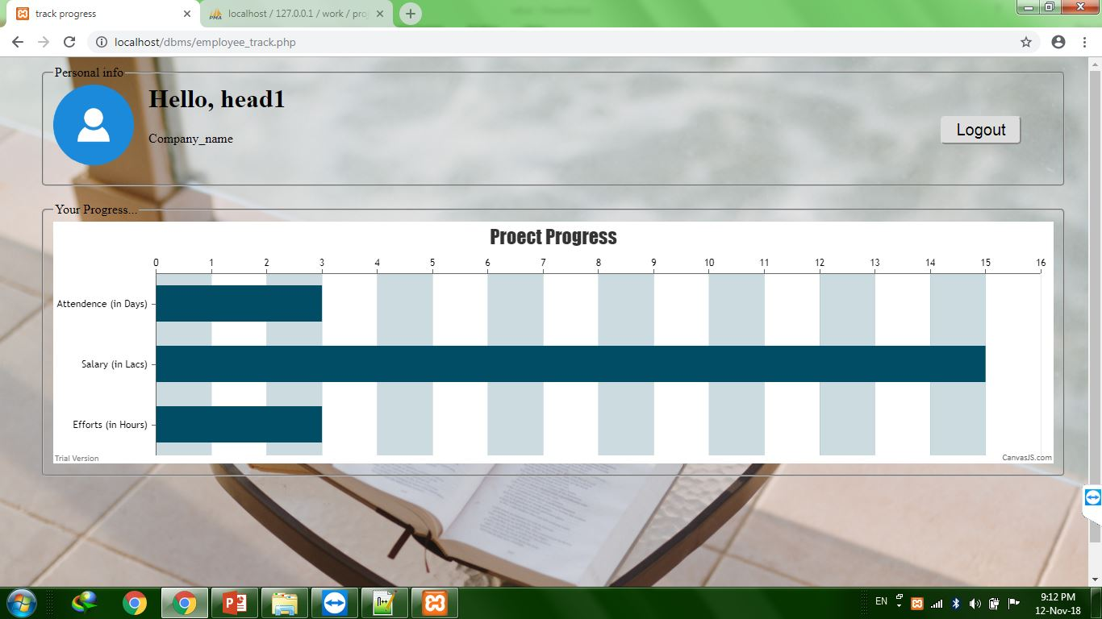

Slide 16
ADMIN Features
Specific:
Admin handles localhost email server and decides username
Admin has full control of Database
Admin can add other members except Superhead
Admin can resolve all the requests made by others
Admin can track each member’s chat on forum
Admin take care of all submissions directories

Slide 17
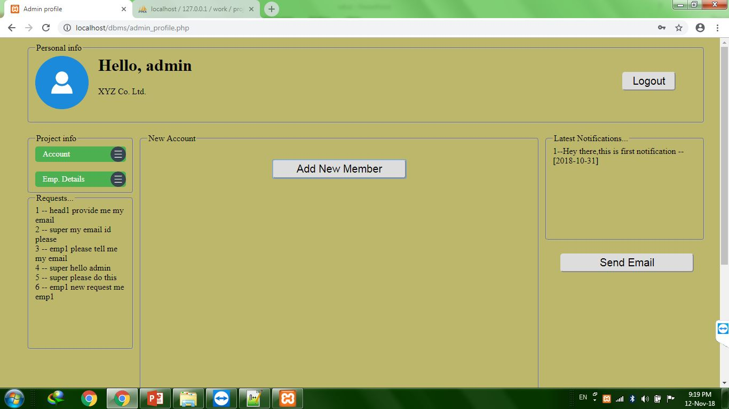

Slide 18
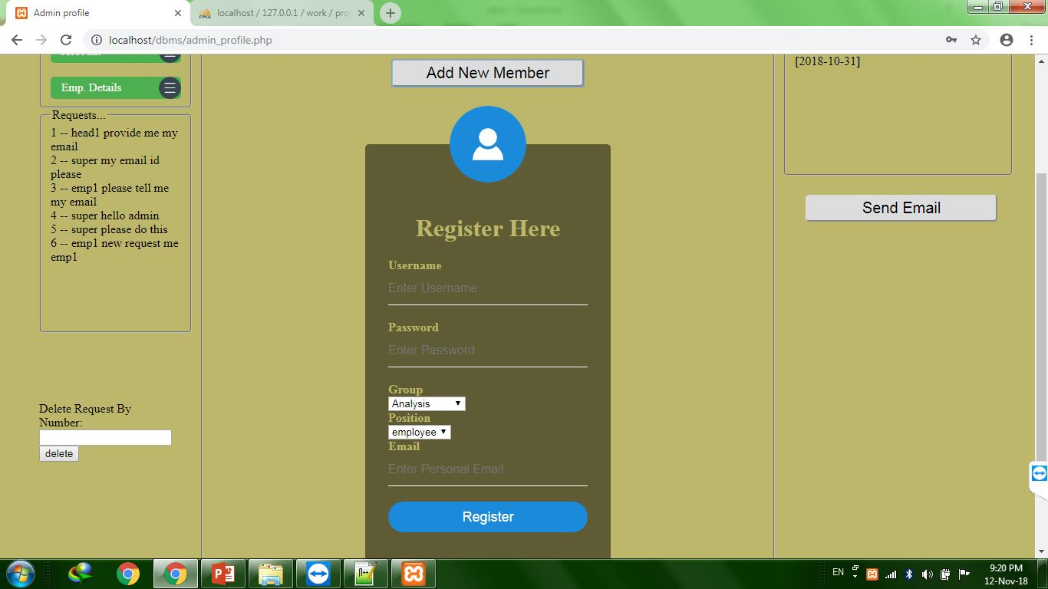

Slide 19
SUPERHEAD Features
Specific:
Superhead handles all project related details
Superhead decides head for particular phase
Superhead can track overall project progress
Superhead updates general project details for everyone
Superhead can access all submissions made by Heads
Superhead give commands to Admin before manipulation of DB

Slide 20
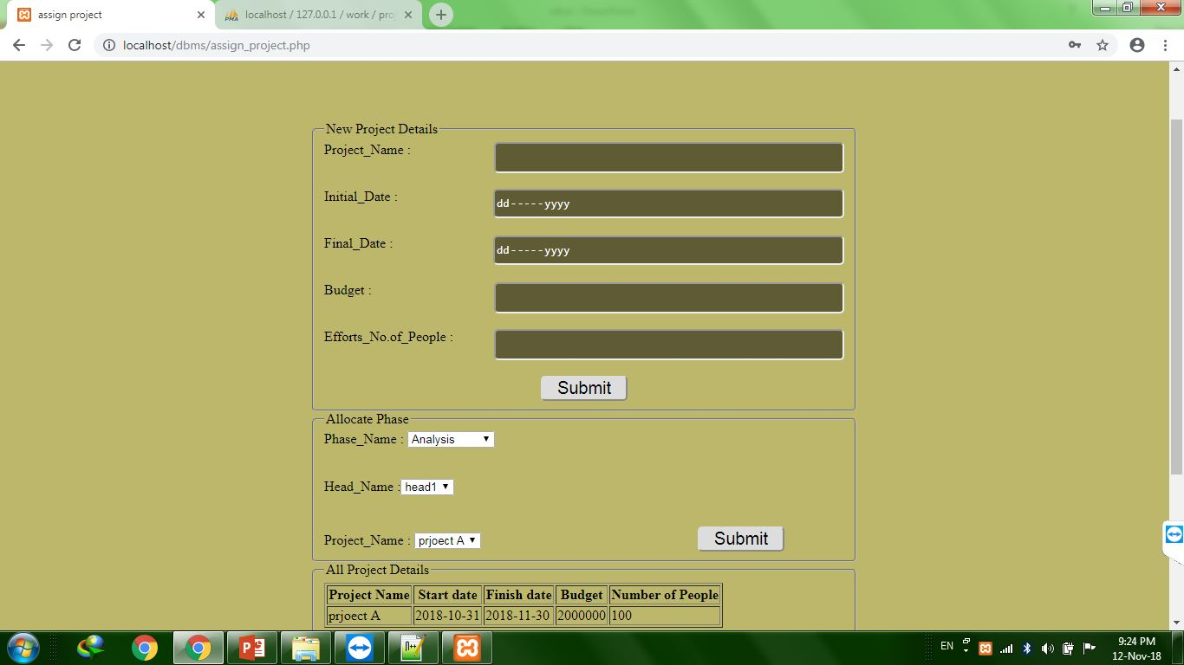

Slide 21
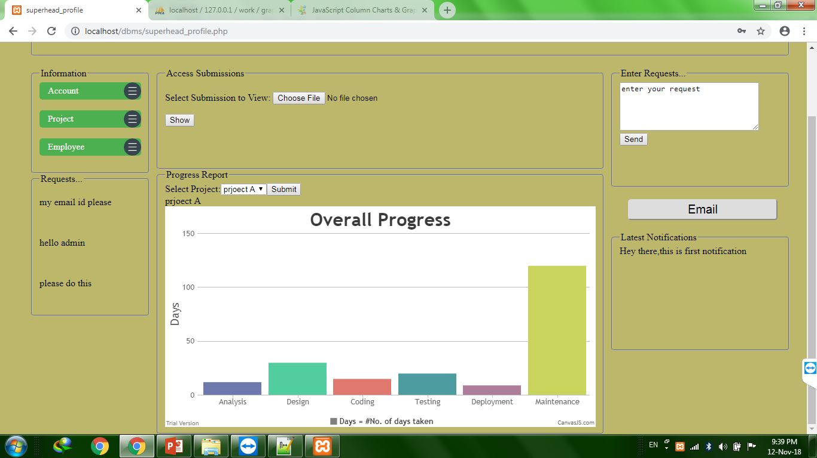

Slide 22
HEAD Features
Specific:
Head decides the team members
Head can directly check the phase details of other Head’s too
Head can only put the notifications and delete as well
Head can see all submissions by Managers
Head can directly report final submission to Superhead
Head put the details of current project under particular phase

Slide 23
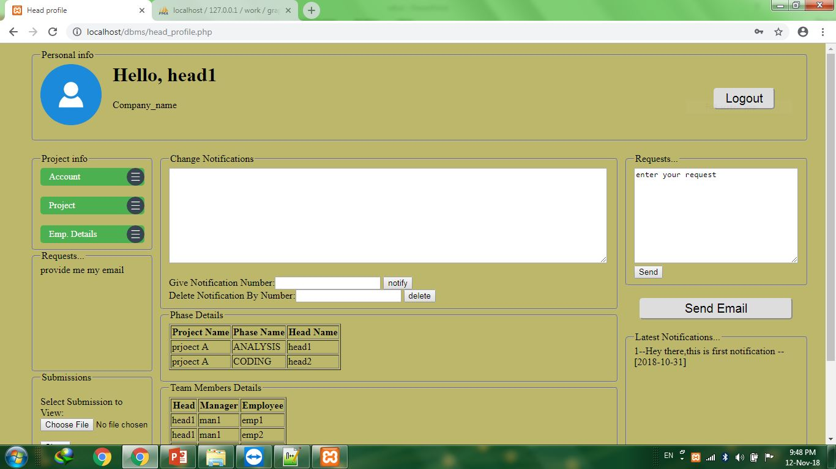

Slide 24
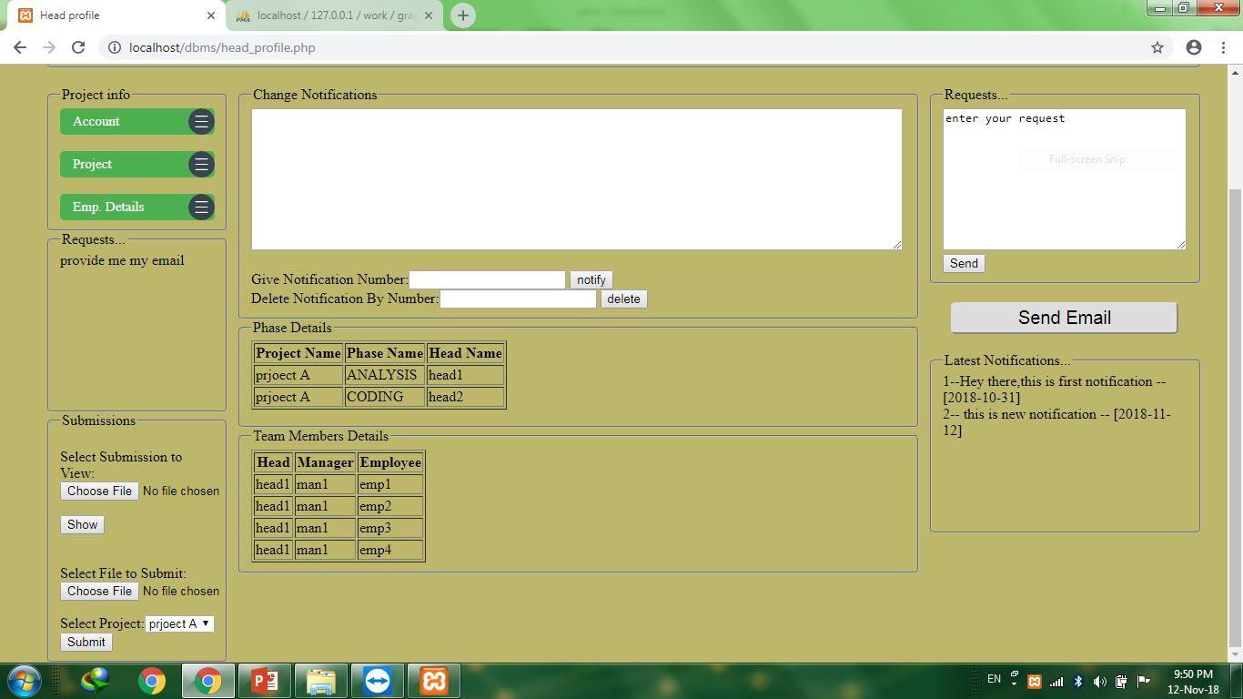

Slide 25
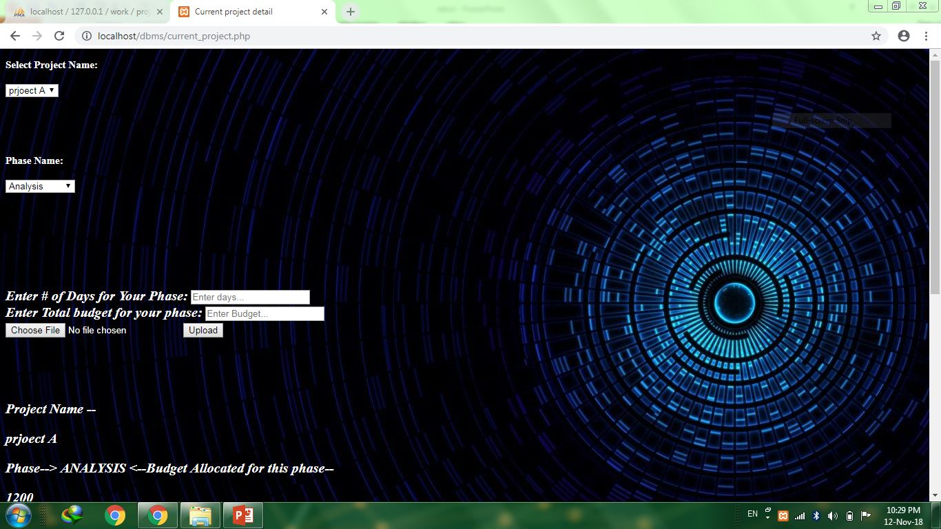

Slide 26
MANAGER Features
Specific:
Manager put task for every employee directly
Manager can view submissions of all employee directly
Manager can report to Head for particular phase submission
Manager can view all task assigned to every employee (phase)

Slide 27
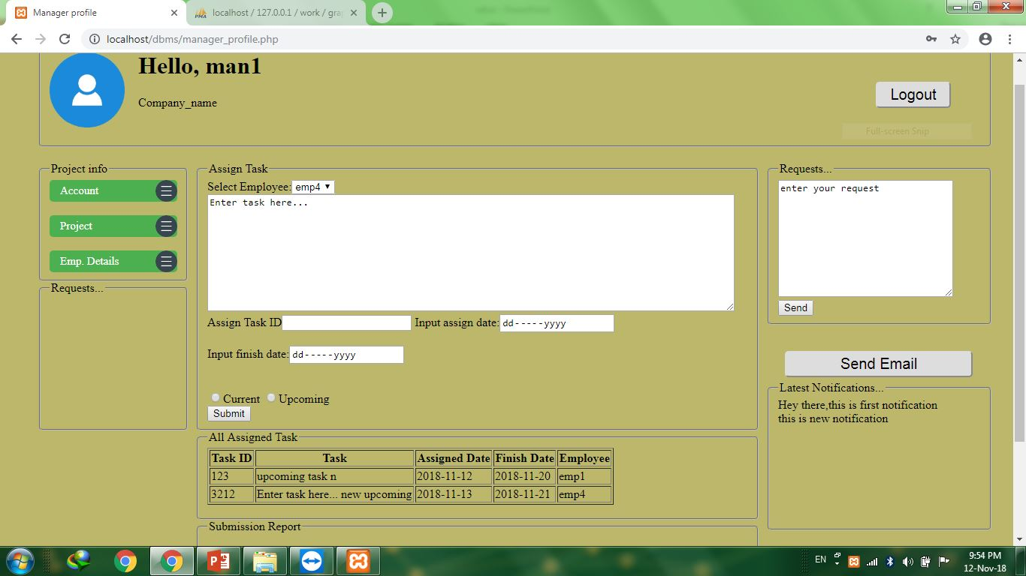

Slide 28
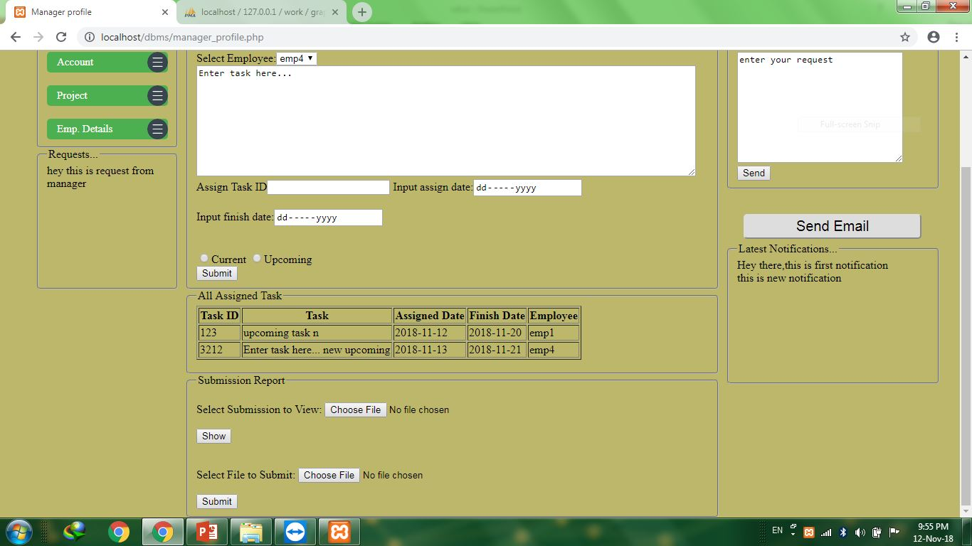

Slide 29
EMPLOYEE Features
Specific:
Employee can view his current task
Employee receive all upcoming tasks
(Provides flexibility to work)
Employee can directly report all task to Manager
Employee can modify his/her own submissions

Slide 30
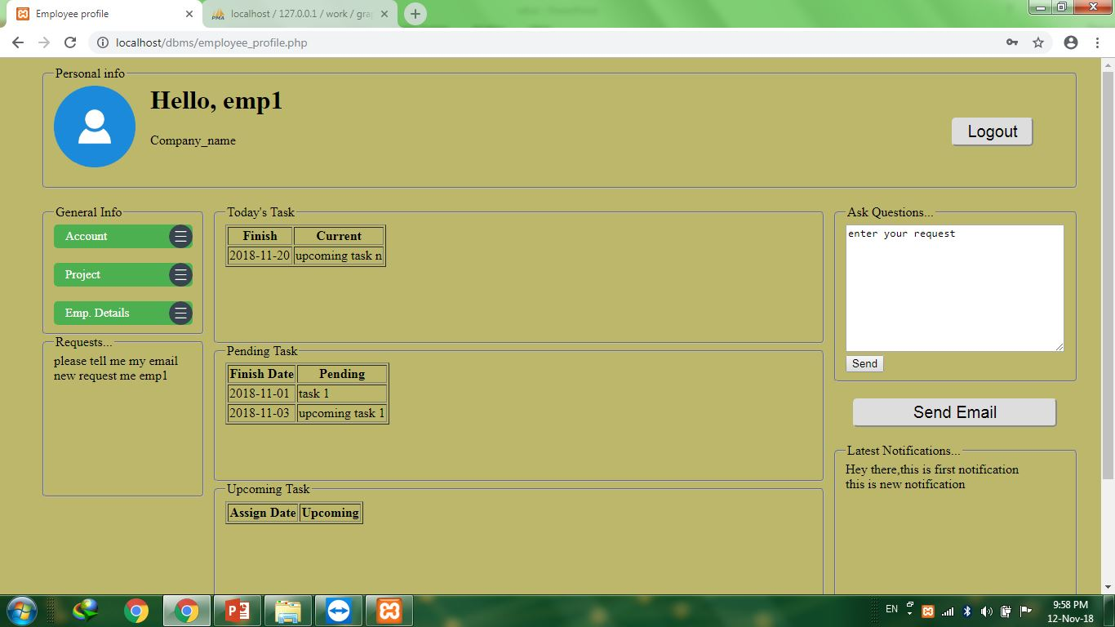

Slide 31
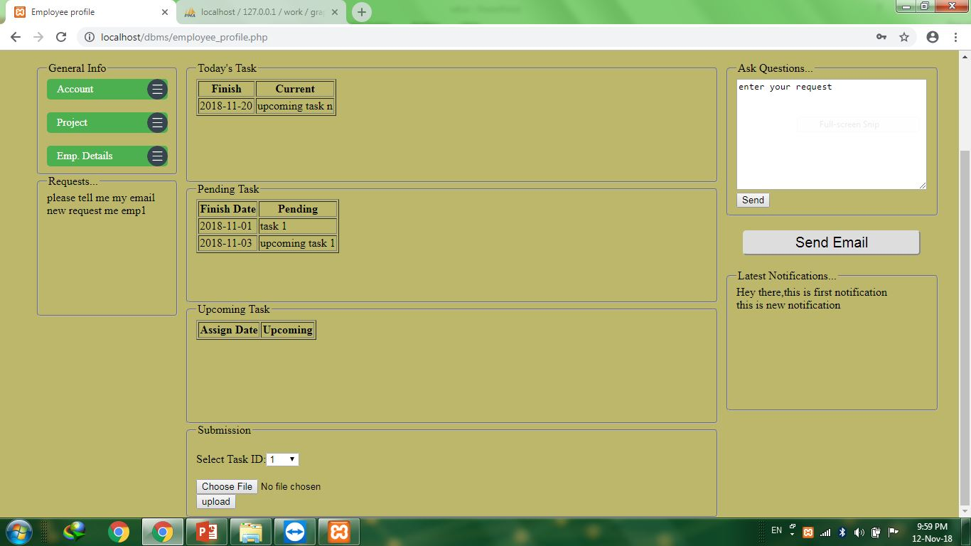

Slide 32
Triggers
on
Insertion
Foreign Key constrains
on
update and delete

Slide 33
Submitted By:
Rajat Kumar
Adit Mathur
Rahul Kumar
Submitted To:
Dr. Namita Mittal
Department of
Computer science &
Engineering
Batch : 2016 -2020

