Slide 1
Global Pollution Overview
Key statistics, causes, impacts, and mitigation strategies (2022‑2024)

Slide 2
Key Statistics (2022‑2024)
~7 million premature deaths per year due to air pollution (WHO).
91 % of world population lives where air quality exceeds WHO limits (WHO 2022).
~2 billion people use drinking‑water sources contaminated with feces (WHO/UNICEF).
Only ~20 % of industrial wastewater is treated before discharge (UN Water).
~400 million t of plastic produced annually; ~8 million t enter oceans each year (UNEP).
33 % of global land degraded; 75 % of agricultural soils have reduced organic matter (FAO).
>1 billion people exposed to unsafe environmental noise levels (WHO).
Pollution‑related health costs ≈ $5 trillion USD per year (~7 % of global GDP) (World Bank).

Slide 3
Primary Causes by Pollution Type
Air:
Fossil‑fuel combustion (power, transport, industry)
Residential solid‑fuel use
Agricultural activities (NH₃)
Industrial processes (SO₂, NOₓ, VOCs)
Water:
Untreated municipal & industrial wastewater
Agricultural runoff (nutrients, pesticides)
Oil spills & marine dumping
Plastic litter
Soil/Land:
Excessive fertilizer/pesticide use
Improper waste disposal (landfills, e‑waste)
Mining & quarrying
Urban sprawl
Noise:
Road, rail, air traffic
Construction activities
Industrial machinery
Light:
Outdoor illumination (streetlights, signage)
Architectural lighting

Slide 4
Major Effects of Pollution
Human Health:
Respiratory & cardiovascular diseases (PM₂.5, ozone)
Cancer (benzene, asbestos)
Water‑borne diseases (cholera, dysentery)
Neurological impacts from noise & heavy‑metal exposure
Ecosystem Degradation:
Acidification of lakes & soils
Eutrophication → algal blooms, dead zones
Biodiversity loss (habitat contamination)
Climate Interaction:
Black carbon & methane are both pollutants and potent GHGs
Deforestation reduces carbon sinks
Economic Burden:
Healthcare costs, lost labor productivity
Reduced agricultural yields
Cleanup & remediation expenses
Social Inequity:
Disproportionate impact on low‑income & marginalized communities

Slide 5
Mitigation & Adaptation Strategies
Policy & Regulation:
Emission standards (EU Industrial Emissions Directive)
Cap‑and‑trade or carbon pricing
Ban on single‑use plastics
Technology & Innovation:
End‑of‑pipe controls (scrubbers, catalytic converters)
Renewable energy deployment
Advanced wastewater treatment (membrane bioreactors)
Low‑emission vehicles (EVs)
Circular Economy:
Reduce‑reuse‑recycle loops
Extended producer responsibility for packaging
Plastic‑to‑fuel technologies
Agricultural Practices:
Precision fertilization
Integrated pest management (IPM)
Conservation tillage
Urban Planning:
Low‑emission zones, public‑transport expansion
Urban tree canopy, green roofs
Noise barriers, shielded lighting
Public Awareness:
Education campaigns (air‑quality alerts)
Incentives for eco‑friendly commuting
International Cooperation:
Paris Agreement (GHG mitigation)
UN SDG 12 (Responsible Consumption)

Slide 6
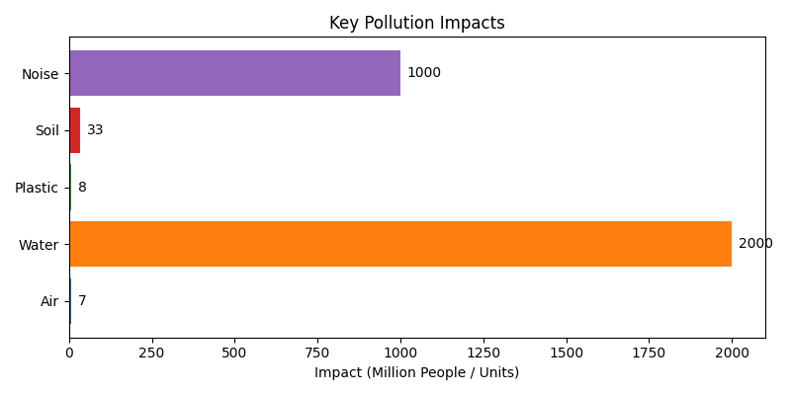
Key Pollution Impacts (Illustrative)

Slide 7
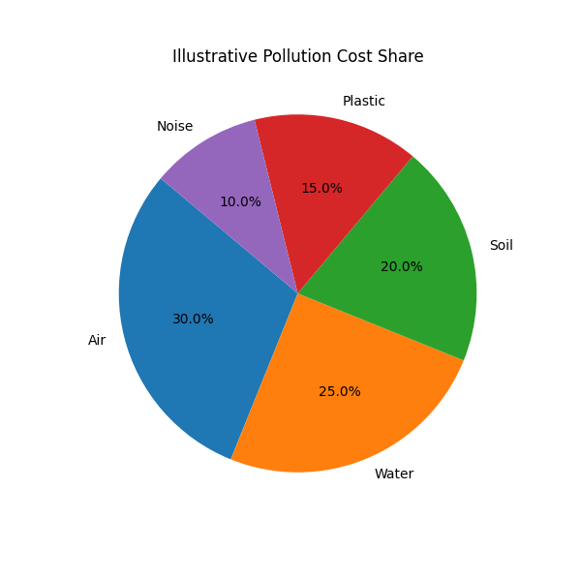
Illustrative Pollution Cost Share

Slide 8
Implementation Tips
Data‑Driven Targeting: Use satellite‑derived air‑quality data and water‑quality monitoring to prioritize hotspots.
Co‑benefit Assessment: Quantify health co‑benefits of GHG mitigation for immediate mortality reductions.
Equity Lens: Conduct environmental‑justice mapping to ensure interventions do not exacerbate disparities.
Monitoring & Verification: Deploy low‑cost sensor networks (AirQo, OpenAQ) for continuous feedback and policy adjustment.

Slide 9
References
WHO, Ambient Air Pollution: A Global Assessment (2021).
WHO, Ambient Air Quality Guidelines (2022).
WHO/UNICEF, Progress on Drinking Water, Sanitation and Hygiene (2022).
UN Water, Industrial Wastewater Treatment Statistics (2022).
UNEP, Plastic Pollution Outlook (2022).
FAO, The State of the World’s Soils (2022).
World Bank, Pollution and Health (2023).
EU Industrial Emissions Directive, EU Green Deal Documents.
IPCC AR6 (2021‑2022).
Various national and international policy documents (Clean Air Act, Paris Agreement).

