Slide 1
Java Session
Class 12

Slide 2
Collection Framework
Collection framework provides Interfaces and Classes which helps in storing and processing the data efficiently
Each class has some specific feature and functions that makes work easy
Instant use of Data Structures which are optimized
Solves every problems of using array

Slide 3
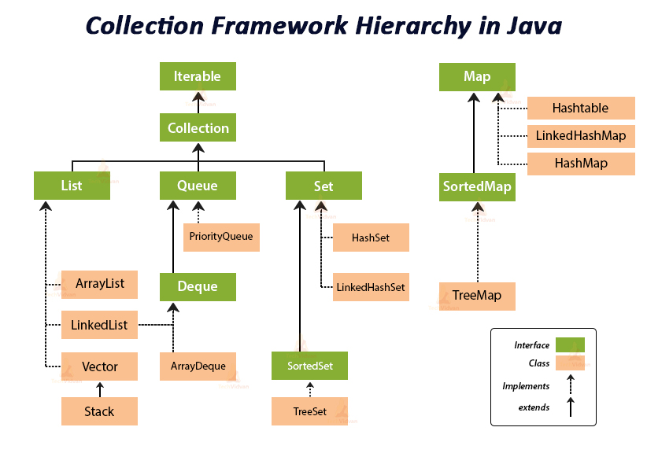

Slide 4
Array VS ArrayList
Array has fixed size while ArrayList is dynamic
To add or retrieve value Array uses []
To add or retrieve value ArrayList uses methods
Array can store primitive and object values
ArrayList can only store object values

Slide 5
ArrayList
Similar to array
No need to give fixed size
Size grows automatically when we insert element
Uses methods to manipulate data

Slide 6
ArrayList Syntax
ArrayList<T> variableName = new ArrayList<T>();
List<T> variableName = new ArrayList<T>();
Collection<T> variableName = new ArrayList<T>();

Slide 7
ArrayList Methods()
add( element) - Inserts element at end
add( index, element) - Inserts element at given index
get( index) – returns element of that index
set( index, element) – sets element at given index

Slide 8
ArrayList Methods()
contains( element) – return whether element is in list or not
indexOf( element) - return index of an element
size() – given total number of elements
isEmpty() - checks whether list is empty or not

Slide 9
ArrayList Methods()
remove( index) - removes element from given index
remove( object) - removes object
clear() - removes all elements

Slide 10
Basic Challenge
There are 10 numbers given in a list add only unique values to another list and print them
Input : 1, 4, 7, 2, 4, 6 , 7, 3
Output : 1, 4, 7, 2, 6, 3

