Slide 1

KIET GROUP OF INSTITUTIONS, GHAZIABAD Computer Science Engineering
Internship Presentation
On
Prediction on the Boston Housing Dataset (Machine Learning)
Aug-Sept
(2021)
Submitted By – Rajat Maurya
Btech- CSE (V-B)
University Roll No - 1900290100116

Slide 2

Introduction to Machine Learning
Machine Learning is an application of artificial intelligence that involves algorithms and data that automatically analyse and make decision by itself without human intervention.
Machine learning is the study of computer algorithms that can improve automatically through experience and by the use of data.
Eg – Image recognition, Speech recognition, medical diagnosis, predictions,etc.

Slide 3
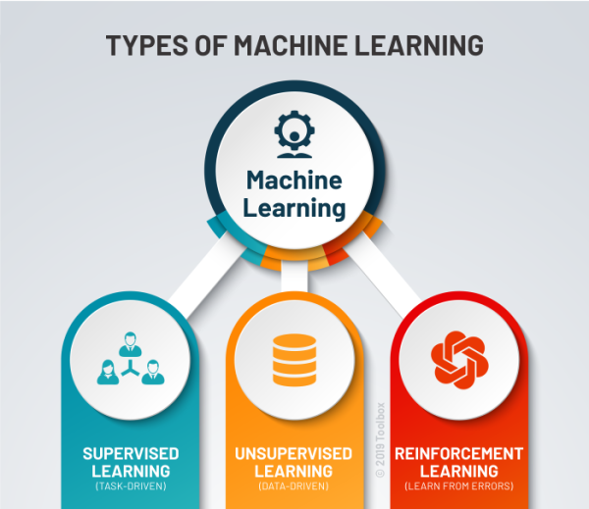
Types of Machine Learning
Unsupervised Learning
Supervised Learning
identify patterns in data sets containing data points that are neither classified nor labeled
machines are trained using well "labelled" training data, and on basis of that data, machines predict the output
Reinforcement Learning
It features an algorithm that improves upon itself and learns from new situations using a trial-and-error method. Favorable outputs are encouraged or ‘reinforced’, and non-favorable outputs are discouraged or ‘punished’.

Slide 4
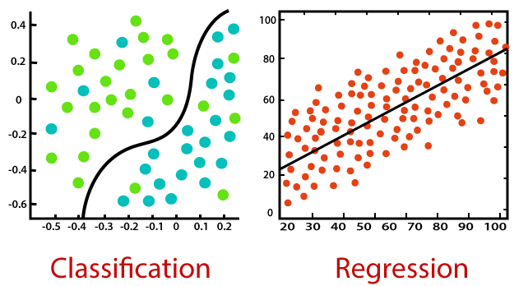
Types of Supervised Learning
Classification And Regression
Data is labelled into two or more classes
Eg - Given a patient with a tumour, we have to predict whether the tumour is malignant or benign.
Allow data to predict a continuous outcome(y) based on the value of one or more predictor variables(x).
Eg- Given a picture of a person, we have to predict their age on the basis of the given picture

Slide 5
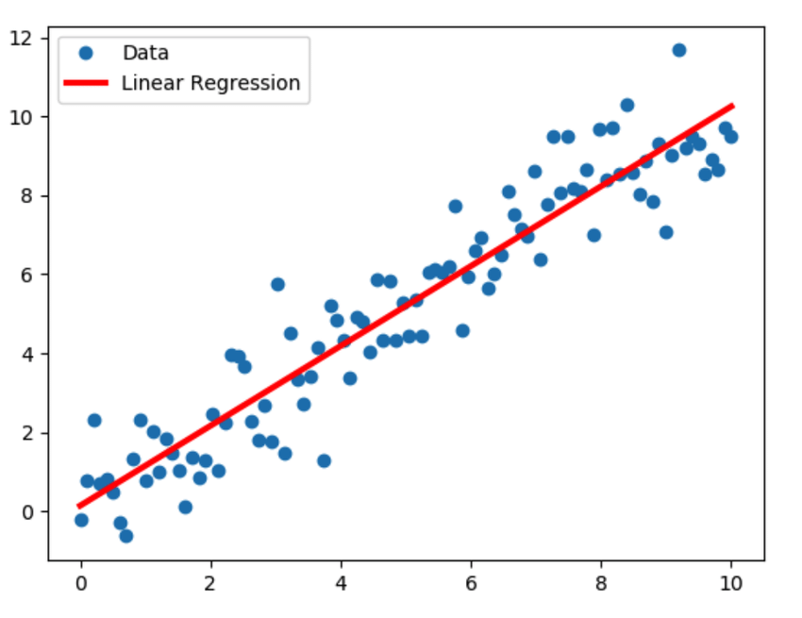
Linear Regression
Linear regression performs the task to predict a dependent variable value (y) based on a given independent variable (x).
this regression technique finds out a linear relationship between x (input) and y(output).
The regression line is the best fit line for our model.
the model aims to predict y value such that the error difference between predicted value and true value is minimum.

Slide 6
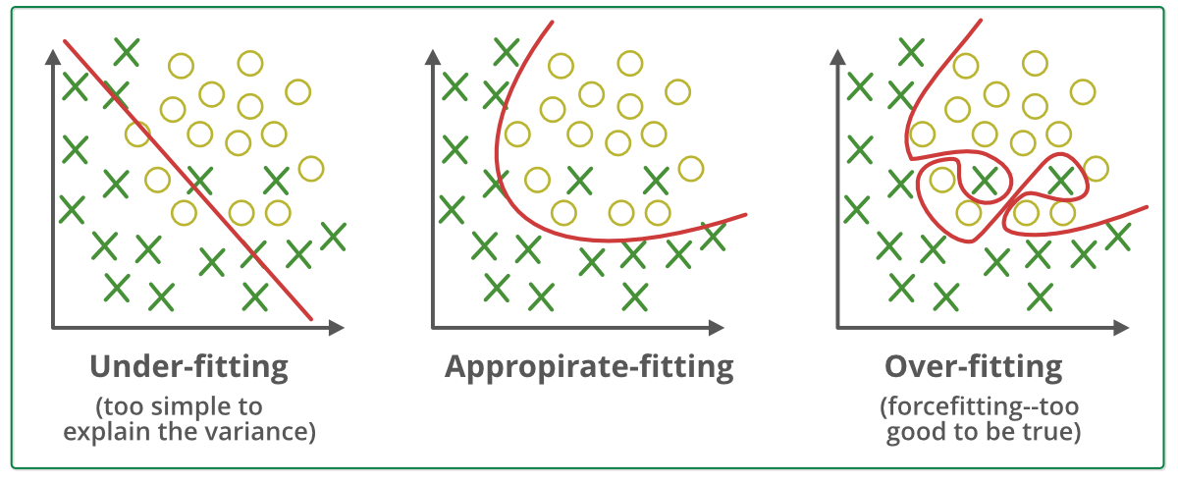
Overfitting, Appropriate fitting and Underfitting
Underfitting - it means not training the model than much well and data of the model is also limited
Appropriate fitting - we have trained the data perfectly, non-linear curve, only two items are misclassified in above fig. good model
Overfitting - we have trained the model to much, included many features in it.

Slide 7


Slide 8
Introduction of Project Internship
Boston House Prices Dataset was collected in 1978 and has 506 entries with 14 attributes or features for homes from various suburbs in Boston. Boston Housing Dataset Attribute Information (in order):
- CRIM per capita crime rate by town
- ZN proportion of residential land zoned for lots over 25,000 sq.ft
- INDUS proportion of non-retail business acres per town
- CHAS Charles River dummy variable (= 1 if tract bounds river; 0 otherwise)
- NOX nitric oxides concentration (parts per 10 million)
- RM average number of rooms per dwelling
- AGE proportion of owner-occupied units built prior to 1940
- DIS weighted distances to five Boston employment centres
- RAD index of accessibility to radial highways
- TAX full-value property-tax rate per $10,000
- PTRATIO pupil-teacher ratio by town
- B 1000(Bk - 0.63)^2 where Bk is the proportion of blacks by town
- LSTAT % lower status of the population
- MEDV Median value of owner-occupied homes in $1000's

Slide 9
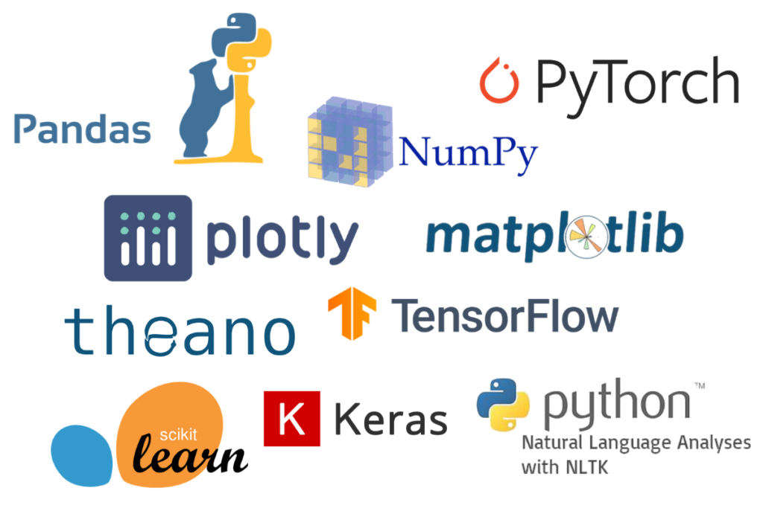
Step – 1
Python inbuilt libraries used in making this project includes:
Pandas - pandas is a fast, powerful, flexible and easy to use open source data analysis and manipulation tool
NumPy - NumPy is a Python library used for working with arrays. It also has functions for working in domain of linear algebra, Fourier transform, and matrices.
Seaborn - used for making statistical graphics, Seaborn is a data visualization library built on top of matplotlib, The graphs created can also be customized easily.
Matplotlib.pyplot - creates a figure, creates a plotting area in a figure, plots some lines in a plotting area, decorates the plot with labels, etc.
Seaborn uses fewer syntax and has stunning default themes and Matplotlib is more easily customizable through accessing the classes.

Slide 10
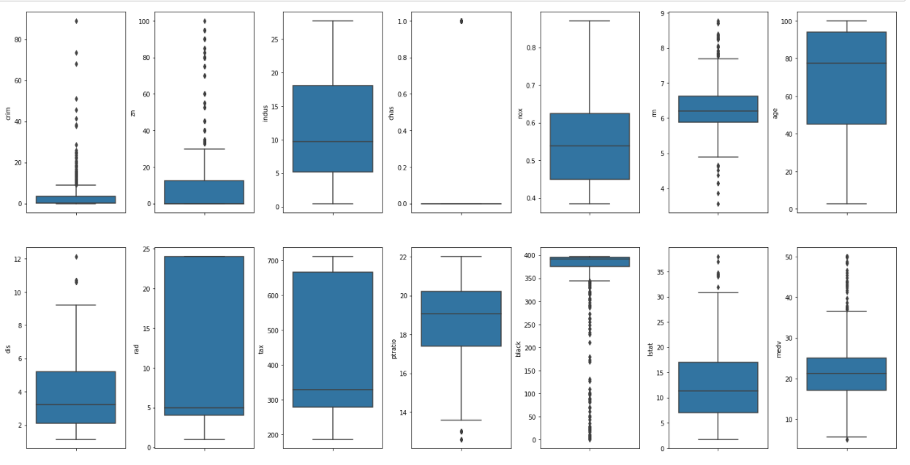
Step – 2
Import Dataset.csv (comma-separated values) File
Step – 3
Pre-processing of Data
creating box plots from the 14 attributes
box plot= a simple way of representing statistical data on a plot (graph)
After removing the overlapping in plot, we get

Slide 11
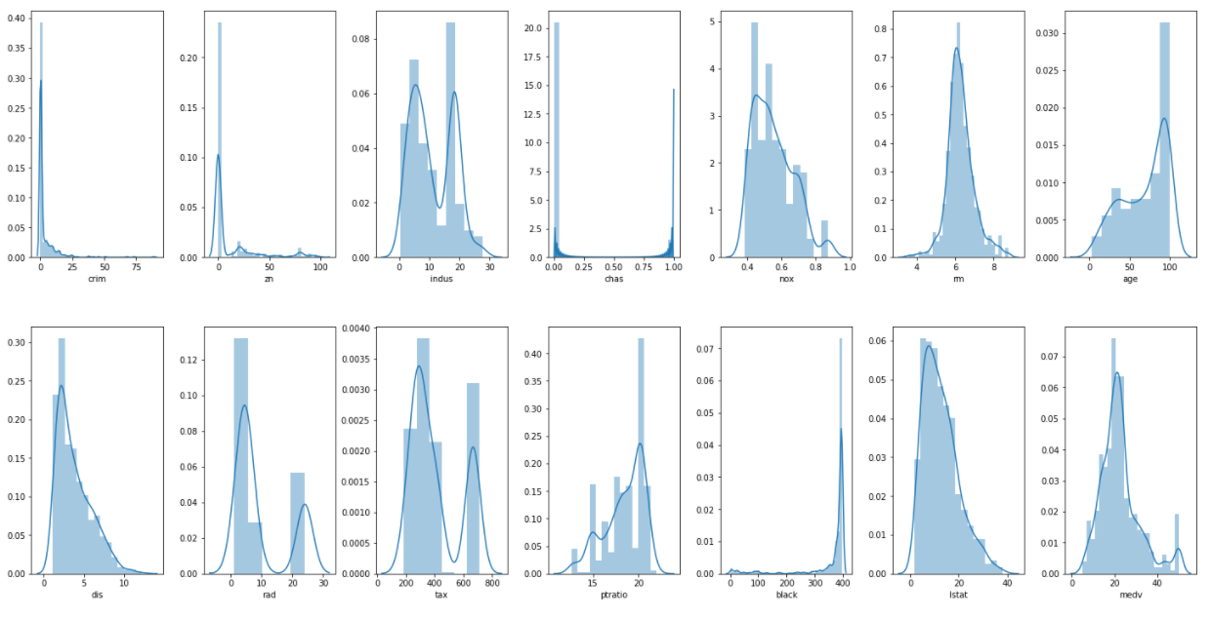
Step – 4
Drawing Dist plot to see the uniformity in the plot
A Distplot or distribution plot, depicts the variation in the data distribution
if the plot is on left we say left skewed plot
if the plot is on right we say right skewed plot

Slide 12
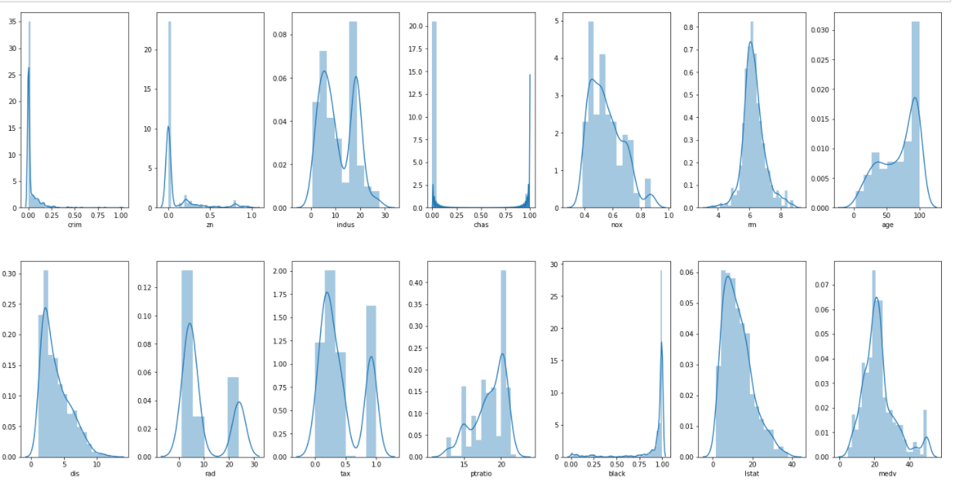
Step – 5
Doing Min Max Normalization
if the values have so much difference then we use min max normalization.
after doing min max normalization we will get range 0 to 1.
If outliers are more we do min max normalization, if less outliers we ignore them.
every other value gets transformed into a decimal between 0 and 1.
cols = ['crim', 'zn', 'tax', 'black’] we have used min max normalization in these columns

Slide 13
X_new = (X - mean)/Std
Step – 6
Now performing Standardization
standardization is the process of bringing data into a uniform format that allows analysts and others to research, analyze, and utilize the data.
Standardization or Z-Score Normalization is the transformation of features by subtracting from mean and dividing by standard deviation
X_new = (X - mean)/Std
Step -7
Drawing Correlation Matrix
A correlation matrix is simply a table which displays the correlation
We can plot correlation matrix to show which variable is having a high or low correlation in respect to another variable.
Correlation is an indication about the changes between two variables.

Slide 14
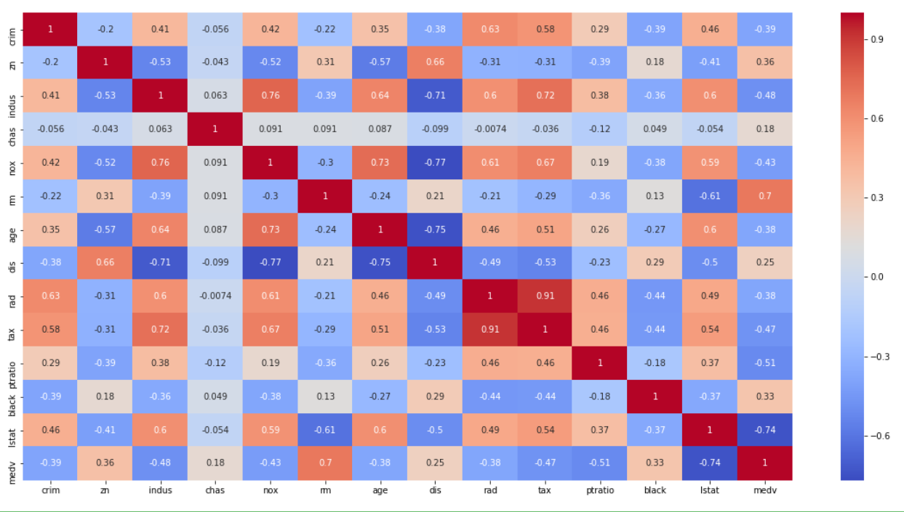

Slide 15
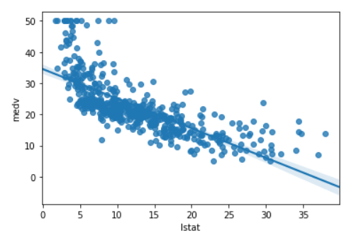
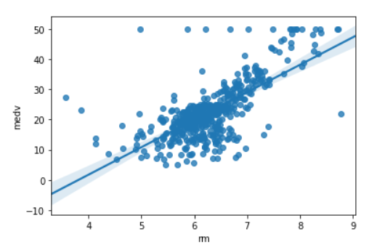
Step -8
Drawing Linear Regression Plot
regplot() : This method is used to plot data and a linear regression model fit.
Medv - Median value of owner-occupied homes in $1000’s
Linear Regression Plot
price decreases when the lstat(lower status of the population) is increasing.
- price of houses increases when the rm( average rooms) increases

Slide 16
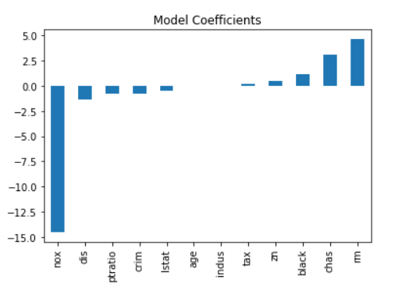
Step – 9
Now Training and Testing Data
33% Testing data
67% Training data
using cross validation score and MSE(Mean squared Error ) values we will determine which model is performing better.
- If our model had predicted the exact value as the actual values then the mean squared error function would have returned a value of 0.
- values closer to zero indicate a better fit.
Here I am using Linear Regression Model First:
Which gives MSE: 23.87100506
CV(cross validation score) Score: 35.5813662107

Slide 17
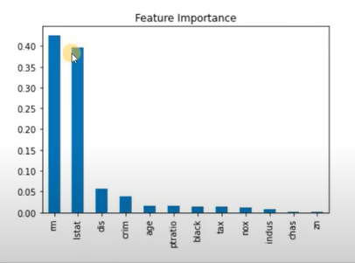
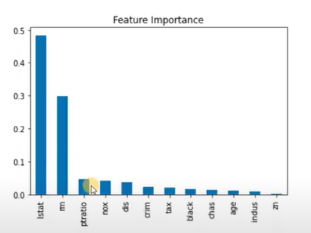
Some other better Model Like
Random forest regression
- Here MSE: 9.97558989
- CV Score – 21.41457768
2) XG Boost
- Here MSE: 10.0323161065
- CV Score: 17.9712904185

Slide 18


