Slide 1

Presented By:
Aryan Upadhyay (201500160)
Priyanshi (201500525)
Rajat Mishra (201500553)
Akash Yadav (201500061)
Krishna Gautam (201500350)
Presented To:
Mr. Mandeep Singh
(Technical Trainer)
GLA University,
Mathura

Slide 2

PG-Finder
(Online PG Listing Web Site)
GitHub link : pg-finder-mini

Slide 3
Topics to be covered
Introduction
Problem Explored
Technologies Used
Design
Project Model View
Features
Advantages
Conclusion

Slide 4
Introduction:
It is an online platform to browse, search and like properties, PGs and Rooms for the students, fresh graduates & professionals. First it is designed for the web but in future it could be made accessible on all the platforms.
The main use of this project is to list all the PGs available in the selected city. Users can show their interest using this web application, and can save property for future reference.
The best part, using this, you can get all the PGs and rooms that are available and other properties free of cost and it is also hassle-free as providing list of PGs with provided amenities is saving a lot of efforts and time of an Individual.

Slide 5
What is the need of PG Finder?
Almost all the websites available on the internet now-a-days which show property listing are only focusing on end of the spectrum. The people who are looking for a place to stay for a day or two.
But, no website available on the web addresses the needs of student & hostellers who have to stay at a place for longer periods e.g. 3-6months. The type of properties of this sort has very low amount of listings.
People often have to go to other cities and stay there for many days in order to find a PG just enough to live due to lack of choices (or their knowledge)

Slide 6





Tech Stack:
Frontend
Backend

Slide 7
Frontend
The frontend of PG Finder is built using HTML, CSS and JavaScript. The styling part also includes few pieces inculcated from Bootstrap.
HTML: (Hypertext Markup Language) HTML is the language in which most websites are written. HTML is used to create pages and make them functional.
CSS: (Cascading Style Sheet) CSS is a style sheet language used for describing the presentation of a document written in a markup language such as HTML or XML.
JavaScript: JavaScript, often abbreviated as JS, is a programming language that is one of the core technologies of the World Wide Web, alongside HTML and CSS.

Slide 8
Backend
The backend of PG Finder is built using PHP using MySQL Database.
PHP: PHP is a server scripting language, and a powerful tool for making dynamic and interactive Web pages. PHP is a widely-used, free, and efficient alternative to competitors such as Microsoft's ASP.
MySQL: MySQL is a widely used relational database management system (RDBMS). MySQL is free and open-source. MySQL is ideal for both small and large applications.

Slide 9
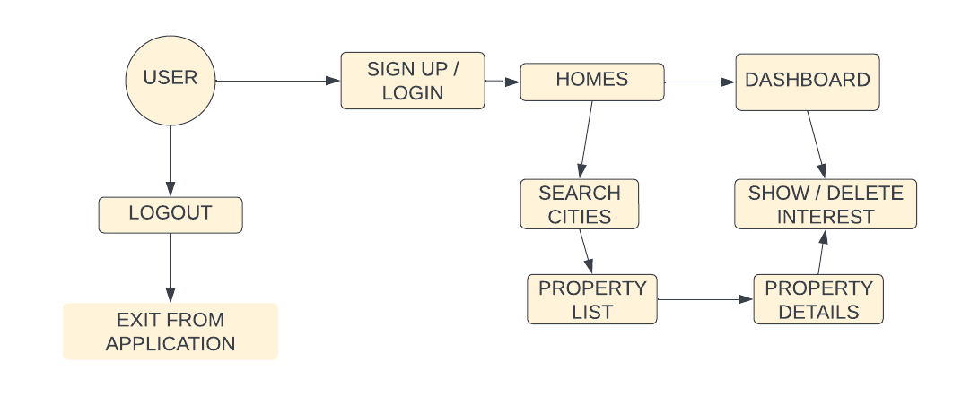
Design:

Slide 10
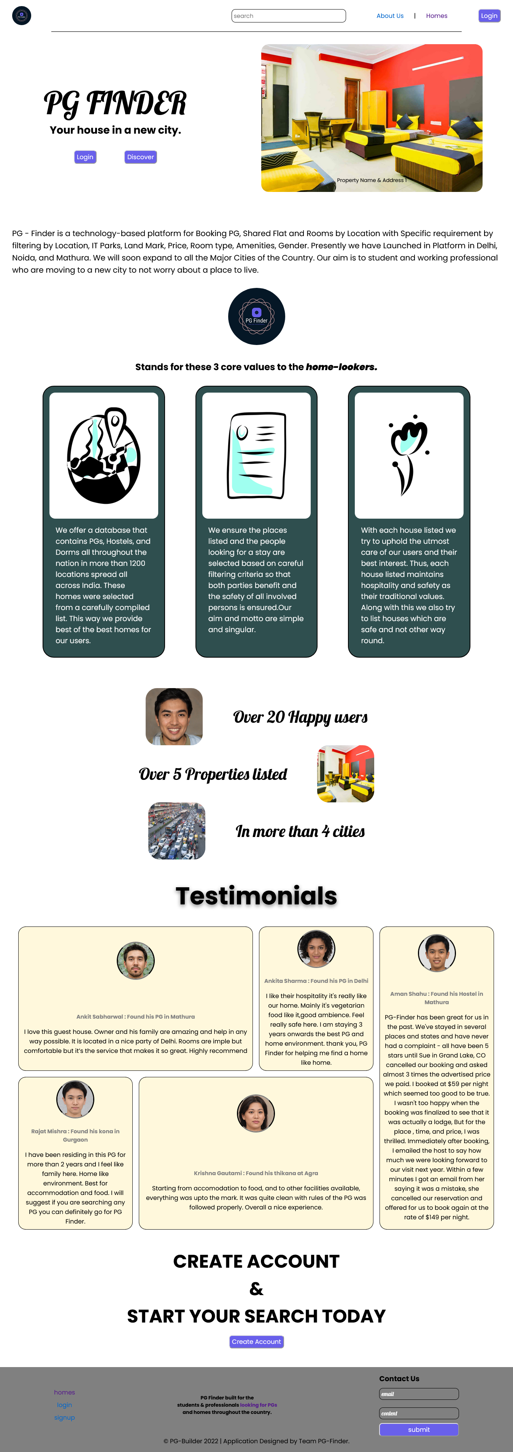
Project Model View:
Home screen:
This is the main screen or page of the application from where user can access the whole application.
User can reach to the different sections of the application from this page. Also shows the values of our Web Application (Accessibility, Documented, Hospitality).
It shows live details of project database by listing number of properties etc.

Slide 11
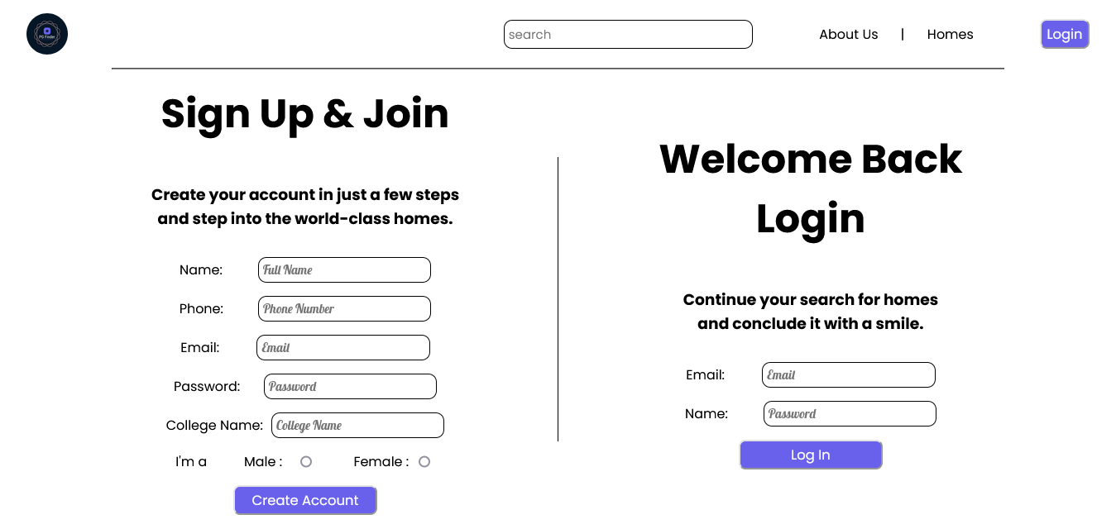
Sign in / Sign Up screen:
For signing in to the application user must have an account on the database.
User has to enter his/her valid email id and password to access the application.
If user doesn’t have an account already that he/she can create it also, Providing valid details.

Slide 12
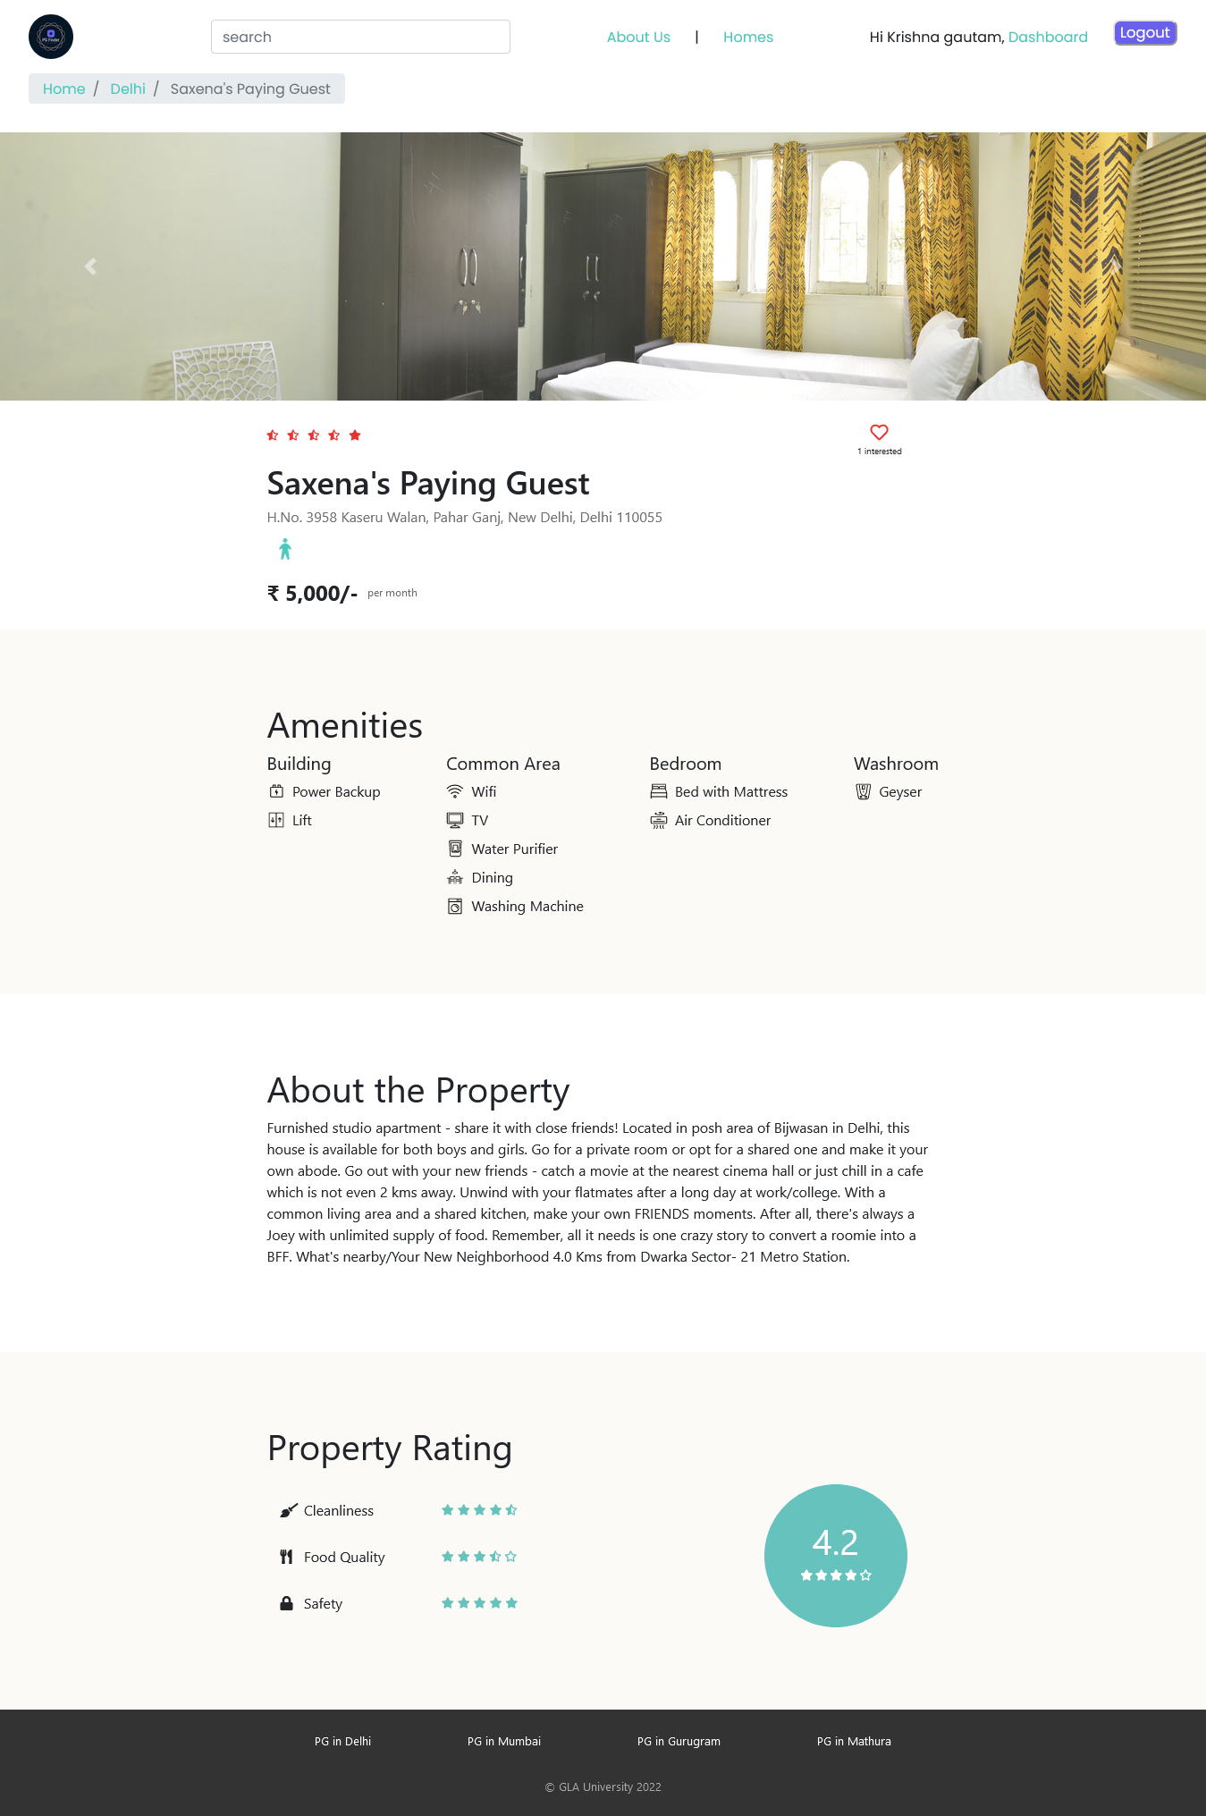
Property Detail screen:
This page allows user to view further details of the property such as amenities, rating.
This also about the property section which is a curated text having all the details in a property.
The amenities has listing of various types such as building, common area facilities etc.

Slide 13
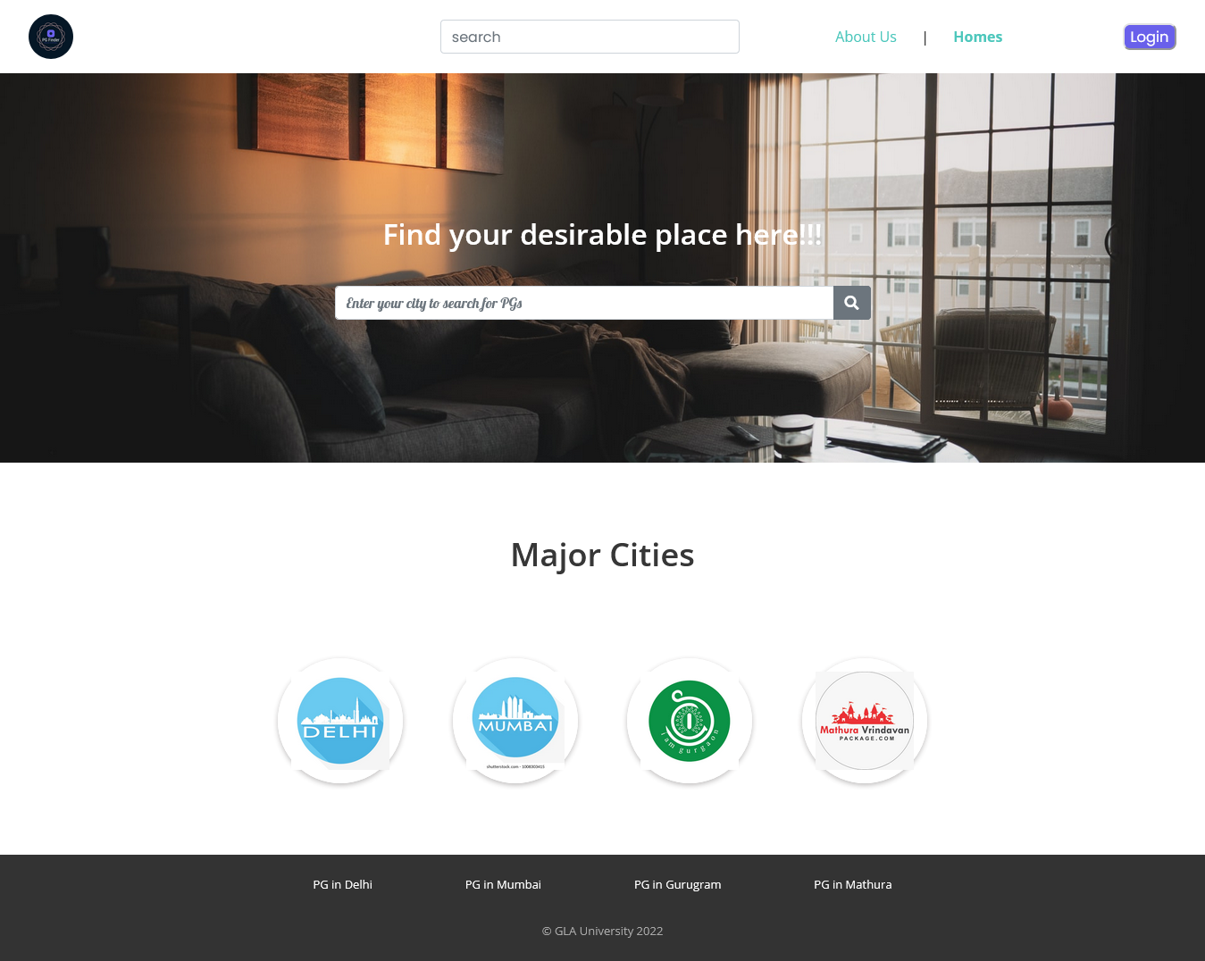
Homes Page:
This page is the landing page for properties.
From here user can search for different cities and property availability in that city.
It also has placeholder buttons for four major cities.
It also has search bar.

Slide 14
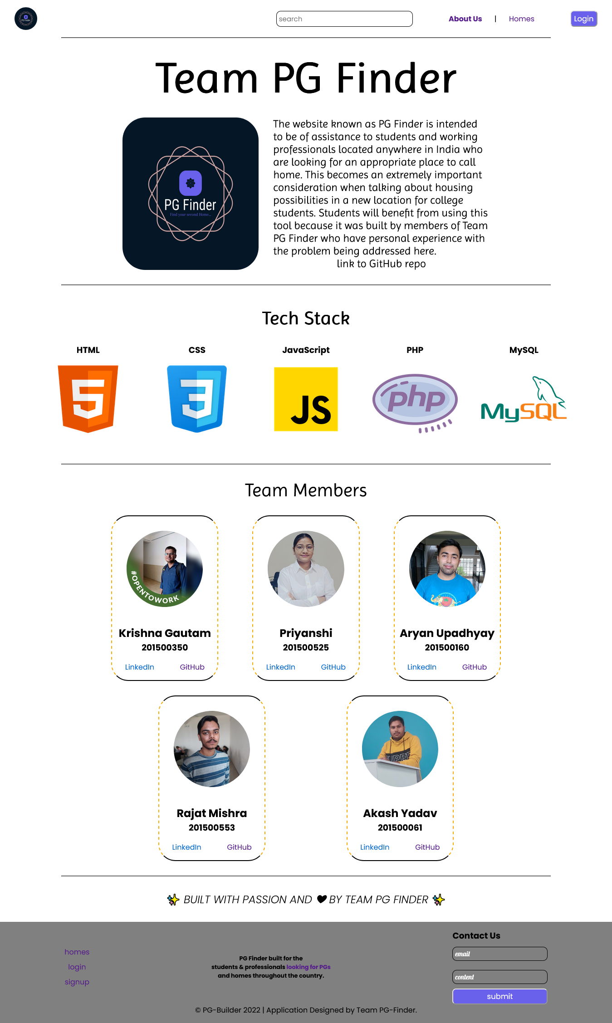
About us Page:
The about us page is used to show the idea behind creating this application and it’s tech stack.
It also has a board for all the member of the project and their links.

Slide 15
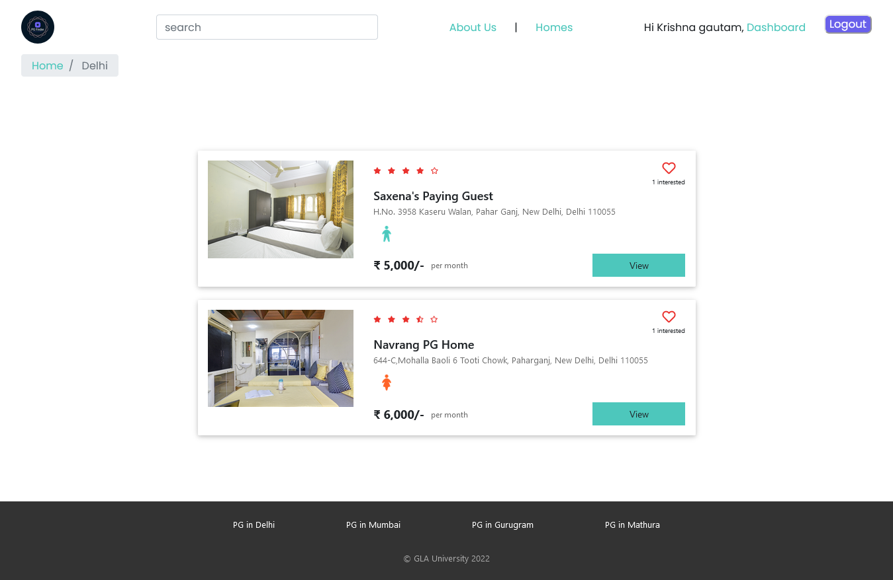
Property List / Result Page:
This page is used to display the result of a search query entered by the user in the homes page.
It has individual listing of each property and some details about the property such as name and rent price.
The navbar of all the pages contains a persistent search bar so to ease the searching process in times of need.

Slide 16
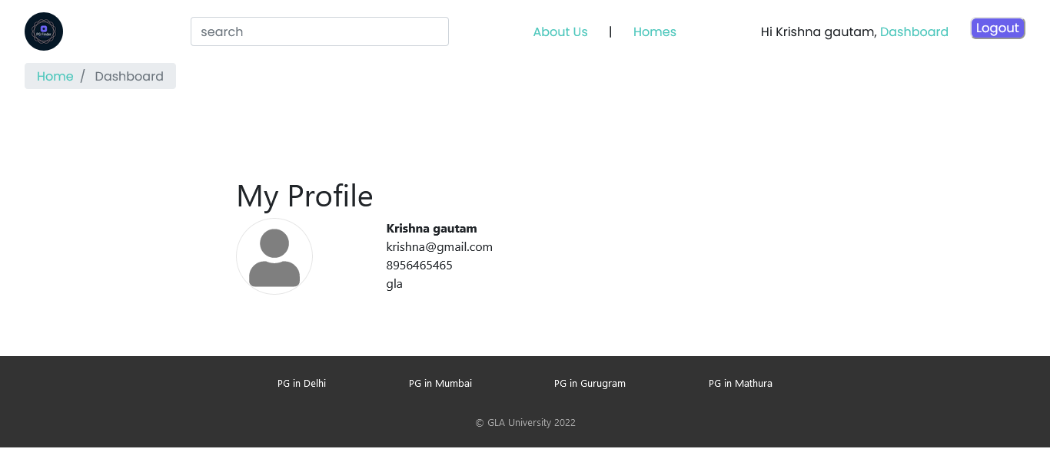
Dashboard Page:
This page is internal to the user, only accessible by the user when logged in.
This page shows the list of all properties which were marked interested by the user.
User on this page can also unmark (remove from favourites) the property.
Each page when logged in has a Logout button all the time.

Slide 17
Advantages:
Ease to access.
Reduces human effort to find a place.
An ecosystem can be built by using this business.
Demand of a particular property can be determined, which property in which users are more interested.

Slide 18
Conclusion:
Everyone needs to locate a place to live, whether they are new students or working professionals, and the difficulty of this task multiplies tenfold when we move to a city that we are not familiar with. Applications such as PG Finder can be a real help in these kinds of situations. Because by using this, a person may find all of the potential PGs and their pricing, and then decide which one to go to, all while remaining in the comfort of their own home and avoiding any unnecessary difficulty. The expansion of the database and making PG Finder easier to use are two of our goals for the future of this project.

Slide 19
Thank You

