Slide 1
TOPIC:
WaveCluster with Differential Privacy
Rajat Raj Singh
Indian Institute of Technology Roorkee

Slide 2
Problem Statement
A newly developed grid-based clustering algorithm-
WaveCluster
Aim:
Study different ways in which differential privacy can be applied to the WaveCluster algorithm.
Ensuring utility of results is preserved even if the results are differentially private.
Development of a quantitative measure to compare the utility of different algorithms proposed.

Slide 3
Important Concepts
1. Differential Privacy:
In various data analysis scenarios where the data to be analyzed involves personal information of different individuals, we need to make sure that not to compromise the privacy of any individual.
Differential privacy is a privacy model, which guarantees that an adversary cannot infer an individual’s presence in a dataset from the randomized output, despite having knowledge of all remaining individuals in the data set.
There are 2 common ways to ensure 𝜖-differential privacy:
Laplace Mechanism: The output result is modified by adding Laplacian noise before publishing.
Exponential Mechanism: All the possible outputs are assigned a score by a quality function, and a randomized algorithm outputs the result with probability proportional to the exponent of the score of the outputs.

Slide 4
Important Concepts
2. WaveCluster
WaveCluster is a very specialized clustering algorithm as it works by applying a wavelet transform to differentiate between clusters.
By applying a wavelet transform, it distinguishes between high-frequency areas and low-frequency areas.
Applying WaveCluster consists of 4 steps:

Slide 5
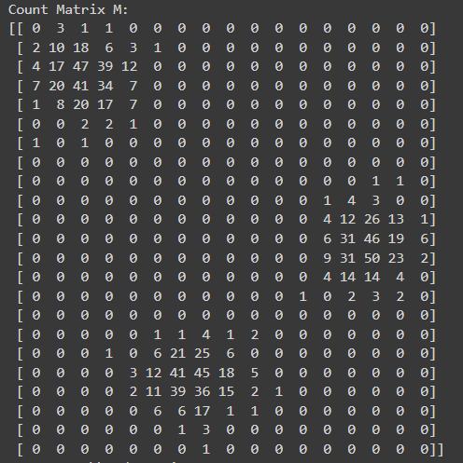
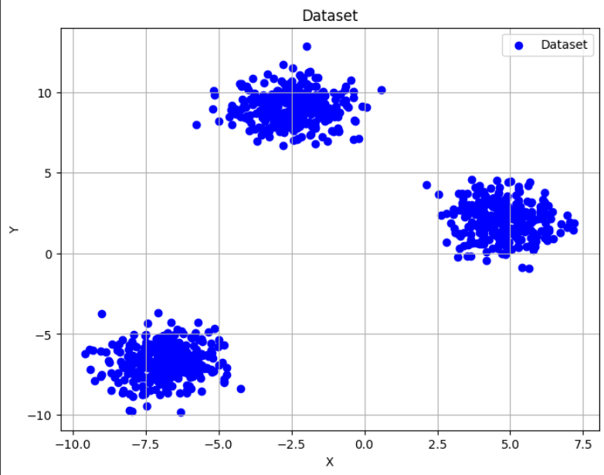
Quantization
First quantize the feature space into grids and get the count of data points occurring in each grid, thus creating a count matrix M.

Slide 6
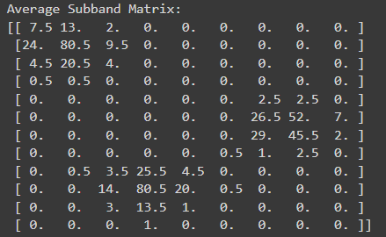
Wavelet Transform
Then apply a wavelet transform to it and get the transformed matrix W. In this research, we have used Haar Transform as the wavelet transform.

Slide 7
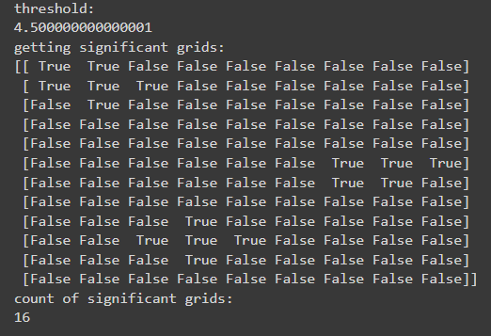
Significant Grid Identification
To identify significant grids from matrix W:
Take the positive values of the matrix W and store it in a list L in sorted order.
Take the pth percentile value of this list as the threshold. (Here p is a parameter)
Mark the values of matrix W which are greater than threshold.

Slide 8
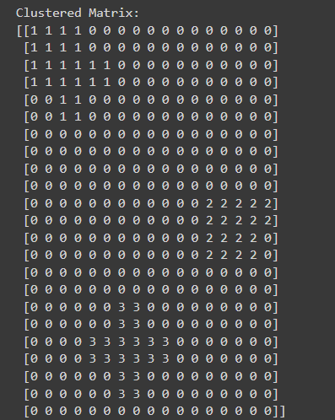
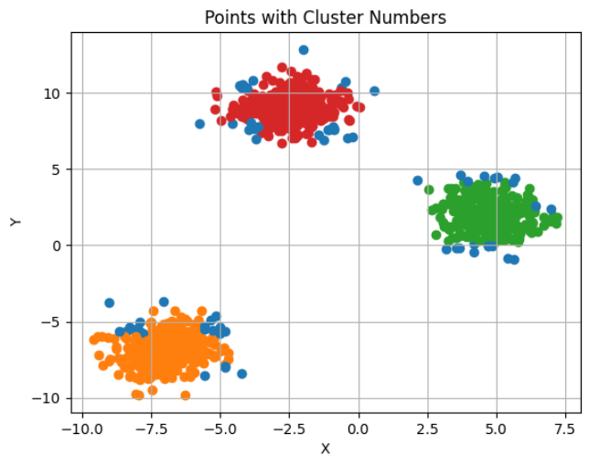
Cluster Identification
Group all the significant grids in the matrix W into clusters by using connected component analysis.
Then map the clusters back to the original multi-dimensional space, finally labeling the original data points into their relevant clusters.

Slide 9
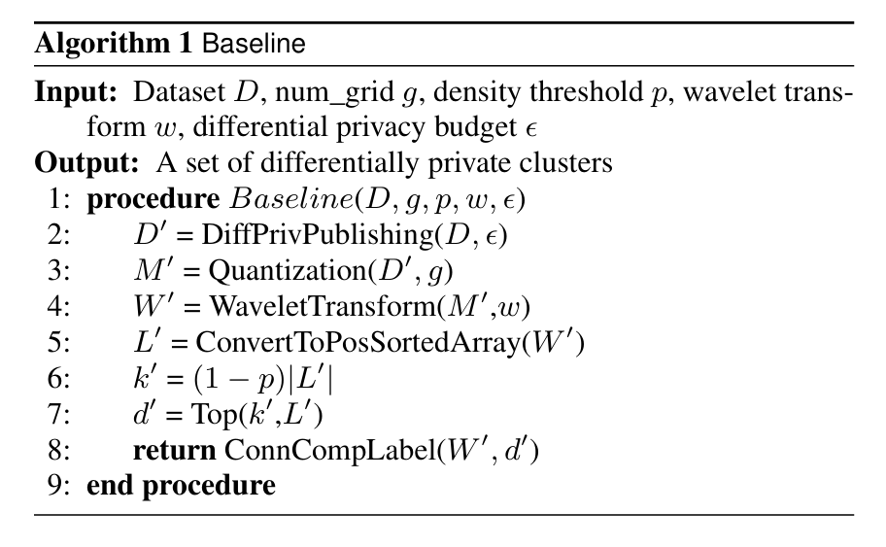
Baseline Approach

Slide 10
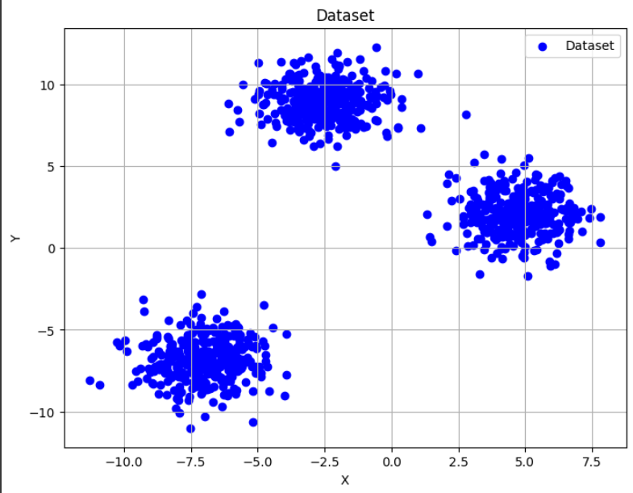
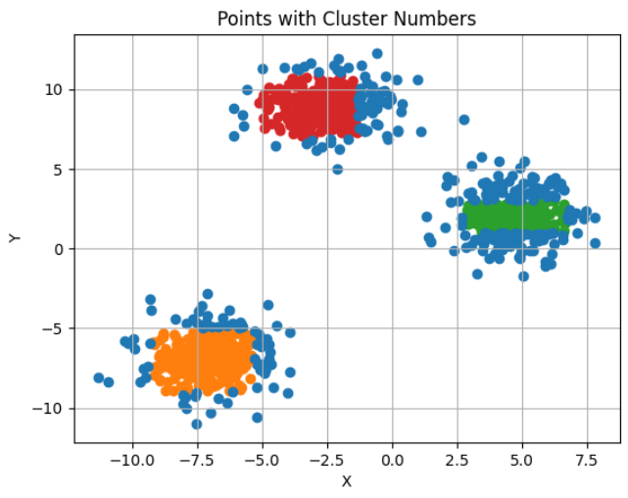
Baseline Approach
Generating Synthetic Dataset
WaveCluster result

Slide 11
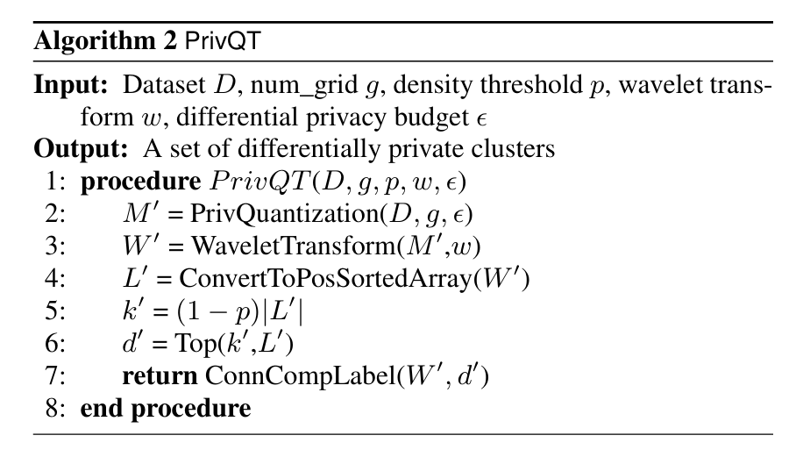
PrivQT (Private Quantization)

Slide 12
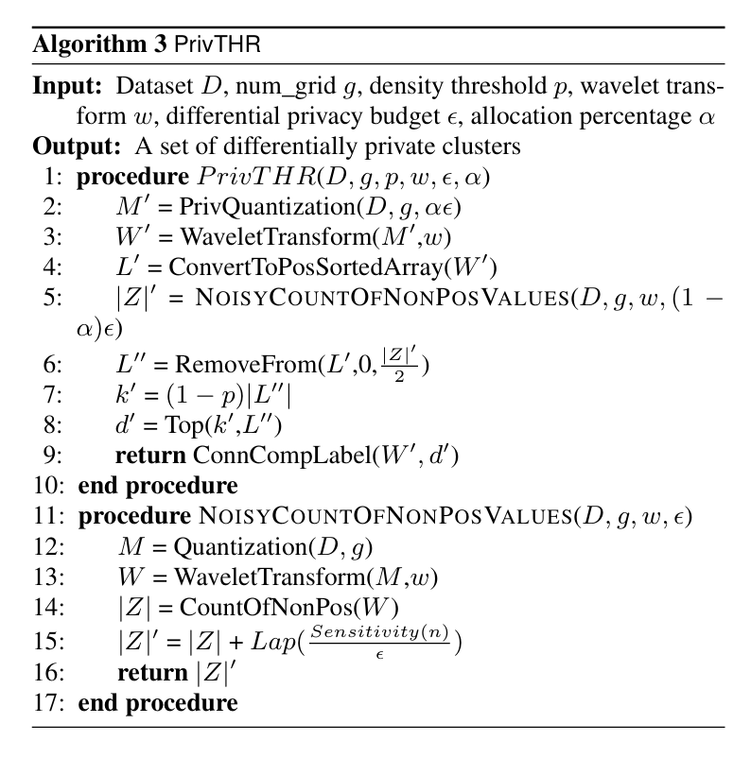
PrivTHR(Private Quantization with refined noisy density threshold)

Slide 13
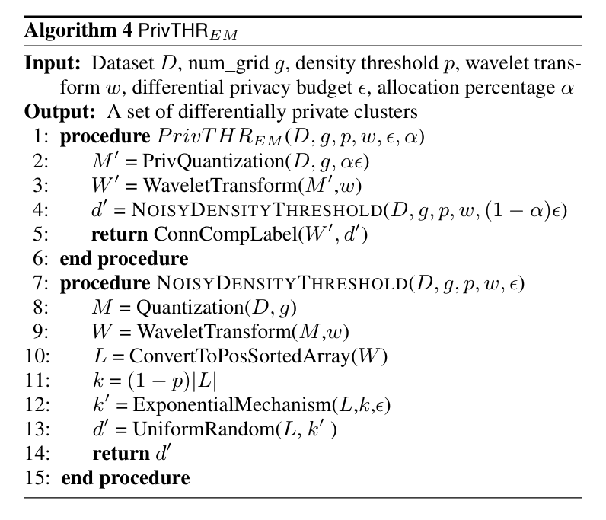
PrivTHRem (Private Quantization with Noisy Threshold using Exponential Mechanism)

Slide 14
Dissimilarity Index
A quantitative measure that compares the differentially private results with the true results and outputs their dissimilarity level.
The Dissimilarity Index is calculated as follows:
First define the distance between 2 clusters Ci and Cj as max {|𝐶𝑖 − 𝐶𝑗| , |𝐶𝑗 − 𝐶𝑖|} .
We then map each differentially private wave cluster to its true cluster and then sum the distances of all these cluster pairs. Let’s call this sum as M_cost.
Dissimilarity Index is defined as ( M_cost / |T| ). Here T is the set of significant grids in true WaveCluster results.

Slide 15
Calculations and Results
Original WaveCluster Results
Grid size: 1.0
p = 0.5
Transform used: Haar transform

Slide 16
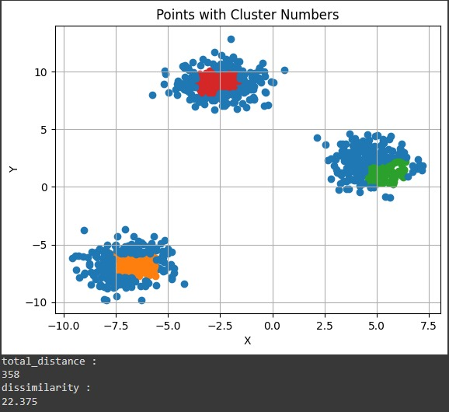
Results
PrivQT Result
𝜖 = 2.0.

Slide 17
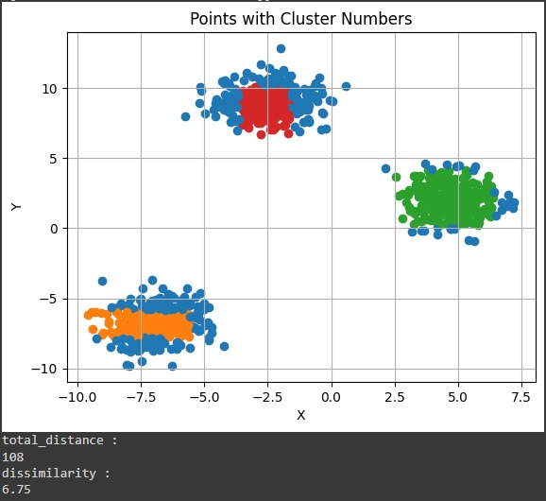
Results
PrivTHR Result
𝜖 = 2.0.
𝛼 = 0.9

Slide 18
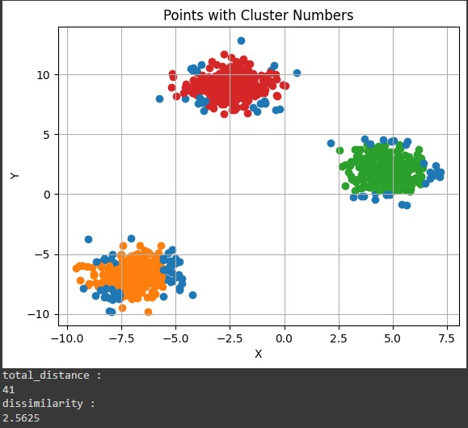
Results
PrivTHRem Result
𝜖 = 2.0.
𝛼 = 0.7

Slide 19
Thanks ☺
Reference:
L. Chen, T. Yu, and R. Chirkova. Wavecluster with differential privacy. CoRR, abs/1508.00192, 2015

