Slide 1
FLIGHT PRICE PREDICTION MODEL
Anyone who has booked a flight ticket knows how unexpectedly the prices vary. The cheapest
available ticket on a given flight gets more and less expensive over time. This usually happens as
an attempt to maximize revenue based on Time ,Airline and many more.
The following ,model is made to get apt insights from the data of flights between Delhi Mumbai on a limited span of a month.

Slide 2
Steps followed for the model

Slide 3
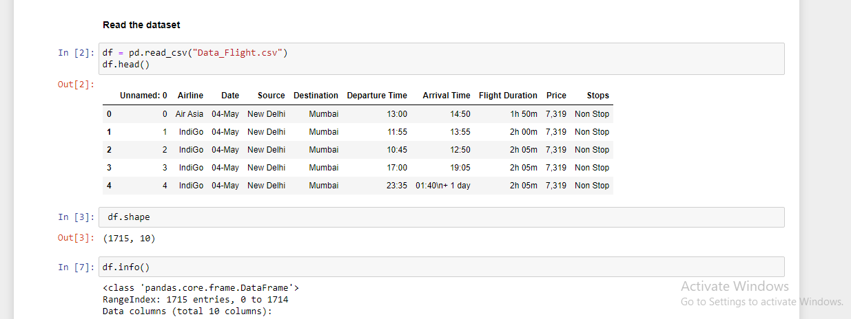
Step-1
Reading the dataset

Slide 4
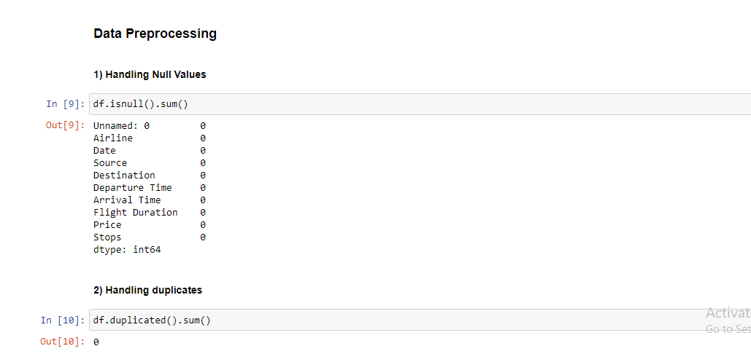
Step-2
Checking null values and duplicated values

Slide 5
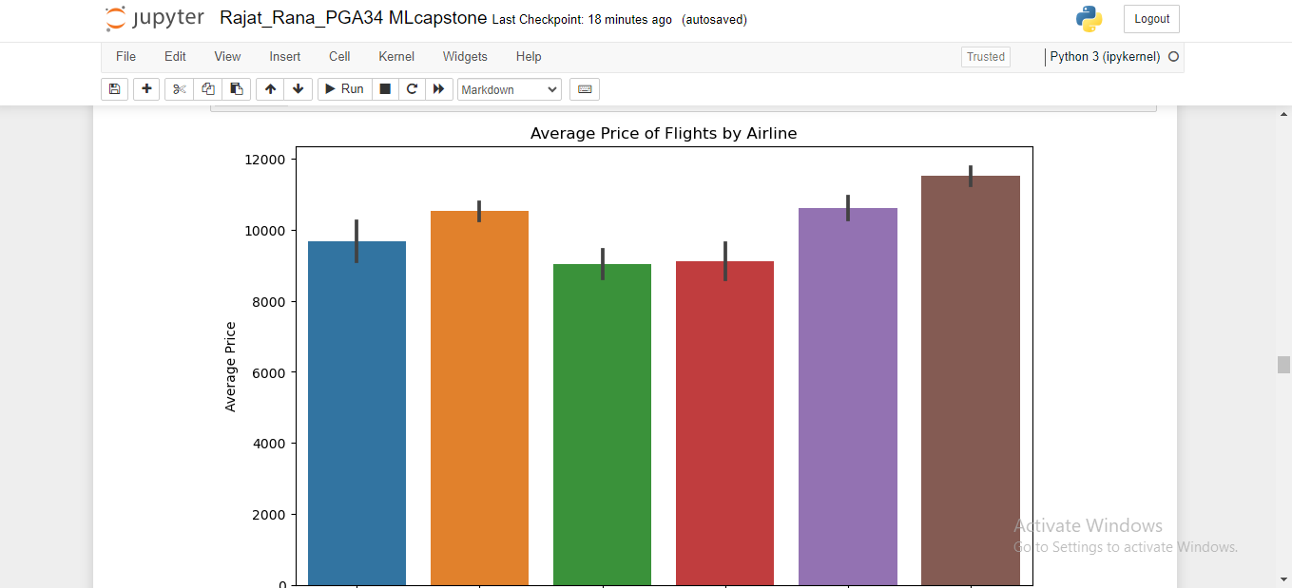
Step-3
Took Insights from the data

Slide 6
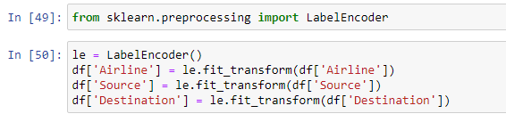
Step 4
Step 4: The next step we take is encode the object type data into numerical types.

Slide 7
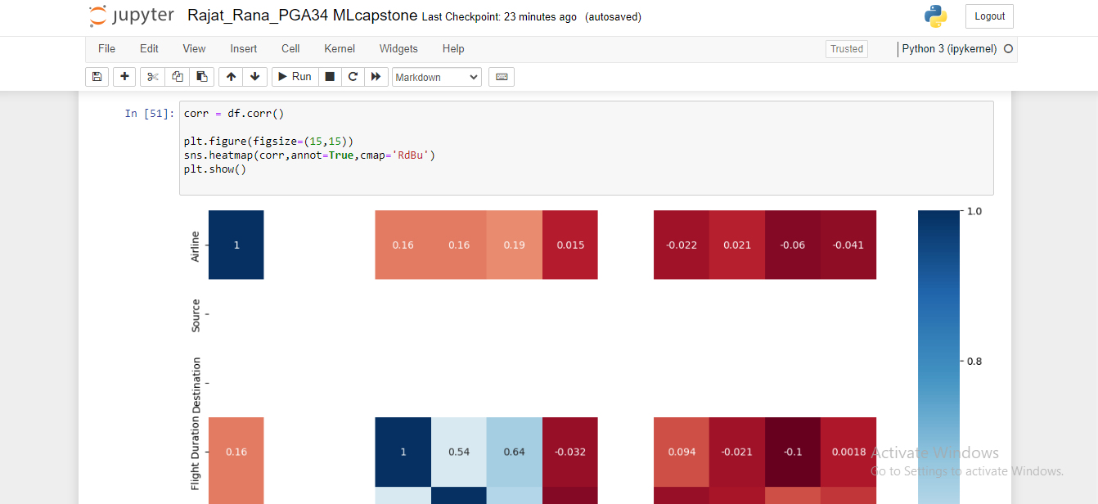
Step 5
Heatmap is produced for correlation

Slide 8
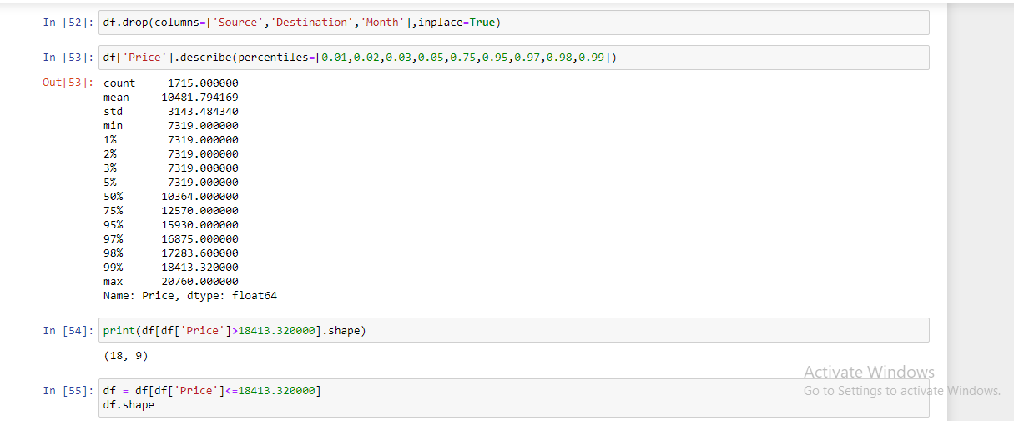
Step 6
Removing uncorrealted columns and outliers

Slide 9
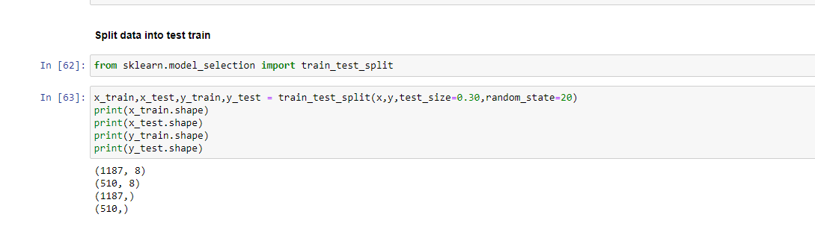
Step 7
Splitting data into TEST and TRAIN data

Slide 10
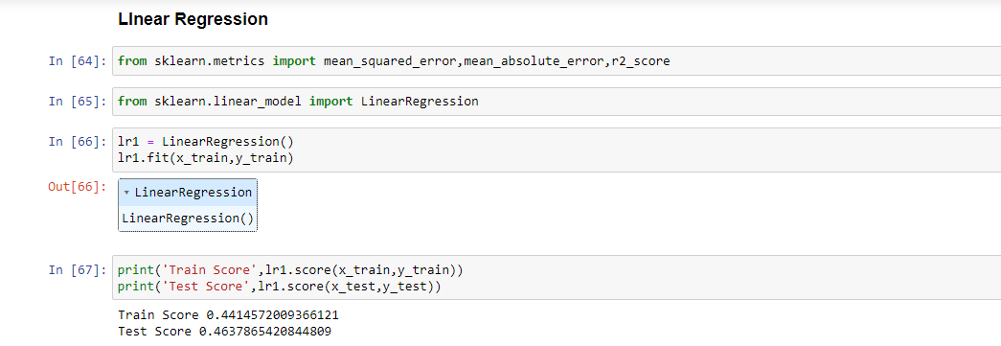
Step 8
Created 4 Models, and out of 4 Random Forest scored well.

Slide 11
INSIGHTS
Various insights we get from the data are:
1. On an average 'Go First' flights are cheaper followed by 'SpiceJet'.
2. Flight with departure around midnight is the cheapest for any particular day
3. For Delhi-Mumbai flight, non-stop flights are comparitively cheaper.

