Slide 1
Customer Shopping
Behavior Analysis
Python • PostgreSQL / SQL • Power BI
Transactional analysis of 3,900 customer purchases
1

Slide 2
1. Project Overview
Analyze customer shopping behavior using transactional data from 3,900 purchases.
Understand spending patterns and customer segments.
Identify product preferences and subscription behavior.
Translate findings into business decisions and recommendations.
3,900
Purchases
18
Columns
37
Missing Review Ratings
2

Slide 3
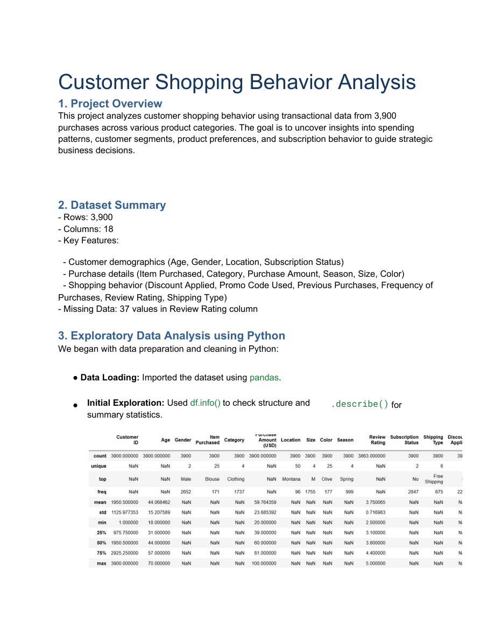
2. Dataset & Data Preparation
Customer demographics: Age, Gender, Location, Subscription Status.
Purchase details: Item Purchased, Category, Purchase Amount, Season, Size, Color.
Shopping behavior: Discount Applied, Promo Code Used, Previous Purchases, Frequency of Purchases, Review Rating, Shipping Type.
Python/pandas was used for loading, exploration, summary statistics, cleaning, and preparation.
37 missing values in Review Rating were imputed using the median rating of each product category.
Columns were standardized to snake_case for readability.
3

Slide 4
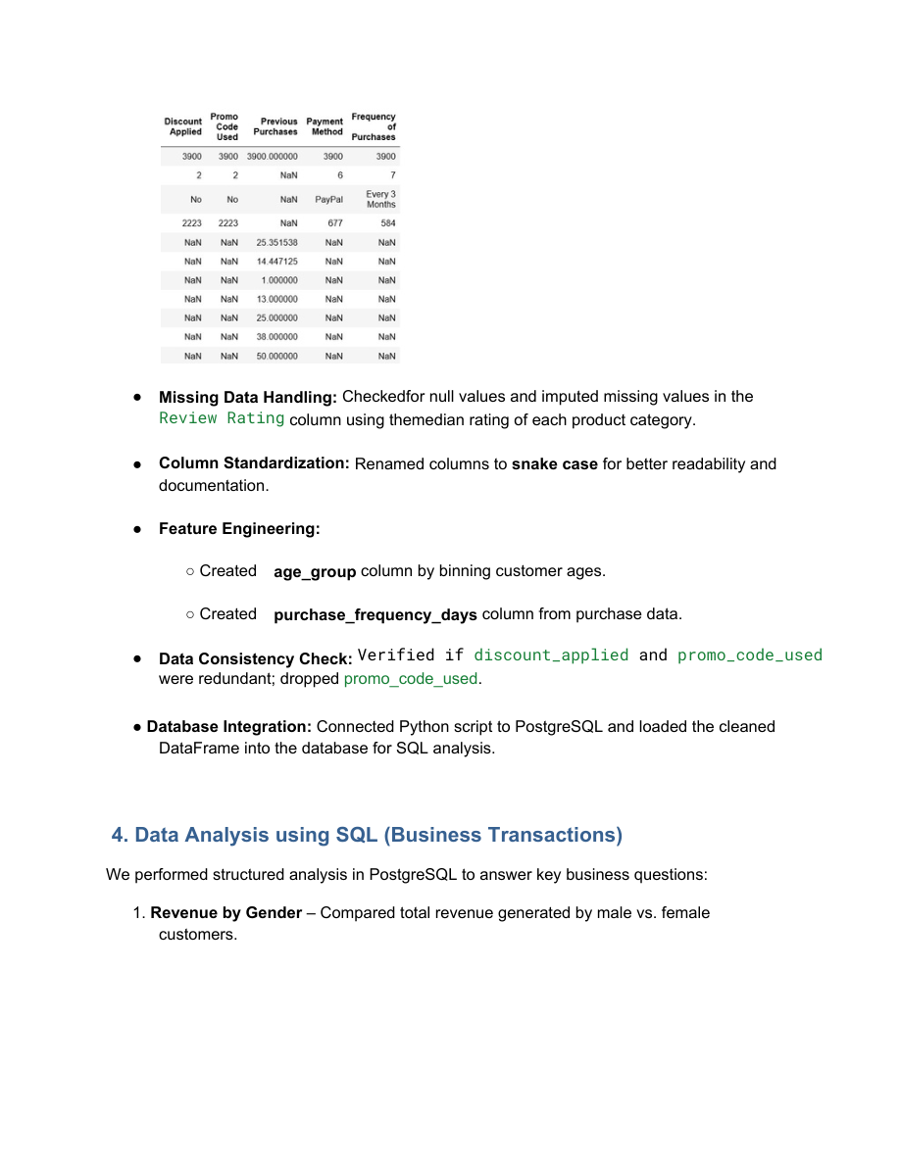
3. Feature Engineering & SQL Analysis
Created age_group by binning customer ages.
Created purchase_frequency_days from purchase data.
Checked discount_applied and promo_code_used for redundancy; promo_code_used was dropped.
Connected the cleaned Python DataFrame to PostgreSQL for structured SQL analysis.
SQL analysis focused on revenue, high-spending discount users, product ratings, shipping, subscriptions, segmentation, and repeat buying.
4

Slide 5
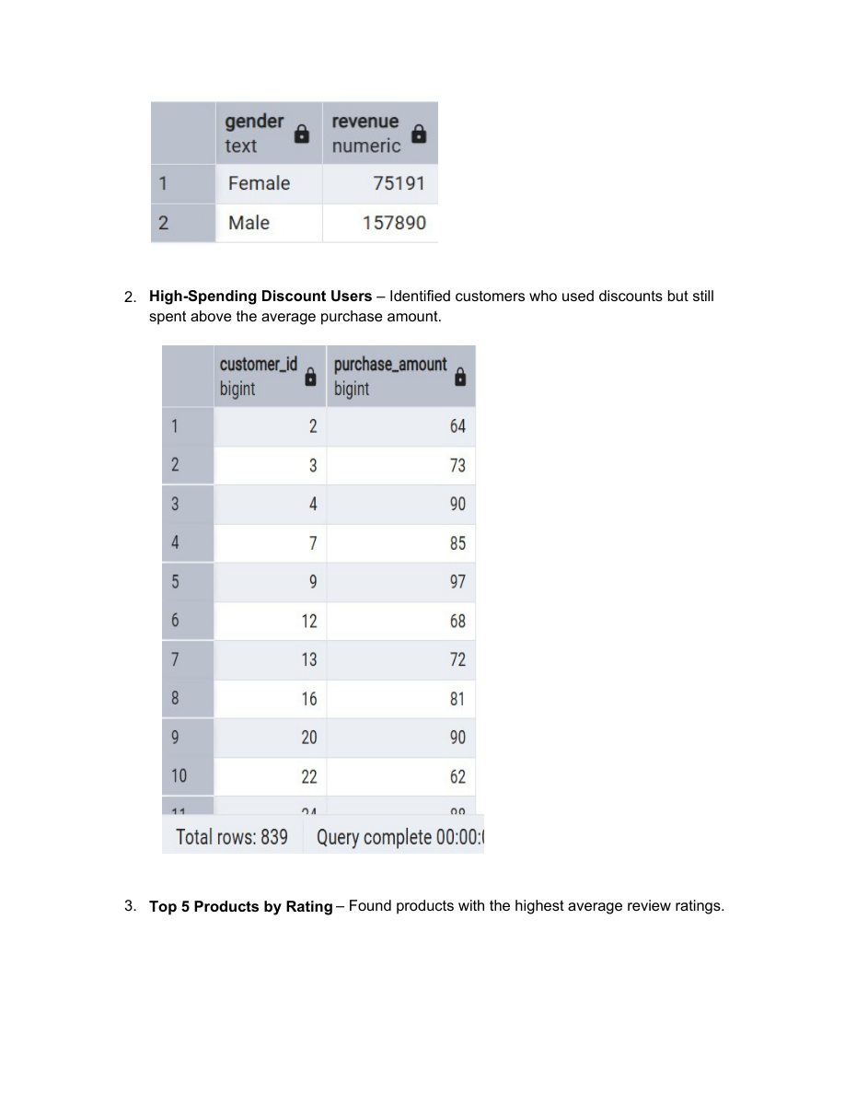
4. Key SQL Results — Revenue & Spending
Gender | Revenue
Female | $75,191
Male | $157,890
High-Spending Discount Users: 839 customers met the analysis condition of using discounts while spending above the average purchase amount.
This highlights a sizeable group that combines promotional usage with relatively high purchase value.
5

Slide 6
5. Product Ratings, Shipping & Subscription
Top-rated product | Avg. Rating
Gloves | 3.86
Sandals | 3.84
Boots | 3.82
Hat | 3.80
Skirt | 3.78
Shipping Type | Avg. Purchase
Standard | 58.46
Express | 60.48
Subscription | Customers | Avg Spend | Revenue
Yes | 1,053 | 59.49 | 62,645
No | 2,847 | 59.87 | 170,436
The report compares average purchase amounts for Standard and Express shipping.
It also compares subscriber and non-subscriber customer counts, average spend, and total revenue.
6

Slide 7
6. Discount-Dependent Products & Customer Segmentation
Product | Discount Rate
Hat | 50.00%
Sneakers | 49.66%
Coat | 49.07%
Sweater | 48.17%
Pants | 47.37%
Customer Segment | Customers
Loyal | 3,116
Returning | 701
New | 83
Customer segmentation was based on purchase history.
The report identifies products with the highest percentage of discounted purchases.
7

Slide 8
7. Product Rankings, Repeat Buyers & Age Groups
Category | Top Product | Orders
Accessories | Jewelry | 171
Clothing | Blouse | 171
Footwear | Sandals | 160
Outerwear | Jacket | 163
Subscription | Repeat Buyers
No | 2,518
Yes | 958
Age Group | Total Revenue
Young Adult | 62,143
Middle-aged | 59,197
Adult | 55,978
Senior | 55,763
Top-3 products were listed for each category in the SQL analysis.
Revenue by age group was calculated to identify the contribution of each customer age segment.
8

Slide 9
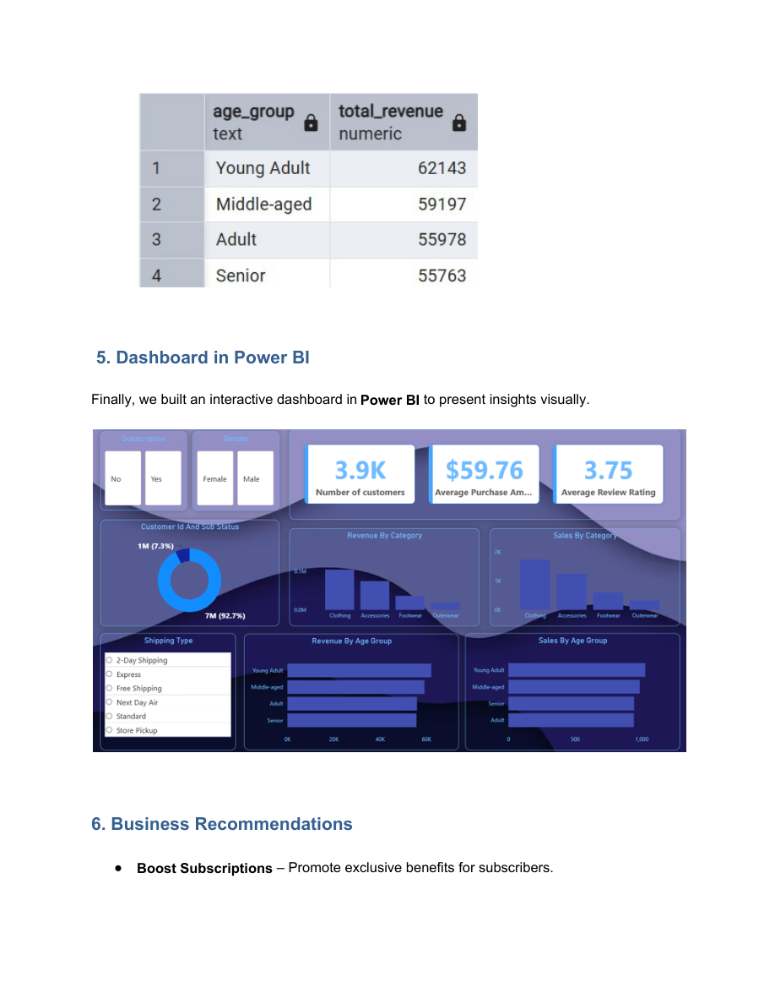
8. Dashboard in Power BI
9

Slide 10
9. Business Recommendations
Boost Subscriptions — Promote exclusive benefits for subscribers.
Customer Loyalty Programs — Reward repeat buyers to move them into the “Loyal” segment.
Review Discount Policy — Balance sales boosts with margin control.
Product Positioning — Highlight top-rated and best-selling products in campaigns.
Targeted Marketing — Focus efforts on high-revenue age groups and express-shipping users.
10

Slide 11
10. Conclusion
The project combines Python data preparation, PostgreSQL/SQL business analysis, and Power BI visualization.
The analysis covers customer demographics, purchase behavior, discounts, product ratings, shipping, subscriptions, segmentation, and age-group revenue.
The resulting dashboard provides an interactive visual layer for communicating the analyzed customer-shopping patterns.
The documented recommendations connect the analysis to subscription growth, loyalty, pricing/discount control, product promotion, and targeted marketing.
Python
Clean & prepare
SQL
Analyze business questions
Power BI
Visualize insights
11

