Slide 1
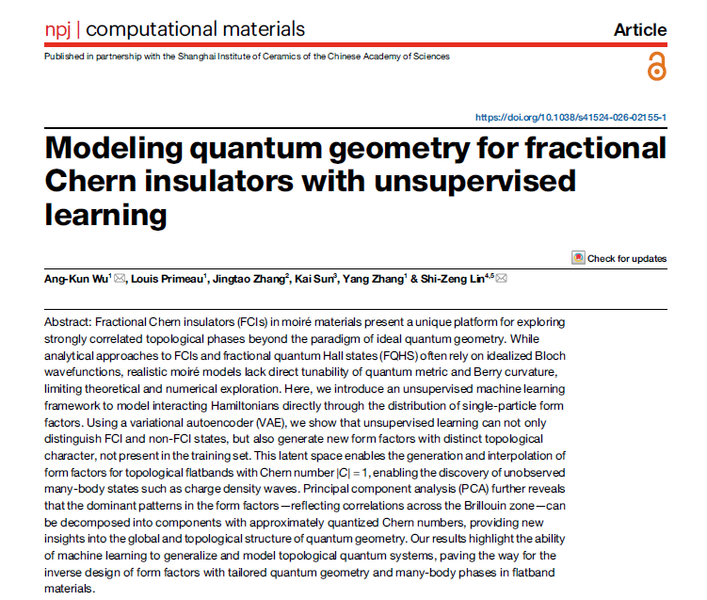
Physics-informed learning of quantum geometry and topology
We use the following base paper for learning the Momentum Space, as a source of Inspiration.
They have used Variational Autoencoders to learn the surface of the Bloch Vectors.
The latent space is generated using VAE, which is a lower dimensional version of the momentum space.
You can read the article here:
https://rdcu.be/fBYLC
(Open Access on Nature)
Motivation of the Project and Base Paper:
Author: Rajat Shuvra Saha (2211083), 5th Year: School of Physical Sciences . Co-Guide: kush.saha@niser.ac.in

Slide 2
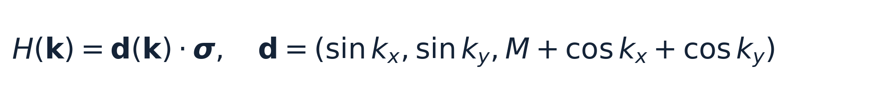
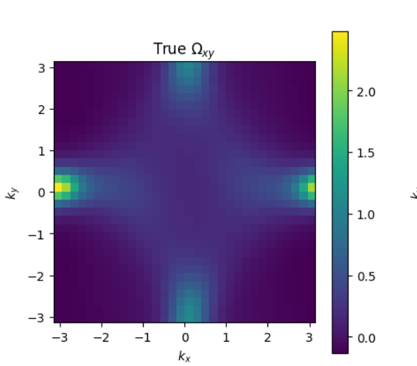
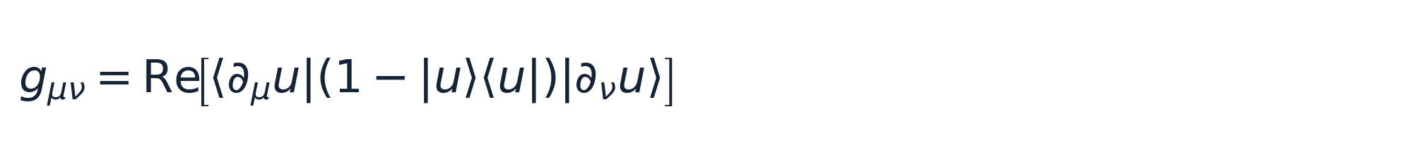
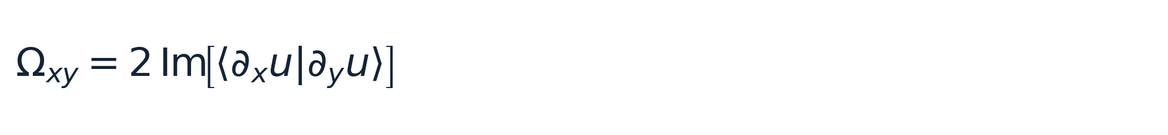
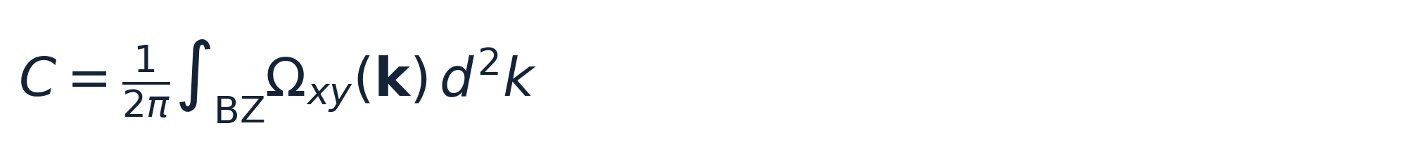
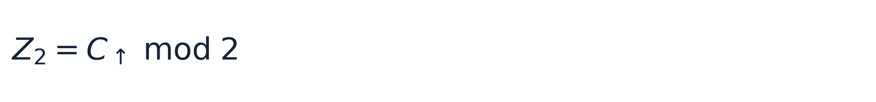
PHYSICS CORE
GEOMETRIC VIEW
Local quantum geometry encodes global topology
From local maps to an integer invariant
• Input: momentum-space Bloch texture / Hamiltonian samples
• Targets: quantum metric and Berry-curvature maps
• Constraint: integrated curvature must reproduce the topological sector
Berry curvature varies continuously over k-space; the Chern number is the quantized Brillouin-zone integral.
QGT → response → topology
Physics-informed ML proposal | Quantum geometry | Topological materials

Slide 3
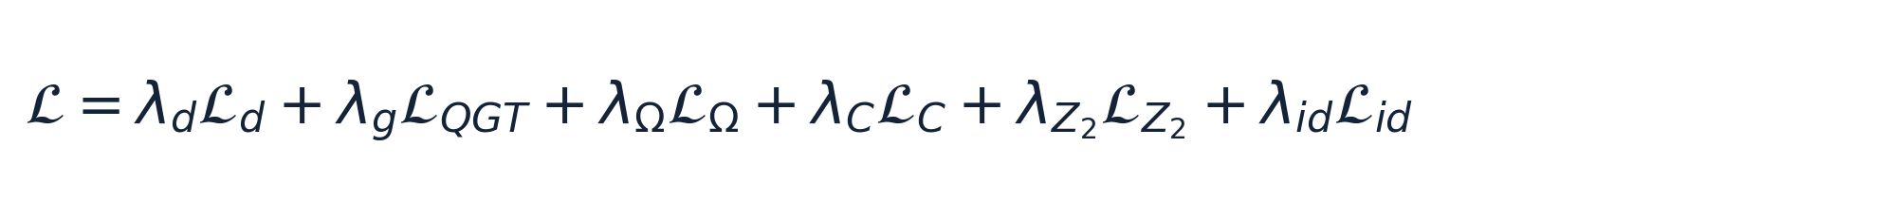
Proposed ML architecture: Physics-informed U-Net
Dense k-space prediction + global topological constraints
WORKFLOW
Hamiltonian
Bloch texture
U-Net
QGT heads
Topology
H(k)
d(k) / P(k)
dense prediction
gxx, gxy, gyy, Ω
C, Z₂
PHYSICS LOSS
U-NET
Input
C×N×N
Encoder
features
Bottleneck
Decoder
QGT
maps
• Supervised geometry: metric + Berry curvature
• Global topology: integrated Chern loss
• Symmetry: time-reversal / spin-sector consistency
• Two-level identity: det(g) = Ω² / 4 when applicable
Skip connections retain localized k-space structure and symmetry features.
Train → validation → unseen-Hamiltonian test
Reference and Base Paper:
Wu et. Al., Modelling Quantum Materials Geometry for Fractional Chern Insulators with Unsupervised Learning, npj Computational Materials (2026)
Physics-informed ML proposal | Quantum geometry | Topological materials

Slide 4
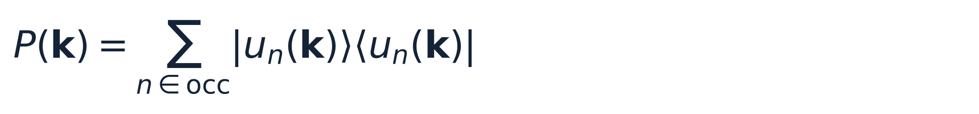
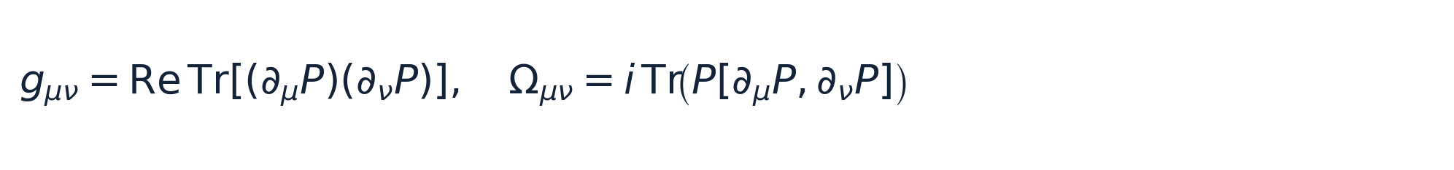
Extension to real JARVIS–DFT / Wannier Hamiltonians
The two-band Bloch vector is replaced by a gauge-invariant occupied-band projector
MULTI-BAND THEORY
JARVIS PIPELINE
Gauge-invariant occupied subspace
Data → k-space sampling → ML → material-level test
JARVIS-DFT / Wannier
H(k), E_F, atoms
Uniform k-mesh
H(k) on N×N grid
Why this enables real materials
• Handles 84×84 and larger Wannier Hamiltonians
• No two-band d-vector assumption
• QGT is defined from the occupied subspace
• Provides a common representation across materials
Occupied projector
P(k)
Objective: learn QGT maps and recover topology from H(k).
Physics-informed U-Net
QGT + topology
Timeline:
14-15th Sept: Extension to Qi Wu Zhang Model
26-27th Oct: Extension to BHZ Model with time reversal symmetry
16-17th Nov. : Final Presentation on Real Data of Wannier Orbitals from JARVIS DFT Database.
Unseen material
gap, C / Z₂, errors
REPORTING METRICS
QGT MAE • Ω MAE • Chern error • Z₂ accuracy • gap-conditioned generalization
Physics-informed ML proposal | Quantum geometry | Topological materials

