Slide 1
IMDb Natural Language Processing
Presentation & Project by: Rajat Sethi

Slide 2

Episode and Movie Reviews
IMDb is a Database where users can post reviews for TV shows and Movies.
Each review consists of two major components:
  Rating (1-10)
  Review Text
Contains valuable information on what makes good literature and design.

Slide 3
Project’s Three Main Phases
Data Collection
  Collecting a large sample size of reviews and ratings from IMDb’s website.
  Storing this data into a file for future use.
Data Processing
  Cleaning up reviews by removing stop words and punctuation
  Converting words into tokens and vectors
Data Modeling
  Developing a Pipeline/Model to extrapolate ratings (label) from a review.
  Future Work: Advancing the model for improved accuracy.
  Future Work: Utilizing the model for Natural Language Generation.

Slide 4
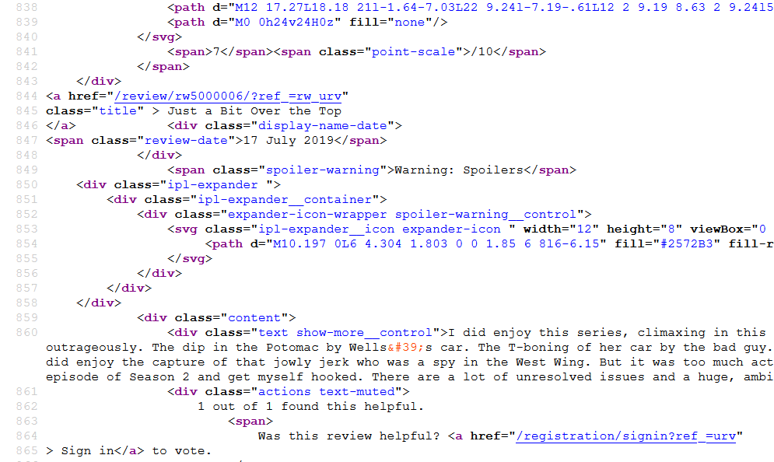
Data Collection - Web Scraping
Each IMDb Review has their own webpage in the following form:
  https://www.imdb.com/review/rw{review_id}/
These webpages have publicly-available source code with review data.
Data extracted using Selenium, then parsed using regular expressions.

Slide 5
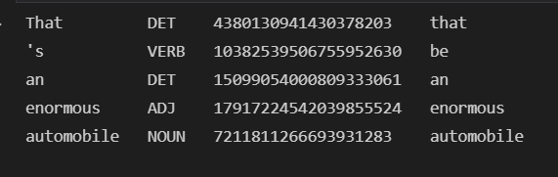
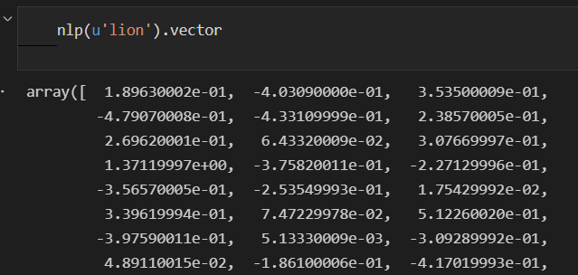
Data Processing – Spacy and Scikit-Learn
Sentences must be broken down into “tokens”, objects that contain the word’s attributes and meaning.
Punctuation, capitalization, and common “stop” words are all removed.
Words are “quantified” through word vectorization and TF-IDF transformation

Slide 6
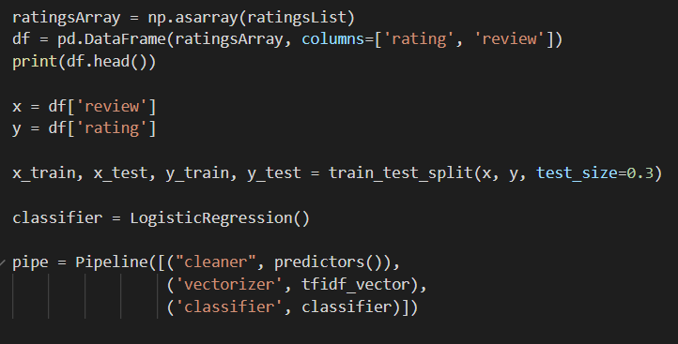
Data Modeling – Scikit-Learn
Create a pipeline that combines data processing with data modeling.
Use Logistic Regression to extrapolate ratings from a review.
Current results show 40% accuracy. (As opposed to 10% from randomly guessing).

Slide 7
Future Work
Machine Learning Related:
  Adding more layers to the model using TensorFlow/Keras.
  Adding more pre-processing layers to the pipeline (Taggers, NER).
  Using the model to generate reviews for non-existent movies (NLG).
Cybersecurity Related:
  Prevent data poisoning and add security to the model.
  Benchmark effects of poisoned reviews in the dataset.

