Slide 1
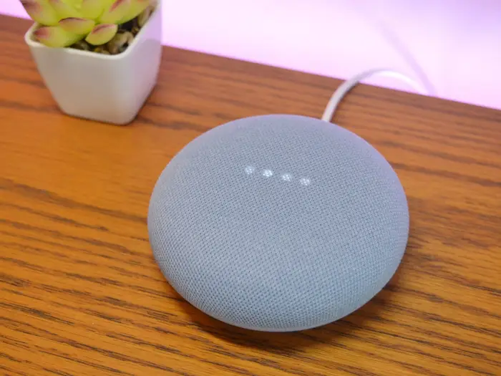
Voice-Recognition bypasses and Broken Access control in the google nest mini
Project Proposal – Rajat Sethi, Sai Krishna Musunuri, V. S. Haneesh Vijayaramaraju Dandu, Hemanth Prudhvi Raju Addada.
Notes:
NOTE:
To change the image on this slide, select the picture and delete it. Then click the Pictures icon in the placeholder to insert your own image.

Slide 2

Home Assistants
Alexa, Google, Siri
Wake-up Keywords
Ask general questions
Ask personal questions
Protections?

Slide 3
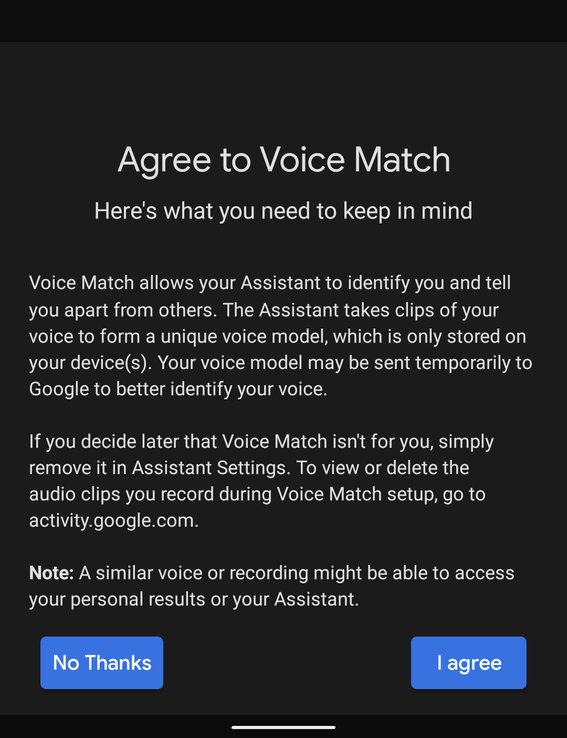
Points of Attack – Voice Match
Train the system to recognize voice.
Block guests from asking certain questions
Opt-In – Not Mandatory
Bypass Warning

Slide 4
Points of Attack – Full (Root) Access
What happens when we break through the voice match?
What happens if the user does not set up voice match?
What data can we extract from the machine?
What settings can we reset or lock?

Slide 5
Points of Attack – Guest Access
What if we cannot break through the voice recognition?
Can we still bypass the system using guest commands?
Can we still retrieve sensitive information?
Is it possible to link the device to a different phone?
Any other features that are not password blocked?

