Slide 1
Bayes for Beginners
Rumana Chowdhury & Peter Smittenaar
Methods for Dummies 2011
Dec 7th 2011

Slide 2
A disease occurs in 0.5% of population
A diagnostic test gives a positive result
in 99% of people that have the disease
in 5% of people that do not have the disease (false positive)
A random person from the street is found to be positive on this test. What is the probability that they have the disease?
A: 0-30%
B: 30-60%
C: 60-90%

Slide 3
A disease occurs in 0.5% of population
A diagnostic test gives a positive result
in 99% of people that have the disease
in 5% of people that do not have the disease (false positive)
A = disease
B = positive test result
P(A) = 0.005 probability of having disease
P(~A) = 1 – 0.005 = 0.995 probability of not having disease
P(B) = 0.005 * 0.99 (people with disease) + 0.995 * 0.05 (people without disease) = 0.0547 (slightly more than 5% of all tests are positive)
conditional probabilities
P(B|A) = 0.99 probability of pos result given you have disease
P(~B|A) = 1 – 0.99 = 0.01 probability of neg result given you have disease
P(B|~A) = 0.05 probability of pos result given you do not have disease
P(~B|~A) = 1 – 0.05 = 0.95 probability of neg result given you do not have disease
P(A|B) is probability of disease given the test is positive (which is what we’re interested in)
Very different from P(B|A): probability of positive test results given you have the disease.

Slide 4
A = disease
B = positive test result
population = 100
positive test result P(B)
5.47
disease P(A)
0.5

Slide 5
A = disease
B = positive test result
P(A,B) is the joint probability, or the
probability that both events occur.
P(A,B) is the same as P(B,A).
But we already know that the
test was positive, so we have to
take that into account.
Of all the people already in
the green circle, how many
fall into the P(A,B) part? That’s
the probability we want to
know!
That is:
P(A|B) = P(A,B) / P(B)
You can write down same thing
for the inverse:
P(B|A) = P(A,B) / P(A)
The joint probability can be expressed
in two ways by rewriting the equations
P(A,B) = P(A|B) * P(B)
P(A,B) = P(B|A) * P(A)
Equating the two gives
P(A|B) * P(B) = P(B|A) * P(A)
P(A|B) = P(B|A) * P(A) / P(B)
population = 100
positive test result P(B)
5.47
P(B,~A)
disease P(A)
0.5
P(A,B)
P(A,~B)

Slide 6
A = disease
B = positive test result
P(A) = 0.005 probability of having disease
P(B|A) = 0.99 probability of pos result given you have disease
P(B) = 0.005 * 0.99 (people with disease) + 0.995 * 0.05 (people without disease) = 0.0547
Bayes’ Theorem
P(A|B) = P(B|A) * P(A) / P(B)
P(A|B) = 0.99 * 0.005 / 0.0547
= 0.09
So a positive test result increases your probability of having the disease to ‘only’ 9%, simply because the disease is very rare (relative to the false positive rate).
P(A) is called the prior: before we have any information, we estimate the chance of having the disease 0.5%
P(B|A) is called the likelihood: probability of the data (pos test result) given an underlying cause (disease)
P(B) is the marginal probability of the data: the probability of observing this particular outcome, taken over all possible values of A (disease and no disease)
P(A|B) is the posterior probability: it is a combination of what you thought before obtaining the data, and the new information the data provided (combination of prior and likelihood)

Slide 7
Let’s do another one…
It rains on 20% of days.
When it rains, it was forecasted 80% of the time
When it doesn’t rain, it was erroneously forecasted 10% of the time.
The weatherman forecasts rain. What’s the probability of it actually raining?
A = forecast rain
B = it rains
What information is given in the story?
P(B) = 0.2 (prior)
P(A|B) = 0.8 (likelihood)
P(A|~B) = 0.1
P(B|A) = P(A|B) * P(B) / P(A)
What is P(A), probability of rain forecast? Calculate over all possible values of B (marginal probability)
P(A|B) * P(B) + P(A|~B) * P(~B) = 0.8 * 0.2 + 0.1 * 0.8 = 0.24
P(B|A) = 0.8 * 0.2 / 0.24
= 0.67
So before you knew anything you thought P(rain) was 0.2. Now that you heard the weather forecast, you adjust your expectation upwards P(rain|forecast) = 0.67

Slide 8
Probability
Priors
All of which brings you to…

Slide 9

Bayes theorem
likelihood
Marginal probability does not depend on θ, so can remove to obtain unnormalised posterior probability…
prior distribution
posterior distribution
marginal probability

Slide 10
P (θ|data) ∝ P (data|θ).P(θ)
i.e. posterior information is proportional to conditional x prior
Given a prior state of knowledge, can update beliefs based on observations

Slide 11
Classical approach | Bayesian approach
Fixed ‘true’ θ | Unknown quantity that has probability distribution (i.e. account for uncertainty)
Confidence intervals: if collect data lots of times, the interval we construct will contain θ on 95% of occasions | Confidence interval: 95% probability that θ lies within this interval
P-value is probability data is observed if the null hypothesis is true i.e. can only reject NH | Can get probabilities of null and alternative models, so can accept the null hypothesis
Assumptions for convenience e.g. noise normally distributed | Can use previous knowledge combined with current data (i.e. use prior)
Make inferences on probability of the data given the model i.e. P (data|θ) | Make inferences on the probability of the model given the data i.e. P (θ|data) (i.e. the inverse)
Compare nested models (reduced vs full model) | Compare any models of the same data (Bayesian model comparison)
Notes:
Mistake with CI – 95% proability that true population value of theta lies in this interval, but we assume theta has a fixed ‘true’ value, so this is not correct,(unless theta has a distribution) ie theta is either in the interval or not
Adding variable imprpve explanatory power = nested

Slide 12
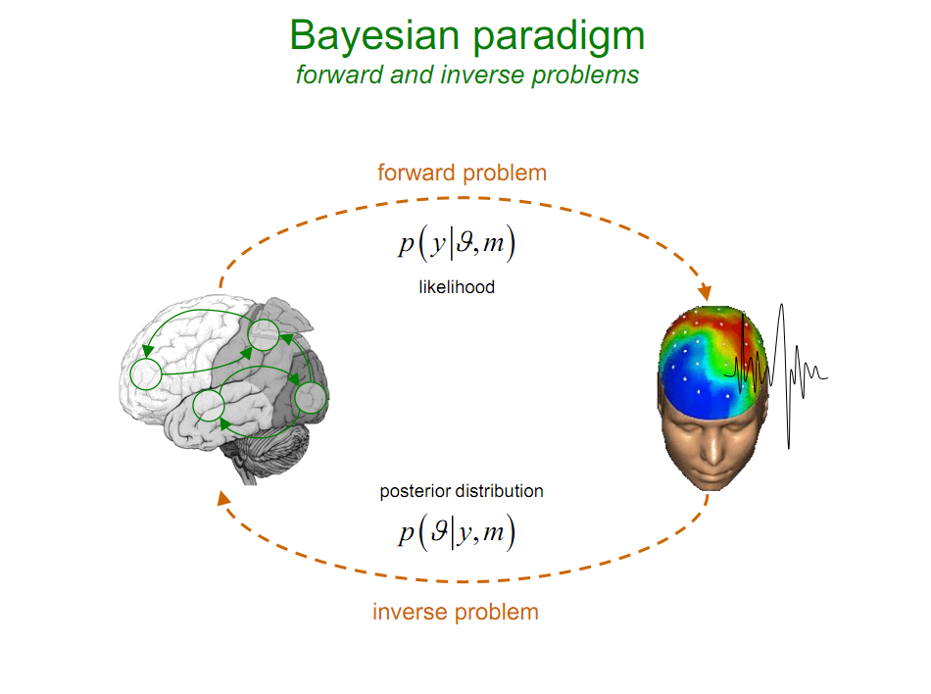
P(y|θ)
P(θ|y)
Notes:
From Jean Daunizeau
Given my model whats the probability of pobserving data
LNE axmple

Slide 13
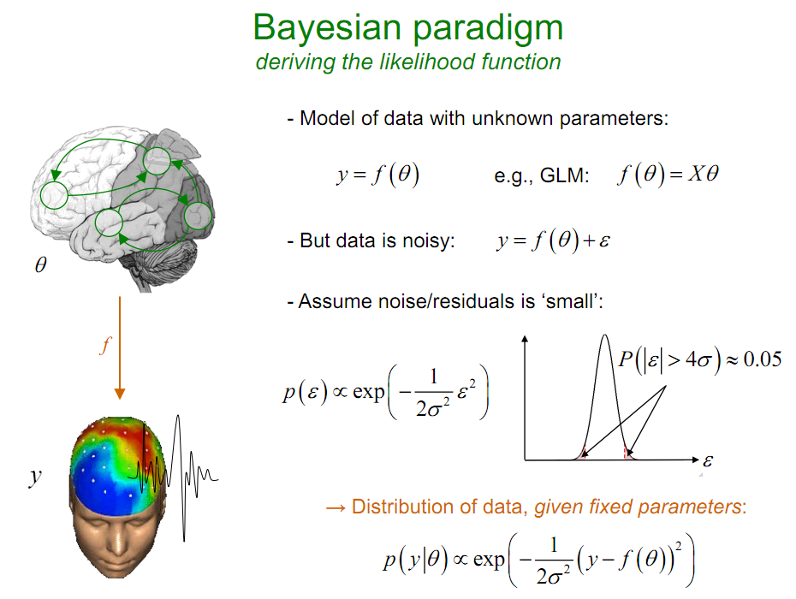
To determine P(y|θ) is straightforward:
y = f(θ)
But data is noisy
y = f(θ) + noise
By making a simple assumption about the noise i.e. that it is normally distributed
Noise = n(0,σ²)
We can calculate the likelihood of the data given the model
P(y|θ) ∝ f(θ) + noise

Slide 14
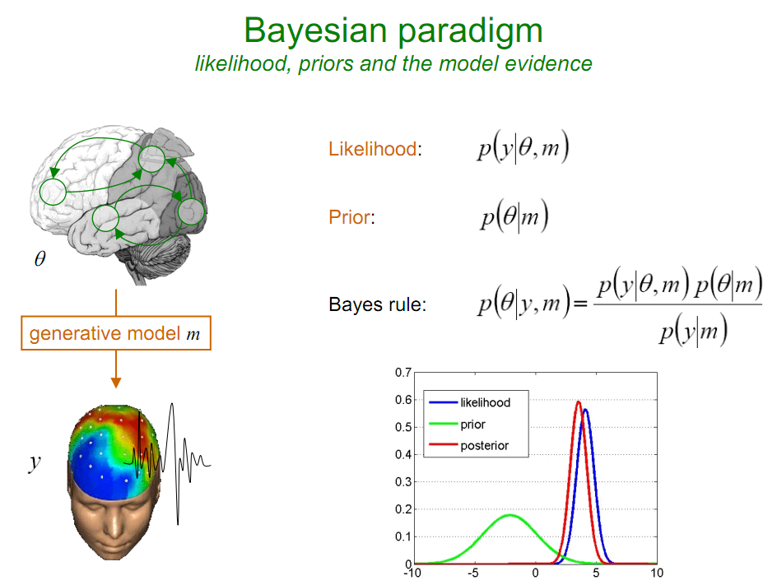
Precision = 1/variance
Notes:
From Jean Daunizeau
Precision weighting
combining

Slide 15
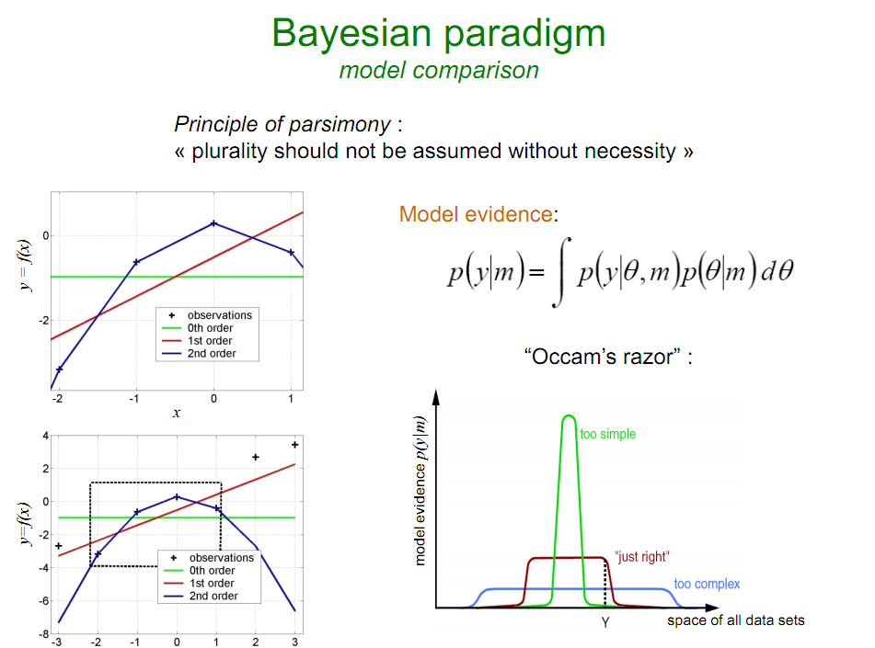
Notes:
Complicated models penalised under bayes ie both how well model fits data and how ‘simple’ it is
From Jean Daunizeau

Slide 16
Where is Bayes used in neuroimaging
Dynamic causal modelling (DCM)
Behavior, e.g. compare reinforcement learning models
Model-based MRI: take parameters from model and look for neural correlates
Preprocessing steps (segment using prior knowledge)
Multivariate decoding (multivariate Bayes)
Notes:
Extra slide applying bayes:
DCM
Reinforcement learning, model comparison
Model-based fMRI
Priors for segmentation
Multivariate decoding models MVB

Slide 17
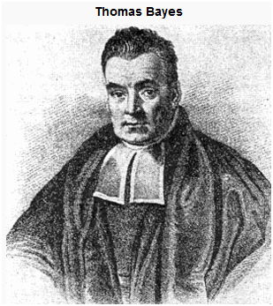
Summary
Take uncertainty into account
Incorporate prior knowledge
Invert the question (i.e. how good is our hypothesis given the data)
Used in many aspects of (neuro)science
c. 1701 – 1761

Slide 18
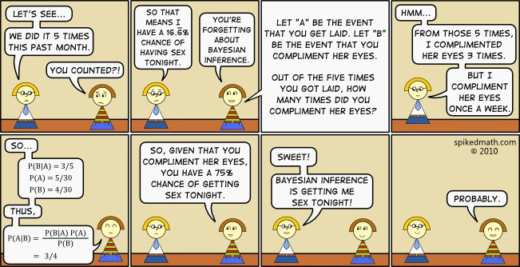
references
Jean Daunizeau and his SPM course slides
Past MFD slides
Human Brain Function (eds. Ashburner, Friston, and Penny) www.fil.ion.ucl.ac.uk/spm/doc/books/hbf2/pdfs/Ch17.pdf
http://faculty.vassar.edu/lowry/bayes.html (disease example)
http://oscarbonilla.com/2009/05/visualizing-bayes-theorem/ (Venn diagrams & Bayes)
http://yudkowsky.net/rational/bayes (very long explanation of Bayes)
http://www.faqoverflow.com/stats/7351.html (link to more links)
Thanks to our expert Ged!

