Slide 1
Introduction to Statistics –C1
Rajat Srivastava

Slide 2
Agenda:
Definitions of Statistics, Probability, and Key Terms
Data
Sampling
Frequency, Frequency Tables, and Levels of Measurement
Concept of Correlation and Causal relationship between variables
Idea of Population Sample Vs. Population
Introduction to Mean, Median and Mode
Introduction to Skewness and Kurtosis
Introduction to Data Spread and Range
Introduction to Quartiles and Inter Quartile Range
Measures of Dispersion
Introduction to Outliers
Stem-and-Leaf Graphs , Line Graphs, and Bar Graphs
Histograms, Frequency Polygons, and Time Series Graphs
Impact of Scaling and Shifting of origin

Slide 3
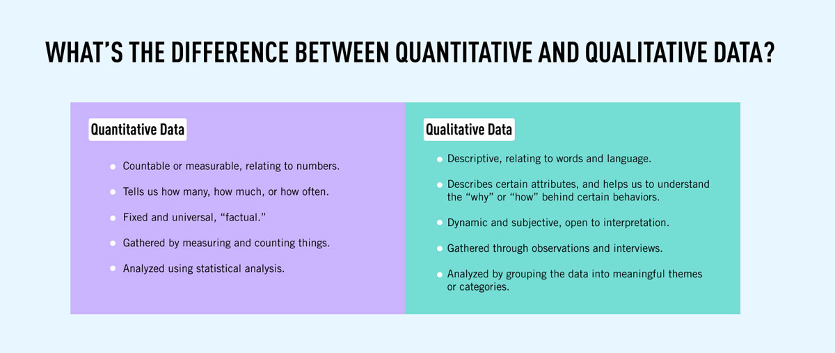

Slide 4
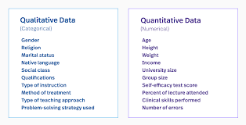
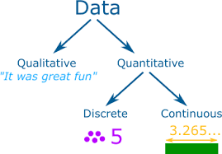

Slide 5
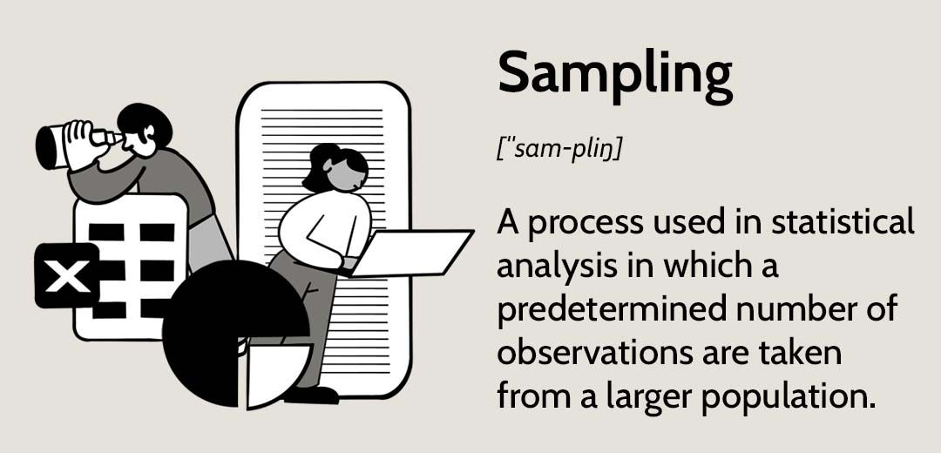

Slide 6
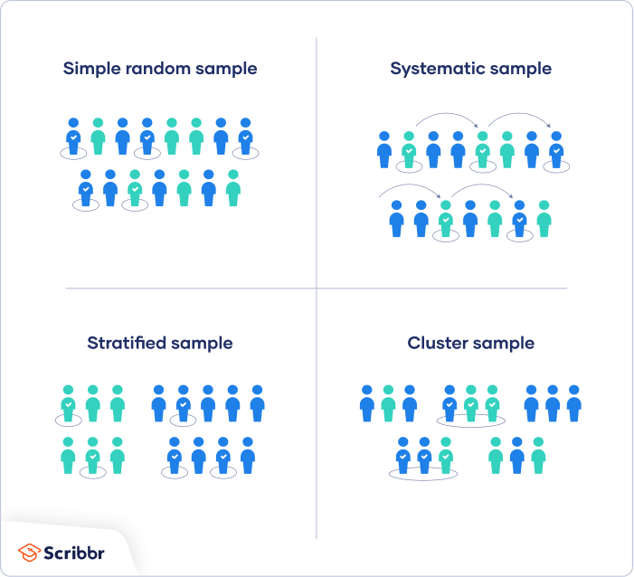
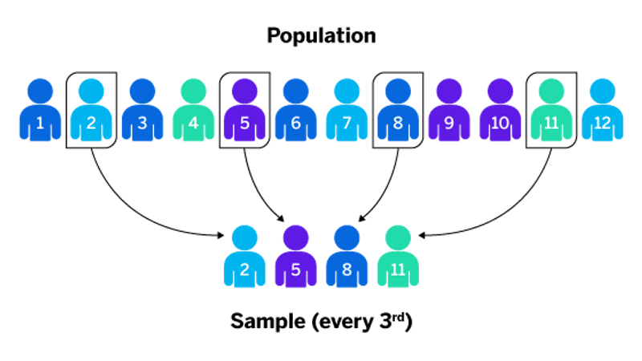
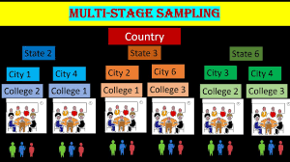

Slide 7
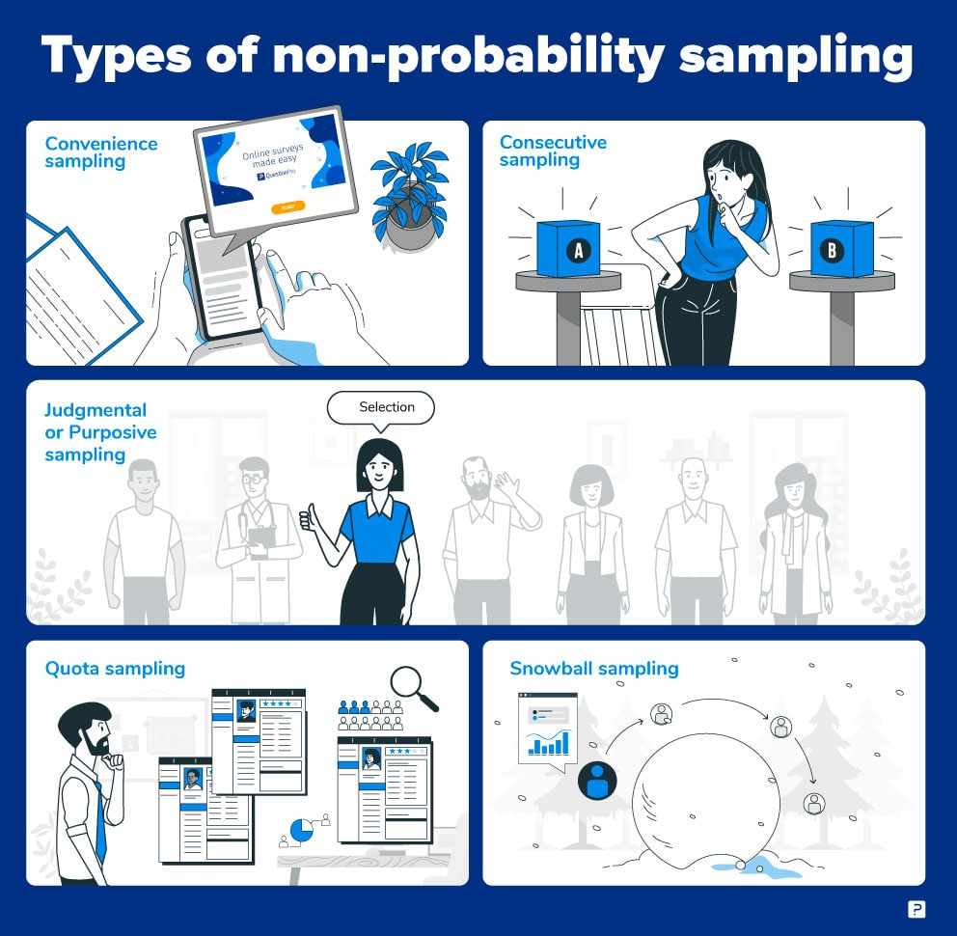

Slide 8
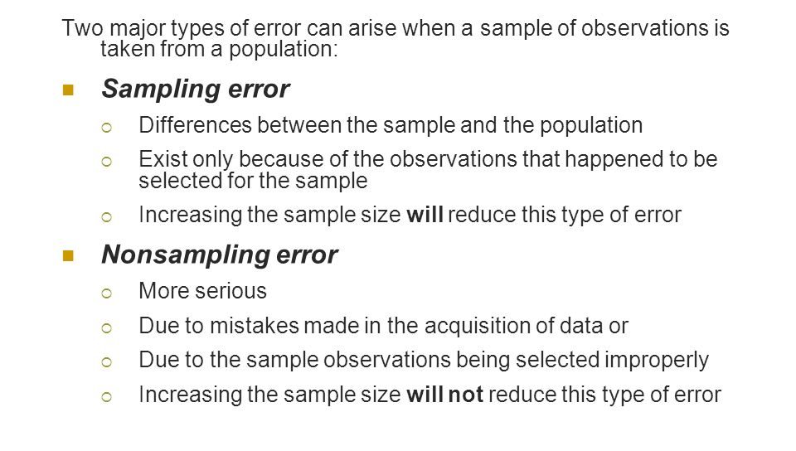

Slide 9
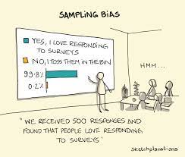

Slide 10
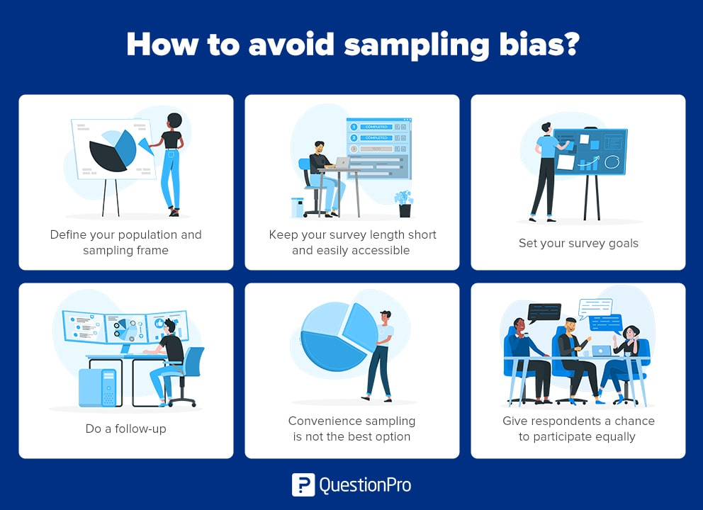

Slide 11
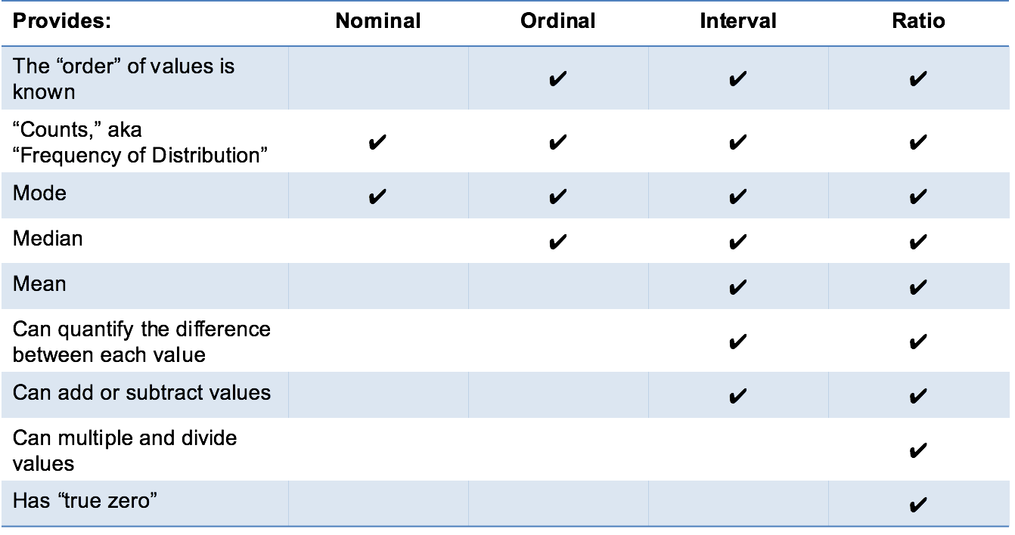
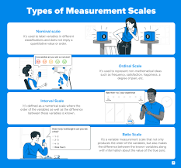

Slide 12
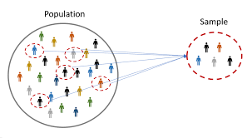
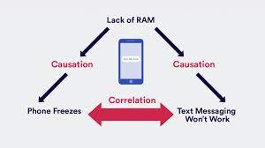
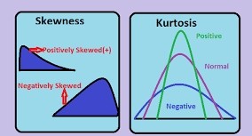
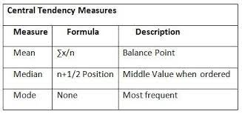

Slide 13
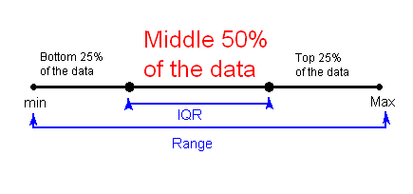
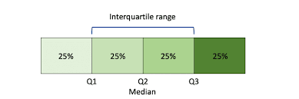

Slide 14
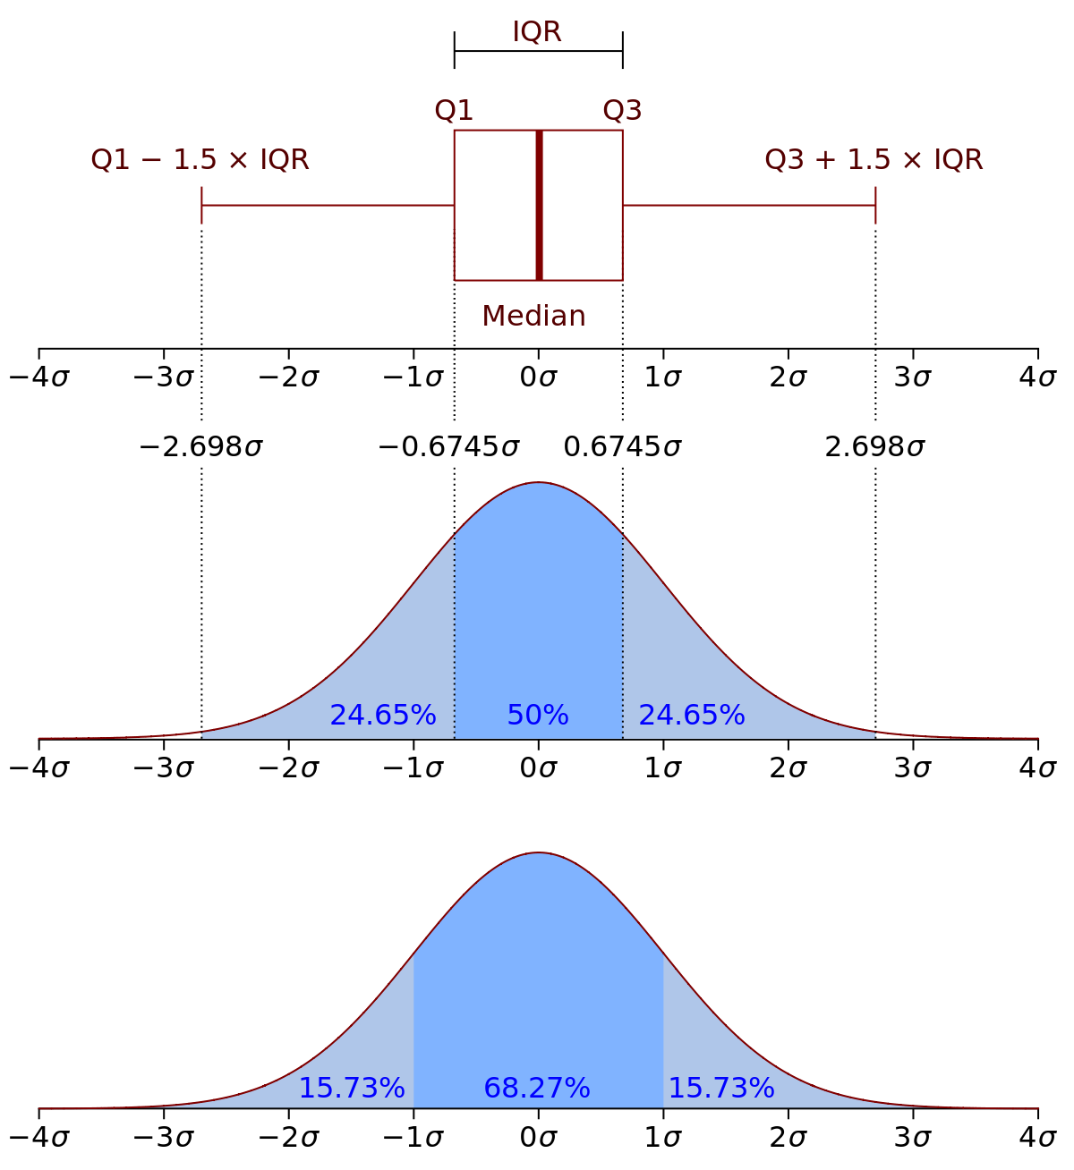

Slide 15
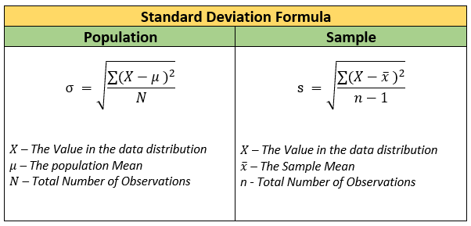
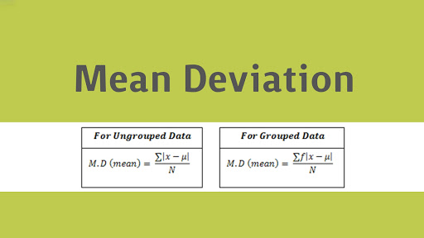
The average deviation, or mean absolute deviation, is calculated similarly to standard deviation, but it uses absolute values instead of squares to circumvent the issue of negative differences between the data points and their means.
What does this standard deviation/mean Deviation tell you?
The standard deviation is the average amount of variability in your data set. It tells you, on average, how far each score lies from the mean.
The mean deviation gives information about how far the data values are spread out from the mean value.

Slide 16
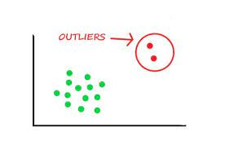
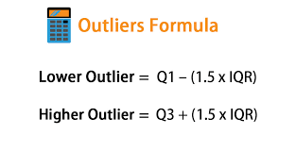

Slide 17
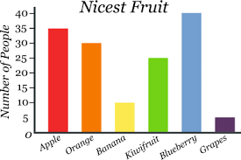
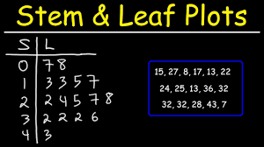
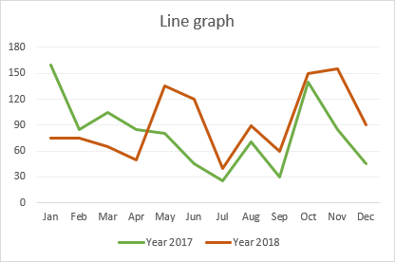

Slide 18
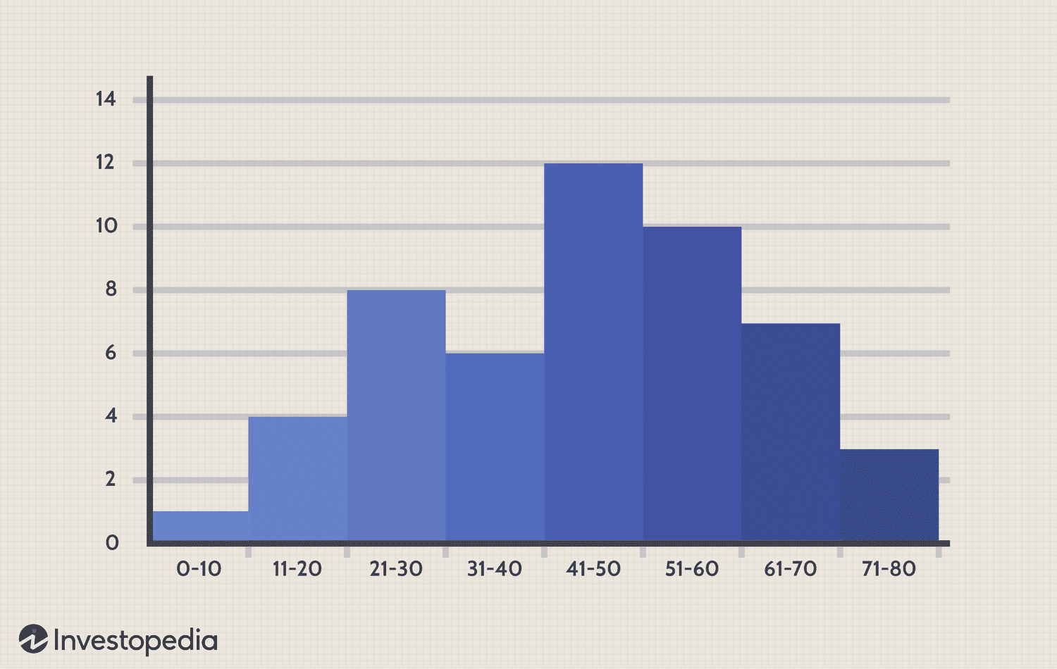
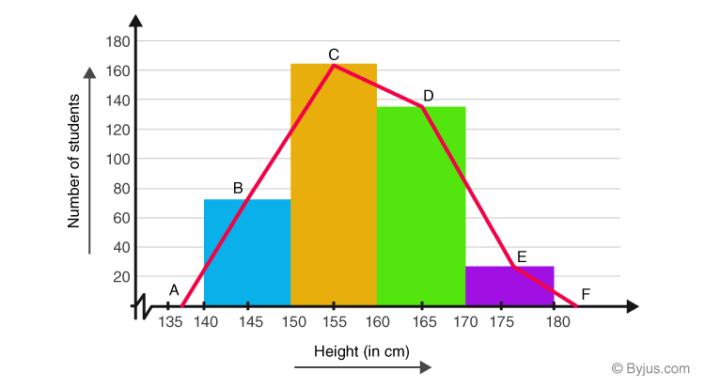

Slide 19
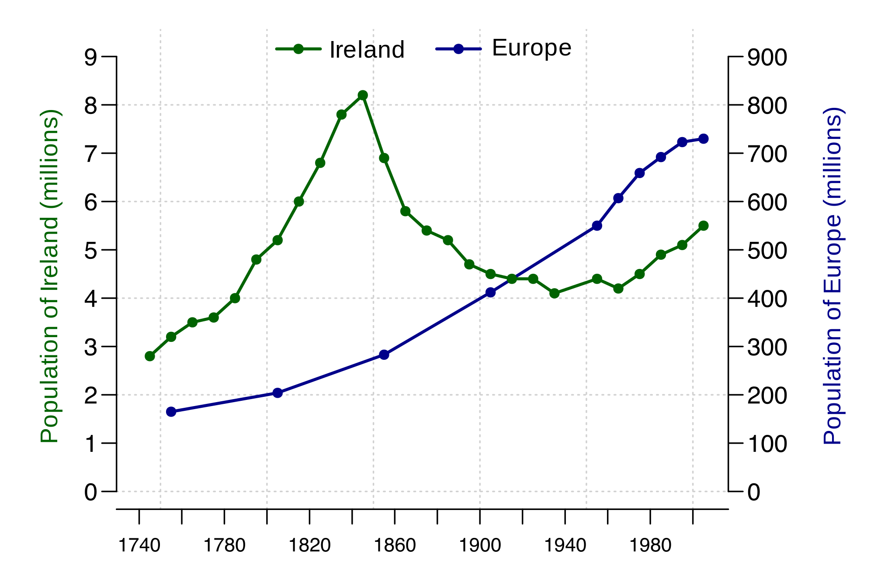

Slide 20
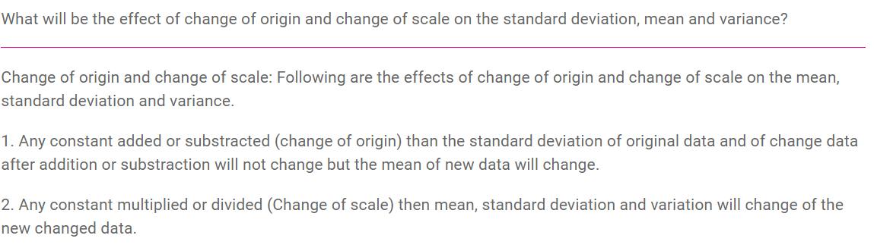

Slide 21
Thank You

