Slide 1
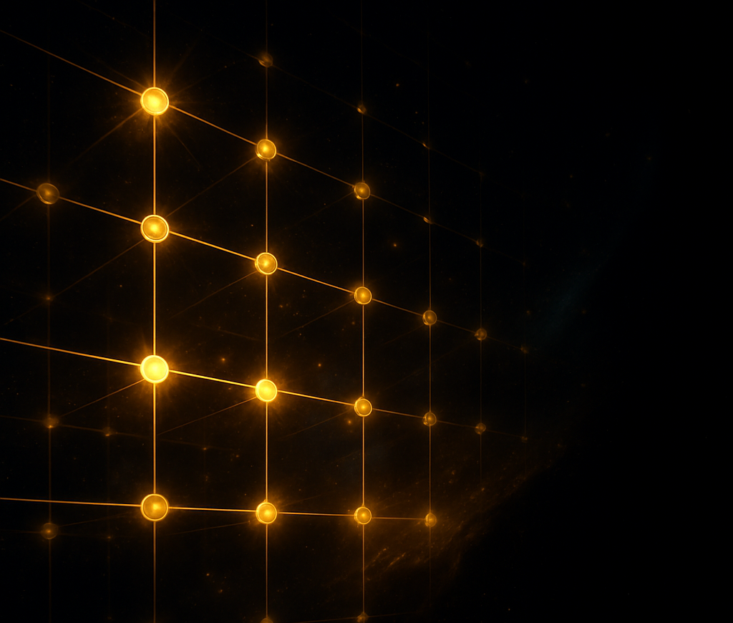

Compiler Aware QuantumDARTS
Differentiable Quantum Architecture Search for Max Cut problem with Compiler based optimization
CU Boulder Final Project Presentation Rajath Shashikanth Vasisth
Course: Quantum Computer Architecture and Error Correction
Instructor: Prof. Ramin Ayanzadeh
Dec 10th, 2025

Slide 2
Motivation & Context
QuantumDARTS is a QAS framework to automatically design quantum circuits (parameterized quantum circuits / ansätze) using:
Differentiable architecture search
Gumbel-Softmax to learn which gates to use
Gradient-based optimization instead of brute-force circuit search
Current VQA performance is highly dependent on the choice of ansatz
QuantumDARTS learns the best circuit structure and parameters jointly
Reduces the need for manual design in:
VQE (ground state estimation)
QAOA (combinatorial optimization)
Quantum Neural Networks (QNN)

Slide 3
Why Differentiable Architecture Search? Can we do better?
Instead of Randomly or categorically selecting a gate at each position of the circuit, this method uses:
Learnable logits α_{ij}​
Gumbel-Softmax sampling to pick gates
Differentiable gate selection during backprop
Update architecture A and parameters θ via gradient descent
Uses two strategies:
Macro Search: Search the entire circuit and perform global circuit optimization
Micro Search: Search sub circuits and learn smaller blocks to finally stack them up and build the bigger circuit. Very useful for deeper and larger circuits.
Experiments show positive results for Quantum Chemistry, Max Cut and Image Classification (MINST)
We will focus on applying compiler awareness to this Algorithm for the Max Cut Problem!

Slide 4
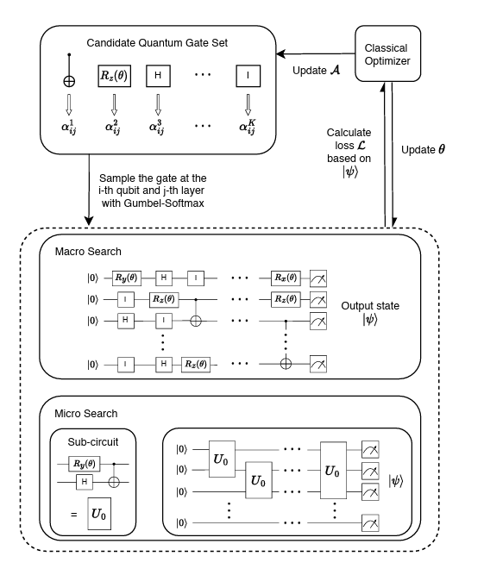
Architecture and Current Approaches
1. Evolutionary Algorithms (Genetic Algorithms)
Use genetic evolution to design circuits.
Cannot easily handle parameterized rotation gates
2. Reinforcement Learning Approaches
Agent selects gates sequentially
Reward based on circuit performance
Works for very small systems due to large search space
3. Sampling-Based Methods
Sample circuits from a candidate gate set
Monte Carlo sampling used to explore architectures
4. Differentiable Neural Architecture Search (NAS)
Converts discrete choices into continuous parameters
Optimizes architecture via Softmax or Gumbel-Softmax

Slide 5
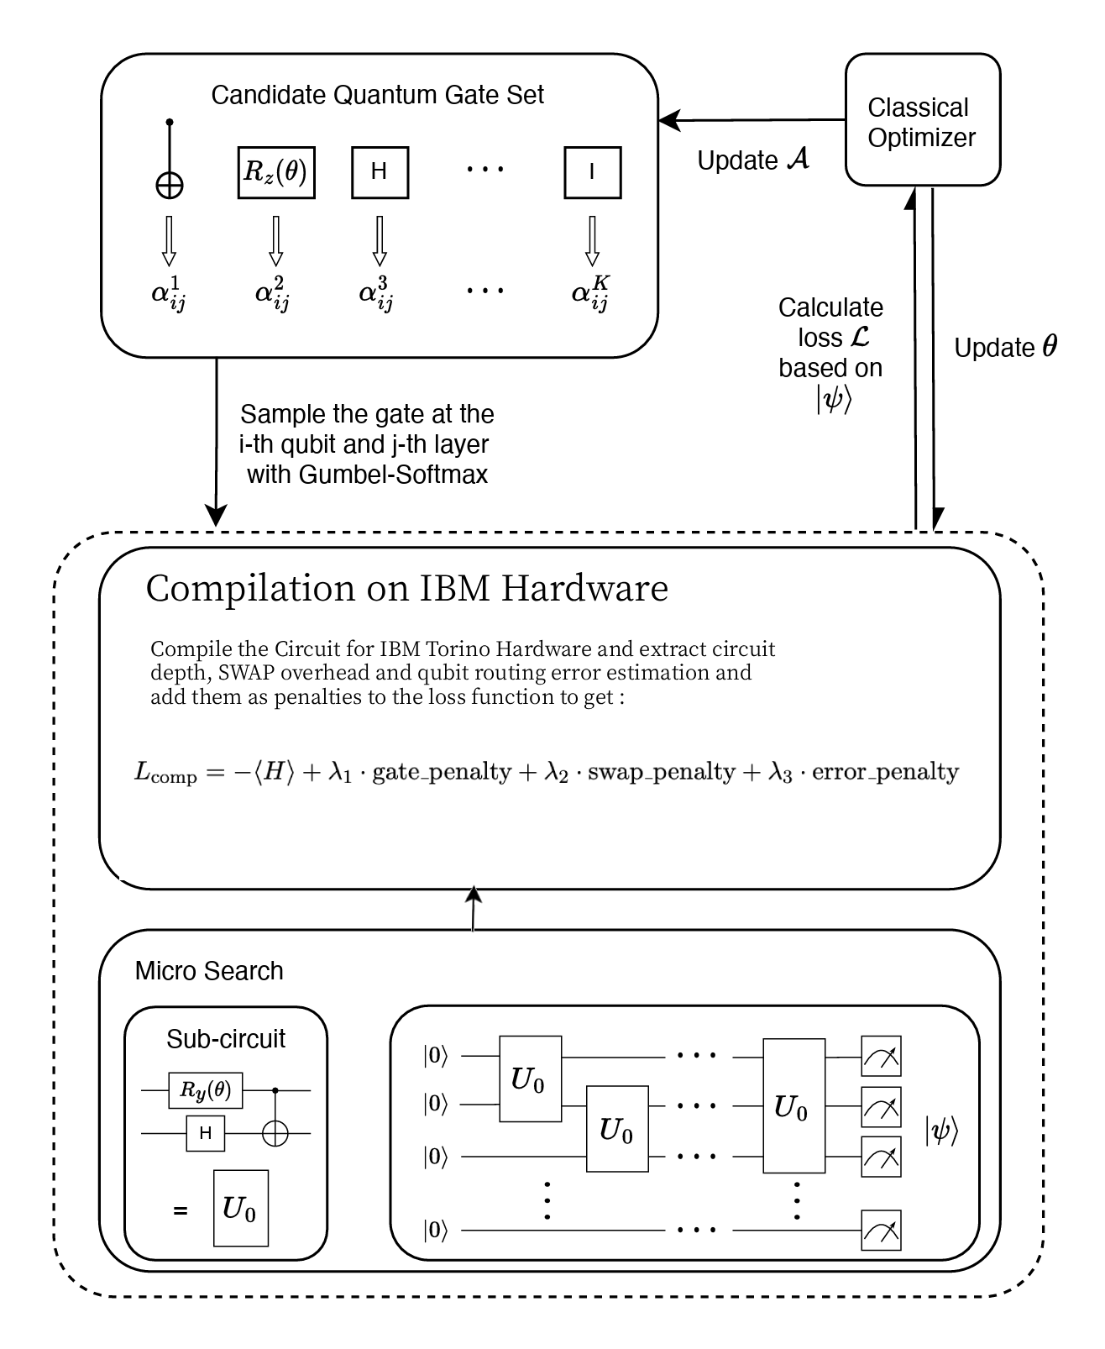
What is new in Compiler Aware Architecture for Max Cut?
The circuit that the Algorithm comes with for Micro Search is compiled using noisy constraints for IBM hardware such as torino.
This gives us the number of gates used in the circuit, circuit depth, SWAP penalty and approximate error in qubit routing and executing 2 and 1 qubit gates.
These metrics are applied as a scalar non differentiable penalty to the loss function to further optimize architecture search.
The final equation is as shown in the figure.

Slide 6
Methodology (Original)
Build a full quantum circuit from a candidate gate set G (n x m). Taking two-qubit gate CZ as an example, G = CZ is an abbreviation of G = {CZ_{1, …….,} CZ_{n-1}} which means each two-qubit gate will add n² number of gates with all combinations of target and control qubits and each Quantum gate is mapped to a 2^{n} x 2^{n} unitary with irrelevant qubits as identity so that final state vector can be simulated.
Use Gumbel-Softmax to pick gates at each (qubit (n), layer(m))
Construct unitary U from selected gates
Compute loss (VQE/QNN)
Update:
architecture weights P, Q
rotation parameters θ
Gumbel-Softmax provides a differentiable approximation by adding noise from Gumbel Distribution between categorical gate choices.
Allows backpropagation over architecture choices

Slide 7
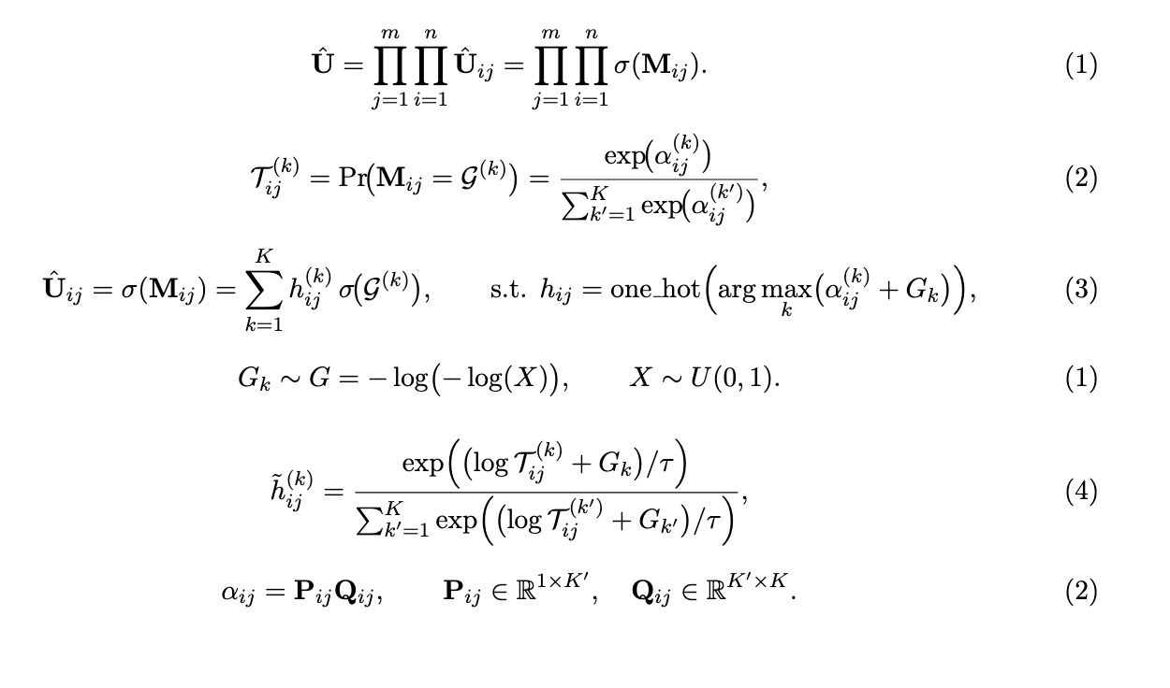

Methodology (Original)
Main Components
M_{ij}: gate choice at qubit i, layer j
α_{ij}​: architecture logits
T_{ij}​ (k): gate probability
h_{ij}​: Gumbel-Softmax sample
U_hat: resulting circuit unitary
|G| = K = number of gates in set
If a single-qubit gate 𝐺 acts on qubit 2 (middle qubit) of a 3-qubit system, the corresponding full-system unitary is:
A single qubit gate is a 2x2 matrix while the unitary is 8x8

Slide 8
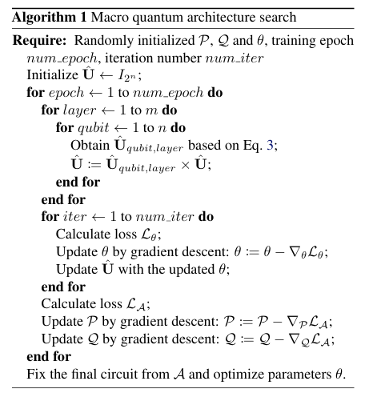
Methodology (Original – Macro Search)
Outer loop (epochs): Repeatedly update the circuit architecture using learnable gate-selection parameters (P, Q) with Gumbel-Softmax sampling.
Inner loop (θ-update):
Sample gates for each qubit/layer from the gate library using argmax one hot encoding.
Construct the full circuit unitary Û layer by layer.
Optimize gate parameters θ using the quantum loss Lθ.
Architecture update:
Compute architecture loss L_A based on circuit performance.
Update architecture parameters P and Q using gradient descent.
Finalization:
Fix the best architecture A, then perform a final fine-tuning of gate parameters θ.
The

Slide 9
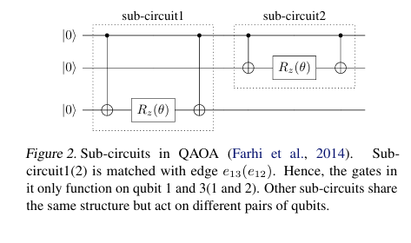
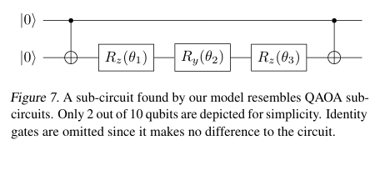
Micro Search Sub Circuits in Max Cut – My Setup
For micro search 2 qubit sub circuits are modeled and 4x4 unitaries are formed for L layers which form one edge connection in max cut.
These subcircuits are then tiled which basically form interaction between edges in the max cut problem.
So final unitaries of size 2^{n} x 2^{n} are multiplied only |E| times as opposed to n x m times in macro search which reduces number of computations drastically.

Slide 10
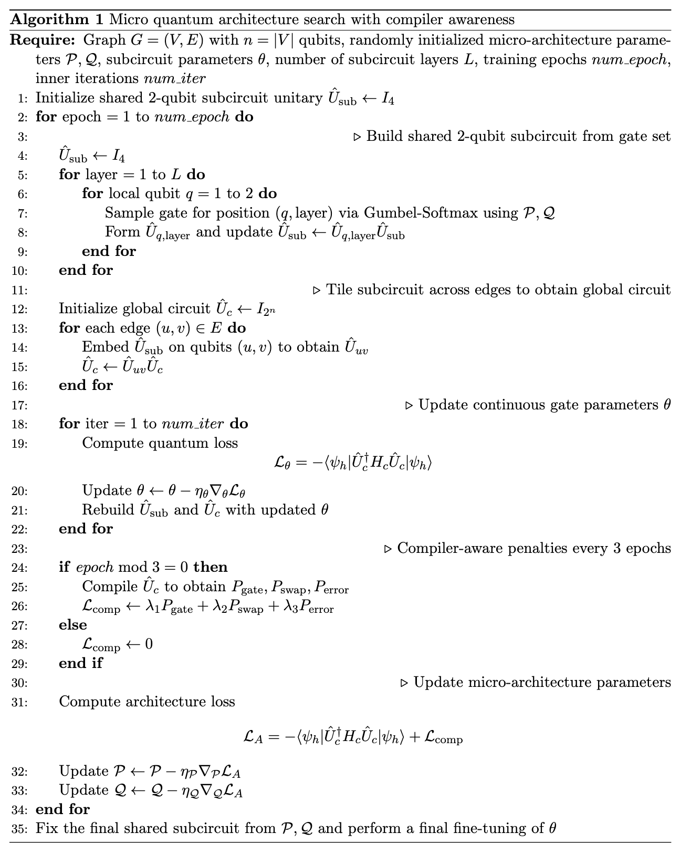
Micro Search in Max Cut with Compiler Awareness
Learns a shared 2-qubit subcircuit and tiles it across all graph edges to build the full Max-Cut circuit.
Uses Gumbel-Softmax to select gates and optimize both architecture parameters and gate parameters jointly.
Every few epochs, the circuit is compiled to evaluate hardware-realistic costs (gate count, SWAPs, error).
Updates the architecture using a compiler-aware loss, encouraging circuits that are both accurate and hardware-efficient.

Slide 11
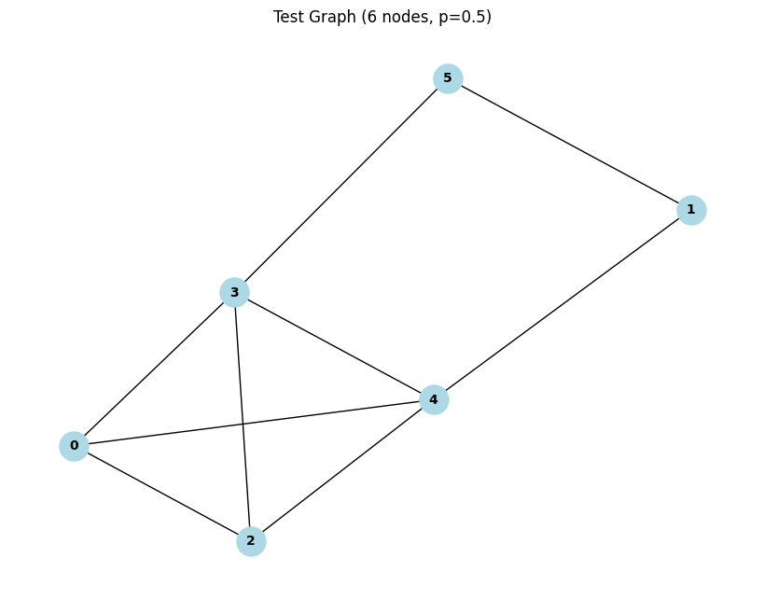
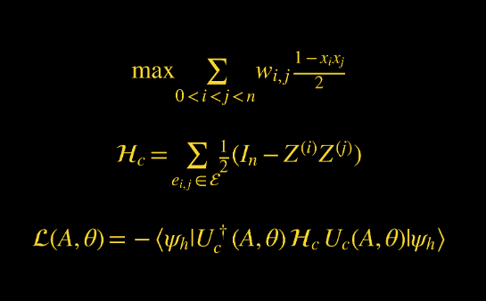
Results – Unweighted Max Cut using Macro Search
Evaluated using Erdos Renyi randomly generated 6 node graph with edge density = 0.5
Gate set used same as QuantumDARTS paper G = {R_{z} R_{y} R_{z}, C-NOT, I}. Trained for 50 epochs.
Final max cut value is extracted from highest probability cut value. For example, if it was |100>, then x₁ = 1, x₂ = -1, x₃ = -1 which is applied the equation.

Slide 12
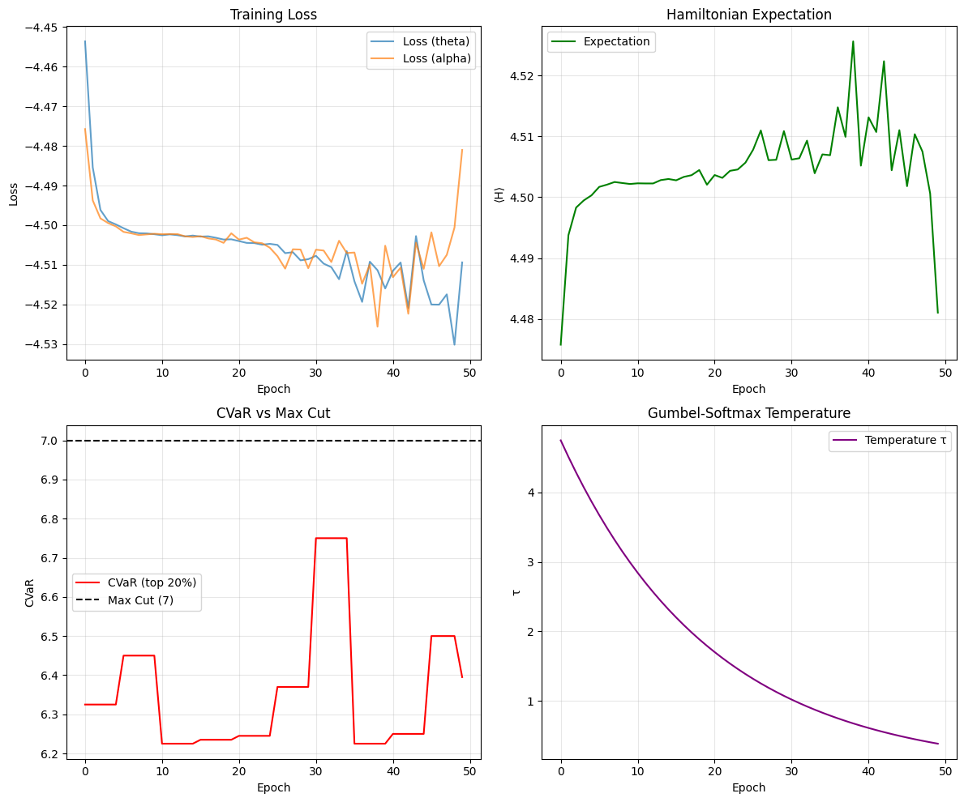
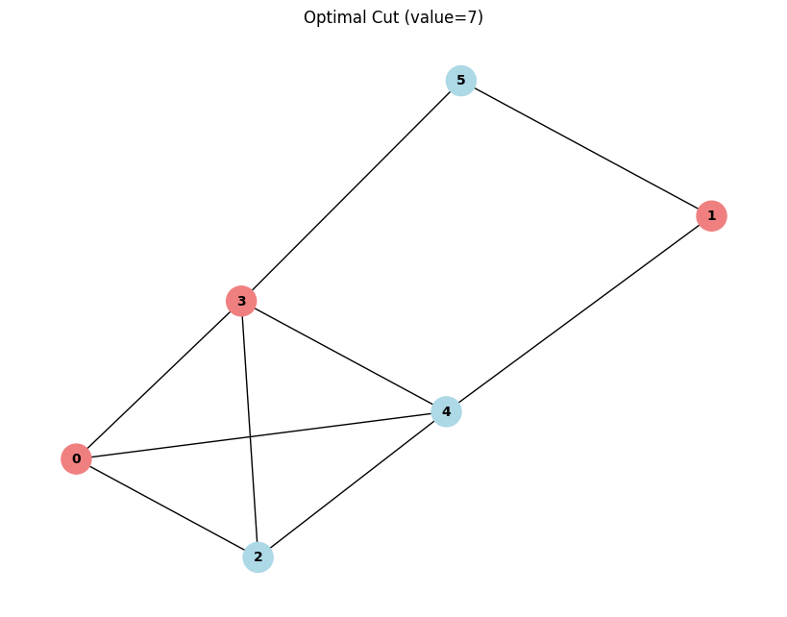
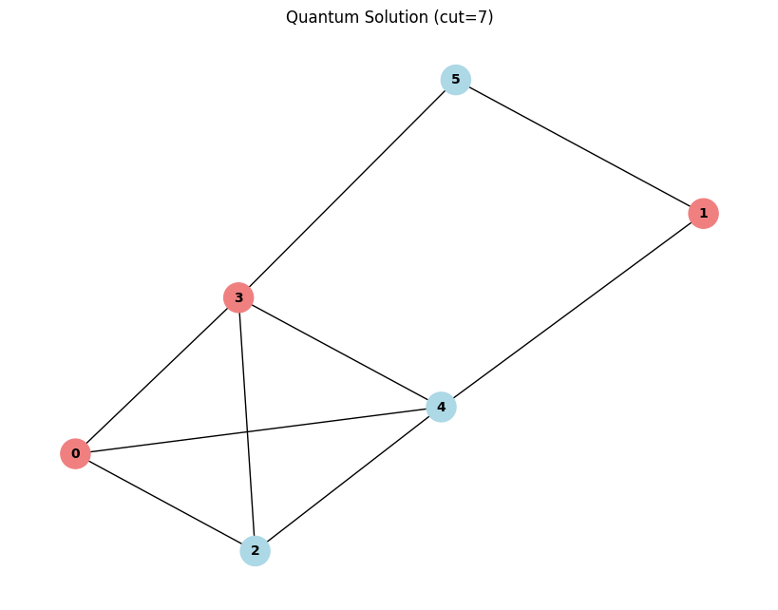
Results – Unweighted Max Cut using Macro Search

Slide 13
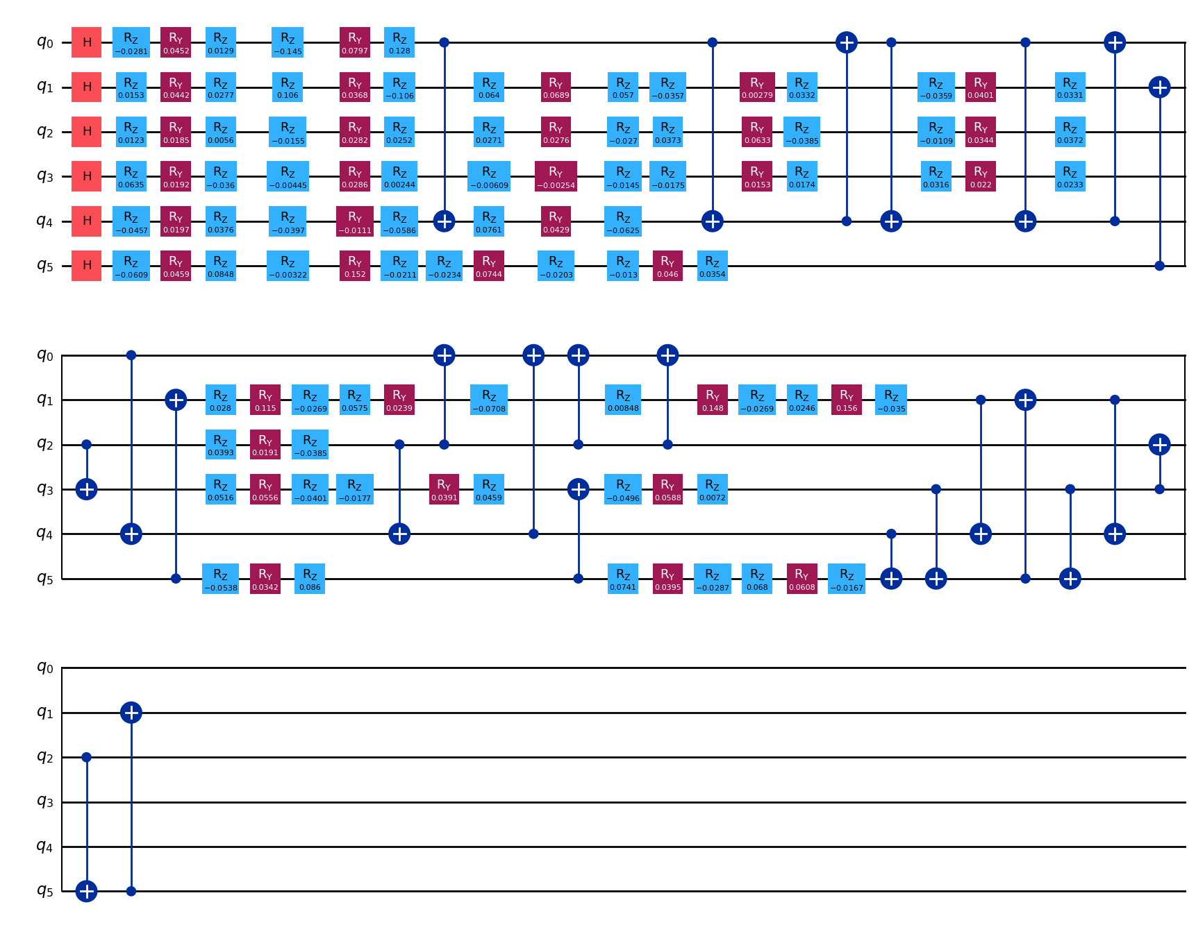
Results – Unweighted Max Cut using Macro Search

Slide 14
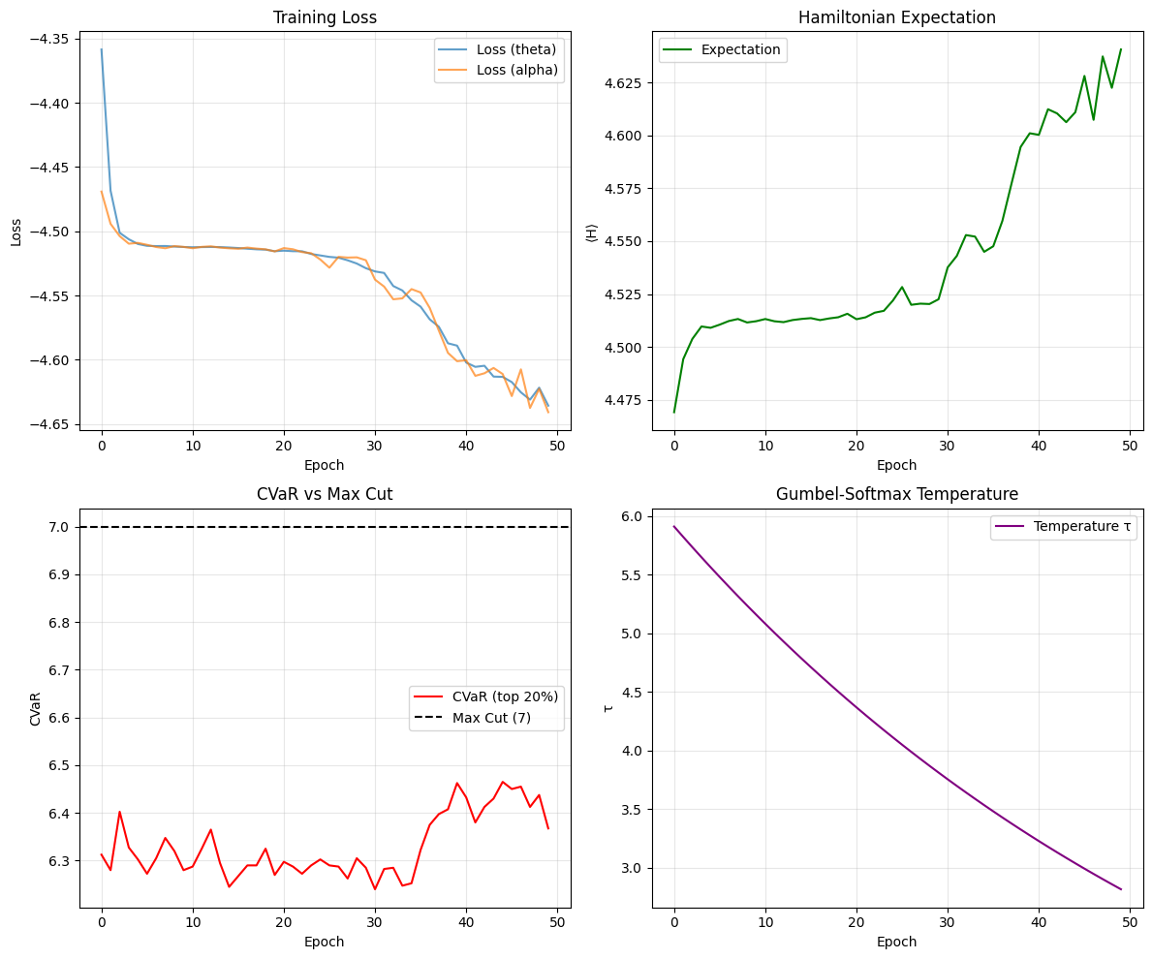
Results – Unweighted Max Cut using Micro Search
{
'cvar': 6.515999794006348,
'max_cut_classical': 7,
'best_bitstring': [0, 1, 1, 1, 0, 0],
'best_partition': [-1, 1, 1, 1, -1, -1],
'cut_value': 7,
'solution_prob': 0.04110576584935188,
'found_optimal': True
}

Slide 15
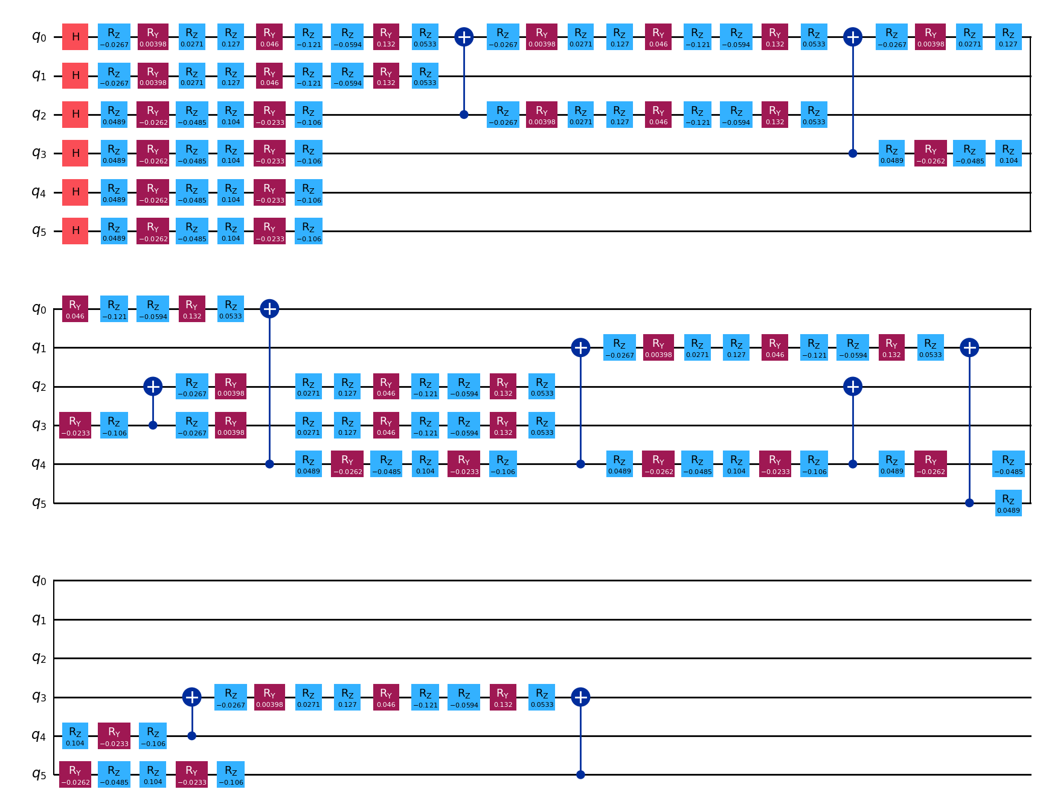
Results – Unweighted Max Cut using Micro Search

Slide 16
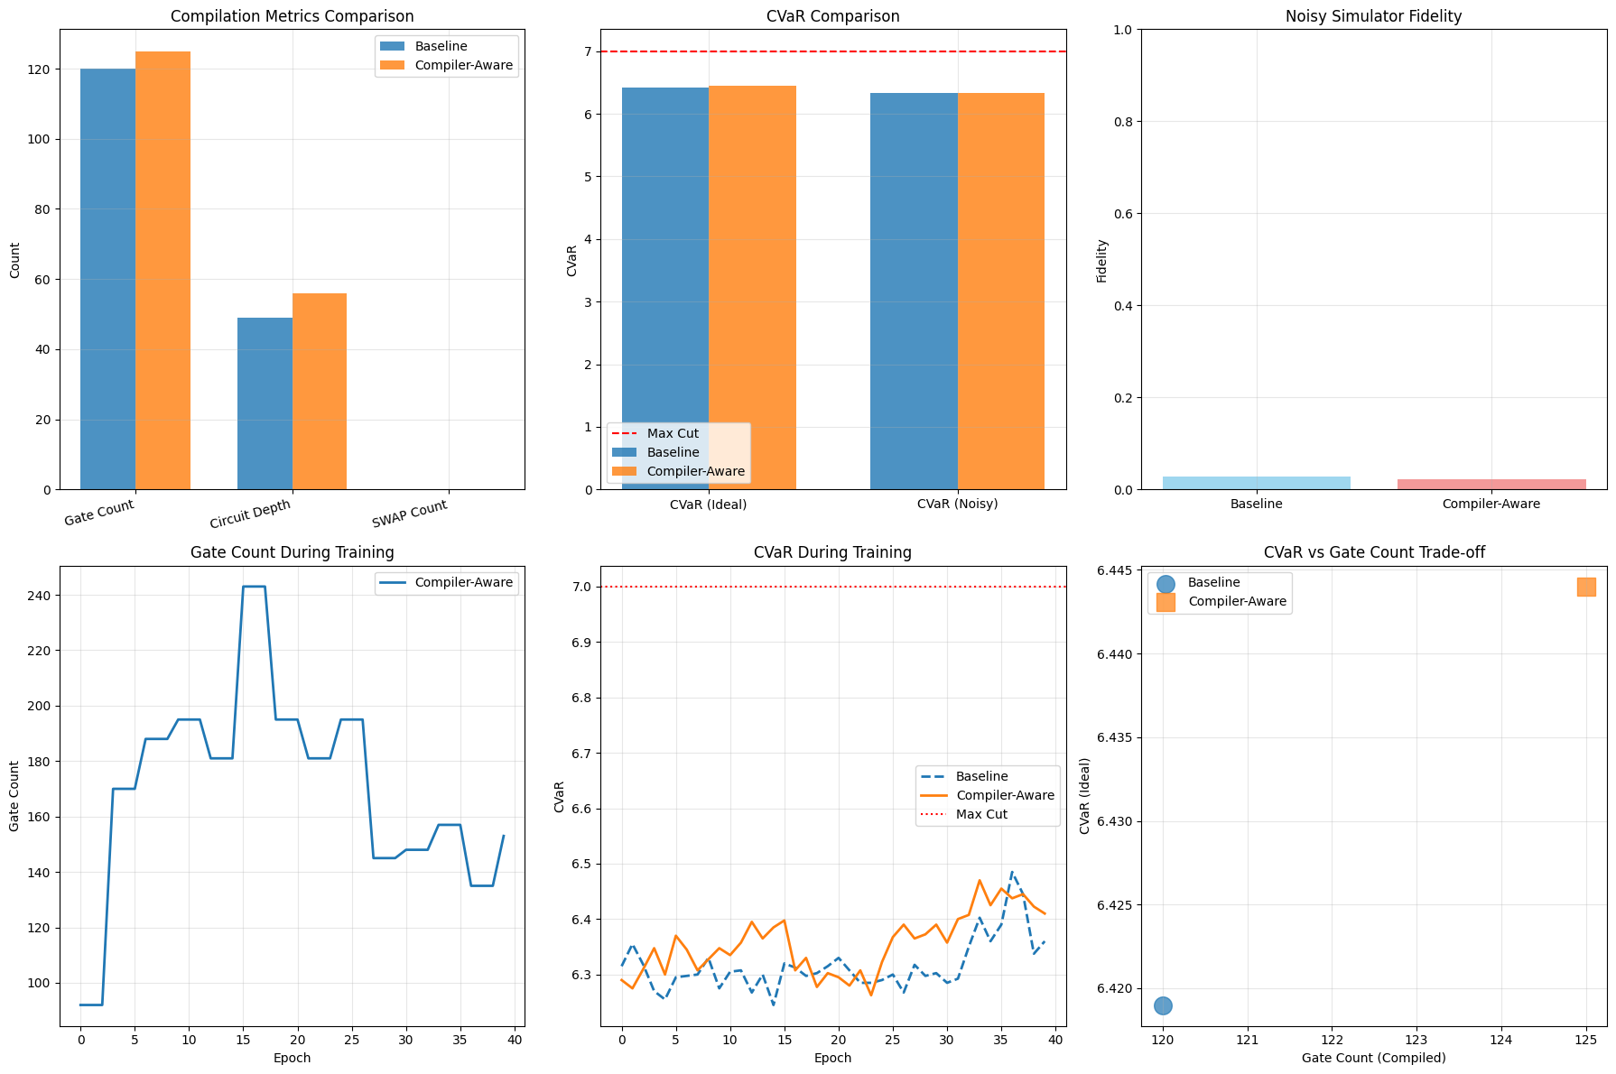
Compiler Aware Micro Search – 6 nodes, edge density = 0.5

Slide 17
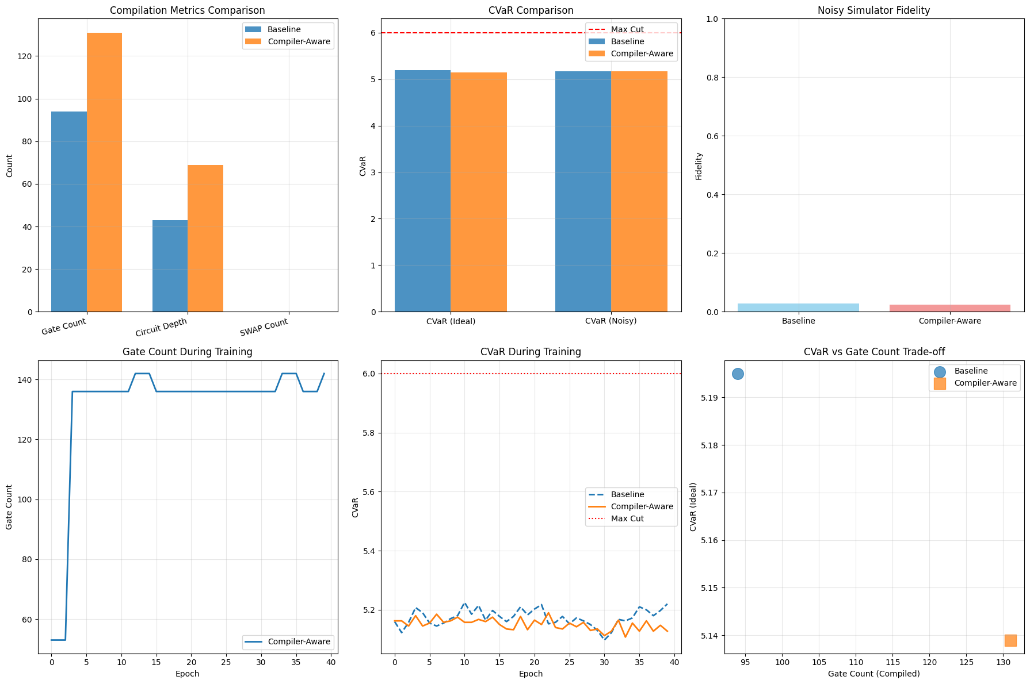
Compiler Aware Micro Search – 6 nodes, edge density = 0.25

Slide 18
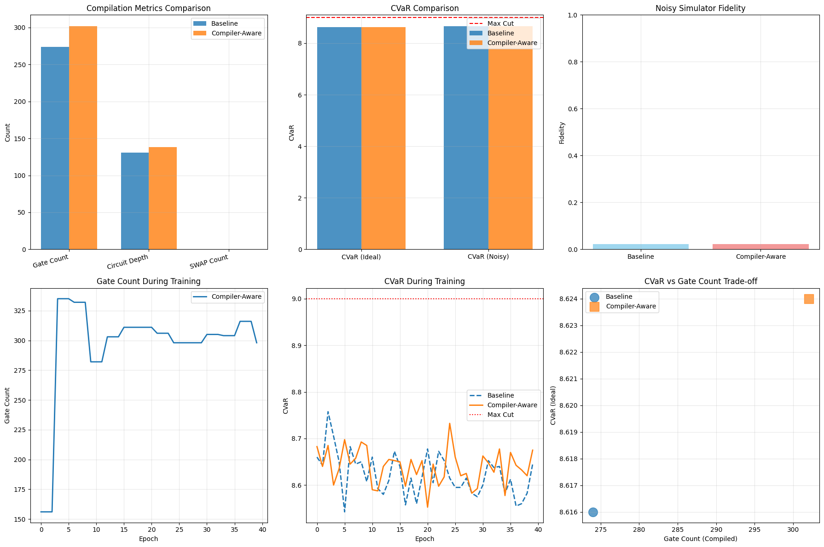
Compiler Aware Micro Search – 6 nodes, edge density = 0.75

Slide 19
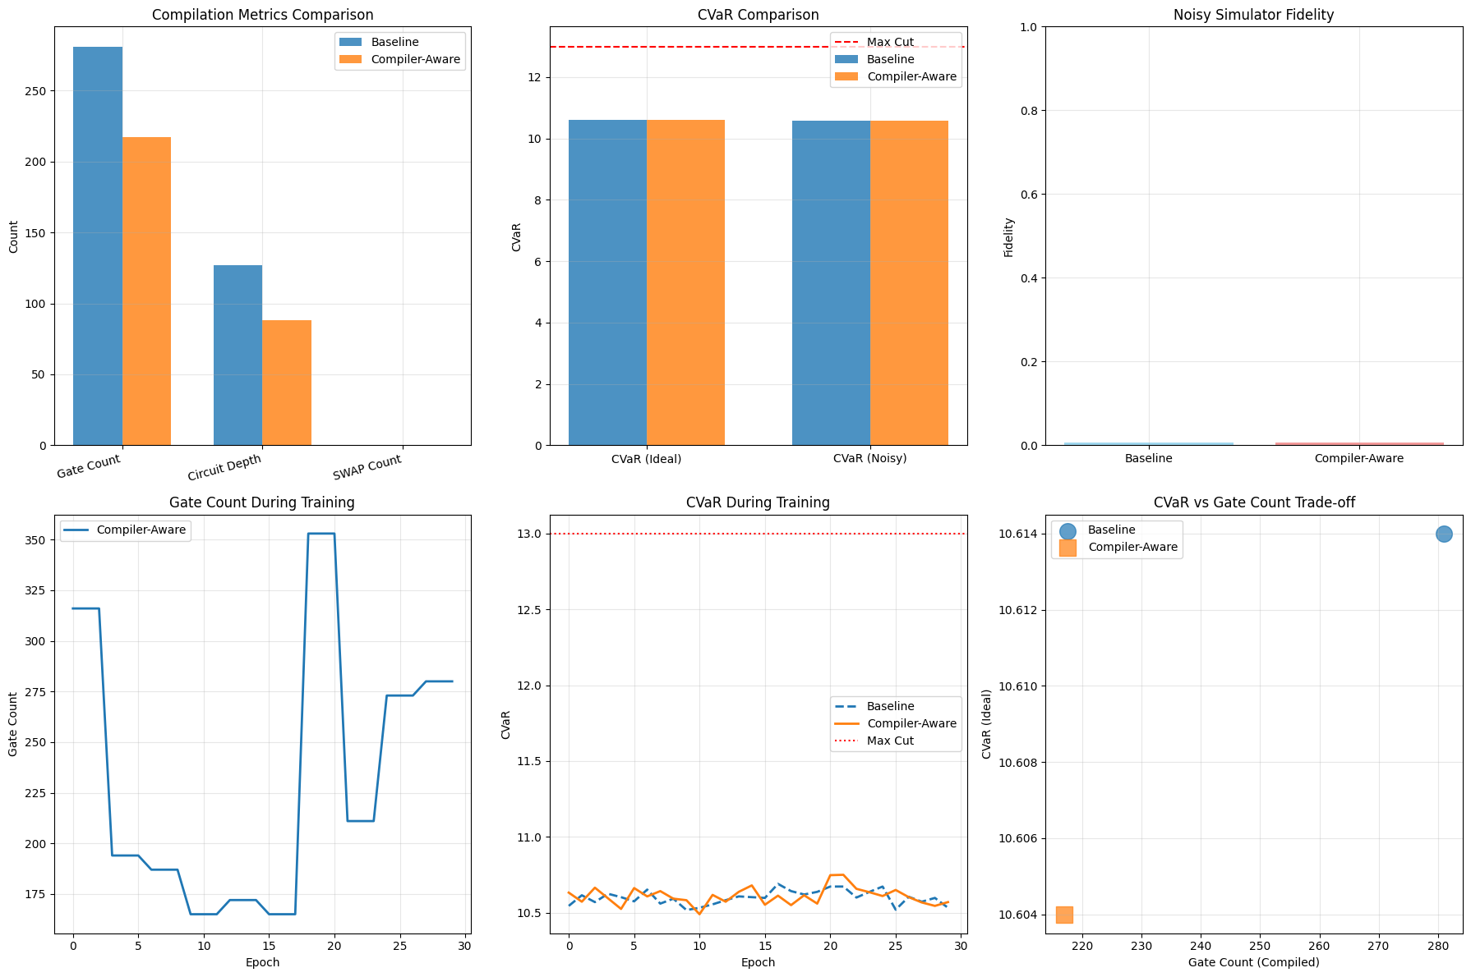
Compiler Aware Micro Search – 8 nodes, edge density = 0.5

Slide 20
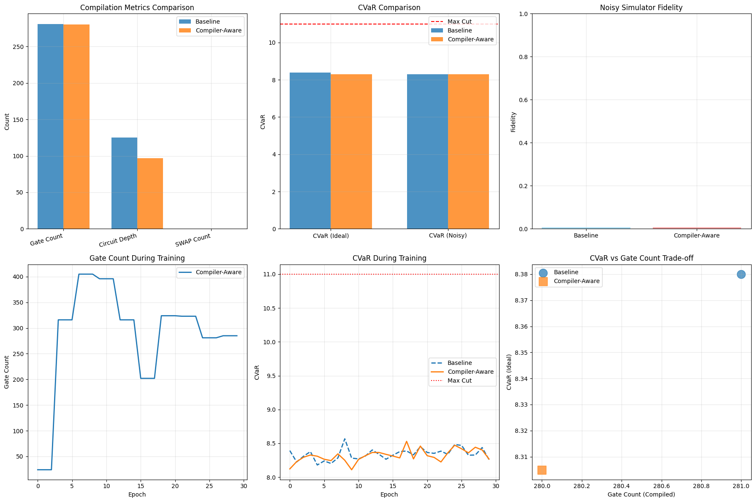
Compiler Aware Micro Search – 8 nodes, edge density = 0.25

Slide 21
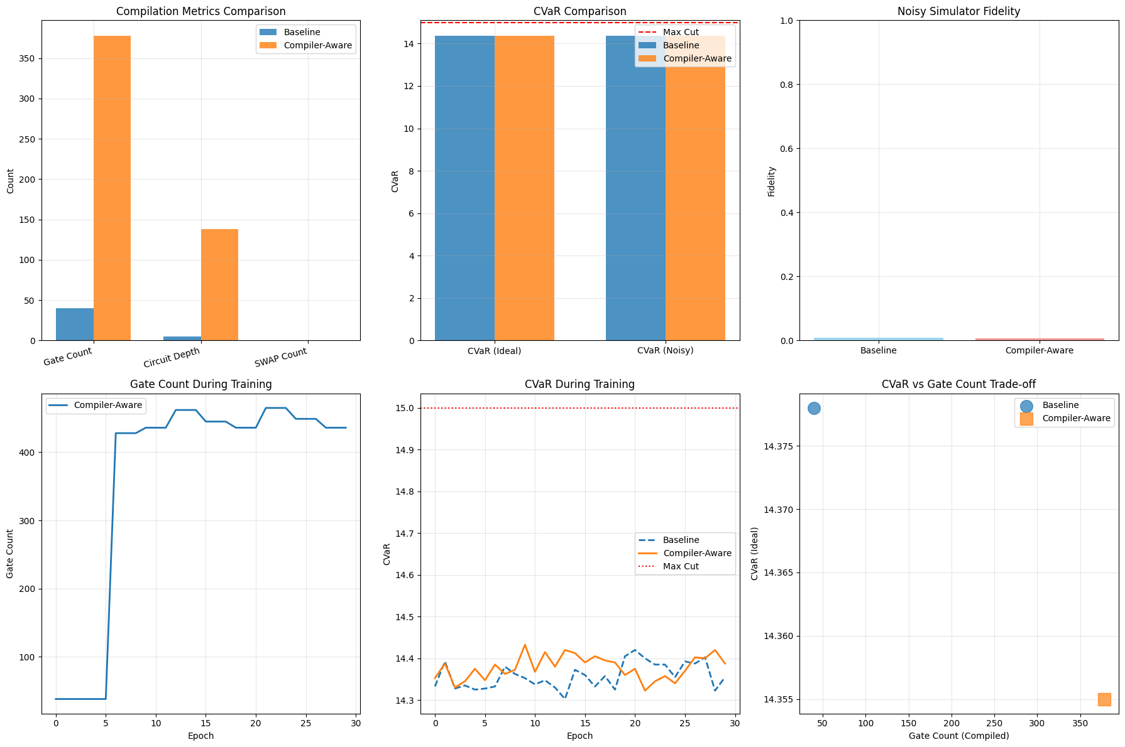
Compiler Aware Micro Search – 8 nodes, edge density = 0.75

Slide 22
Conclusion and Future Work
QuantumDARTS is a fully differentiable Quantum Architecture Search (QAS) algorithm using Gumbel-Softmax evaluated compiler awareness on this.
Macro search is very slow for Max Cut.
Micro search shows scalability by discovering effective subcircuits for MaxCut.
Compiler Aware Micro search showed no promise for graphs with lower number of nodes (6 nodes).
Two out of 3 instances of 8 node graph showed significant improvement with compiler awareness.
Future Work:
Evaluate trends for larger graphs with compiler awareness.
Evaluate on multiple shots for each (node, edge density pair)
Evaluate compiler awareness for other parameterized quantum circuits.

