Slide 1
Node.js Time Server on Ubuntu
Title: Node.js Time Server on Ubuntu
Presented By: Rajat Raju Kamble
Git Hub Link:
https://github.com/Rajatkamble99/Cloud_computing/tree/main/Time_Server

Slide 2
Table of Contents
Introduction
Design
Implementation
Test
Enhancement Ideas
Conclusion
Bibliography / References
Appendix (Optional)

Slide 3
Introduction
Overview of the Project:
This project aims to set up a simple time server using Node.js on an Ubuntu server. The server provides the current date and time upon request via specific API endpoints.
Objectives:
Set up a working Node.js environment on Ubuntu.
Implement a time server that responds to HTTP requests with time data.
Ensure the server can handle multiple API endpoints for time-related data.

Slide 4
Design
Why This Approach?
Platform Choice: Node.js is known for its lightweight and efficient handling of HTTP requests, making it a suitable choice for a time server.
Environment Choice: Ubuntu is a stable and widely used Linux distribution, ideal for server-side applications.
Problem Identification and Understanding:
Problem: Create a server that can accurately deliver time information to clients.
Understanding: Requires a simple, non-blocking server capable of handling JSON requests and responses.

Slide 5
Design
Solution Investigation and Selection:
Explored Solutions:
Using Python with Flask
Using Node.js with Express
Using pure Node.js with the HTTP module
Theoretical Comparison:
Node.js with HTTP module was chosen for its simplicity, performance, and ease of implementation.
Python Flask was considered but found more suitable for complex API needs.
Final Decision:
Node.js with the built-in HTTP module offers better performance for a simple time server.

Slide 6

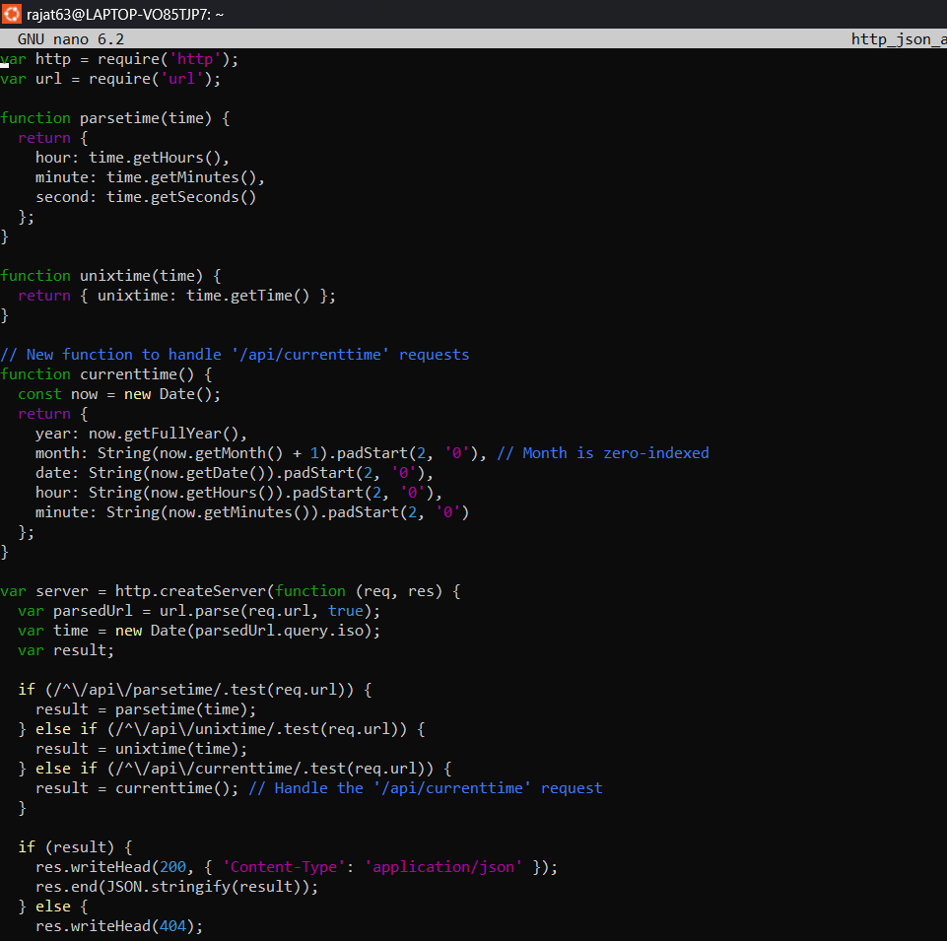
Implementation
2. Code Implementation:
Write the time_server.js file to handle time-based API requests.
Functions like parsetime(), unixtime(), and currenttime() were used to format and provide time data.

Slide 7
Implementation
2. Code Implementation:
Write the time_server.js file to handle time-based API requests.
Functions like parsetime(), unixtime(), and currenttime() were used to format and provide time data.

Slide 8

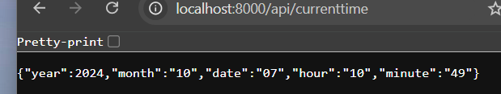
Implementation
3 . Server Execution:​
Start the server with node time_server.js 8000.​
Test the server using a browser and curl.

Slide 9
Test
Testing the Node.js Time Server:
Test Methodology:
Use both a web browser and command-line tools like curl to test the API responses.
Verify different endpoints like /api/parsetime, /api/unixtime, and /api/currenttime.
Example Test Results:
curl http://localhost:8000/api/currenttime returns { year: 2024, month: '10', date: '07', hour: '10', minute: '49' }.
Ensured that invalid endpoints return a 404 status.
Challenges and Resolutions:
Encountered issues with time zone discrepancies, which were resolved by adjusting server time settings.

Slide 10
Enhancement Ideas
Future Improvements:
Add Timezone Support:
Enable users to request time based on specific time zones.
Enhance Error Handling:
Implement more informative error messages for different scenarios.
Scalability:
Use a load balancer to manage requests if the server needs to handle a large number of clients.
Expand API Functionality:
Add endpoints for time-related conversions (e.g., converting between different time formats).

Slide 11
conclusion
Summary of Accomplishments:
Successfully set up a Node.js-based time server on an Ubuntu environment.
Implemented a working API that delivers time data to clients.
Demonstrated the server's ability to respond to different time-related queries.
Takeaways:
Node.js is effective for lightweight servers.
A simple time server can be an excellent introduction to HTTP handling with Node.js.

