Slide 1
Exploratory Data Analysis of
Large-Scale Retail Transaction Data
Univariate • Bivariate • Multivariate • Time-Based Analysis
Python | Pandas | NumPy | Matplotlib | Seaborn
1

Slide 2
1. Project Overview
Objective: understand patterns, distributions, relationships, outliers and trends in retail transactions.
EDA performed before predictive modelling and business decision-making.
Analysis covers numerical, categorical, correlation, multivariate and time-based dimensions.
Transaction value is represented by final_price.
2

Slide 3
2. Dataset Overview
Uploaded retail_large_dataset.csv
100,000
Rows
18
Columns
0
Missing Values
0
Duplicate Rows
Date range: 01-Jan-2023 to 30-Dec-2025.
Numerical variables include age, product_price, quantity, discount_percentage, final_price and delivery_days.
Categorical variables include gender, location, customer segment, product category, payment method, shipping type and return status.
order_date supports monthly, quarterly, yearly and day-of-week analysis.
3

Slide 4
3. Data Preparation & EDA Workflow
Loaded the CSV using Pandas.
Checked how many Rows and Columns.
Checked datatype, checked numerical and Categorical columns.
Checked missing values and duplicate records.
Created derived time variables: Year, Month, Quarter, Week and Day_Name.
Encoded return_status as a binary return flag for return-rate analysis.
Applied descriptive statistics, visualizations and correlation analysis.
Using different different Plot for Numerical and Cateogrical Columns.
4

Slide 5
4. Univariate Numerical Analysis
Variable | Mean | Median | Std Dev | Min | Max
age | 41.56 | 42.00 | 13.85 | 18.00 | 65.00
product_price | 30,164.53 | 30,148.00 | 17,139.68 | 500.00 | 59,998.00
quantity | 2.50 | 3.00 | 1.12 | 1.00 | 4.00
discount_percentage | 15.01 | 15.00 | 8.95 | 0.00 | 30.00
final_price | 64,165.72 | 49,752.39 | 49,969.28 | 357.00 | 239,980.00
delivery_days | 5.51 | 5.00 | 2.87 | 1.00 | 10.00
5

Slide 6
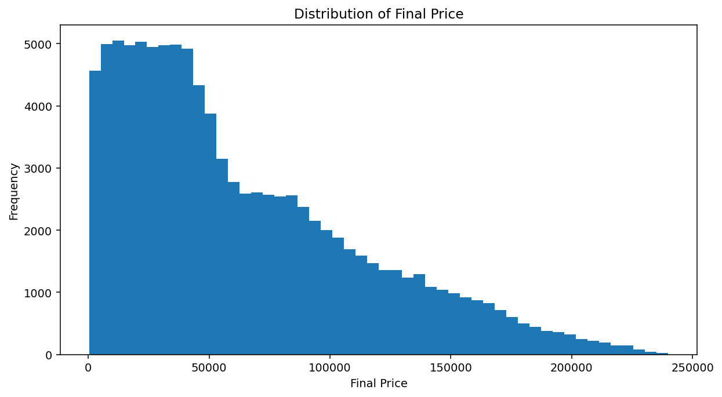
5. Final Price Distribution
Mean final_price: ₹64,165.72
Median final_price: ₹49,752.39
Skewness: 0.9347 → right-skewed distribution.
The mean is higher than the median, consistent with higher-value transactions extending the right tail.
6

Slide 7
6. Categorical Analysis
Categorical frequency distributions were examined to understand customer composition and transaction patterns.
Overall return rate: 14.81%.
Customer segments: New (33,488), Regular (33,361), Premium (33,151).
Product category, payment method and return status were also analysed using frequency counts.
Using many Plot to Describe Categorical Analysis.
7

Slide 8
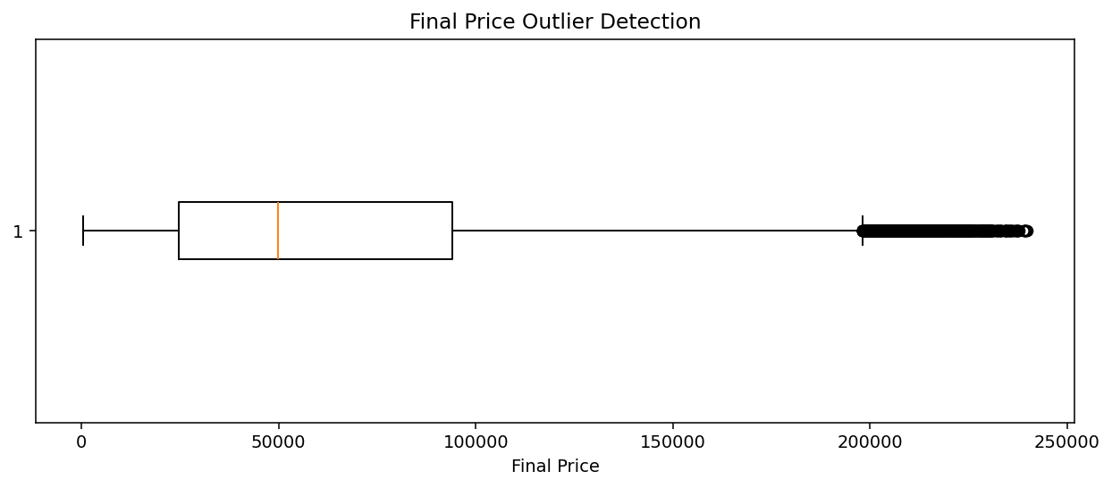
7. Outlier Detection
IQR outliers in final_price: 1,335 (1.33%).
Z-score > 3 observations: 503.
Outliers should not automatically be removed.
High-value transactions may represent genuine premium or bulk purchases.
Potential data errors should be investigated separately.
8

Slide 9
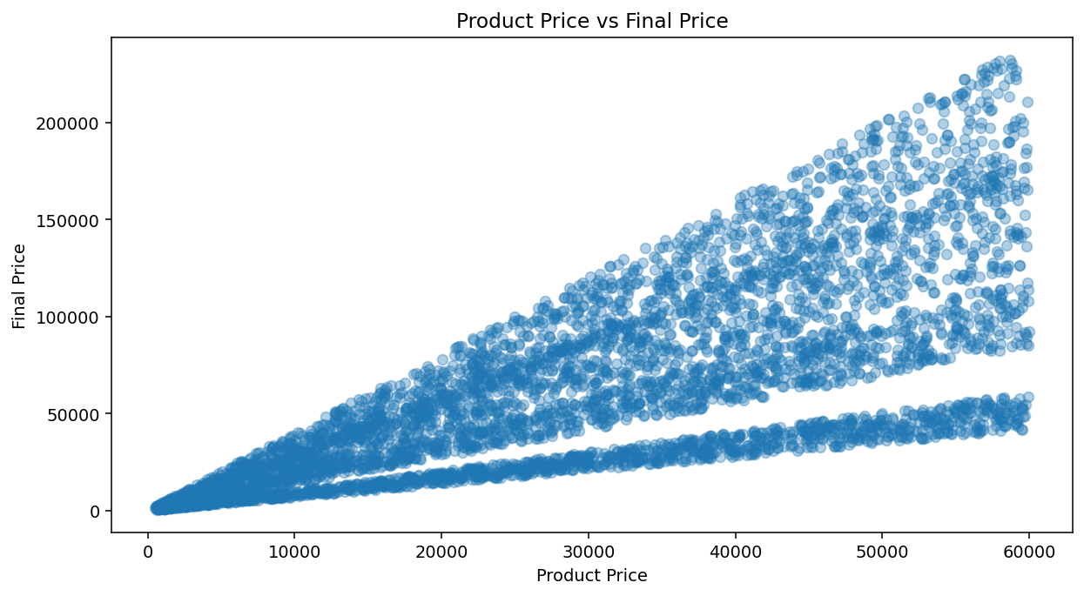
8. Bivariate Analysis: Product Price vs Final Price
Pearson correlation: 0.731.
Higher product prices are associated with higher transaction values.
Correlation measures association, not causation.
Quantity vs final_price correlation: 0.575.
9

Slide 10
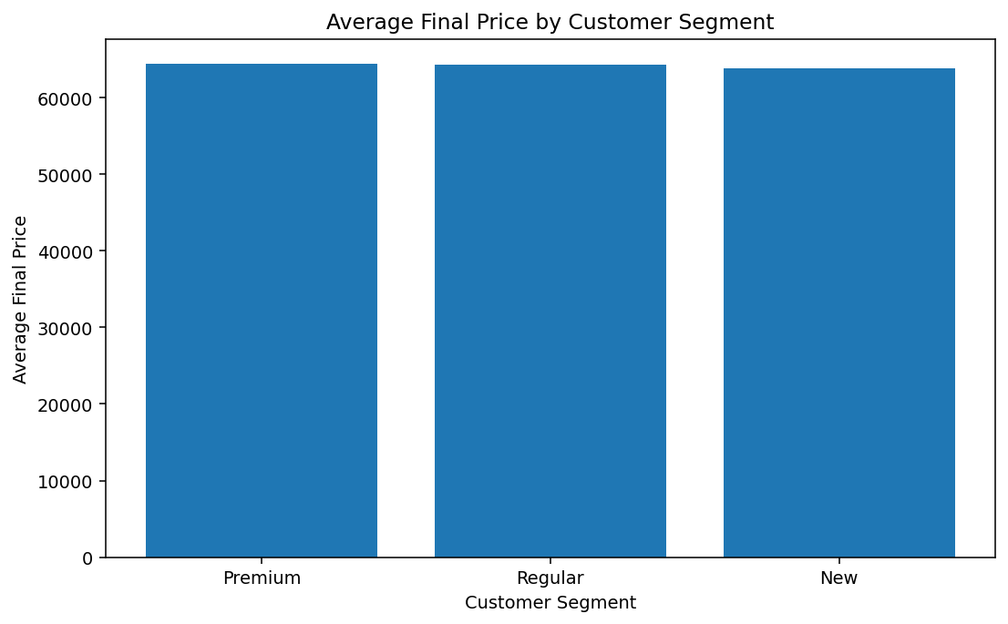
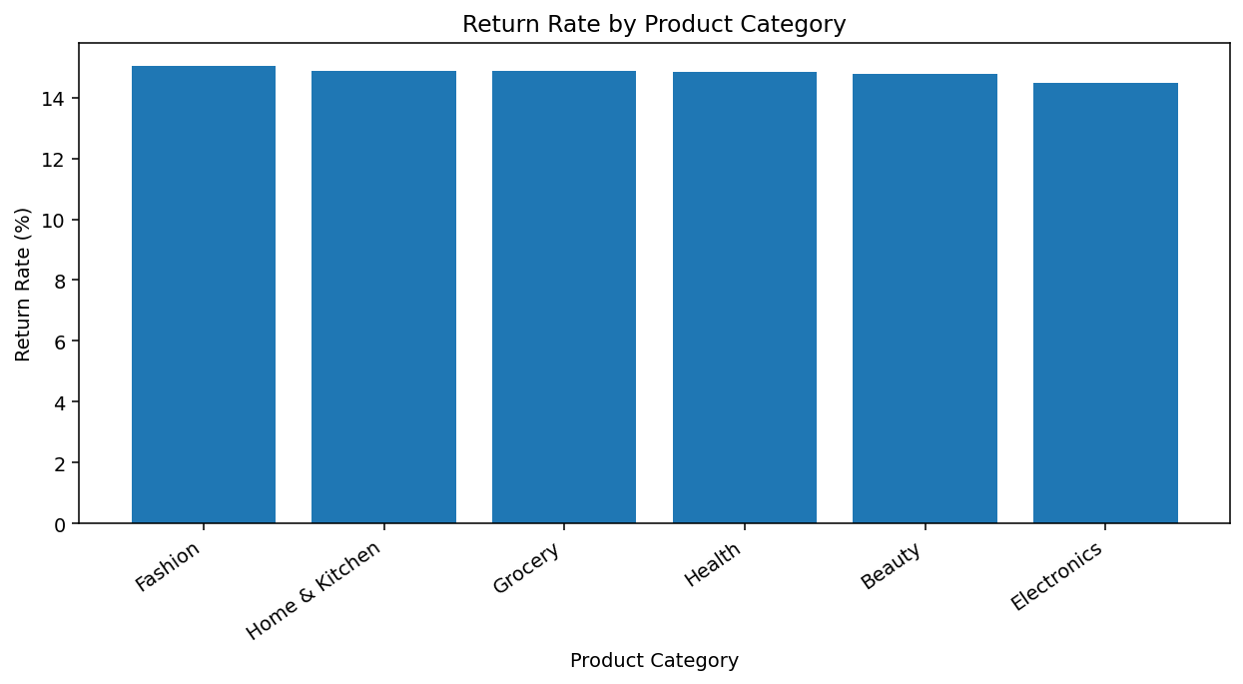
9. Numerical vs Categorical Analysis
10

Slide 11
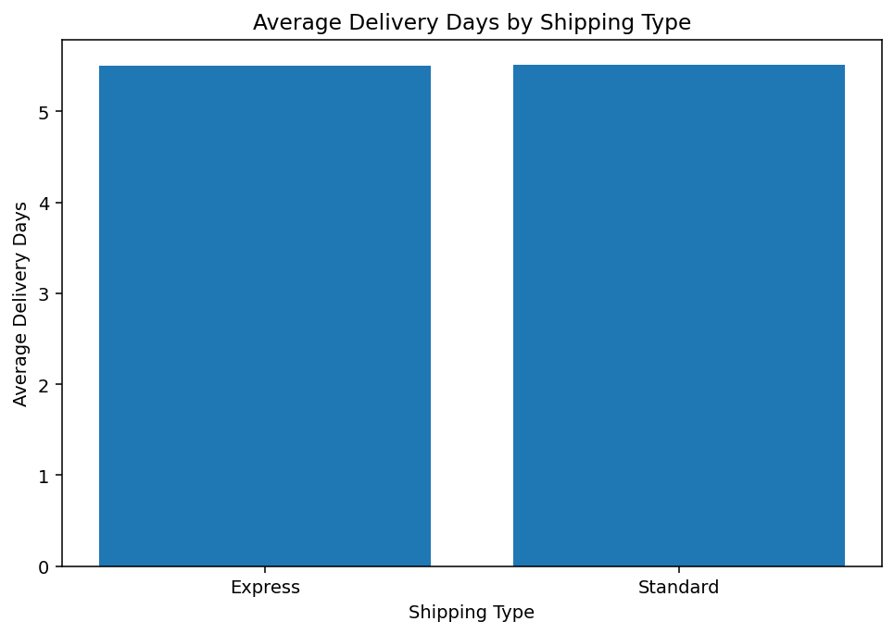
10. Shipping & Delivery Analysis
Express average delivery: 5.50 days.
Standard average delivery: 5.51 days.
The two averages are nearly identical in this dataset.
Therefore, a strong delivery-time reduction from Express shipping is not supported by these averages.
11

Slide 12
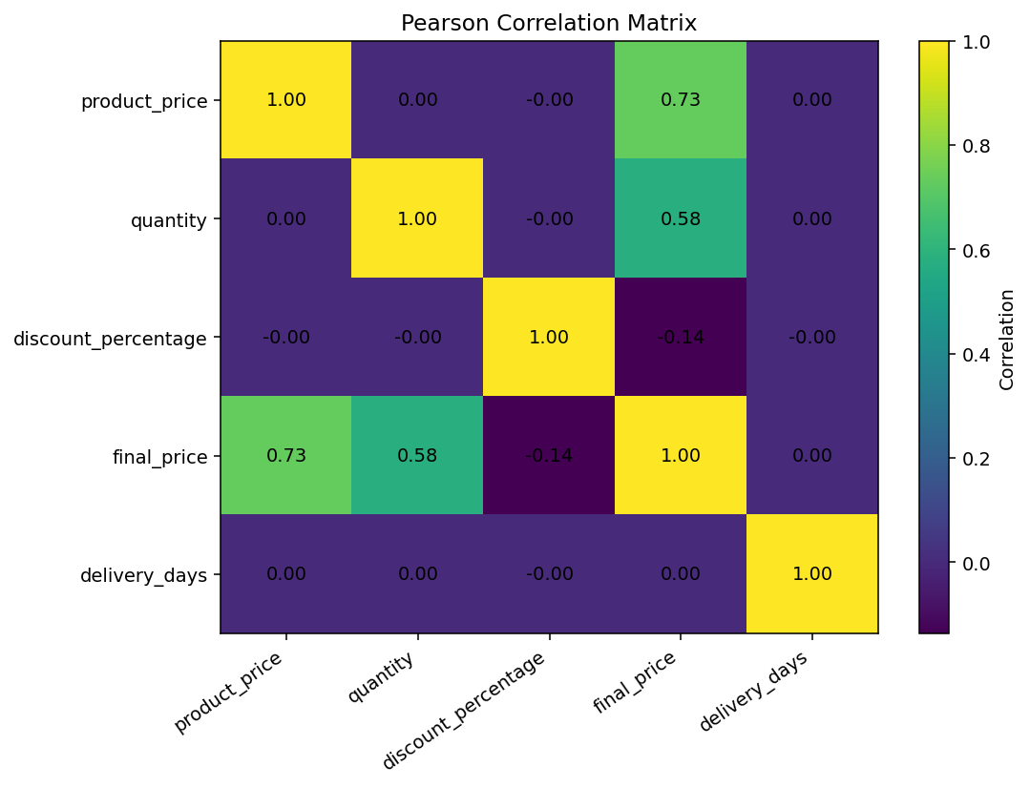
11. Correlation Matrix
product_price ↔ final_price: 0.731
quantity ↔ final_price: 0.575
discount_percentage ↔ final_price: -0.137
delivery_days ↔ final_price: 0.004
The strongest observed linear relationships with final_price are product_price and quantity.
12

Slide 13
12. Skewness & Kurtosis Interpretation
Variable | Value | Interpretation
product_price | 0.0032 | Approximately symmetric
final_price | 0.9347 | Right-skewed
final_price | 0.1690 | Not unusually high kurtosis
final_price is the main variable showing meaningful positive skewness.
The right tail reflects a smaller number of higher-value transactions.
product_price has skewness close to zero.
The final_price kurtosis value does not support describing the distribution as highly heavy-tailed solely from kurtosis.
13

Slide 14
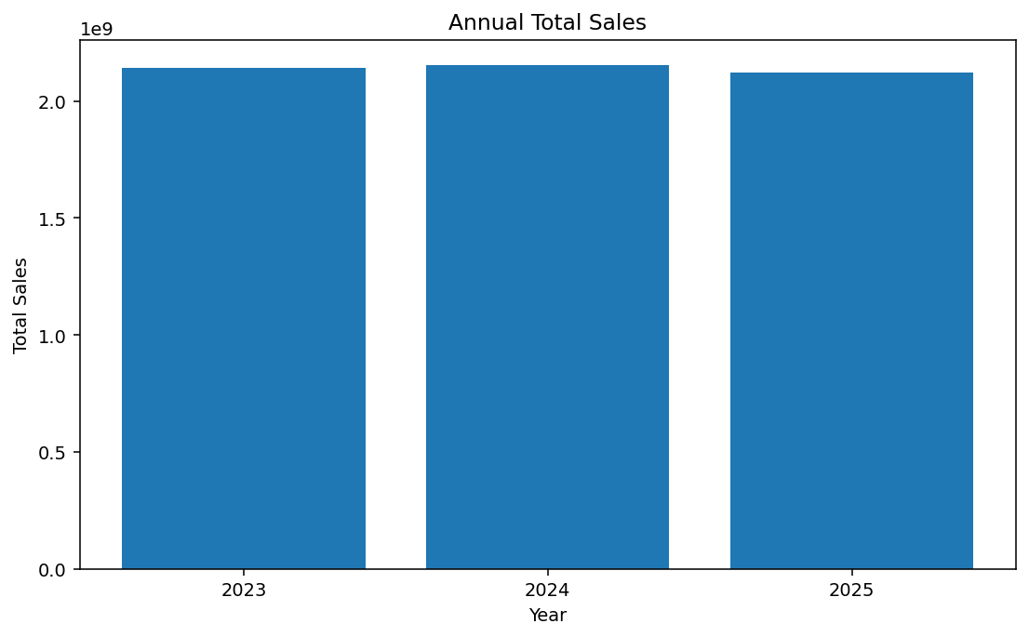
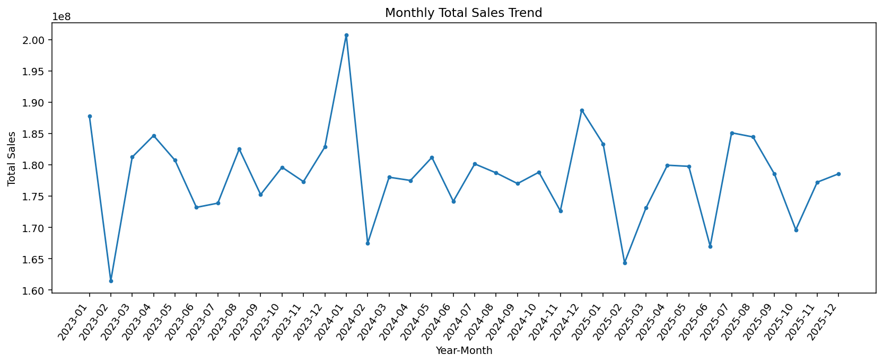
13. Time-Based Analysis
2023 sales: ₹2,140,485,043
2024 sales: ₹2,155,130,180
2025 sales: ₹2,120,957,115
Highest-sales month: 2024-01.
14

Slide 15
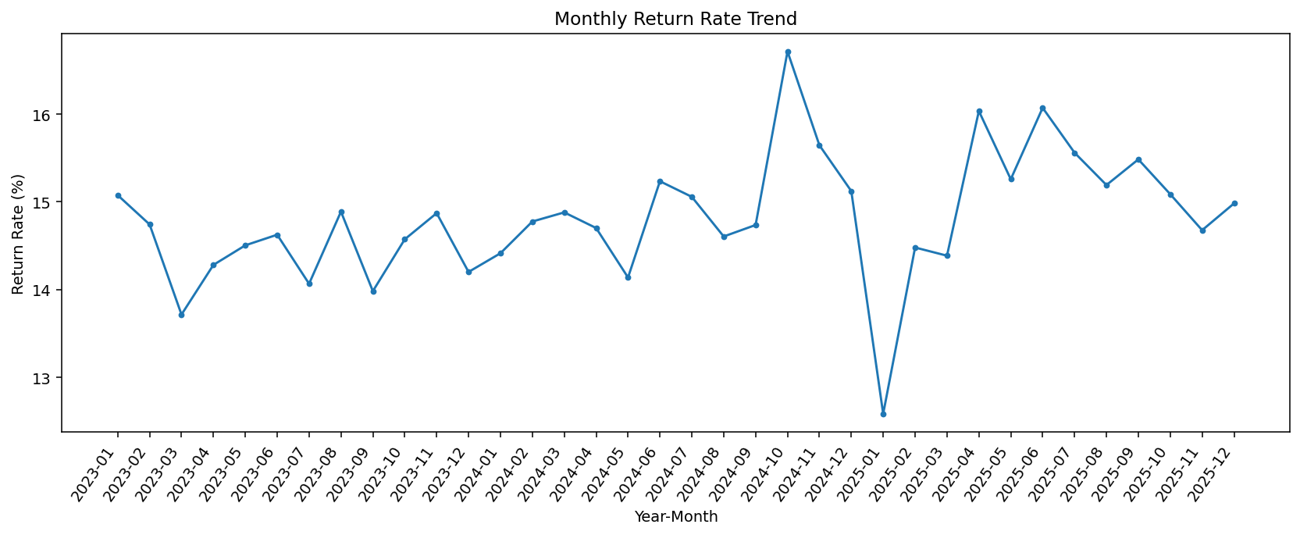
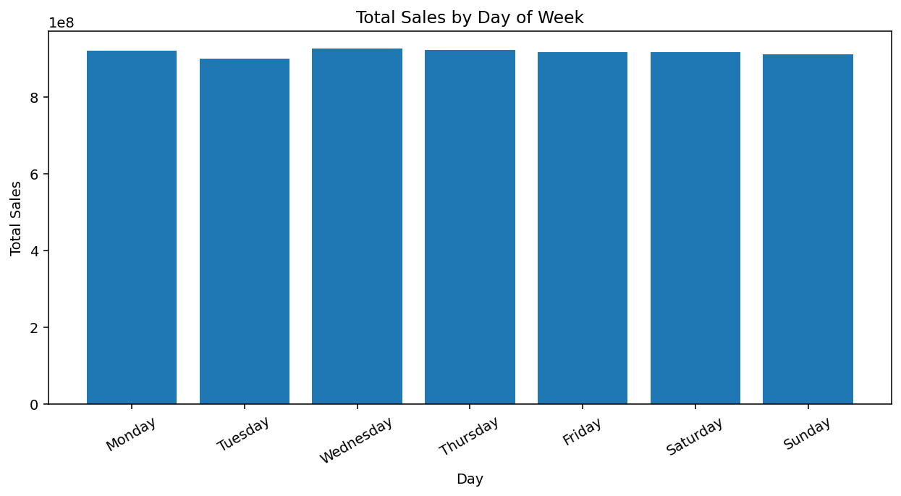
14. Return & Weekly Sales Trends
Overall return rate: 14.81%.
Monthly return rates can be monitored for temporal variation.
Day-of-week analysis provides an additional view of purchasing activity.
15

Slide 16
15. Key Findings & Conclusion
The dataset contains 100,000 retail transactions across 18 variables with no missing or duplicate records.
final_price is right-skewed (skewness ≈ 0.9347), while product_price is approximately symmetric.
Product price and quantity show positive relationships with final_price (r = 0.731 and 0.575).
Overall return rate is 14.81%; category return rates are relatively close.
Time-based analysis reveals annual, monthly and weekly transaction patterns.
Outliers require investigation because unusual values may represent legitimate high-value transactions.
EDA provides a strong foundation for forecasting, customer segmentation and predictive modelling.
16

