Slide 1
PROJECT REPORT • 2026
Feature Extraction &
Mobile Phone Price Prediction
A machine-learning workflow to estimate phone prices from specifications and interpret which input features help predictions.
REGRESSION
MODEL COMPARISON
FEATURE IMPORTANCE

Slide 2
Executive summary
What the notebook's saved results indicate
₹1,591
0.899
541 → 531
Memory
Extra Trees test MAE
Extra Trees test R²
Rows after duplicate removal
Top feature in main workflow
• Storage and RAM show the clearest positive relationships with price among numeric variables.
• Permutation importance ranks Memory, Front Camera, Model and RAM highest in the main Extra Trees workflow.
• A second Random Forest workflow ranks Front Camera first; importance is model/split dependent.
• The saved notebook contains two different model runs—results are reported separately, not blended.
MOBILE PRICE PREDICTION • 02

Slide 3
Project objective & questions
From device specifications to an interpretable price estimate
• Predict observed mobile-phone Price from specification fields.
• Explore how storage, RAM, battery, cameras, model, processor and colour relate to price.
• Compare five regression algorithms using a held-out test split.
• Use permutation importance to estimate how much each input contributes to predictive performance.
• Translate the findings into practical guidance while avoiding causal claims.
Regression
Supervised learning
20% Test set
Held-out evaluation
Permutation
Feature importance
MOBILE PRICE PREDICTION • 03

Slide 4
Dataset at a glance
Notebook output: 541 records and 11 fields after index-column removal
541
11
6
5
records before deduplication
columns reported by df.info()
numeric columns incl. target
categorical columns
• Target: Price (cleaned to numeric; source column was named Prize before renaming).
• Numeric: Memory, RAM, Battery, AI Lens, Mobile Height, Price.
• Categorical: Model, Colour, Rear Camera, Front Camera, Processor.
• Source is a processed Flipdata mobile listing dataset; currency is interpreted as ₹ based on the notebook's price context.
MOBILE PRICE PREDICTION • 04

Slide 5
Data preparation pipeline
Sequence visible in the notebook
01
02
03
Load CSV
Normalize names
Clean types
Processed_Flipdata dataset
Battery_, Processor_, Prize → Battery, Processor, Price
Price string → numeric; remove exported index
04
05
06
Remove duplicates
Prepare inputs
Split & fit
10 duplicate rows reported; deduplication applied
Median imputation for numeric; mode + one-hot for categorical
80% train / 20% test; fixed random seed
MOBILE PRICE PREDICTION • 05

Slide 6
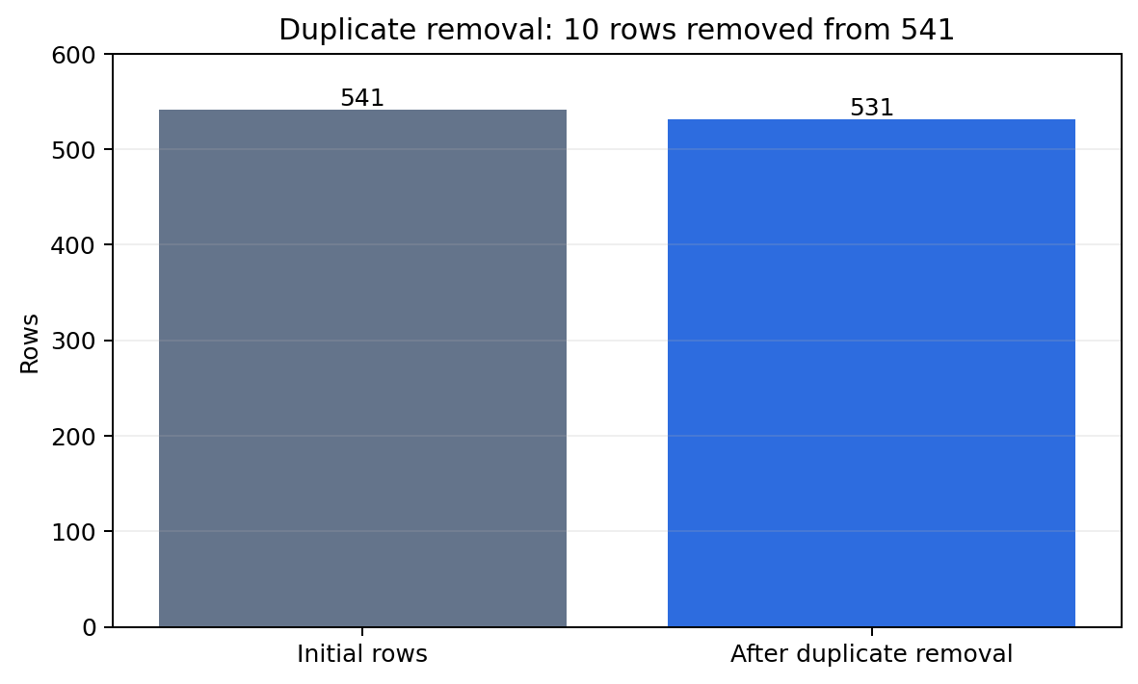
Data quality & caveats
What cleaning does—and does not—guarantee
• The notebook reports 10 duplicate records and then drops duplicates.
• A later df.info() output shows 541 non-null values across 11 fields; this appears to be from before the duplicate-removal step or a separate execution state.
• The notebook does not display a complete missing-value summary in its saved outputs, so missingness cannot be quantified confidently here.
• One later modelling block uses a different split seed and Random Forest configuration; its importance values differ.
MOBILE PRICE PREDICTION • 06

Slide 7
Price target: how to read the outcome
Observed prices vary widely; model errors are reported in the same price units
• The notebook includes a price histogram with KDE and a price boxplot, but the saved notebook does not expose numeric quantiles in the output text.
• Price is the regression target; predictions are continuous values.
• Outliers can strongly affect RMSE because squared errors penalize large misses more heavily.
• MAE is easier to interpret as a typical absolute miss; the best MAE in the primary comparison is about ₹1.59k.
₹1,591
Primary best-model MAE
₹3,539
Primary best-model RMSE
The notebook's actual price-distribution plot is present in the source, but exact median/range values are not printed in the captured outputs.
MOBILE PRICE PREDICTION • 07

Slide 8
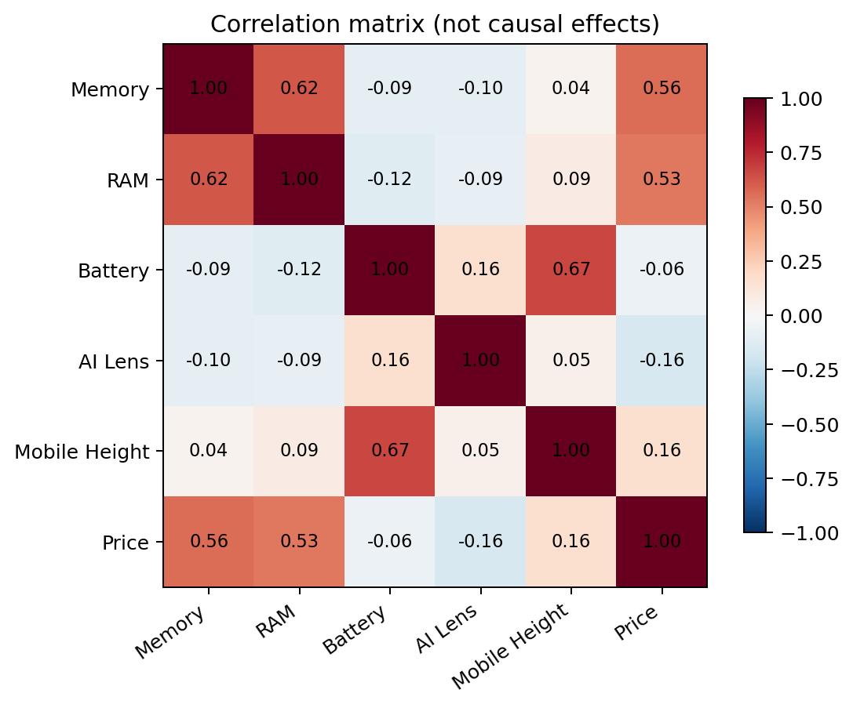
Numeric relationships with price
Pearson correlations from the notebook's first correlation matrix
• Memory ↔ Price: +0.560
• RAM ↔ Price: +0.527
• Mobile Height ↔ Price: +0.160
• Battery ↔ Price: −0.059
• AI Lens ↔ Price: −0.159
• Correlations summarize linear association only; they do not establish causation or capture all categorical effects.
MOBILE PRICE PREDICTION • 08

Slide 9
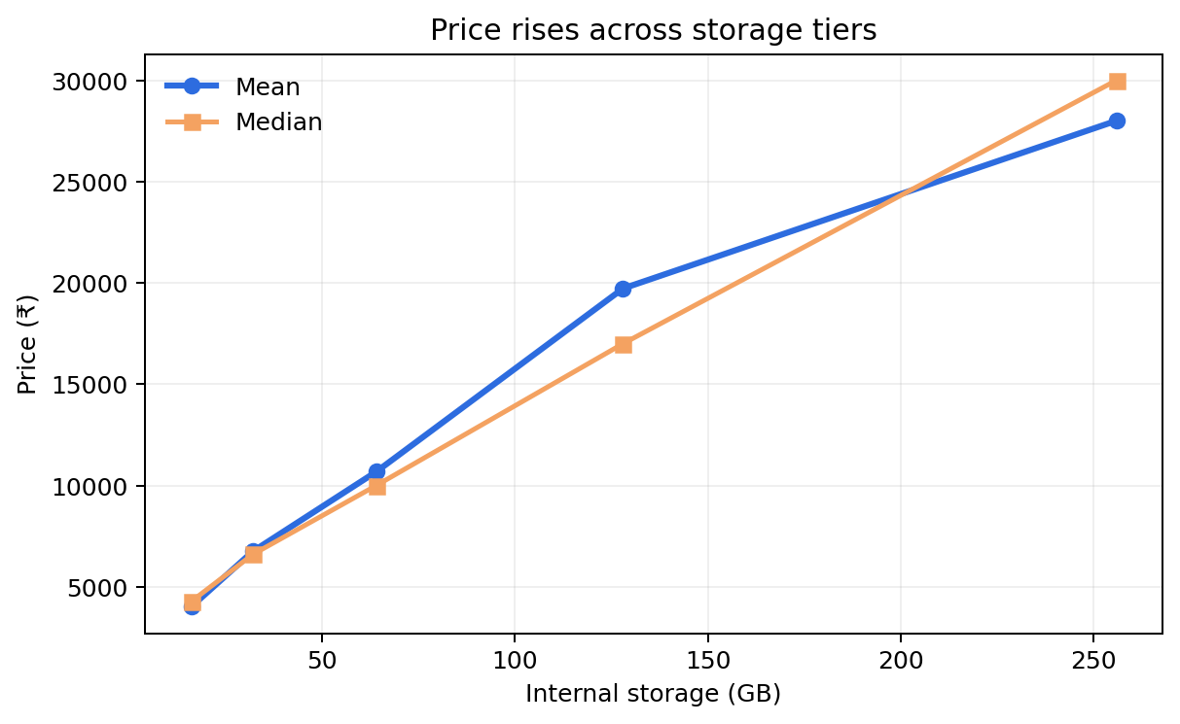
Storage is a strong price signal
Average and median prices rise across the observed storage tiers
• 16 GB: mean ₹4,012 (n=4)
• 64 GB: mean ₹10,679 (n=161)
• 128 GB: mean ₹19,722 (n=249)
• 256 GB: mean ₹28,003 (n=55)
• 128 GB is the most common tier in this dataset. Small groups, especially 16 GB, make their means less stable.
MOBILE PRICE PREDICTION • 09

Slide 10
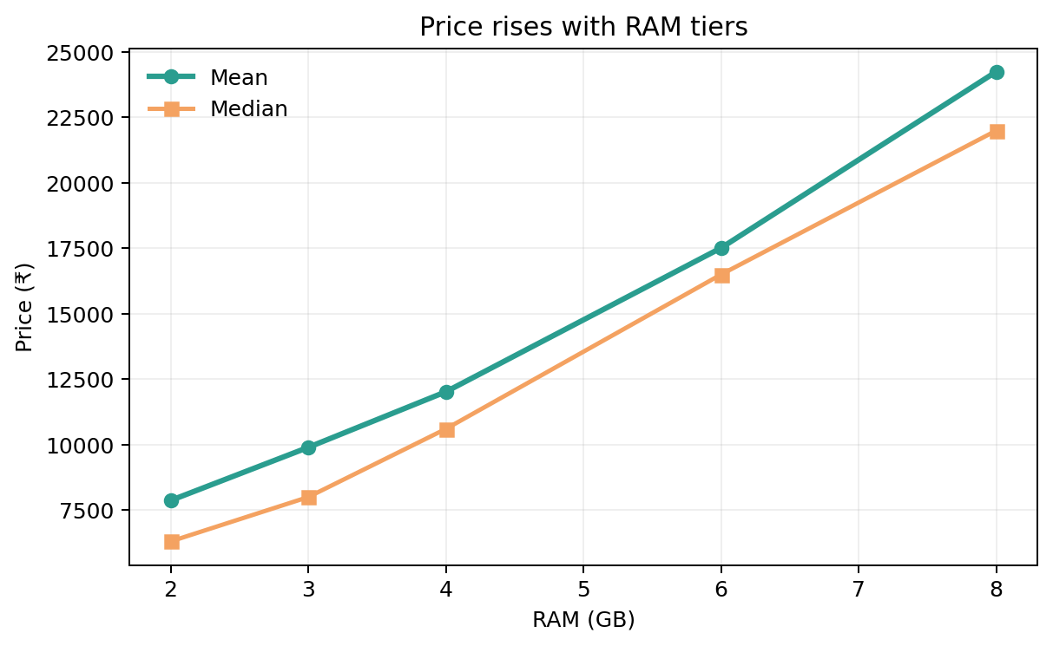
RAM is also strongly associated with price
Mean price grows from 2 GB to 8 GB RAM tiers
• 2 GB: mean ₹7,865 (n=37)
• 4 GB: mean ₹12,017 (n=174)
• 6 GB: mean ₹17,514 (n=117)
• 8 GB: mean ₹24,250 (n=153)
• Memory and RAM correlate with each other (+0.624), so their individual effects overlap.
MOBILE PRICE PREDICTION • 10

Slide 11
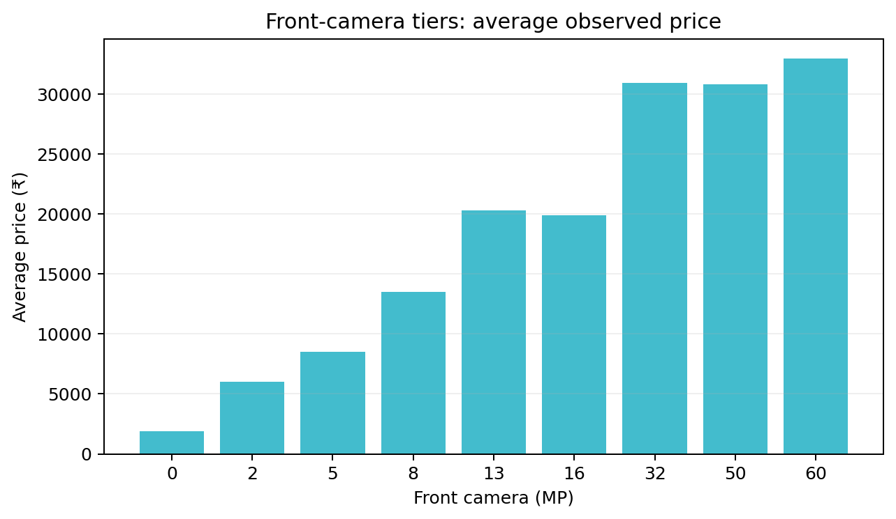
Camera features: useful, but not simple price rules
Average price by front-camera megapixel tier
• Front Camera is #2 in the primary permutation-importance run.
• The 32 MP group averages about ₹30,987; 16 MP averages ₹19,936.
• Camera tiers contain different phone models and price segments, so these are descriptive comparisons, not isolated camera effects.
• Some tiers have very few records (e.g., 50 MP n=7; 60 MP n=4).
MOBILE PRICE PREDICTION • 11

Slide 12
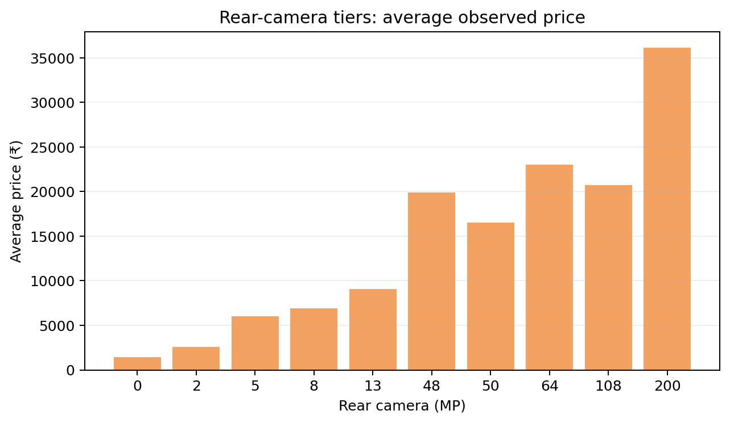
Rear-camera tiers show mixed price patterns
Average price by rear-camera megapixel tier
• 50 MP is the most frequent rear-camera category in the saved summary (n=250).
• 200 MP phones average ₹36,124, but only 8 records are in that tier.
• 12 MP averages ₹48,768 with only 10 records, illustrating why sample size and model mix matter.
• Megapixels alone should not be treated as a direct measure of camera quality or price.
MOBILE PRICE PREDICTION • 12

Slide 13
Feature interactions & context
Why one-feature comparisons can be misleading
• The notebook plots Memory vs Price with RAM encoded by colour/size.
• It also plots RAM vs Price with Battery as an additional dimension.
• Camera scatterplots compare rear-camera and front-camera specifications.
• A RAM × Memory summary table shows some high-price combinations have very few observations.
• Together, these views support interaction-aware models rather than a single linear rule.
Memory × RAM
Joint capacity profile
Model × Specs
Brand/model positioning
Camera × Tier
Segment confounding
MOBILE PRICE PREDICTION • 13

Slide 14
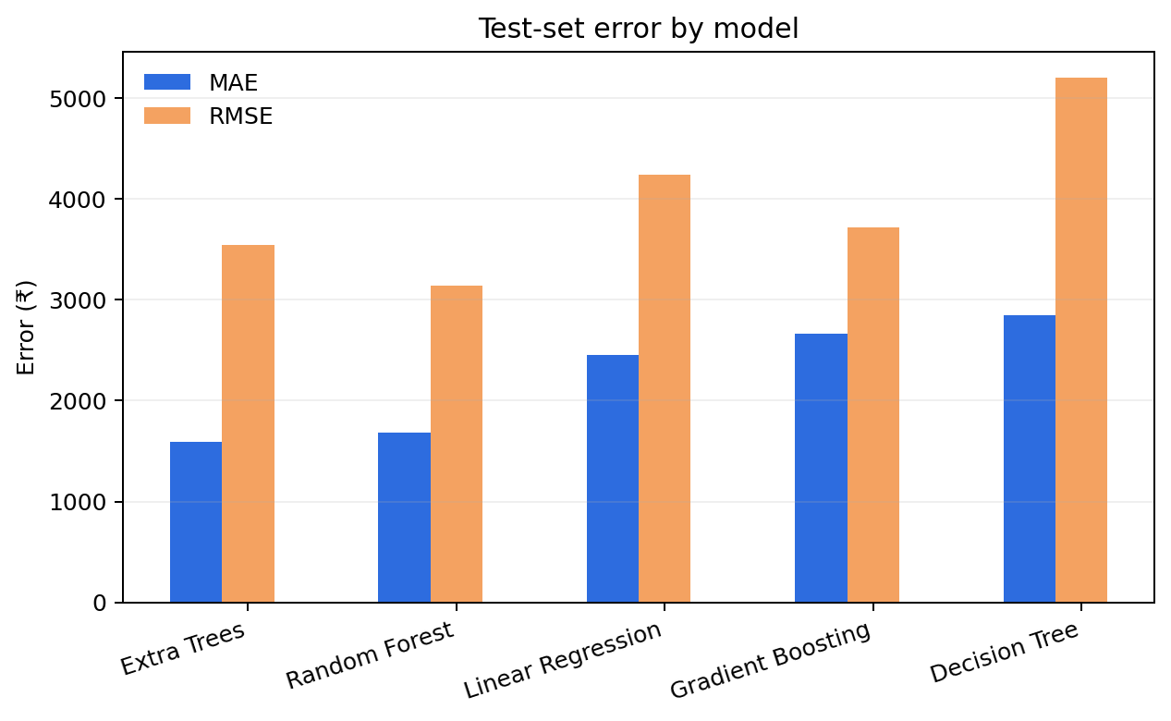
Model comparison: held-out test results
Primary workflow: 80/20 split, random_state=4210
• Extra Trees: MAE ₹1,591; RMSE ₹3,539; R² 0.899
• Random Forest: MAE ₹1,682; RMSE ₹3,140; R² 0.921
• Linear Regression: MAE ₹2,451; RMSE ₹4,243; R² 0.855
• Gradient Boosting: MAE ₹2,661; RMSE ₹3,722; R² 0.889
• Decision Tree: MAE ₹2,843; RMSE ₹5,200; R² 0.783
MOBILE PRICE PREDICTION • 14

Slide 15
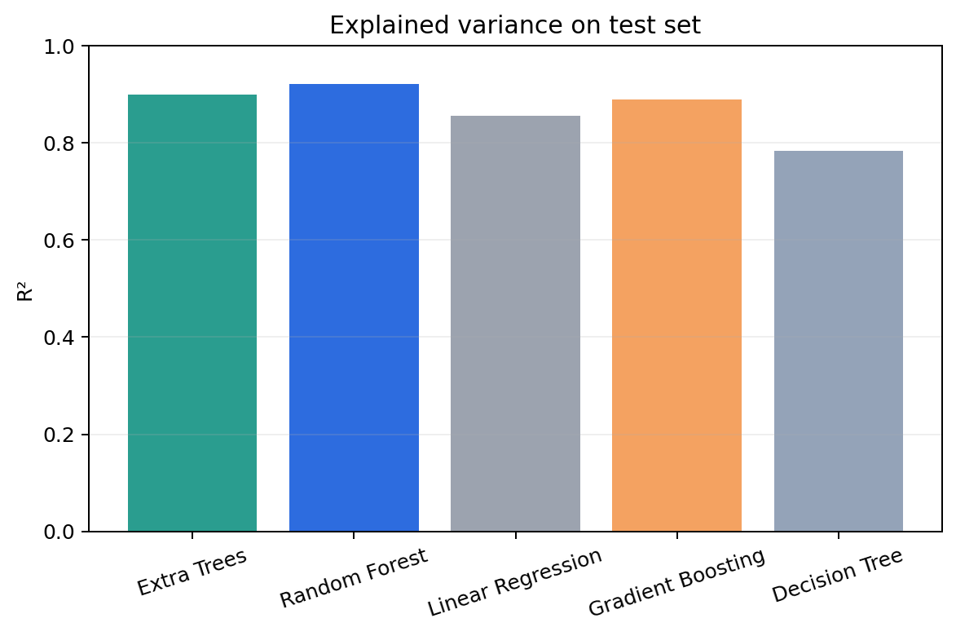
Accuracy lens: R² versus absolute error
No single metric tells the whole story
• Random Forest has the highest R² (0.921) and lowest RMSE (₹3,140).
• Extra Trees has the lowest MAE (₹1,591), so the notebook labels it best by test MAE.
• Use Extra Trees when typical absolute error is the priority; Random Forest may be preferred if RMSE/R² matter more.
• The best model depends on the operational cost of different error types.
MOBILE PRICE PREDICTION • 15

Slide 16
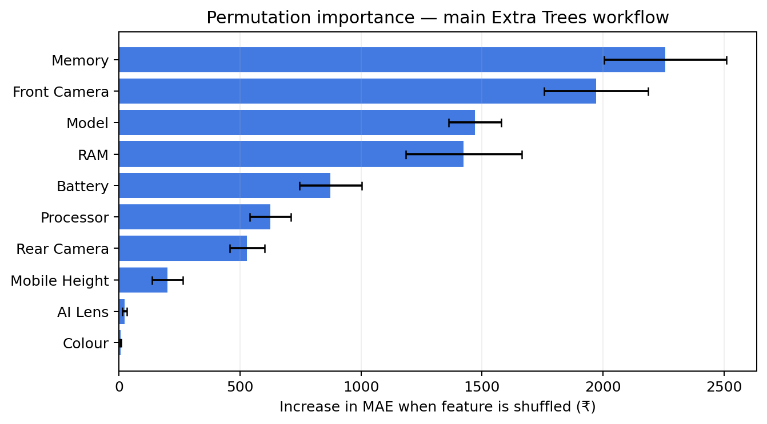
Feature importance: Primary workflow
Permutation importance on the held-out test set; higher means shuffling worsens MAE
• 1. Memory: +₹2,258 MAE
• 2. Front Camera: +₹1,971
• 3. Model: +₹1,471
• 4. RAM: +₹1,425
• 5. Battery: +₹874
• Colour and AI Lens add little in this fitted pipeline.
MOBILE PRICE PREDICTION • 16

Slide 17
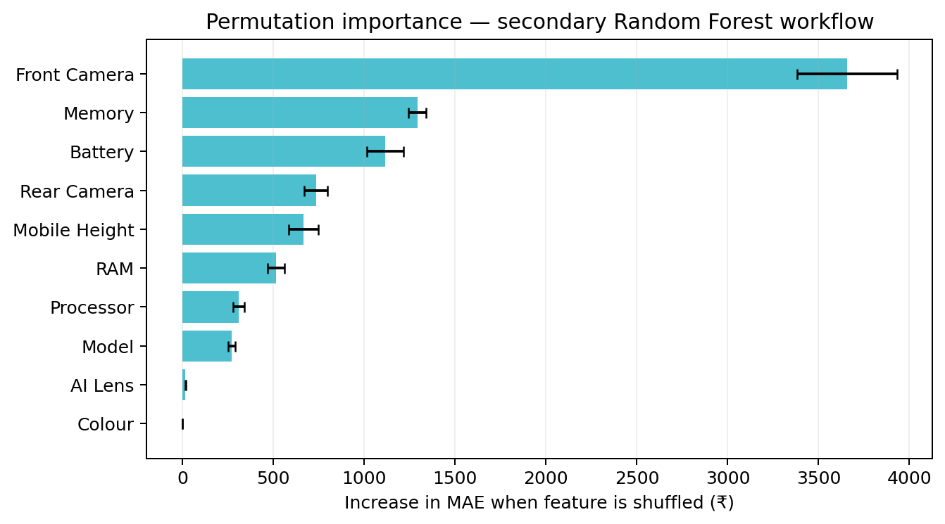
Second run: importance order changes
Notebook's later Random Forest block uses random_state=42 and a different test split
• Front Camera ranks first (+₹3,657 MAE), followed by Memory (+₹1,291) and Battery (+₹1,116).
• Colour is slightly negative (−₹0.55): effectively no useful contribution in this run.
• These values are not directly interchangeable with the Extra Trees run.
• Differences can arise from model type, split, fitted pipeline and permutation settings; report each configuration clearly.
MOBILE PRICE PREDICTION • 17

Slide 18
Conclusions & next steps
A practical interpretation of the notebook findings
• Storage and RAM are strong, intuitive price signals; their price-tier averages rise consistently.
• Model identity and camera specifications matter to prediction quality, but feature importance is model- and split-dependent.
• Primary test performance: Extra Trees MAE ≈ ₹1,591; Random Forest has stronger R²/RMSE in the same comparison.
• Do not interpret permutation importance as a causal price premium or as a percentage contribution.
• Next: use cross-validation, lock one reproducible pipeline, report confidence intervals, inspect residuals by price band, and validate on newer listings.
Prioritize
Storage + RAM
Validate
Cross-validation
Monitor
New listing data
MOBILE PRICE PREDICTION • 18

