Slide 1
IBM University Engagement Project Submission
“Exploring the Power of Agentic AI with IBM Granite and LangFlow”

Slide 2

Project Tile – Agentic AI for Personalized Course Pathways.
Domain of Project – EDUCATION
Github link – https://github.com/Rajatpundir7/IBM-PERSONAL_AGENT
Live link - https://ibmpersonagent-gamma.vercel.app/
Pptx – link - https://github.com/Rajatpundir7/IBM-PERSONAL_AGENT/RajatPundir_Project_ppt.pptx
Student Name | Recent Passport Photo | Email ID | Mobile number [WhatsApp]
RAJAT PUNDIR |  | rajatpundir07@gmail.com | 8923365987

Slide 3
Problem Statement -
Problem Statement : Agentic AI for Personalized Course Pathways (LearnMate AI)
The Challenge
Students and aspiring engineers often struggle with course discovery paralysis, fragmented curricula, and lack of personalized mentoring due to the overwhelming volume of unstructured online content. Information about engineering pathways (DSA, Distributed Systems, AI/ML) is scattered and rigid. Without dynamic, real-time guidance and continuous skill baselining, learners drop out or fail to achieve industry and MNC technical readiness.
The Objective
Build an AI-powered Career & Learning Pathway Orchestrator that delivers dynamic, milestone-driven technical roadmaps adapted to individual pacing and goals. The solution should:
Personalized Course Pathways – Generate phased learning roadmaps tailored to target career roles (e.g., Tier-1 MNC SDE, Distributed Systems Architect, AI Engineer), background, and weekly bandwidth.
Knowledge RAG & Catalog Grounding – Ground all curricula, module dependencies, and measurable exit criteria via verified course indexes.
Continuous Skill Assessment & Diagnostics – Evaluate current proficiency using multi-tier diagnostic checks to prevent generic recommendations.
Adaptive Remediation Engine – Dynamically adjust milestones in real time by injecting prerequisite remediation modules when learners struggle.
Multi-Agent / Multi-Persona Mentorship –
  Intake & Diagnostic Coach (Jeetu Bhaiya Persona): Evaluates baseline skills, weekly velocity, and goal setting.
  Conceptual Systems Architect (Rancho Persona): Guides first-principles thinking, low-level design, and system architecture.
  MNC Interview Readiness Evaluator (Gaitonde Persona): Assesses mock interview performance and production capstones.
  Dynamic Remediation Specialist (Babu Rao Persona): Injects emergency doubt-clearing sessions and prerequisite repair nodes.
Interactive Visual Dashboard – Provide an adaptive timeline with live node injection, progress metrics, and direct conversational guidance

Slide 4
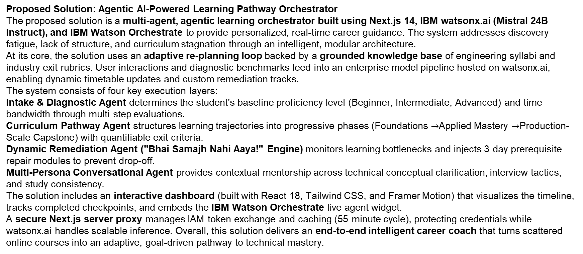
Proposed Solution -
Proposed Solution: Agentic AI-Powered Learning Pathway Orchestrator
The proposed solution is a multi-agent, agentic learning orchestrator built using Next.js 14, IBM watsonx.ai (Mistral 24B Instruct), and IBM Watson Orchestrate to provide personalized, real-time career guidance. The system addresses discovery fatigue, lack of structure, and curriculum stagnation through an intelligent, modular architecture.
At its core, the solution uses an adaptive re-planning loop backed by a grounded knowledge base of engineering syllabi and industry exit rubrics. User interactions and diagnostic benchmarks feed into an enterprise model pipeline hosted on watsonx.ai, enabling dynamic timetable updates and custom remediation tracks.
The system consists of four key execution layers:
Intake & Diagnostic Agent determines the student's baseline proficiency level (Beginner, Intermediate, Advanced) and time bandwidth through multi-step evaluations.
Curriculum Pathway Agent structures learning trajectories into progressive phases (Foundations $→$Applied Mastery $→$Production-Scale Capstone) with quantifiable exit criteria.
Dynamic Remediation Agent ("Bhai Samajh Nahi Aaya!" Engine) monitors learning bottlenecks and injects 3-day prerequisite repair modules to prevent drop-off.
Multi-Persona Conversational Agent provides contextual mentorship across technical conceptual clarification, interview tactics, and study consistency.
The solution includes an interactive dashboard (built with React 18, Tailwind CSS, and Framer Motion) that visualizes the timeline, tracks completed checkpoints, and embeds the IBM Watson Orchestrate live agent widget.
A secure Next.js server proxy manages IAM token exchange and caching (55-minute cycle), protecting credentials while watsonx.ai handles scalable inference. Overall, this solution delivers an end-to-end intelligent career coach that turns scattered online courses into an adaptive, goal-driven pathway to technical mastery.

Slide 5
Technology Used
Technology Used
Langflow / watsonx Orchestrate platform – For visually designing, configuring, and orchestrating multi-agent workflows, state machines, and autonomous ReAct loops.
IBM Granite / watsonx.ai Foundation Model – For e.g. – ibm/granite-3-2-8b-instruct / mistralai/mistral-small-3-1-24b-instruct-2503 – For natural language understanding, dynamic diagnostic evaluation, intent extraction, and personalized pathway generation.
IBM Cloud (Lite Services) – Provides the core cloud infrastructure to deploy, host, and scale the LearnMate Agent securely. IBM Cloud enables a reliable, secure, and scalable environment with IAM token-based authentication.
RAG (Retrieval-Augmented Generation) – RAG to fetch real accredited course data and syllabi first, then generate intelligent roadmaps, eliminating hallucinations and grounding measurable exit milestones.
IBM Watsonx.ai – For model deployment, enterprise token caching, prompt engineering, embedding generation, and AI governance.
Vector Store / Knowledge Base (Milvus / OpenSearch / Local Ingestion) – For semantic retrieval of modular course roadmaps, prerequisite dependency graphs, and technical interview rubrics.
Next.js 14 & Tailwind CSS – Full-stack framework with server-side proxy routes for secure API key protection and high-performance, responsive UI delivery.

Slide 6
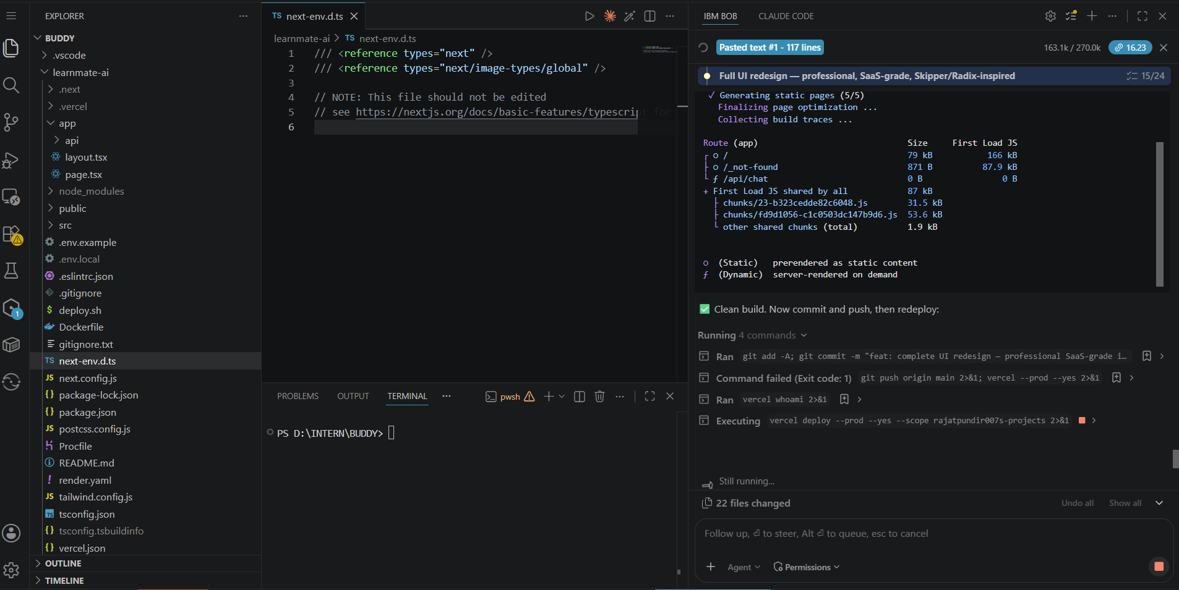

Slide 7
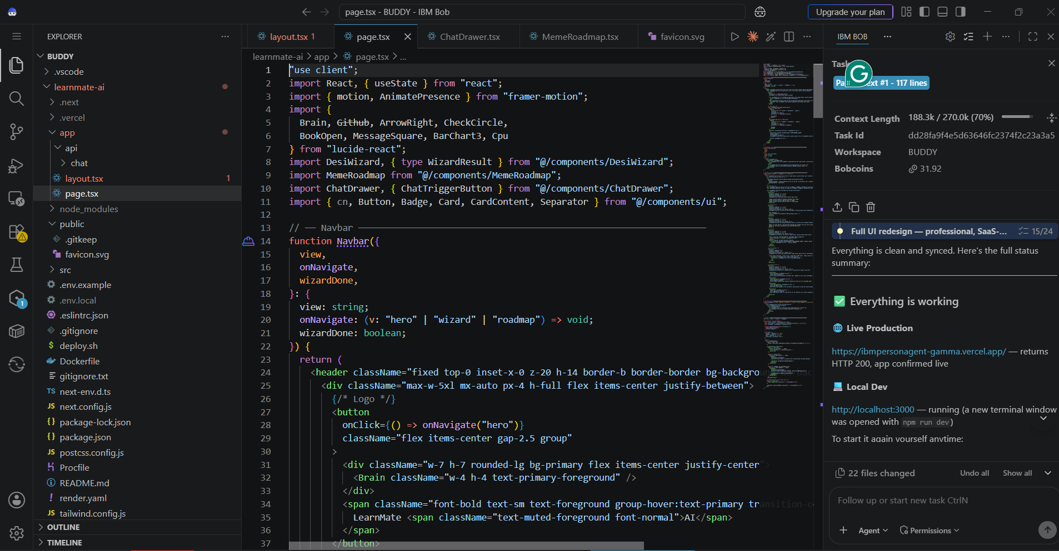

Slide 8
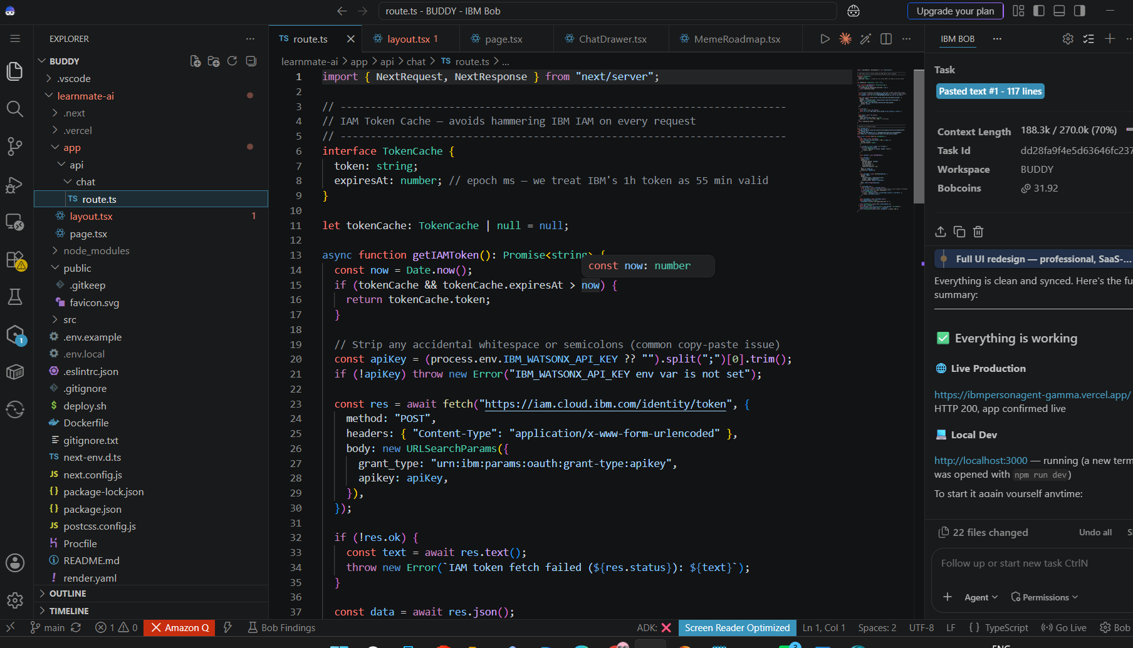

Slide 9
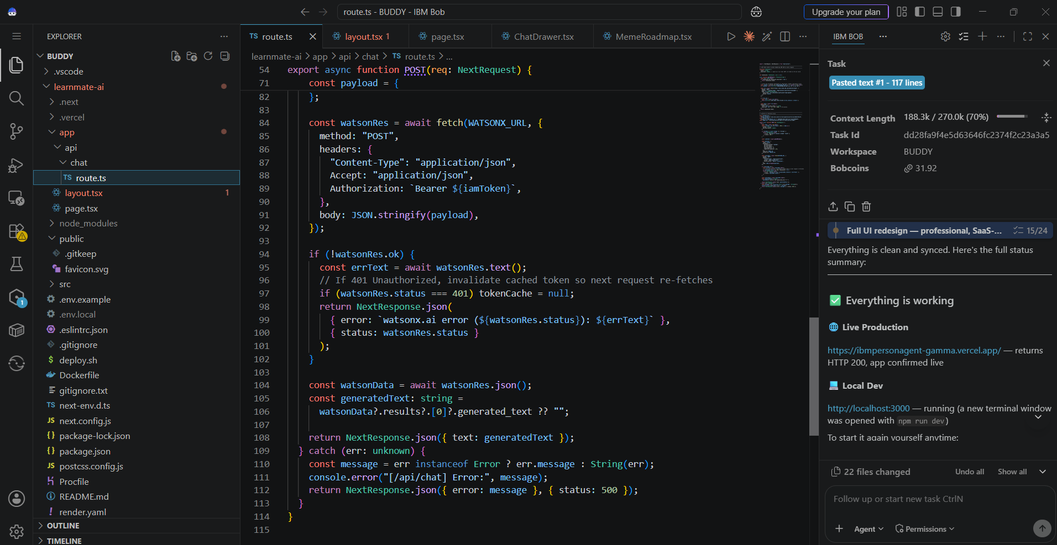

Slide 10
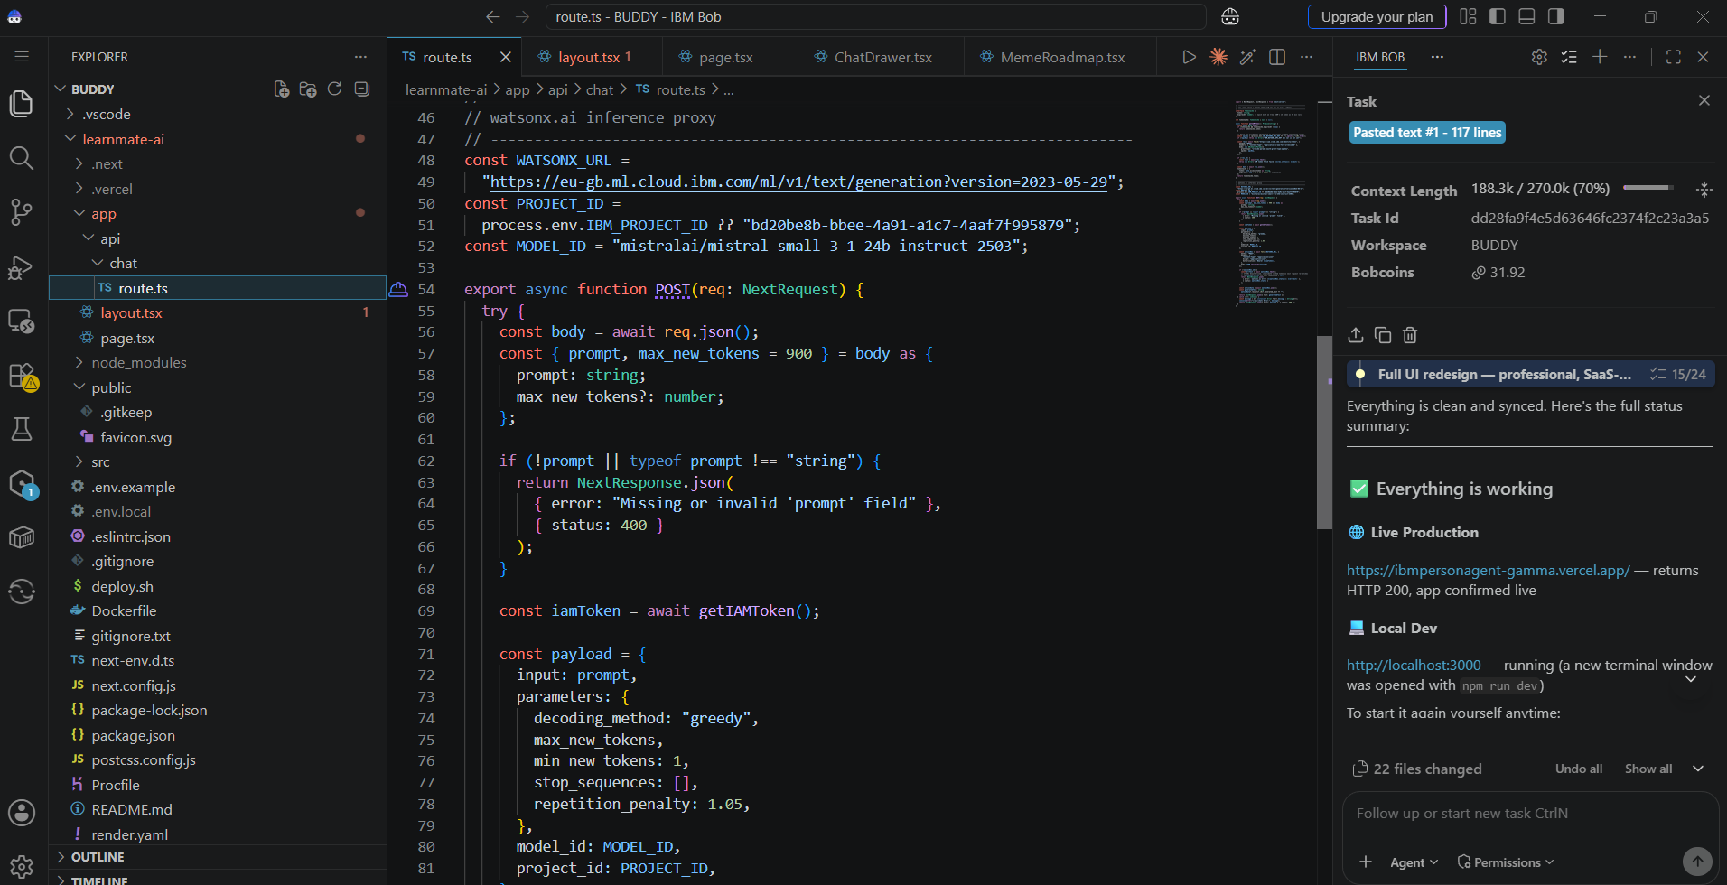

Slide 11
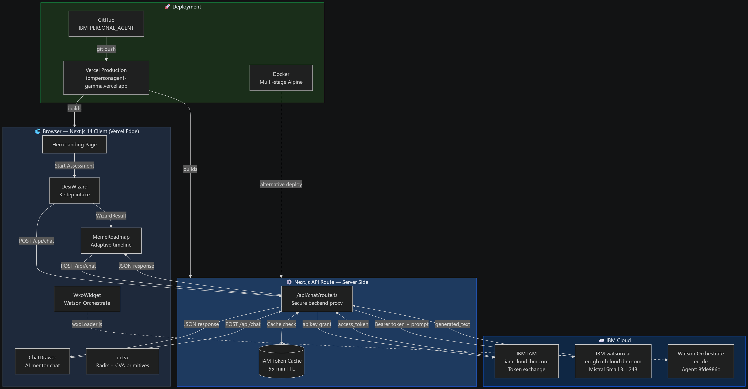

Slide 12
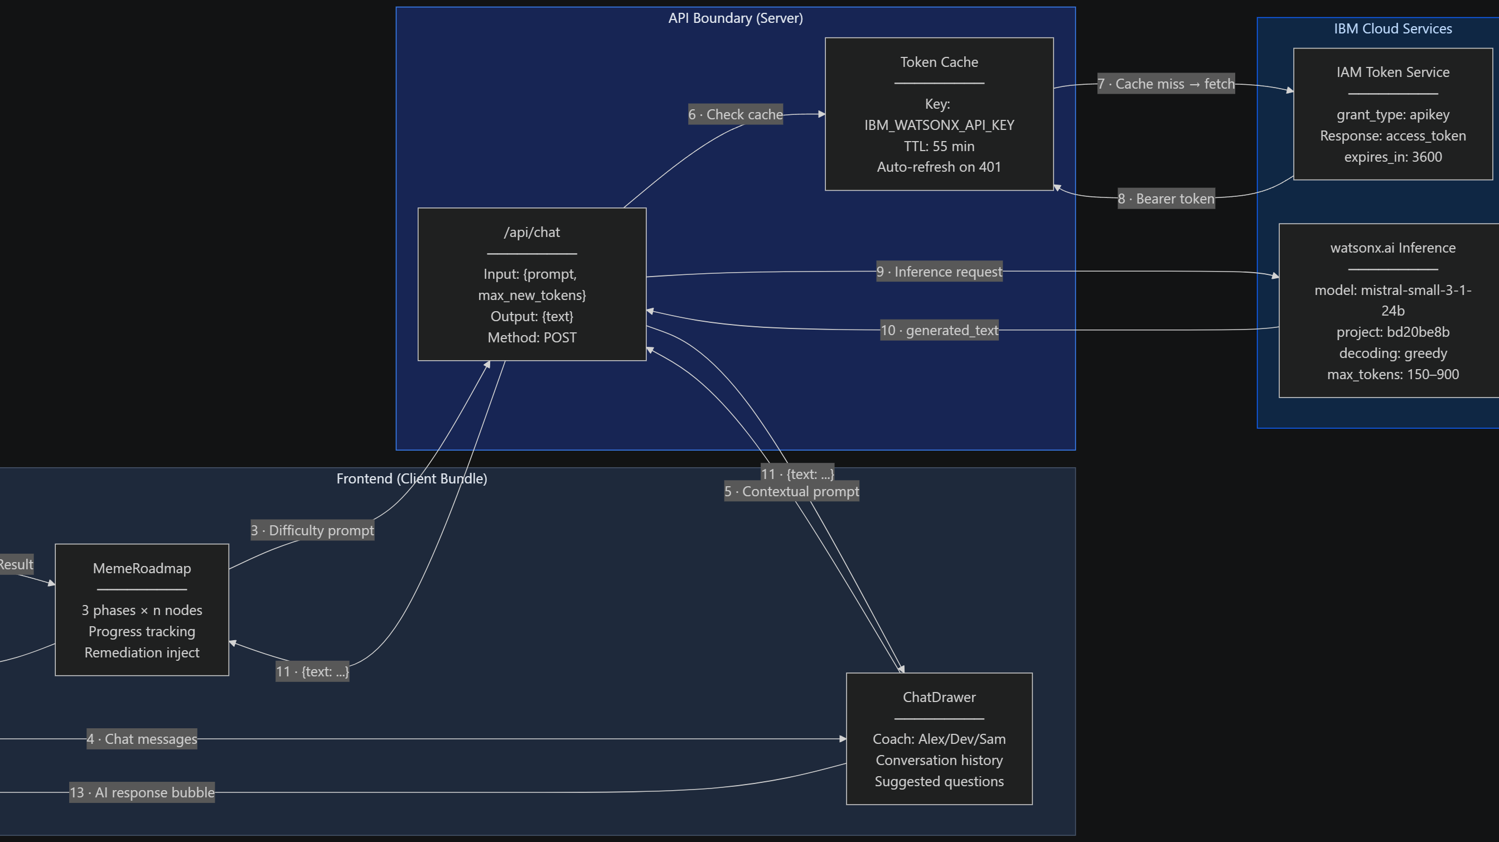

Slide 13
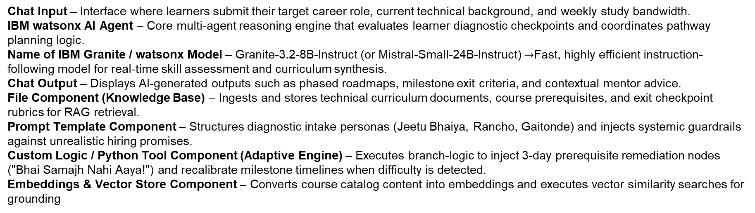
Langflow component Used -
Chat Input – Interface where learners submit their target career role, current technical background, and weekly study bandwidth.
IBM watsonx AI Agent – Core multi-agent reasoning engine that evaluates learner diagnostic checkpoints and coordinates pathway planning logic.
Name of IBM Granite / watsonx Model – Granite-3.2-8B-Instruct (or Mistral-Small-24B-Instruct) $→$Fast, highly efficient instruction-following model for real-time skill assessment and curriculum synthesis.
Chat Output – Displays AI-generated outputs such as phased roadmaps, milestone exit criteria, and contextual mentor advice.
File Component (Knowledge Base) – Ingests and stores technical curriculum documents, course prerequisites, and exit checkpoint rubrics for RAG retrieval.
Prompt Template Component – Structures diagnostic intake personas (Jeetu Bhaiya, Rancho, Gaitonde) and injects systemic guardrails against unrealistic hiring promises.
Custom Logic / Python Tool Component (Adaptive Engine) – Executes branch-logic to inject 3-day prerequisite remediation nodes ("Bhai Samajh Nahi Aaya!") and recalibrate milestone timelines when difficulty is detected.
Embeddings & Vector Store Component – Converts course catalog content into embeddings and executes vector similarity searches for grounding

Slide 14

Role of Agentic AI in the solution
Role of Agentic AI in LearnMate
Agentic AI enables LearnMate to function as an intelligent, autonomous coaching system rather than a static course catalog or simple FAQ bot. Using IBM watsonx.ai and IBM Granite / Mistral models, it coordinates multiple specialized sub-agents to deliver personalized, goal-driven career roadmaps.
Each agent performs a specialized role—such as evaluating technical baseline proficiencies, retrieving grounded syllabi from vector storage, generating progressive milestone tracks, and executing dynamic timeline re-planning—while working collaboratively. This multi-agent approach replaces rigid one-size-fits-all roadmaps with flexible, modular task orchestration.
Agentic AI also brings deep context awareness, continuously accounting for user constraints such as target engineering roles (MNC SDE, Distributed Systems, AI/ML), current skill levels (L1–L3), and weekly time availability to produce realistic schedules. It supports real-time adaptation, actively monitoring assessment performance and user feedback to dynamically inject 3-day prerequisite remediation tracks ("Bhai Samajh Nahi Aaya!" loop) when stagnation or concept failure occurs.
Additionally, the agents communicate with each other across shared memory, enabling unified decision-making, prerequisite dependency validation, and interview-aligned capstone checks.
Overall, Agentic AI transforms the platform from a passive content directory into a proactive, outcome-oriented smart digital career coach that drives students toward verifiable technical mastery and MNC interview readiness

Slide 15
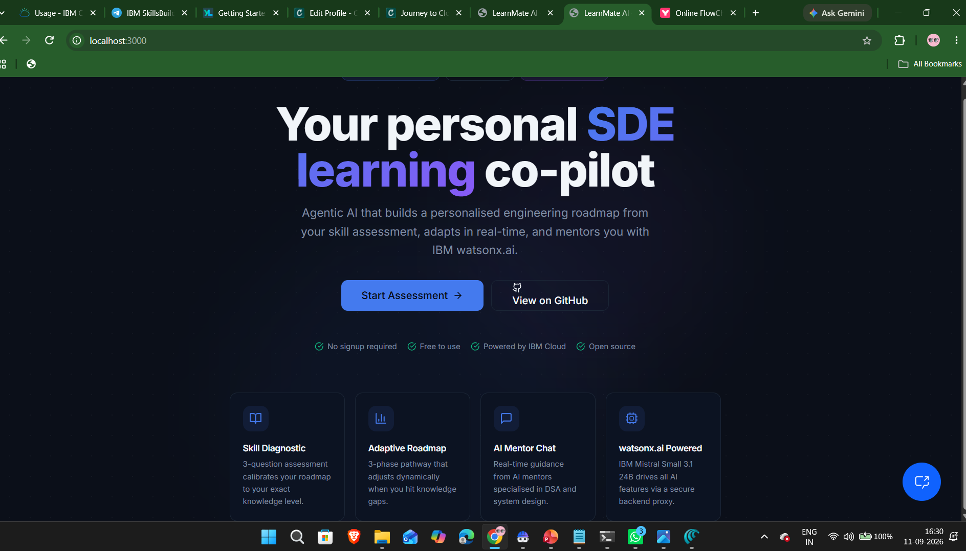

Slide 16
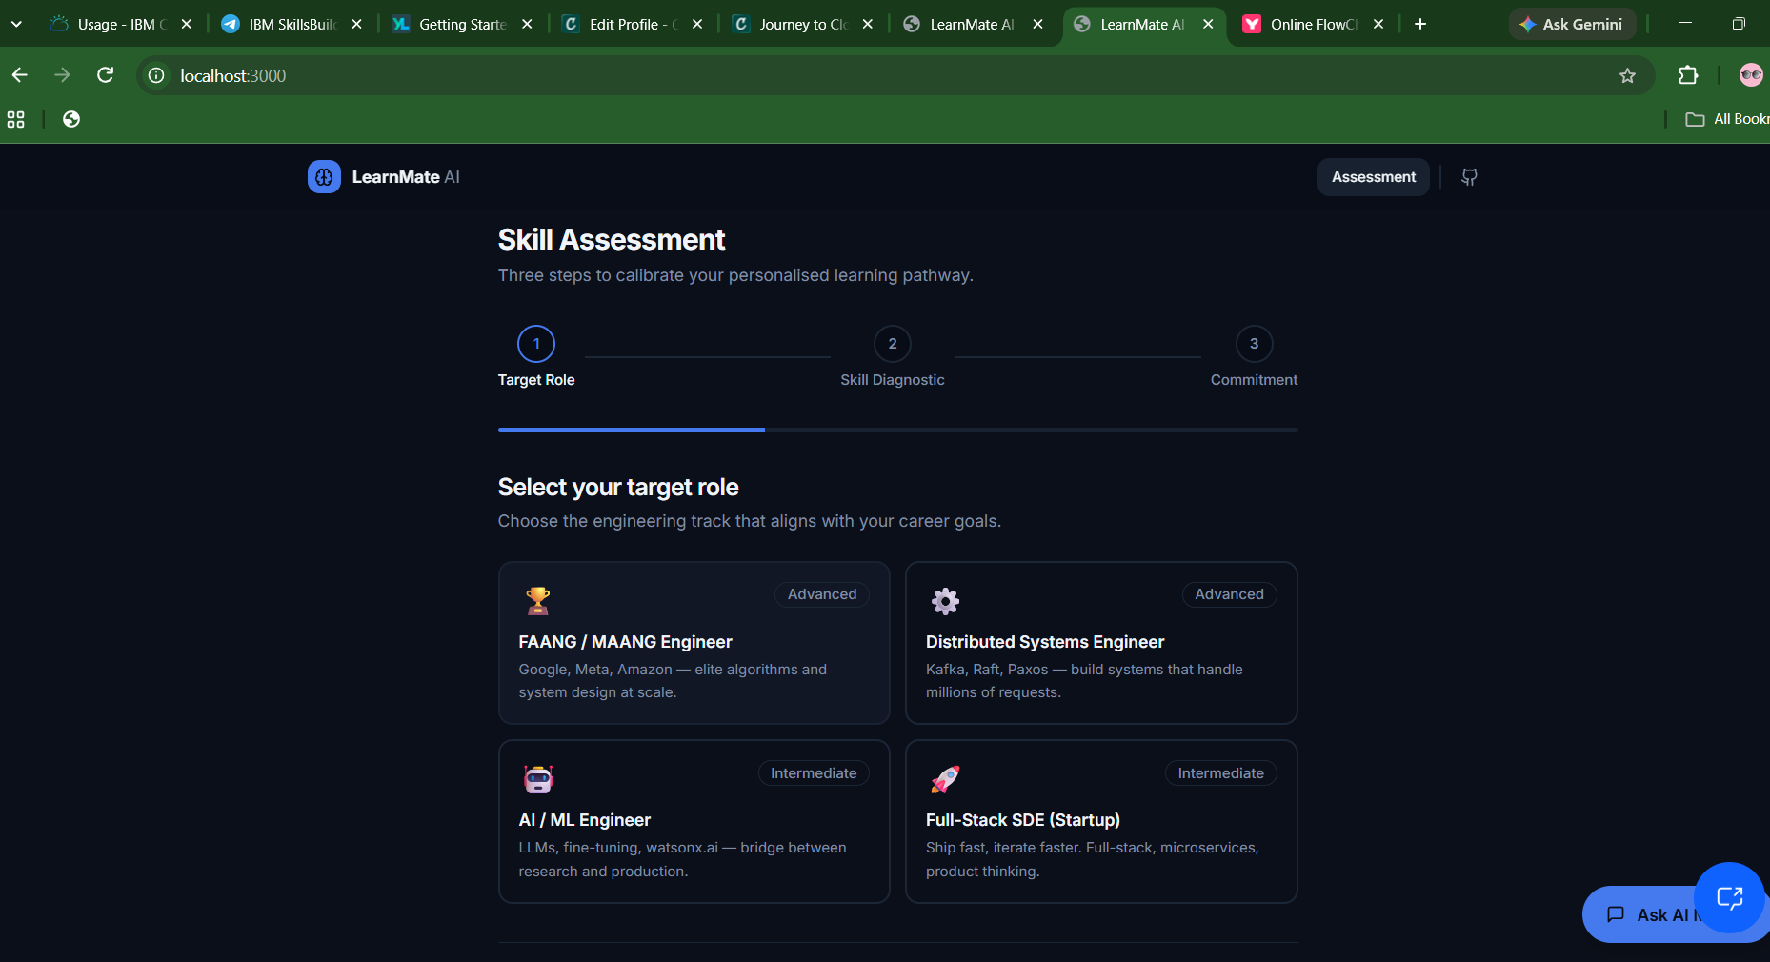

Slide 17
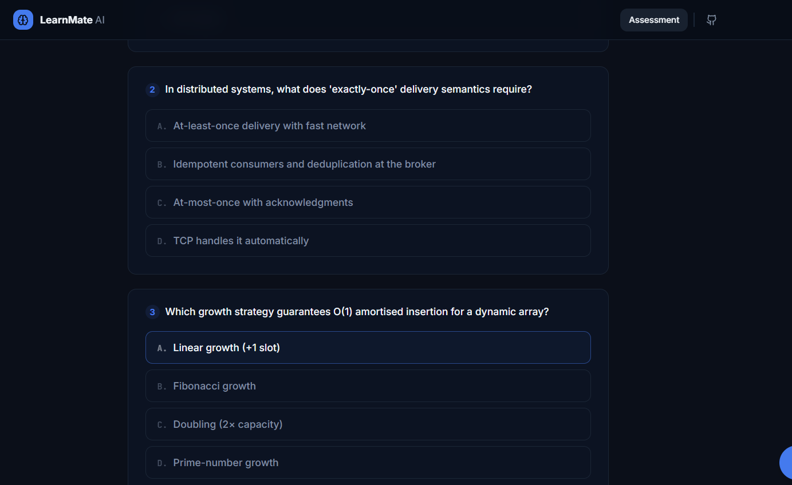

Slide 18
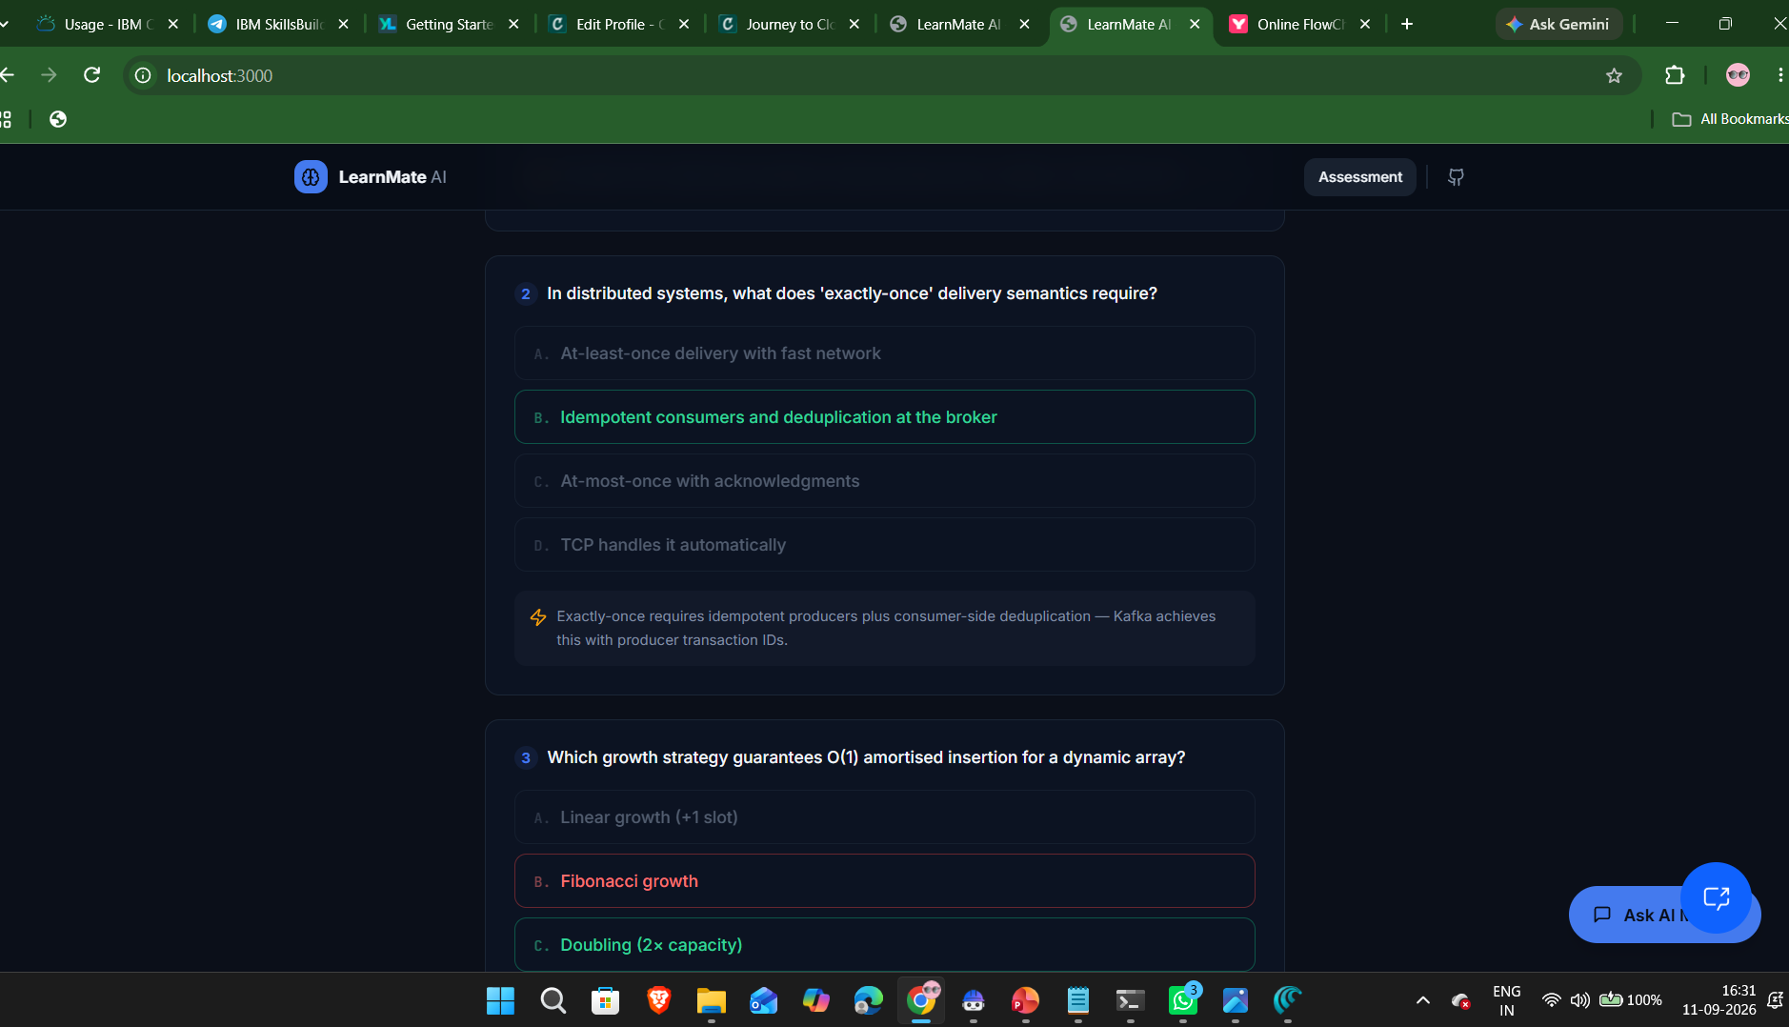

Slide 19
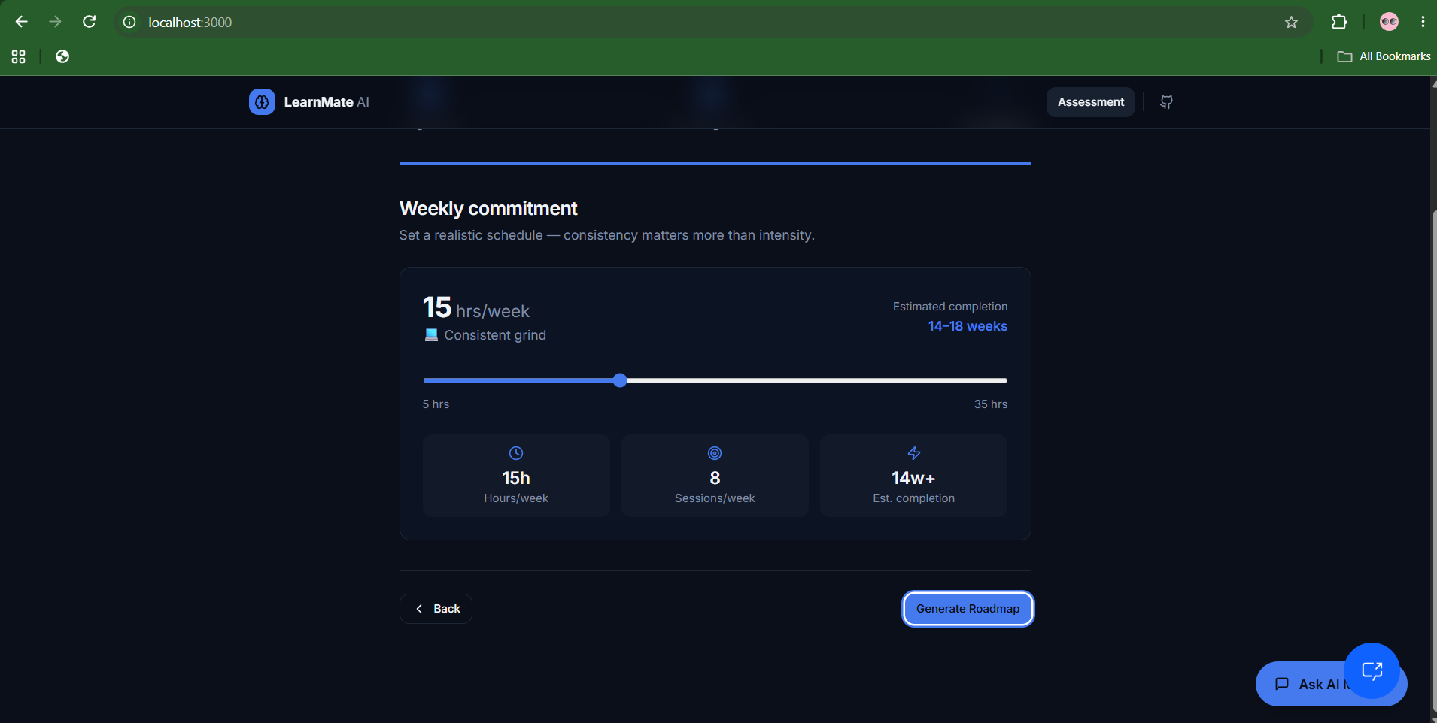

Slide 20
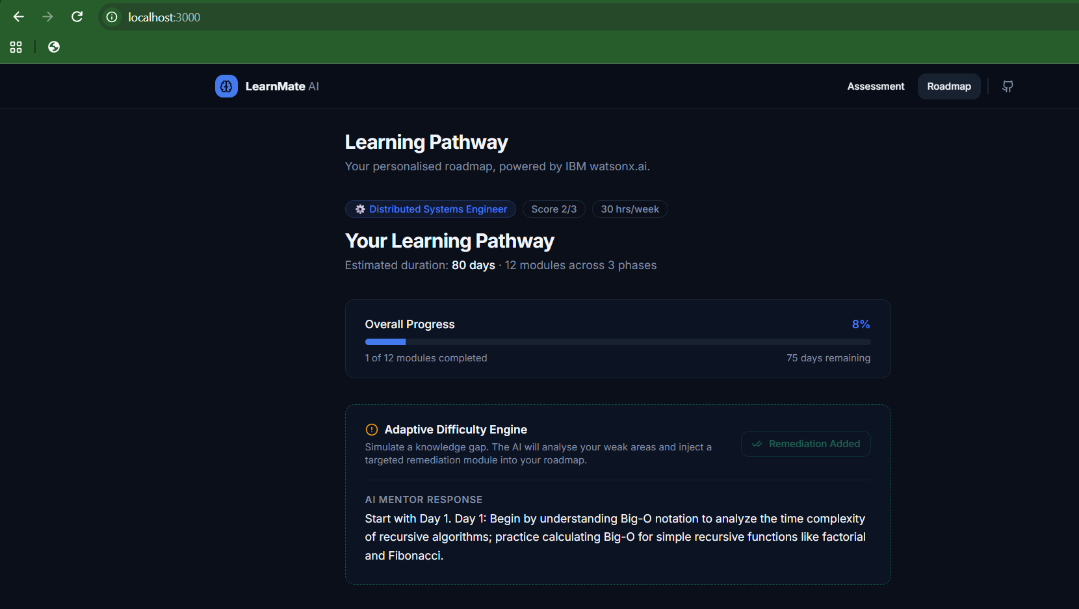

Slide 21
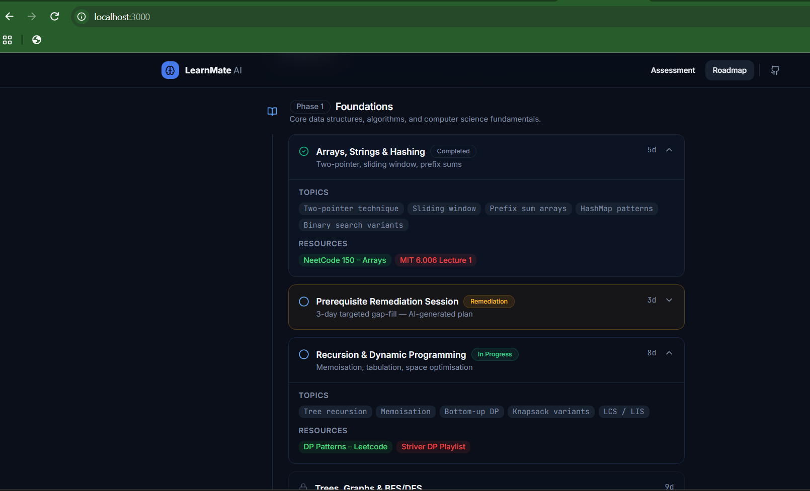

Slide 22
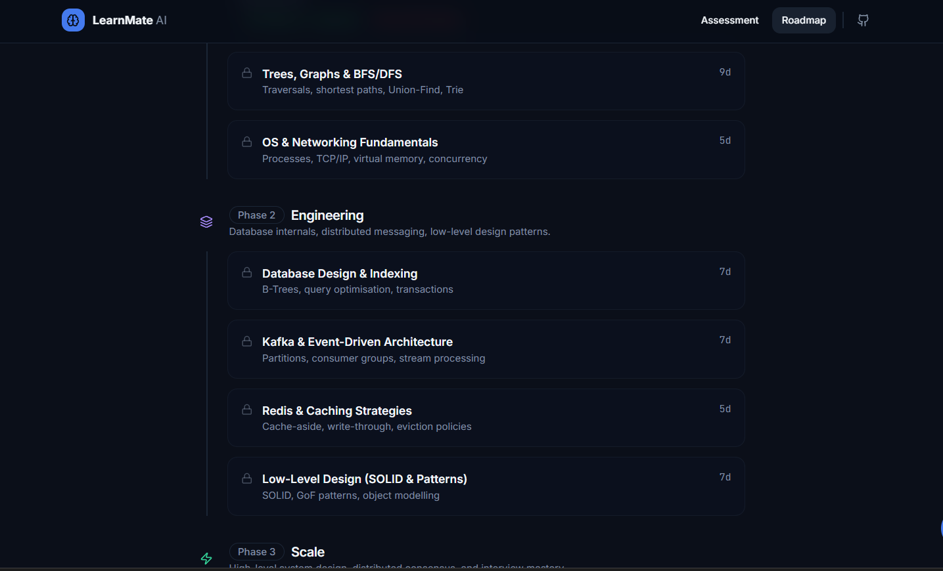

Slide 23
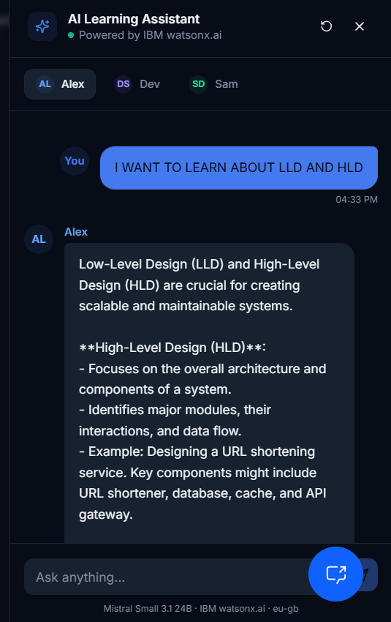

Slide 24
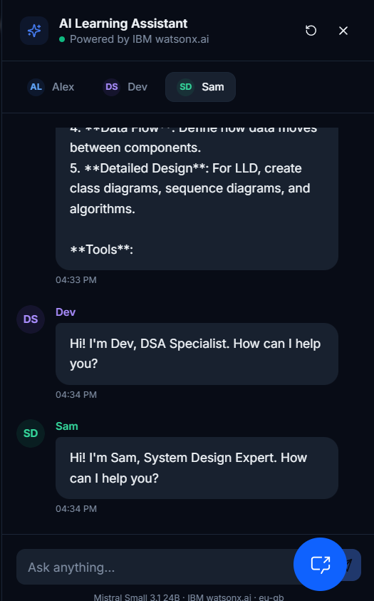

Slide 25
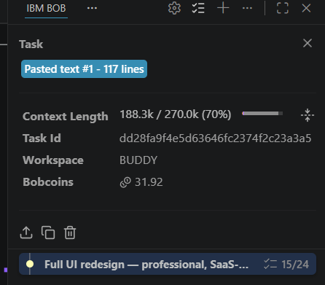
Token Usage
11,761 token are used
Before Prompt
After the Prompt
·
·
·

Slide 26
Novelty and Uniqueness
Multi-Agent Intelligence – Instead of a static chatbot, specialized sub-agents collaborate to baseline skills, structure phased learning tracks, and evaluate exit milestones.
RAG-Based Grounding – Integrates vector-grounded course catalogs with model generation, eliminating generic or fabricated tutorials and ensuring verified technical prerequisites.
Hyper-Personalization – Tailors curricula based on target career tracks (MNC SDE, Distributed Systems, AI/ML, UI/UX), current competency level, and weekly study velocity.
Real-Time Adaptation Loop – Continuously evaluates progression and dynamically injects 3-day prerequisite remediation tracks ("Bhai Samajh Nahi Aaya!" engine) when stagnation is detected.
Measurable Exit Criteria – Replaces passive completion with quantifiable engineering benchmarks (e.g., timed MNC mock simulations, modular system design implementations).
Multi-Persona Mentorship Voice – Uses culturally resonant, relatable coaching personas (Jeetu Bhaiya, Rancho, Gaitonde, Babu Rao) to maximize student engagement and retention.
Scalable & Enterprise-Ready – Built on IBM watsonx.ai with secure server-side IAM token caching, ensuring reliable performance and AI governance.

Slide 27
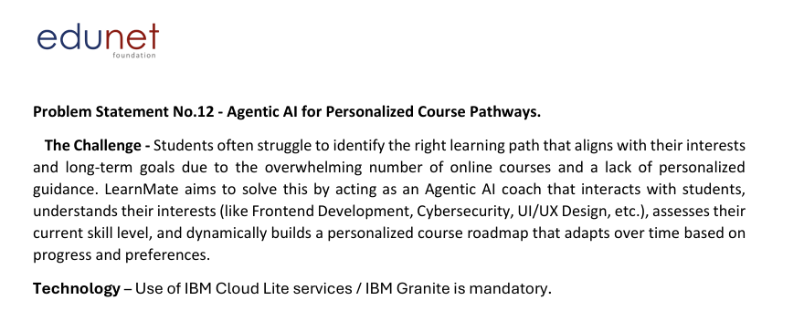
Git Hub Link
Github link – https://github.com/Rajatpundir7/IBM-PERSONAL_AGENT
Live link - https://ibmpersonagent-gamma.vercel.app/
Pptx – link - https://github.com/Rajatpundir7/IBM-PERSONAL_AGENT/RajatPundir_Project_ppt.pptx
·
·

Slide 28
Future Scope
Future Scope & Enhancements
1. Integration with Developer Platforms & Coding Ecosystems –
The system can be integrated with GitHub, LeetCode, HackerRank, and Codeforces to automatically track solved problems, commit history, code quality, and algorithm execution runtime. This will enable LearnMate to bypass manual self-reporting and dynamically adapt course roadmaps based on verified coding submissions and real-time development velocity.
2. AI-Powered Voice Mentor & Multilingual Professtional Coaching –
Enhancing the system with a voice-enabled coaching interface and native multilingual support (Hindi, Hinglish, Tamil, Telugu, and regional languages) will expand accessibility for tier-2/3 college students. Learners can conduct hands-free mock technical interviews and ask conceptual doubt-clearing questions in their natural tongue, making technical mentorship more inclusive and interactive.
·
·
·

Slide 29
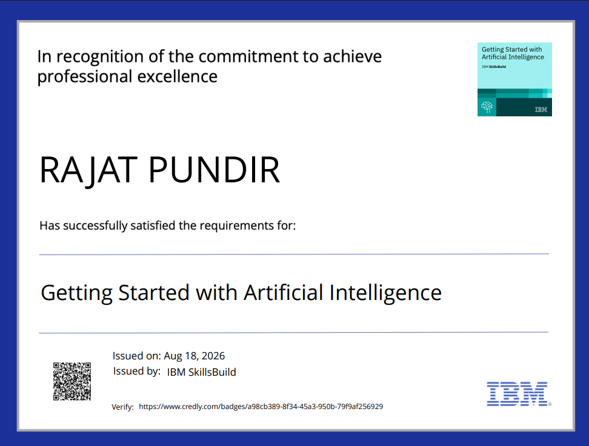
Certificates Earned:
Please add your credly certificate

Slide 30
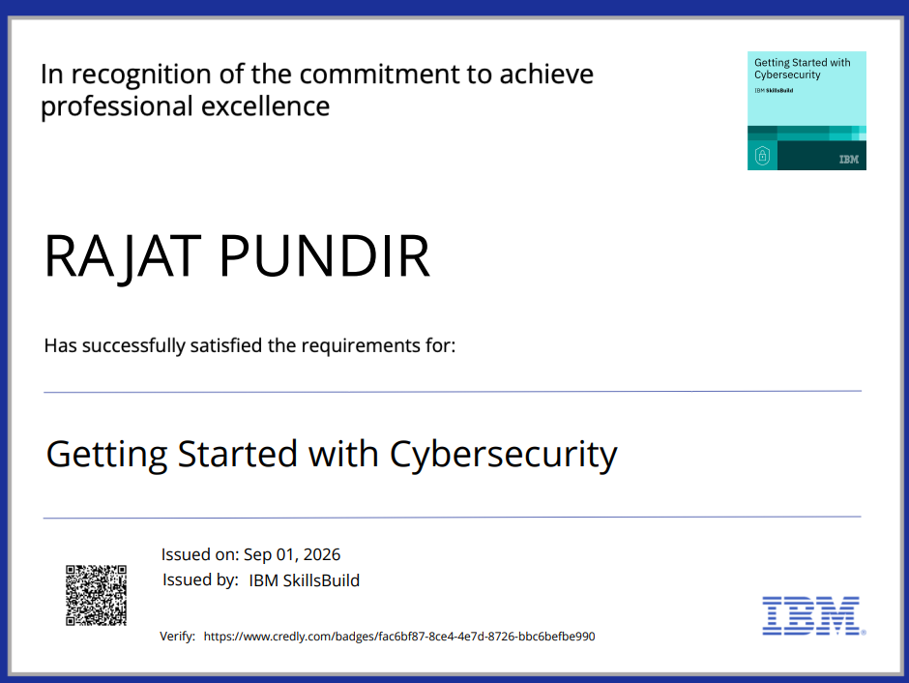

Slide 31
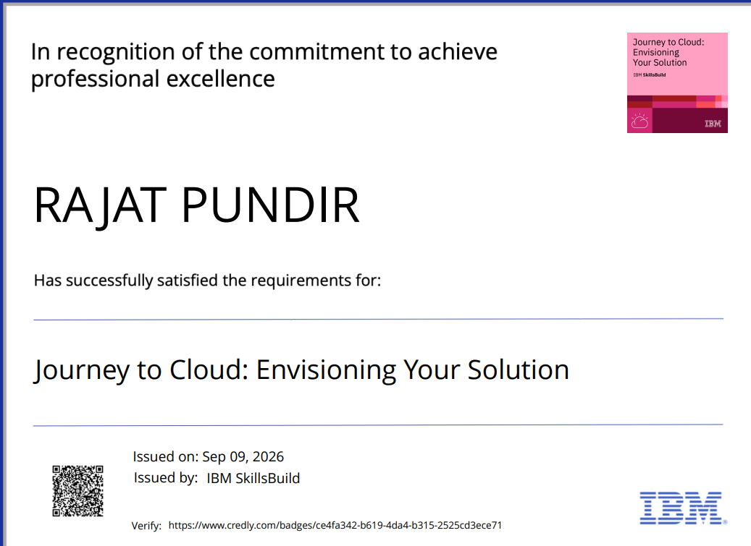

Slide 32
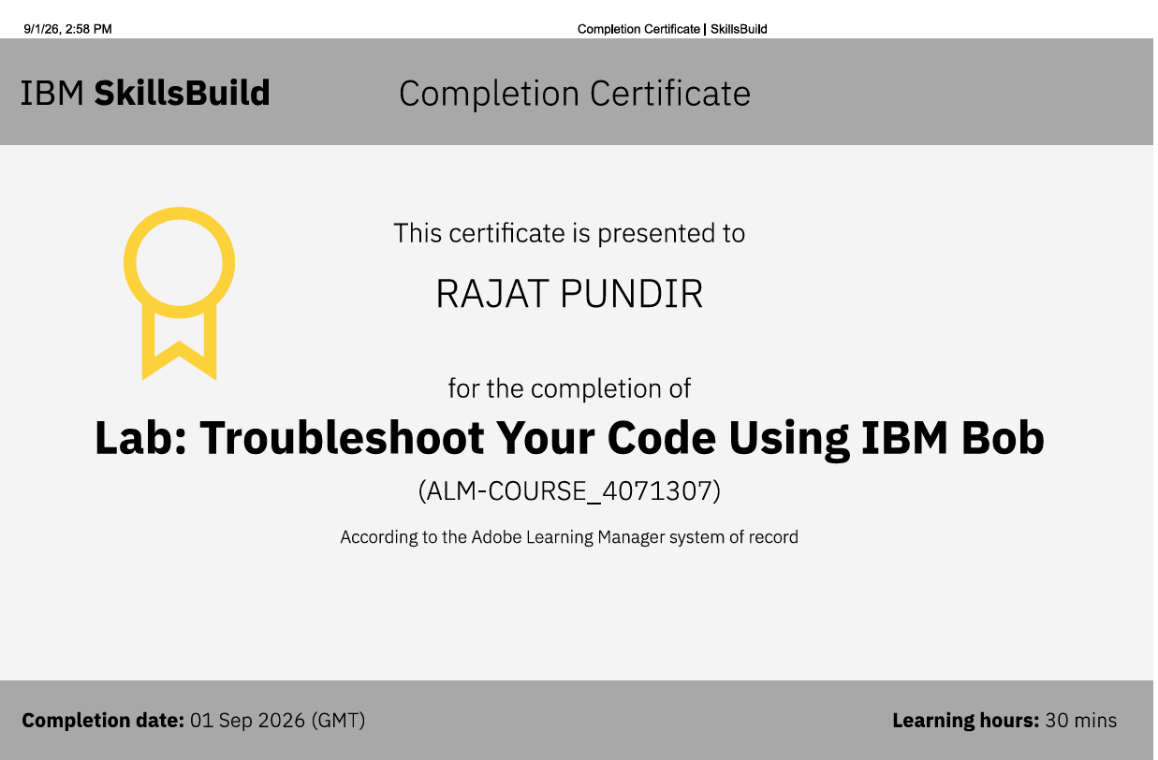
Certificates Earned:​
Add your IBM BOB Certificate

Slide 33
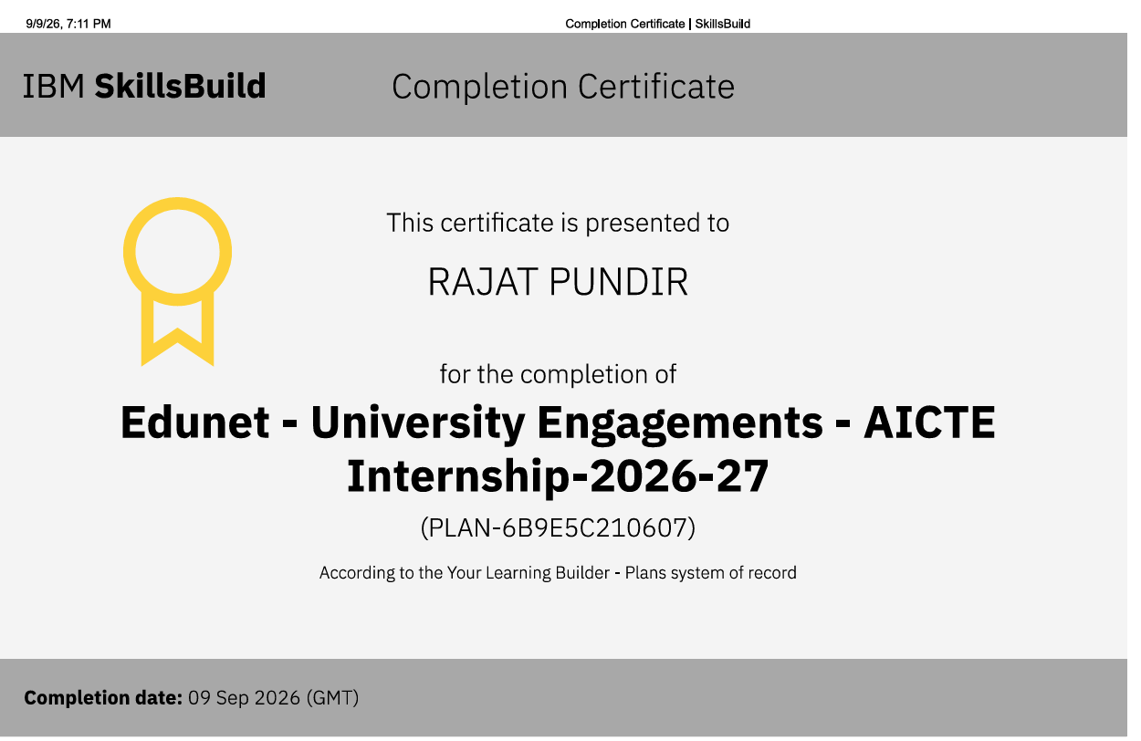

Slide 34


