Slide 1

DEEP DOMAIN ADAPTATION IN COMPUTER VISION
rAJAT SHARMA
Supervisors:
Prof. Dr. Michael Granitzer
PROF. DR. HARALD KOSCH
ADVISOR: MR. SAHIB JULKA

Slide 2

Agenda
Introduction
Motivation
Related Work
Methods
Research goals
Datasets
Experiments
Results
Discussion and Conclusion

Slide 3
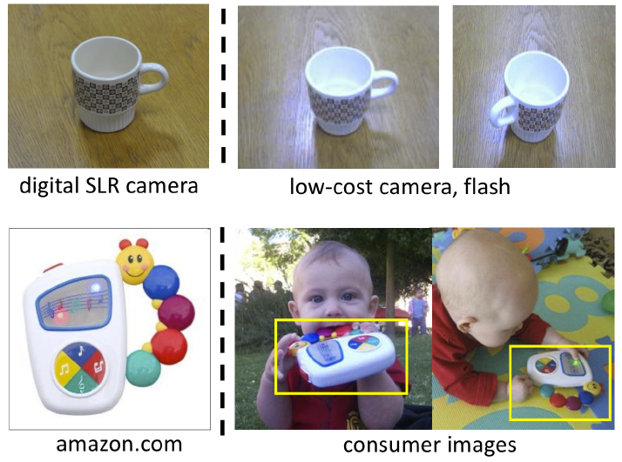
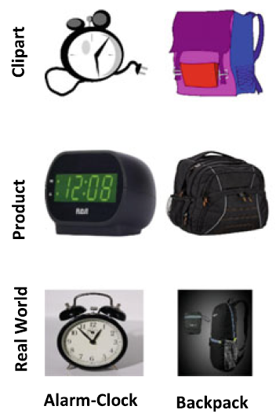
1. Introduction
Human intelligence
Transfer learning
Variations
Same domain, different task
Different domain, same task
Domain Adaptation (DA)
Example¹
Office-Home dataset²
1 source: https://people.eecs.berkeley.edu/~jhoffman/domainadapt/
2 source: Venkateswara H, Eusebio J, Chakraborty S, Panchanathan S (2017) Deep hashing network for unsupervised domain adaptation. In: The IEEE conference on CVPR
Notes:
Traditional Machine Learning
Availability of large-scale labeled training data
Humans can transfer knowledge learnt previously to novel situations.
Can the machine learn the most general characteristics like humans ?
Domain Adaptation (DA): Network trained on a source domain (for a specific task) is adapted to the target domain.
Transfer learned representations from a related task or domain to another domain.
Transfer Learning is the ability to apply knowledge learned in previous tasks to novel tasks.

Slide 4
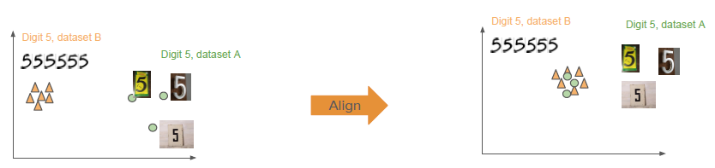

2. Motivation
Expensive Data Acquisition and Annotation Problems
Expensive and time-consuming
Impossible to collect annotated data in some domains
Presence of Domain Shift or Dataset Bias
Training and test sets come from similar but different distributions
Feature spaces or marginal probability distribution or both
End goal is to learn the features that are:
Discriminative for the main learning task on the source domain
Indiscriminate in terms of bias
Notes:
What if annotated task specific target data is less ?
The size of this shift is measured by the distance between source and target subspaces.
Difference either in the feature space or in the marginal probability distribution or even in both
What should we do in presence of Domain Shift ?
Mapping the source distribution to the target distribution
Mapping both domains into common shared domain where the distributions are aligned. (Ours)

Slide 5
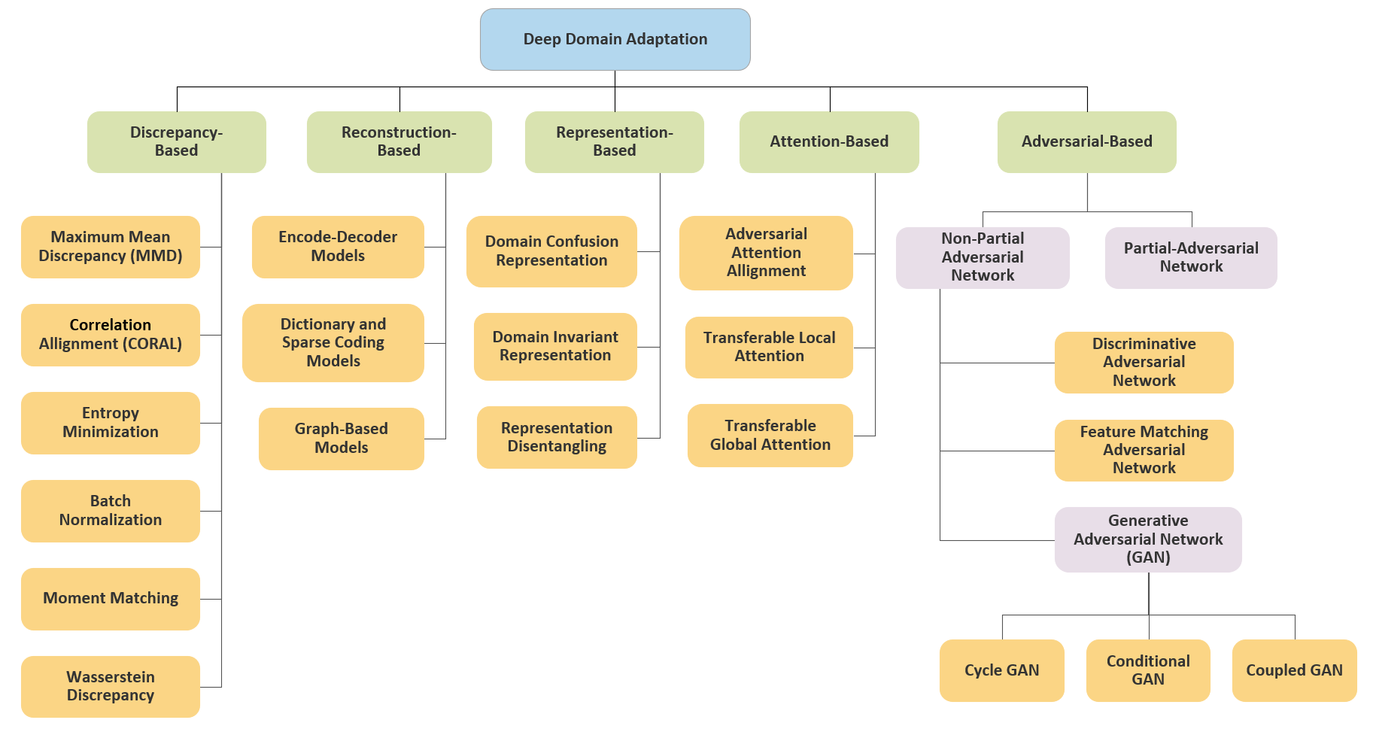
3. Related Work - Unsupervised Domain Adaptation (UDA) Approaches
Five main groups based on the technique adopted.
Focused on discrepancy-based techniques.
Unsupervised Domain Adaptation (no labeled samples in target domain)
Settings and assumptions
Single source
Closed-set (same label space)
Single-step (no intermediate domains)
Homogeneous (same feature space)
No unseen domains
Image Reconstructed from: Yeganeh Madadi et al. “Deep Visual Unsupervised Domain Adaptation for Classification Tasks: A Survey". In: Iet Image Processing (2020)
Notes:
Categorized into five main groups based on the technique adopted.

Slide 6





4. Methods
These are the general steps performed in the implemented techniques:
Feature Extraction
Xception CNN (pretrained on ImageNet dataset)
Distribution alignment using CORAL loss
.
Image Classification task
.
Categorical cross-entropy loss
Optimization function
..
Hyperparameter $λ$ : Different values such as 0.5, 0.75 and 1
Notes:
CORAL loss: A distance between the second-order statistics (covariances) of the source and target distributions.
It is simply a categorical cross-entropy loss due to the presence of multiple classes in the target domain.
, where t denotes the number of CORAL loss layers
Hyperparameter $λ$ (a weighting factor of the CORAL loss) : Different values were chosen like 0.5, 0.75 and 1

Slide 7
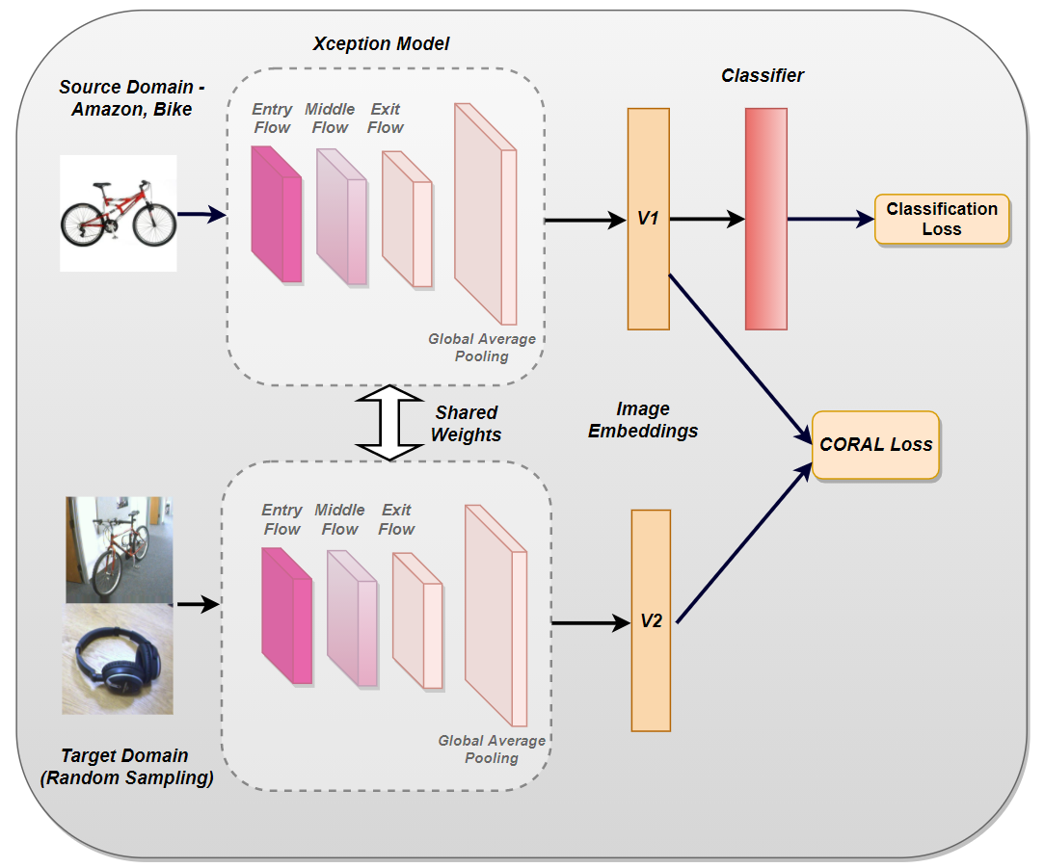
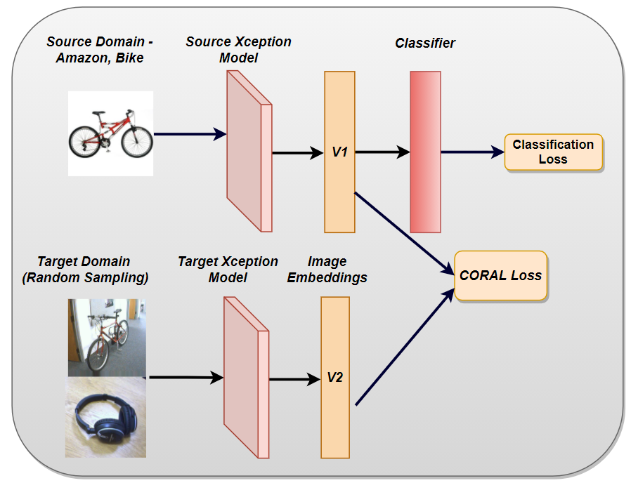
4.1. Methods (cont.) – Implemented techniques
Modified Baseline Network (MBM)
Siamese Network
20.87 million parameters
Custom Domain Adaptive Network (CDAN)
Separate networks
41.67 million parameters

Slide 8
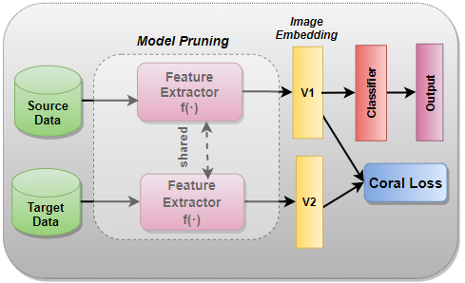
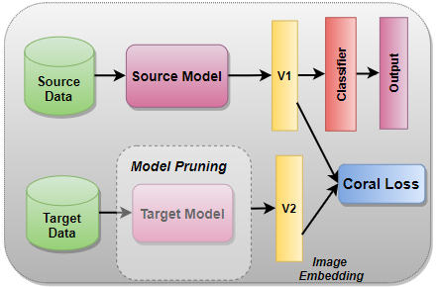
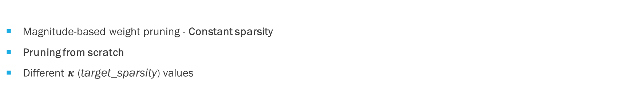
4.2. Methods (cont.) - Pruning target feature extractors
Pruning architecture diagram of MBM technique.
Pruning architecture diagram of CDAN technique.
Magnitude-based weight pruning - Constant sparsity
Pruning from scratch
Different $κ \text{(}\text{target}\text{_}\text{sparsity}\text{)} \text{values}$

Slide 9
5. Research Questions
Below are the research objectives defined in this thesis:
Backbone model selection based on “no domain adaptation accuracy”.
Performance comparisons – MBM vs CDAN vs Original Baseline.
Impact of data augmentation on MBM and CDAB (Ablation study).
Effect of model optimization using Magnitude-based weight pruning.
These questions were answered by conducting several experiments on different domain adaptation scenarios.
Notes:
The primary goal is to solve the domain shift problem in various computer vision tasks by mapping both the domains into a common shared domain where the distributions are aligned.

Slide 10
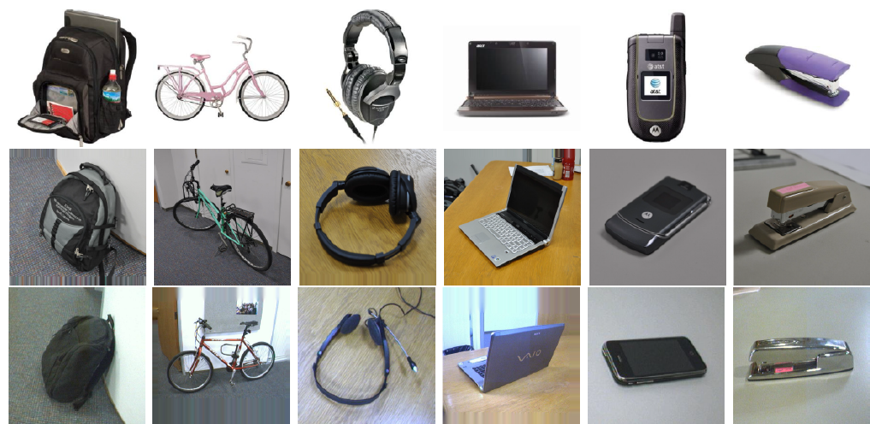
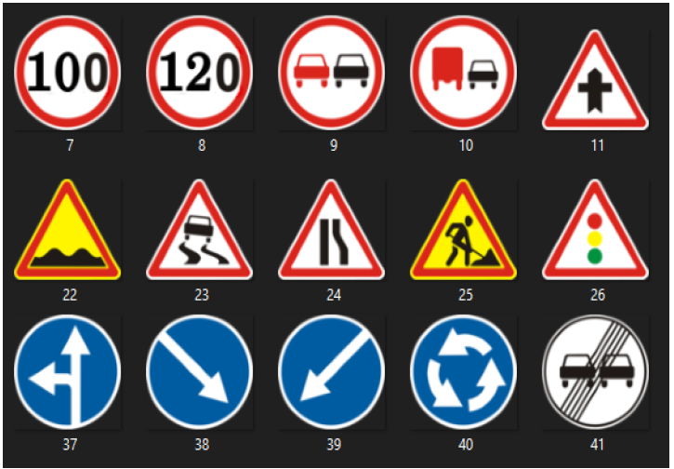

6. Domain Adaptation Scenarios
Domains
Dataset | Train Images | Classes
Office-31 (Amazon, Webcam, DSLR domains) | Total - 4652 (A - 2818, W – 795, D – 498) | 31
Synthetic Signs (Simulated Traffic signals) | 100K | 43
GTSRB (Traffic Signals) | 51,839 | 43
Office-31 dataset
(Amazon)
(Webcam)
(DSLR)
GTSRB dataset
Following five different DA scenarios were tried:
Amazon(A) Webcam(W) images
Amazon DSLR(D) images
W A images
D A images
Synthetic-Signs(S) GTSRB(G) signs
Notes:
Following five different DA scenarios were tried to answer the defined research questions:

Slide 11

7. Experiments
Data Augmentation
Colour Augmentations (random hue, random saturation, random brightness, random contrast)
Random greyscale conversions
Addition of random gaussian noise
Horizontal flipping (only in Office-31 dataset)
20% probability for randomizations
Evaluation Metrics
Classification accuracy
Precision, Recall, F1-Score and Confusion Matrix
Experimental Configurations
Optimizer: Adam
Base epochs: 50
Learning Rate: 0.0001
Weight initialization: He-Normal distribution
Early stopping and reducing learning rate on plateau were applied.
Notes:
Classification Accuracy – for comparing model performances
Precision Recall used for Image Classification Analysis

Slide 12
8. Results
DA Scenario | (Original) (W/ DA) | (Xception) W/O DA | MBM |  | CDAN
 |  |  | W/ Aug | W/O Aug | W/ Aug | W/O Aug
A → W | 66.40 % | 70 % | 76.34 % | 80.40 % | 75.80 % | 76.13 %
A → D | 66.80 % | 72.07 % | 77.84 % | 81 % | 80.61 % | 79.26 %
W → A | 52 % | 54 % | 60.40 % | 63.50 % | 60.36 % | 63.10 %
D → A | 53 % | 51.04 % | 60.82 % | 62.36 % | 58.60 % | 61.43 %
S → G | 60 % | 66.05 % | 77.75 % | 75.73 % | 74.20 % | 76.86 %
Average | 59.64 % | 62.63 % | 70.63 % | 72.60 % | 69.91 % | 71.35 %
Test classification accuracy comparisons
Notes:
All accuracies except for pruning result from the average of the accuracies achieved with three $λ$ values

Slide 13

8.1. Results (cont.)
Xception CNN (Original W/ DA vs Xception W/O DA)
Tested different networks such as ResNet32, VGG16, ResNet50
About 3 % performance improvement in the average classification accuracy
Average accuracies: Original W/DA – 59.64% vs Xception W/O DA – 62.63%
Modified depth wise separable convolution blocks, residual connections
61 million parameters (Alexnet) vs 22.8 million parameters (Xception)
MBM & CDAN techniques (W/ DA vs W/O DA).
8 % improvement in the average classification accuracy (considered W/ Aug accuracies)
Average accuracies: No DA - 62.63% vs MBM - 70.63% vs CDAN - 69.91%.

Slide 14
8.2. Results (cont.)
MBM vs CDAN
Both were comparable in average accuracies,
MBM performed better
Data Augmentation - Ablation Study
Average accuracy of W/O Aug. vs average accuracy of W/ Aug.
For S → G scenario, 77.75% (W/ Aug accuracy) was better than 75.73% (W/O Aug accuracy)
Availability of sufficient training data
Notes:
MBM was better in comparison in terms of average classification accuracy.
Data Augmentation - Ablation Study (Checking the robustness of the two techniques)
The average accuracy of W/O Aug. was slightly better than the average accuracy of W/ Aug. for all DA scenarios.

Slide 15
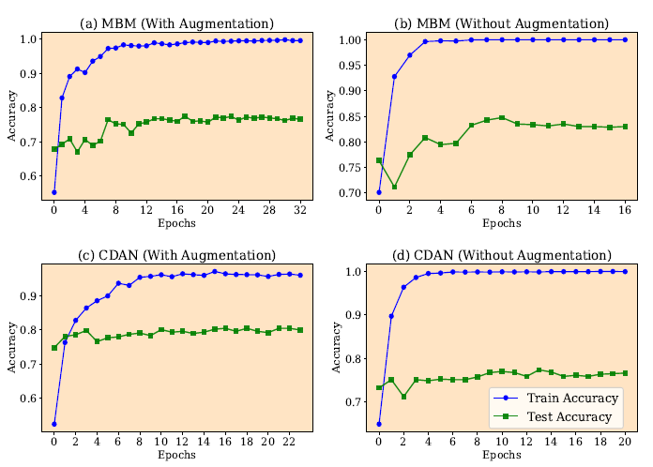
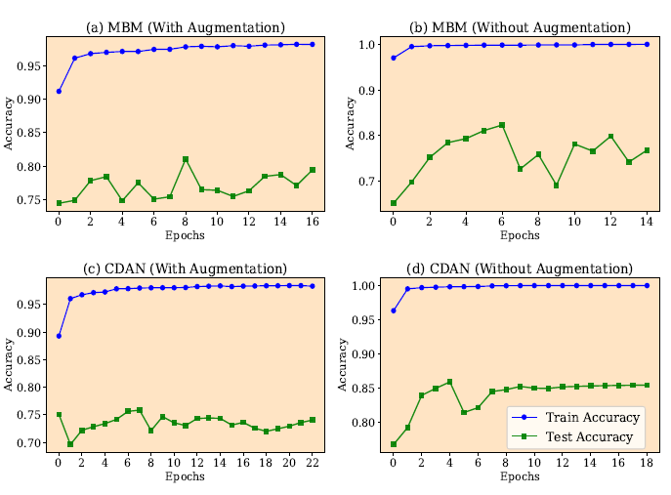
8.3. Results (cont.)
(A → W accuracy graphs)
(S → G accuracy graphs)

Slide 16

8.4. Pruning Results
MBM
Test accuracy decreased significantly with increasing $κ$
For S → G scenario, (only 7% drop in performance at 90% pruning)
Performance dependency on the training set
CDAN
No significant reduction in test accuracy even when $κ$ = 90%
The model could be over-parameterized
The target parameters might not be that important
MBM vs CDAN performance comparison after pruning
Notes:
Test accuracy decreased significantly with increasing $κ$, even when $κ$ was chosen between 1% and 10%.
Pruning CDAN showed no significant reduction in test accuracy in all scenarios, even when $κ$ = 90%.
The model could be over-parameterized.
The target parameters might not be that important and were therefore dropped.
After pruning, the classification performance of the CDAN technique was better than that of the MBM technique.

Slide 17
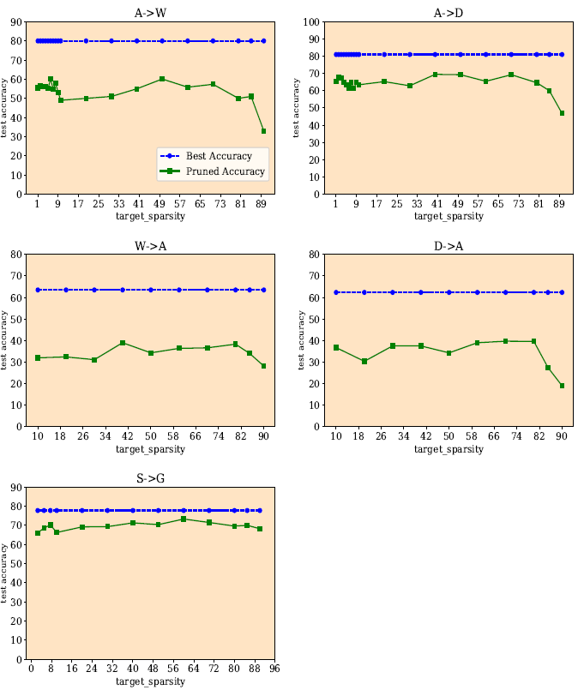
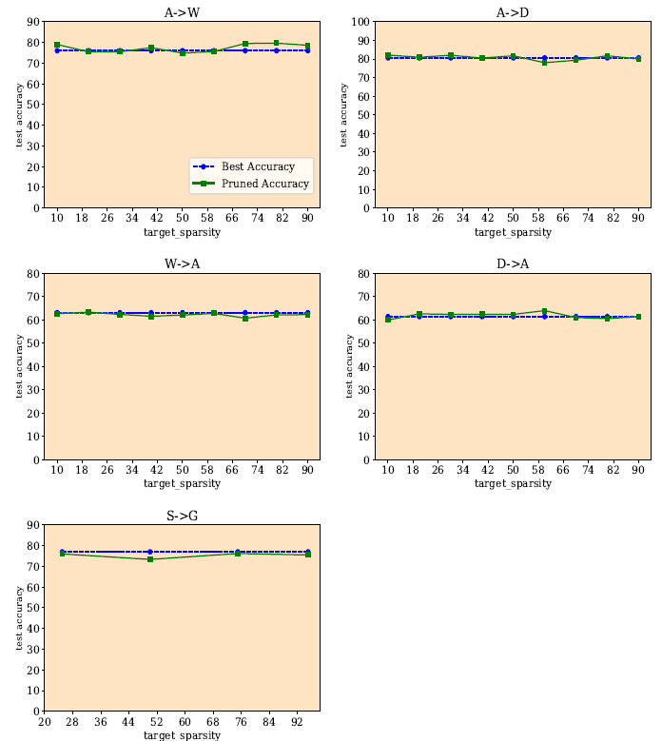
8.5. Pruning Results (cont.)
(MBM pruning results)
(CDAN pruning results)

Slide 18
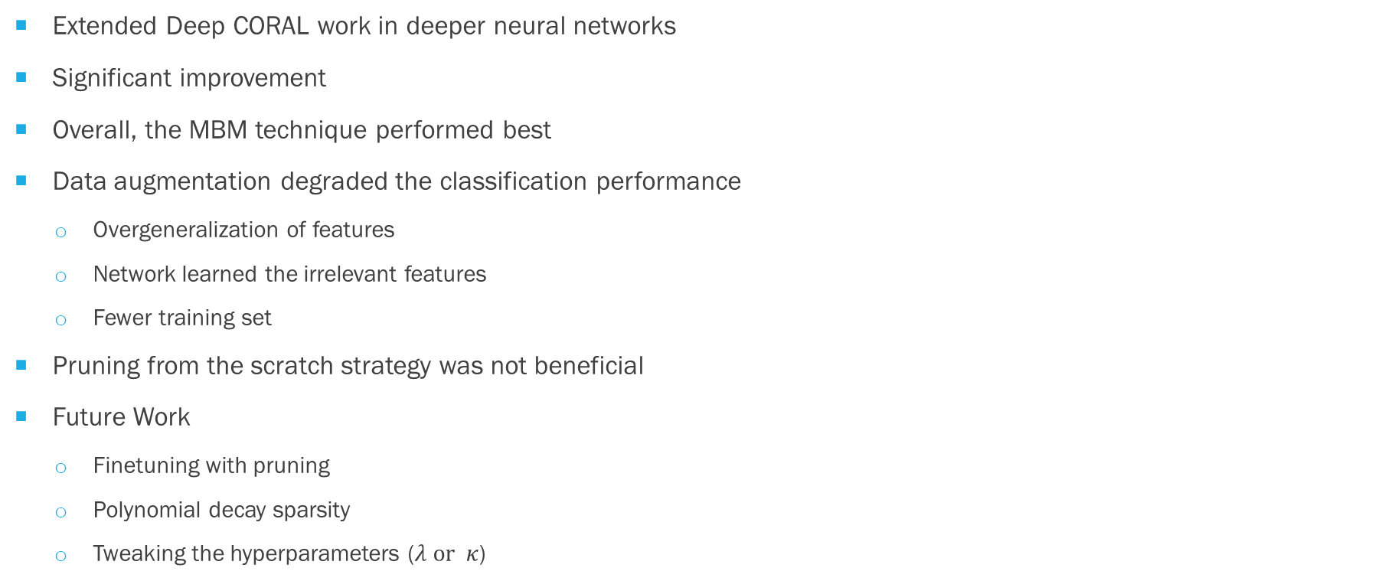
9. Discussion and Conclusion
Extended Deep CORAL work in deeper neural networks
Significant improvement
Overall, the MBM technique performed best
Data augmentation degraded the classification performance
Overgeneralization of features
Network learned the irrelevant features
Fewer training set
Pruning from the scratch strategy was not beneficial
Future Work
Finetuning with pruning
Polynomial decay sparsity
Tweaking the hyperparameters ($λ or κ$)
Notes:
Both the approaches showed significant improvements over the baseline model and other discrepancy-based techniques.
Overall, the MBM technique performed best compared to CDAN in terms of classification accuracy and complexity (number of parameters).
Network learned the irrelevant features or more noise.
Fewer training images in Office-31 dataset as compared to Synthetic Signs or GTSRB dataset.
Pruning from the scratch strategy was not beneficial in neural network optimization.
Tweaking the hyperparameters ($λ or κ$) could have yielded more promising results among the discrepancy-based methods.
SOTA:
Office31: Ours: 72%, DADA: 88.8 %
S to G : 97% Reconstruction based , Ours : 76%

Slide 19
Thank you
Questions?

