Slide 1

Deep Domain Adaptation in Computer Vision
Rajat Sharma
Supervisors:
Prof. Dr. Michael Granitzer,
Mr. Sahib Julka

Slide 2

Agenda
Introduction
Motivation
Background
Related Work
Research goals
Methods
Datasets
Experiments
Schedule

Slide 3
1. Introduction
Traditional Machine Learning
Availability of large-scale labeled training data
Humans can transfer knowledge learnt previously to novel situations.
Can the machine learn the most general characteristics like humans ?
What if annotated task specific target data is less ?
Source and Target dataset come from similar but different distributions ?
Use Transfer Learning techniques
We can transfer learned representations from a related task or domain to another domain.

Slide 4

2. Motivation
Expensive Data Acquisition and Annotation Problems
Expensive and time-consuming
Impossible to collect annotated data in some domains
Presence of Domain Shift or Dataset Bias
Training and test sets come from similar but different distributions
Difference either in the feature space or in the marginal probability distribution or even in both.
End goal is to learn the features that are:
Discriminative for the main learning task on the source domain
Indiscriminate in terms of bias

Slide 5
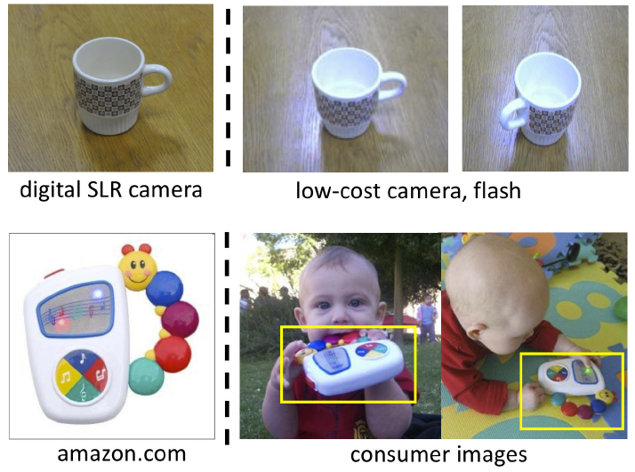
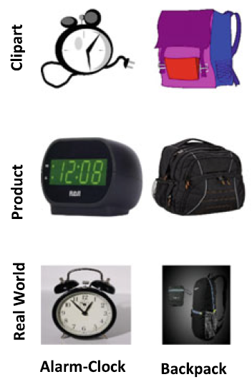
3. Background: Transfer Learning and Domain Adaptation
Transfer learning is the ability to apply knowledge learned in previous tasks to novel tasks.
Variations
Same domain, different task
Different domain, same task
Domain Adaptation: Take a network trained on a different domain for a particular task and adapt it to our domain.
Example¹
Office-Home dataset²
1 source: https://people.eecs.berkeley.edu/~jhoffman/domainadapt/
2 source: Venkateswara H, Eusebio J, Chakraborty S, Panchanathan S (2017) Deep hashing network for unsupervised domain adaptation. In: The IEEE conference on CVPR

Slide 6
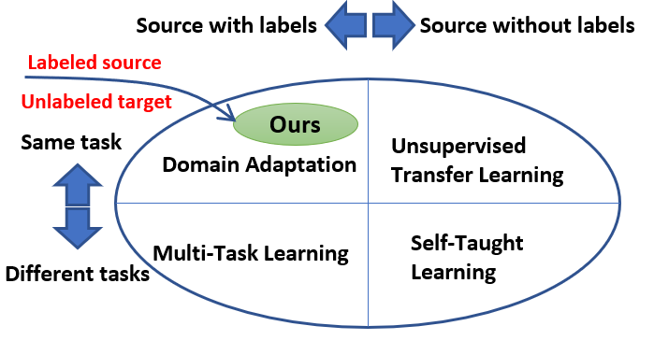
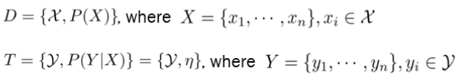
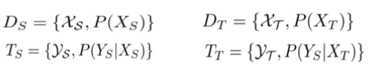
3.1 Transfer Learning and Domain Adaptation
Domain
Feature Space
Marginal Probability Distribution
Task
Predictive Function
Label Space
Transfer Learning Categories¹
D_{s} = D_{T} | T_{S} = T_{T} | Learning Technique
No | Yes | Domain Adaptation
Yes | No | Transfer Learning
No | No | Transfer Learning
Yes | Yes | Machine Learning
Source Domain
Target Domain
Source Task
Target Task
¹ Image source: Kumar, Deepak, Chetan Kumar, and Ming Shao. "Cross-database mammographic image analysis through unsupervised domain adaptation." 2017 IEEE International Conference on Big Data (Big Data) . IEEE, 2017
.

Slide 7
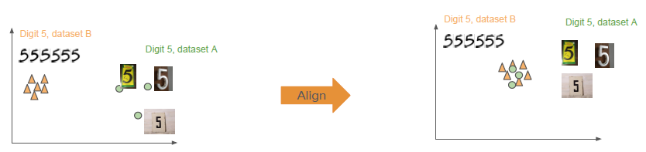
3.2 Domain Shift or Domain Divergence
The size of this shift is measured by the distance between source and target subspaces.
What should we do in presence of Domain Shift ?
Mapping the source distribution to the target distribution
Mapping both domains into common shared domain where the distributions are aligned. (Ours)

Slide 8
3.3 Different Settings and Current Research
DA Setting | #Target Domains | Domain Labels | Open Classes | Open Domains
Unsupervised DA | Single | known | No | No
Multi-Target DA | Multiple | known | No | No
Open/Partial Set DA | Single | known | Yes | No
Open Compound DA | Multiple | unknown | No | Yes
Homogeneous vs Heterogeneous
One-Step vs Multi-Step
Unsupervised and Semi-Supervised
Close Set vs Open set or Partial set
Single-Source and Multi-Source
Open Compound Domain Adaptation¹
Unseen weather, like Overcast
¹ Ziwei Liu et al. "Compound domain adaptation in an open world". In: arXiv preprint arXiv:1909.03403 (2019)
.

Slide 9
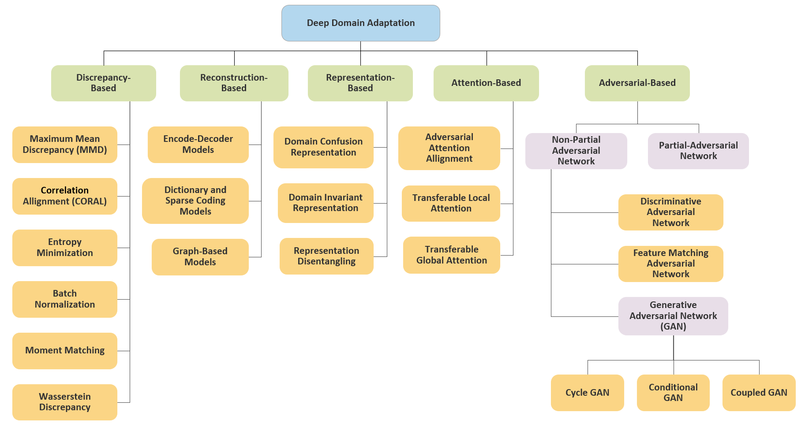
4. Related Work: Unsupervised Domain Adaptation Approaches
Categorized into five main groups based on the technology adopted.
We will focus on Discrepancy based techniques.
Image Reconstructed from: Yeganeh Madadi et al. “Deep Visual Unsupervised Domain Adaptation for Classification Tasks: A Survey". In: Iet Image Processing (2020)

Slide 10
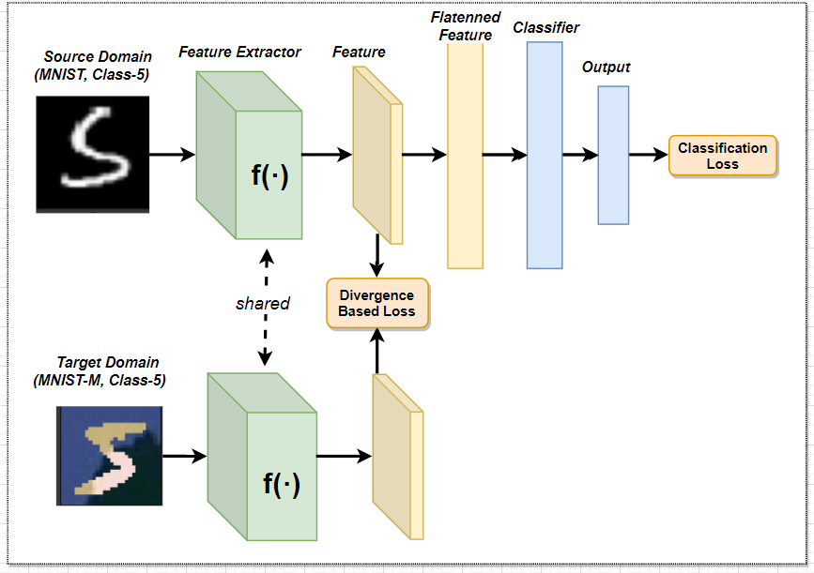
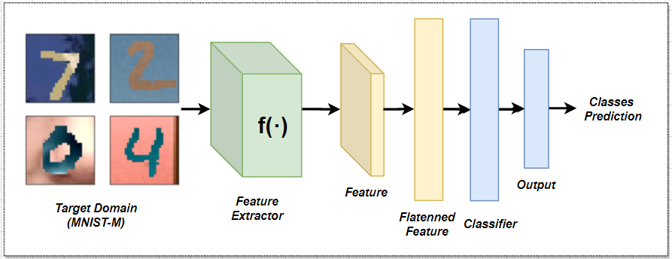

4.1 Discrepancy-based techniques
Training phase
Evaluation phase
Different techniques
Maximum Mean Discrepancy
Correlation Alignment
Kullback–Leibler divergence
Wasserstein Distance
.
Original Paper: Baochen Sun and Kate Saenko. “Deep coral: Correlation alignment for deep domain adaptation". In: European conference on computer vision. Springer.2016, pp. 443-450
.

Slide 11

5. Research Goals
The primary goal is to make progress in solving Domain shift problem in various computer vision tasks. Below are some of the research objectives:
How sophisticated is the target network compared to the source network in terms of complexity ?
How does selecting different CNN feature extractors (e.g., ResNet50, VGG16) in our proposed architecture change domain transfer task accuracy ?
How do pruning lower magnitude weights of the proposed model (approach-2) would impact domain transfer task accuracy ?
To find the right threshold for pruning the target network so that there is no significant reduction in the performance of domain transfer task accuracy?
I will answer these questions by conducting several experiments on different datasets.

Slide 12
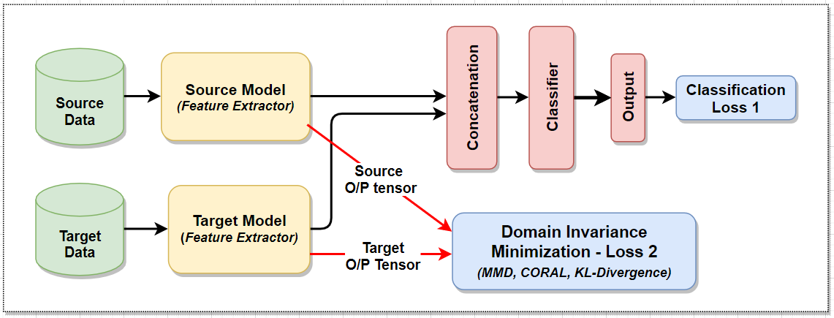
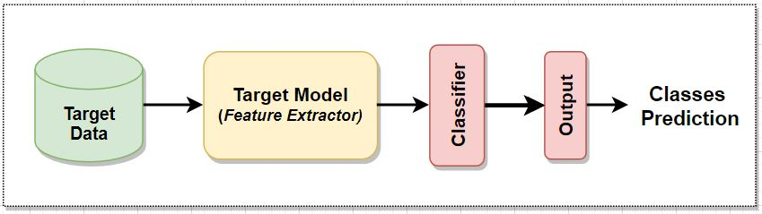
6. Methods: Base Model (Approach-1)
Training phase
Concatenation of Source and Target CNN Feature Extractors.
.
Evaluation phase

Slide 13
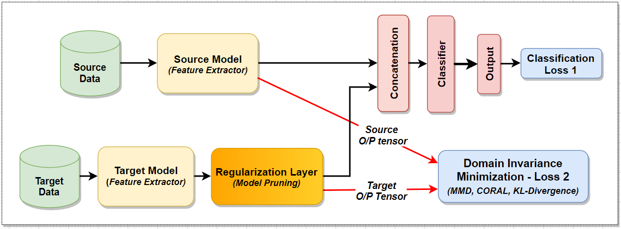
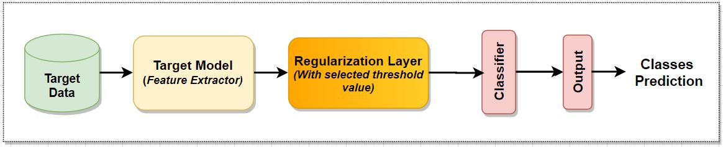
6.1 Pruned Base Model (Approach-2)
Training phase
Magnitude-based weight pruning will be applied.
Retrieve weight matrices for Target feature extractor.
Prune weights below a certain threshold and train again.
Retrieve performance and compare
Evaluation phase

Slide 14

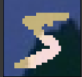



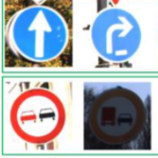
7. Datasets
Dataset | Train Set | Test Set | Classes
MNIST (digits) | 60K | 10K | 10
MNIST-M (digits) | 60K | 10K | 10
USPS (digits) | 7291 | 2007 | 10
Synthetic Signs (Simulated Traffic signals) | 100K | - | 43
GTSRB (Traffic Signals) | 51,839 | - | 43
MNIST
MNIST-M
USPS
Synthetic Signs
GTSRB

Slide 15

8. Experiments
To answer our research questions, following experiments will be performed
MNIST MNIST-M digits transfer
MNIST USPS digits transfer
Synthetic-Signs GTSRB street signs transfer
Domain adaptation settings and assumptions
Single source
Closed-set (same label space)
Single-step (no intermediate domains)
Homogeneous (same feature space)
No unseen domains
Evaluation Metrics
Classification accuracy
Confusion Matrix
t-SNE embedding plots for visualization

Slide 16
8.1 Initial Results
Source Model: ResNet50
Target Model: VGG-16
Optimizer: Adam
Epochs: 50
Learning Rate: 0.001
Used old evaluation strategy (Taken output from both feature extractors for generating output class)
Experiments require hyperparameter tuning
Regularization can improve the test accuracy and decrease training accuracy.
Source DS | Target DS | Test Accuracy | Training Accuracy | Additional Loss
MNIST | MNIST-M | 51 % | 99.5 % | CORAL, λ= 0.5
MNIST | MNIST-M | 62.2 % | 99.5 % | CORAL, λ= 1
MNIST-M | MNIST | 97.5 % | 99.5 % | CORAL, λ= 1

Slide 17

9. Schedule
Research
4 weeks
Testing
2 weeks
Documentation
8 weeks
Implementation
10 weeks
Total
24 weeks

Slide 18
Thank you
Questions?

