Slide 1
Pipelining: Datapath and Hazards

Slide 2
Introduction
The performance of a Single CPU can be increased by :
Improving the hardware by introducing faster circuits.
Arranging the hardware such that more than one operation can be performed at the same time.
Since, there is a limit on the speed of hardware and the cost of faster circuits is quite high, we have to adopt the 2nd option. This second approach is Instruction Level Parallelism.
Pipelining : Pipelining is a technique for implementing instruction-level parallelism within a single processor.
It is a process of arrangement of hardware elements of the CPU such that its overall performance is increased with simultaneous execution of more than one instruction taking place in a pipelined processor.
Pipelining attempts to keep every part of the processor busy with some instruction by dividing incoming instructions into a series of sequential steps performed by different processor units with different parts of instructions processed in parallel.

Slide 3
Pipelining: Laundry Example
Small laundry has one washer, one dryer and one operator, it takes 90 minutes to finish one load:
Washer takes 30 minutes
Dryer takes 40 minutes
“operator folding” takes 20 minutes
A
B
C
D

Slide 4
Sequential Laundry
6 PM
7
8
9
10
11
Midnight
Time
30
40
20
30
40
20
30
40
20
30
40
20
T
a
s
k
O
r
d
e
r
A
B
C
90 min
D
This operator scheduled his loads to be delivered to the laundry every 90 minutes which is the time required to finish one load. In other words he will not start a new task unless he is already done with the previous task
The process is sequential. Sequential laundry takes 6 hours for 4 loads

Slide 5
Efficiently scheduled laundry: Pipelined Laundry
6 PM
7
8
9
10
11
Midnight
Time
30
40
40
40
40
20
T
a
s
k
O
r
d
e
r
40
40
40
A
B
C
D
Another operator asks for the delivery of loads to the laundry every 40 minutes!
Pipelined laundry takes 3.5 hours for 4 loads

Slide 6
Pipelining Facts
Multiple tasks operating simultaneously
Pipelining doesn’t help latency of single task, it helps throughput of entire workload
Pipeline rate limited by slowest pipeline stage
Potential speedup = Number of pipe stages
Unbalanced lengths of pipe stages reduces speedup
Time to “fill” pipeline and time to “drain” it reduces speedup
6 PM
7
8
9
Time
30
40
40
40
40
20
T
a
s
k
O
r
d
e
r
A
B
C
The washer waits for the dryer for 10 minutes
D

Slide 7
Instruction pipeline versus sequential processing
sequential processing
Instruction pipeline
Notes:
7

Slide 8
Instruction pipeline (Contd.)
sequential processing is
faster for few instructions
Notes:
8

Slide 9
Performance of Pipelining system
Throughput of the instruction pipeline is determined by how often an instruction exits the pipeline. Pipelining does not decrease the time for individual instruction execution. Instead, it increases instruction throughput.
Machine cycle . The time required to move an instruction one step further in the pipeline. The length of the machine cycle is determined by the time required for the slowest pipe stage.
Notes:
9

Slide 10
Performance Measurement
n is equivalent to number of loads in the laundry example
k is the stages (washing, drying and folding.
τ Clock cycle is the slowest task time
n:instructions
k: stages in pipeline
τ: clockcycle
T_{k}: total time
n
k
Notes:
10

Slide 11
Pipeline Datapath for MIPS Instruction

Slide 12
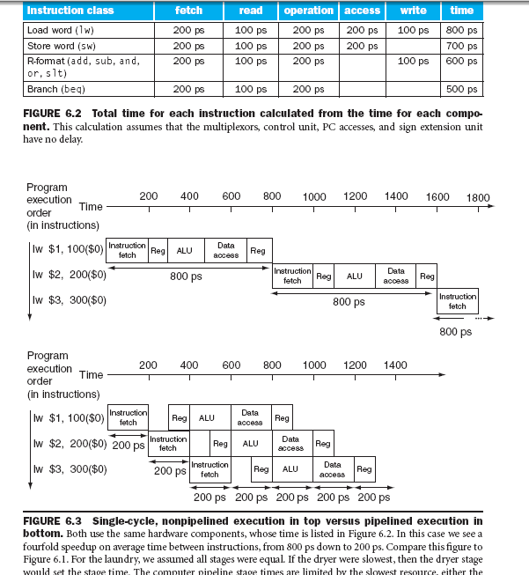
Time Taken by each MIPS Instruction: Sequential Vs Pipeline Execution

Slide 13
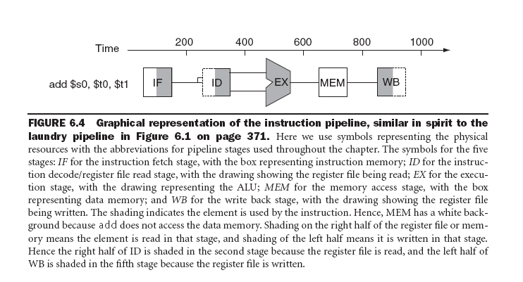
Graphical Representation of ILP

Slide 14
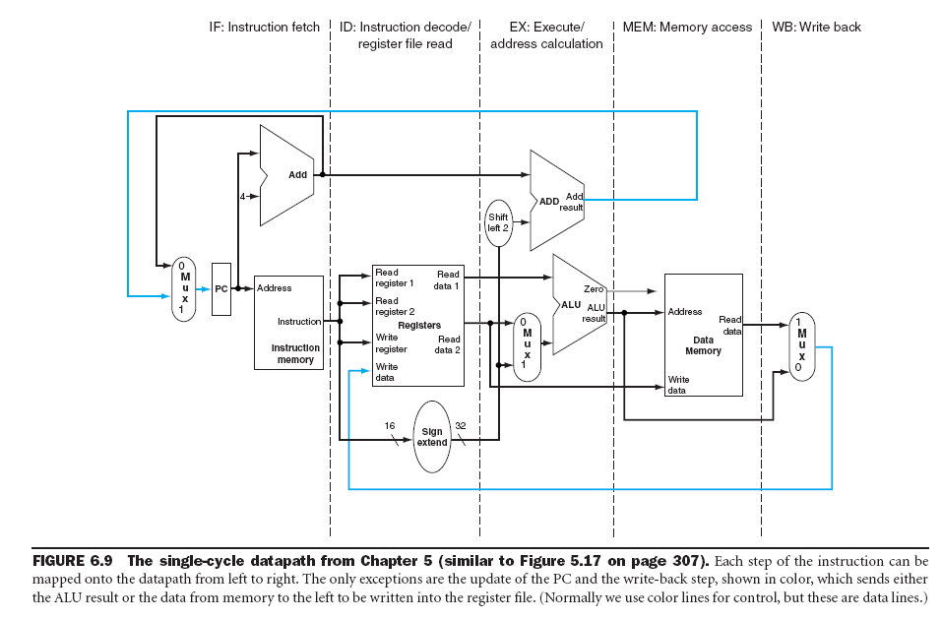
Single Cycle Non Pipeline Datapath

Slide 15
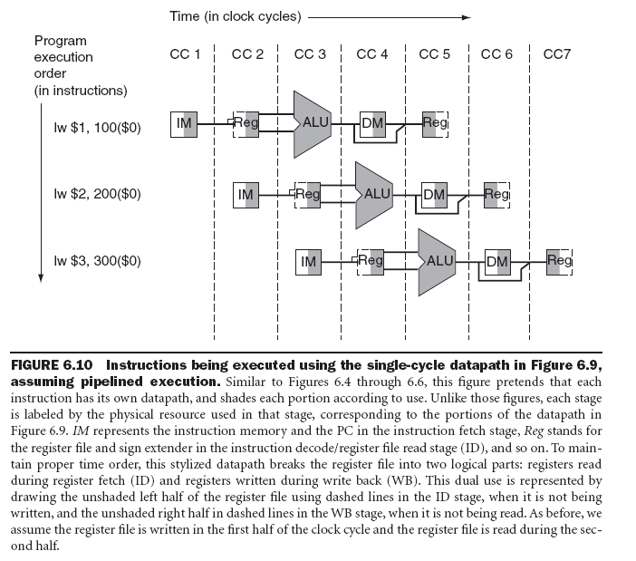
Instruction Execution in Single Cycle Datapath Assuming Pipelining

Slide 16
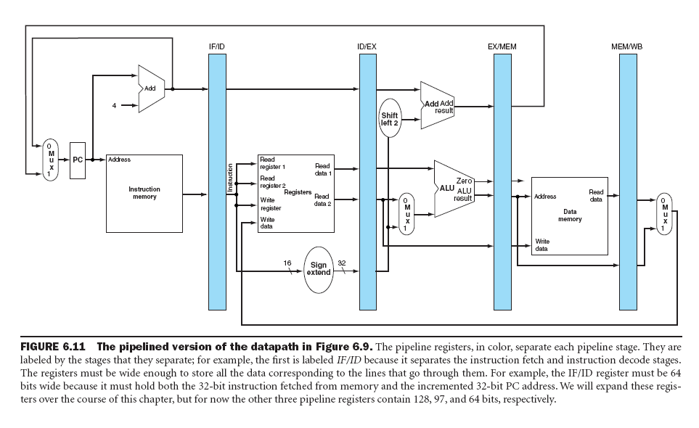
Pipeline Version of Single Cycle Datapath for MIPS

Slide 17
Pipeline Control Issues and Hardware
Here, the following stages perform work as specified:
IF/ID: Initializes control by passing the rs, rd, and rt fields of the instruction, together with the opcode and funct fields, to the control circuitry.
ID/EX: Buffers control for the EX, MEM, and WB stages, while executing control for the EX stage. Control decides what operands will be input to the ALU, what ALU operation will be performed, and whether or not a branch is to be taken based on the ALU Zero output.
EX/MEM: Buffers control for the MEM and WB stages, while executing control for the MEM stage. The control lines are set for memory read or write, as well as for data selection for memory write. This stage of control also contains the branch control logic.
MEM/WB: Buffers and executes control for the WB stage, and selects the value to be written into the register file.

Slide 18
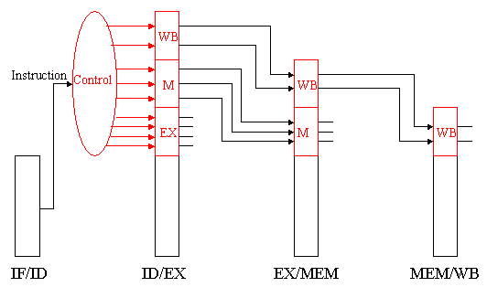

Slide 19
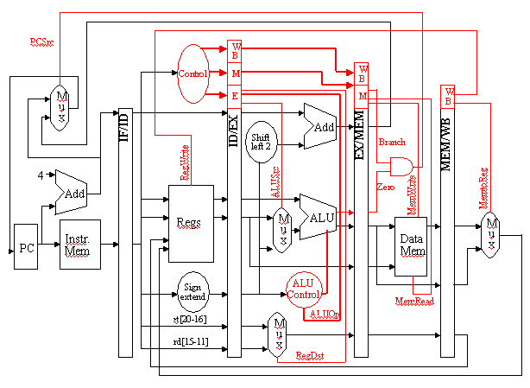

Slide 20
Hazards in
Pipelining System: Data & Branch

Slide 21
Overview of Hazards
Pipeline processors have several problems associated with controlling smooth, efficient execution of instructions on the pipeline. These problems are generally called hazards, and include the following three types:
Structural Hazards occur when different instructions collide while trying to access the same piece of hardware in the same segment of a pipeline. This type of hazard can be alleviated by having redundant hardware for the segments wherein the collision occurs. Occasionally, it is possible to insert stalls or reorder instructions to omit this type of hazard.

Slide 22
Overview of Hazards
Data Hazards occur when an instruction depends on the result of a previous instruction still in the pipeline, which result has not yet been computed. The simplest remedy inserts stalls in the execution sequence, which reduces the pipeline's efficiency.
The solution to data dependencies is two fold.
First, one can forward the ALU result to the writeback or data fetch stages.
Second, in selected instances, it is possible to restructure the code to eliminate some data dependencies.
Control Hazards can result from branch instructions. Here, the branch target address might not be ready in time for the branch to be taken, which results in stalls (dead segments) in the pipeline that have to be inserted as local wait events, until processing can resume after the branch target is executed. Control hazards can be mitigated through accurate branch prediction (which is difficult), and by delayed branch strategies.

Slide 23
Data Hazard
Definition. A data hazard occurs when the current instruction requires the result of a preceding instruction, but there are insufficient segments in the pipeline to compute the result and write it back to the register file in time for the current instruction to read that result from the register file.
We typically remedy this problem in one of three ways:
Forwarding: In order to resolve a dependency, one adds special circuitry to the pipeline that is comprised of wires and switches with which one forwards or transmits the desired value to the pipeline segment that needs that value for computation. Although this adds hardware and control circuitry, the method works because it takes far less time for the required value(s) to travel through a wire than it does for a pipeline segment to compute its result.

Slide 24
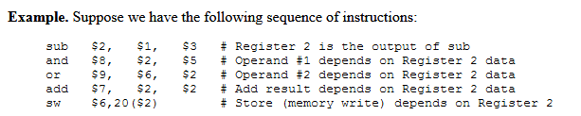
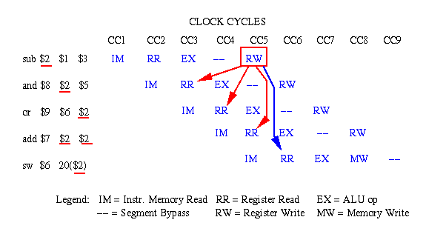
Example of data hazards in a sequence of MIPS instructions, where the red (blue) arrows indicate dependencies that are problematic

Slide 25
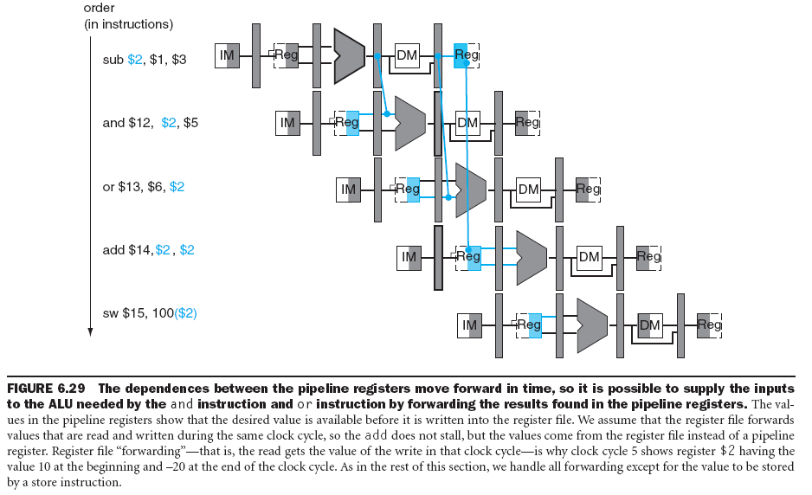
Operand Forwarding

Slide 26
Data Hazards and Stalls
if (ID/EX.MemRead and
((ID/EX.RegisterRt = IF/ID.RegisterRs) or
(ID/EX.RegisterRt = IF/ID.RegisterRt)))
stall the pipeline
lw $s0, 20($t1)
sub $t2, $s0, $t3
Note: The first line tests to see if the instruction is a load: the only instruction that reads data memory is a load. The next two lines check to see if the destination register field of the load in the EX stage matches either source register of the instruction in the ID stage. If the condition holds, the instruction stalls 1 clock cycle.

Slide 27
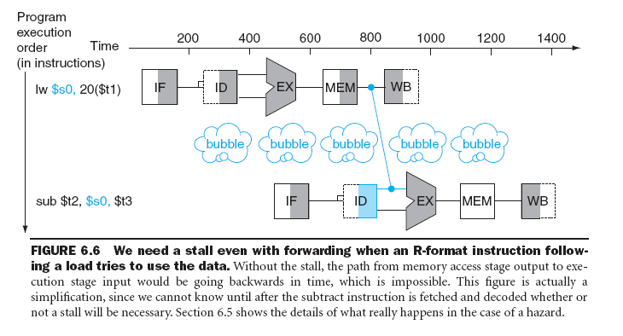
Stall when R-format dependent instruction follow a Load Instruction (pipeline Stall)

Slide 28
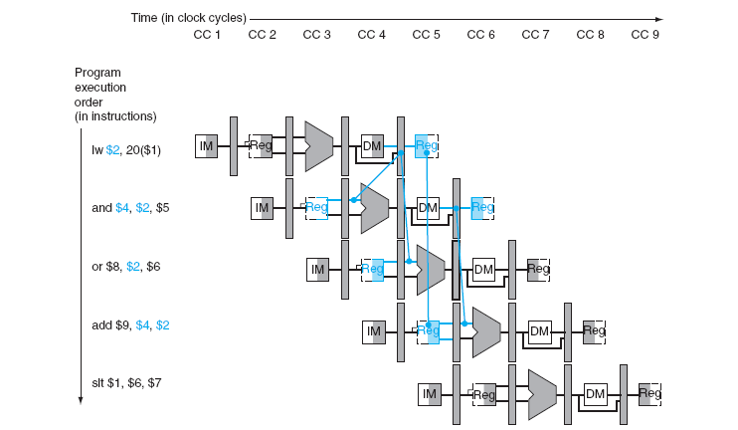
Data Hazard Solution using Operand Forwarding and Stall

Slide 29
Data Hazard
Code Re-Ordering: Here, the compiler reorders statements in the source code, or the assembler reorders object code, to place one or more statements between the current instruction and the instruction in which the required operand was computed as a result. This requires an "intelligent" compiler or assembler, which must have detailed information about the structure and timing of the pipeline on which the data hazard would occur. We call this type of software a hardware-dependent compiler.
Stall Insertion: It is possible to insert one or more stalls (no-op instructions) into the pipeline, which delays the execution of the current instruction until the required operand is written to the register file. This decreases pipeline efficiency and throughput, which is contrary to the goals of pipeline processor design. Stalls are an expedient method of last resort that can be used when compiler action or forwarding fails or might not be supported in hardware or software design.

Slide 30
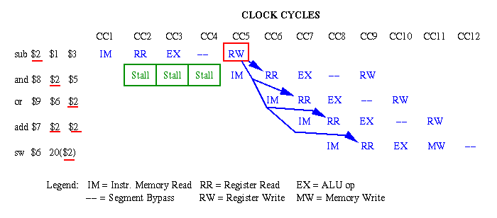
Example of stall insertion to solve data hazards in a sequence of MIPS instructions
the insertion of stalls is the least desirable technique because it delays the execution of an instruction without accomplishing any useful work (in contrast to code re-ordering).

Slide 31
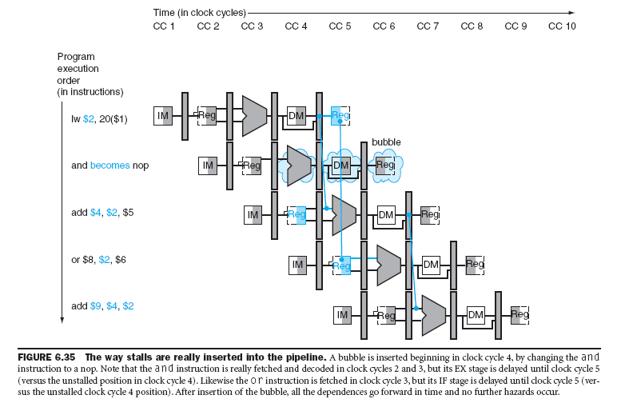
Data Hazard Solution using Operand Forwarding and Stall (Cont.)

Slide 32
Control or Branch Hazards
Control hazards are the most difficult types of hazards arising from normal operation of a program. In the next section, we will see that exceptions (e.g., overflow) can play particularly interesting types of havoc with smooth pipeline execution.
The most common type of control hazard is the branch instruction, which has two alternative results:
(1) jump to the branch target address if the instruction succeeds, or
(2) execute the instruction after the branch (at PC+4 of instruction memory) if the branch fails.
The problem with the branch instruction is that we usually do not know which result will occur (i.e., whether or not the branch will be taken) until the branch condition is computed. Often, the branch condition depends on the result of the preceding instruction, so we cannot precompute the branch condition to find out whether or not the branch will be taken.

Slide 33
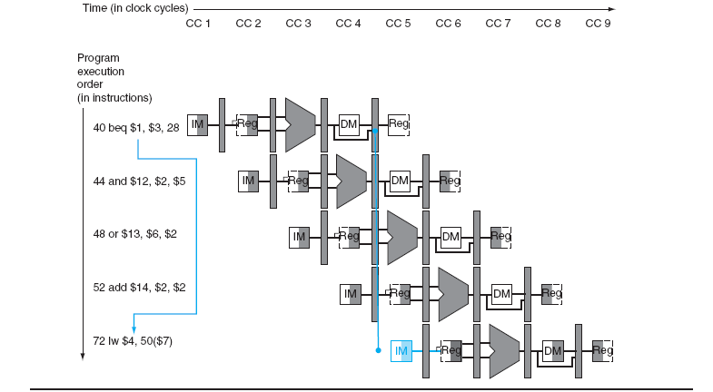
Control or Branch Hazards

Slide 34
Two schemes for resolving control hazards.
Assume Branch Not Taken: A common improvement over branch stalling is to assume that the branch will not be taken and thus continue execution down the sequential instruction stream. If the branch is taken, the instructions that are being fetched and decoded must be discarded. Execution continues at the branch target.
Reducing the Delay of Branches: One way to improve branch performance is to reduce the cost of the taken branch. Thus far we have assumed the next PC for a branch is selected in the MEM stage, but if we move the branch execution earlier in the pipeline, then fewer instructions need be flushed.
Moving the branch decision up requires two actions to occur earlier:
Computing the branch target address
Evaluating the branch decision.

Slide 35
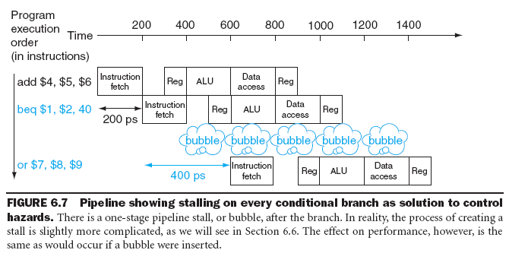
Stalling in Branch Hazard

Slide 36
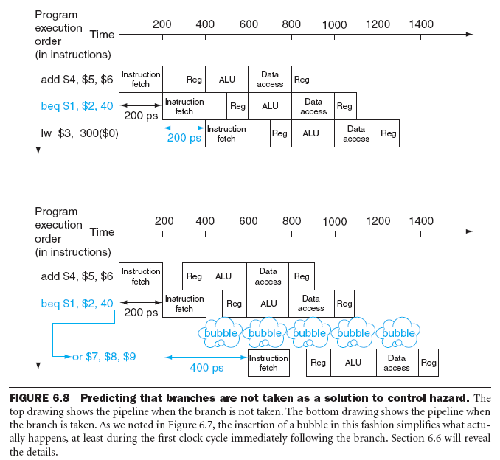
Prediction: Branches are Never Taken

Slide 37
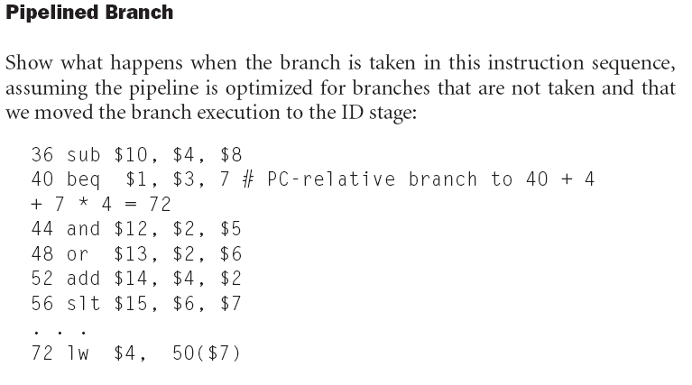

Slide 38
Thank you
https://www.cise.ufl.edu/~mssz/CompOrg/CDA-pipe.html

