Slide 1
E-Commerce Product Review Analysis
Technology: Python, Scikit-Learn, TF- IDF, SVM, Flask
Project Brief:
An AI-driven system that automatically analyzes customer product reviews, classifies sentiment in real time (Positive/Negative/Neutral), and identifies key product aspects to help e-commerce platforms make faster, data-driven decisions.

Slide 2
Team / Group Members
Presented By:
B. ESWAR REDDY-----AP23110011368
B. SIMHADRI-----------AP23110011397
G. NIKHILESH----------AP23110011346
V. SAI PAVAN-----------AP23110011453
B. Bharathkumar-------AP23110011382
Team Strength:
A technically driven group focused on building AI-powered solutions for real-time e-commerce analytics, combining machine learning, NLP, and practical deployment skills.

Slide 3
Problem Statement & Objectives
Problem Statement:
E-commerce platforms receive massive volumes of product reviews.
Manual review analysis is slow, inconsistent, and fails to extract actionable insights quickly.
Objectives:
Build an automated system to classify product reviews as Positive, Negative, or Neutral.
Enable real-time feedback analysis to improve product quality and customer satisfaction.
Identify key product aspects (battery, design, performance, shipping, audio).
Deploy a simple web interface for live predictions.

Slide 4
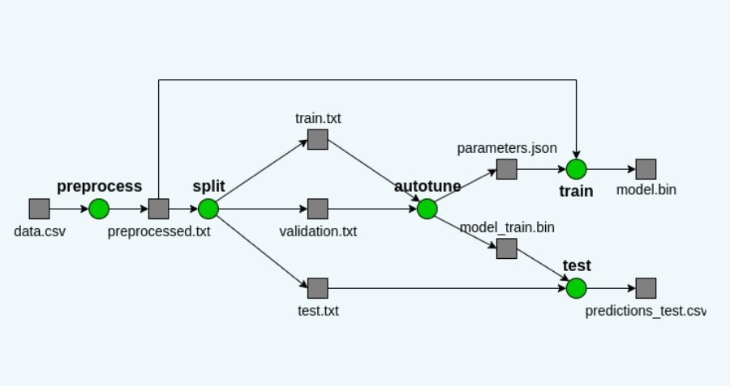
Proposed Solution & Workflow
Solution:
A machine-learning pipeline using TF-IDF feature extraction + Linear SVM classifier integrated into a Flask web app for real-time predictions.

Slide 5
Dataset & Methodology:
Dataset:
Primary Dataset: 20,063 reviews
Columns: title, review, rating (1=Negative, 2=Positive)
Sample Dataset: 60 labeled reviews for demo
Methodology:
Preprocessing: Tokenization, stopword removal, normalization
Feature Extraction: TF-IDF (unigram + bigram)
Classifier: Linear SVM
Evaluation: Accuracy, confusion matrix, classification report

Slide 6
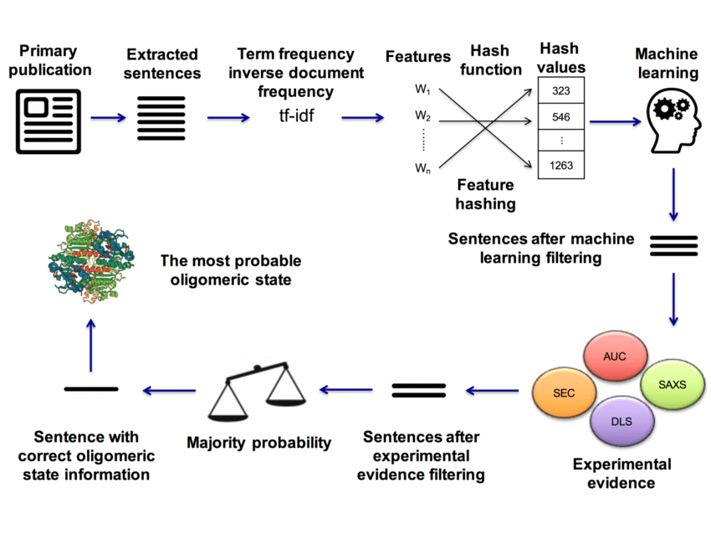
Technologies Used
Languages & Tools:
Python
Flask
Jupyter Notebook
Scikit-Learn
NLTK
Pandas, NumPy
Core Python Files:
ecommerce_sentiment_svm.py — Model training
flask_sentiment_app.py — Web interface
.ipynb notebook — Experimentation & visualization

Slide 7
Results & Findings
Model Performance:
Accuracy: ~87.5%
Algorithm: Linear SVM
Features: TF-IDF bigram vectors
Confusion Matrix: (Add screenshot if needed)
Key Insights:
Positive reviews dominated electronics products
Aspect detection helped pinpoint specific issues:
  Shipping delays
  Battery complaints
  Design appreciation
System handles real-time predictions efficiently

Slide 8
Conclusion & Future Scope
Conclusion:
The SVM-based sentiment analysis system automates review classification, cuts manual workload, and provides meaningful insights to improve product strategy and customer satisfaction.
Future Scope:
Integrate Deep Learning models (BERT, DistilBERT)
Expand aspect detection using NLP techniques
Add trend forecasting using time-series models
Deploy system as a REST API or microservice

Slide 9


