Slide 1
RAJAVEL J
2021503702
CT Dept. MIT, Anna University
TNSDC-Gen AI Project
3/21/2024 Annual Review

Slide 2
PROJECT TITLE
Insights from the SMS Spam Collection

Slide 3


AGENDA
Data collection, preprocessing, and feature engineering
Model selection, training, and evaluation
Interpretation of results
Deployment and integration
Future considerations for improvement and scalability
3/21/2024 Annual Review

Slide 4

PROBLEM STATEMENT
Objective: The objective is to create a spam detection system that can effectively identify and filter out spam messages.
Dataset: The datasets typically consist of a collection of SMS messages labeled as spam or ham.
Goal: develop a robust and accurate spam detection system for SMS messages.
Applications: The applications of this project include improving spam filtering in SMS services, email platforms, and other communication
Scope: The scope of the project encompasses various stages, including data preprocessing,
Key Metrics: Key metrics for evaluating the performance of the spam detection models include accuracy

Slide 5

PROJECT OVERVIEW
Data Collection and Preparation:
In this stage, the SMS Spam Collection dataset is collected and prepared for analysis.
This involves obtaining the dataset, understanding its structure, and performing data cleaning, such as removing duplicates or missing value
Exploratory Data Analysis (EDA):
EDA involves analyzing the dataset to gain insights into its characteristics and distribution.
This includes exploring statistics, visualizations, and patterns within the data, such as the distribution of spam and ham messages, common keywords or phrases in spam messages, message length distributions, and other relevant factors.
3/21/2024 Annual Review

Slide 6
PROJECT OVERVIEW
Model Selection and Training:
SMS Spam Collection, consider algorithms like Naive Bayes, logistic regression, or ensemble methods due to their effectiveness with text data.
Use techniques like tokenization, TF-IDF, or word embeddings for feature representation.
Results and Deployment:
using metrics such as accuracy, precision, recall, and F1 score. Deployment involves integrating the trained model into messaging platforms or email clients, ensuring real-time spam detection without compromising user experience
Conclusion and Future Work:
focus on improving model robustness to handle evolving spam tactics, exploring deep learning architectures for better feature representation, and implementing feedback mechanisms to adapt to changing spam patterns.

Slide 7

WHO ARE THE END USERS?
Messaging app users
Email users
Telecom companies
Businesses
Regulatory authorities
3/21/2024 Annual Review

Slide 8

MY SOLUTION AND ITS VALUE PROPOSITION
SOLUTION:
Utilize techniques like tokenization, stemming, and removing stop words to prepare the text data for analysis.
This ensures that the model focuses on meaningful words and phrases.

Slide 9
MY SOLUTION AND ITS VALUE PROPOSITION
VALUE PROPOSITION:
By automatically filtering out spam messages, the solution improves the overall user experience by reducing clutter and annoyance in messaging platforms or email inboxes.
Users save time and effort by not having to manually sift through spam messages, allowing them to focus on important communications and tasks.

Slide 10

THE WOW IN MY SOLUTION
To add the "wow" factor to your spam detection solution leveraging insights from the SMS Spam Collection dataset, consider incorporating the following elements:
Real-time detection: Implement a lightning-fast detection system that can identify and filter spam messages in real-time, providing an immediate and seamless user experience without any noticeable delays.
Personalization: Utilize machine learning techniques to personalize the spam detection system for each user based on their past interactions, preferences, and feedback, ensuring more accurate and relevant filtering.
3/21/2024 Annual Review

Slide 11
THE WOW IN MY SOLUTION
Multimodal detection: Extend the spam detection capabilities beyond text-based messages to include multimedia content such as images, videos, and voice messages, offering comprehensive protection across various communication channels.
Interactive user interface: Design an intuitive and visually appealing user interface that allows users to interact with the spam detection system, provide feedback, and customize their preferences with ease, empowering them to take control of their messaging experience.
Advanced analytics: Provide insightful analytics and visualizations to users, highlighting trends, patterns, and statistics related to spam messages, empowering them to gain deeper insights into their messaging behavior and security posture.
3/21/2024 Annual Review

Slide 12
MODELLING
Data preprocessing: Clean and preprocess the SMS Spam Collection dataset by removing noise, such as special characters and stop words, and transforming text data into numerical representations suitable for modeling.
Feature extraction: Extract relevant features from the preprocessed text data, such as word frequency, character count, presence of specific keywords, or linguistic patterns indicative of spam messages
.Model selection: Choose appropriate machine learning algorithms for spam detection, such as Naive Bayes, logistic regression, Support Vector Machines (SVM), Random Forests, or neural networks. Consider the strengths and weaknesses of each algorithm in handling text data and class imbalance.

Slide 13
MODELLING
Model training: Split the preprocessed data into training and validation sets and train the selected models using the training data. Experiment with different hyperparameters and optimization techniques to improve model performance.
Evaluation: Evaluate the trained models using appropriate evaluation metrics such as accuracy, precision, recall, and F1 score on the validation set. Compare the performance of different models to select the best-performing one.
Ensemble methods: Optionally, combine multiple models or predictions using ensemble methods such as bagging, boosting, or stacking to further improve the overall performance and robustness of the spam detection system.

Slide 14
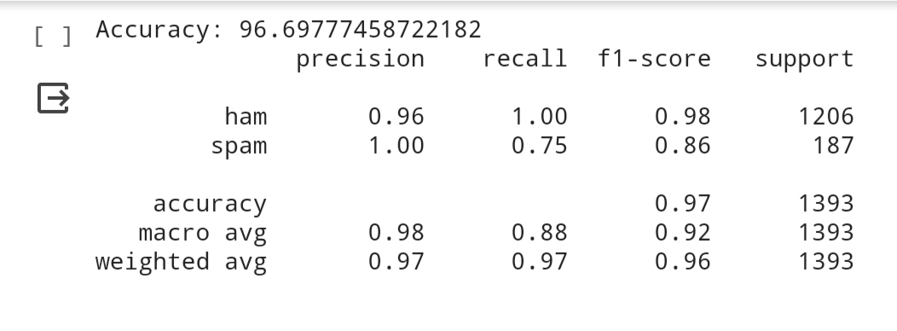
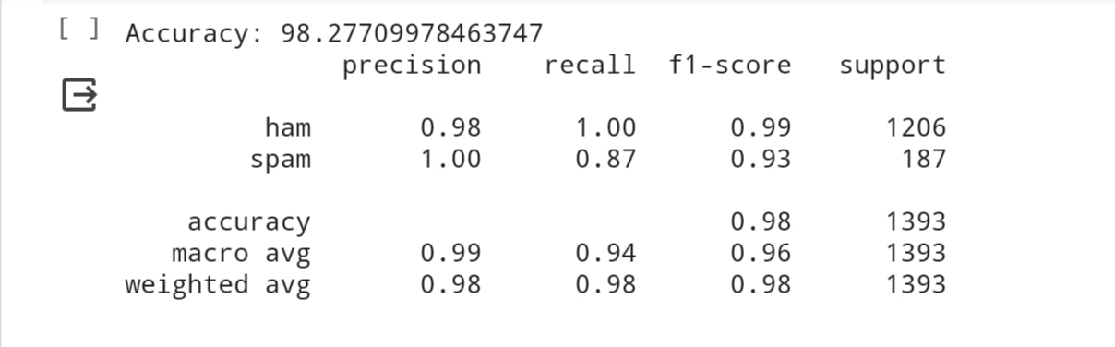
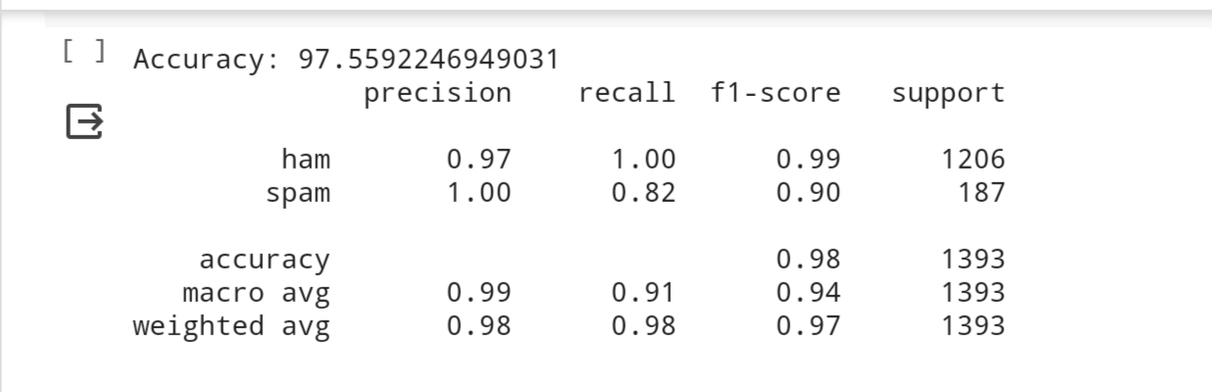
RESULTS
# Predicting Test Set
Descriptive Statistics for Wine Features

Slide 15
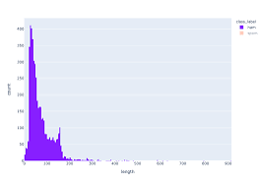
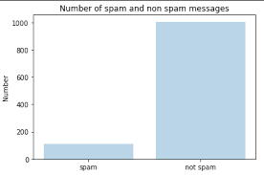
GRAPHS

Slide 16
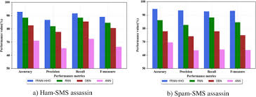
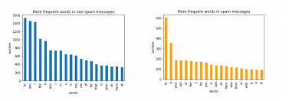
GRAPHS

