Slide 1

Play Store App Review Analysis
By
Rajbeer Singh

Slide 2
CONTENTS
Sr. No. | Topic
1) | PROBLEM STATEMENT
2) | APPROACH
3) | DATA SUMMARY
4) | DATA VISUALIZATIONS
5) | CONCLUSIONS

Slide 3
PROBLEM STATEMENT
Google Play was launched on March 6, 2012, bringing together Android Market, and the Google under one brand, marking a shift in Google's digital distribution strategy. The Google Play store had over 108.5 billion app downloads in 2020.
The Play Store Apps data has enormous potential to drive app-making businesses to success. Actionable insights can be drawn for developers to work on and capture the Android market. The aim of this project is to explore and analyze this data to discover key factors responsible for app engagement and success.

Slide 4
APPROACH
In this project, we analyzed thousands of applications on Google Play Store and their corresponding reviews to understand the Android App market. The project has been divided into 2 parts: Apps analysis and Sentiment Analysis of User reviews. Initially, we imported, cleaned and analyzed various features of the Apps dataset through data exploration and visualizations.
In the next part, we loaded and cleaned the User Reviews dataset. The two datasets are then merged to visualize the composition of the total reviews and the sentiment polarity distribution.

Slide 5
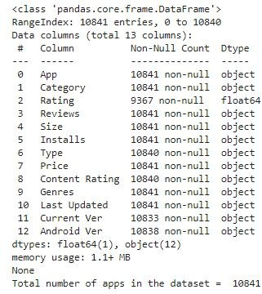
DATA SUMMARY
Apps DataFrame Summary

Slide 6
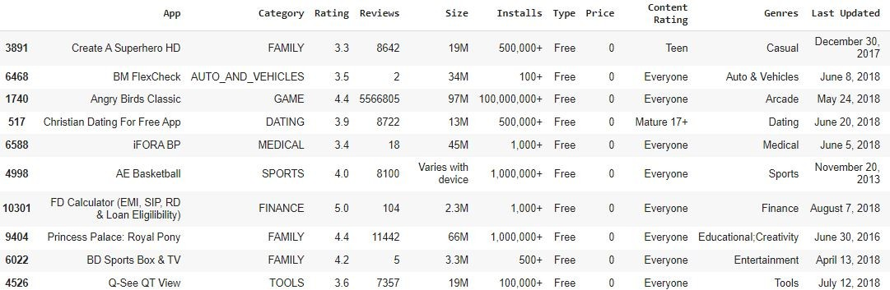
Apps DataFrame before Data Wrangling

Slide 7
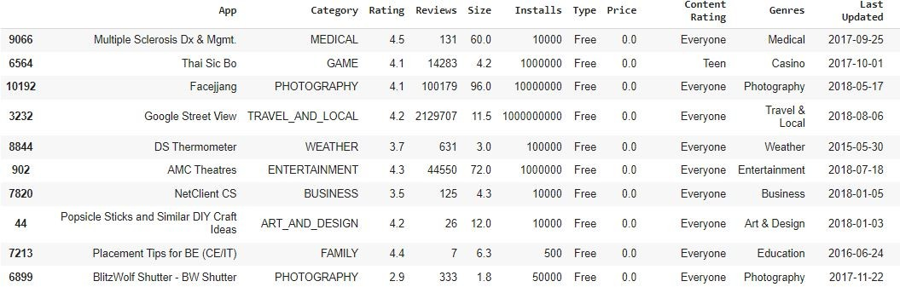
Apps DataFrame after Data Wrangling

Slide 8
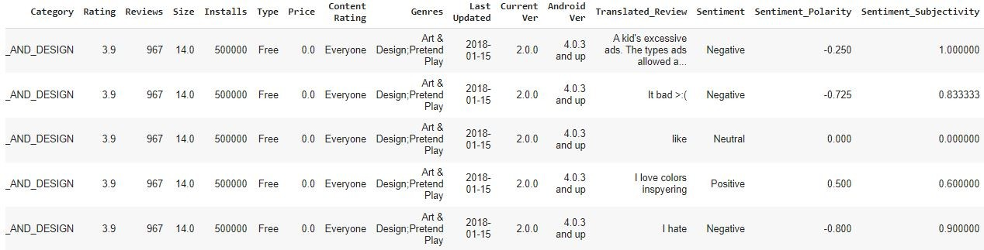
Merged DataFrame (Apps + Reviews)

Slide 9
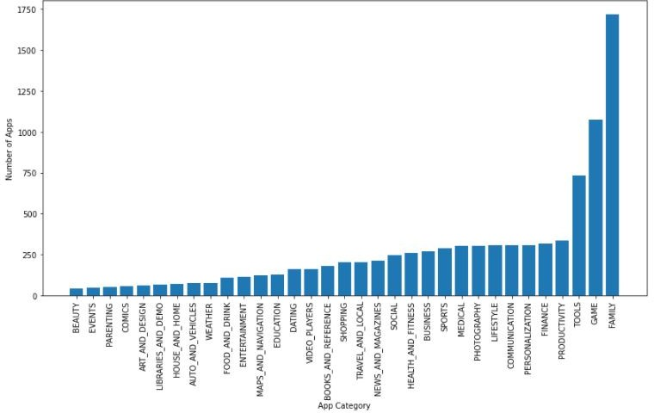
DATA VISUALIZATIONS

Slide 10
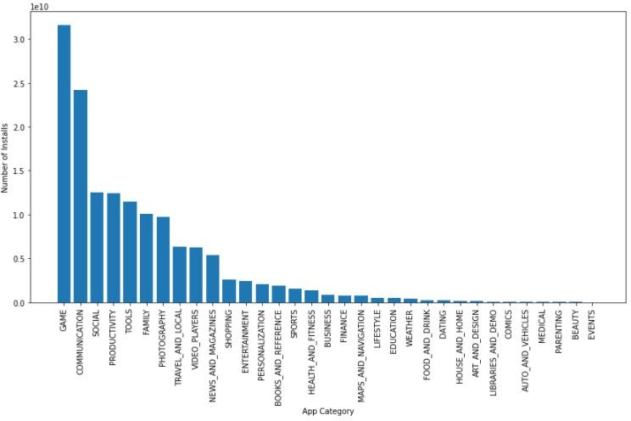

Slide 11
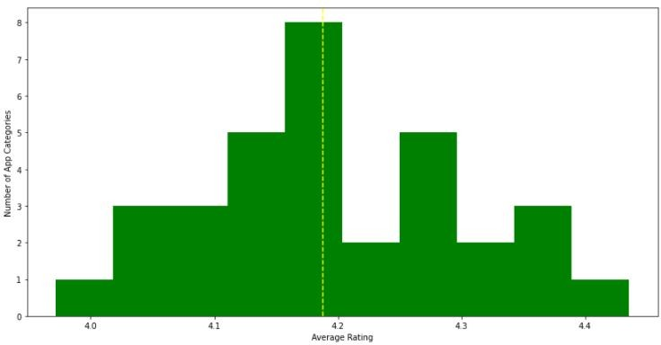

Slide 12
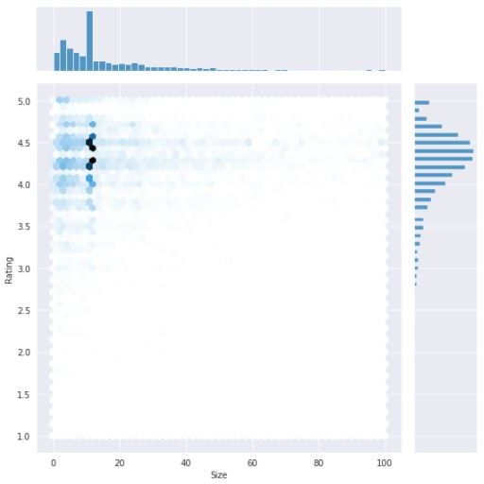

Slide 13
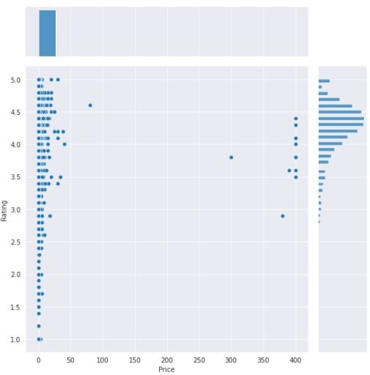

Slide 14
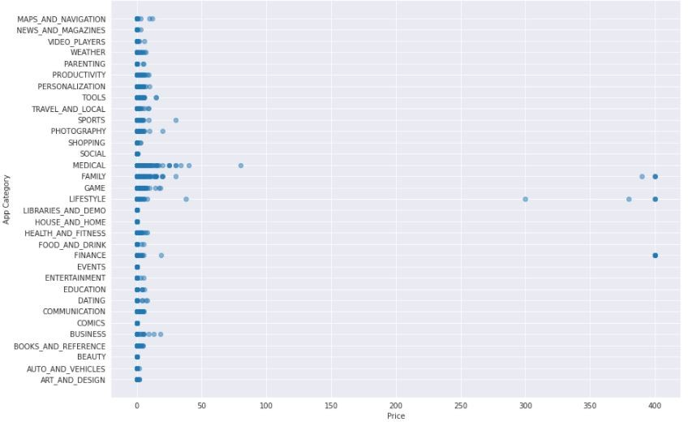

Slide 15
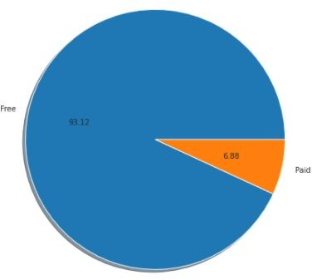
Popularity of Free vs Paid Apps

Slide 16
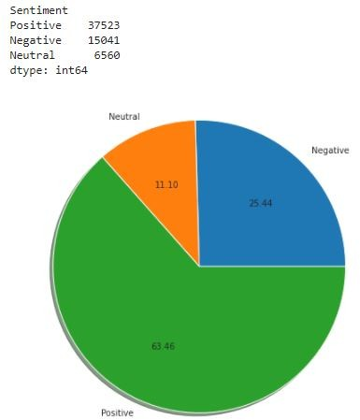
Distribution of Sentiments

Slide 17
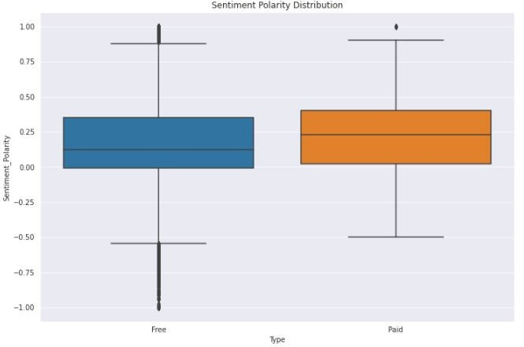

Slide 18
CONCLUSIONS
The most popular App Category is "Game".
A large number of Apps fall into "Family" Category i.e., this is the category with highest number of subsequent apps.
The total average rating of Play Store Apps is 4.18.
The App Categories with least and highest average ratings are "Dating" and "Events" respectively.
Free apps are highly popular when compared to Paid apps.
Most of the apps receive Positive reviews i.e., about 63.5%. Free apps might have a broader range of reviews than Paid apps, but the median of Sentiment Polarity is higher in Paid apps.

