Slide 1
ETIQUETTE
PRESENTED BY:
SACHIN KUMAR SINGH
SACHIN RAJBHAR
RITIK KUMAR
SANCHIT KELKAR
SANSKAR BANSAL
ANMOL SAINI
ABHISHEK PARTI
MOHIL
SUBMITTED TO
FACULTY : DIPANWITA DUTTA CHOWDHURY

Slide 2
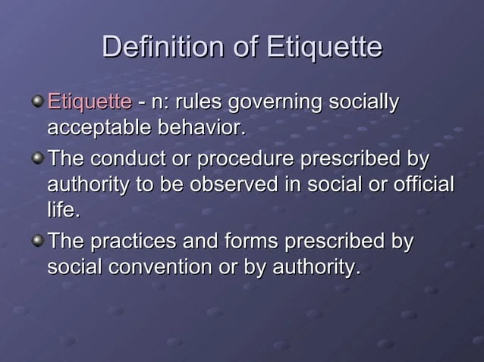

Slide 3
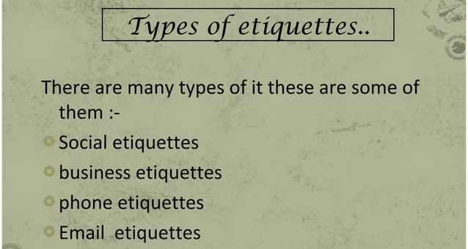

Slide 4
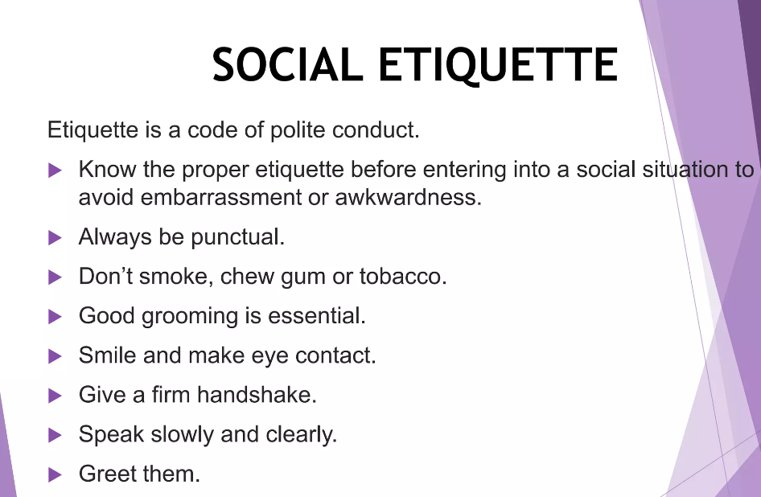

Slide 5
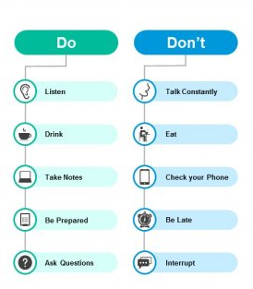
Business Etiquette

Slide 6
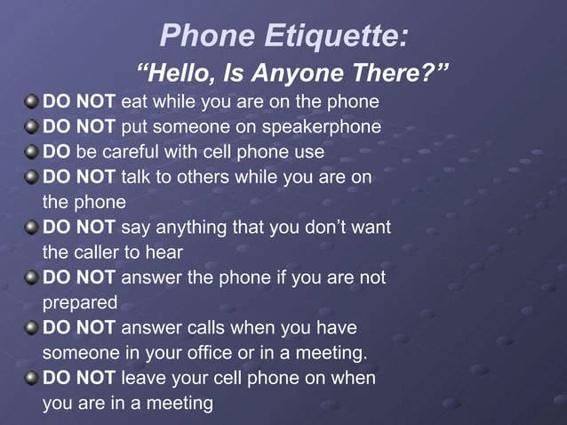

Slide 7
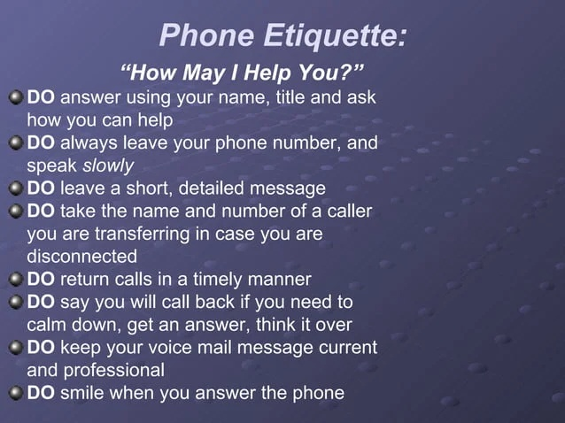

Slide 8
EMAIL ETIQUETTE
Email etiquette is the use of appropriate language, conventions and formality in an email.
Business emails usually demand formal language and strict adherence to proper grammar and spelling.
Using appropriate email etiquette shows the email's recipient that you care about your relationship with them, you value your professionalism and you represent the company for which you work well.

Slide 9
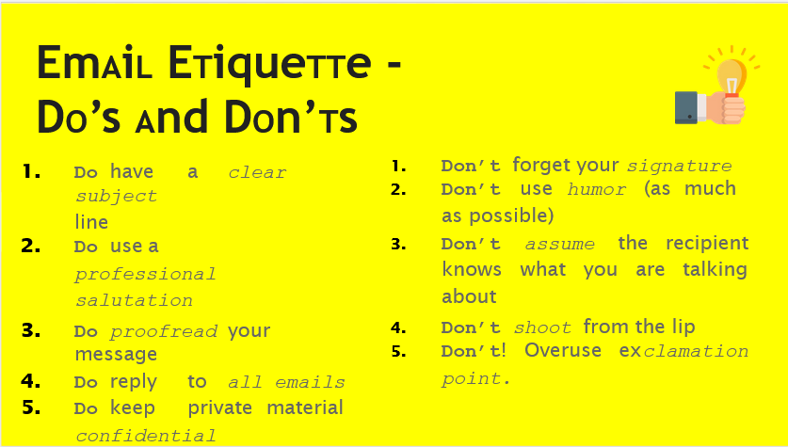

Slide 10
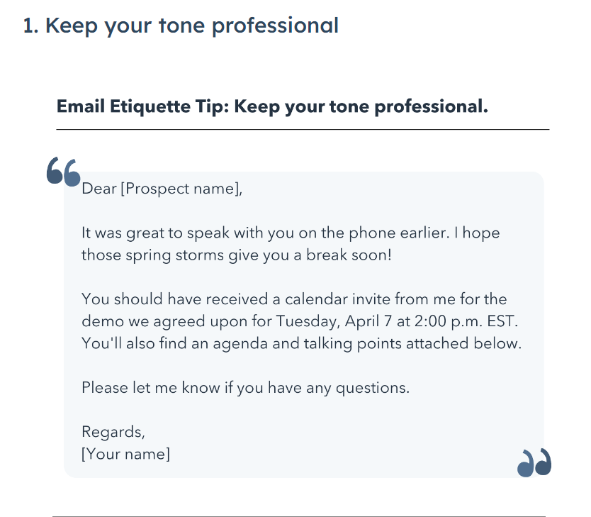
Do’s & Don’t with Examples-

Slide 11
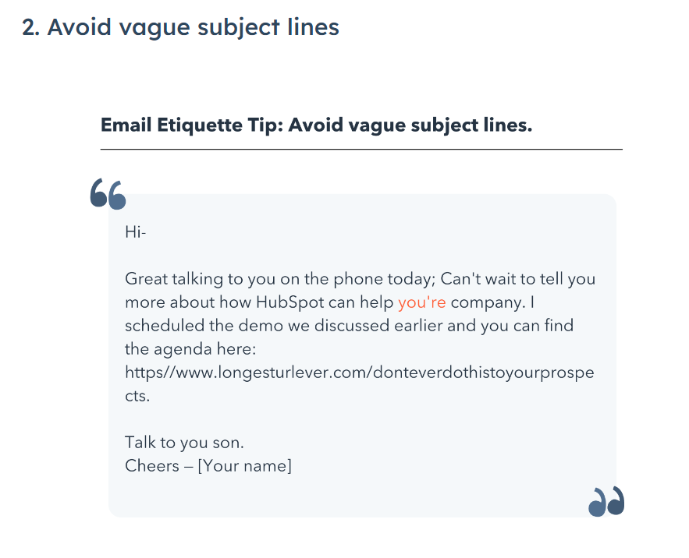

Slide 12
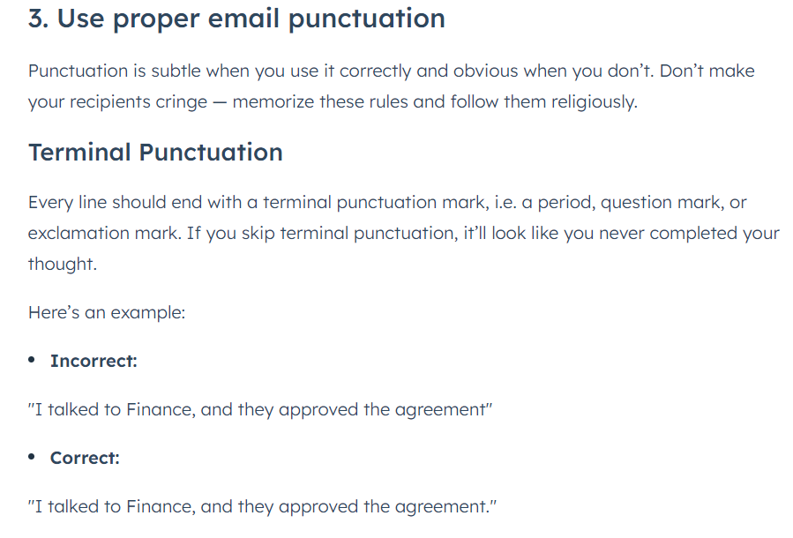

Slide 13


