Slide 1

DBMS
SACHIN RAJBHAR

Slide 2
TOPICS
A. DIFFERENT USERS OF DBMS
B. DIFFERENT TYPES OF DBMS

Slide 3
A. DIFFERENT USERS OF DBMS
1.Database Administrator (DBA) : Database Administrator (DBA) is a person/team who defines the schema and also controls the 3 levels of database. The DBA will then create a new account id and password for the user if he/she need to access the data base. DBA is also responsible for providing security to the data base and he allows only the authorized users to access/modify the data base.
DBA also monitors the recovery and back up and provide technical support.
The DBA has a DBA account in the DBMS which called a system or superuser account.
DBA repairs damage caused due to hardware and/or software failures.

Slide 4
2.Naive / Parametric End Users : Parametric End Users are the unsophisticated who don’t have any DBMS knowledge but they frequently use the data base applications in their daily life to get the desired results.For examples, Railway’s ticket booking users are naive users. Clerks in any bank is a naive user because they don’t have any DBMS knowledge but they still use the database and perform their given task.

Slide 5
3.System Analyst : System Analyst is a user who analyzes the requirements of parametric end users. They check whether all the requirements of end users are satisfied.
4.Sophisticated Users : Sophisticated users can be engineers, scientists, business analyst, who are familiar with the database. They can develop their own data base applications according to their requirement. They don’t write the program code but they interact the data base by writing SQL queries directly through the query processor.

Slide 6
5.Data Base Designers : Data Base Designers are the users who design the structure of data base which includes tables, indexes, views, constraints, triggers, stored procedures. He/she controls what data must be stored and how the data items to be related.
6.Application Program : Application Program are the back end programmers who writes the code for the application programs. They are the computer professionals. These programs could be written in Programming languages such as Visual Basic, Developer, C, FORTRAN, COBOL etc.
7.Casual Users / Temporary Users : Casual Users are the users who occasionally use/access the data base but each time when they access the data base they require the new information, for example, Middle or higher level manager.

Slide 7
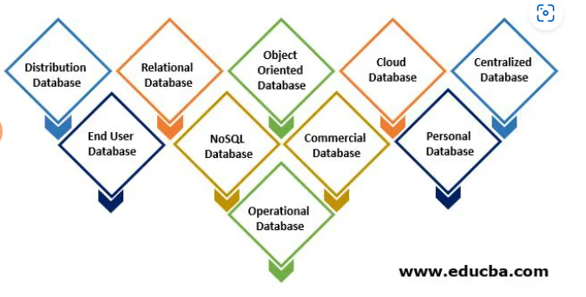
B. DIFFERENT TYPES OF DBMS

Slide 8
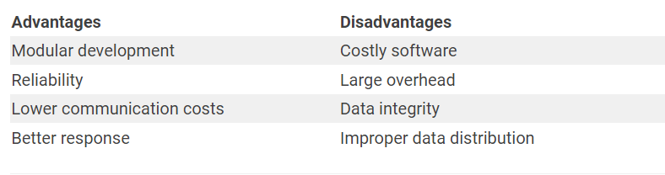
1. Distribution Database
A distributed database in which various parts of a database are located in different physical locations, along with databases replicated and distributed between different points in a network can be imagined. Heterogeneous and homogenous are the two kinds of distribution databases.

Slide 9
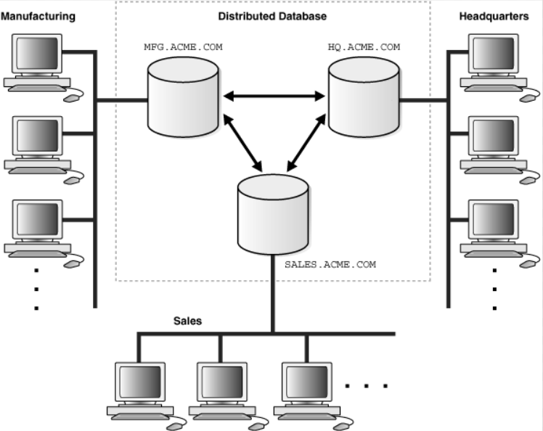

Slide 10
2. Relational Database
Such databases are classified by a set of tables, in which data falls into a predefined classification. The table is made up of rows and columns with data input for a certain category and rows, with the example of the data identified by the category.
ADVANTAGES | DISADVANTAGES
use tables of rows and columns, they display data more simply | relational databases HAVE LIMITED scale.
simply adding rows, columns, or entire tables without changing the overall database structure | Complicated data relations also slow down querying

Slide 11
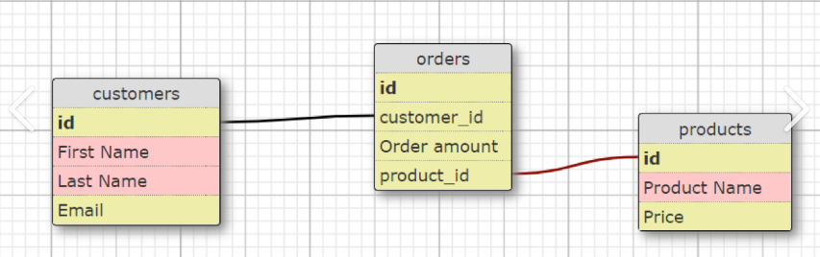

Slide 12
3. Object Oriented Database
An object-driven database is an object-driven and relational database collection.
Different items, such as java and C++, can be saved in a relational database using object-oriented programming languages
An object-oriented database will be organized instead of actions around objects and data instead of logic. In contrast to an alphanumeric value, a multimedia record in a relational database can be a definable data object.
ADVANTAGES | DISADVANTAGES
Easy to save and retrieve data quickly. | Lacks theoretical foundations and standards.
Extensible with custom data types. | High complexity causes performance issues

Slide 13
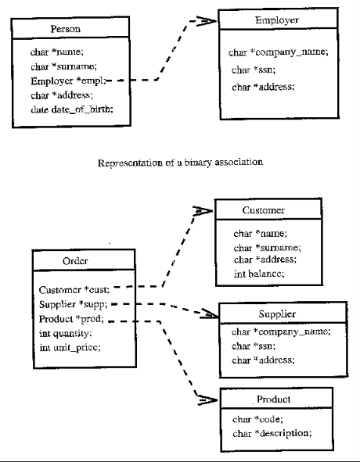

Slide 14
4. Cloud Database
A cloud database is an automated or built-in database for such a virtualized environment. A cloud service offers various advantages, including the ability to pay per user storage capacity and bandwidth and provides scalability on request and high availability.
ADVANTAGES | DISADVANTAGES
Fast Deployment | Downtime is often cited as one of the biggest disadvantage
Increased flexibility and innovative features | Vulnerability to attack

Slide 15
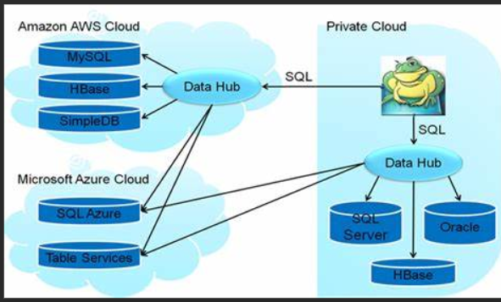

Slide 16
5. Centralized Database
The data is stored centrally and users from various locations can access this data. This database includes hiring processes that help users access the data from a remote location.
ADVANTAGES | DISADVANTAGES
It allows for working on cross-functional projects. | There is a risk of loss. And it becomes unresponsive
Higher levels of security can be obtained. | It may increase costs.

Slide 17
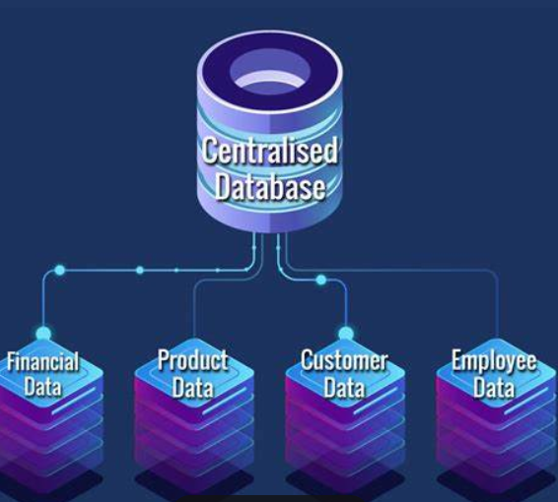

Slide 18
6. End User Database
The end-user is generally not worried about purchases or transactions at different levels and only understands the commodity, a program, or an application. It is, therefore, a collaborative database designed specifically for the end-user, as do the managers at various levels.
This database offers a list of all the details.
ADVANTAGES | DISADVANTAGES
Helps in the decision making | may cause loss of data or database failure
end users do not have to wait for approval from an IT governance body | complexity becomes an issue

Slide 19
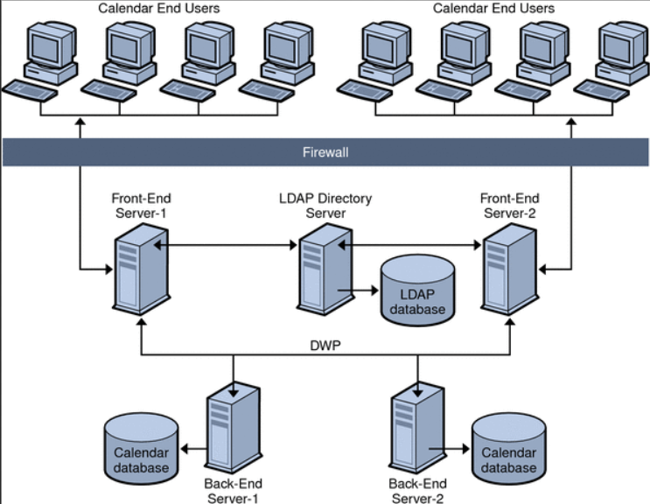

Slide 20
7. NoSQL Database
These are used for large data sets. Certain big data performance problems are handled effectively by relational databases, and NoSQL databases can easily address such problems. The analysis of large-size, unstructured information can be done very efficiently on several cloud virtual servers.
ADVANTAGES | DISADVANTAGES
Handle large volumes of data at high speed with a scale-out architecture | may cause loss of data or database failure
end users do not have to wait for approval from an IT governance body | complexity becomes an issue

Slide 21
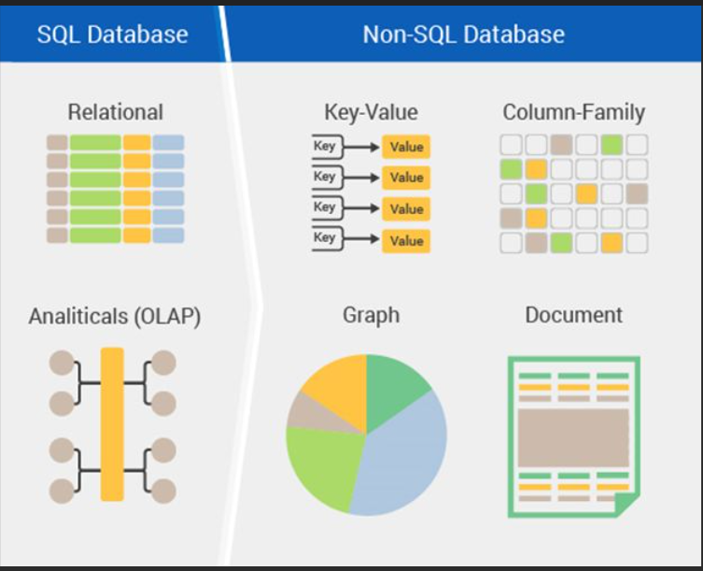

Slide 22
8. Commercial Database
These are the paid versions of the enormous databases designed for users who wish to access the information for assistance. These databases are specific subjects, and such huge information can not be maintained. Commercial links provide access to such databases.
ADVANTAGES | DISADVANTAGES
Proven reliability and advanced security features | Increased Cost
Utmost performance | Technical staff requirement

Slide 23
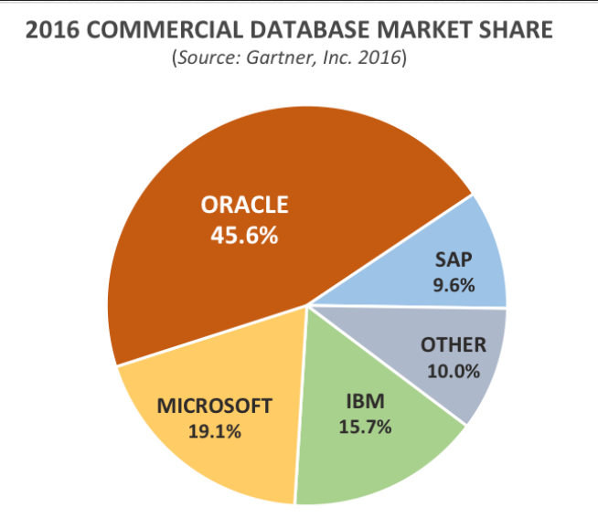

Slide 24
9. Personal Database
Data is collected and stored on small and easily manageable personal computers. The data are usually used by the same company department and are viewed by a small number of individuals.
ADVANTAGES | DISADVANTAGES
Integrity of data and faster processing | Fewer amounts of data
Security of data | No connectivity for external database

Slide 25
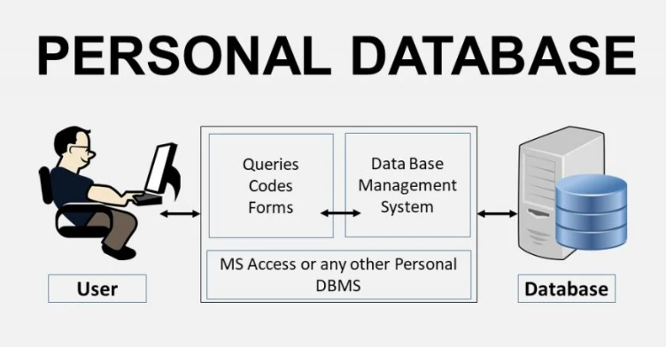

Slide 26
10. Operational Database
In this folder, information on a company’s operations is stored. These databases are needed for functional lines such as marketing, employee relationships, customer service, etc.
ADVANTAGES | DISADVANTAGES
greatly versatile and accommodate distributed systems like NoSQL, SQL, New SQL Databases. | installation process requires time and effort
These systems are highly available, fault-tolerant and highly scalable | Huge Size and Database Failure

Slide 27
