Slide 1
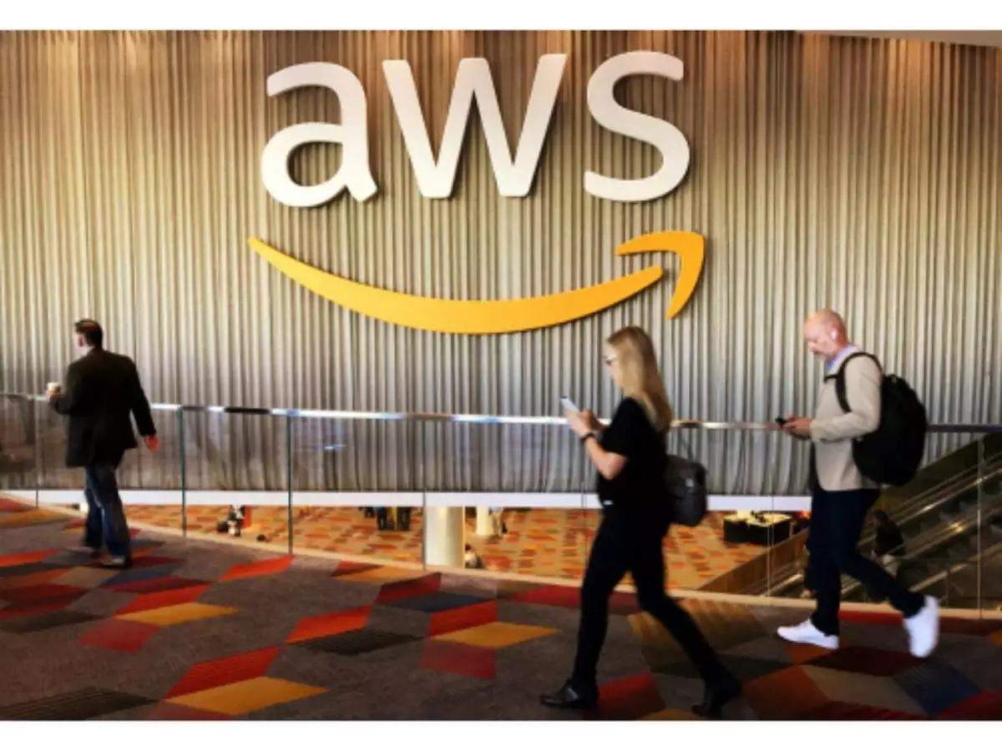
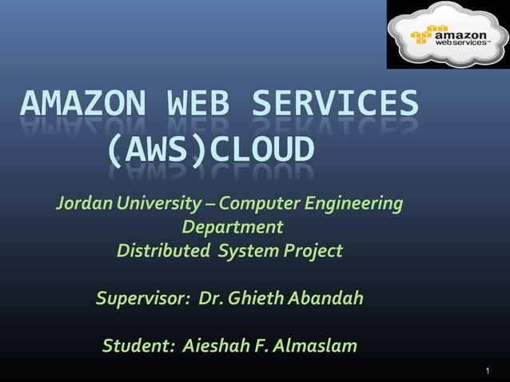
Presented By: Sachin Rajbhar 41221139 BCA 4rth Sem

Slide 2
OUTLINE
AWS Introduction /Cloud Computing
AWS Global Infrastructure
AWS Cloud Services
AWS Features & Benefits
AWS Cloud Architecture (use-case)
Conclusion & Critical Evaluation

Slide 3
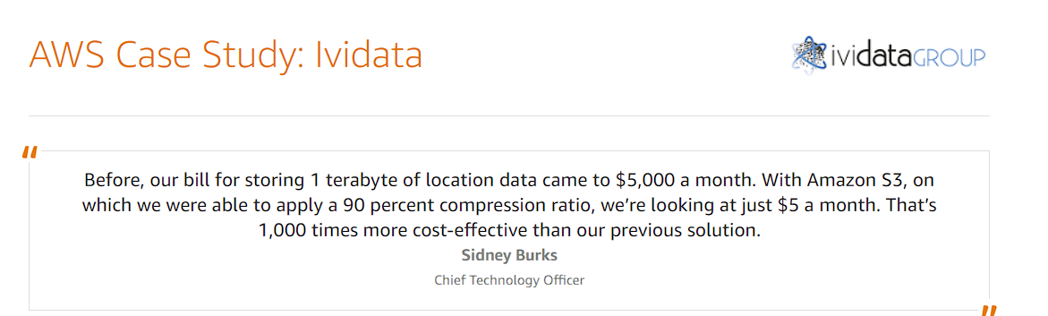
AWS Introduction
Amazon is the largest online store right now,
it was started by Jeff Bezos in 1995.
AWS Cloud Services was launched in 2006.
AWS is a collection of various web services that together make up a cloud computing platform.
It uses pay-as-you-go cloud computing services

Slide 4

CLOUD COMPUTING
The term cloud refers to a network or the internet. It is a technology that uses remote servers on the internet to store, manage, and access data online rather than local drives.
The data can be anything such as files, images, documents, audio, video, and more.

Slide 5
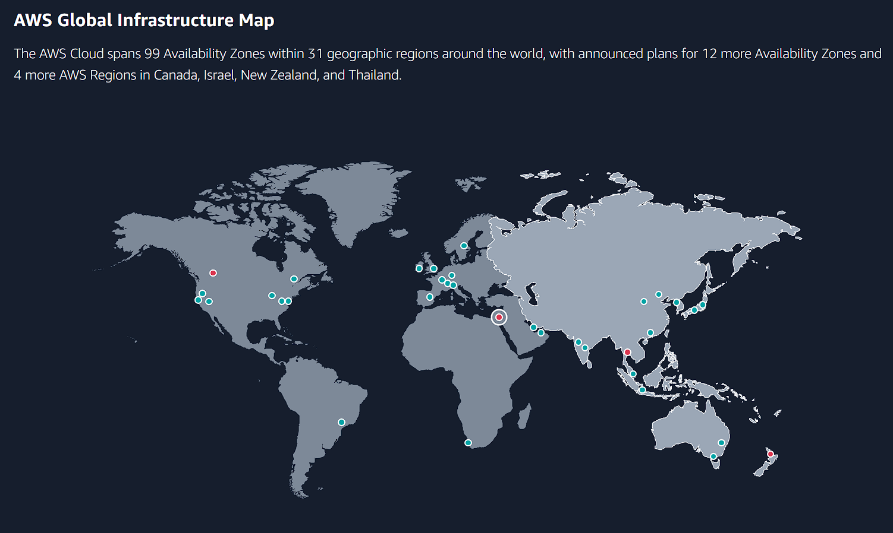
AWS Cloud Infrastructure

Slide 6
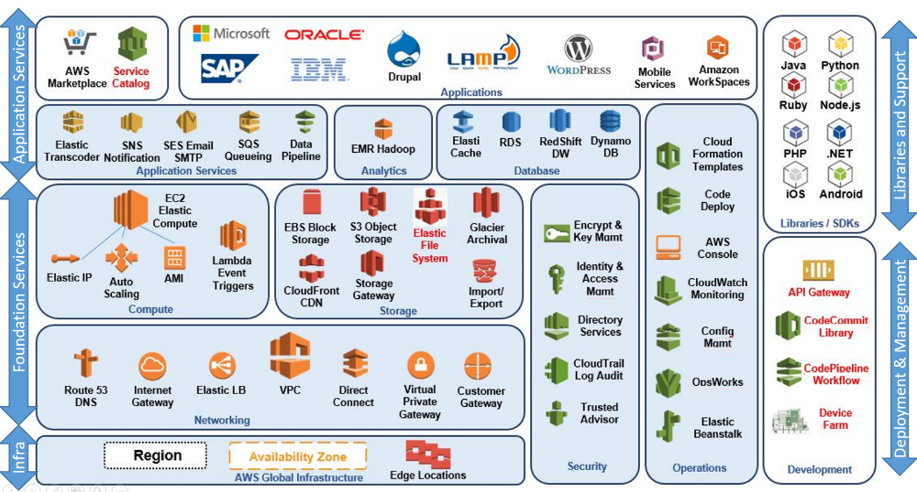
AWS Cloud Services

Slide 7
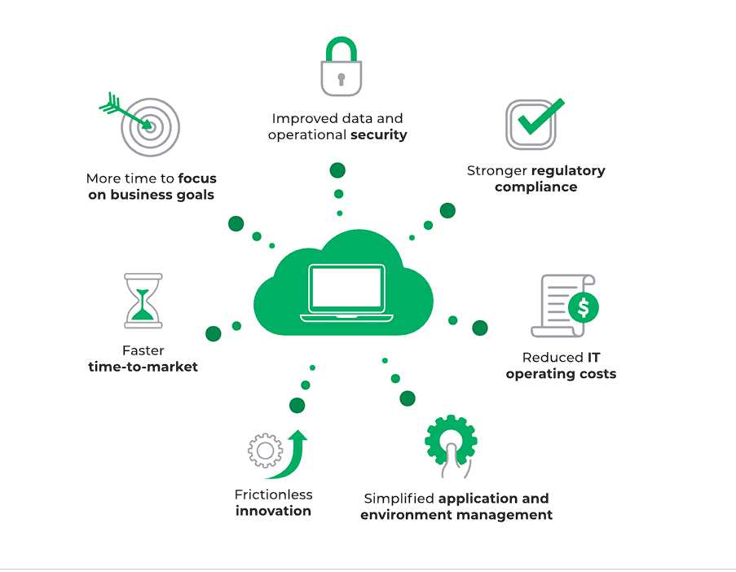
AWS Features & Benefits

Slide 8
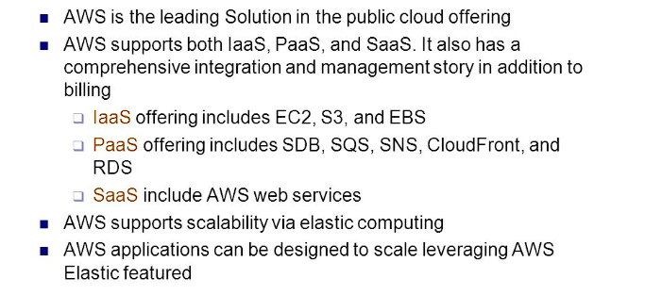
Conclusion & Critical Evaluation

Slide 9
Some Data Breaches:
Sure, here are some examples of security breaches that have affected AWS:
Capital One (2019): In July 2019, Capital One announced that a data breach had exposed the personal information of over 100 million customers and applicants. The breach was caused by a misconfigured firewall in an AWS instance.
Dow Jones (2017): In August 2017, Dow Jones announced that a data exposure had exposed the personal information of 2.2 million customers. The exposure was caused by a misconfigured AWS S3 bucket.
Timehop (2018): In July 2018, Timehop, a social media app, announced that a data breach had exposed the personal information of 21 million users. The breach was caused by a misconfigured AWS S3 bucket.
It's important to note that these breaches were caused by misconfigurations or vulnerabilities in specific AWS instances, rather than a fundamental flaw in the AWS platform itself.
AWS provides a wide range of security features and tools to help customers secure their data and applications, but it's ultimately up to individual businesses to implement these measures effectively.

Slide 10
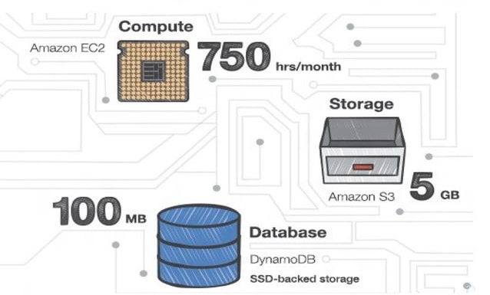
AWS Free Usage Tier

