Slide 1
CHERNOBYL NUCLEAR DISASTER
GROUP MEMBER NAMES AND ID
1. Munib Bakrawala (CE003) – 21CEUOS149
2. Bharad Raj (CE009) – 21CEUBS106
3. Shyam Chauhan (CE014) – 21CEUOS005

Slide 2
CONTENT PAGE
Introduction
Literature Review
Data Analysis
Conclusion
References
Page no. - 3
Page no. - 5
Page no. -10
Page no. - 19
Page no. - 21

Slide 3
INTRODUCTION
The Chernobyl Power Complex, lying about 130 km north of Kiev, Ukraine, and about 20 km south of the border with Belarus, consisted of four nuclear reactors of the RBMK-1000 design
The Chernobyl disaster was a nuclear accident that occurred on 26 April 1986 at the No. 4 reactor in the Chernobyl nuclear power plant, near the city of Pripyat in the north of the Ukrainian SSR in the Soviet Union.
It is considered the worst nuclear disaster in history both in cost and casualties.
The accident occurred during a safety test on the steam turbine of an RBMK- nuclear reactor.
During a planned decrease of reactor power in preparation for the test, the power output unexpectedly dropped to near-zero. The operators were unable to restore the power level specified by the test program, which put the reactor in an unstable condition.
This risk was not made evident in the operating instructions, so the operators proceeded with the test. Upon test completion, the operators triggered a reactor shutdown. However, a combination of operator negligence and critical design flaws had made the reactor primed to explode. Instead of shutting down, an uncontrolled nuclear chain reaction began, releasing enormous amounts of energy

Slide 4
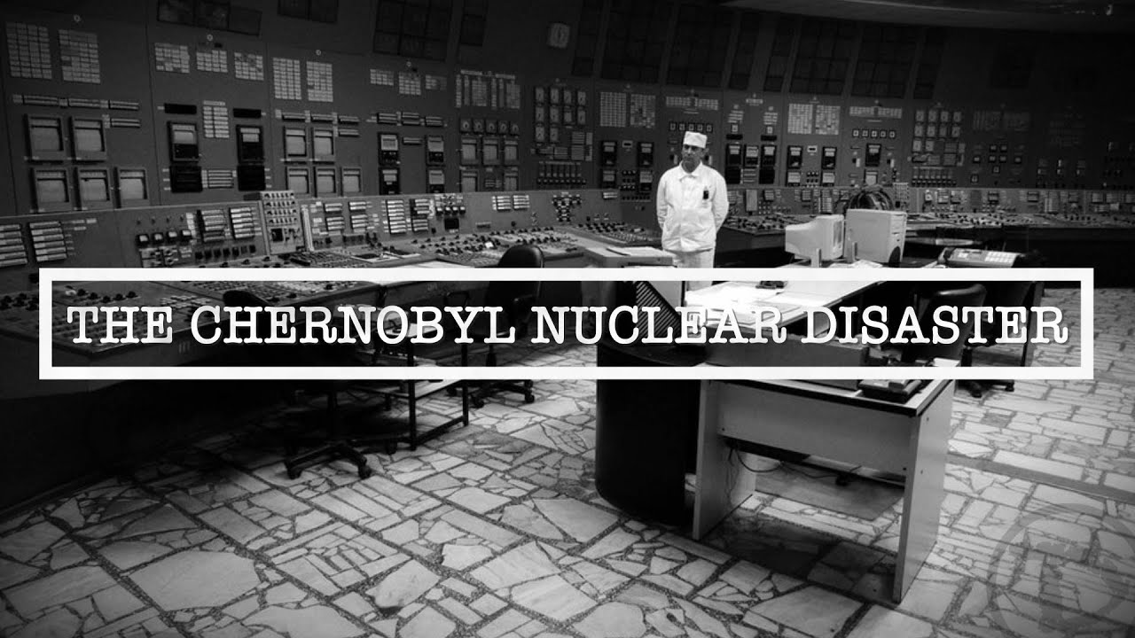
The core melted down and two or more explosions ruptured the reactor core and destroyed the reactor building. This was immediately followed by an open-air reactor core fire. It released considerable airborne radioactive contamination for about nine days that precipitated onto other parts of the USSR and Western Europe, before finally ending on 4 May 1986.
Some 70% of fallout landed in Belarus, 16 kilometres away. The fire released about the same amount of contamination as the initial explosion. As a result of rising ambient radiation levels off-site, a 10-kilometre radius exclusion zone was created 36 hours after the accident.. The exclusion zone was later increased to 30 kilometres when a further 68,000 people were evacuated from the wider area, and later it became the Chernobyl Exclusion Zone covering an area of approximately 2,600 km²

Slide 5
LITERATURE REVIEW
There are many Books and review article in which a detailed description has given on this topic.
The description which was given about how the nuclear blast has occur in the nuclear plant in many articles is as follows:
On 25 April, prior to a routine shutdown, the reactor crew at Chernobyl 4 began preparing for a test to determine how long turbines would spin and supply power to the main circulating pumps following a loss of main electrical power supply. This test had been carried out at Chernobyl the previous year, but the power from the turbine ran down too rapidly, so new voltage regulator designs were to be tested.
A series of operator actions, including the disabling of automatic shutdown mechanisms, preceded the attempted test early on 26 April. By the time that the operator moved to shut down the reactor, the reactor was in an extremely unstable condition.

Slide 6
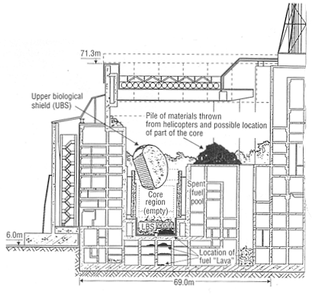
LITERATURE REVIEW
The design characteristics of the reactor were such that substantial damage to even three or four fuel assemblies would – and did – result in the destruction of the reactor. The overpressure caused the 1000 t cover plate of the reactor to become partially detached, rupturing the fuel channels and jamming all the control rods, which by that time were only halfway down. Intense steam generation then spread throughout the whole core causing a steam explosion and releasing fission products to the atmosphere. About two to three seconds later, a second explosion threw out fragments from the fuel channels and hot graphite

Slide 7
LITERATURE REVIEW
As per the research by TTU (Texas Tech University) which was under the guidance of Dr. Robert Baker :
The TTU research team members have conducted more than 70 trips to Chernobyl to conduct research on the biological impacts of radiation exposure, to assist in the planning of an International Radioecology Laboratory in Ukraine
The primary goal of Texas Tech's Chernobyl research team has been to determine the genetic consequences of radiation exposure to wildlife in the region.
Members of the team and many colleagues have visited the site multiple times to collect small mammal specimens, primarily field mice and voles, from the contaminated areas as well as from "control" regions with little or no radioactive contamination.
They have evalualed the radiation loads and genetic consequences to the rodents over time. The specimens and tissue samples collected during these research expeditions were deposited into the Radioactive Collection at the NSRL.

Slide 8
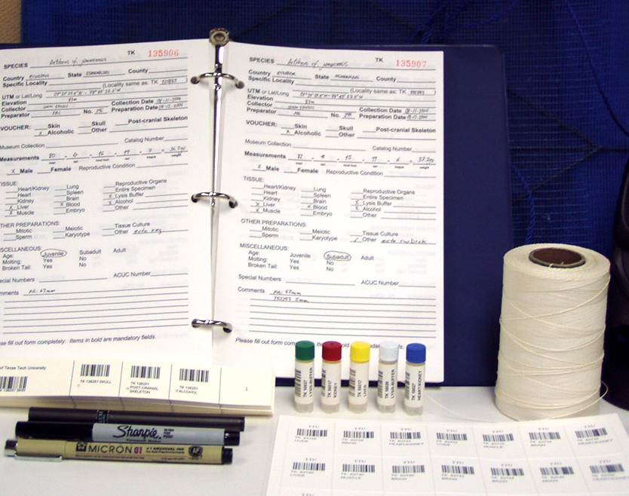
LITERATURE REVIEW
In addition to their genetic research, the Texas Tech team documented many ecological observations from the Chernobyl zone.
When the Texas Tech team began their research (8 years after the accident), the Red Forest area had become a grassland habitat, and grassland species of mammals were commonly found.
The species present in the area has been as expected based on local ecology. If there is an effect of the presence of radiation on the ecosystem, other than removal of humans, it has not been obvious from a gross perspective.
Because most of the human population has been removed from the area, there is essentially no hunting pressure or agricultural impact on the wild animal population in the Exclusion Zone. This absence of human habitation led to an increase in numbers of native wild animals.

Slide 9
LITERATURE REVIEW
The Chernobyl disaster was a unique event and the only accident in the history of commercial nuclear power where radiation-related fatalities occurrede.
The design of the reactor is unique and in that respect the accident is thus of little relevance to the rest of the nuclear industry outside the then Eastern Bloc.
However, it led to major changes in safety culture and in industry cooperation, particularly between East and West before the end of the Soviet Union.
Former President Gorbachev said that the Chernobyl accident was a more important factor in the fall of the Soviet Union than Perestroika – his program of liberal reform

Slide 10
DATA ANALYSIS
Referring to the forested biocoenosis—the environmental system that had reportedly suffered most from the Chernobyl accident—the project concluded that the radioactive contamination was not on a massive scale and affected mainly pine forests: the death of the pine plantations, although severe in the immediate vicinity of the plant, amounted to less than 0.5% of the forested area of the exclusion zone.
The WHO International Programme on the Health Effects of the Chernobyl Accident (IPHECA) recently published and discussed at the WHO International Conference on the Health Consequences of the Chernobyl, held in Geneva, 20–23 November 1995.
The IPHECA analysis can be summarized as follows:
Psychosocial effects, believed to be unrelated to radiation exposure, resulted from the lack of information immediately after the accident, the stress and trauma of compulsory relocation to less contaminated areas, the breaking of social ties, and the fear that radiation exposure could cause health damage in the future.

Slide 11
DATA ANALYSIS
A sharp increase in thyroid cancer was reported, especially among children living in the affected areas. By the end of 1994, 565 children aged 0–14 years were diagnosed as having thyroid cancer (333 in Belarus, 24 in the Russian Federation, 208 in Ukraine).
There was no significant increase in the incidence of leukaemia and other blood disorders.
Some evidence was found to suggest retarded mental development and deviations in behavioral and emotional reactions in a small number of children exposed to radiation in utero; however, the extent to which radiation might have contributed to such mental changes cannot be determined because of the absence of individual dosimetry data.
The types and distribution of oral diseases observed in the residents of “contaminated” areas were the same as those of the residents of “uncontaminated” areas.

Slide 12
DATA ANALYSIS
DATA ANALYSIS OF THE PEOPLE DIED IN THE BLAST:
The number of people who suffered clinically observed health effects individually attributable to radiation exposure due to the Chernobyl accident was relatively modest, given the accident's dimensions
A total of 237 persons, all of them workers dealing with the accident, were suspected of suffering clinical syndromes of radiation exposure and were hospitalized, and 134 of them were diagnosed with acute radiation syndrome.
Of these, 28 died of the consequences of radiation injuries Some years after the accident, 14 additional persons in this group died; however, their deaths were found to be not necessarily attributable to radiation exposure.
Fewer than 50 deaths have been directly attributed to radiation from the disaster, up to 4000 people had due to radiation exposure .
Three other persons died at the time of the accident two due to non-radiation blast injuries and one due to a coronary thrombosis.

Slide 13
DATA ANALYSIS
DATA ANALYSIS OF THE PEOPLE AFFECTED DUE TO THYRIOD CANCER:
The situation in relation to thyroid effects is serious.
Up to the end of 1995, there were more than 800 cases of thyroid cancer reported in children, mainly in Belarus.
Thyroid cancer may be induced by causes other than radiation, but all these cases seem likely to be associated with radiation exposure due to the accident. They represent a dramatic increase in the normal incidence of this rare type of cancer and the increase seems not to persist among children born after 1986.
Thyroid cancer is usually non-fatal with early diagnosis, treatment and attention.
At the time of the Chernobyl Conference, three of the children affected had already died.
The prospects cannot be precisely predicted the high incidence is expected to continue for some time and the number of reported cases may be in the thousands the mortality will depend very much on the quality and intensity of the treatment given to the affected children.

Slide 14
DATA ANALYSIS
There is no evidence to date of any increase in the incidence of any malignancies other than thyroid carcinoma or of any hereditary effects attributable to radiation exposure caused by the Chernobyl accident.
The Chernobyl Conference found that social, economic, institutional and political impacts were also important consequences of the Chernobyl accident. Large economic losses attributed to the accident were reported in this official document and also in the national statements delivered at the Chernobyl Conference.

Slide 15
DATA ANALYSIS
FINANCIAL LOSS DUE TO CHERNOBYL DISASTER:
Direct losses of fixed assets and other material goods when counted, summed the disaster amount to 9.2 billion Ruble between 1986 and 1989.
The non-productive and productive fixed assets loss amounted to 900 million Rubles.
Lost output in agriculture and other sectors amounted to about 1.2 billion Rubles.
Expenditure on the social and cultural facilities, construction of housing, and services for the population affected by the Chernobyl disaster, road-building, measures to protect forests and water, decontamination operations, and the provision of gas supplies to settlements amounted to 2.94 billion Rubles.
Various kinds of compensation were paid to the population amounting to 1.25 billion Rubles. Payment of cash benefits because of restrictions on the consumption of agricultural products from private plots and local farms amounted to 180 million Rubles.
Indirect losses represented an incomparably larger amount. The expenditure in question had been financed mainly from the State budget. Apart from budgetary allocations by the USSR State insurance agency, insurance payments have been made to individuals and agricultural and co-operative organizations in the amount of 274 million rubles.

Slide 16
DATA ANALYSIS
The total expenditure also included money contributed voluntarily by individuals and organizations to the assistance fund for dealing with the after-effects of the Chernobyl disaster in the amount of 532 million roubles.
Workers constructed a concrete and steel sarcophagus around Unit 4.﻿ This structure had weakened, so a permanent structure was built around it. Its cost was approx. $765 million.
The area around the plant was mostly rural. The main source of income for the people before the accident was agriculture – in the form of large collective farms and also small individual plots (cultivated for household consumption and local sale). There were a few factories around the area mainly of food processing and wood products.
Agriculture was the worst hit by this accident. A huge area of land consisting of 784,320 hectares of agricultural land was removed from service and, timber production was halted for a total of 694,200 hectares of forest.
The production has remained possible in many areas because of remediation efforts, but it came with a higher cost of products since it meant higher use of additives, fertilizers, and special cultivation processes. Even though safe products were being developed/cultivated by the locals, the consumers rejected the products from the affected areas.
Revenues from certain types of production declined, agricultural activities had fallen, and some facilities had closed altogether.

Slide 17
DATA ANALYSIS
CHERNOBYL CLEAN UP COST:
Due to the conservative policies of the then government, actual cost of clean up could never be determined.
Further, nuclear waste is not known to degrade in short time.
This means that clean up can go even upto 6-7 decades or more. While the initial costing was at around $70 billion (when matched with levels as on 2019), the overall costing tends to breach $250 billion as on date.
This figure shall increase, as the clean up process reaches its goal.

Slide 18
DATA ANALYSIS
CHERNOBYL EFFECT ON COUNTRY ECONOMY:
Ukraine government still spends 5 to 7 percent of government spending each year on Chernobyl-related programs and benefits.
If you consider the total amount of spending by Ukraine after the dissolution of the Soviet Union, it caused the country to lose at least a decade in terms of economic development.
Even Belarus was impacted severely. The government spends 22.3 percent of the national budget on the Chernobyl related issues in 1991 which by 2002 declined to 6.1 percent.
Belarus had spent more than the US $ 13 billion on Chernobyl between 1991 and 2003.
There was a huge cost of initially moving over 100,000 residents and later another quarter of a million on the economies of Belarus, Ukraine, and Russia and they were unable to bare the load, especially after the collapse of the Soviet Union.

Slide 19
CONCLUSION
The accident at the Chernobyl nuclear power plant in 1986 was a tragic event for its victims, and those most affected suffered major hardship.
Some of the people who dealt with the emergency lost their lives.
Although those exposed as children and the emergency and recovery workers are at increased risk of radiation-induced effects, the vast majority of the population need not live in fear of serious health consequences due to the radiation from the Chernobyl accident.
For the most part, they were exposed to radiation levels comparable to or a few times higher than annual levels of natural background, and future exposures continue to slowly diminish as the radionuclides decay.
Lives have been seriously disrupted by the Chernobyl accident, but from the radiological point of view, generally positive prospects for the future health of most individuals should prevail.

Slide 20
CONCLUSION
Despite the terrible tragedy we have had many advancements in reactor technology and now the RBMK Reactor is not used and new reactors have to go through rigorous testing and safety checks before they can operate.
The question now is how do we make sure an accident like that never happens again. Hopefully the current technology won't allow for this type of incident to ever happen again.
The key differences in U.S. reactor design, regulation and emergency preparedness make it highly unlikely that a Chernobyl-type accident could occur in the United States.

Slide 21
REFERENCES
Following are the links to refere more about the Chernobyl nuclear disaster:
Introduction to Chernobyl disater:
https://en.wikipedia.org/wiki/Chernobyl_disaster
Literature Review:
https://www.depts.ttu.edu/nsrl/About/research-highlights/chernobyl-summary/index.php
Data Analysis:
https://www.sciencedirect.com/topics/engineering/chernobyl-accident
https://globalhealth.usc.edu/2016/05/24/the-financial-costs-of-the-chernobyl-nuclear-power-plant-disaster-a-review-of-the-literature/
http://www.mint2save.com/chernobyl-disaster-effect-on-economy/

Slide 22
REFERENCES
Conclusion:
http://large.stanford.edu/courses/2017/ph241/moshkovich1/#:~:text=Conclusion%20The%20Chernobyl%20accident%20was%20a%20travesty%20that,and%20residents%20living%20in%20the%20most%20contaminated%20areas
http://9proeglb.weebly.com/conclusion.html

