Slide 1
SANJAYA EDGE
AI Road Safety Co-Pilot
Real-Time Violation Detection | Legal Explainability | Citizen-Facing
YOLOv8n
FastAPI
React + Vite
OpenCV HSV
MVA 1988 + IPC 283
IIT Madras CoERS Road Safety Hackathon 2026 | DriveLegal Track
github.com/Rajbharti06/SANJAYA-EDGE

Slide 2
SANJAYA EDGE
02 / 07
The Problem
1,68,491
53%
Top 3
< 2%
road crash deaths in India (2022)
of fatalities are 18-45 yr working age
causes: red-light jump, wrong-side, no helmet
violations ever result in a challan
The Gap — Why Existing Systems Fail
Reactive, not proactive
Police enforce after the fact. No real-time citizen warning.
Legally opaque
Challans cite a section number — citizens don't know what law they broke or what fine applies.
No city-scale coverage
Camera density is low. Most violations go completely undetected.
No multi-violation awareness
Existing tools detect one class. Real intersections involve 4-5 simultaneous risks.
IIT Madras CoERS Road Safety Hackathon 2026 · DriveLegal Track
github.com/Rajbharti06/SANJAYA-EDGE

Slide 3
SANJAYA EDGE
03 / 07
Solution — SANJAYA EDGE
A real-time AI legal co-pilot that detects violations, cites the exact law, and announces the state-specific fine — proactively, before harm occurs.
D1
Red Light Jump
D2
Helmet Violation
D3
Wrong-Side Driving
D4
Traffic Blocking
D5
Pedestrian in Lane
MVA Sec. 119
MVA Sec. 129
MVA Sec. 184
IPC Sec. 283
MVA Sec. 283
Rs. 1,000 / Rs. 2,000
Rs. 1,000 + 3-mo. ban
Rs. 5,000
Rs. 5,000 + Rs. 2,000
Rs. 500
YOLOv8 + HSV 4-frame temporal
Custom head/helmet classifier
Lucas-Kanade optical flow
Vectorised IoU cluster >= 6
Aspect-ratio + zone filter
Every Alert Delivers:
Violation name + exact MVA / IPC section
National fine + TN / MH / KA state-specific amount
Risk statement (why it is dangerous)
Voice announcement (Web Speech API | en-IN)
IIT Madras CoERS Road Safety Hackathon 2026 · DriveLegal Track
github.com/Rajbharti06/SANJAYA-EDGE

Slide 4
SANJAYA EDGE
04 / 07
Technical Architecture
BACKEND (Python · FastAPI)
FRONTEND (React · Vite · Tailwind)
Performance
YOLOv8n
Live Feed
imgsz
320px
COCO 80-class object detection
Annotated JPEG frames from WebSocket
OpenCV HSV
Event Log
Skip
3 frames
Traffic light colour analysis
Color-coded cards: Critical / High / Safe
WebSocket base64 JPEG + JSON
Resize
416px
Lucas-Kanade
Stats Strip
Optical flow wrong-side detection
Events · Critical · Confidence · Fine total
JPEG
Q60 / 640px
IoU Cluster
Voice Co-Pilot
Traffic blocking gridlock detector
Web Speech API · en-IN · reads every alert
Pool
2 threads
Thread Executor
5 Scenarios
Non-blocking async inference
Red light, helmet, wrong-side, blocking
Warmup
startup
rules.json
HUD Overlay
MVA 1988 + IPC 283 legal database
Speed, GPS, detector status, REC indicator
CUDA
auto
IIT Madras CoERS Road Safety Hackathon 2026 · DriveLegal Track
github.com/Rajbharti06/SANJAYA-EDGE

Slide 5
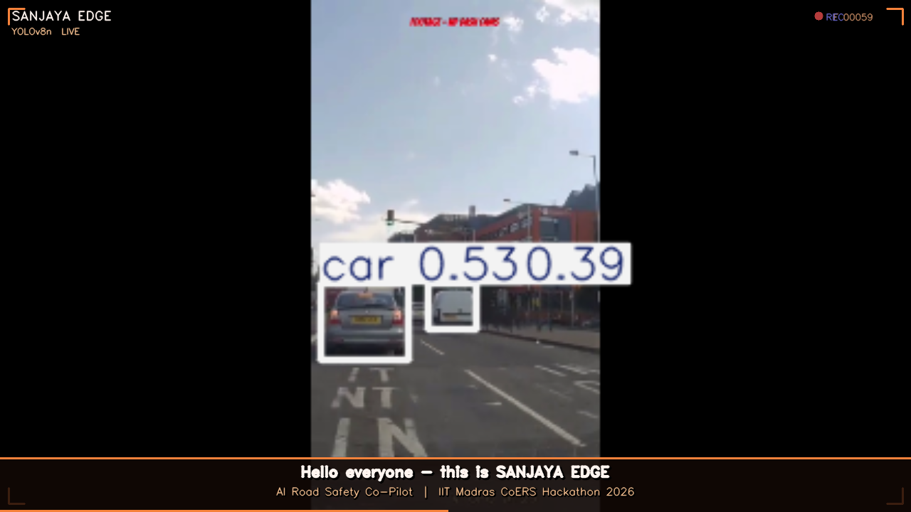
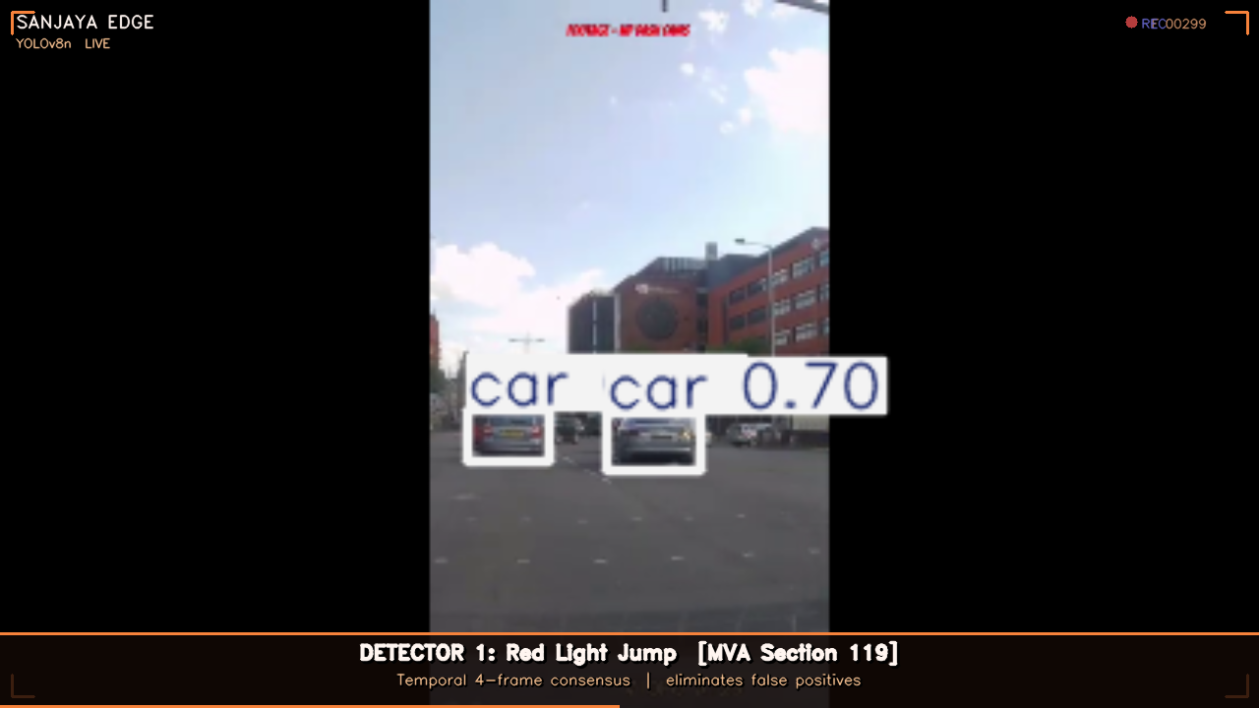
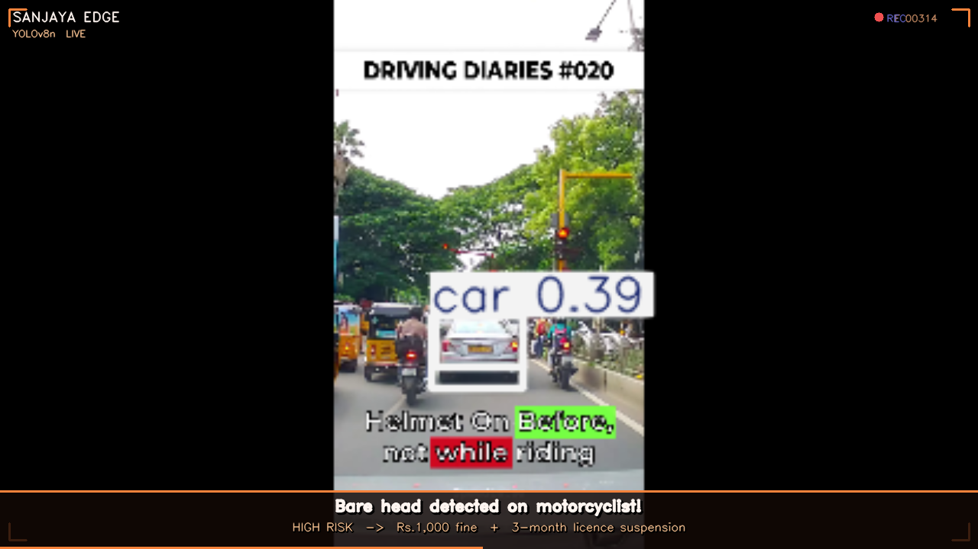
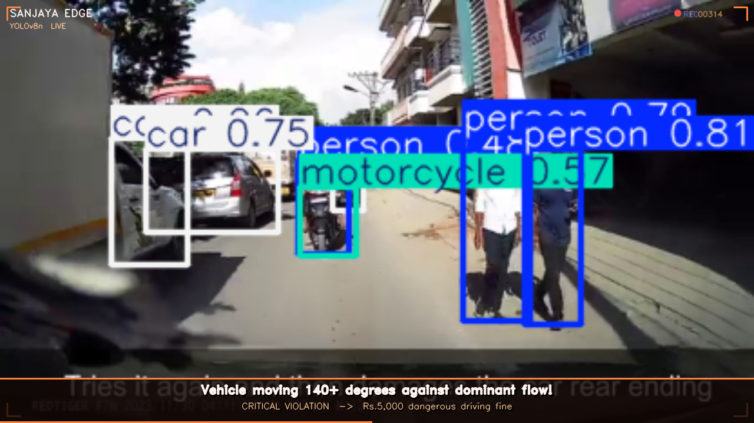
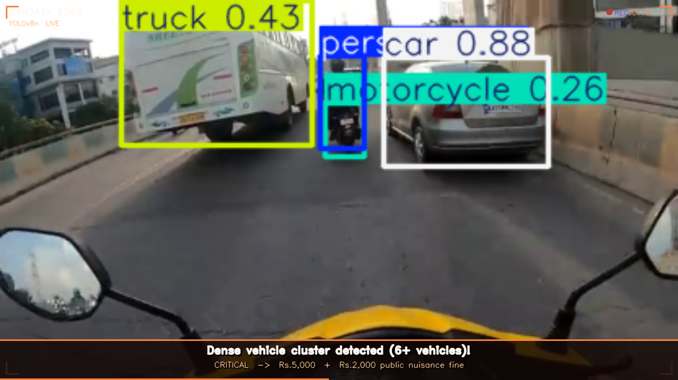
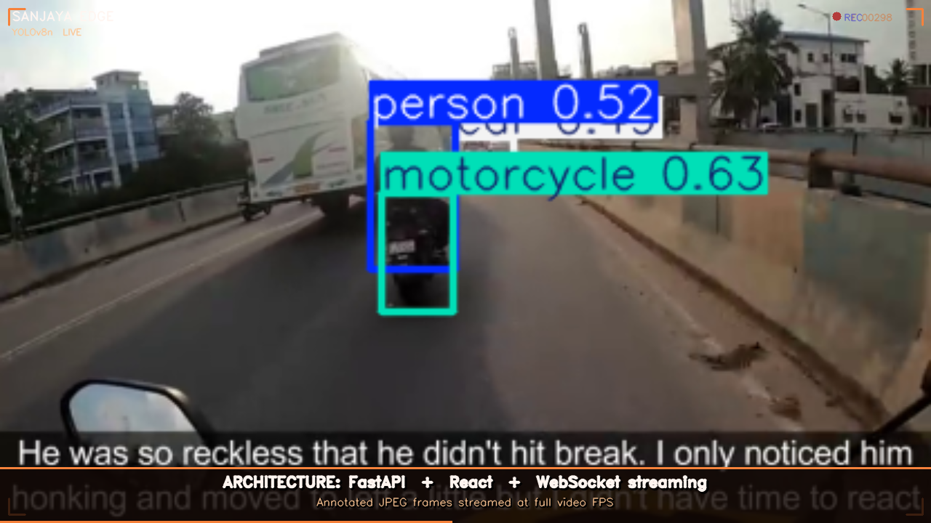
SANJAYA EDGE
05 / 07
Live Demo — Real Indian Traffic
YOLOv8n live scanning
Red Light Detection
Helmet Violation
Wrong-Side Driving
Traffic Blocking
Architecture Overview
IIT Madras CoERS Road Safety Hackathon 2026 · DriveLegal Track
github.com/Rajbharti06/SANJAYA-EDGE

Slide 6
SANJAYA EDGE
06 / 07
Innovation & Impact
What Makes It Different
Potential Impact
Temporal Consensus
Scalable to any camera
4-frame HSV filter eliminates false red-light positives from sunlight glare.
Dashcam, CCTV, traffic pole cam — no hardware lock-in.
Optical Flow Detection
Zero police dependency
Lucas-Kanade flow on vehicle centres flags wrong-side with no GPS needed.
Citizens receive legal education at point-of-violation, not after.
Citizen-Facing Legal DB
State-specific fines
Every alert names the exact law section + fine per state (TN/MH/KA).
Covers TN, MH, KA. Database extensible to all 28 states.
Thread-Pool Inference
Proactive deterrence
YOLO runs in executor — async event loop never blocks; WebSocket stays smooth.
Real-time voice warning before the next violation, not after the first.
Voice Co-Pilot
Open source
Web Speech API (en-IN) announces each violation aloud within 200ms.
MIT-licensed. Deployable by any smart-city or transport authority.
5 Detectors Simultaneously
Roadmap: seatbelt, phone use
Red light + helmet + wrong-side + blocking + pedestrian all run in one pass.
3 more detectors ready to add. Legal DB already has entries.
IIT Madras CoERS Road Safety Hackathon 2026 · DriveLegal Track
github.com/Rajbharti06/SANJAYA-EDGE

Slide 7
Thank You
SANJAYA EDGE — Making Every Road Safer, One Detection at a Time
Code Repository
Tech Stack
Legal Coverage
Hackathon
github.com/Rajbharti06/SANJAYA-EDGE
YOLOv8n · FastAPI · React · OpenCV · Python 3.11
MVA 1988 · IPC 283 · TN / MH / KA State Rules
IIT Madras CoERS Road Safety Hackathon 2026 · DriveLegal
Submitted for IIT Madras CoERS Road Safety Hackathon 2026

