Slide 1
Data Analytics Internship
Task 4: Data Storytelling & Statistical Analysis
Raj Chandravanshi

Slide 2
Objective:
The goal of this analysis is to evaluate sales performance over time and identify key trends that can support data-driven business decisions.
This project focuses on understanding growth patterns, category performance, and overall business improvement.
In short : Analyze sales data and generate insights

Slide 3
Data Cleaning
- Removed missing values
- Removed duplicates
- Converted date
- Created Year column

Slide 4
EDA Insights
- Category performance
- Sales trends
- Data patterns

Slide 5
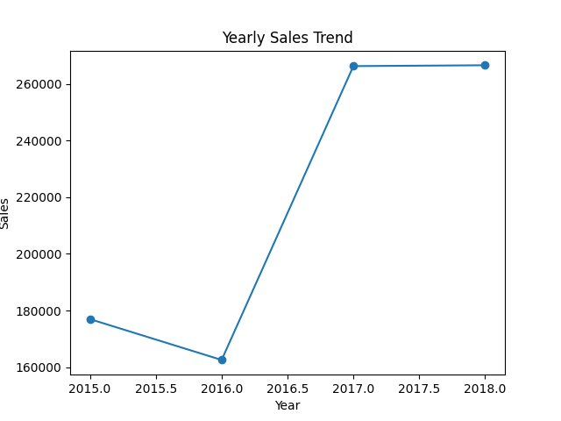
Yearly Sales Trend

Slide 6
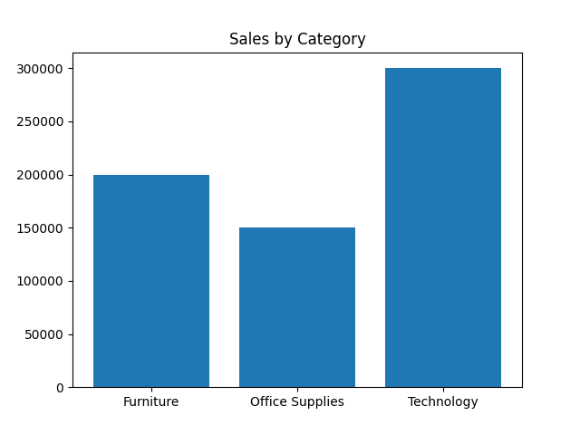
Sales by Category

Slide 7
Analysis
Sales dipped in 2016 but increased in 2017 & 2018

Slide 8
Hypothesis
Sales increased in recent years
H0: Sales have not increased over time
H1: Sales have increased over time

Slide 9
Conclusion
This analysis demonstrates a complete data analytics workflow — from data cleaning to storytelling.
The findings clearly show that sales have improved over time, indicating positive business growth.
Data-driven insights can significantly enhance strategic decision-making.
In short : Business growth is positive

