Slide 1

Chapter 2
Network Models
Copyright © The McGraw-Hill Companies, Inc. Permission required for reproduction or display.

Slide 2
2-1 LAYERED TASKS
We use the concept of layers in our daily life. As an example, let us consider two friends who communicate through postal mail. The process of sending a letter to a friend would be complex if there were no services available from the post office.
Topics discussed in this section:
Sender, Receiver, and Carrier
Hierarchy

Slide 3
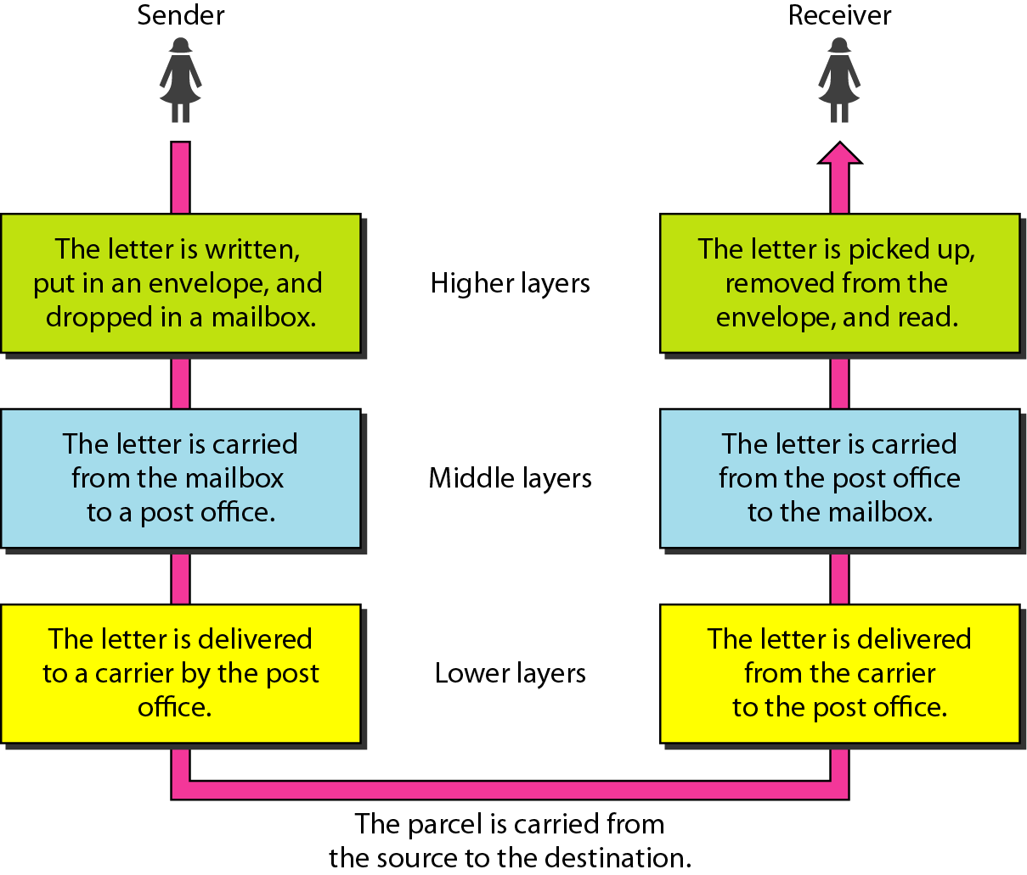
Figure 2.1 Tasks involved in sending a letter

Slide 4
2-2 THE OSI MODEL
Established in 1947, the International Standards Organization (ISO) is a multinational body dedicated to worldwide agreement on international standards. An ISO standard that covers all aspects of network communications is the Open Systems Interconnection (OSI) model. It was first introduced in the late 1970s.
Topics discussed in this section:
Layered Architecture
Peer-to-Peer Processes
Encapsulation

Slide 5

Note
ISO is the organization.
OSI is the model.

Slide 6
The OSI model is a layered framework for the design of network systems that allows communication between all types of computer systems.
It consists of seven separate but related layers, each of which defines a part of the process of moving information across a network
An understanding of the fundamentals of the OSI model provides a solid basis for exploring data communications.

Slide 7
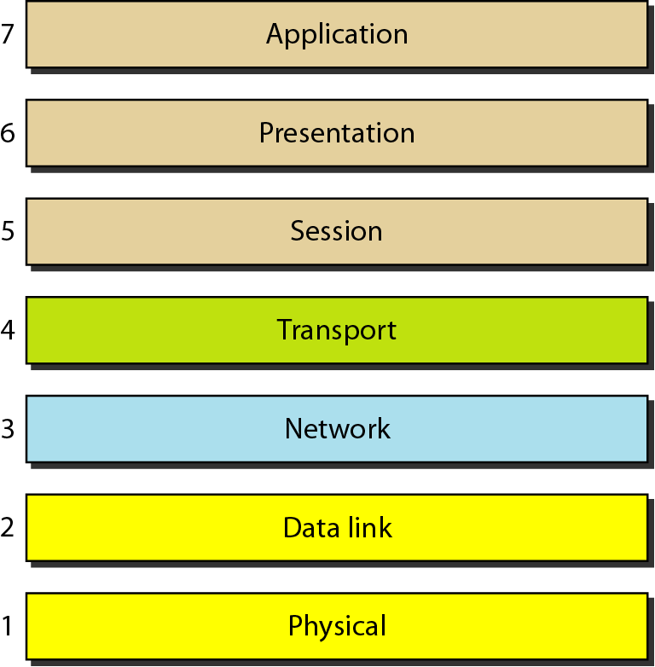
Figure 2.2 Seven layers of the OSI model

Slide 8
As the message travels from A to B, it may pass through many intermediate nodes.
These intermediate nodes usually involve only the first three layers of the OSI model.

Slide 9
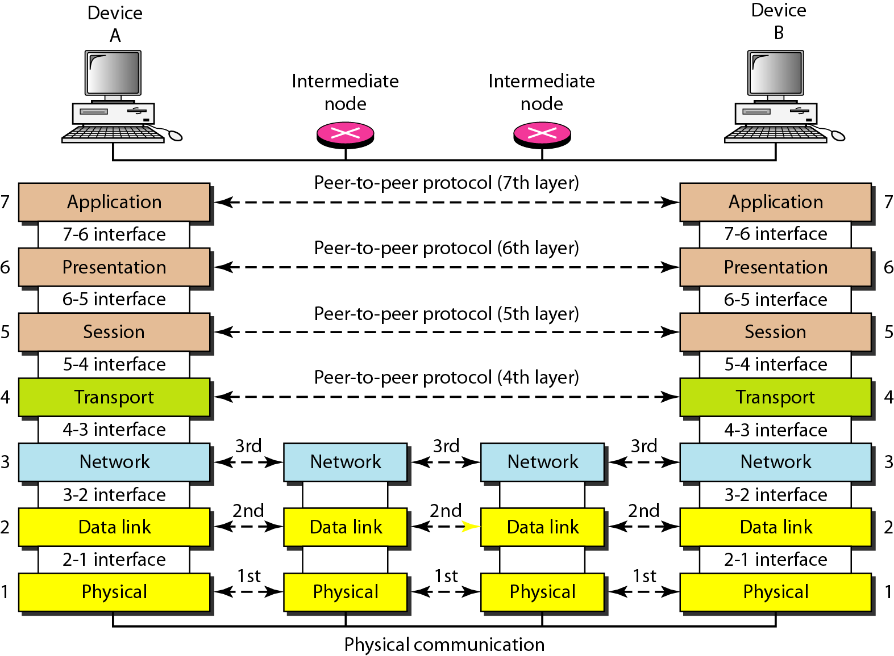
Figure 2.3 The interaction between layers in the OSI model

Slide 10
Within a single machine, each layer calls upon the services of the layer just below it.
Layer 3, for example, uses the services provided by layer 2 and provides services for layer 4.
Between machines, layer x on one machine communicates with layer x on another machine.
This communication is governed by an agreed-upon series of rules and conventions called protocols.
The processes on each machine that communicate at a given layer are called peer-to-peer processes.
Communication between machines is therefore a peer-to-peer process using the protocols appropriate to a given layer.

Slide 11
Peer-to-Peer Processes
At the physical layer, communication is direct: In Figure 2.3, device
A sends a stream of bits to device B (through intermediate nodes).
At the higher layers, however, communication must move down through the layers on device A, over to device B, and then back up through the layers.
Each layer in the sending device adds its own information to the message it receives from the layer just above it and passes the whole package to the layer just below it.

Slide 12
At layer 1 the entire package is converted to a form that can be transmitted to the receiving device.
At the receiving machine, the message is unwrapped layer by layer, with each process receiving and removing the data meant for it.
For example, layer 2 removes the data meant for it, then passes the rest to layer 3.
Layer 3 then removes the data meant for it and passes the rest to layer 4, and so on.

Slide 13
Interfaces Between Layers
The passing of the data and network information down through the layers of the sending device and back up through the layers of the receiving device is made possible by an interface between each pair of adjacent layers.
Each interface defines the information and services a layer must provide for the layer above it.

Slide 14
Organization ofthe Layers
The seven layers can be thought of as belonging to three subgroups.
Layers 1, 2, and 3-physical, data link, and network-are the network support layers;
  deal with the physical aspects of moving data from one device to another
  Electrical specifications
  physical connections
  physical addressing
  transport timing and reliability

Slide 15
Layers 5, 6, and 7-session, presentation, and application- user support layers;
  allow interoperability among unrelated software systems.
Layer 4, the transport layer
  links the two subgroups and ensures that what the lower layers have transmitted is in a form that the upper layers can use.
The upper OSI layers are almost always implemented in software
lower layers are a combination of hardware and software
physical layer, which is mostlyhardware.

Slide 16
The process starts at layer 7 (the application layer)
Moves in descending, sequential order.
At each layer, a header, or possibly a trailer, can be added to the data unit.
Commonly, the trailer is added only at layer 2.
  When the formatted data unit passes through the physical layer (layer 1),
  it is changed into an electromagnetic signal and transported along a physical link.
Upon reaching its destination, the signal passes into layer 1 and is transformed back into digital form. The data units then move back up through the OSI layers.
higher layer, the headers and trailers attached to it at the corresponding sending layer are removed
layer 7, the message is again in a form appropriate to the application and is made available to the recipient.

Slide 17
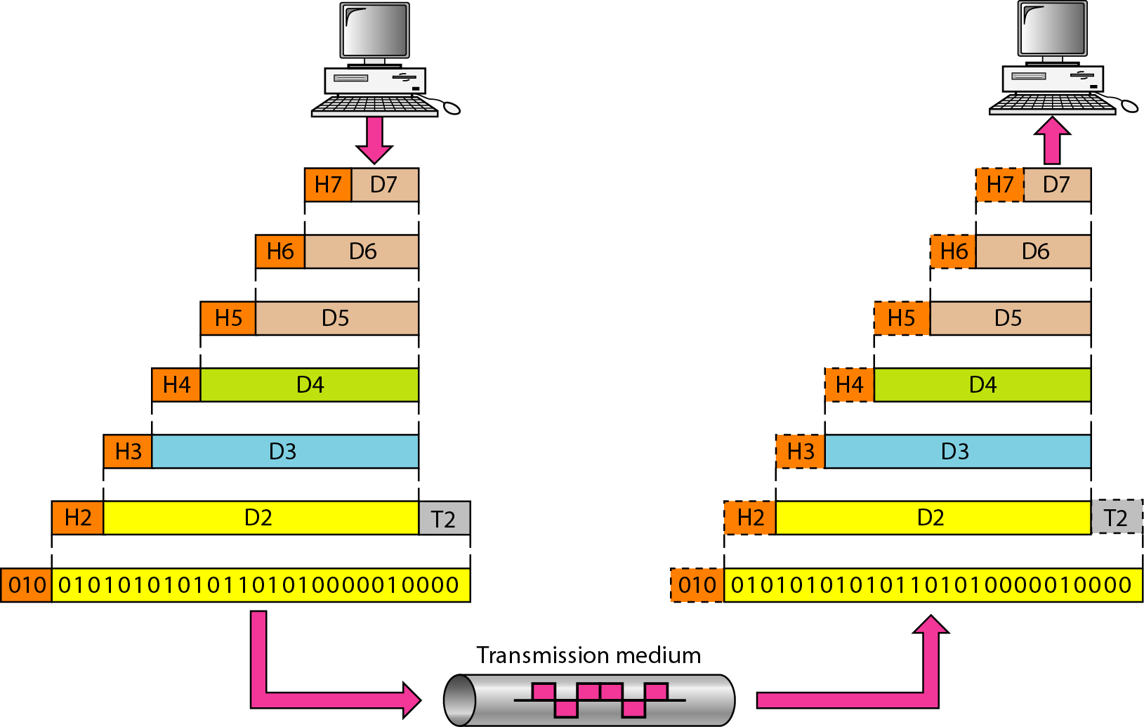
Figure 2.4 An exchange using the OSI model

Slide 18
Encapsulation
The data portion of a packet at level N - 1 carries the whole packet (data and header and maybe trailer) from level N.
Level N - 1 is not aware of which part of the encapsulated packet is data and which part is the header or trailer.
For level N - 1, the whole packet coming from level N is treated as one integral unit.

Slide 19
2-3 LAYERS IN THE OSI MODEL
In this section we briefly describe the functions of each layer in the OSI model.
Topics discussed in this section:
Physical Layer
Data Link Layer
Network Layer
Transport Layer
Session Layer
Presentation Layer
Application Layer

Slide 20
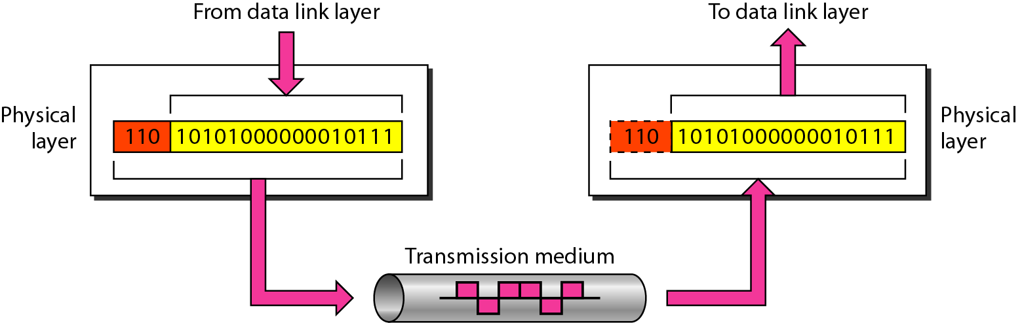
Figure 2.5 Physical layer

Slide 21
Note
The physical layer is responsible for movements of
individual bits from one hop (node) to the next.

Slide 22
Physical Layer
The physical layer coordinates the functions required to carry a bit stream over a physical medium.
defines the procedures and functions that physical devices and interfaces have to perform for transmission to Occur.

Slide 23
Tasks
Physical characteristics of interfaces and medium.
Defines the characteristics of the interface between the devices and the transmission medium.
It also defines the type of transmission medium.
Representation of bits. The physical layer data consists of a stream of bits (sequence of Os or 1s) with no interpretation.
To be transmitted, bits must be encoded into signals--electrical or optical.
The physical layer defines the type of encoding

Slide 24
Data rate
  The transmission rate-the number of bits sent each second
  defines the duration of a bit, which is how long it lasts.
Synchronization of bits.
  The sender and receiver not only must use the same bit rate but also must be synchronized at the bit level. In other words
  clocks must be synchronized.
Line configuration
  connection of devices to the media.
  point-to-point
  multipoint

Slide 25
Physical topology.
  how devices are connected to make a network.
Transmission mode
  direction of transmission between two devices
  simplex, half-duplex, or full-duplex

Slide 26
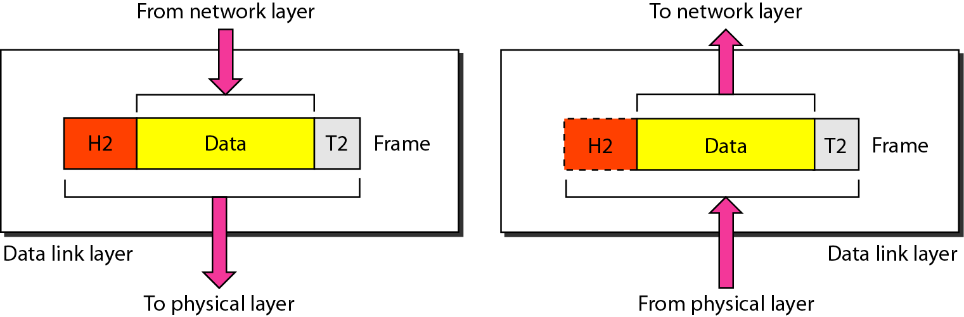
Figure 2.6 Data link layer

Slide 27
Note
The data link layer is responsible for moving
frames from one hop (node) to the next.

Slide 28
The data link layer transforms the physical layer, a raw transmission facility, to a reliable link.
It makes the physical layer appear error-free to the upper layer (network layer).
Framing: divides the stream of bits received from the network layer into manageable data units called frames.

Slide 29
Physical addressing
  If frames are to be distributed to different systems on the network, the data link layer adds a header to the frame to define the sender and/or receiver of the frame.
  If the frame is intended for a system outside the sender’s network, the receiver address is the address of the device that connects the network to the next one.
Flow control
  imposes a flow control mechanism to avoid overwhelming the receiver.

Slide 30
Error control.
  The data link layer adds reliability to the physical layer by adding mechanisms to detect and retransmit damaged or lost frames
  Mechanism to recognize duplicate frames.
  Error control is normally achieved through a trailer added to the end of the frame.
Access control
  When two or more devices are connected to the same link, data link layer protocols are necessary to determine which device has control over the link at any given time.

Slide 31
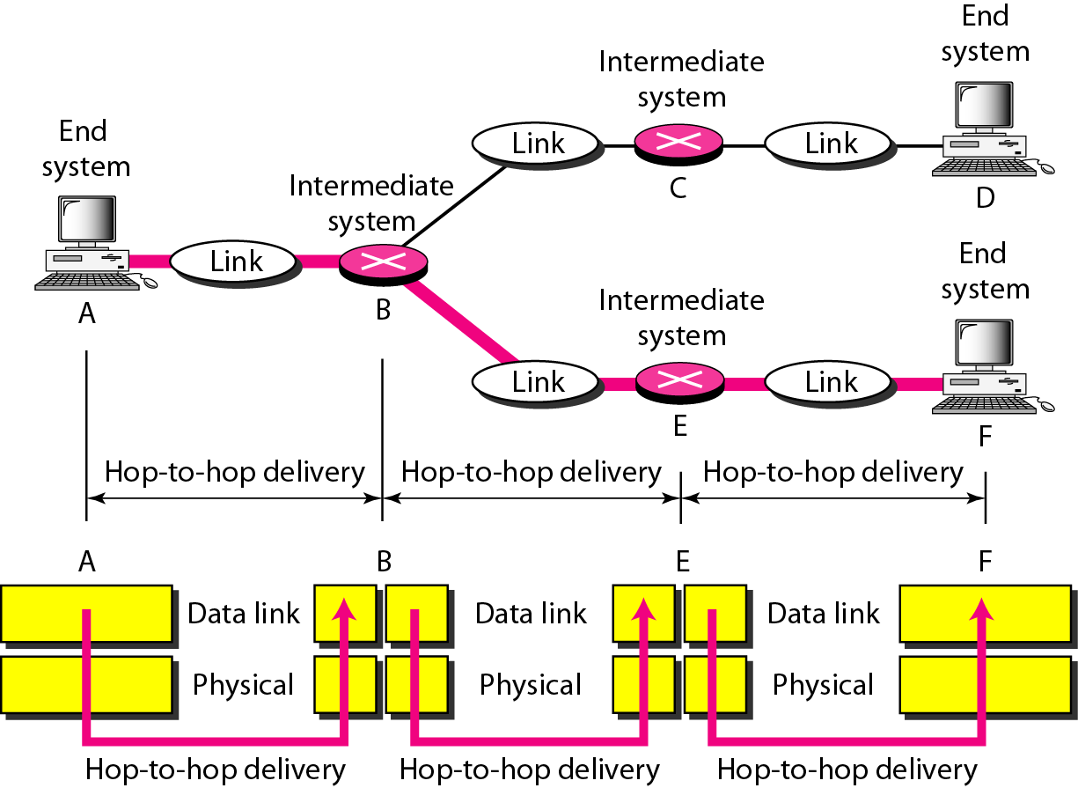
Figure 2.7 Hop-to-hop delivery

Slide 32
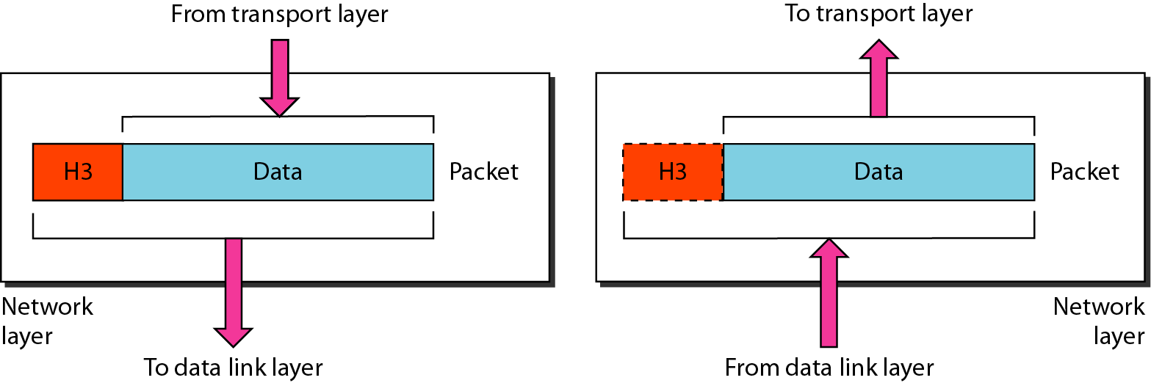
Figure 2.8 Network layer

Slide 33
The network layer is responsible for the source-to-destination delivery of a packet, possibly across multiple networks (links).
Whereas the data link layer oversees the
delivery of the packet between two systems on the same network (links)
the network layer ensures that each packet gets from its point of origin to its final destination.
If two systems are connected to the same link: no need for a network layer.
If the two systems are attached to different networks (links) : need for the network layer to accomplish source-to-destination delivery.

Slide 34
Note
The network layer is responsible for the
delivery of individual packets from
the source host to the destination host.

Slide 35
Responsibility
Logical addressing
  If a packet passes the network boundary, we need another addressing system to help distinguish the source and destination systems.
  The network layer adds a header to the packet coming from the upper layer ,includes the logical addresses of the sender and receiver.
Routing
  independent networks or links are connected to create internetworks (network of networks) or a large network, the connecting devices (called routers or switches) route or switch the packets to their final destination.

Slide 36
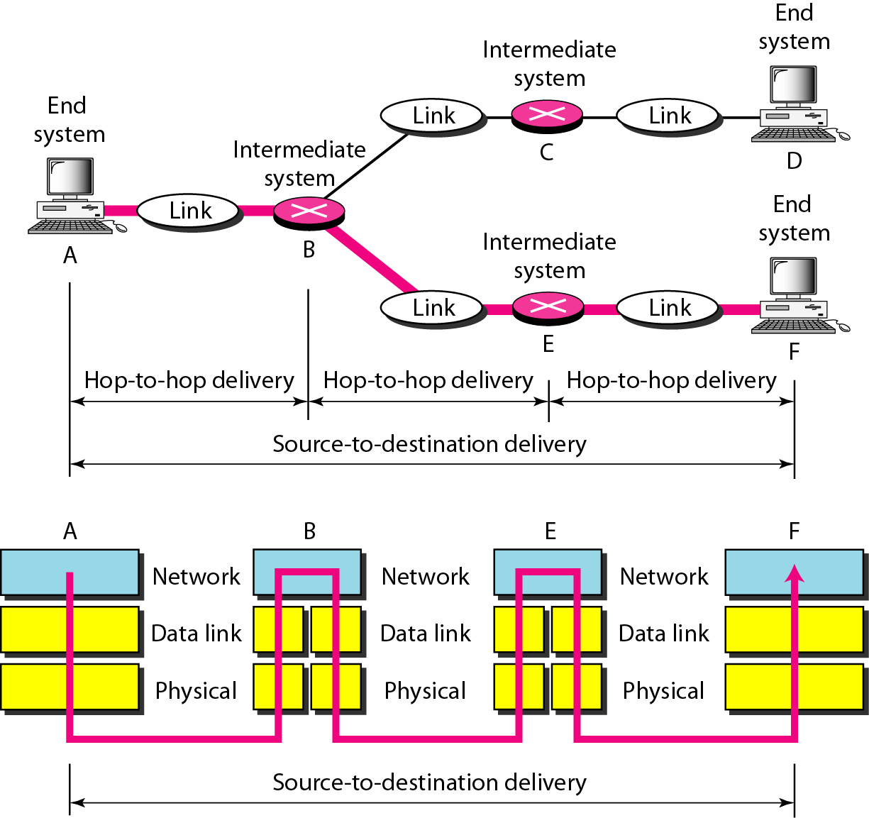
Figure 2.9 Source-to-destination delivery

Slide 37
Source-to-destination delivery
The network layer at A sends the packet to the network layer at B.
When the packet arrives at router B, the router makes a decision based on the final destination (F) of the packet.
B uses its routing table to find that the next hop is router E.
The network layer at B, therefore, sends the packet to the network layer at E.
The network layer at E, in tum, sends the packet to the network layer at F.

Slide 38
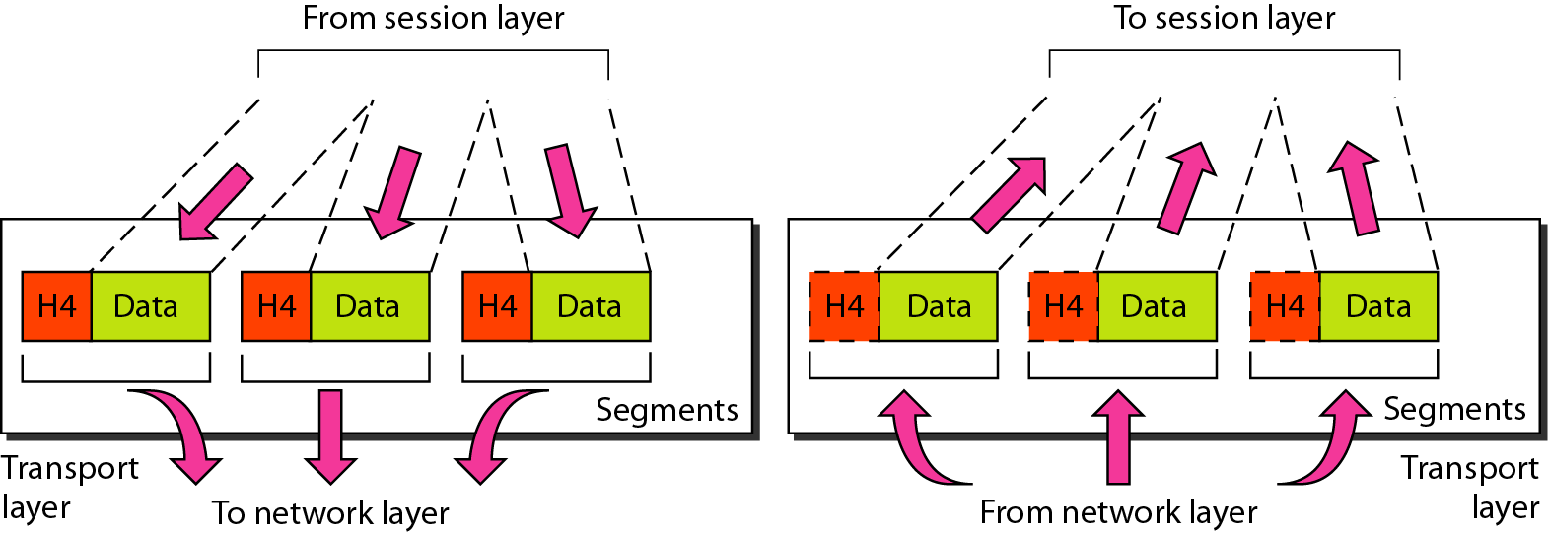
Figure 2.10 Transport layer

Slide 39
Note
The transport layer is responsible for the delivery
of a message from one process to another.

Slide 40
The transport layer is responsible for process-to-process delivery of the entire message.
A process is an application program running on a host.
network layer oversees source-to-destination delivery of individual packets, it does not recognize any relationship between those packets.
It treats each one independently, as though each piece belonged to a separate message, whether or not it does.
The transport layer, ensures that the whole message arrives intact and in order

Slide 41
Service-point addressing:
  Computers often run several programs at the same
  time.
  source-to-destination delivery-not only from
  one computer to the next but also from a specific process (running program) on one computer to a specific process (running program) on the other.
  include a type of address called a service-point
  address (or port address).
  The network layer gets each packet to the correct
  computer; the transport layer gets the entire message to the correct process on that computer.

Slide 42
Segmentation and reassembly
  message into segments
  each segment containing a sequence number.
  reassemble the message correctly upon arriving at the destination
  identify and replace packets that were lost in transmission.

Slide 43
Connection control.
  either connectionless or connection oriented.
  A connectionless transport layer treats each segment as an independent packet and delivers it to the transport layer at the destination machine.
  A connection oriented transport layer makes a connection with the transport layer at the destination
  machine first before delivering the packets.
  After all the data are transferred,the connection is terminated.

Slide 44
Flow control
  flow control at this layer is performed end to end rather than across a single link.
Error control:
  error control at this layer is performed process-to process
  rather than across a single link.
  The sending transport layer makes sure that the entire message arrives at the receiving transport layer without error
  (damage, loss, or duplication).
  Error correction is usually achieved through retransmission.

Slide 45
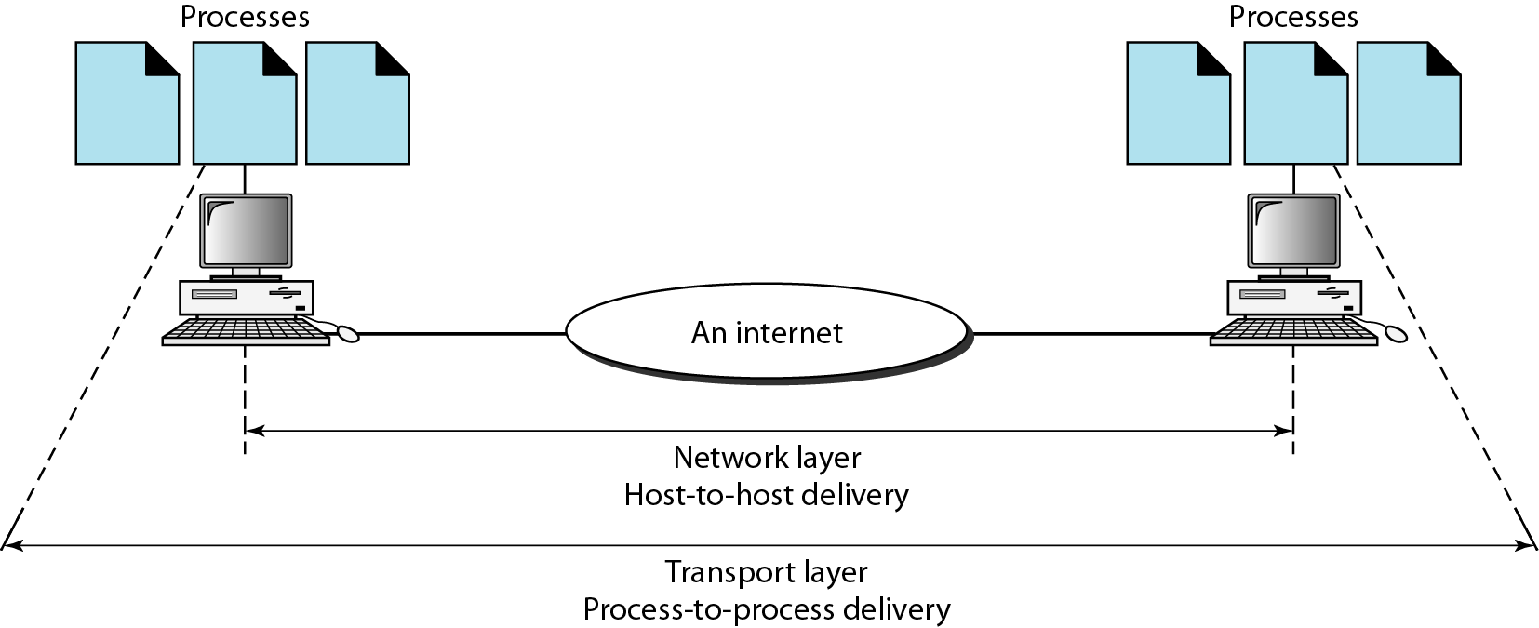
Figure 2.11 Reliable process-to-process delivery of a message

Slide 46
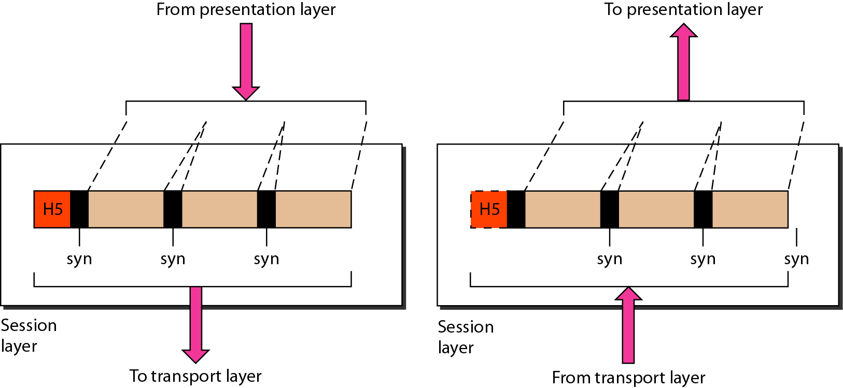
Figure 2.12 Session layer

Slide 47
Note
The session layer is responsible for dialog
control and synchronization.

Slide 48
Dialog control
  The session layer allows two systems to enter into a dialog.
  It allows the communication between two processes to take place in either half duplex or full-duplex mode.
Synchronization
  The session layer allows a process to add checkpoints, or synchronization points, to a stream of data.
  For example, if a system is sending a file of 2000 pages, it is advisable to insert checkpoints after every 100 pages to ensure that each 100-page unit is received and acknowledged independently.
  if a crash happens during the transmission of page 523, the only pages that need to be resent after system recovery are pages 501 to 523.

Slide 49
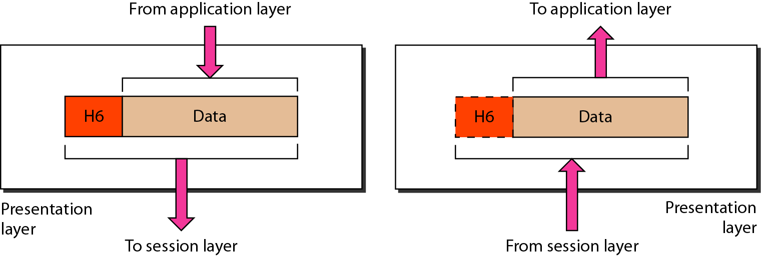
Figure 2.13 Presentation layer

Slide 50
Note
The presentation layer is concerned with the syntax and semantics of the information exchanged between two systems.
The presentation layer is responsible for translation, compression, and encryption.

Slide 51
Translation:
  The processes (running programs) in two systems are usually exchanging information in the form of character strings, numbers, and so on.
  interoperability between these different encoding methods
  at the sender changes the information from its sender-dependent format into a common format and vice versa
Encryption
Compression

Slide 52
Application Layer
The application layer enables the user, whether human or software, to access the network.
It provides user interfaces and support for services such as electronic mail, remote file access and transfer, shared database management, and other types of distributed information services.

Slide 53
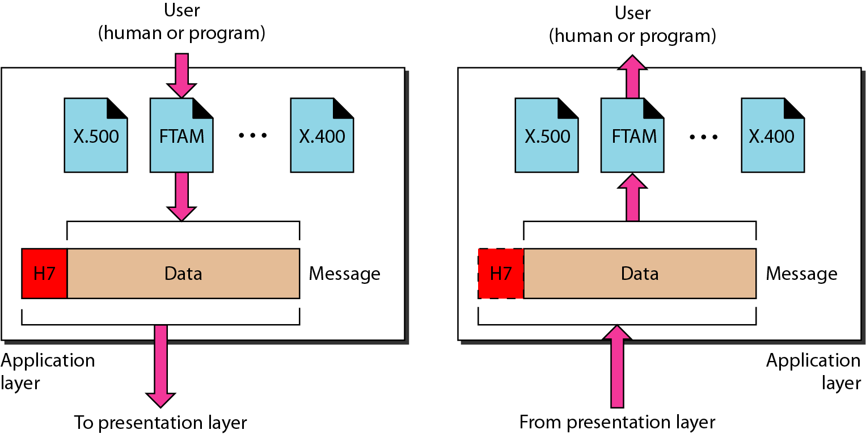
Figure 2.14 Application layer

Slide 54
Note
The application layer is responsible for
providing services to the user.

Slide 55
File transfer, access, and management: allows a user to access files in a remote host (to make changes or read data), to retrieve files from a remote computer for use in the local computer, and to manage or control files in a remote computer locally.
Mail services: This application provides the basis for e-mail forwarding and storage.

Slide 56
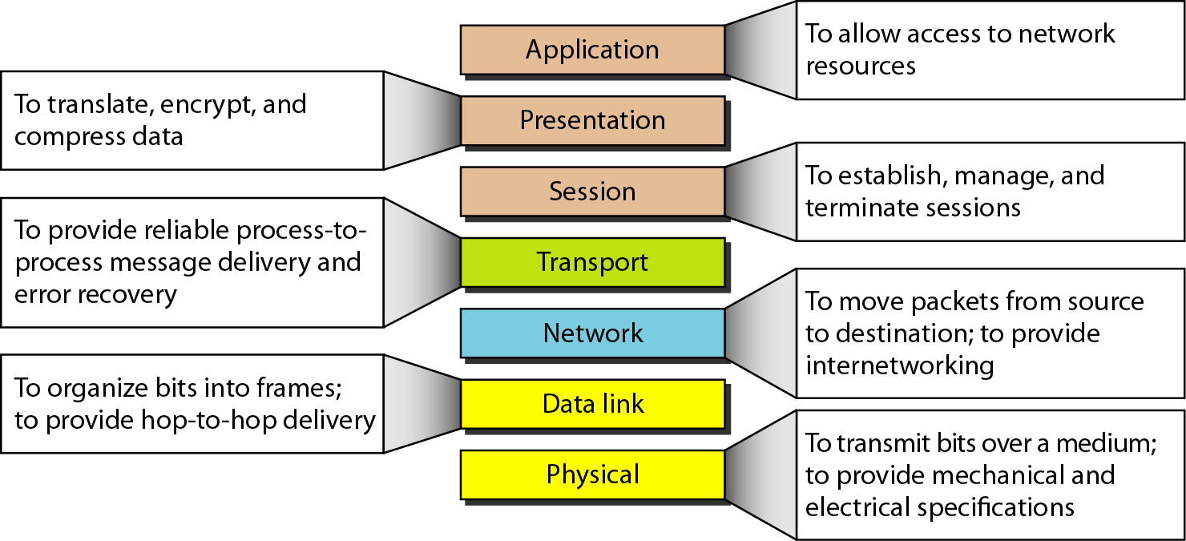
Figure 2.15 Summary of layers

Slide 57
2-4 TCP/IP PROTOCOL SUITE
The layers in the TCP/IP protocol suite do not exactly match those in the OSI model. The original TCP/IP protocol suite was defined as having four layers: host-to-network, internet, transport, and application. However, when TCP/IP is compared to OSI, we can say that the TCP/IP protocol suite is made of five layers: physical, data link, network, transport, and application.
Topics discussed in this section:
Physical and Data Link Layers
Network Layer
Transport Layer
Application Layer

Slide 58
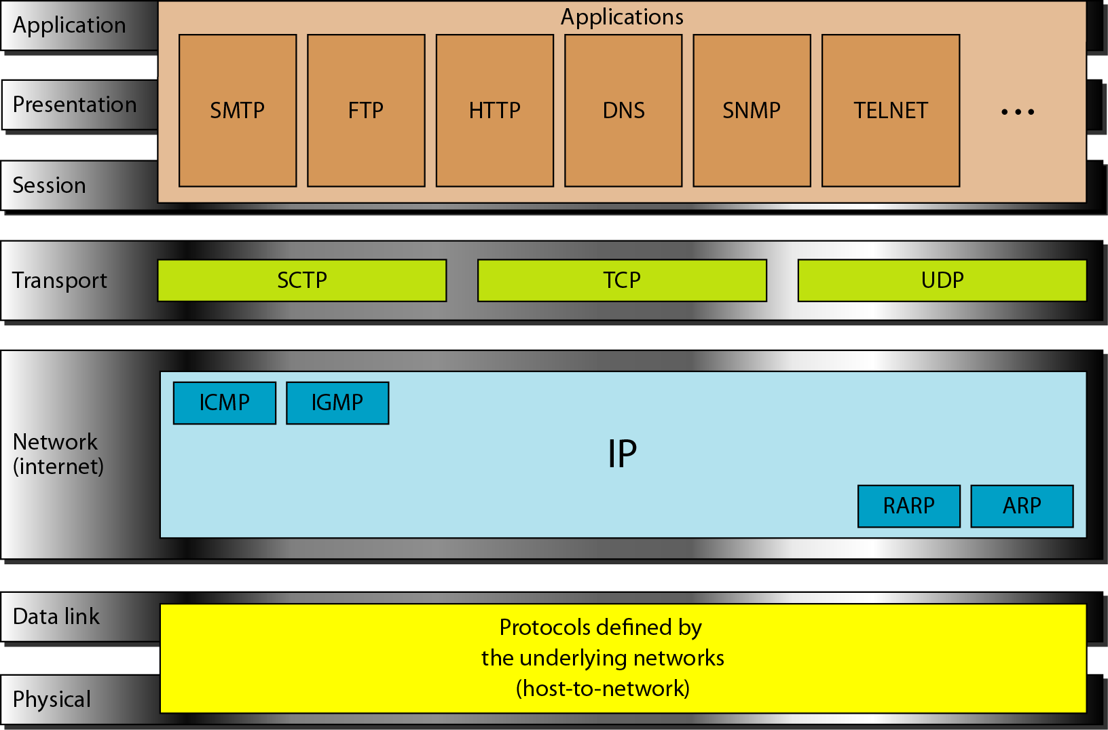
Figure 2.16 TCP/IP and OSI model

Slide 59
Physical and Data Link Layers
At the physical and data link layers, TCPIIP does not define any specific protocol.
It supports all the standard and proprietary protocols.
A network in a TCPIIP internetwork can be a local-area network or a wide-area network.

Slide 60
Network Layer
Internetworking Protocol (IP)
transmission mechanism used by the TCP/IP protocols.
It is an unreliable and connectionless protocol-a best-effort delivery service.
best effort: error checking or tracking
IP transports data in packets called datagrams, each of which is transported separately.
Datagrams can travel along different routes and can arrive out of sequence or be duplicated.
IP does not keep track of the routes and has no facility for reordering datagrams once they arrive at their destination

Slide 61
Address Resolution Protocol
  associate a logical address with a physical address.
  On a typical physical network, such as a LAN, each device on a link is identified by a physical or station address
  ARP is used to find the physical address of the node when its Internet address is known.
Reverse Address Resolution Protocol
  allows a host to discover its Internet address when it knows only its physical address.

Slide 62
Internet Control Message Protocol
  The Internet Control Message Protocol (ICMP) is a mechanism used by hosts and gateways to send notification of datagram problems back to the sender.
Internet Group Message Protocol
  The Internet Group Message Protocol (IGMP) is used to facilitate the simultaneous transmission of a message to a group of recipients.

Slide 63
Transport Layer
User Datagram
  process-to-process protocol that adds only port addresses, checksum error control, and length information to the data from the upper layer
Transmission Control Protocol
  connection-oriented
Stream Control Transmission Protocol
  support for newer applications such as voice over the Internet.

Slide 64
Application Layer
combined session, presentation and application layers in the OSI model

Slide 65
2-5 ADDRESSING
Four levels of addresses are used in an internet employing the TCP/IP protocols: physical, logical, port, and specific.
Topics discussed in this section:
Physical Addresses
Logical Addresses
Port Addresses
Specific Addresses

Slide 66
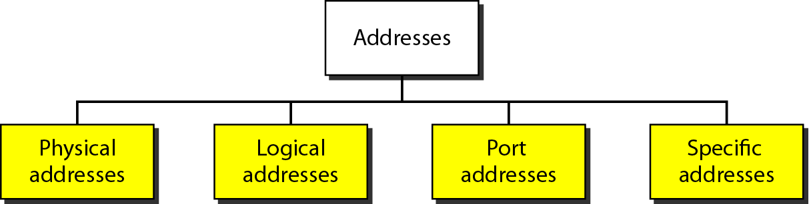
Figure 2.17 Addresses in TCP/IP

Slide 67
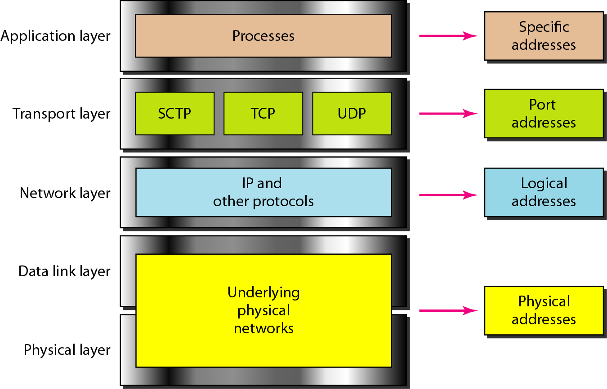
Figure 2.18 Relationship of layers and addresses in TCP/IP

Slide 68
Example 2.1
In Figure 2.19 a node with physical address 10 sends a frame to a node with physical address 87. The two nodes are connected by a link (bus topology LAN). As the figure shows, the computer with physical address 10 is the sender, and the computer with physical address 87 is the receiver.

Slide 69
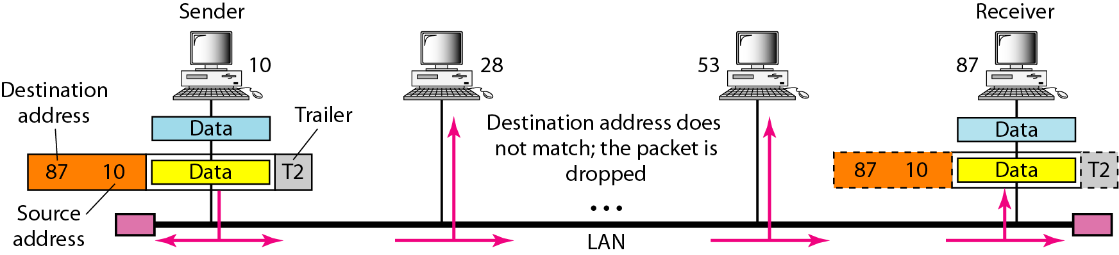
Figure 2.19 Physical addresses

Slide 70
Example 2.2
Most local-area networks use a 48-bit (6-byte) physical address written as 12 hexadecimal digits; every byte (2 hexadecimal digits) is separated by a colon, as shown below:
07:01:02:01:2C:4B
A 6-byte (12 hexadecimal digits) physical address.

Slide 71
Example 2.3
Figure 2.20 shows a part of an internet with two routers connecting three LANs. Each device (computer or router) has a pair of addresses (logical and physical) for each connection. In this case, each computer is connected to only one link and therefore has only one pair of addresses. Each router, however, is connected to three networks (only two are shown in the figure). So each router has three pairs of addresses, one for each connection.

Slide 72
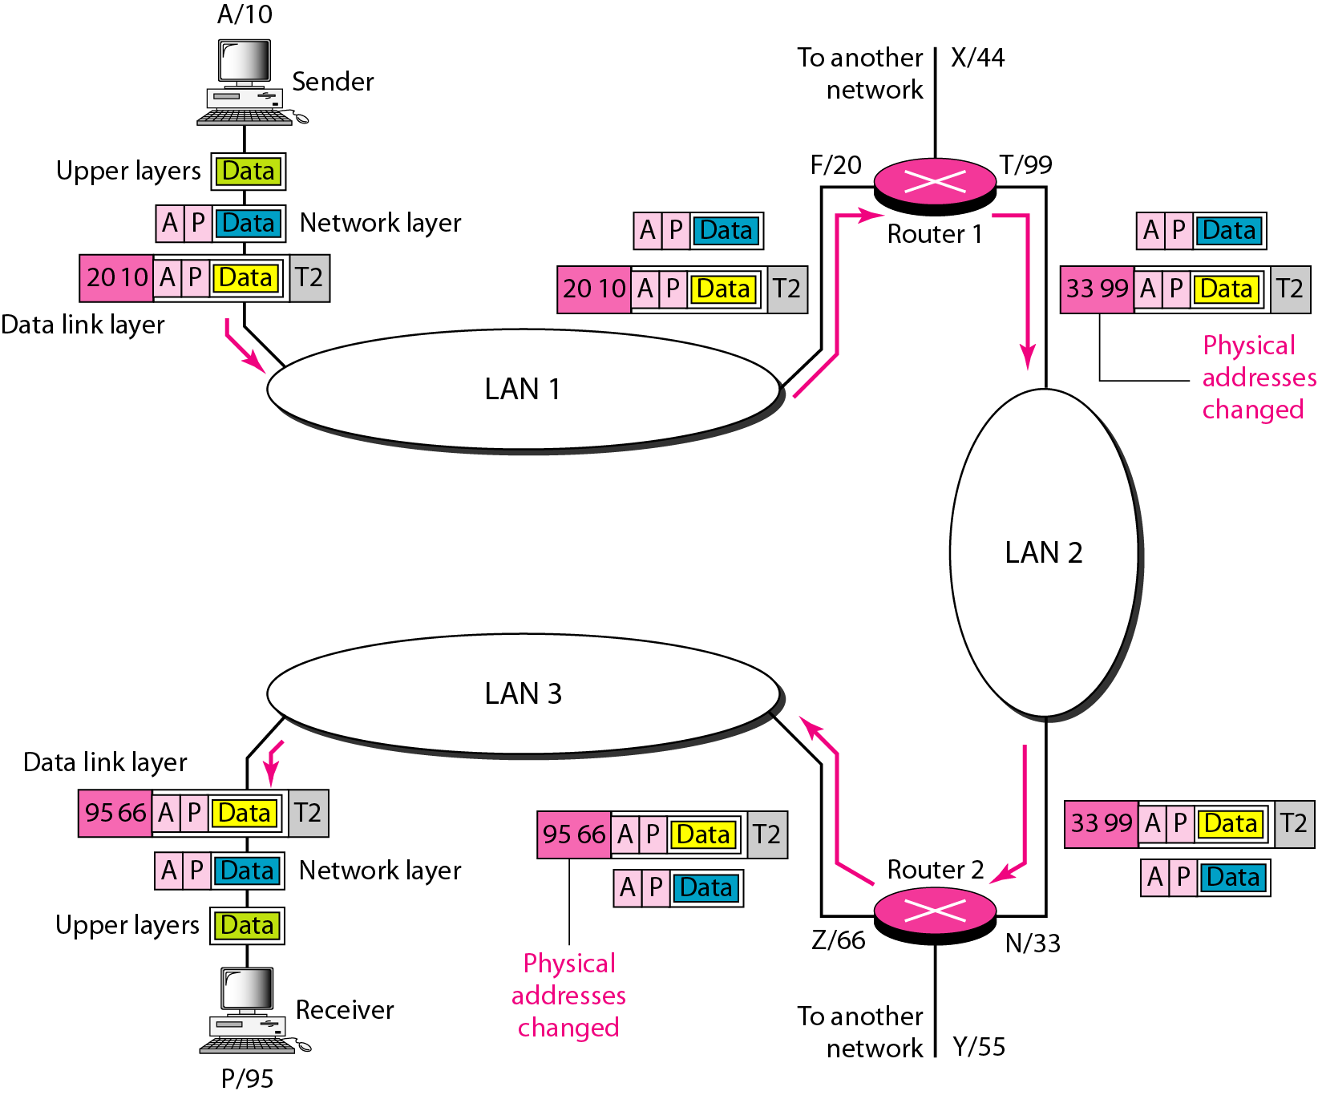
Figure 2.20 IP addresses

Slide 73
Example 2.4
Figure 2.21 shows two computers communicating via the Internet. The sending computer is running three processes at this time with port addresses a, b, and c. The receiving computer is running two processes at this time with port addresses j and k. Process a in the sending computer needs to communicate with process j in the receiving computer. Note that although physical addresses change from hop to hop, logical and port addresses remain the same from the source to destination.

Slide 74
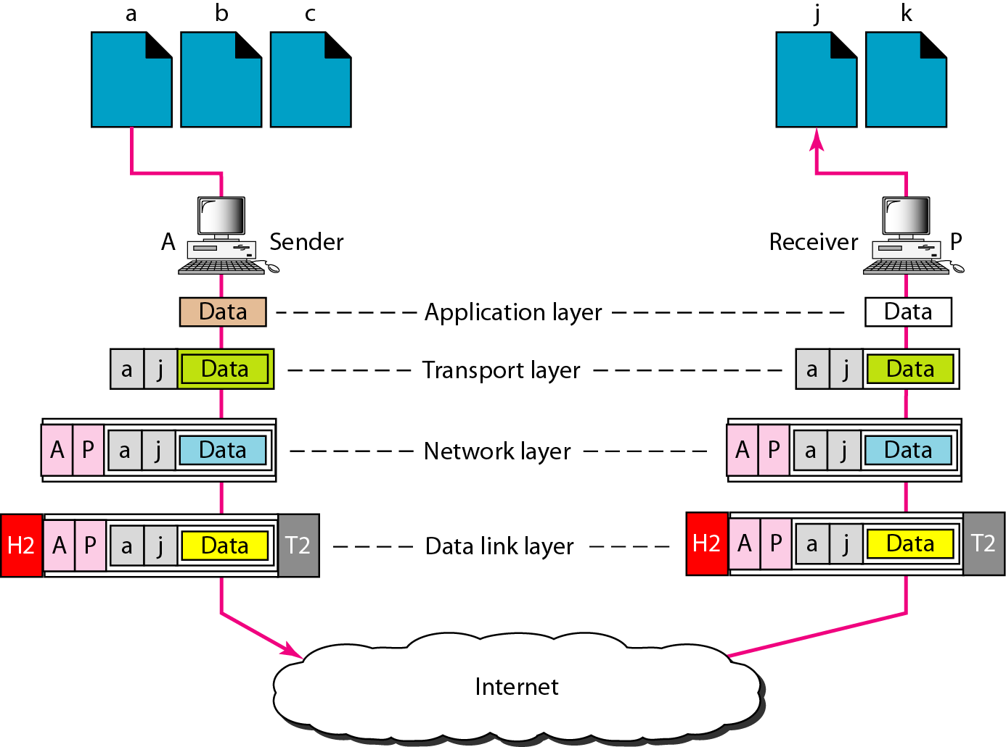
Figure 2.21 Port addresses

Slide 75
Note
The physical addresses will change from hop to hop,
but the logical addresses usually remain the same.

Slide 76
Example 2.5
A port address is a 16-bit address represented by one decimal number as shown.
753
A 16-bit port address represented
as one single number.

