Slide 1
Ef, nuf #Elastic properties of the fibre
Em,num #Elastic properties of the matrix
vf #volume fraction of the fibre
Xt, Xc, Yt, Yc, S #Strength of the lamina in tension, compression, different directions
[0,15,45,90] #layup sequence, each lamina seperated by comma
# assume all lamina to have equal thickness
Text file with above data is input.
Implement the entire flow-chart (see next slide) for classical lamination theory, including damage modelling and estimation of the margin of safety for each lamina.
Your code should be modular, and should be capable of plotting elastic properties as function of the volume fraction and equivalent properties as function of the orientation of lamina
Code to be well-commented so that we can follow what is being done
For calculation of the elastic properties, use rule or inverse rule of mixtures as appropriate
For damage calculation, use Hoffman failure criteria
You can assume fibres to be isotropic with positive non-zero stiffness in all cases.

Slide 2
Ef, Em, νf, νm
Gf, Gm, Vf
Mechanical tests
ply n° k
loads, support
geometry
CLT
static loads
& moments
(x-y) axes
Failure criterion
2
Notes:
2

Slide 3
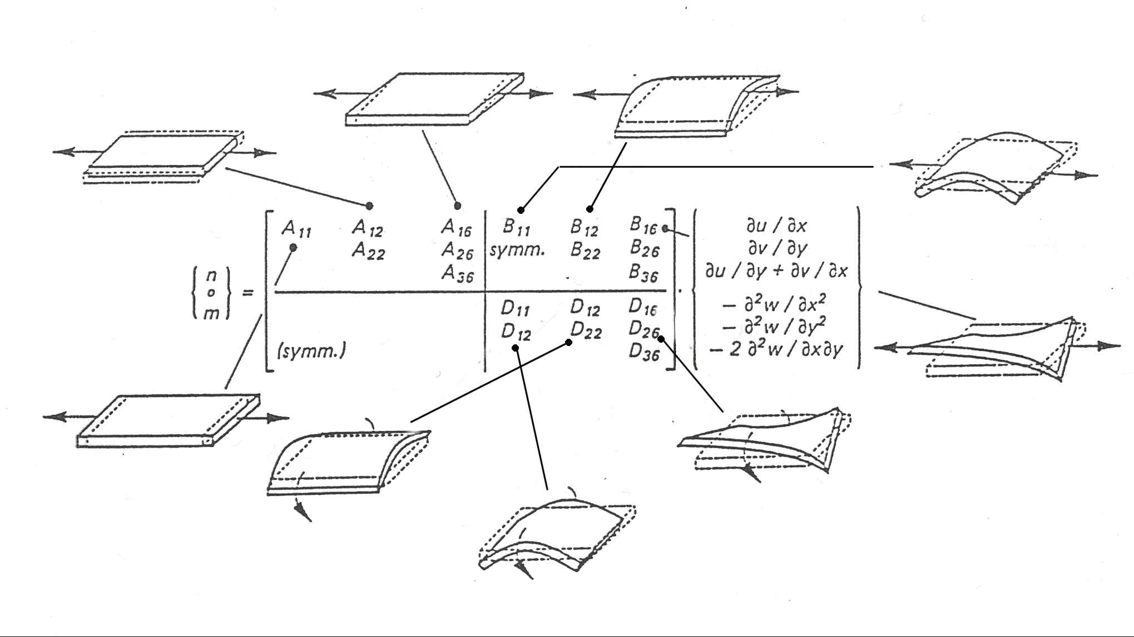
Illustration of [A], [B] and [D]
Notes:
3

