Slide 1
Name: Rajdeep Saha
Batch – DS C58
EDA Credit Risk Assignment

Slide 2
Credit EDA Assignment
Business Problem:
A company wants to understand the driving factors (or driver variables) behind loan default, i.e. the variables which are strong indicators of default. The company can utilize this knowledge for its portfolio and risk assessment.

Slide 3
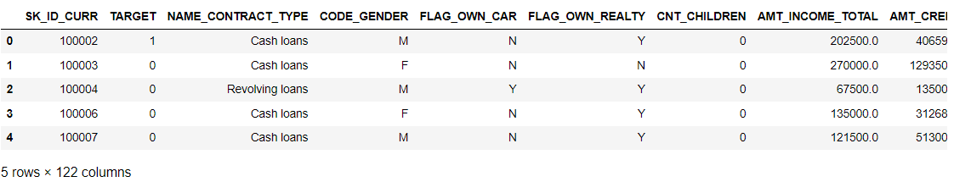
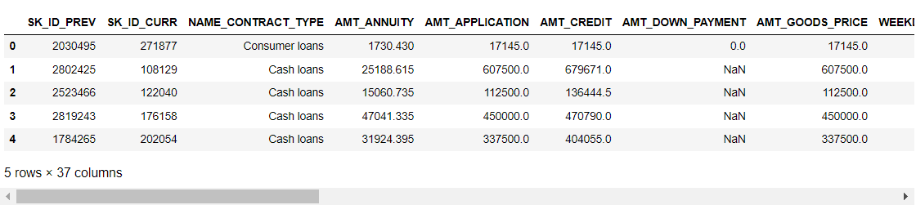
Dataset Description
There are three datasets :
application_data.csv (for understanding the features responsible for loan application and parameters)
previous_application.csv (for understanding the features which were considered when the applicants asked for loan last time)
Columns_description.csv (for understanding the attributes’ meaning in order to do the exploratory Data Analysis)
The application_data dimension : (307511, 122)
The previous_application data dimension : (1670214, 37 )
application_data.csv
Previous_application.csv

Slide 4
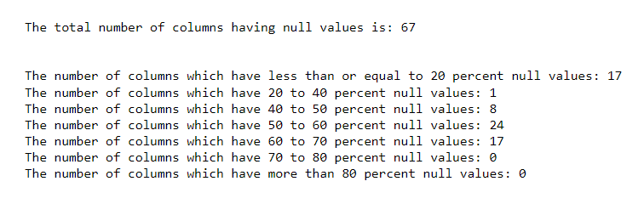
Approach of Exploratory Data Analysis
First in the “application_data” file, we found there are a lot of columns and percentage of missing values in different column was different.
So, before proceeding with variable exploration, found out the percentage of missing values in each column and based on that created few groups of missing columns and after that started my analysis.
All the attributes whichever having 60-70% null values directly dropped because imputing those variables could create biased dataset, hence in future, machine learning on it can create a lot of problems.
The Analysis involved Univariate , Bivariate and Multivariate Analysis.
Data Transformation (wherever required) and handling Outliers and handling missing values.
Inferring insights from the charts, made in the analysis.
Checking Correlation .
Grouping and segmenting the data to understand one particular value movement across all the features of that segment.
Making Conclusion and Future Steps.

Slide 5

Data Imbalance
Any dataset having one particular category in high percentage than the other category in the ‘target feature’ is called an imbalanced dataset.
In this case, ‘application_data file is also an imbalanced dataset where the Non-defaulter’s percentage is 91% and defaulter’s percentage is 9%. Ideally in real scenario, defaulter percentage should be as less as possible because having higher defaulter percentage is not good for any banking business.
The imbalance in dataset can be handled by ‘Up-sampling’, ‘Down-sampling’ or ‘SMOTE’ which we can apply in future stage.
Target variable:
1 : Defaulters
0 : Non-Defaulters

Slide 6
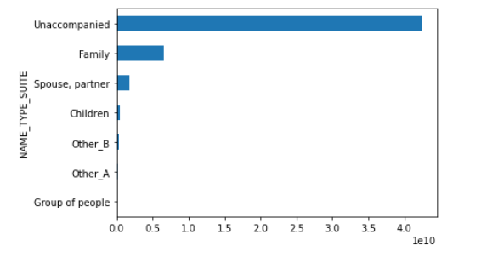
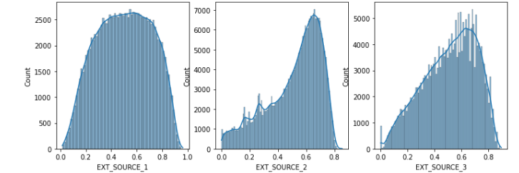
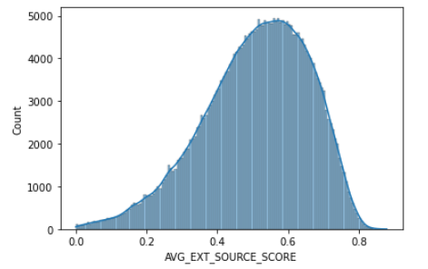
Univariate Analysis
The Unaccompanied persons’ count is highest among all other accompanied group.
This attribute intuitively seem to be important for determining the factor for approving loan and defaulters. Though Hypothesis testing could have been done for proving the significance of it which can be implemented in future step.
The External Sources were not much clear with their meaning. An assumption had been made here : all the external sources score are related with credit score. So , as the method of data transformation, all these scores’ average have been taken and replaced instead of these three which is normally distributed.

Slide 7
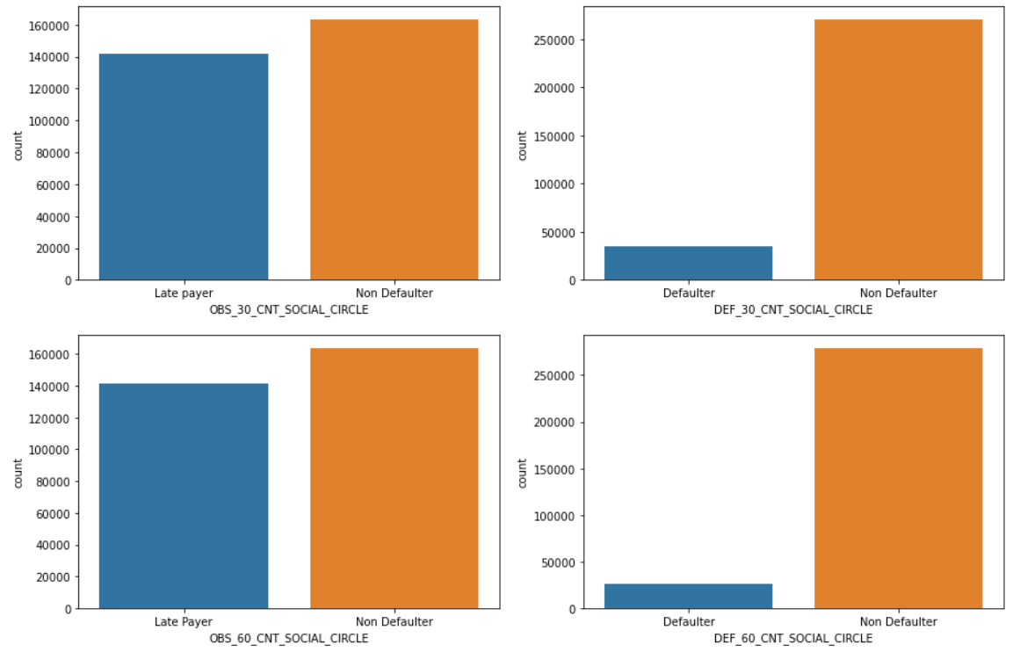
Univariate Analysis(Contd.)
For the number of observations in the client surroundings for 30 days and 60 days past due first , I did the analysis with the numerical feature and got the below inferences:
0 defaulters are contributing to 50% of all the defaulters in the social circle of the customers.
In the attribute “DEF_30_CNT_SOCIAL_CIRCLE” the single defaulter for all customer surrounding cumulatively giving 28201 which comprises of 0.09% among all.
Similar type of observations found for 60 days past due cases as well.
Data Transformation applied: wherever the presence is 1 they we named as latepayer/defaulter else they were named as ‘non-defaulter’. Thus the numeric variable was converted to categorical.
The graph of these are as below:
Observations:
After changing the attributes to categorical, we can see in 30 Days past the due date, The non-defaulter count is higher
The Late payer in 30 days and 60 days are quite higher than the number of defaulters

Slide 8
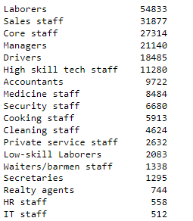
Univariate Analysis(Contd.)
All the AMT_REQ_CREDIT attributes are skewed towards right and all have outliers.
I have handled the outliers by removal from the instances from the dataset as the percentage of it was very less.
All of these 6 attributes show that number of applicants not asking any questions is highest and number of applicants having difficulty in payment is less for these attributes
OCCUPATION_TYPE Attribute:
The Occupation type is one of the important attributes of this dataset having 30%-40% missing values. The unique counts is as follows:
There are some missing values in OCCUPATION_TYPE attribute, for these we can say that few persons' professions are unknown might be it has happened during the data collection.
Though there was a chance of imputing those null instances using the mode but that could make the data biased towards Laborers as the Laborers have higher count

Slide 9
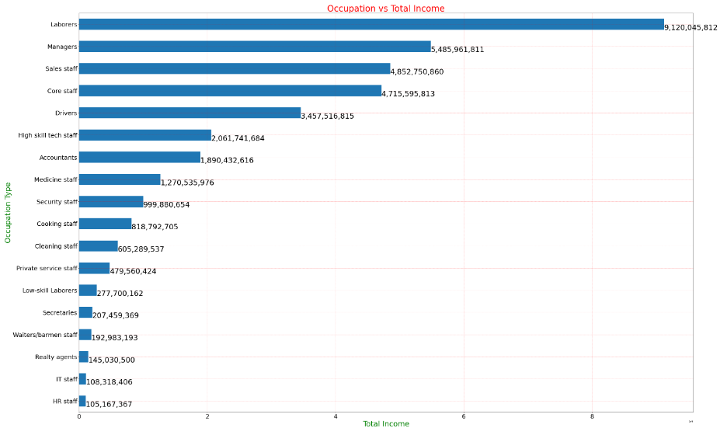
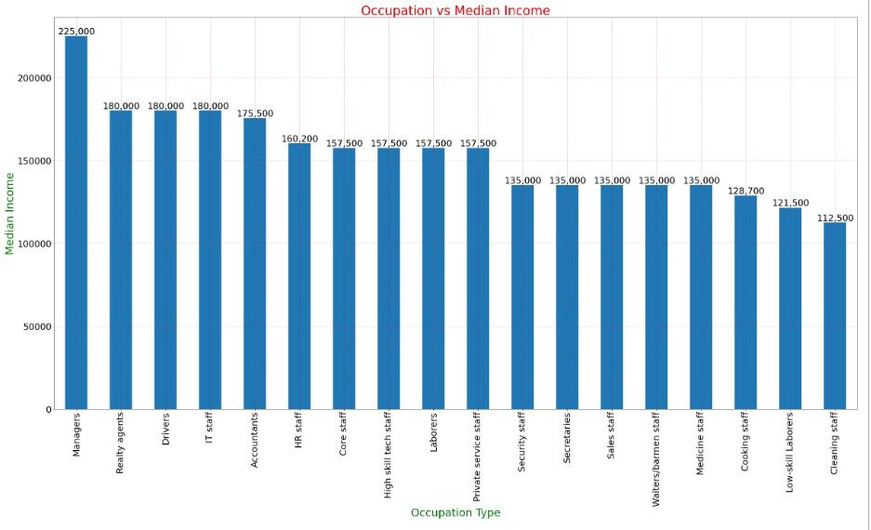
Bivariate Analysis between OCCUPATION_TYPE and AMT_INCOME_TOTAL
The total Income of “Laborer” group is highest because their count is also highest. So while observing the median income of each group it was found that, the “Managers” group has the highest median salary whereas Laborers come at 9th position.
Graphs are as below:

Slide 10
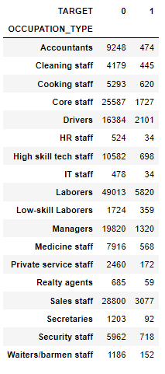
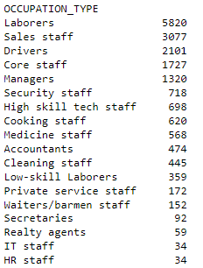
Multivariate Analysis among OCCUPATION_TYPE, AMT_INCOME_TOTAL & ‘TARGET’
Checking the count of payment Difficulties and non-difficulties grouped by OCCUPATION_TYPE
Sorting the count of persons having Loan paying difficulties across all occupation type
Observation:
Though there was a chance of imputing those null instances using the mode but that could make the data biased towards Laborers as the Laborers have higher count.
Though the Laborers category have highest total income but inspecting the median income of all the categories, it's found that Laborers came at 9th position whereas Managers have highest Median Income.
Count wise Managers are coming at 5th position as having loan payment difficulties
From all these observations this OCCUPATION_TYPE and AMT_INCOME_TOTAL seem to be very useful attributes for deciding Loan Payment Difficulty
TARGET -> 1 implies to payment difficulties
TARGET -> 0 implies to payment non-difficulties

Slide 11
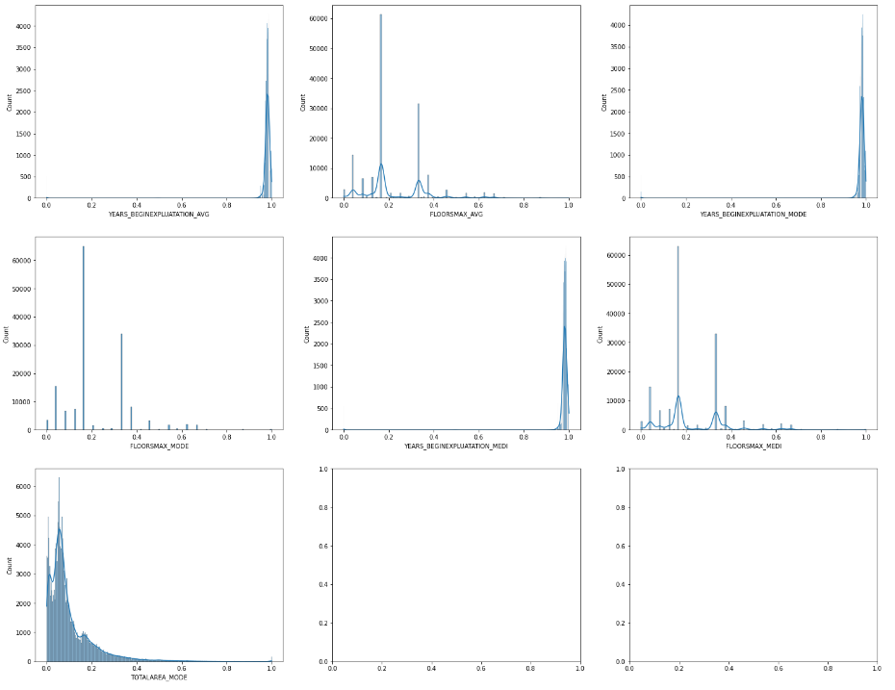
Handling the columns having 40 – 50 % null values
The attributes which come under this category are: 'YEARS_BEGINEXPLUATATION_AVG','FLOORSMAX_AVG','YEARS_BEGINEXPLUATATION_MODE','FLOORSMAX_MODE','YEARS_BEGINEXPLUATATION_MEDI','FLOORSMAX_MEDI','TOTALAREA_MODE','EMERGENCYSTATE_MODE’
Distribution of these attributes are as below:
All these attributes are skewed and intuitively don't seem to be much useful for Loan approval (By Intuition).
But still I have validated few things on these attributes, hence merged two dataframes (application_data and previous_application)

Slide 12



Few points on merged dataset
In the merged dataset Target variable has 4 categories: “Approved”, “Cancelled”, “Refused” and “Unused offer” and count of these are as follows:
The ‘TARGET’ variable’s categories have maintained their percentage weight properly:
I observed that previously around 30% customers had null values for these attributes but loan had been approved for them.
Going forward will remove these columns, but there is a scope of using Hypothesis testing in this scenario to prove the significance of these properties. As of now , I have used my intuition and assumptions in many cases.

Slide 13
Columns having 50-60 percent and 60-70 percent null values
The following columns have 50-60 percent null values: 'EXT_SOURCE_1','APARTMENTS_AVG','BASEMENTAREA_AVG','ELEVATORS_AVG','ENTRANCES_AVG','LANDAREA_AVG','LIVINGAREA_AVG','NONLIVINGAREA_AVG','APARTMENTS_MODE','BASEMENTAREA_MODE','ELEVATORS_MODE','ENTRANCES_MODE','LANDAREA_MODE','LIVINGAREA_MODE','NONLIVINGAREA_MODE','APARTMENTS_MEDI','BASEMENTAREA_MEDI','ELEVATORS_MEDI','ENTRANCES_MEDI','LANDAREA_MEDI','LIVINGAREA_MEDI','NONLIVINGAREA_MEDI','HOUSETYPE_MODE','WALLSMATERIAL_MODE’
All of these are numerical in type and have skewed distribution:
Same type of operation had been carried out here as well and the observation is : previously 30% customers have null values for these attributes but loan had been approved for them.
The attributes which had 60-70 percent null values had been straightaway dropped from the dataset.
After that total column number came down to 73 (numerical column number 56 and categorical is 17)

Slide 14
Observation of univariate, bi-variate and multivariate non-null categorical features
‘NAME_CONTRACT_TYPE’ - Customer having difficulty in loan repayment predominantly exists in those participants who are taking Cash Loans But as it's an imbalanced dataset, the visualization is biased.
‘FLAG_OWN_CAR’ - The attribute has defaulter in those customers who don't have car.
‘CODE_GENDER’ – Though the male customers have higher number of defaulters but we can’t say that, this is an evident matter. So this particular attribute ca be dropped.
‘FLAG_OWN_REALTY’ – The number of persons having Realty has higher number of loan defaulters.
‘NAME_TYPE_SUITE’ – Higher number of defaulters for unaccompanied persons.
‘NAME_INCOME_TYPE’ – The working group has highest number of difficulties in loan repayment. Though Business group has highest median salary, but they don’t have any defaulters.
‘NAME_EDUCATION_TYPE’ - For Secondary/ Secondary Special education and Higher Education the number of defaulter is more than any other type of education holder.
According to data , ‘Academic Degree’ has the highest median salary , but the overall loan applicant of that education group is less (only 163) , whereas Higher Education applicants have second highest median salary and Secondary/Secondary Special Education holders have lowest median salary. So the loan approver might need to think before giving approval for loan to Higher Education holder and Secondary education holder.
(Python Notebook has all the visual evidence of these observations)

Slide 15
Observation of univariate, bi-variate and multivariate non-null categorical features
The Married persons are highest in the count for taking loan and they have highest number of defaulters present.
Separated persons have highest median income and their defaulter count is not much w.r.t to the other categories.
The attribute , by intuition, doesn't seem to be much helpful or useful for deciding any factor for defaulters.
Good to go with the analysis excluding this attribute(Assumption, marital status doesn't impact much )
The participants whoever have applied for loan , maximum are coming under House/Appartment owner. By Assumption, it may be a house loan.
Even if House/Appartment owners stand at the second point of median salary, they are highest in terms of being defaulter. Also in terms of loan payment, they have a good count.
Co-operative appartment owners have highest median salary and they are lowest in terms of taking loan. as a result they are lowest in terms of being defaulters.
The persons who are living with partners have lowest median salary and they have second highest count in terms of being defaulters.
By intuition, this attribute seems to be very important for deciding Loan approval/ defaulter selection.

Slide 16
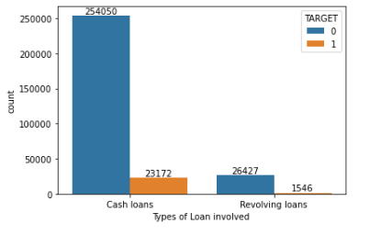
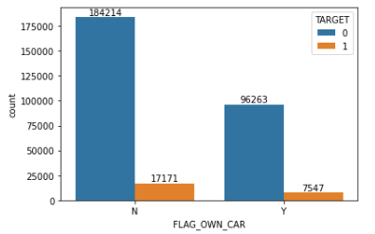
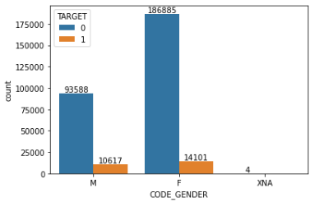
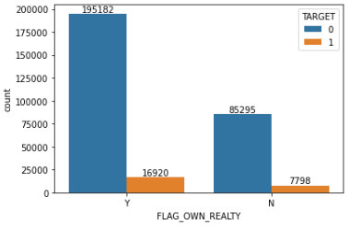
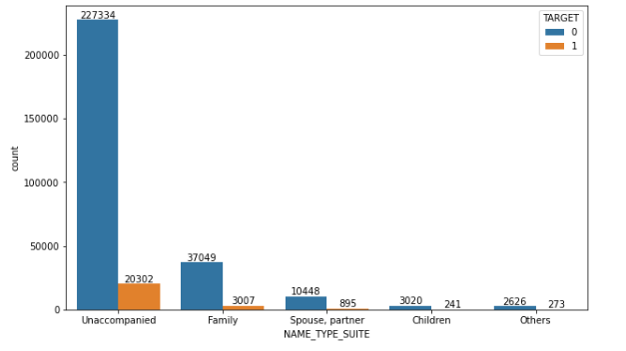
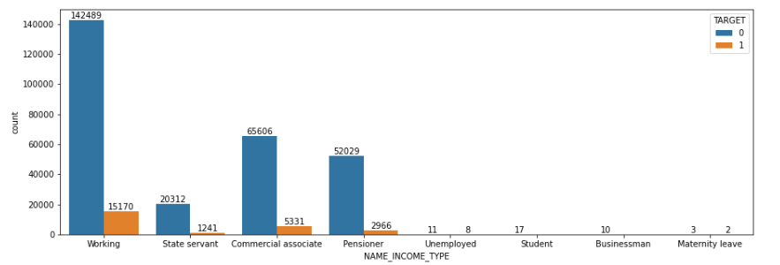
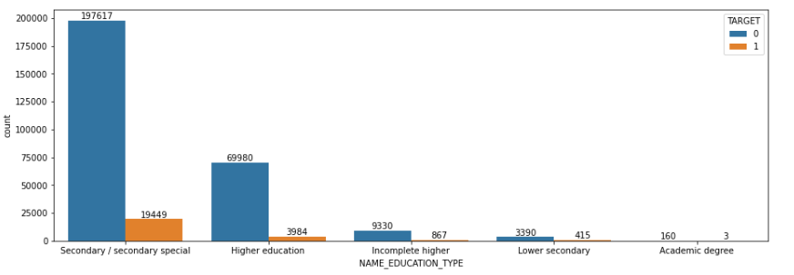
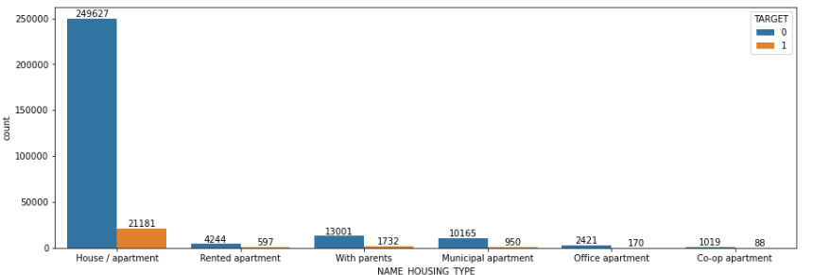
Observation of univariate, bi-variate and multivariate non-null categorical features

Slide 17
Analysis of Organization_Type
The attribute seems to be important because a person's financial condition is dependent on the type of organization he/she works in and its market growth.
But here in this dataset we can see a lot of categories for this attribute which might be a problem while applying machine learning model on it further because on applying One hot encoding there will be too many variables generated
Few categories can be merged combined together in order to reduce the variation
'XNA' seems to be null ( By Assumption )
All the business entity types have problem in paying loan as well as 'Other' category and 'Self-Employed'
Also these three organization types have taken loan most.
The Company might need to think of paying loan to these categories

Slide 18
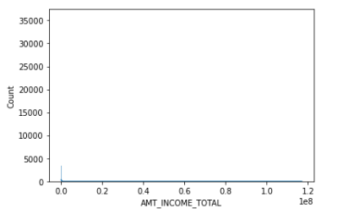
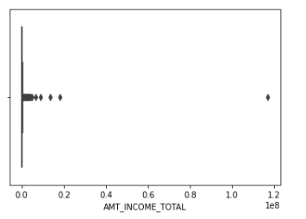
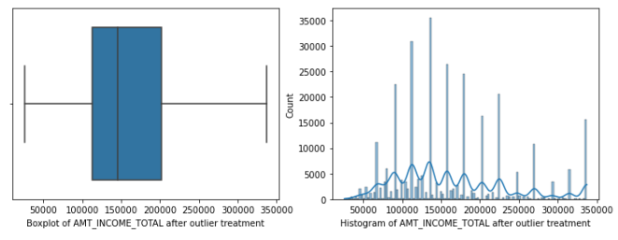
Analysis of Numerical variables
Count of Children in this dataset didn’t seem to be useful (applying realtime sense)
For ANT_INCOME_TOTAL did the outlier imputation by capping
The Distribution plot and box plot before Outlier imputation
The Distribution plot and box plot after Outlier imputation

Slide 19
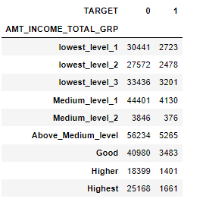
Analysis of Numerical variables
The AMT_INCOME_TOTAL has been categorized based on 10 percentile group.
After that this is the loan defaulter picture for the attribute:
This AMT_INCOME_TOTAL seems to be one of the most important attribute for detecting defaulter
After creating the custom groups of Income amount based on 10 percentile gap , we can see that the lowest group i.e, persons belonging to the first 10 percentile group have the difficulties in repaying the loan. Surprisingly in 10 -20 percentile group the defaulters' count is less.
Again Medium level (30-40) percentile group comes immediate after the 10 percentile group
70-80 percentile group coming in the next number to it.

Slide 20
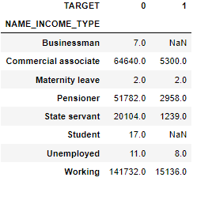
Analysis of Numerical variables
There is a positive correlation present between AMT_INCOME_TOTAL and AMT_CREDIT for both Defaulter and Non-Defaulter categories of TARGET.
The persons who have been accompanied by children factor or spouse,partner haave higher chances of being defaulter as the median amount of loan of those categories are highest.
For AMT_GOODS_PRICE only 2% are outlier. So we can remove these outliers.
The Cash loan category has pretty high median AMT_GOODS_PRICE , means for them the price of the goods for which they have applied loan is higher.
Businessmen count for defaulter is null, seems that no business man have been defaulter. So for them the median of loan annuity is 0.
Commercial Associates are highest in count in terms of being defaulter. Their Median Annuity amount is highest.
The Maternity Leave taken persons being little in count , they have very high median annuity amount.
For working persons the count of defaulter is less than the count of non-defaulters but the median Amount of a loan annuity for defaulters is quite high

Slide 21
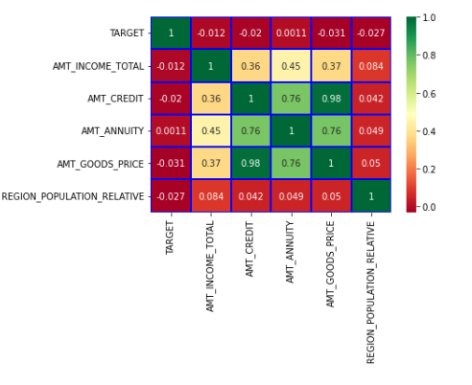
Analysis of Numerical variables
Below attributes have been found with multi-collinearity but except the ‘REGION_POPULATION_RELATIVE’ all these attributes are very important.
Below is the heatmap:
The multicollinearity can be seen here between AMT_CREDIT, AMT_ANNUITY, AMT_GOODS_PRICE
VIF(Variance Inflation Factor) can be done for identifying the multicollinearity and also we can understand important features from here

Slide 22
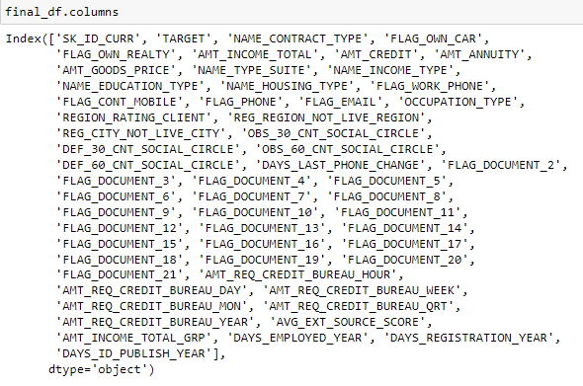
Final Analysis and Conclusion
These are the final list of columns which I found to be most important. The total number is 57.

Slide 23
Final Conclusion & Future Scope
Conclusion:
Though 'Organization_Type' seems to be an important column because it sometimes helps the loan approver think whether to approve loan or not based on the knowledge of income in the current market industry.
Here some features have been dropped from the datafrae based on intuition and assumption but technically some hypothesis testing could have been done(Chi-Square Test) in order to understand which categorical features are independent.
As we have Income information, so as of now I am deleting the 'ORGANIZATION_TYPE' attribute as it has a lot of categories, so after one hot encoding it might create a lot of variables which is not desirable.
If the person :
has taken cash loan.
isn't a car owner.
is owner of a realty.
is unaccompanied at the time of taking loan.
lies under pensioner group.
having education level till secondary/secondary special or higher education.
owner of house/apartments(being highest in terms of median income).
or living with partners(with lowest median income) being second highest of defaulters.
also if his/her permanent address and contact address is matching
comes under lowest 10 percentile of whole income
Then there is a chance for that person to be identified as a defaulter.
Future Scope:
Hypothesis Testing
PCA
VIF Test
Machine Learning application for predictive modelling

