Slide 1
BDSN End Term Assignment (Machine Learning with Python and Spark)
Car Price Prediction Using Regression

Slide 2
Research Objective
For the given dataset we have to predict the target feature ‘Selling Price’ for different cars having different features. For this prediction we have to build up a machine learning model. Along with that some general analysis based on the features are also required to be conducted.

Slide 3
Dataset Description
The dataset is taken from Kaggle and it has some details of different cars.
Total number of features is 8 and total number of instances are 4340.
The columns are: ‘name’, ‘year’, ‘km_driven’, ‘fuel’, ‘seller_type’, ‘transmission’, ‘owner’, ‘selling_price’
I have to predict ‘selling_price’ which is continuous in nature. So the problem is a regression problem.

Slide 4
Data Attributes
Numerical type of attributes: year, selling_price, km_driven
Categorical type of attributes: name, fuel, seller_type, transmission, owner
The dataset has been read as a spark dataframe from a csv file wuith the help of below command:

Slide 5
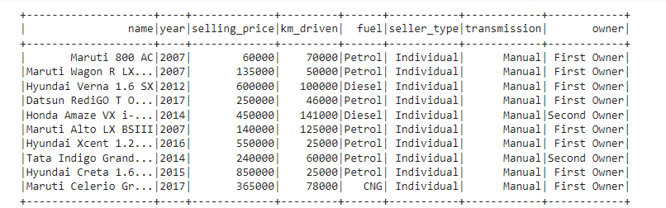
Dataset Snapshot
Below is the first 10 rows of the dataframe ‘data’:

Slide 6
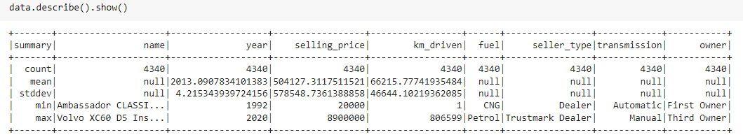
Summary statistics
Summary of the dataset consists of 5 properties: count, mean(average), stddev(standard deviation), min, max:
As 'name', 'fuel', 'seller_type' and 'transmission' are all categorical attributes so they don't have mean and standard deviation, as a result in summary for the mentioned attributes these particular things are null.

Slide 7
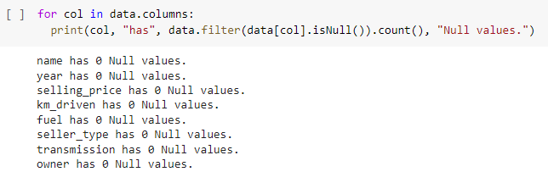
Data Exploration
The dataset doesn’t have any null value. Below is its proof.

Slide 8
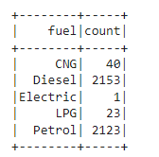
Exploratory Data Analysis(Contd.)
Showing Group wise count:
Based on the categories of ‘Fuel’ attribute:
Analysis:
As the number of instance with 'Electric' as fuel is only 1 so we can't keep it because it won't help in random split of the data because this instance will go to either in train set or test set. So after training the model it can create problem for prediction.

Slide 9
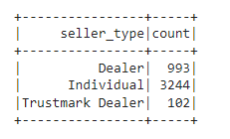
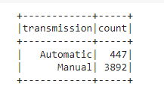
Analysis on Seller_Type and Transmission
Below is the count of each category of seller_type.
Only 3 types of seller are present
Below is the count of each category of Transmission.
Transmission is of 2 types.

Slide 10
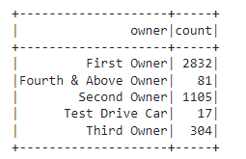
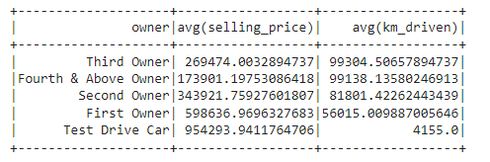
Analysis based on Owners:
There are 5 types of owners and below is their count.
Below is the average selling price and km_driven based on owner.

Slide 11
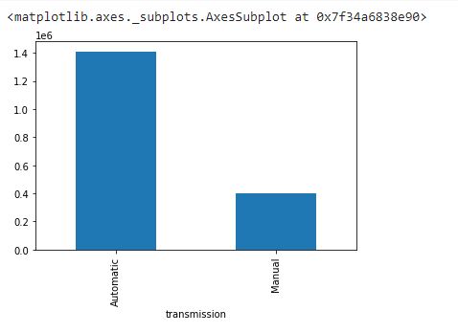
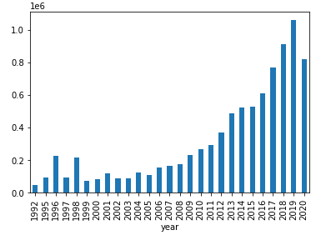
Visualization based on Transmission and Year
Cars with Automatic transmission has higher average selling price.
with increasing year the selling price of a car has been increased gradually or in other words, the car with highest year of service has lowest selling price i.e, the oldest car has lowest selling price

Slide 12
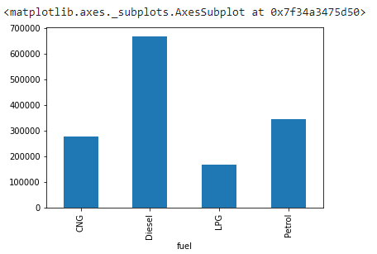
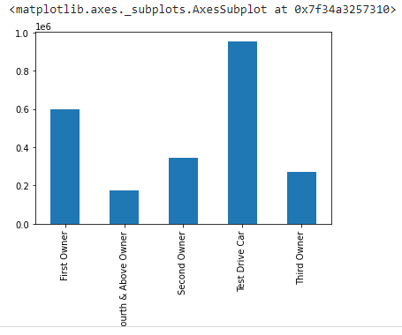
Visualization based on Fuel and Owner:
Average Selling_Price based on Fuel:
We can see that Average selling price is highest for fuel Diesel. Looking at the variation it can be said that this attribute can be a good predictor
Average Selling_Price based on Owner:
Test Drive Car has the highest average selling price . Looking at the variation it can be said that this attribute can be a good predictor

Slide 13
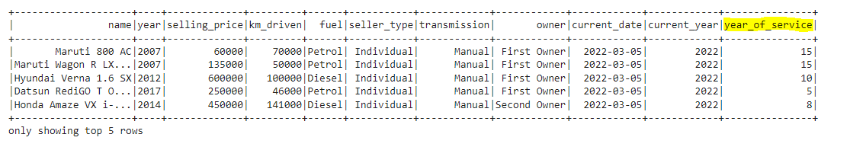
Feature Engineering on year column:
In this dataframe ‘year’ column is numerical with ‘int’ datatype. But a new column has been added to define ‘year_of_service’ .
The formula is: year(current_date) - year

Slide 14
Preprocessing on the data: (Categorical attributes)
For Preprocessing we had to handle the numerical and categorical data separately.
For all the categorical data the preprocessing consists of 2 steps:
String Indexing
OneHot Encoding
Both have to be downloaded from the pyspark.ml.feature. These two preprocessors are used for converting the categorical attributes in onehot encoded vectors. Then vector assembler is used for assembling these two separate vectors . One thing is to be notified here : The output of string indexer works as input of Onehot Encoder. So for each and every categorical attribute we have to apply these two preprocessors separately.

Slide 15
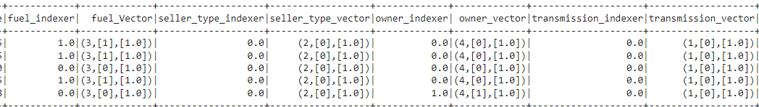
String Indexer and Onehot Encoder
String Indexer encodes the string column of labels to a column of label indices. It is used to perform the task of ordering.
One Hot Encoder is used for converting the categorical columns to numerical columns or numeric vector which the ML models can understand.
In the picture fuel_vector, seller_type_vector, owner_vector, transmission_vector are the results of One hot Encoding.

Slide 16
Preprocessing on the data: (Numerical Attributes)
For Numerical attributes we can use Standard Scaler for bringing all the numerical attributes to the same scale.
Standard Scaler is also imported from pyspark.ml.feature.
All the preprocessed results are then combined with the help of Vector Assembler. Generally we don’t keep all the attributes separately. We keep all the features together and name them as feature and along with that the label is also kept which are fitted to the model for training.

Slide 17
Train-Test Split
Before fitting the model we normally split our data into train and test .
Normally we use random split and split our data into 70% and 30% data where 70% is used for training our model and 30% is for validation.

Slide 18
Training – Testing- Prediction- Evaluation
As it’s regression problem so I have used Linear Regression Model which have been imported from pyspark.ml.regression library.
We fit our model to the train set that we create through the train test split.
After fitting the model we use it to predict the test set.
As a evaluation metric we use Root Mean Square Error and R2 Score . The Root mean square error should be as low as possible along with that the R2 score should be as high as possible to prove the good fit of the model.
In my project I got R2 score as 0.47948 i.e, approximately 0.48. So , here we can say that the built model can express 48% of the variability of the entire target feature.

Slide 19
Conclusion
After the prediction the score is not that good, as a result I can’t say that the model is one of the best model. But it can be further using some other algorithms. It is also found sometimes that always the perfect linear relationship is not always obeyed among the features. So we can try some non-linear model here.

Slide 20
Thank You

