Slide 1
Unit-2
LINEAR DATA STRUCTURE

Slide 2
Contents…
Introduction- ADT-Abstract Data Types
Stack
Queue
  Circular Queue
  Double ended queue
Application of Stack
Application of Queue
Linked lists
  Singly Linked List
  Circularly Linked List
  Doubly Linked List
Applications of linked list

Slide 3
Data Type and Data structure
Data Structure-
  A data structure is a technique of organizing the data so that the data can be utilized efficiently.
Data Type-
  A data type specifies the type of data that a variable can store
Common Types
In-built data types
  Example- integer, float, character, etc.
  These are primitive data types and perform basic operations
  Example- addition, subtraction, division, multiplication, etc.
User-defined data type
  Perform operations for our user-defined data type which have defined.

Slide 4
Abstract Data Type (ADT)
To simplify the process of solving problems, we can create data structures along with their operations, which are not in-built are known as Abstract Data Type (ADT).
The Abstract Data Type(ADT) is special kind of data type, whose behavior is defined by a set of values and set of operations.
ADT only mentions what operations are to be performed but not how these operations will be implemented.
It does not specify how data will be organized in memory and what algorithms will be used for implementing the operations.
It is called abstract because it gives an implementation-independent view.

Slide 5
Abstract data type model
In Abstract Datatypes, we can logically work with the datatype, but would not know the inner workings of the datatype.
Abstraction:
  It is a technique of hiding the internal details from the user and only showing the necessary details to the user.
Encapsulation:
  It is a technique of combining the data and the member function in a single unit is known as encapsulation.

Slide 6
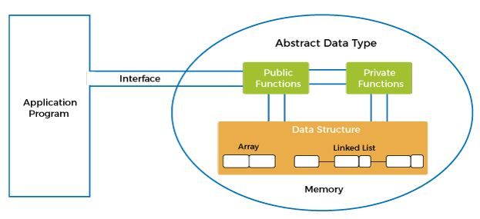
Abstract data type model
ADT model contains
  Two models
    Public function
    Private function
  Data structure
In this model,
first encapsulation is performed, all the data is wrapped in a single unit, i.e., ADT.
Then, the abstraction is performed.

Slide 7
Abstract data type
There are many different types of abstract data types in Java.
  Stack
  Queue
  List

Slide 8
Stack
A Stack is a linear data structure.
It is used to store the collection of elements.
It is used as memory storage with limited capacity called as stack memory.
Stack follows the LIFO (Last-In-First-Out) principle.
Stack has one end, to add and remove the element.
Element is added on the top of the stack, and the element can be deleted only from the top of the stack.
Stack can be defined as,
  A container in which insertion and deletion of element can be done from the one end known as the top of the stack.

Slide 9
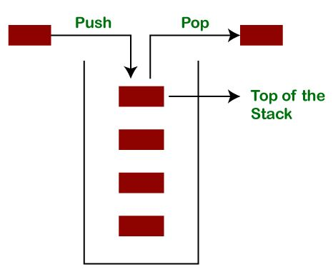
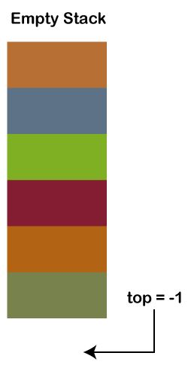
Representation of Stack

Slide 10
Stack
A Stack is an abstract data type with a pre-defined capacity, which can store the elements of a limited size.
It follows some order to insert and delete the elements, and that order can be LIFO or FILO.
It contains top pointer pointing to the topmost element of the stack.
Top pointer is also called as Stack pointer (SP).
When the new element is added in a stack, the value of the top/SP gets incremented, i.e., top=top+1.
When the element is removed from stack, the value of the top/SP gets decreased, i.e., top=top-1.

Slide 11
Stack Operations
Two primary operations on Stack −
  push()
  pop()
To use a stack efficiently, need to check the status of stack with operations −
  peek()
  isFull()
  isEmpty()
A stack can be implemented by means of Array, Structure, Pointer and Linked List.

Slide 12
Stack Operations
Two primary operations on Stack −
  push() − Pushing (storing/inserting) an element on the stack.
  pop() − Removing (accessing/deleting) an element from the stack.
To use a stack efficiently, need to check the status of stack with following operations −
  peek() − get the top data element of the stack, without removing it.
  isFull() − check if stack is full or not.
  isEmpty() − check if stack is empty or not.

Slide 13
Push Operation
The process of putting a new data element onto stack is known as a Push Operation.
When we insert an element in a stack then the operation is known as a push.
If the stack is full and we are trying to insert the element in a stack then the overflow condition occurs.
This condition is called as Stack overflow.
Before inserting an element in a stack, we check whether the stack is full or not.

Slide 14
Push Operation
Empty Stack:
  If the stack has no element is known as an empty stack.
  When the stack is empty the value of the top variable is -1.
To initialize a stack, set the value of top/SP as -1 to check that the stack is empty.
When new element is pushed in a stack, value of the top/SP gets incremented by 1.
  i.e., top=top+1 or SP=SP+1
Then element will be placed at the new position of the top.
The elements will be inserted until we reach the max size of the stack.

Slide 15
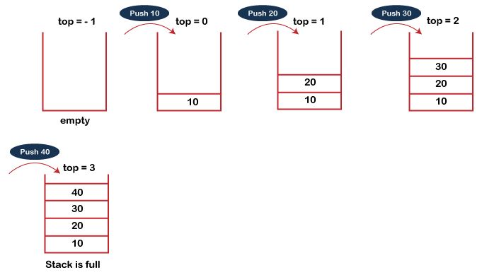
Push Operation
Stack size=3
Insert elements=
10, 20, 30, 40

Slide 16
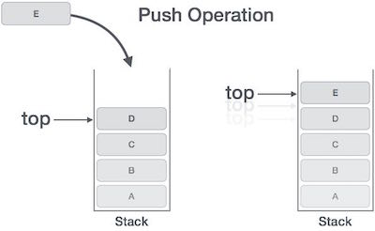
Push operation involves the steps −
Step 1 − Checks if the stack is full.
Step 2 − If stack is full, produces an error and exit.
Step 3 − If stack is not full, increments top/SP to point next empty space.
Step 4 − Adds element to the stack location, where top/SP is pointing.
Step 5 − Returns success.

Slide 17
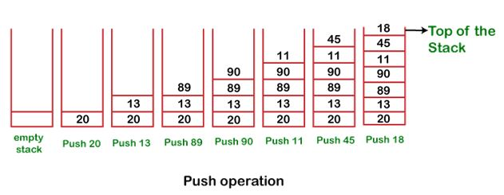
Push Operation
Push 20, 13, 89, 90, 11, 45, 18 respectively into the stack.

Slide 18
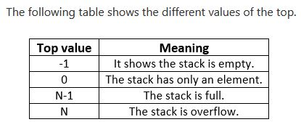
Stack top values and meaning

Slide 19
Pop Operation
When we delete an element from the stack, operation is known as a pop.
Accessing/removing the content from stack is known as a Pop Operation.
The stack is empty means no element exists in the stack.
Before deleting the element from stack, check whether stack is empty.
If we try to delete the element from the empty stack, then the underflow condition occurs.
This condition is called as Stack underflow.
If the stack is not empty-
  First delete an element which is pointed by the top/SP (pop operation)
  Then top/SP is decremented by 1, i.e., top=top-1 or SP=SP-1.

Slide 20
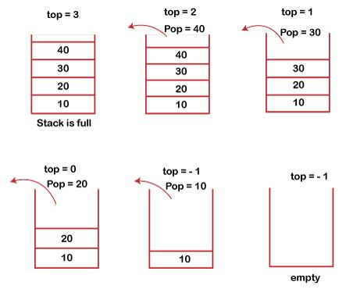
Pop Operation
Stack size=3
Access elements=
10, 20, 30, 40

Slide 21
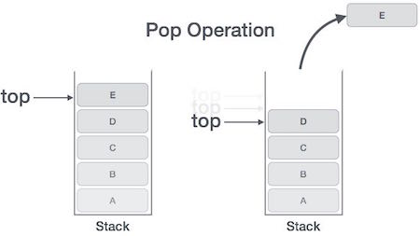
A Pop operation involves the following steps −
Step 1 − Checks if the stack is empty.
Step 2 − If stack is empty, produces an error and exit.
Step 3 − If stack is not empty, accesses element at which top/SP is pointing.
Step 4 − Decreases the value of top/SP by 1.
Step 5 − Returns success.

Slide 22
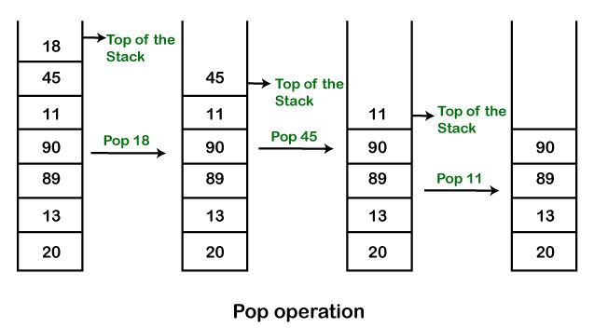
Pop Operation
Remove (pop) 18, 45, and 11 from the stack.

Slide 23
Applications of Stack
String reversal
UNDO/REDO
Recursion
DFS(Depth First Search)
Backtracking
Memory management

Slide 24
 | Applications of Stack
String reversal | Stack is also used for reversing a string.
UNDO/REDO | It can also be used for performing UNDO/REDO operations.
Recursion | The function is calling itself again. To maintain the previous states, the compiler creates a system stack in which all the previous records of the function are maintained.
DFS(Depth First Search) | This search is implemented on a Graph, and Graph uses the stack data structure.
Backtracking | In order to come at the beginning of the path to create a new path, we have to use the stack data structure.
Memory management | The stack manages the memory. The memory is known as stack memory as all the variables are assigned in a function call stack memory.

Slide 25
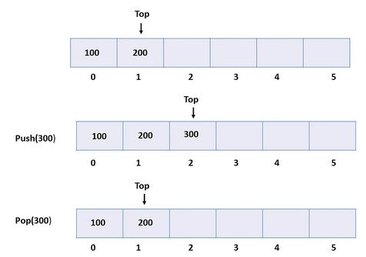
Array implementation of Stack
In array implementation, the stack is formed using an array.
All the operations are performed using arrays.

Slide 26
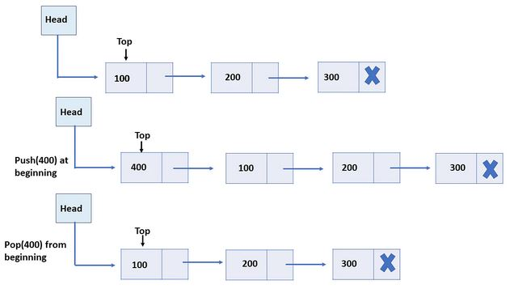
Linked List implementation of Stack
Every new element is inserted as a top element in the linked list.
Newly inserted element
is pointed to the top.
Whenever you want to
remove an element from
the stack, remove the
node indicated by the top,
by moving the top to its
previous node in the list.

Slide 27
Queue
A Queue is a linear data structure defined as an ordered list.
It is used to store the collection of elements.
Queue follows the FIFO (First-In-First-Out) principle.
Queue has two ends to insert and delete the element.
Queue enables
  Insert operations to be performed at one end called REAR
  Delete operations to be performed at another end called FRONT.
Element is added only at rear and deleted only from front.
Example, people waiting in line for a rail ticket form a queue.

Slide 28
Queue Operations
Two primary operations on Queue −
  enqueue()
  dequeue()
To use a queue efficiently, need to check the status of queue with operations −
  peek()
  isFull()
  isEmpty()
A queue can be implemented by means of Array, Structure, Pointer and Linked List.

Slide 29
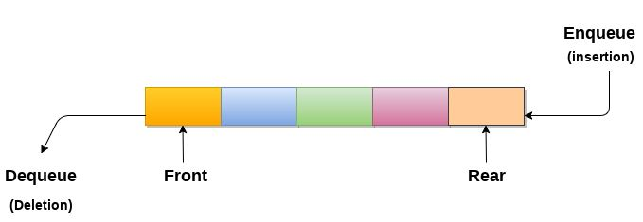
Queue Operations and Representation
Two primary operations on queue −
  enqueue() − add (store) an item to the queue.
    - Insertion of an item at rear is called as Enqueue operation.
  dequeue() − remove (access) an item from the queue
    - Deletion of an item from front is called as Dequeue operation.

Slide 30
Steps to enqueue (insert) data into a queue −
1 − Check if the queue is full.
2 − If the queue is full, produce overflow error and exit.
3 − If queue is not full, increment rear pointer to point the next empty space.
4 − Add data element to the queue location, where the rear is pointing.
5 − Return success.
Steps are taken to perform dequeue operation −
1 − Check if the queue is empty.
2 − If the queue is empty, produce underflow error and exit.
3 − If the queue is not empty, access the data where front is pointing.
4 − Increment front pointer to point to the next available data element.
5 − Return success.

Slide 31
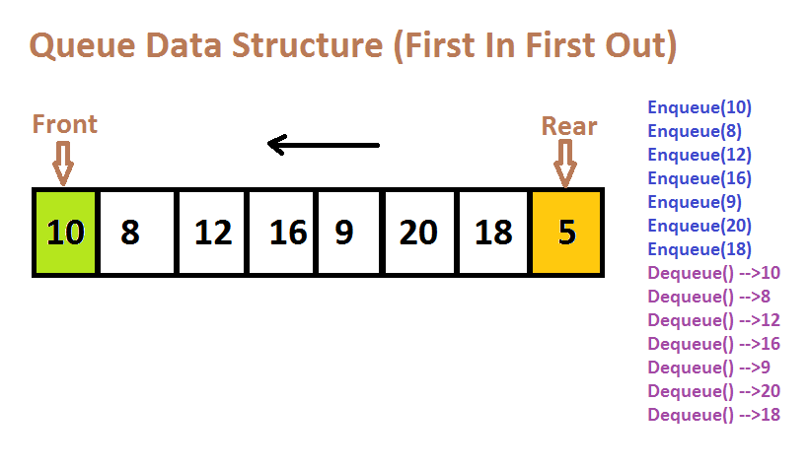
Example

Slide 32
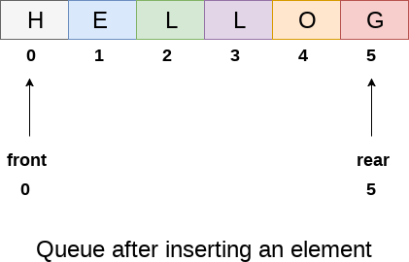
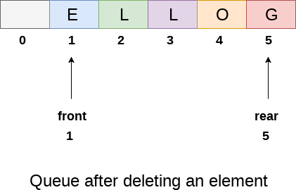
Ways to implement the queue
Queue Implementation using array:
The sequential allocation in a Queue can be implemented using an array.
Initially, value of front and queue is -1 which represents an empty queue.

Slide 33
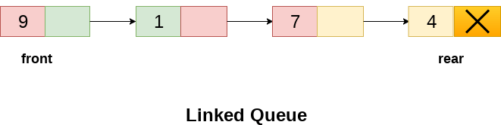
Queue Implementation using Linked list:
The linked list allocation in a Queue can be implemented using a linked list.
In a linked queue, each node of the queue consists of two parts i.e. data part and the link part.
Each element of the queue points to its immediate next element in the memory.

Slide 34
Applications of Queue
A queue performs actions on first in first out basis which is quite fair for the ordering of actions.
Queues are widely used
  As waiting lists for a single shared resource like printer, disk, CPU.
  In asynchronous transfer of data (where data is not being transferred at the same rate between two processes) e.g. pipes, file IO, sockets.
  As buffers in most of the applications like MP3 media player, CD player, etc.
  To maintain the play list in media players in order to add and remove the songs from the play-list.
  In operating systems for handling interrupts.

Slide 35
Types of Queue
There are four different types of queue -
  Simple Queue or Linear Queue
  Circular Queue
  Priority Queue
  Double Ended Queue (or Deque)

Slide 36
Simple Queue or Linear Queue
In a simple queue,
  insertion takes place at one end called as rear and
  removal occurs at the another end called as front.
It strictly follows the FIFO (First in First out) rule.
Drawback- insertion is done only from the rear end.
Representation-
Front Rear
Deletion Insertion

Slide 37
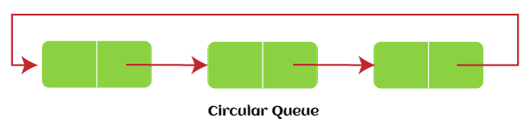
Circular Queue
In Circular Queue, all the nodes are represented as circular.
A circular queue is similar to a simple queue, with additional property of joining the front end to the rear end.
In a circular queue, the last element points/connects to the first element making a circular link.
It is also known as Ring Buffer.
It follows the FIFO rule where the rear is connected to the front end.
Representation-

Slide 38
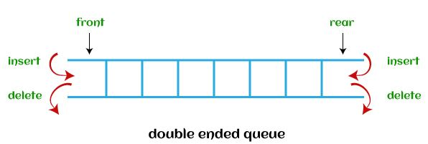
Double Ended Queue
In a double ended queue, insertion and deletion can be done from both ends of the queue either from the front or rear.
We can insert and delete elements from both front and rear ends of the queue.
Thus, it does not follow the FIFO (First In First Out) rule.
Representation-

Slide 39
Linked List
A list is a sequence of data/items in linear fashion.
A list can be defined as the collection of ordered set of elements.
A linked list is a sequence of data structures, which are connected together via links.
Linked List can be defined as collection of objects called nodes that are stored in the memory.
A node contains two fields i.e. data part and the pointer/link part.
  data part stores actual information/element and
  Pointer/link contains the address of the next node in the memory.

Slide 40
Linked List
Linked list has head and tail node.
In linked list, first node is connected to second node and second node to third node and so on.
The last node of the list contains pointer to the null.
Linked List Representation

Slide 41
Basic Operations
Basic operations supported by a list.
Insertion − Adds an element at the beginning of the list.
Deletion − Deletes an element at the beginning of the list.
Display − Displays the complete list.
Search − Searches an element using the given key.
Delete − Deletes an element using the given key.

Slide 42
Types of Linked List
The various types of linked list.
Singly Linked List − Item navigation is forward only.
Doubly Linked List − Items can be navigated forward and backward.
Circular Linked List − Last item contains link of the first element as next and the first element has a link to the last element as previous.

Slide 43
Singly Linked List
Singly linked list is defined as the collection of ordered set of elements.
The number of elements vary according to need of the program.
Singly linked list has collection of nodes.
Each node consists of two parts: data part and link part.
  Data part of the node stores actual information
  Link part of the node stores the address of its immediate successor.
Singly linked list is also called as One way chain.
It is traversed only in one direction.
Each node contains only next pointer, so we can not traverse the list in the reverse direction.

Slide 44
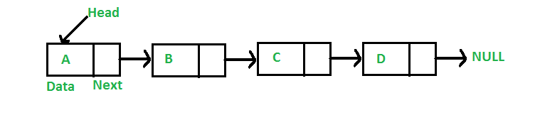
Singly Linked List
The arrow represents the links.
The data part of every node contains the data/element
The last node is null pointer which presents in the address part of the last node.
Operations on Singly Linked List
  Node creation
  Insertion
  Deletion
  Traversing
  Searching

Slide 45
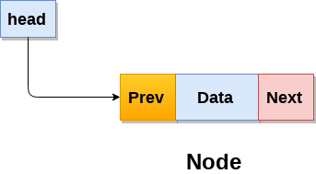
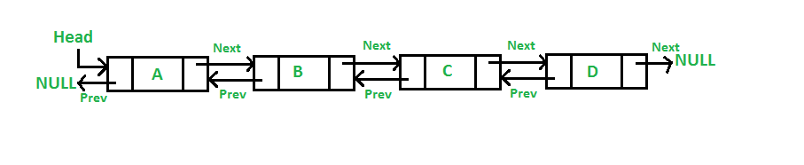
Doubly linked list
Doubly linked list is a complex type of linked list
Node contains a pointer to the previous as well as the next node in the sequence.
In a doubly linked list, a node consists of three parts:
  node data
  pointer to the next node in sequence (next pointer)
  pointer to the previous node (previous pointer)

Slide 46
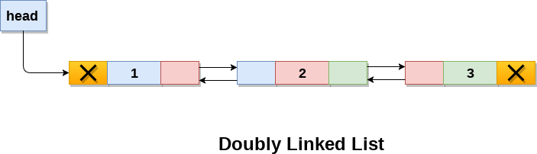
Items can be navigated forward and backward.
Each node contains previous and next pointers, so we can traverse the list in both the directions.
The prev part of the first node and the next part of the last node will always contain null indicating end in each direction.
Operations on doubly linked list
  Node Creation
  Insertion
  Deletion
  Traversing
  Searching

Slide 47
Circular Linked List
In a circular linked list, the last node of the list contains a pointer to the first node of the list.
It is a linked list where all nodes are connected to form a circle.
It has circular singly linked list as well as circular doubly linked list.
We traverse a circular linked list until we reach the same node where we started.
The circular liked list has no beginning and no ending.
There is no null value present in the next part of any of the nodes

Slide 48
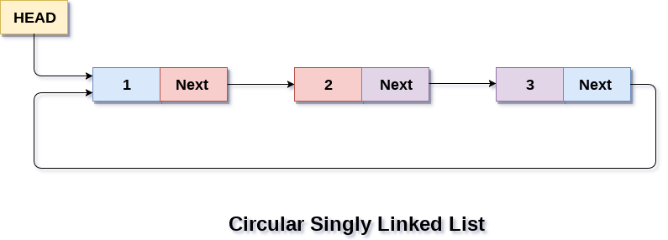
Operations on Circular linked list:
Insertion
Deletion
Traversing
Searching

Slide 49
End of Unit-2

