Slide 1
Unit-3
NON LINEAR DATA STRUCTURE

Slide 2
Contents…
Binary Tree
Expression Trees
Binary Tree traversals
Applications of trees
Huffman tree
  Binary Search Tree
  Balanced Trees
AVL Tree
  B-Tree, Splay Trees
Heap- Heap Operations
  Binomial Heaps
  Fibonacci Heaps

Slide 3
Tree- Data Structure
A tree is a non-linear data structure.
It does not store data/elements in a sequential manner.
It efficiently stores the data in a hierarchical way.
A tree is defined as a collection of objects or entities known as nodes.
Nodes are linked together to represent hierarchy.
It is a hierarchical structure.
Elements in a Tree are arranged in multiple levels.
In Tree, the topmost node is known as a root node.
Each node contains some data, and data can be of any type.
Each node contains some data and link of other nodes called as children.

Slide 4
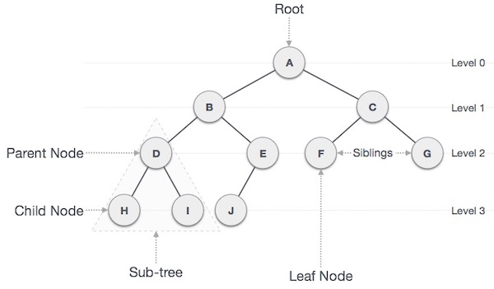
Tree Representation
A tree is represented in hierarchical manner with different levels.
Tree contains various terms:
  Path/link
  Root
  Parent Node
  Child Node
  Sibling
  Leaf Node
  Internal nodes

Slide 5
Terminology | Definition
Path | Link between the two nodes or edge of tree is called as Path.
Root | The node at the top of the tree is called root. There is only one root per tree. Root node is numbered as 1 in tree.
Parent Node | If node contains any sub-node, then that node is called as parent of that sub-node.
Child Node | If node is a descendant of any node, then node is known as a child node. The node below a given node connected by its edge downward is called its child node.
Leaf Node | The node which does not have any child node is called leaf node. A leaf node is the bottom-most node of the tree. Leaf nodes can also be called external nodes.
Internal nodes | A node has atleast one child node known as an internal
Siblings | The nodes that have the same parent are known as siblings.

Slide 6
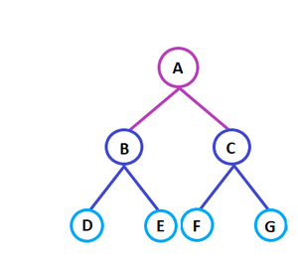
Degree of Node and Tree
A tree is a non-linear data structure which contains nodes.
Nodes are linked together to represent hierarchy.
Degree of node
  The maximum number of children than can exist for a node is
called as degree of node.
Degree of Tree
  The degree of a tree is the
maximum degree of any of its nodes.
Node A, B, C have maximum
two children. So degree is equal to 2.
Terminal node
    It is a node with degree zero.

Slide 7
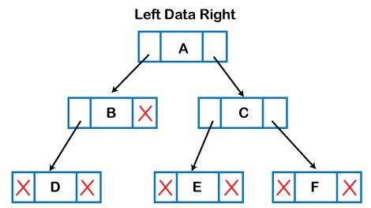
Representation of tree data structure in the memory:
The node contains three fields- Left, Data, Right
  The second field stores the data;
  The first field stores the address of the left child,
  The third field stores the address of the right child.
It is a Linked List
representation tree.

Slide 8
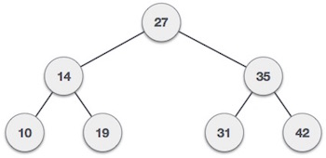
Binary Tree
Binary tree is a finite set of data elements.
Each node has a maximum two children.
In a binary tree,
  Every element/parent node has at most 2 children.
  Each node can have either 0, 1, or 2 children.
  Binary name itself suggests that 'two‘.
  The 2 children are called the left child and the right child.
  A left child must have a value less than
  its parent's value and the right child
  must have a value greater than its
  parent value.
  Maximum degree of binary tree is 2.

Slide 9
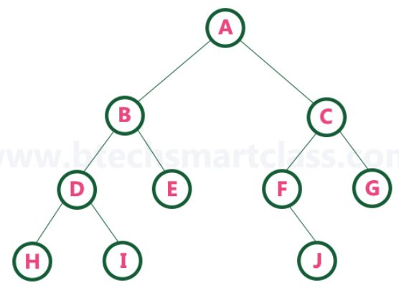
Types of Binary Tree
In a binary tree, every node can have either 0 child or 1 child or 2 children but not more than 2 children.
Types of Binary Tree
  Strictly Binary tree
  Complete Binary tree
  Extended Binary tree

Slide 10
Strictly Binary Tree
A binary tree in which every node has either two or zero number of children is called as Strictly Binary Tree.
In strictly binary tree, every node should have exactly two children or none.
If binary tree is filled with left and right sub-tree, then tree is called as Strictly binary tree.
Strictly binary tree is also called as Full Binary Tree or Proper Binary Tree.
Strictly binary tree data structure is used to represent mathematical expressions.

Slide 11
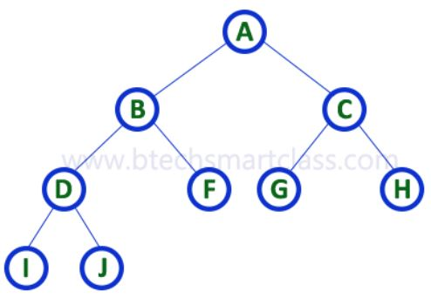
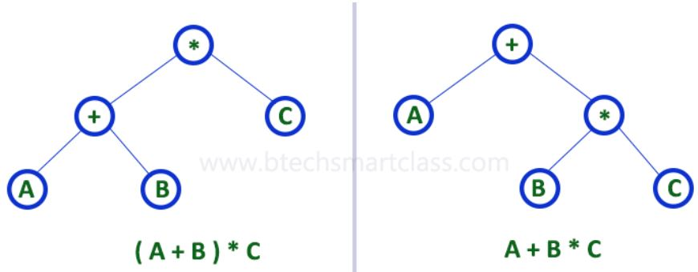
Strictly Binary Tree

Slide 12
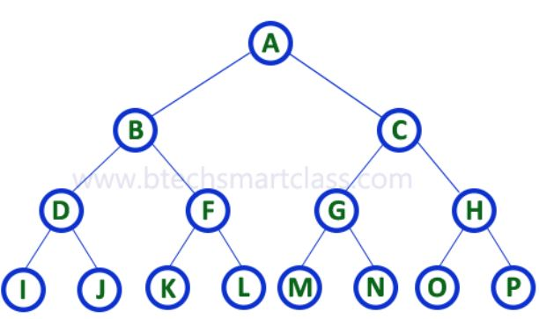
Complete Binary Tree
A binary tree in which every internal node has exactly two children and all leaf nodes are at same level is called Complete Binary Tree.
Complete binary tree is also called as Perfect Binary Tree.
A binary tree in which each
of its nodes has two
children, except the last
nodes, is called as
complete binary tree.

Slide 13
Complete Binary Tree
In complete binary tree,
  At level maximum number of nodes is equal to 2.
  At level 0, only one node i.e. root node
  At level 1, maximum nodes must be 2.
  At level 2, maximum nodes must be 4.
  At level 3, maximum nodes must be 8.

Slide 14
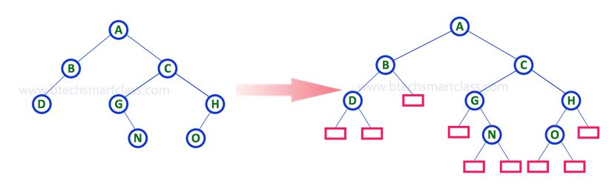
Extended Binary Tree
The full binary tree obtained by adding dummy nodes to a binary tree is called as Extended Binary Tree.
The nodes in binary tree that have only one child can be extended with one more child as external node.

Slide 15
Extended Binary Tree
When every node has either 0 or 2 children then such tree is called as extended binary tree.
It is also called as 2-Tree.
The node with two children is called as internal nodes.
The node without children is called as external nodes.
Internal nodes identified with circle.
External nodes identified with square.
Use- implementing algebraic equation.
Left and right nodes are operands and parent represents operator.

Slide 16
Operations on Binary Tree
Tree Traversals
Insertion of nodes
Deletion of nodes
Searching for a given node
Representation of Binary Tree
Array representation
Linked List representation

Slide 17
Applications of trees
The applications of trees:
Storing naturally hierarchical data:
        -Naturally hierarchical data in file system.
Organize data: It is used to organize data for efficient insertion, deletion and searching.
Heap: It is also a tree data structure implemented using arrays.
  It is used to implement priority queues.
B-Tree and B+ Tree:
These are tree data structures used to implement indexing in databases.
Routing table:
Tree is used to store data in routing tables in the routers.

Slide 18
Expression Trees
Expression tree is a binary tree in which each internal node corresponds to operator and each leaf node corresponds to operand.
The expression tree is a tree used to represent the various expressions.
In Expression tree,
  The internal node always denotes the operators.
  The leaf nodes always denote the operands.
  The operations are always performed on these operands.
Applications-
  It is used to evaluate, analyze and modify the various expressions.
  It is also used to solve the postfix, prefix and infix expression evaluation.

Slide 19
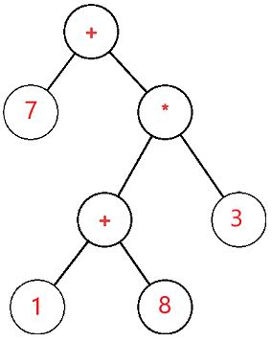
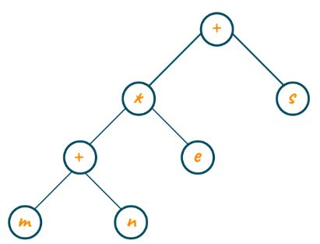
Expression Tree- Example
Expression tree for 7 + ((1+8)*3)
Expression tree for (m+n)* e+s

Slide 20
Expression Tree Construction
Construct an Expression tree for (a+b)*(c*(d+e))

Slide 21
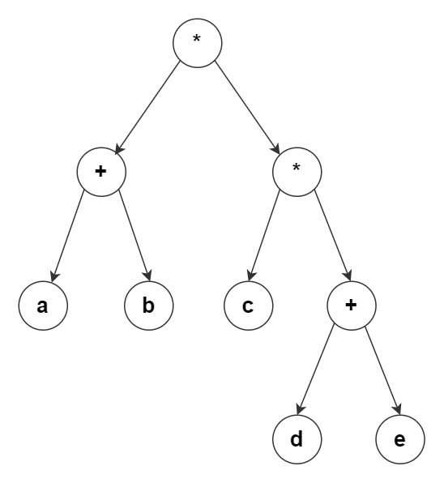
Expression Tree
Expression tree for
(a+b)*(c*(d+e))

Slide 22
Binary Tree traversals
Three parameters are needed for formation of binary tree.
  Node, left sub-tree, right sub-tree
To visit every node in given tree is called as Tree traversal.
Traversal means passing through every node of the tree one by one.
Every node is traversed only once.
Traversal is examining every node in given tree.
Traversing one of important operation on non-empty binary tree.
Binary trees can be traversed in different ways.
  Inorder Traversal
  Preorder Traversal
  Postorder Traversal

Slide 23
Inorder Traversal
In Inorder traversal, firstly left sub-tree is traversed, then root node and lastly right sub-tree is traversed.
Inorder (Left, Root, Right)
Inorder(tree)
1. Traverse the leftmost sub-tree
2. Visit the root.
3. Traverse the rightmost sub-tree
Uses of Inorder
  Used in binary search trees (BST).
  Inorder traversal gives nodes in non-decreasing order.

Slide 24
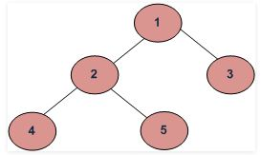
Inorder traversal
Inorder traversal= 4 2 5 1 3

Slide 25
Preorder Traversal
In Preorder traversal, first root node is visited, then left sub-tree and right sub-tree is visited.
Preorder (Root, Left, Right)
Preorder(tree)
1. Visit the root.
2. Traverse the left most sub-tree
3. Traverse the right most sub-tree
Uses of Preorder
  It is used to create a copy of the tree.
  It is used to get prefix expression of an expression tree.

Slide 26
Preorder traversal
Preorder traversal = 1 2 4 5 3

Slide 27
Postorder traversal
In Postorder traversal, first left sub-tree and right sub-tree is visited, then root node is visited.
Postorder (Left, Right, Root)
Postorder(tree)
1. Traverse the left most sub-tree
2. Traverse the right most sub-tree
3. Visit the root.
Uses of Postorder
  It is used to delete the tree.
  Used to get the postfix expression of an expression tree.

Slide 28
Postorder traversal
Postorder traversal = 4 5 2 3 1

Slide 29
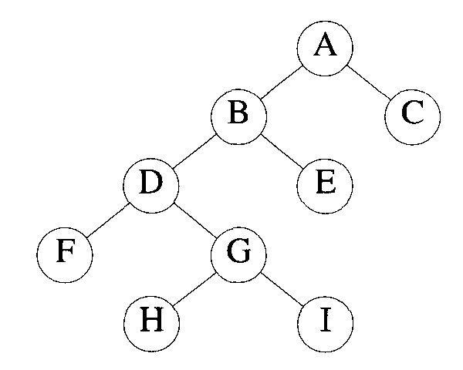
Binary Tree
Find Inorder, Preorder and Postorder traversal for following non-empty binary tree.

Slide 30
Solution:
Inorder traversal = FDHGIBEAC
Preorder traversal = ABDFGHIEC
Postorder traversal = FHIGDEBCA

Slide 31
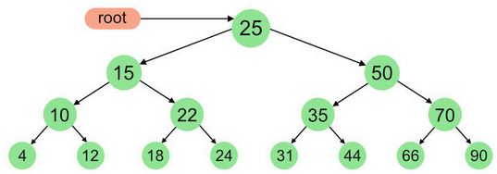
Binary Tree
Find Inorder, Preorder and Postorder traversal of following binary tree.

Slide 32
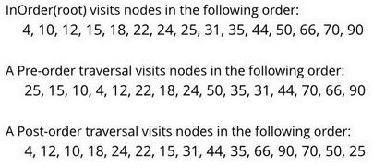
Solution

Slide 33
Binary Search tree
A binary search tree follows some order to arrange the elements.
Binary search tree is also called as Binary Sorted Tree.
Binary search tree is either empty or each node N of the tree satisfies following property:
  The key value of left node/child is not more than the value of root/parent node,
  The key value of right node/child is more than or identical to the value of parent node.
  Above rules applied recursively to the left and right sub-trees of the root.

Slide 34
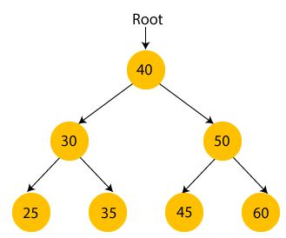
Binary search tree Example
The root node is 40.
All the nodes of the left sub-tree are smaller than the root node, and
All the nodes of the right sub-tree are greater than the root node.
The left child of root node is greater than its left child and smaller than its right child.
It satisfies the property of binary search tree.

Slide 35
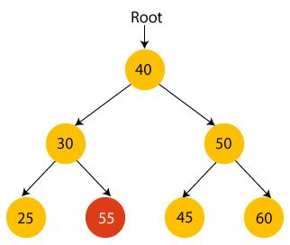
Not a binary search tree
Check whether the tree will be binary search tree or not if we change the value of node 35 to 55

Slide 36
Creating a binary search tree
Suppose the data elements are - 45, 15, 79, 90, 10, 55, 12, 20, 50.
Create the binary search tree for the above data.
Steps:
  First, we have to insert 45 into the tree as the root of the tree.
  Then, read the next element;
    if it is smaller than the root node, insert it as the root of the left sub-tree, and move to the next element.
    if the element is larger than the root node, then insert it as the root of the right sub-tree.

Slide 37
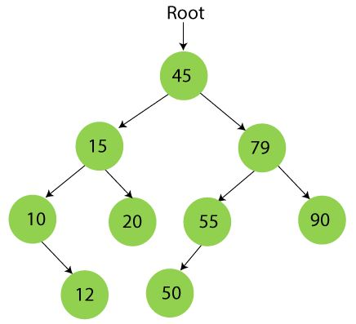
Creating a binary search tree
Binary search tree for data elements - 45, 15, 79, 90, 10, 55, 12, 20, 50.

Slide 38
Operations on binary search tree
Following are the basic operations-
Search − Searches an element in a tree.
Insert − Inserts an element in a tree.
Delete − Deletes an element from a tree
Pre-order Traversal − Traverses a tree in a pre-order manner.
In-order Traversal − Traverses a tree in an in-order manner.
Post-order Traversal − Traverses a tree in a post-order manner.

Slide 39
Searching in Binary search tree
Searching means to find a specific element or node in a data structure.
In BST, searching a node is easy because elements stored in a specific order.
Steps:
  First, compare the element to be searched with the root element of tree.
  If root is matched with the target element, then return the node's location.
  If it is not matched, then check whether the item is less than the root element, if yes, then move to the left sub-tree.
  If it is larger than the root element, then move to the right sub-tree.
  Repeat the above procedure recursively until the match is found.
  If the element is not found or not present in the tree, then return NULL.

Slide 40
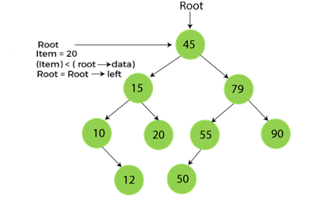
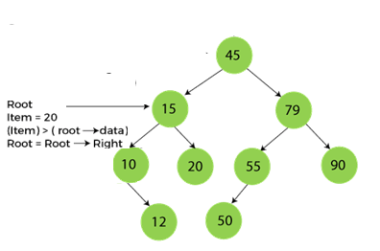
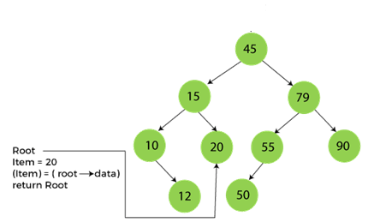
Find node 20 from the BST
Step-1 Step-2
Step-3

Slide 41
Deletion in Binary Search tree
In a binary search tree, we must delete a node from the tree without violating property of BST.
To delete a node from BST, there are three possible situations occur -
  The node to be deleted is the leaf node
  The node to be deleted has only one child
  The node to be deleted has two children

Slide 42
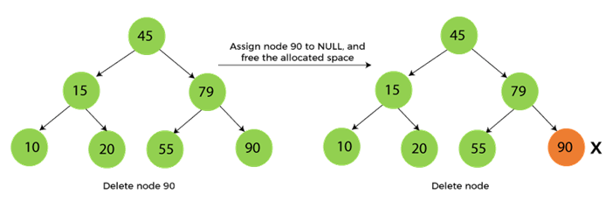
When the node to be deleted is the leaf node
It is the simplest case to delete a node in BST.
We have to replace the leaf node with NULL and simply free the allocated space.

Slide 43
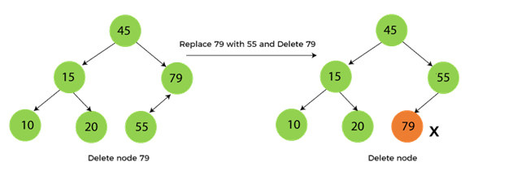
When the node to be deleted has only one child
In this case, we have to replace the target node with its child, and then delete the child node.

Slide 44
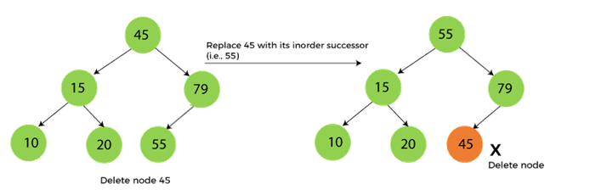
When the node to be deleted has two children
First, find the inorder successor of the node to be deleted.
After that, replace that node with the inorder successor until the target node is placed at the leaf of tree.
And at last, replace the node with NULL and free up the allocated space.

Slide 45
Insertion in Binary Search tree
A new key in BST is always inserted at the leaf.
To insert an element in BST, we have to start searching from the root node;
if the node to be inserted is less than the root node, then search place in left sub-tree, otherwise in right sub-tree.

Slide 46
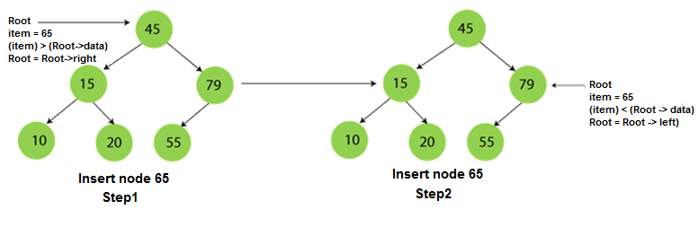
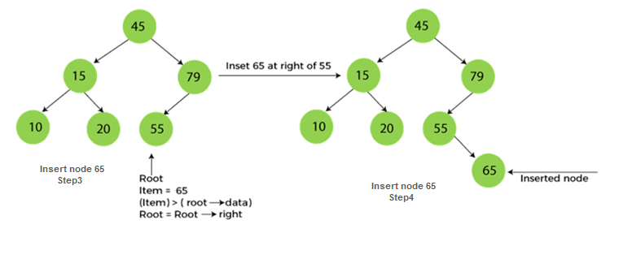

Slide 47
Balanced Trees
A balanced binary tree is also known as height balanced tree.
It is defined as binary tree in which the difference between the height of the left sub-tree and right sub-tree is not more than 1.
The height of a tree is the number of edges on the longest path between the root node and the leaf node.
Following are the conditions for a height-balanced binary tree:
  difference between the left and the right sub-tree for any node is not more than one
  the left sub-tree is balanced
  the right sub-tree is balanced

Slide 48
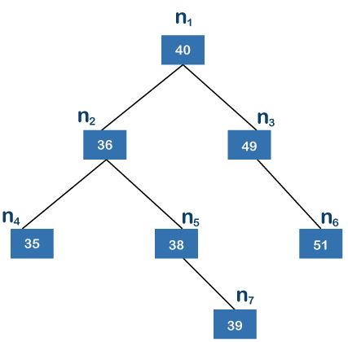
Balanced binary Trees
The left sub-tree contains the nodes
n2, n4, n5, and n7
The right sub-tree contains the nodes
n3 and n6.
The left sub-tree has two leaf nodes n4 and n7.
The edge between the node n2 and n4 is 1
The edge between the node n2 and n7 is 2
The height of the left sub-tree is 2

Slide 49
Balanced Trees
The right sub-tree contains the nodes
n3 and n6.
The right sub-tree contains only one
leaf node n6
The edge between the node n3 and n6 is 1
The height of the right sub-tree is 1
The difference between the heights of
the left sub-tree and right sub-tree is 1.
The above tree is a height-balanced tree.

Slide 50
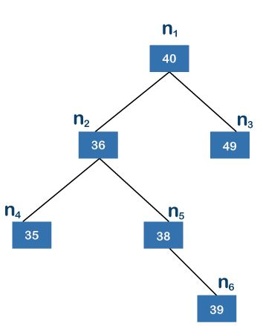
Check whether it is balanced Tree or not?

Slide 51
Unbalanced Tree
The height of the left sub-tree is 2.
The height of the right sub-tree is 0.
So the difference between the height of the left sub-tree and right sub-tree is 2.
According to the definition,
the difference between the height of left sub tree and the right sub-tree must not be greater than 1.
The above binary tree is an unbalanced tree.

Slide 52
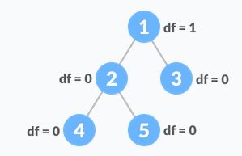
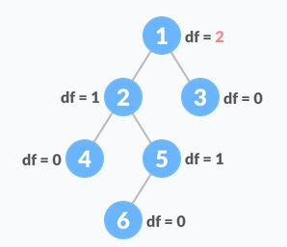

Balanced Trees
Balanced Tree Unbalanced Tree

Slide 53
AVL Tree
AVL Tree is invented by GM Adelson, Velsky and EM Landis in 1962.
AVL tree is named after their inventor Adelson, Velsky & Landis,
AVL trees are height balancing binary search tree.
AVL tree checks the height of left and right sub-trees and assures that the difference is not more than 1.
This difference is called the Balance Factor
Each node is associated with a balance factor.
It is calculated by subtracting height of its right sub-tree from its left sub-tree
Tree is said to be balanced if balance factor of each node is in between -1 to 1, otherwise, the tree will be unbalanced.

Slide 54
AVL Tree
Balance Factor (k) = height (left sub-tree) - height (right sub-tree)
Balance factor of each node is in between -1 to 1.
If balance factor of any node is
  If 1 means left sub-tree is one level higher than the right sub-tree.
  If 0 means that the left sub-tree and right sub-tree contain equal height.
  If -1 means that left sub-tree is one level lower than right sub-tree.
If difference is more than 1, tree is balanced using some rotation techniques.
AVL Rotations
  To balance itself, AVL tree perform the following rotations −
    Left rotation
    Right rotation
    Left-Right rotation
    Right-Left rotation

Slide 55
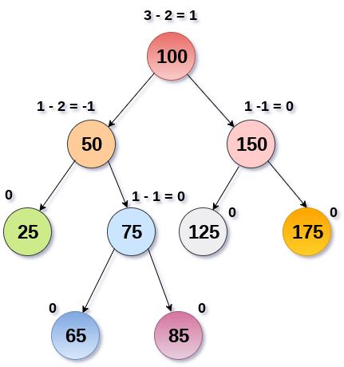
AVL Tree

Slide 56
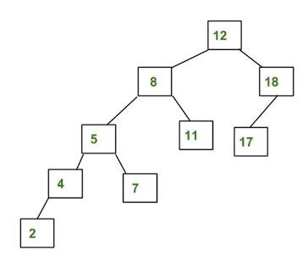
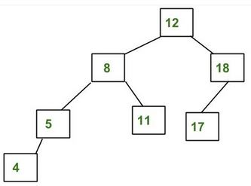
AVL Tree or not???

Slide 57
AVL Tree or not???
Not AVL Tree AVL Tree

Slide 58
B Tree
B Tree is a specialized m-way tree.
A B-Tree of order m can have at most m-1 keys and m children.
B tree of order m contains all the properties of an M way tree.
It contains the following properties.
  Every node in a B-Tree contains at most m children.
  Every node in a B-Tree except the root node and the leaf node contain at least m/2 children.
  The root nodes must have at least 2 nodes.
  All leaf nodes must be at the same level.
It is not necessary that, all the nodes contain the same number of children but, each node must have m/2 number of nodes.

Slide 59
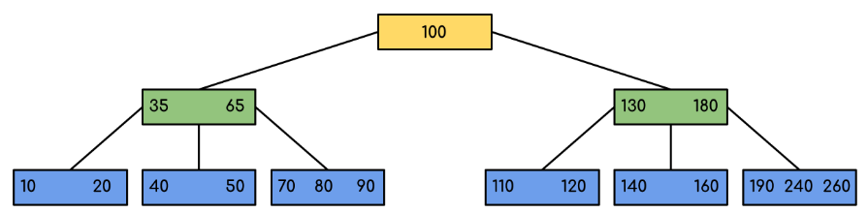
B Tree
The all the leaf nodes are at the same level and all non-leafs have no empty sub-tree and have keys one less than the number of their children.

Slide 60
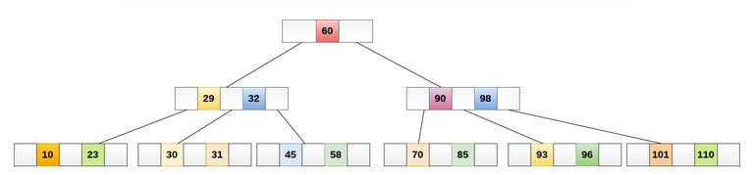
B Tree

Slide 61
Splay Tree
Splay trees are the self-balancing or self-adjusted binary search trees.
Splay trees are the variants of the binary search trees.
It has one extra property that makes it unique is splaying.
A splay tree contains the same operations as binary search trees.
Insertion, deletion and searching.
It also contains one more operation, i.e., splaying.
So, all the operations in the splay tree are followed by splaying.
Splaying means that the operation that we are performing on any element should become the root node after performing some rearrangements.
The rearrangement of the tree will be done through the rotations.

Slide 62
Rotations
There are six types of rotations used for splaying:
  Zig rotation (Right rotation)
  Zag rotation (Left rotation)
  Zig zag (Zig followed by zag)
  Zag zig (Zag followed by zig)
  Zig zig (two right rotations)
  Zag zag (two left rotations)

Slide 63
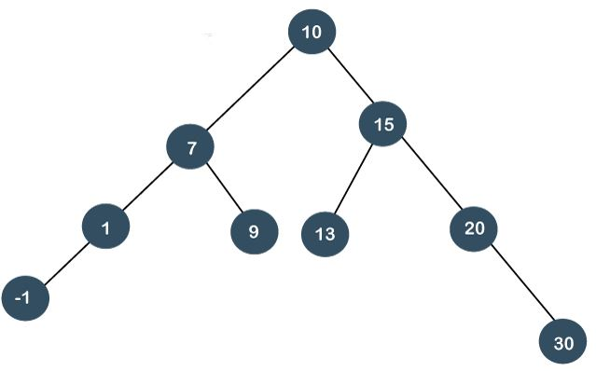
Search 7 element in the tree

Slide 64
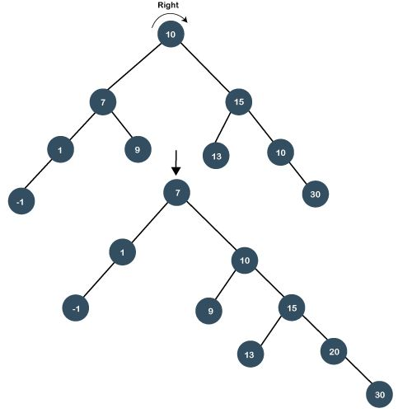

Slide 65
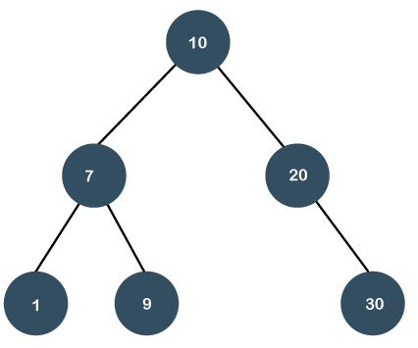
Search 20

Slide 66
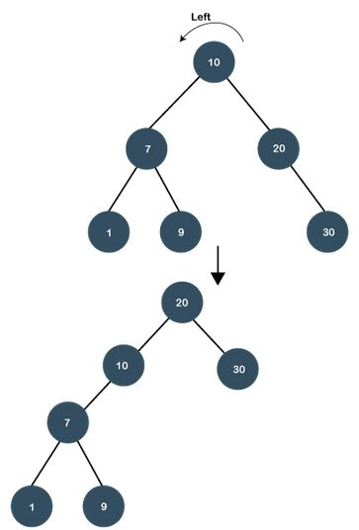

Slide 67
Heap
A Heap is a special Tree-based data structure in which the tree is a complete binary tree.
A heap is a complete binary tree, and the binary tree is a tree in which the node can have utmost two children.
A binary tree in which every internal node has exactly two children and all leaf nodes are at same level is called Complete Binary Tree.
There are two types of the heap:
  Min Heap
  Max heap

Slide 68
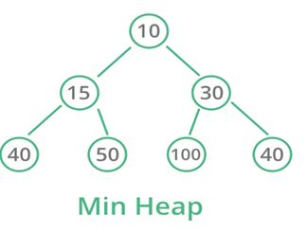
Min Heap
Value of parent node should be less than or equal to either of its children.
Mathematically, it can be defined as
  A[Parent(i)] <= A[i]
In a Min-Heap, key present at the root
node must be minimum among keys
present at all of it’s children.
The same property must be recursively
true for all sub-trees in that Binary Tree.

Slide 69
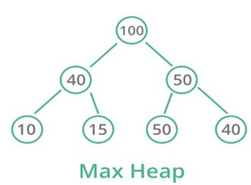
Max Heap
The value of the parent node is greater than or equal to its children.
Mathematically, it can be defined as:
A[Parent(i)] >= A[i]
In a Max-Heap, key present at root
node must be greatest among keys
present at all of it’s children.
The same property must be
recursively true for all sub-trees
in that Binary Tree.

Slide 70
Operations of Heap
Heapify
  A process of creating a heap from an array.
Insertion
  Process to insert an element in existing heap.
Deletion
  Deleting the top element of heap or highest priority element, and then organizing the heap.
Peek
  To check or find the most prior element in the heap, (max or min element for max and min heap).

Slide 71
Example

Slide 72
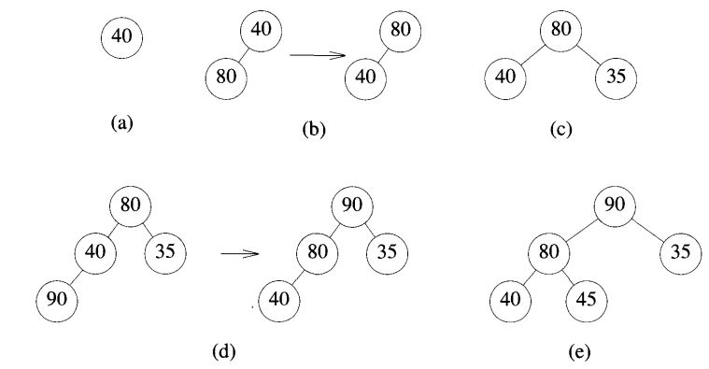

Slide 73
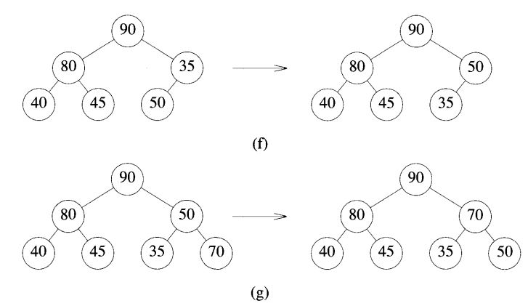

Slide 74
Binomial Heap
Heap-
  A heap is a complete binary tree, and the binary tree is a tree in which the node can have utmost two children.
  There are two types of heap that are defined as follows -
  Min Heap:
  The value of parent node should be less than or equal to either of its children.
  Max Heap:
    The value of the parent node is greater than or equal to its children.
A Binomial Heap is a collection of Binomial Trees.

Slide 75
Binomial Heap
A Binomial Heap is a collection of Binomial Trees.
Binomial tree
  A Binomial tree B_{k} is an ordered tree defined recursively, where k is defined as the order of the binomial tree.
  A binomial Tree is B₀, then the tree consists of a single node..
  A binomial tree B_{k} consists of two binomial trees, i.e., B_{k-1}
  B_{k-1} that are linked together in which one tree becomes the left subtree of another binomial tree.

Slide 76
Example
If B₀, where k is 0, there would exist only one node in the tree.
If B₁, where k is 1, there would be two binomial trees of B₀ in which one B₀ becomes the left subtree of another B₀.
If B₂, where k is 2. there would be two binomial trees of B₁ in which one B₁ becomes the left subtree of another B₁.
If B₃, where k is 3. there would be two binomial trees of B₂ in which one B₂ becomes the left subtree of another B₂.

Slide 77
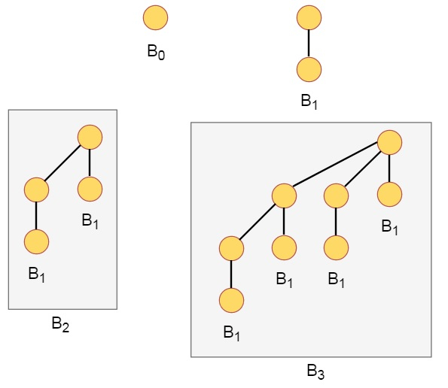
Binomial Tree example

Slide 78
Binomial Heap
A binomial heap can be defined as the collection of binomial trees that satisfies the heap properties, i.e., min-heap.
The min-heap is a heap in which each node has a value lesser than the value of its child nodes.
There are some properties.
  Each binomial tree in H is heap-ordered. So the key of a node is greater than or equal to the key of its parent.
  There is at most one binomial tree in H, whose root has a given degree k.

Slide 79
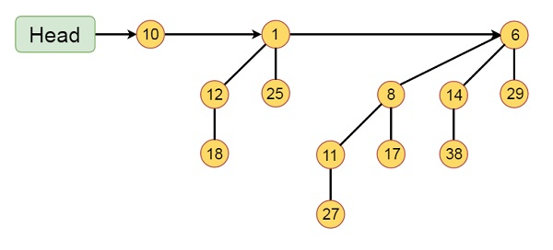
Binomial Heap
This binomial Heap H consists of binomial trees B0, B2 and B3.
Which have 1, 4 and 8 nodes respectively. And in total n = 13 nodes.
The above all three binomial trees satisfy the min heap's property as all the nodes have a smaller value than the child nodes.

Slide 80
Operations on Binomial Heap
The operations that can be performed on binomial heap are-
  Creating a binomial heap
  Finding the minimum key
  Union or merging of two binomial heaps
  Inserting a node
  Extracting minimum key
  Decreasing a key
  Deleting a node

Slide 81
Fibonacci heaps
Fibonacci heaps are collection of trees.
They are loosely based on binomial heaps.
Trees with in binomial heaps are ordered trees within Fibonacci heaps are rooted but unordered.
Fibonacci Heap is a collection of trees with min-heap or max-heap property.
In Fibonacci Heap, trees can have any shape even all trees can be single nodes
Each node x in Fibonacci heaps contains a pointer p[x] to its parent, and a pointer child[x] to any one of its children

Slide 82
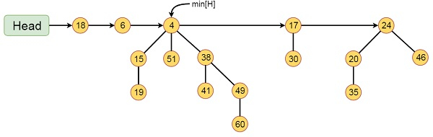
Example
This Fibonacci Heap H consists of five Fibonacci Heaps and 16 nodes.
The line with arrow head indicates the root list.
Minimum node in the list is denoted by min[H] which is holding 4.

Slide 83
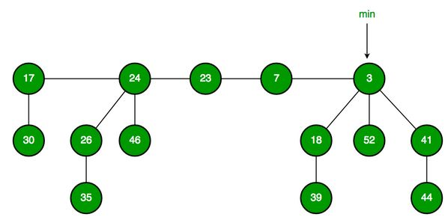
Fibonacci Heap maintains a pointer to minimum value (is root of a tree).
All tree roots are connected using circular doubly linked list, so all of them can be accessed using single ‘min’ pointer.

Slide 84
End of Unit

