Slide 1
ExpCalc
the handwritten calculator

Slide 2
A Short Description
Child Mode
Practice handwriting for young children
Calculator Mode
Takes handwritten expressions as input
Calculation using BODMAS rule
Result Display

Slide 3
Team member and the individual's contribution
NAME | ID NUMBER | CONTRIBUTION
M MANAS | 17CS10025 | GUI, Image Processing, Multiple Digit Recognition
RAJDEEP MONDAL | 17CS10041 | Neural network, Algorithm, GUI, Multiple Digit Recognition

Slide 4
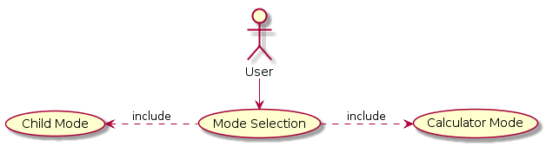
Use Case Diagrams

Slide 5
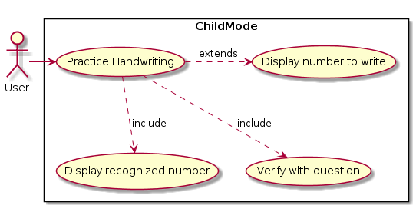
Use Case Diagram Continued ….

Slide 6
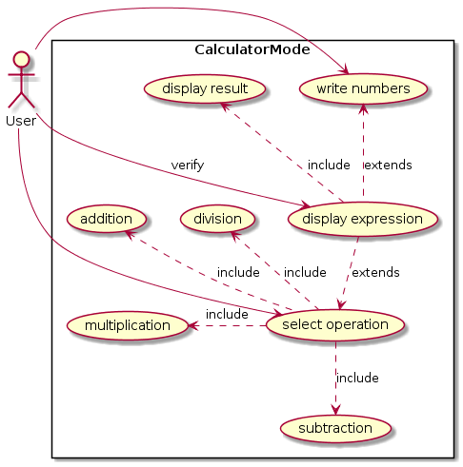
Use Case Diagram Continued ….

Slide 7
ENVIRONMENTS USED
Python 3.6.5
OpenCV
NumPy
Imutils
Java 8
Swing
AWT

Slide 8
Overall work done in the project
A friendly GUI (which implements multiple digit recognition) for users to write on
Buttons to select operators
Facility to clear input in case of error
Calculate expressions of any length using BODMAS rule
Display result and recognized expressions
Added a “CHILD MODE” where children can practice handwriting

Slide 9
Challenges overcome
Dataset of operator images unavailable
- Attempt at a solution: created buttons for selecting operators
Integration of Python and Java Environments
- Attempt at a solution: used Runtime class which allows Java to interact with its environments

